Slide 1
Astronomický proseminář II
Galaxie a galaxie

Slide 2
hvězdné soustavy
dvojhvězdy, vícenásobné hvězdné soustavy
hvězdokupy
galaxie
skupiny galaxií
kupy galaxií
nadkupy galaxií
vyšší struktury

Slide 3
vícenásobné hvězdné soustavy
dvojhvězdy – např. Sirius, Prokyon, Mira
trojhvězdy – Polárka
čtyřhvězdy – Mizar, epsilon Lyr
pětihvězdy – 91 Aql, delta Ori
šestihvězdy – Castor, Alcor (s Mizarem)
sedmihvězdy – AR Cas
katalog Tokovinin http://www.ctio.noao.edu/~atokovin/stars/intro.html

Slide 4

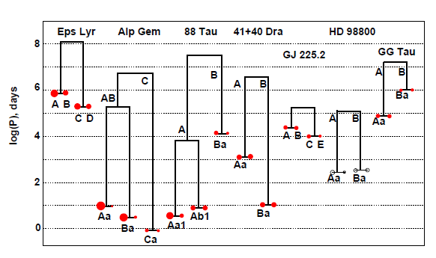
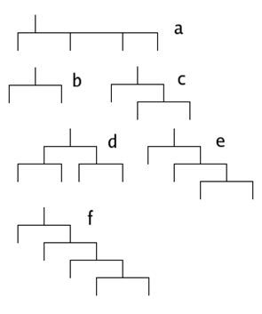
uspořádání soustav

Slide 5
Hvězdné asociace
původ:
rozpad hvězdokup
nově vznikající hvězdokupy – hvězdy mají podobné trajektorie v prostoru
pohybové asociace
  skupina UMa – od UMa, Cep až TrA
  Hyády
  Jesličky
hvězdné asociace
  O asociace (v Ori)
  OB asociace (v Sco – Cen)
  R asociace (střední M, zbytky původní látky – Mon R2)
  T asociace (hvězdy T Tauri)

Slide 6
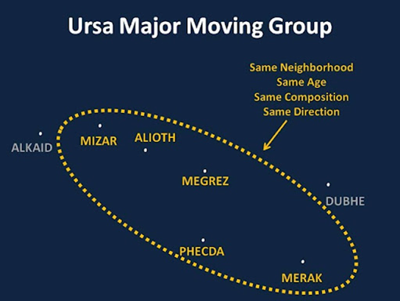

Slide 7
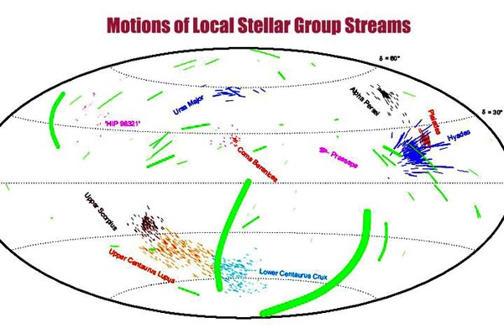

Slide 8
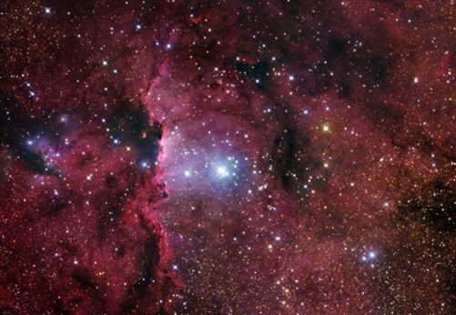
OB asociace Ara OB1

Slide 9
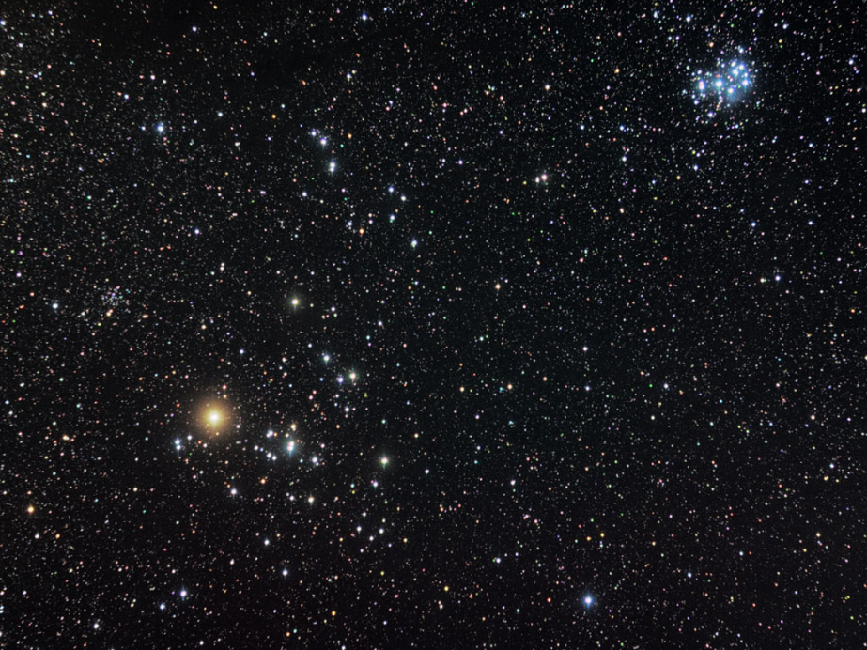
Otevřené hvězdokupy
nepravidelný tvar
stovky hvězd
výskyt u galaktické roviny
obsahují také mezihvězdný prach a plyn
jedná se o relativně mladé hvězdy, jejich seskupení je gravitačně nestabilní
Plejády, Hyády, Jesličky atd.
určení stáří podle umístění charakter. zahnutí na HRD, který je sestaven pro hvězdy konkrétní hvězdokupy

Slide 10
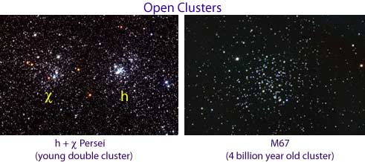
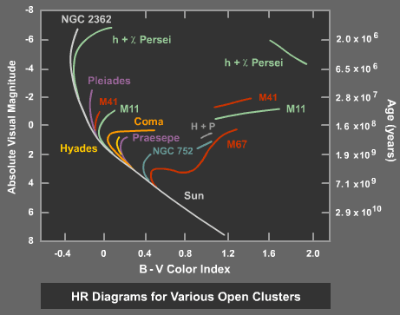

Slide 11
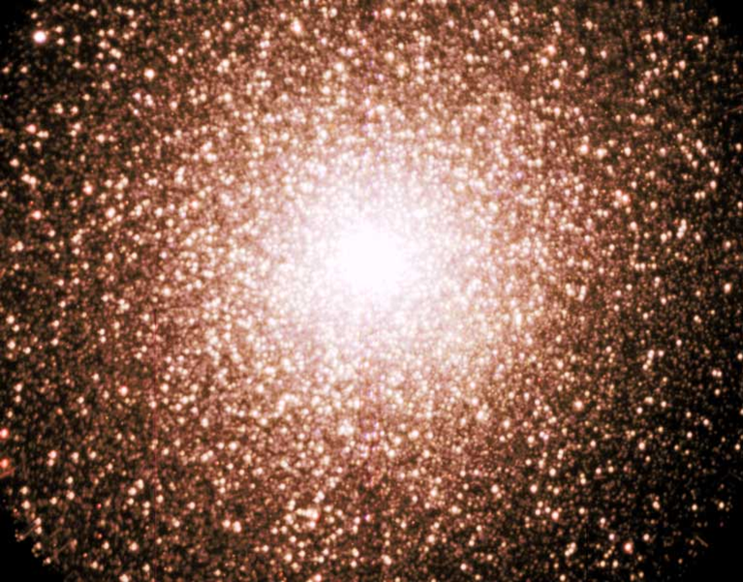
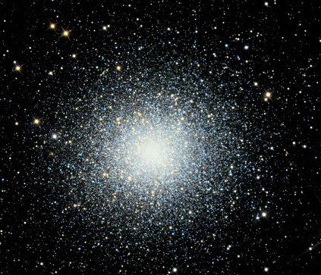
Kulové hvězdokupy
silná koncentrace hvězd směrem ke středu,
počet hvězd řádově 10⁶
staré útvary (∼10¹⁰ let)
gravitačně stabilní
jsou v tzv. galaktickém halu
M 13, 47 Tuc
47 Tuc
M 13

Slide 12

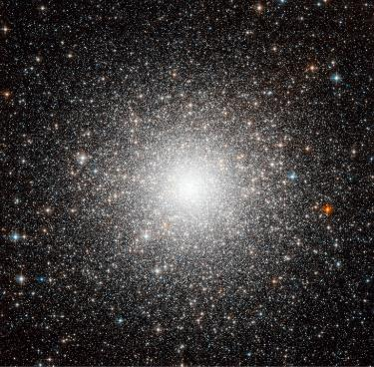
Figure 25.24
Globular Cluster M54. This beautiful Hubble Space Telescope image shows the globular cluster that is now believed to be the nucleus of the Sagittarius Dwarf Galaxy. (credit: ESA/Hubble & NASA)

Slide 13
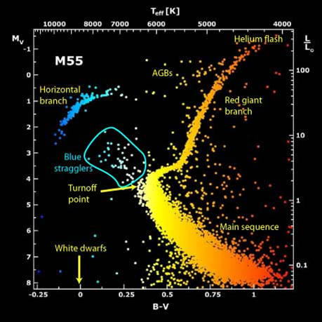

Slide 14
základní údaje o hvězdokupách
Asociace Otevřené h. Kulové h.
tvar nepravidelný nepravidelný kulový
množství málo hvězd málo hvězd mnoho hvězd
koncentrace jen u některých slabá k. silná k.
místo výskytu spirální galaktická galaktické
v Galaxii ramena rovina halo
poloha v HR jako u mladých jako u hvězd jako u hvězd
diagramu hvězd populace I populace II

Slide 15
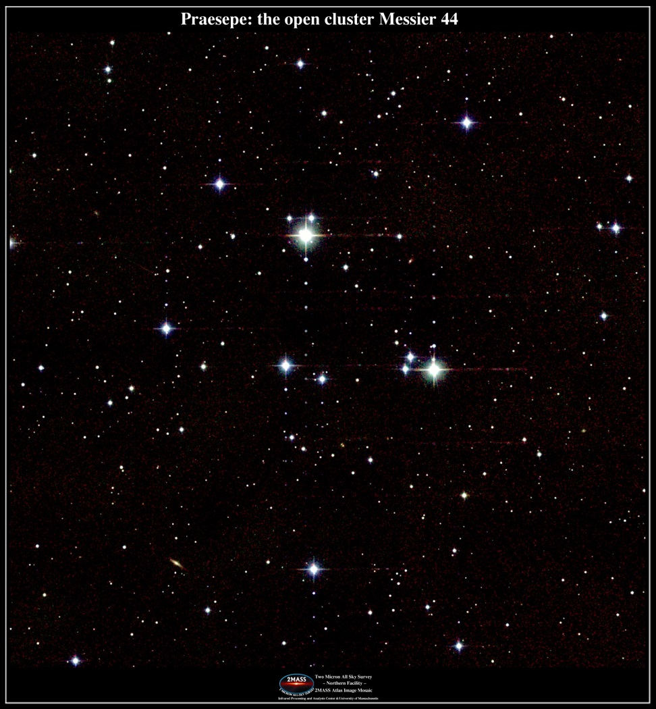
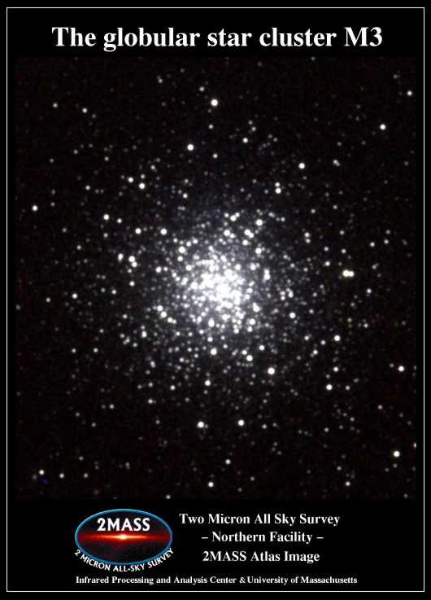
srovnání vzhledu

Slide 16
naše Galaxie

Slide 17
Galaxie
naše Galaxie, resp. její spirální ramena jsou dobře viditelná jako tzv. Mléčná dráha. Také všechny ostatní hvězdy, které jsou viditelné pouhým okem, patří do tohoto systému
Galaxii tvoří několik set miliard hvězd, velké množství mezihvězdné látky a patrně i tzv. skryté hmoty
v centru Galaxie je velmi hmotná černá díra
při pohledu z mimogalaktického prostoru by měla Galaxie plochý tvar (jako dva talíře přiklopené na sebe), pohled „shora“ by ukázal spirálovitou strukturu s centrální příčkou
rotace Galaxie je poměrně složitá
Slunce ve 2/3 vzdálenosti poloměru Galaxie od jejího středu 1 oběh za ∼ 220 mil. let

Slide 18
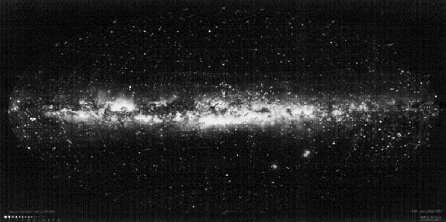

Slide 19
Galaxie
Jak jsme k těmto poznatkům dospěli?
1. model z pozorování – W. Herschel, 18. století
  chyby: totožný zářivý výkon všech hvězd, konstantní prostorová hustota, neznalost mezihvězdné extinkce
  výsledkem byl model Galaxie o průměru 3 kpc, Slunce uprostřed
1922 další model – Kapteyn
  zářivé výkony různé, ale bez extinkce
  elipsoid 8500 x 1700 pc, Slunce 650 pc od středu
1920 – Velká debata – Shapley x Curtis
role mezihvězdné látky odhalena až později
  plyn tvoří až 80 %
  prach – Si, grafitová, kovová a ledová zrnka

Slide 20
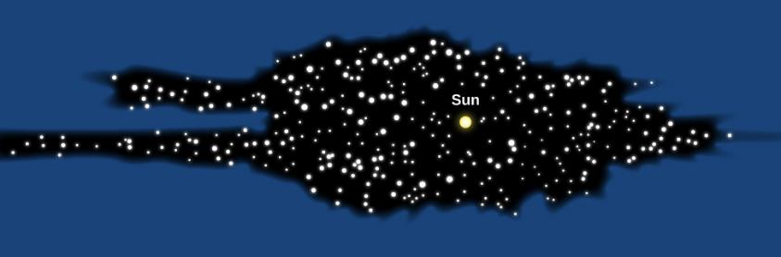
Figure 25.3
Herschel’s Diagram of the Milky Way. Herschel constructed this cross section of the Galaxy by counting stars in various directions.

Slide 21
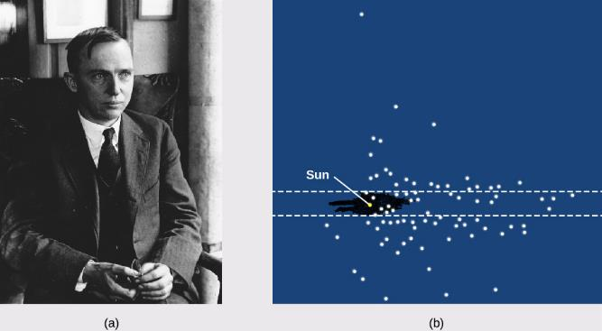
Figure 25.4
Harlow Shapley and His Diagram of the Milky Way.
Shapley poses for a formal portrait.
His diagram shows the location of globular clusters, with the position of the Sun also marked. The black area shows Herschel’s old diagram, centered on the Sun, approximately to scale.

Slide 22
Galaxie
Galaktická souřadnicová soustava
základní rovina – rovina největší koncentrace hvězd
  úhel mezi rovinou galaktického rovníku a rovinou světového rovníku je 62 st. 36 min.
  základní směr (ke středu G) je definován rezolucí IAU (1959): rekt. 17h 42min 29,3vt a deklinace -28st 59min 18vt
  galaktická délka l a šířka b

Slide 23
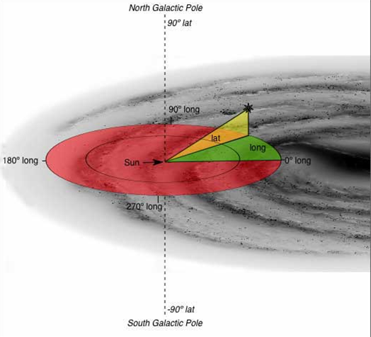

Slide 24
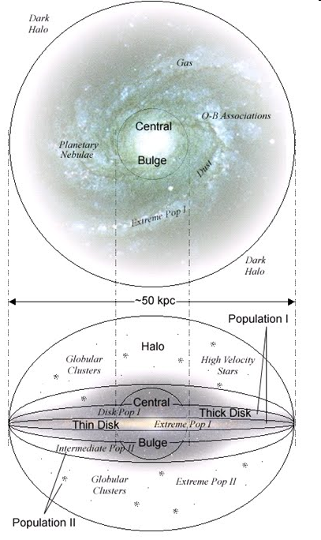
Galaxie
Struktura
složení – hvězdy, mezihvězdná látka, skrytá hmota
  kulová složka (halo)
  disková složka
  plochá složka
  jádro Galaxie

Slide 25
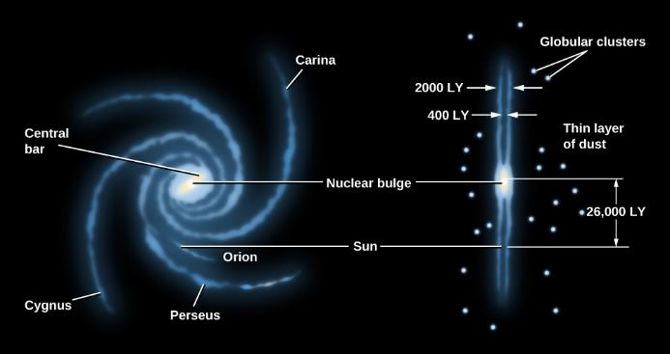
Figure 25.5
Schematic Representation of the Galaxy. The left image shows the face-on view of the spiral disk; the right image shows the view looking edge-on along the disk. The major spiral arms are labeled. The Sun is located on the inside edge of the short Orion spur.

Slide 26
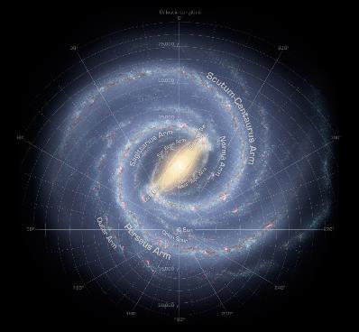
Figure 25.10
Milky Way Bar and Arms. Here, we see the Milky Way Galaxy as it would look from above. This image, assembled from data from NASA’s WISE mission, shows that the Milky Way Galaxy has a modest bar in its central regions. Two spiral arms, Scutum-Centaurus and Perseus, emerge from the ends of the bar and wrap around the bulge. The Sagittarius and Outer arms have fewer stars than the other two arms. (credit: modification of work by NASA/JPL-Caltech/R. Hurt (SSC/Caltech))

Slide 27
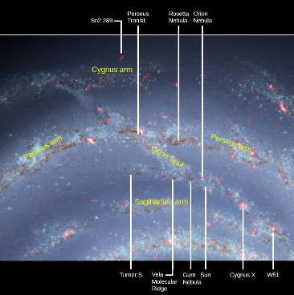
Figure 25.11
Orion Spur. The Sun is located in the Orion Spur, which is a minor spiral arm located between two other arms. In this diagram, the white lines point to some other noteworthy objects that share this feature of the Milky Way Galaxy with the Sun. (credit: modification of work by NASA/JPL-Caltech)

Slide 28
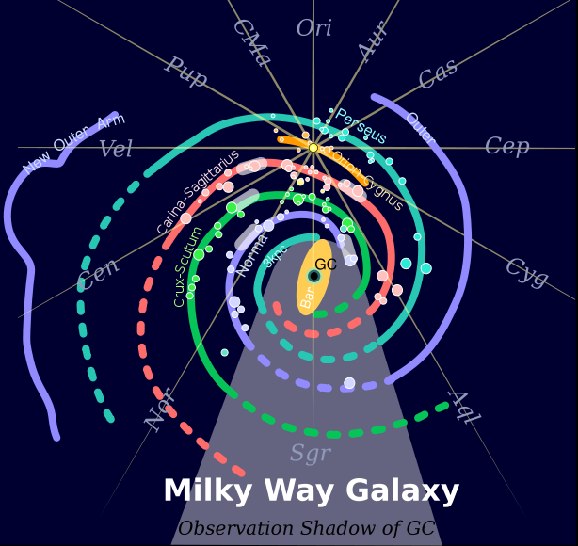
Galaxie
Spirální ramena

Slide 29
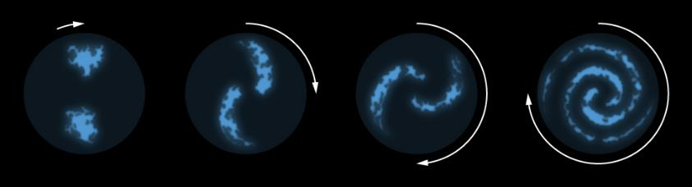
Figure 25.12
Simplified Model for the Formation of Spiral Arms. This sketch shows how spiral arms might form from irregular clouds of interstellar material stretched out by the different rotation rates throughout the Galaxy. The regions farthest from the galactic center take longer to complete their orbits and thus lag behind the inner regions. If this were the only mechanism for creating spiral arms, then over time the spiral arms would completely wind up and disappear. Since many galaxies have spiral arms, they must be long-lived, and there must be other processes at work to maintain them.

Slide 30
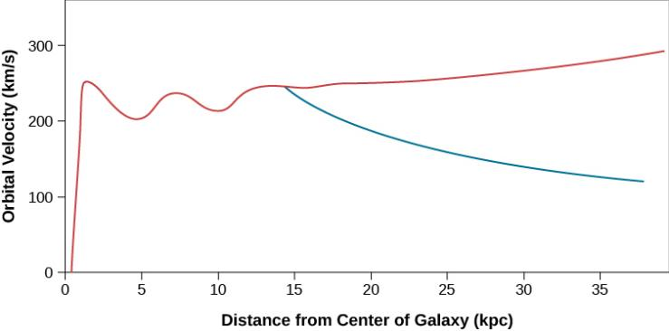
Figure 25.13
Rotation Curve of the Galaxy. The orbital speed of carbon monoxide (CO) and hydrogen (H) gas at different distances from the center of the Milky Way Galaxy is shown in red. The blue curve shows what the rotation curve would look like if all the matter in the Galaxy were located inside a radius of 30,000 light-years. Instead of going down, the speed of gas clouds farther out remains high, indicating a great deal of mass beyond the Sun’s orbit. The horizontal axis shows the distance from the galactic center in kiloparsecs (where a kiloparsec equals 3,260 light-years).

Slide 31
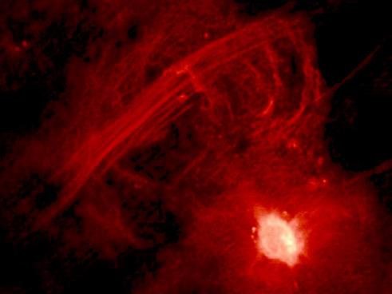
Figure 25.16
Sagittarius A. This image, taken with the Very Large Array of radio telescopes, shows the radio emission from hot, ionized gas in the center of the Milky Way. The lines slanting across the top of the image are gas streamers. Sagittarius A* is the bright spot in the lower right. (credit: modification of work by Farhad Zadeh et al. (Northwestern), VLA, NRAO)

Slide 32
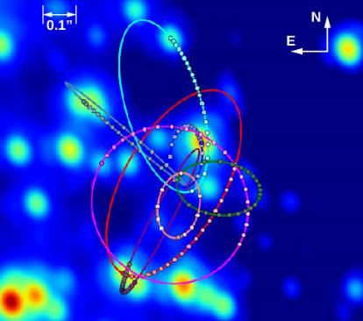
Figure 25.17
Near-Infrared View of the Galactic Center. This image shows the inner 1 arcsecond, or 0.13 light-year, at the center of the Galaxy, as observed with the giant Keck Telescope. Tracks of the orbiting stars measured from 1995 to 2014 have been added to this “snapshot.” The stars are moving around the center very fast, and their tracks are all consistent with a single massive “gravitator” that resides in the very center of this image. (credit: modification of work by Andrea Ghez, UCLA Galactic Center Group, W.M. Keck Observatory Laser Team)

Slide 33
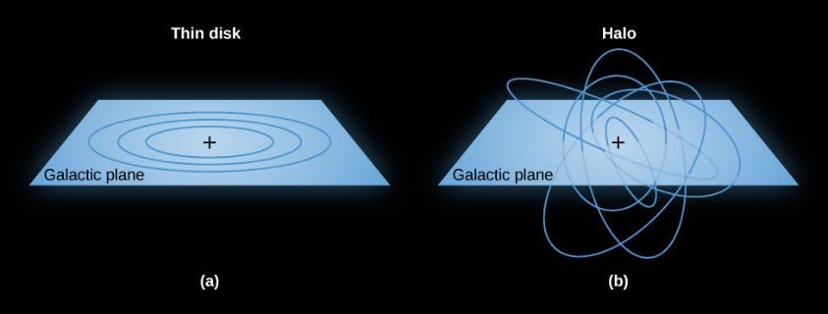
Figure 25.19
How Objects Orbit the Galaxy.
In this image, you see stars in the thin disk of our Galaxy in nearly circular orbits.
In this image, you see the motion of stars in the Galaxy’s halo in randomly oriented and elliptical orbits.

Slide 34
galaxie

Slide 35
extragalaktické systémy
1. objev - 16. století - Magellanova mračna, dnes známo cca 100 miliard
Hubbleova klasifikace (dle vzhledu)
  E eliptické 13 %
  S spirální 62 %
  SO čočkovitý tvar 9 %
  Ir nepravidelné 3 %
13 % zbývajících se z této klasifikace vymyká - tzv. aktivní galaxie
  Seyfertovy
  rádiové galaxie
  kvasary (QSO - quasi stellar object)

Slide 36
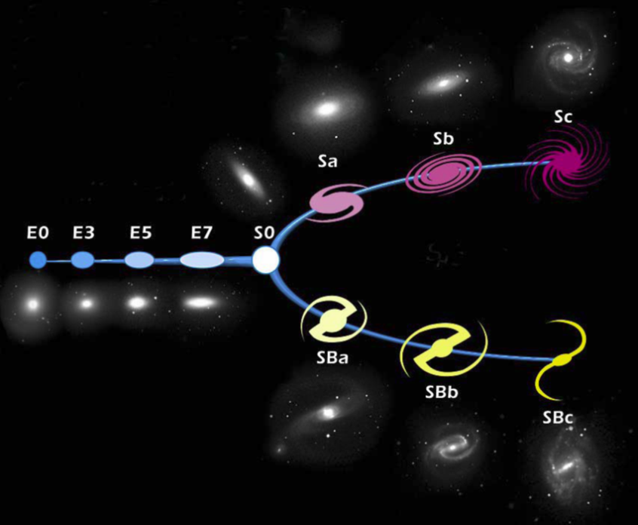
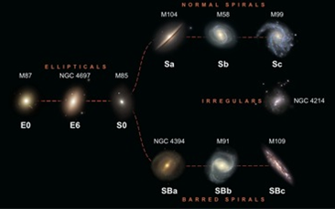
Hubbleova klasifikace

Slide 37
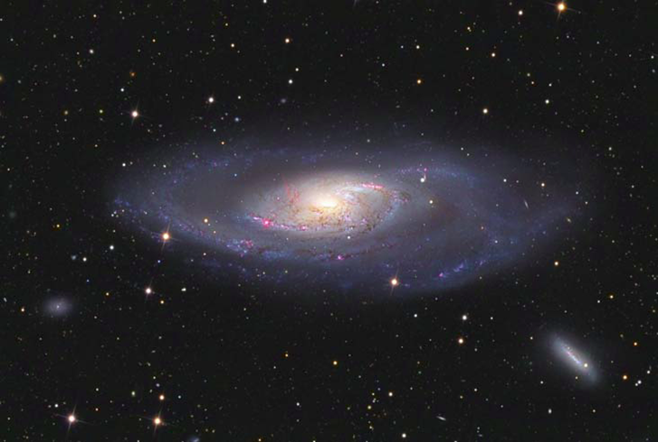
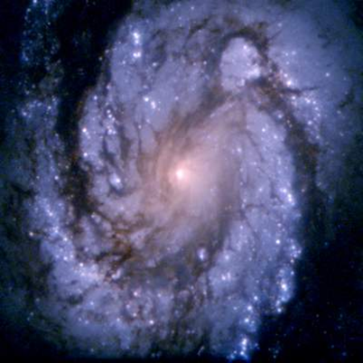
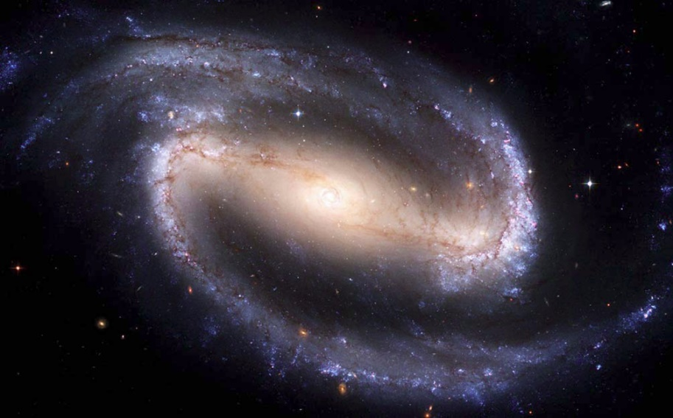
Spirální galaxie

Slide 38
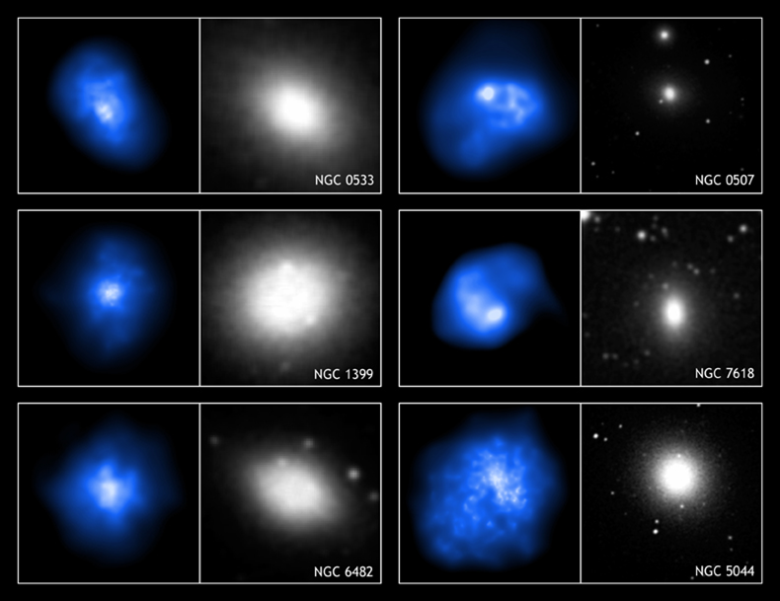
Eliptické galaxie

Slide 39
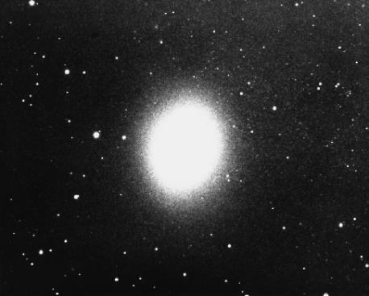
Figure 26.8
Dwarf Elliptical Galaxy. M32, a dwarf elliptical galaxy and one of the companions to the giant Andromeda galaxy M31. M32 is a dwarf by galactic standards, as it is only 2400 light-years across. (credit: NOAO/AURA/NSF)

Slide 40
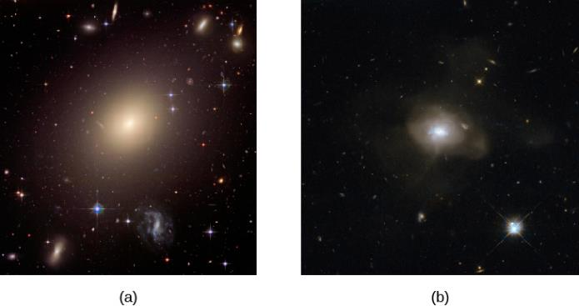
Figure 26.7
Elliptical Galaxies.
ESO 325-G004 is a giant elliptical galaxy. Other elliptical galaxies can be seen around the edges of this image.
This elliptical galaxy probably originated from the collision of two spiral galaxies. (credit a: modification of work by NASA, ESA, and The Hubble Heritage Team (STScI/AURA); credit b: modification of work by ESA/Hubble, NASA)

Slide 41
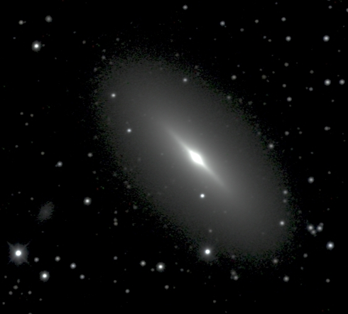
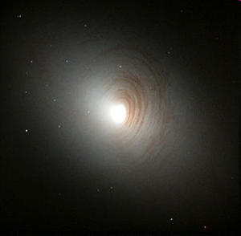
Čočkovité galaxie

Slide 42
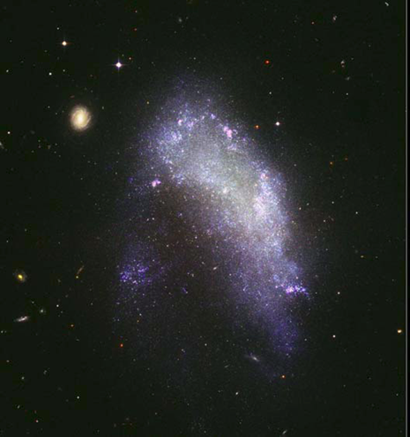
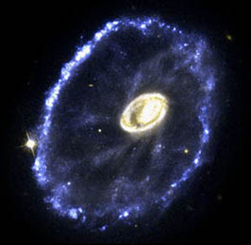
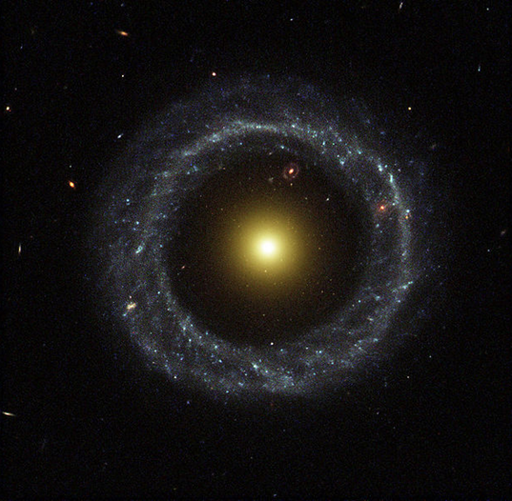
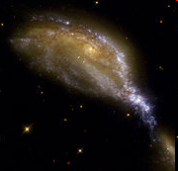
Nepravidelné galaxie

Slide 43
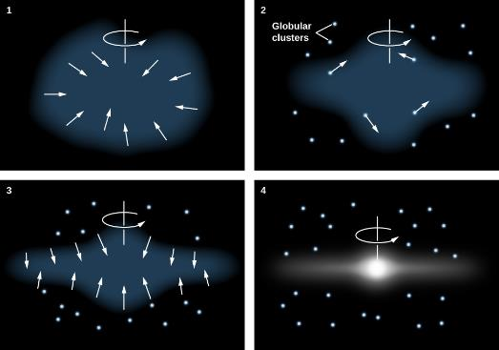
Figure 25.21
Monolithic Collapse Model for the Formation of the Galaxy. According to this model, the Milky Way Galaxy initially formed from a rotating cloud of gas that collapsed due to gravity. Halo stars and globular clusters either formed prior to the collapse or were formed elsewhere. Stars in the disk formed later, when the gas from which they were made was already “contaminated” with heavy elements produced in earlier generations of stars.

Slide 44
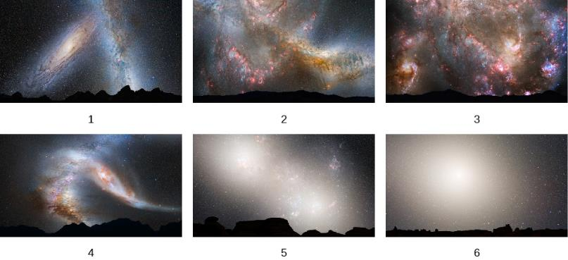
Figure 25.25
Collision of the Milky Way with Andromeda. In about 3 billion years, the Milky Way Galaxy and Andromeda Galaxy will begin a long process of colliding, separating, and then coming back together to form an elliptical galaxy. The whole interaction will take 3 to 4 billion years. These images show the following sequence: (1) In 3.75 billion years, Andromeda has approached the Milky Way. (2) New star formation fills the sky 3.85 billion years from now. (3) Star formation continues at 3.9 billion years. (4) The galaxy shapes change as they interact, with Andromeda being stretched and our Galaxy becoming warped, about 4 billion years from now. (5) In 5.1 billion years, the cores of the two galaxies are bright lobes. (6) In 7 billion years, the merged galaxies form a huge elliptical galaxy whose brightness fills the night sky. This artist’s illustrations show events from a vantage point 25,000 light-years from the center of the Milky Way. However, we should mention that the Sun may not be at that distance throughout the sequence of events, as the collision readjusts the orbits of many stars within each galaxy. (credit: NASA; ESA; Z. Levay, R. van der Marel, STScl; T. Hallas, and A. Mellinger)

Slide 45
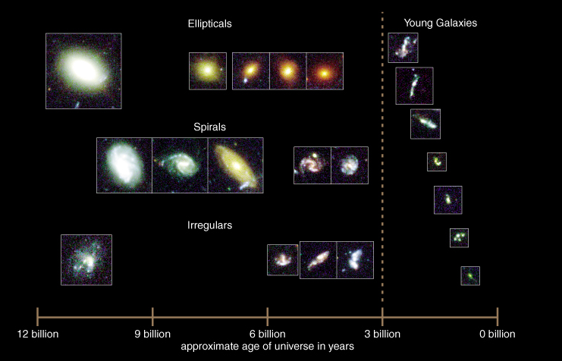
vývoj galaxií podle HDF

Slide 46
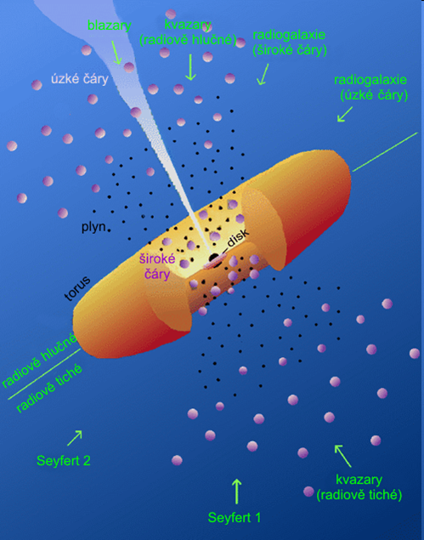
Aktivní galaxie
rádiově tiché
  linery, Seyfertovy, kvasary
rádiově hlučné
  rádiové galaxie, blasary, OVV kvasary

Slide 47
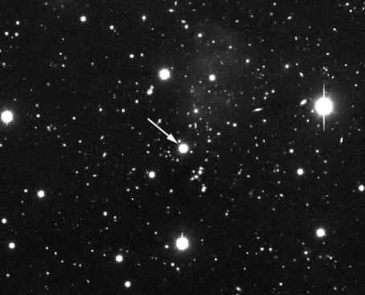
Figure 27.2
Typical Quasar. The arrow in this image marks the quasar known by its catalog number, PKS 1117-248. Note that nothing in this image distinguishes the quasar from an ordinary star. Its spectrum, however, shows that it is moving away from us at a speed of 36% the speed of light, or 67,000 miles per second. In contrast, the maximum speed observed for any star is only a few hundred miles per second. (credit: modification of work by WIYN Telescope, Kitt Peak National Observatory, NOAO)

Slide 48
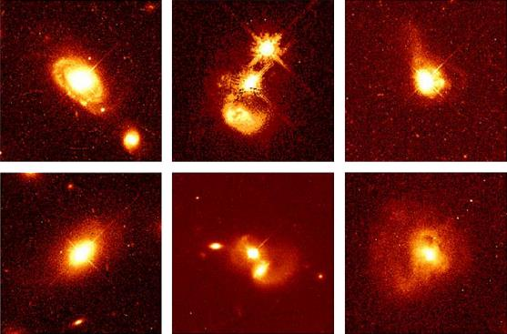
Figure 27.5
Quasar Host Galaxies. The Hubble Space Telescope reveals the much fainter “host” galaxies around quasars. The top left image shows a quasar that lies at the heart of a spiral galaxy 1.4 billion light-years from Earth. The bottom left image shows a quasar that lies at the center of an elliptical galaxy some 1.5 billion light-years from us. The middle images show remote pairs of interacting galaxies, one of which harbors a quasar. Each of the right images shows long tails of gas and dust streaming away from a galaxy that contains a quasar. Such tails are produced when one galaxy collides with another. (credit: modification of work by John Bahcall, Mike Disney, NASA)

Slide 49
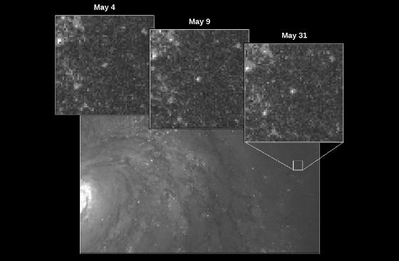
Figure 26.11
Cepheid Variable Star. In 1994, using the Hubble Space Telescope, astronomers were able to make out an individual cepheid variable star in the galaxy M100 and measure its distance to be 56 million light-years. The insets show the star on three different nights; you can see that its brightness is indeed variable. (credit: modification of work by Wendy L. Freedman, Observatories of the Carnegie Institution of Washington, and NASA/ESA)

Slide 50
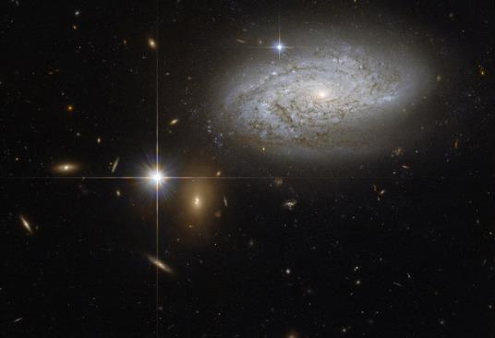
Figure 26.12
Type Ia Supernova. The bright object at the bottom left of center is a type Ia supernova near its peak intensity. The supernova easily outshines its host galaxy. This extreme increase and luminosity help astronomers use Ia supernova as standard bulbs. (credit: NASA, ESA, A. Riess (STScI))

Slide 51

Figure 27.15
Relationship between Black Hole Mass and the Mass of the Host Galaxy. Observations show that there is a close correlation between the mass of the black hole at the center of a galaxy and the mass of the spherical distribution of stars that surrounds the black hole. That spherical distribution may be in the form of either an elliptical galaxy or the central bulge of a spiral galaxy. (credit: modification of work by K. Cordes, S. Brown (STScI))

Slide 52
Velkorozměrové struktury
galaxie jsou většinou ve skupinách
Místní skupina galaxií
  Galaxie, M 31, M 33, LMC, SMC
  průměr 800 kpc
kupy galaxií
buněčná struktura

Slide 53


Slide 54


Slide 55
… konec
Messierovy objekty
katalog

