Slide 1
French influence
Kron

Slide 2
English has borrowed so many words from the French that someone once half-seriously claimed that English is little more than French badly pronounced.
Some of these words have kept their original spelling, while others have become so Anglicized you may not recognize them as originally French.
Nearly half of English French borrowings came into English before the 19th century; thereafter, the adaptations tended to be of a more literaly nature.
However, a little bit of french goes a long way; its overuse can make the speaker or writer seem affected and pretentious.
But French terms can lend both elegance and precision to your self-expression, as well as a certain charm, or what the French call je ne sais quoi (literally „I don‘t know what“) – an indefinable stylish quality that enhances your presentation of yourself.

Slide 3
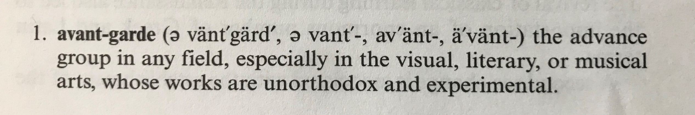
French borrowings used in contemporary English:

Slide 4
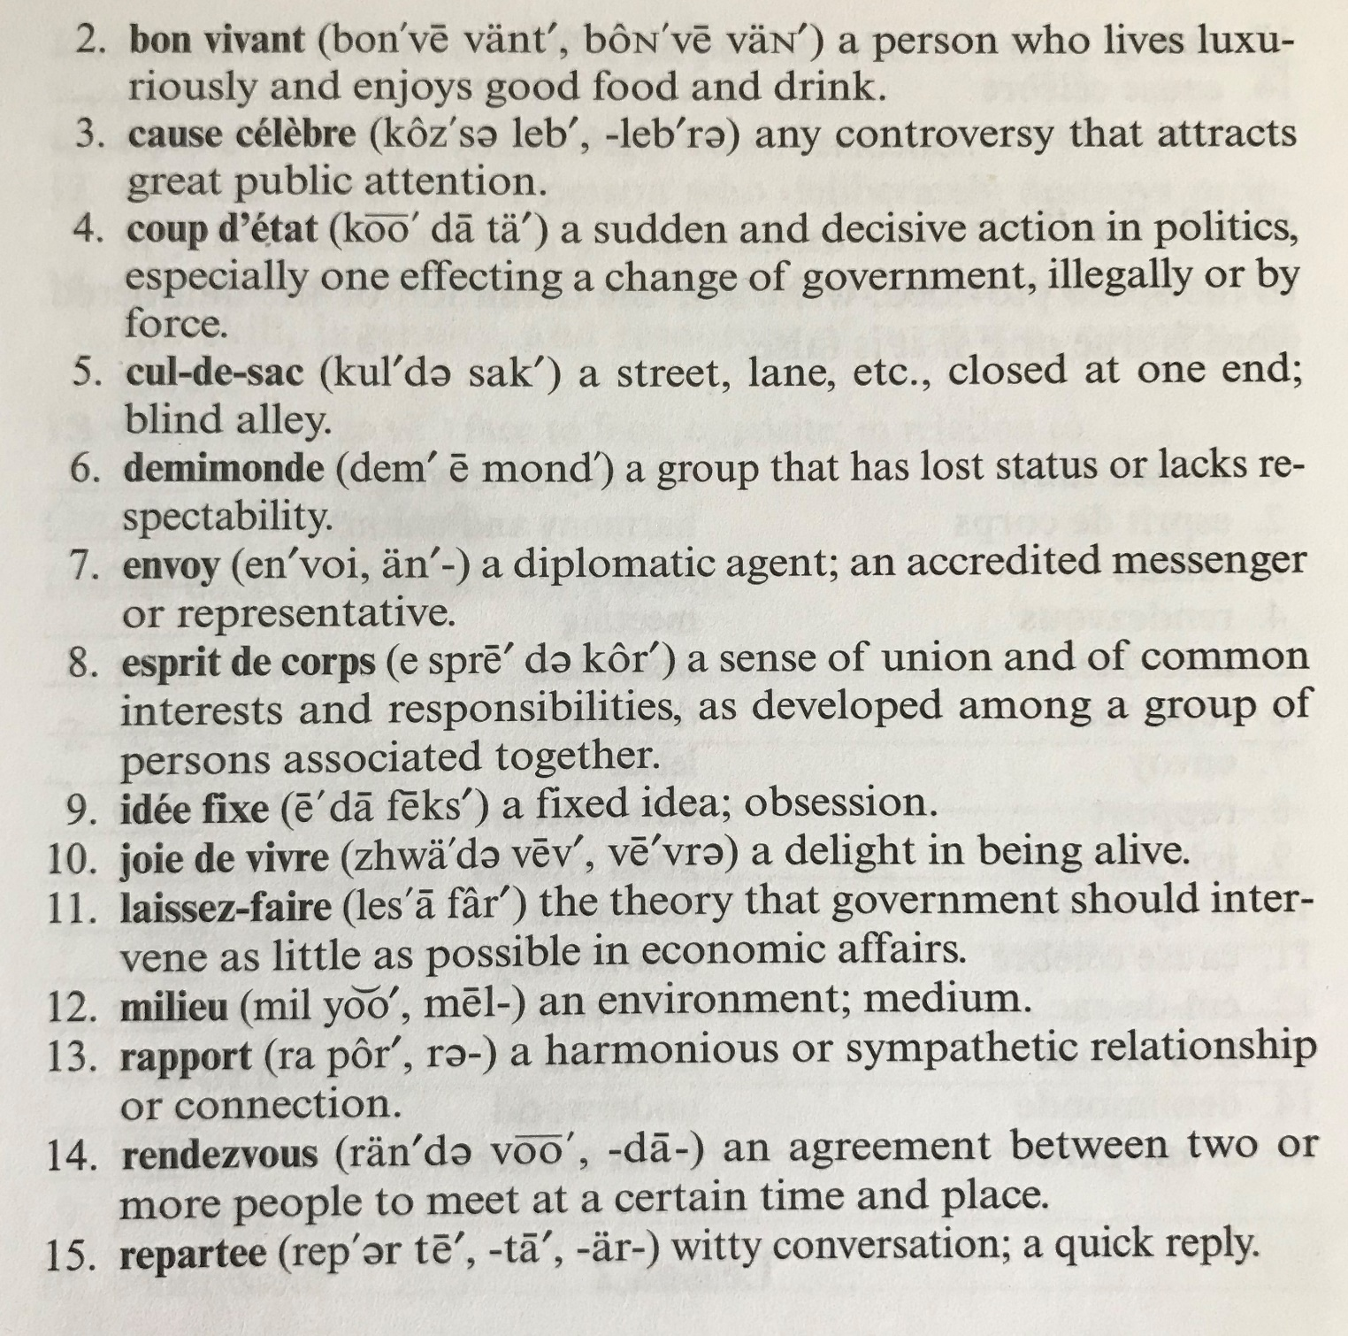

Slide 5
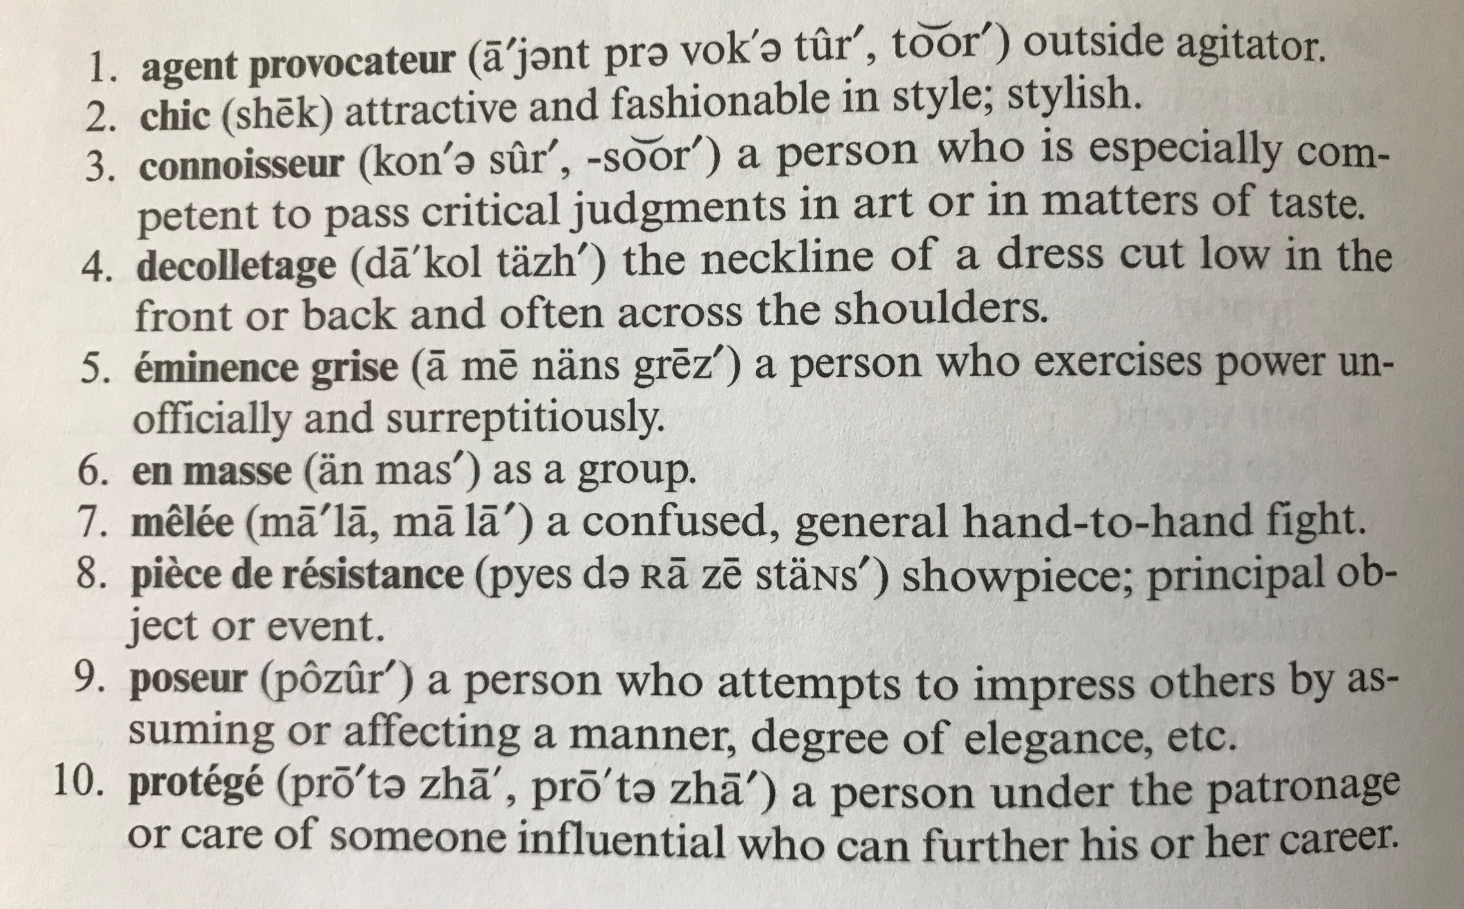

Slide 6
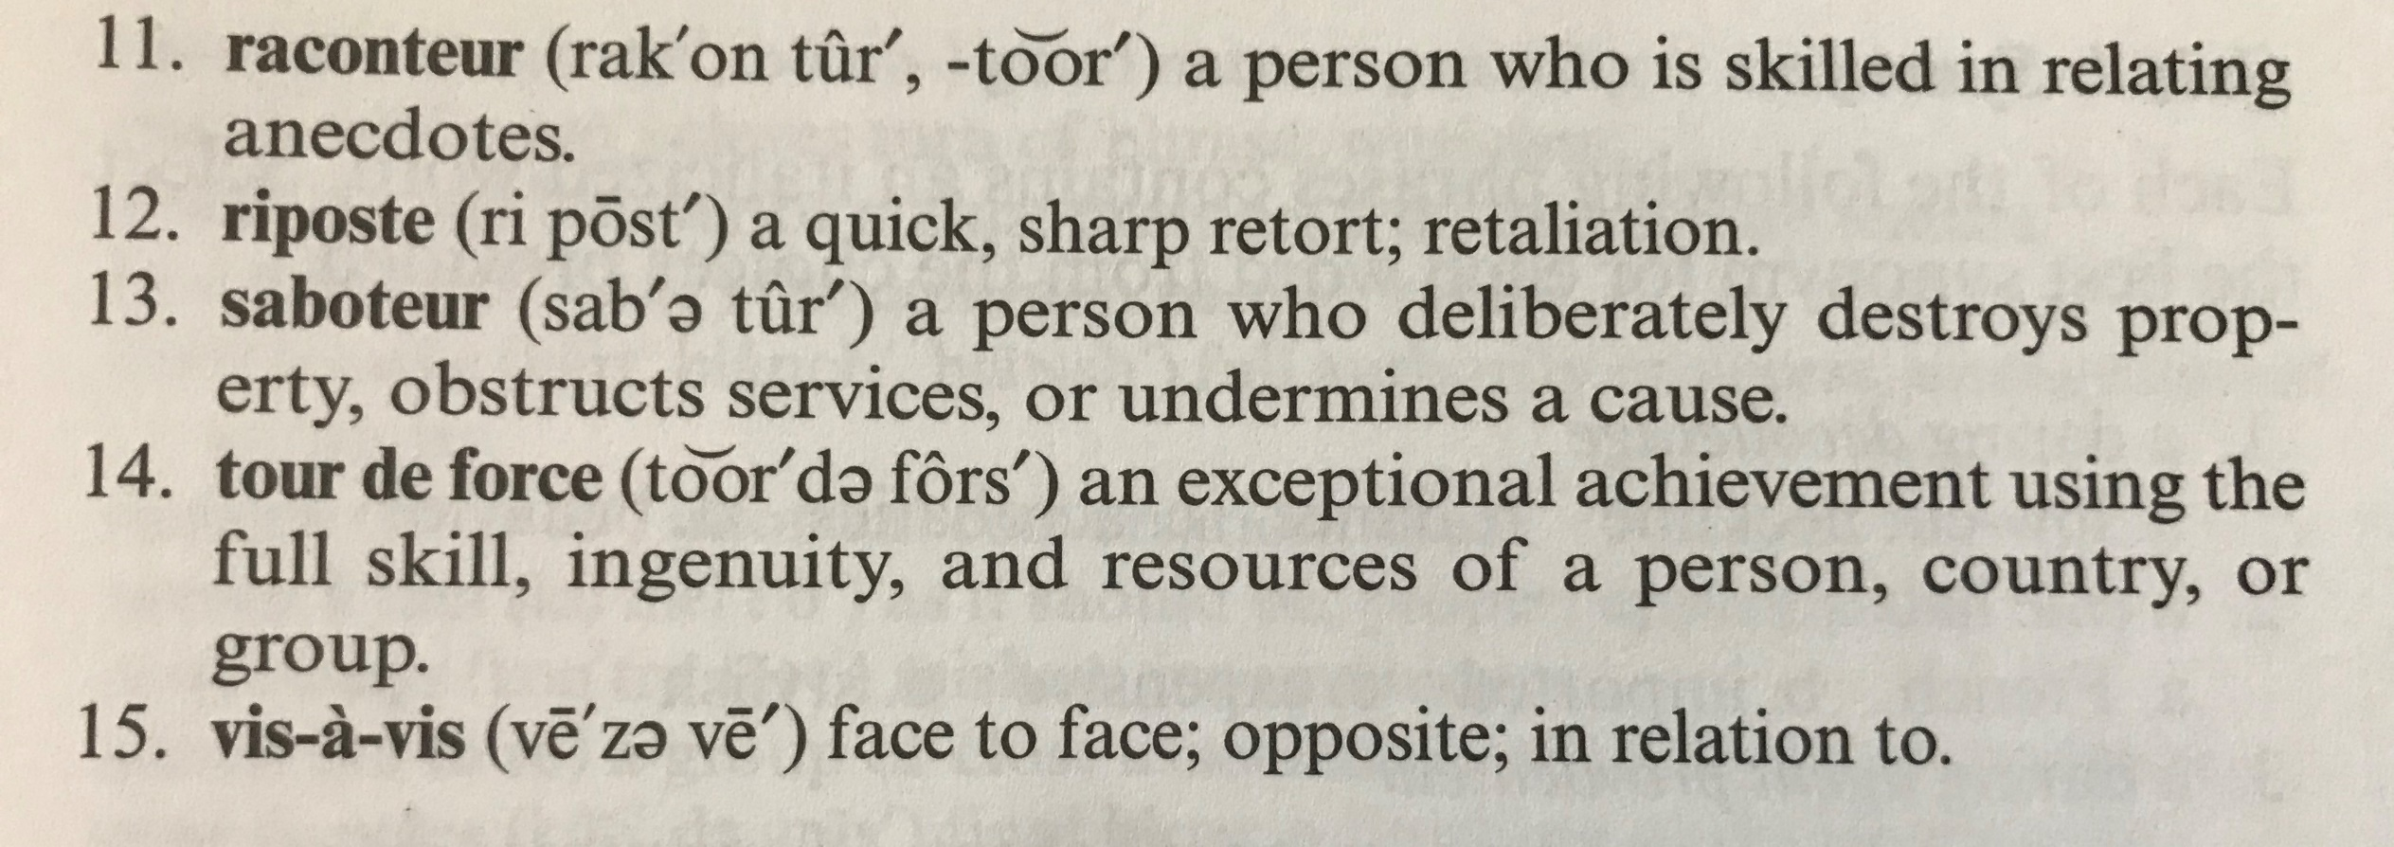

Slide 7
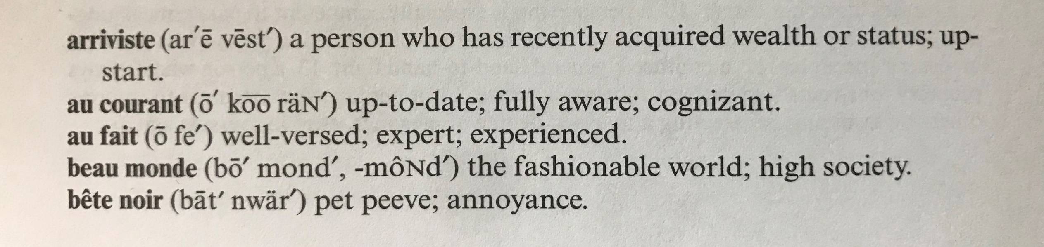

Slide 8
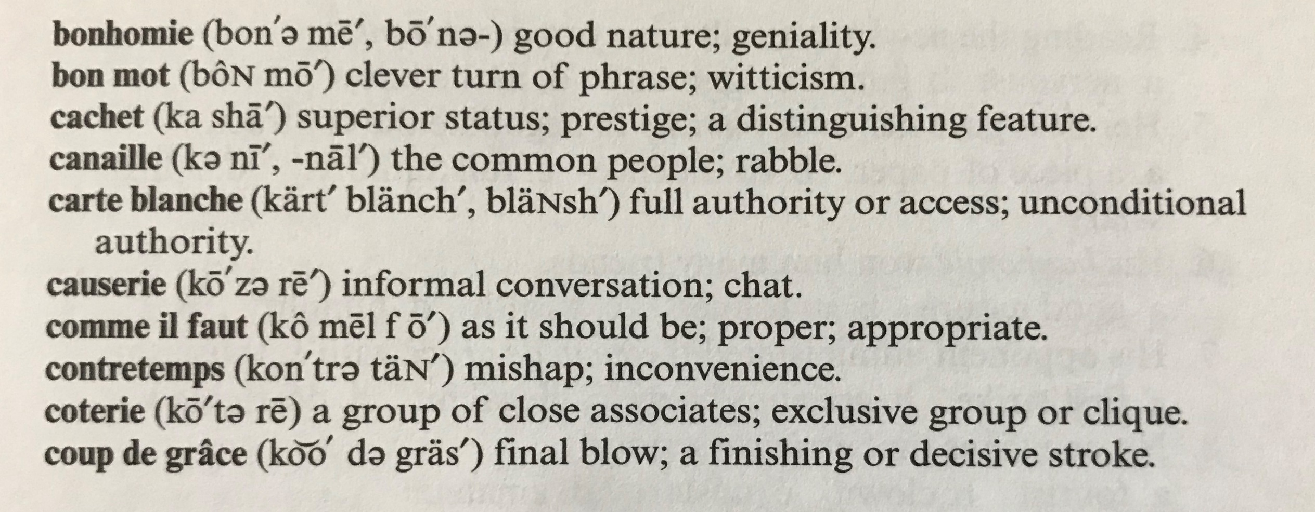

Slide 9
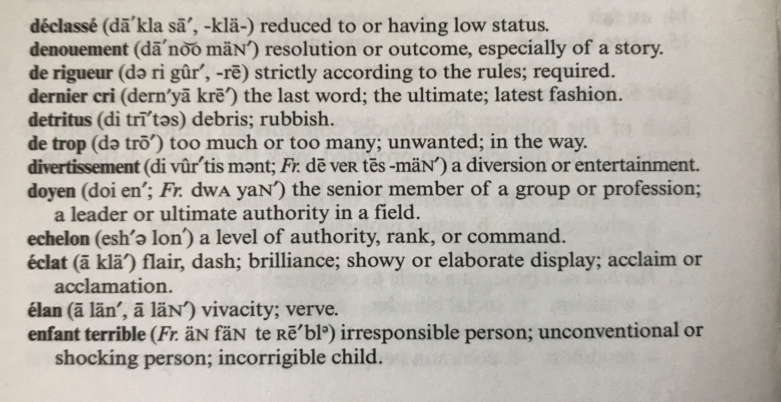

Slide 10
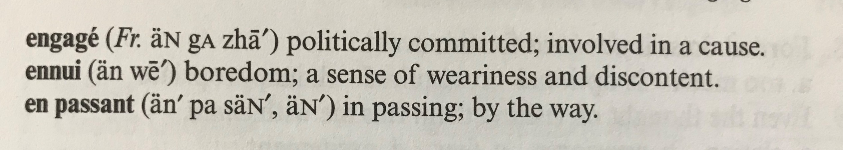

Slide 11
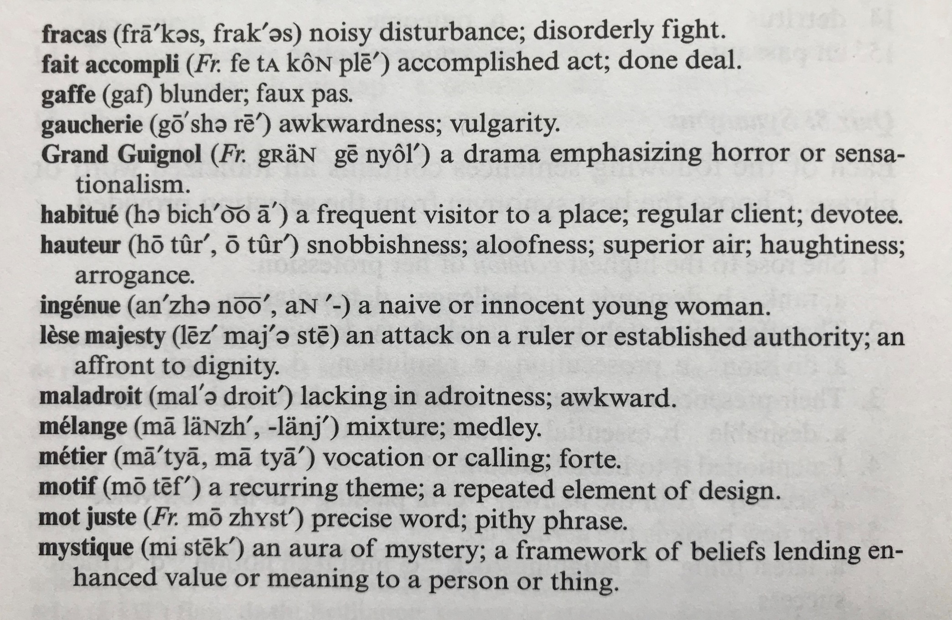

Slide 12
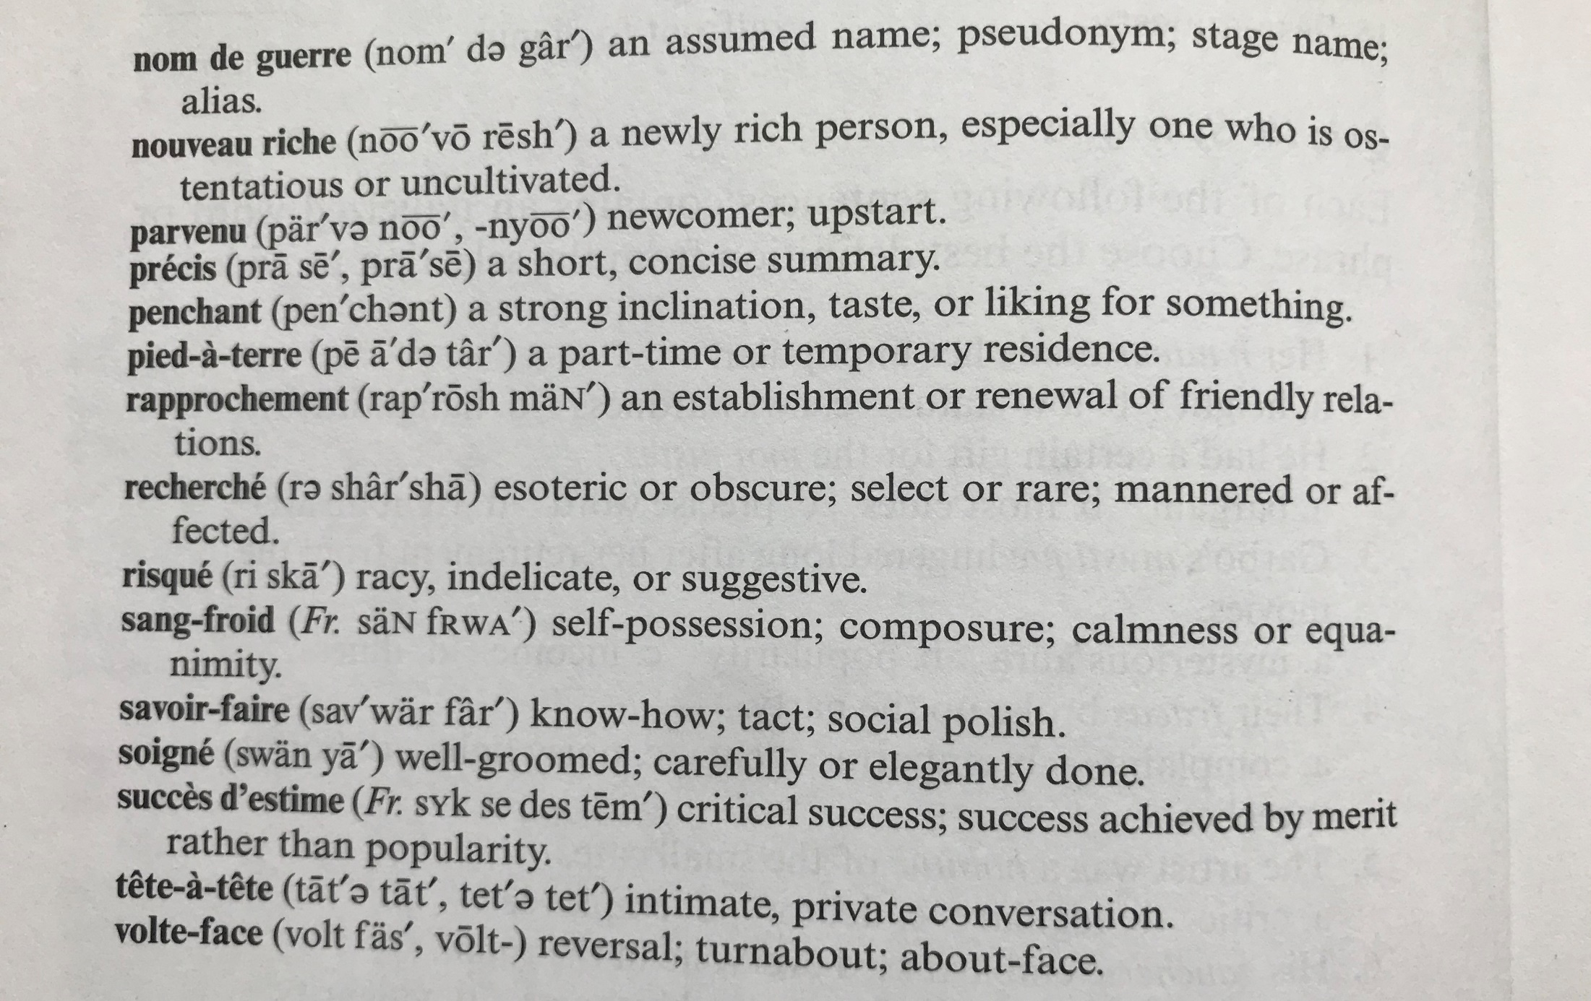

Slide 13
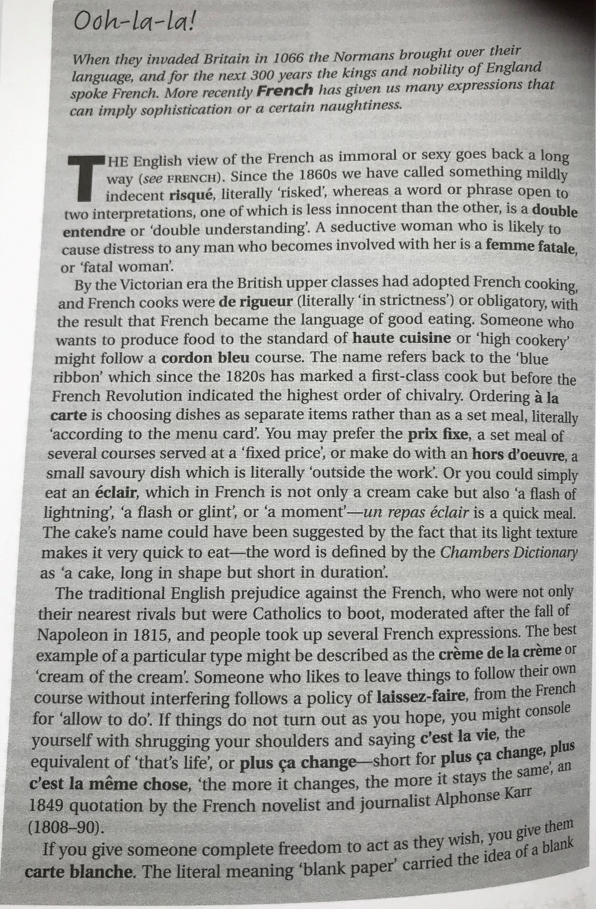

Slide 14
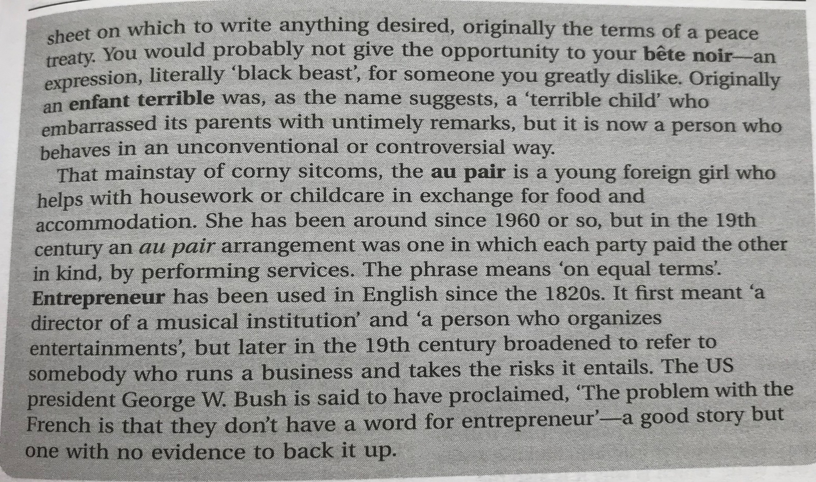

Slide 15
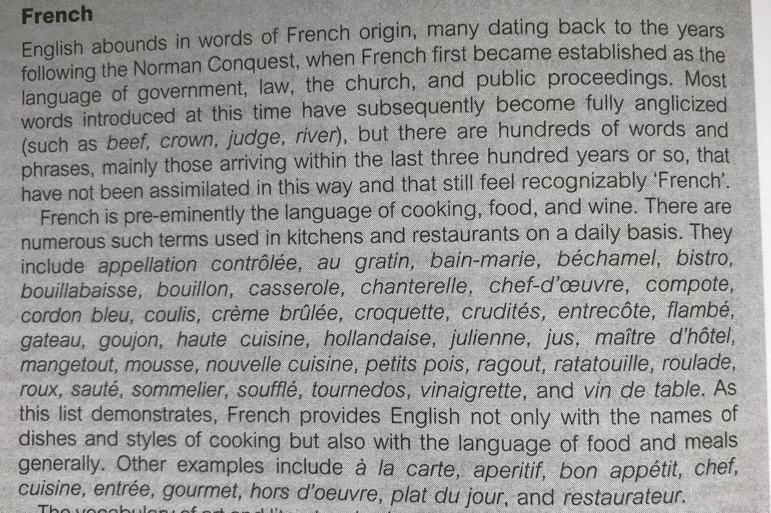

Slide 16
