Slide 1
Dutch in English
Kron

Slide 2
The British colonies started to communicate with other settlements on the East Coast : Dutch, French and German - which led to new words into American English:
Out of the more interesting Dutch borrowing, I consider the following of importance:
boss, cookie, coleslaw, waffle, stoop, sleigh, probably Yankee (from Janke – diminutive of Jan), Santa Claus (Saint Nicolas, clipped to Sinterklaas in Dutch)

Slide 3
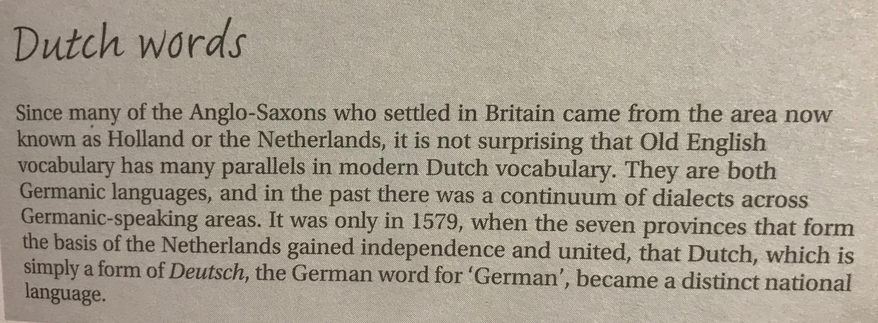

Slide 4
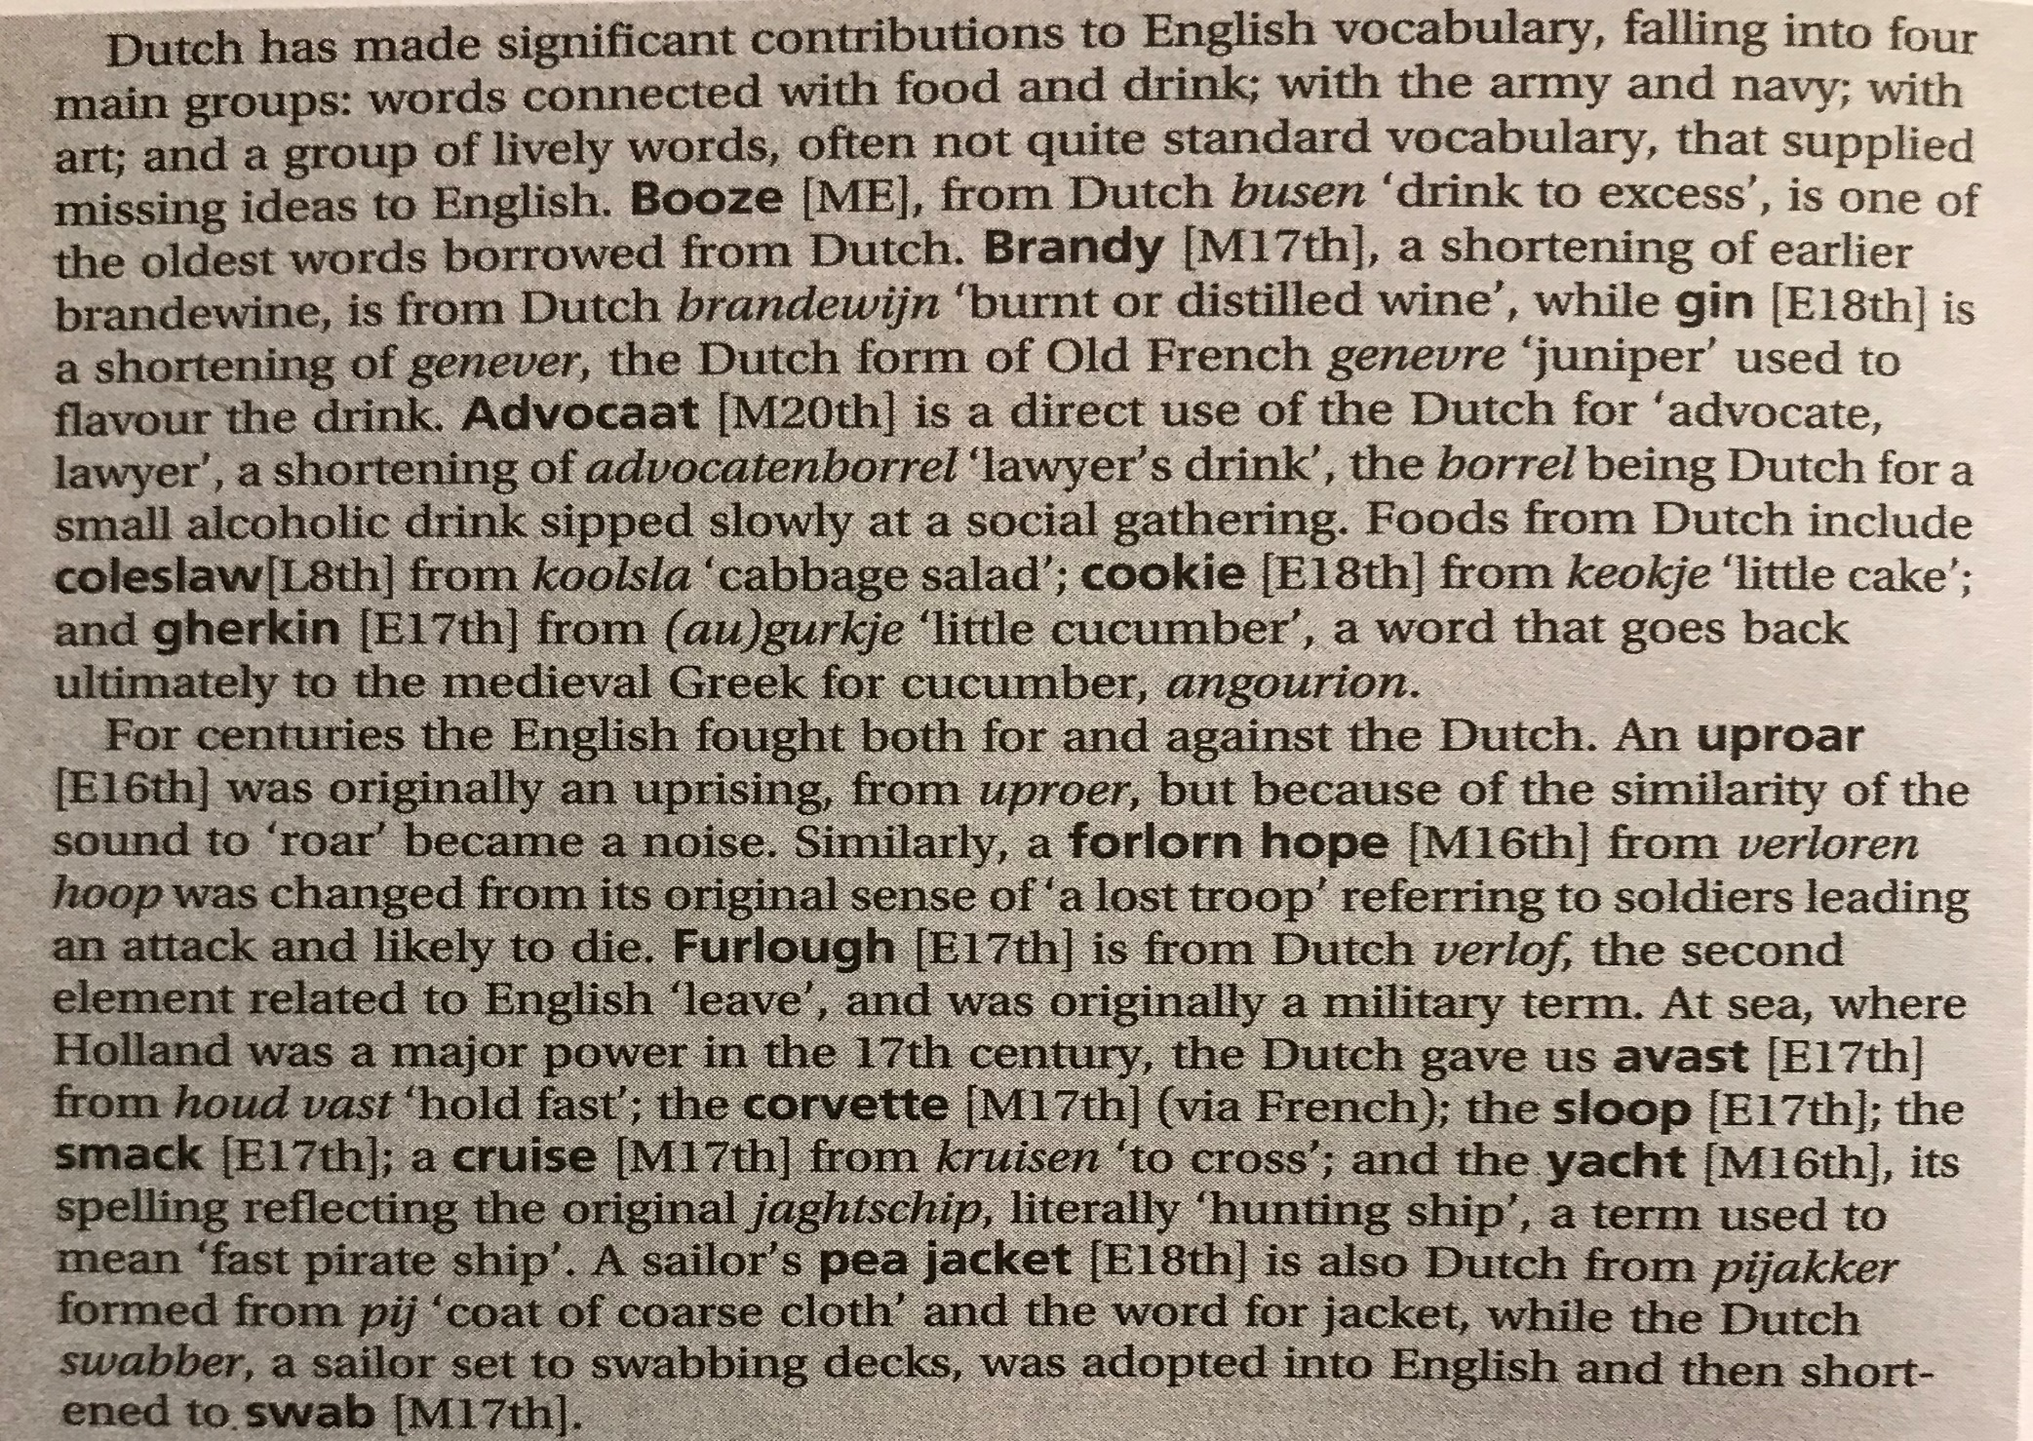

Slide 5
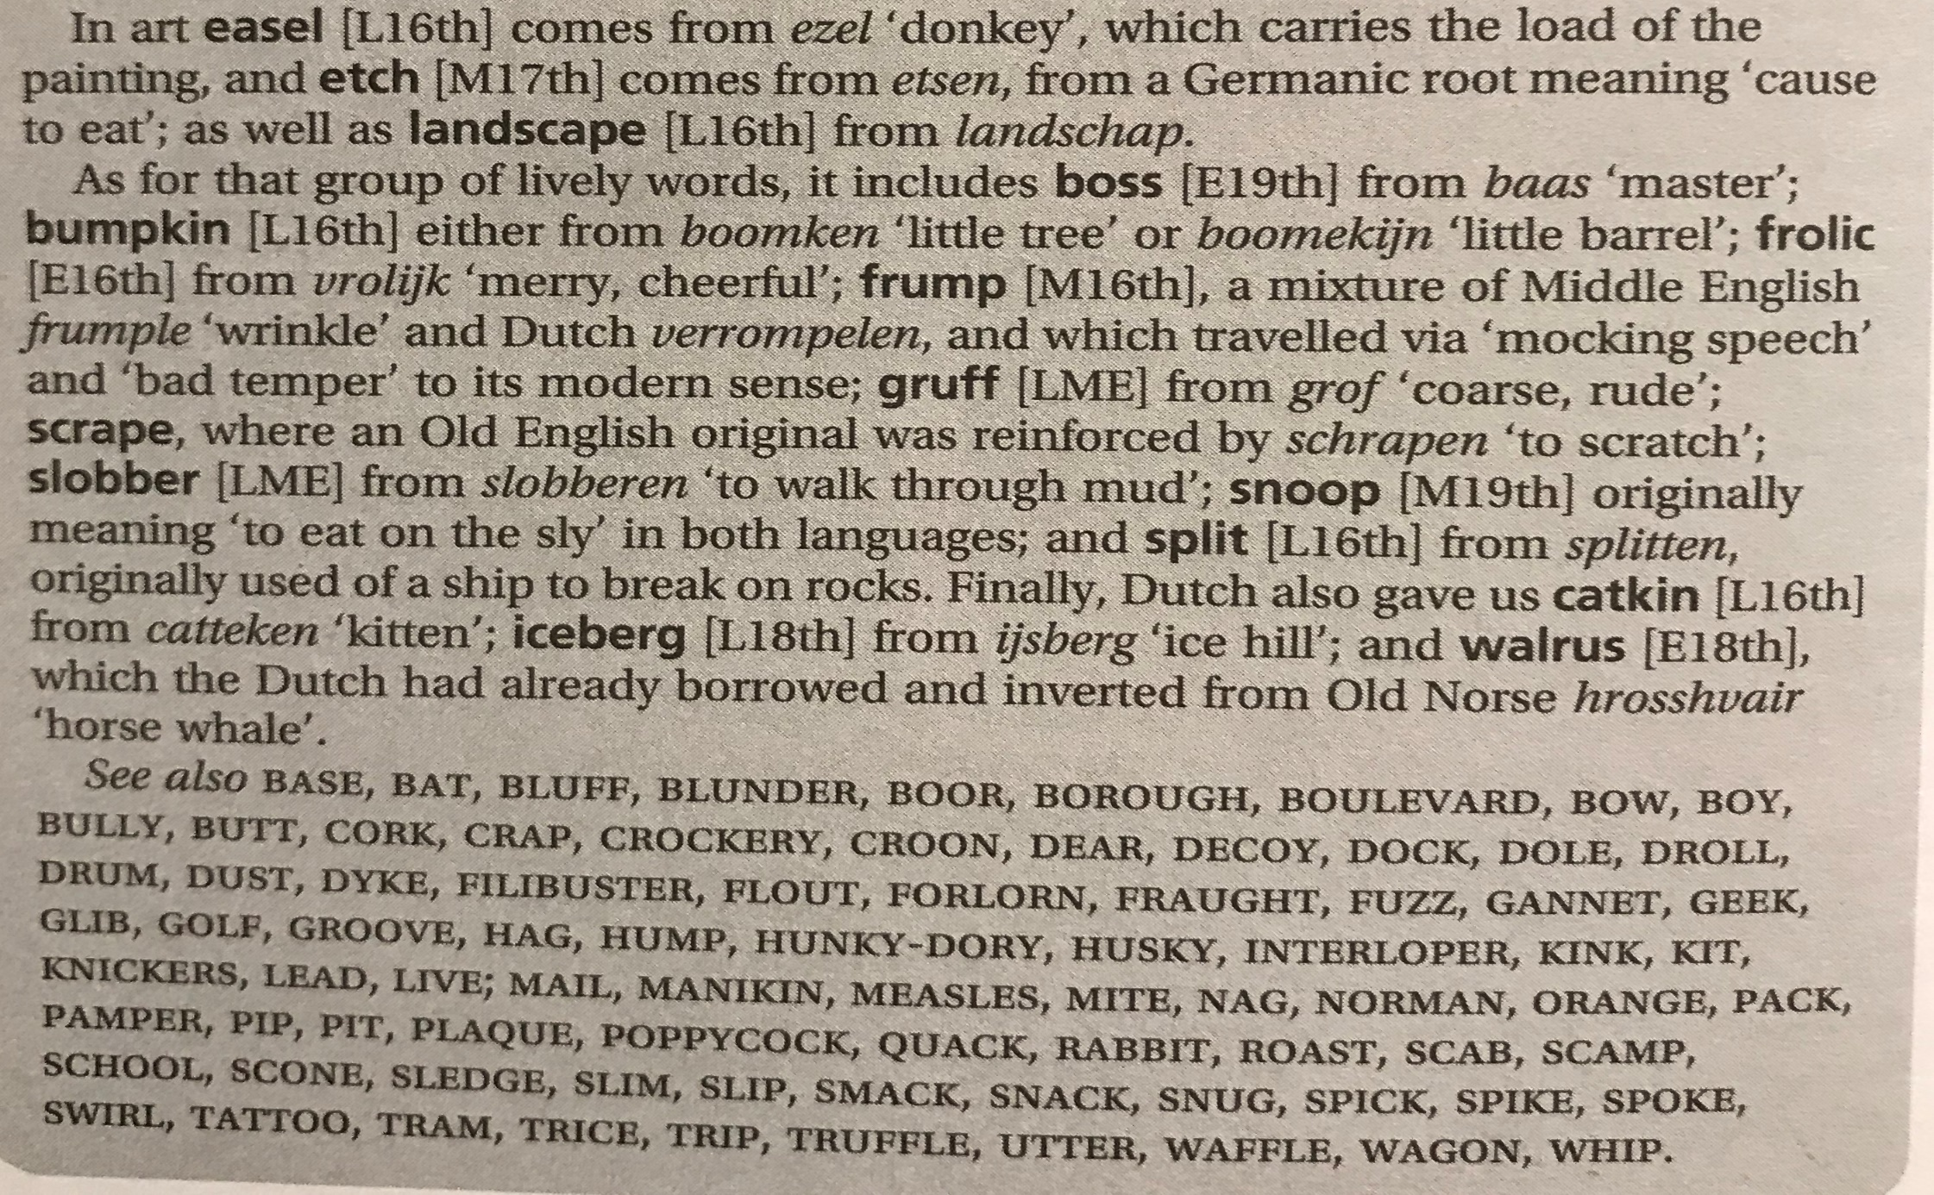

Slide 6
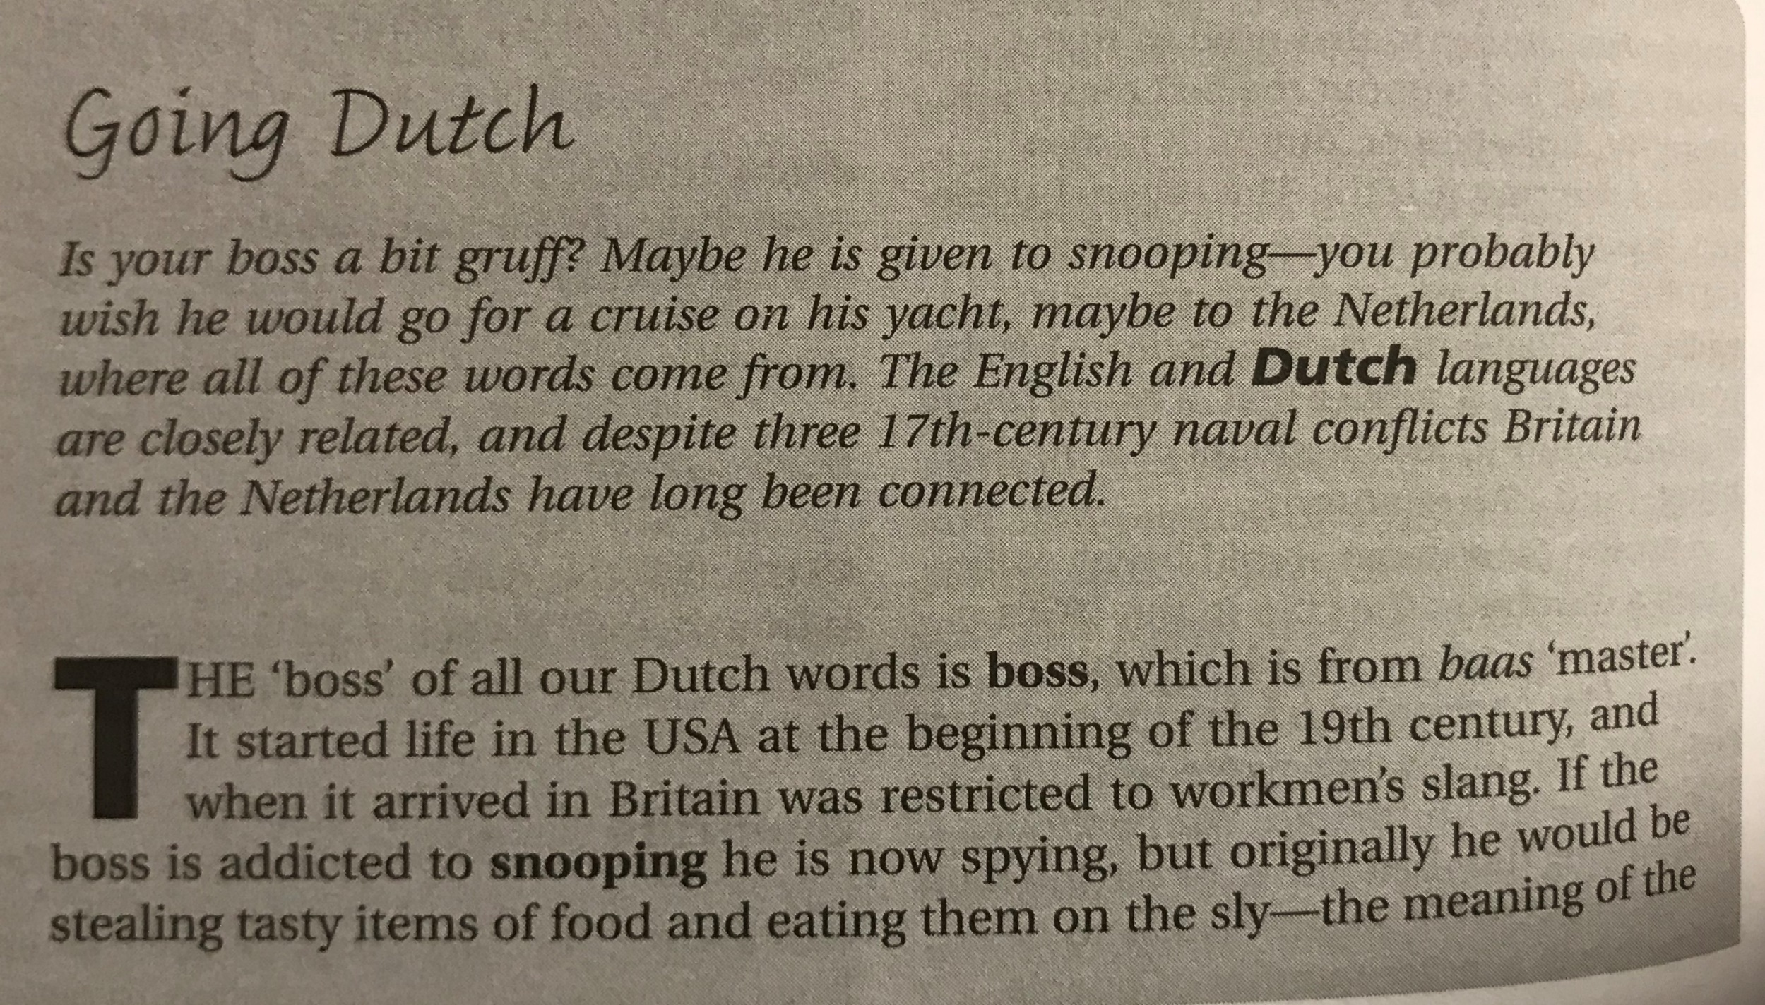

Slide 7
