Slide 1
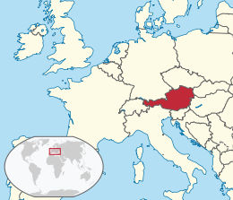
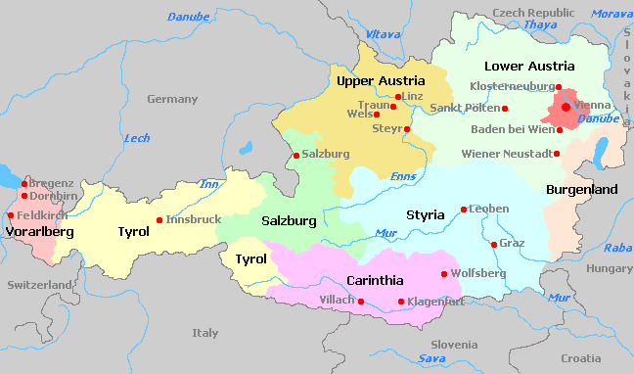
Austria
Österreich or Republic Österreich
Czech Republic & Germany to the north, Hungary & Slovakia to the east, Slovenia & Italy to the south, Switzerland & Liechtenstein to the west
84,000 km² , 8.6 million people
Vienna (Constitutional Law on Neutrality 1955)
25 million foreign tourists

Slide 2
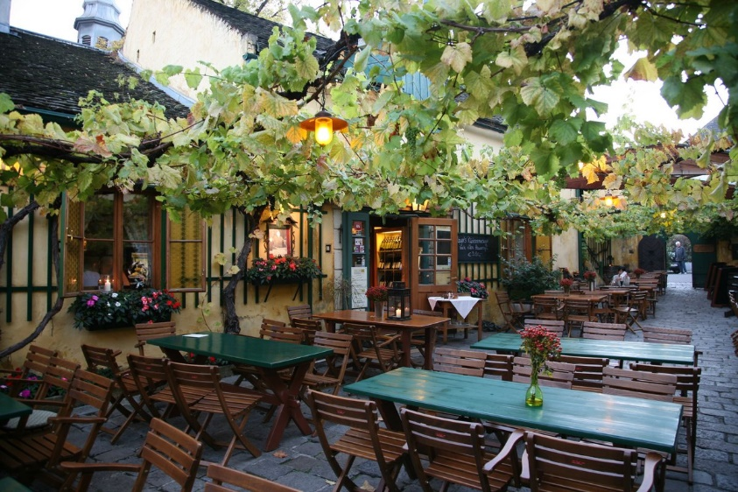
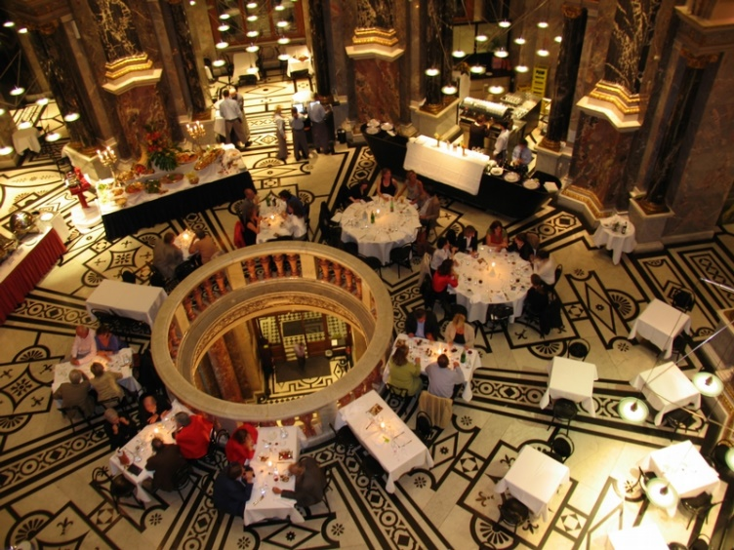
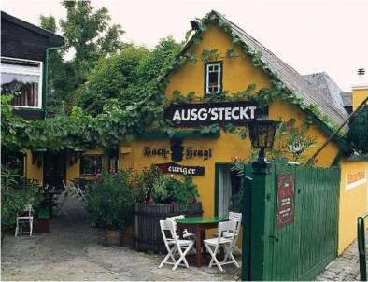
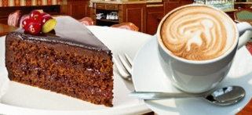
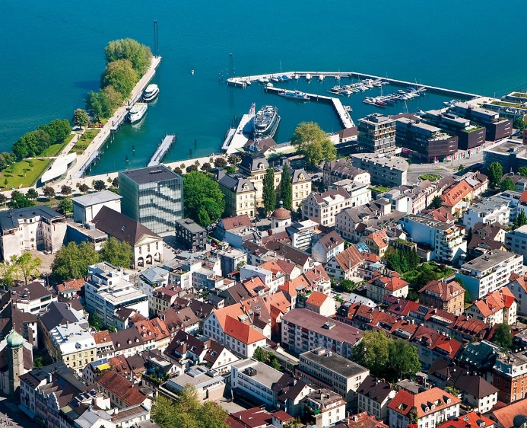
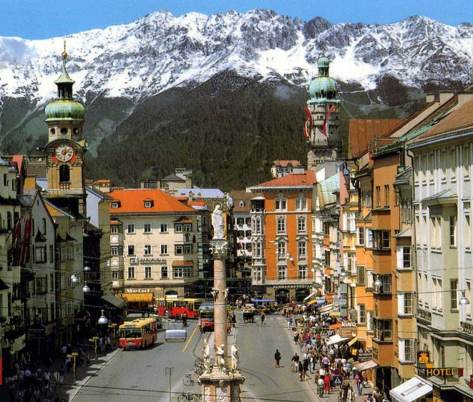
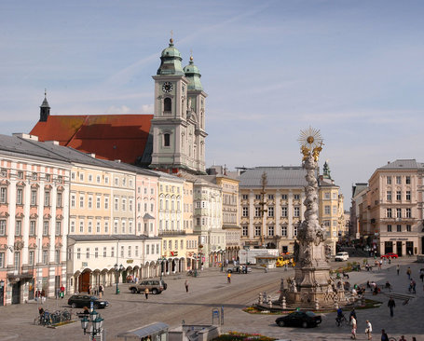
Tourist attractions
Capital city of Vienna – abundant architectural monuments, cultural events, cafés & taverns called Heuriger (specially licenced local winemakers serve their recent year wines)
Bregenz
Insbruck
Linz

Slide 3
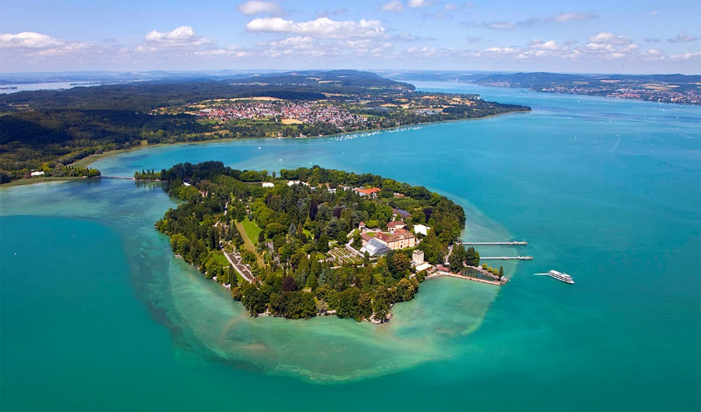
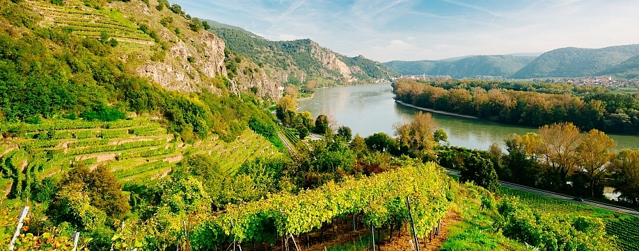
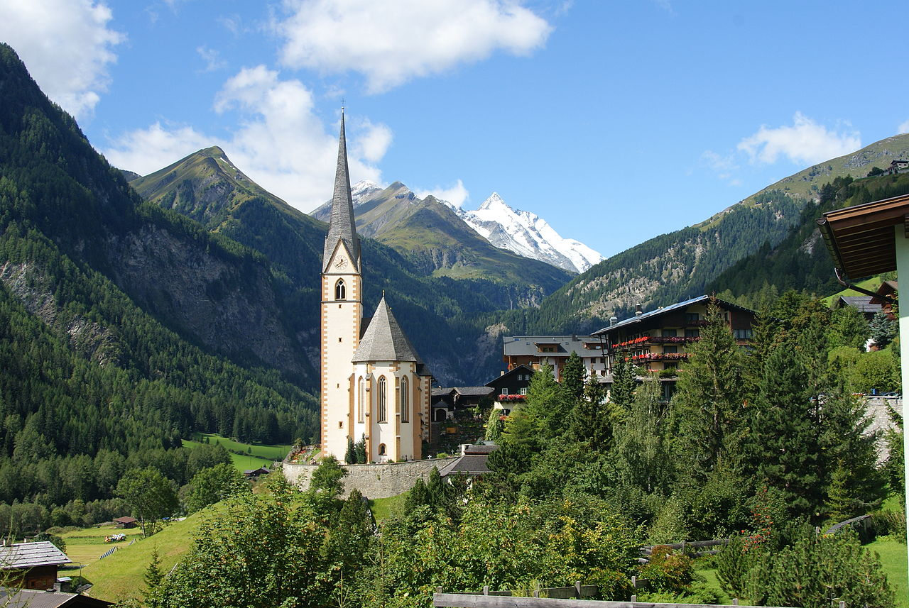
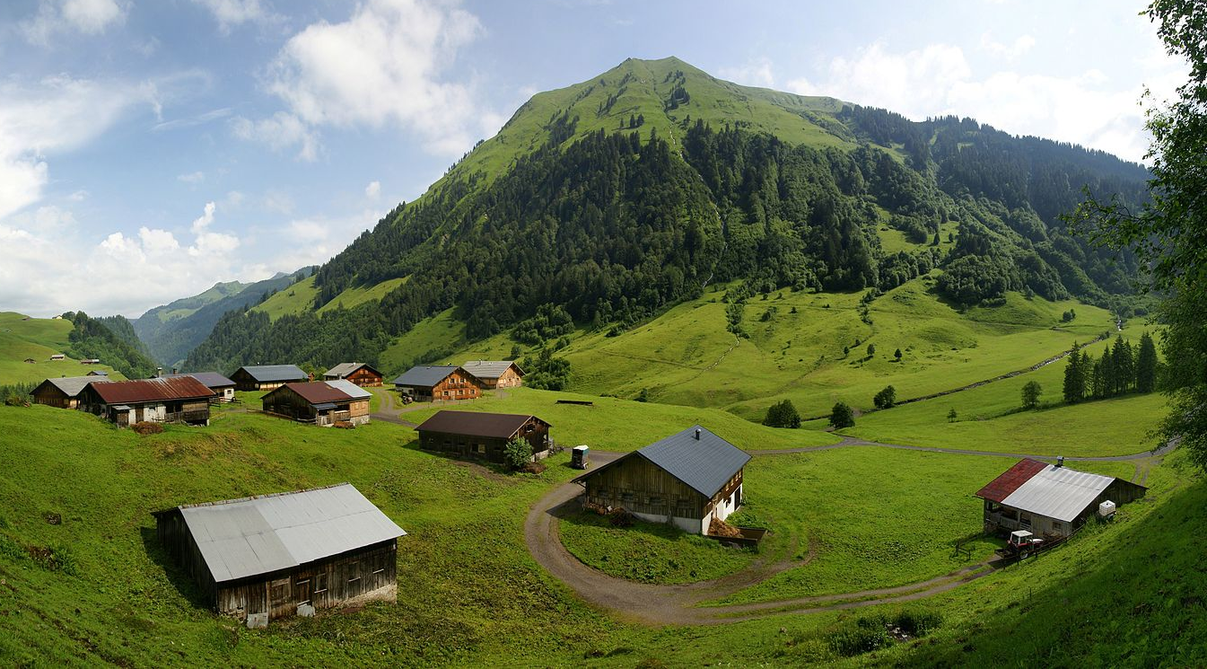
nature
Danube valley with vineyards such (Wachau or Dunkelsteinerwald)
Bodensee (Lake Constance ), Neusiedler See, Wolfgangsee, Grundlsee, Wörthersee
Austrian Alps
Dunkelsteinerwald
Bodensee

Slide 4
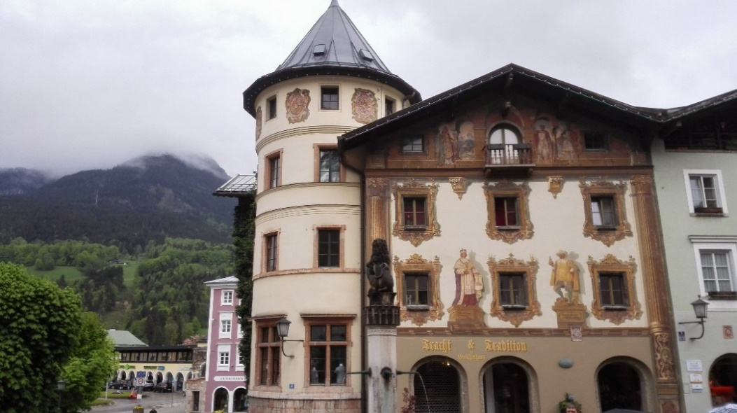
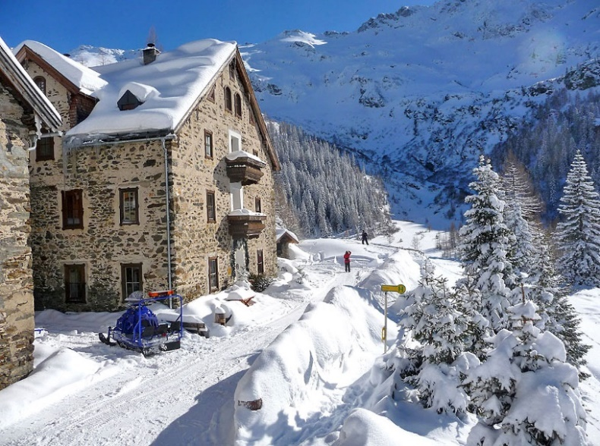
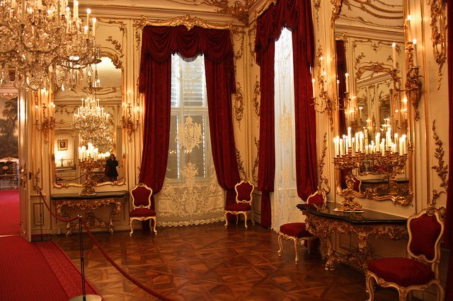
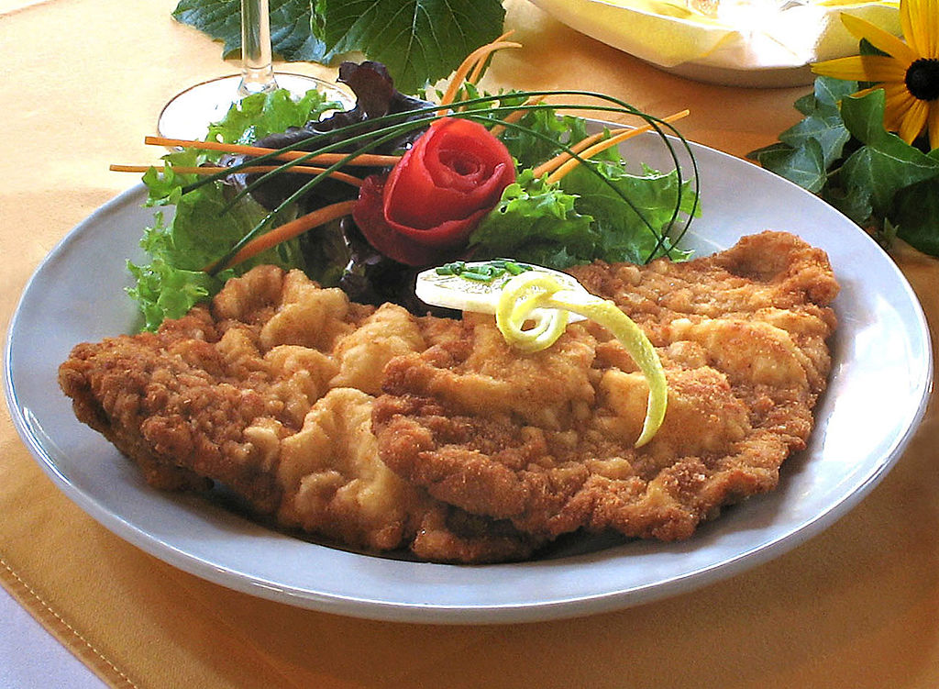
Unesco world heritage sites
Nine cultural sites
One transboundary with Hungary
One with France, Germany, Italy, Slovenia & Switzerland

Slide 5
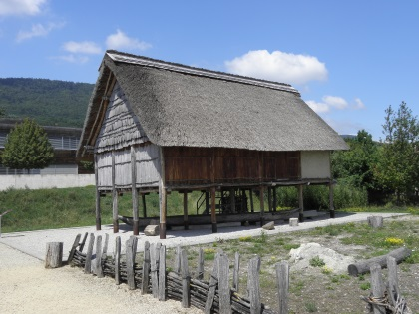
Prehistoric Pile dwellings around the Alps
Serial property of 111 small individual sites
Austria 5 sites, France (11), Germany (18), Italy (19), Slovenia (2) & Switzerland (56)
Remains of prehistoric pile-dwelling (stilt house) settlements
Built from around 5000 to 500 BC on the edges of lakes, rivers & wetlands
Well-preserved & culturally rich archaeological sites (study of early agrarian societies in the region)

Slide 6
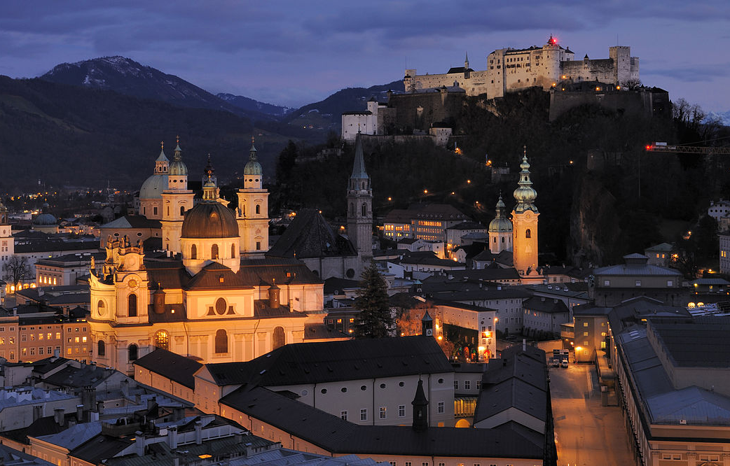
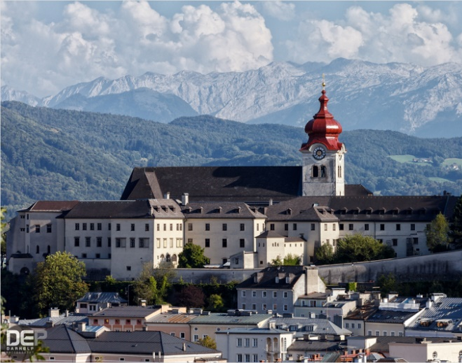
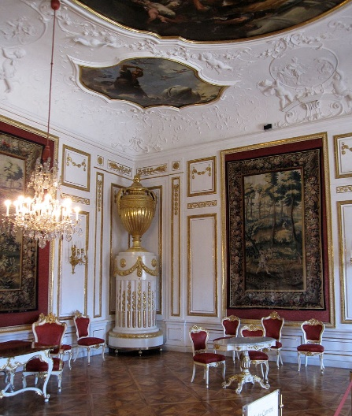
Historic Centre of the City of Salzburg
Attractive setting & scenic Alpine backdrop, birthplace of Wolfgang Amadeus Mozart
City-state ruled by prince-archbishop of the Holy Roman Empire (until beginning of 19c)
Blend of Gothic & Baroque style buildings – Cathedral (17c), Hohensalzburg Castle (one of largest in Europe, atop Festungberg), Franciscan Church (13c), St Peter’s Abbey (Benedictine, 696 by Saint Rupert), Nonnberg Abbey (Benedictine, around 710), Salzburg Residenz (Prince-Archbishops)
Nonnberg Abbey
Cathedral
Franciscan Church
St Peter’s Abbey

Slide 7
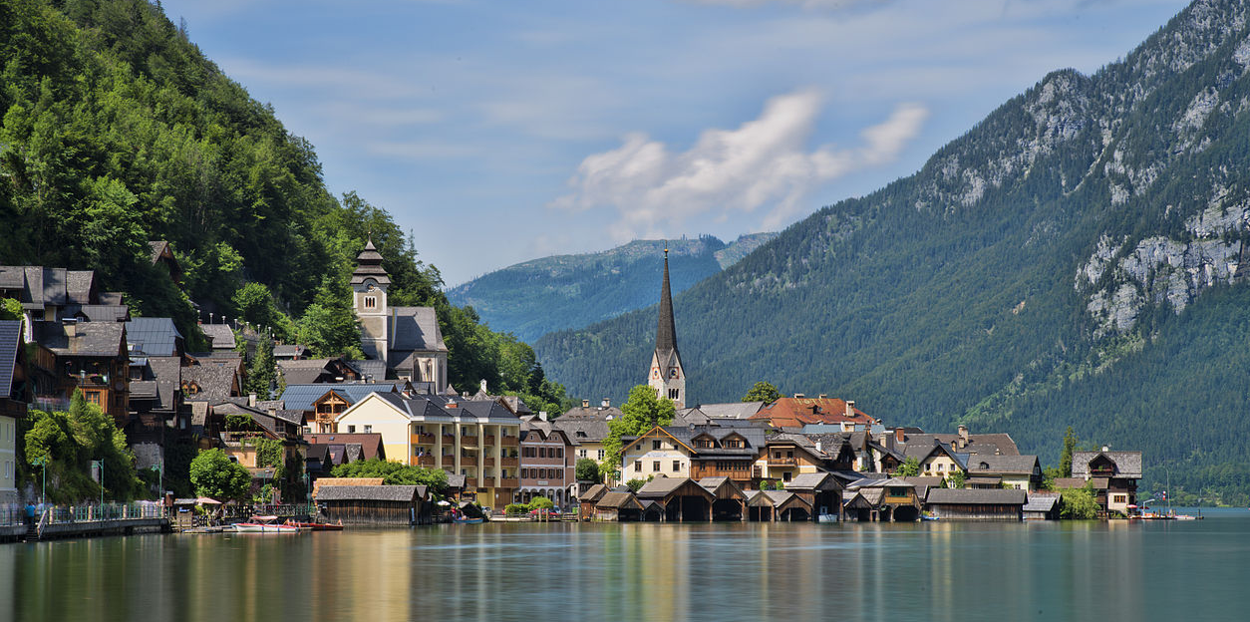
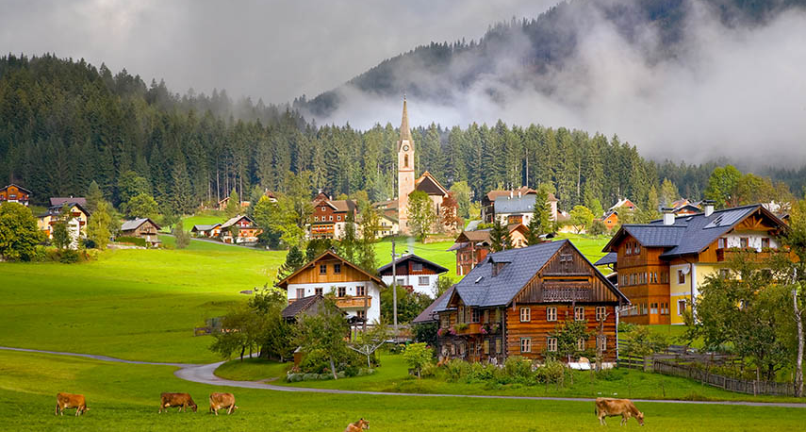
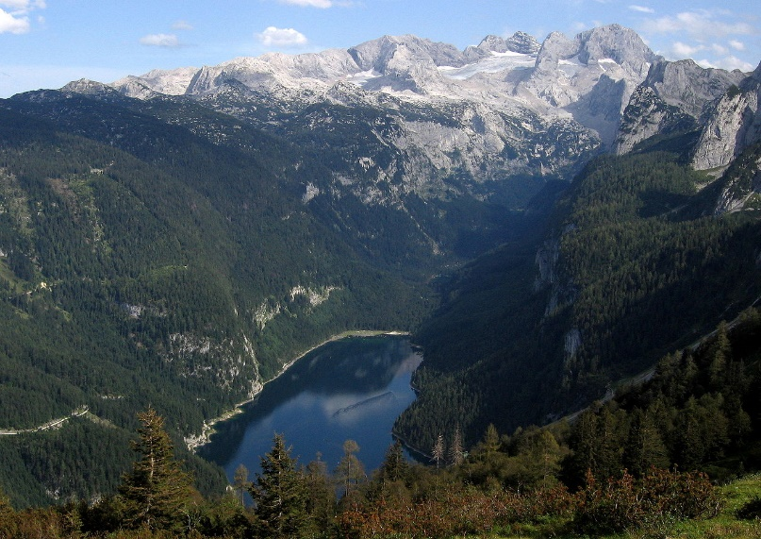
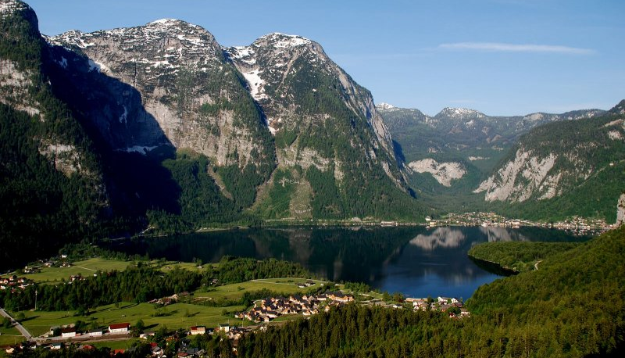
Hallstatt-Dachstein / Salzkammergut Cultural Landscape
Salzkammergut – resort area from Salzburg along Alpine foreland to Dachstein Mountains
Towns of Hallstatt, Obertraun, Gosau, Bad Goisern & their surroundings
Region – result of human activity since prehistoric times (2 millennium BC, salt deposits)
Glacial lakes & mountains (Salzkammergut, Dachstein, Totes Gebirge & Upper Austrian Pre-Alps)
Hallstatt
Gosau
Dachstein
Obertraun

Slide 8
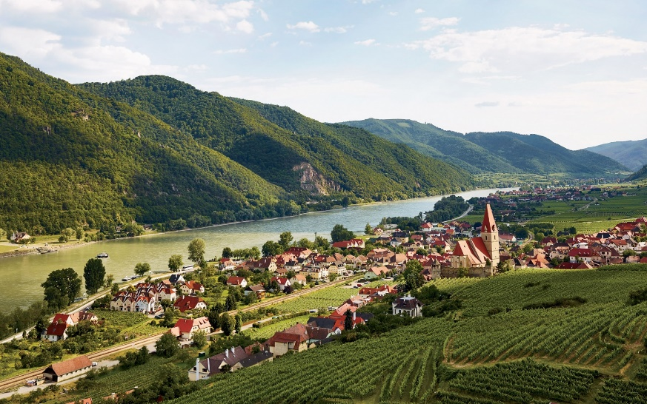
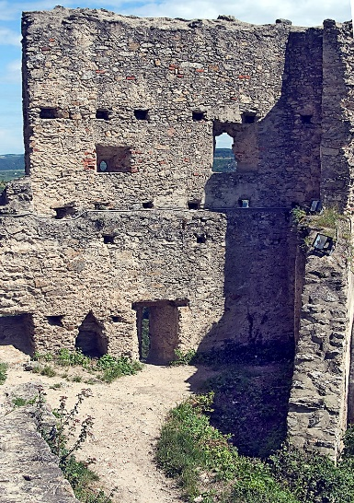
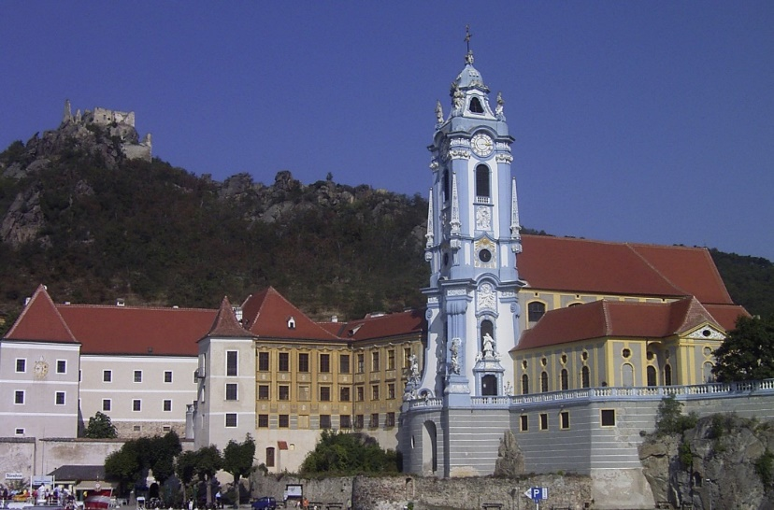
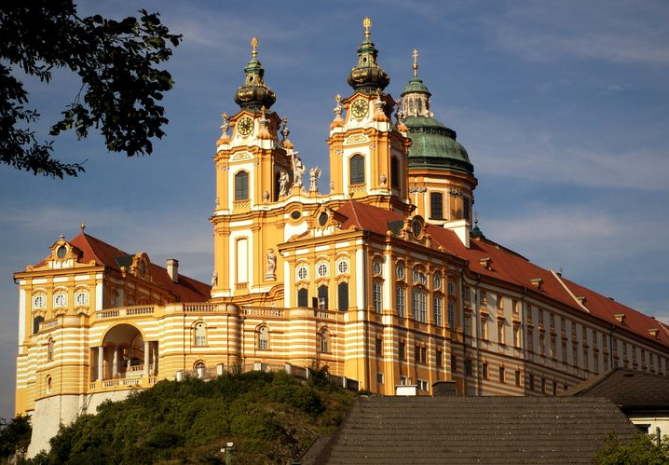
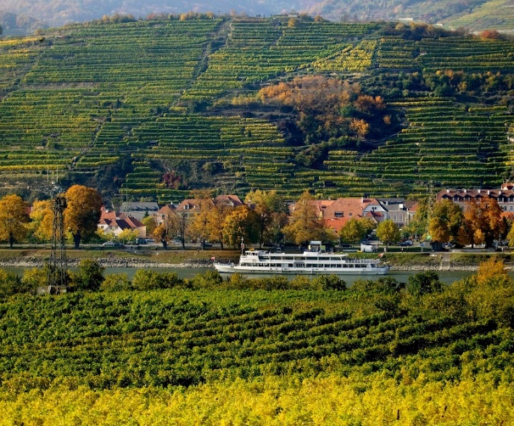
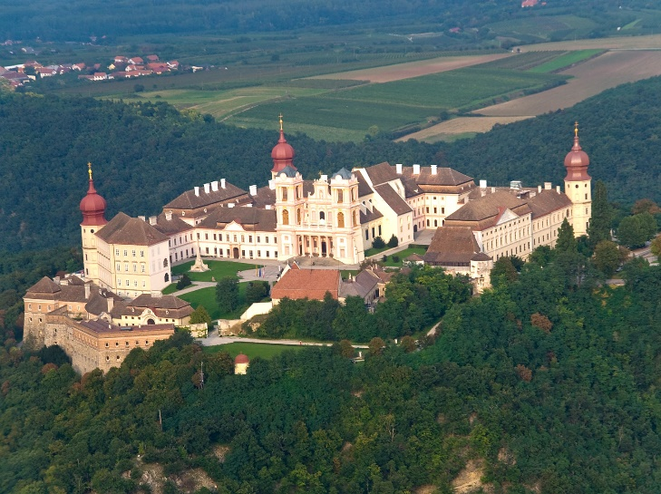
Wachau Cultural Landscape
40 kilometres long valley along River Danube between Melk & Krems (settled in prehistoric times)
Ancient monasteries (Benedictine Abbey of Melk, Göttweig Abbey), castles (Renaissance Schallaburg Castle), ruins (Aggstein Castle), towns & villages, terraced vineyards
Dürnstein with ruin of castle (Richard the Lion-Heart imprisoned)
Dürnstein
Melk
Göttweig

Slide 9
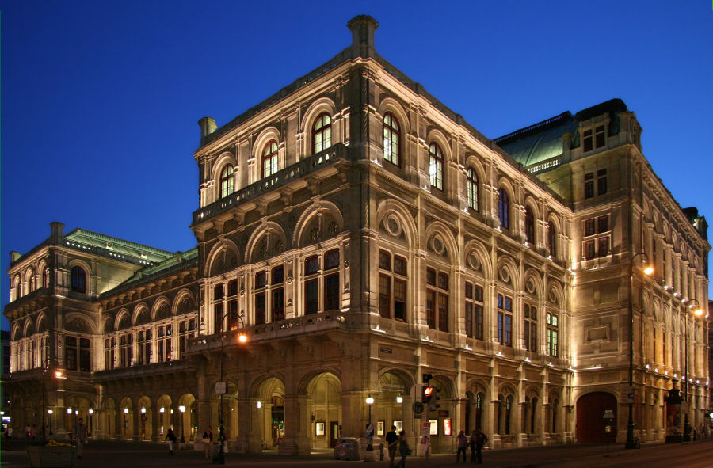
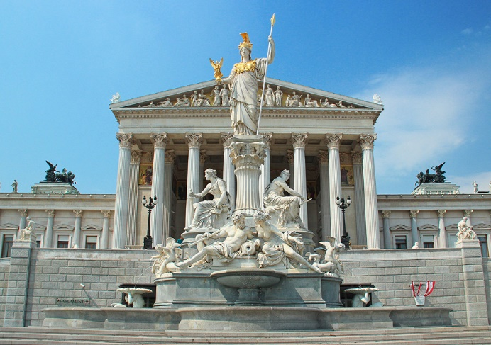
Historic Centre of Vienna
Roman castrum – fortified frontier city Vindobona (15 BC, on site of earlier Celtic settlement)
Capital of Duchy of Austria (12c), resident city of Habsburg dynasty (1440), capital of Holy Roman Empire, capital of Austro-Hungarian Empire
Ringstraße – boulevard surrounding historical town (19c – town walls pulled down, lined with public & private buildings, monuments & parks) – twin museums of Natural History & Fine Art, Vienna State Opera (Wiener Staatsoper), Imperial Court Theatre (Burgtheater), Parliament
Naturhistorische & Kunsthistorische Museums
Parliament
Staatsoper
Parliament
Burgtheater

Slide 10
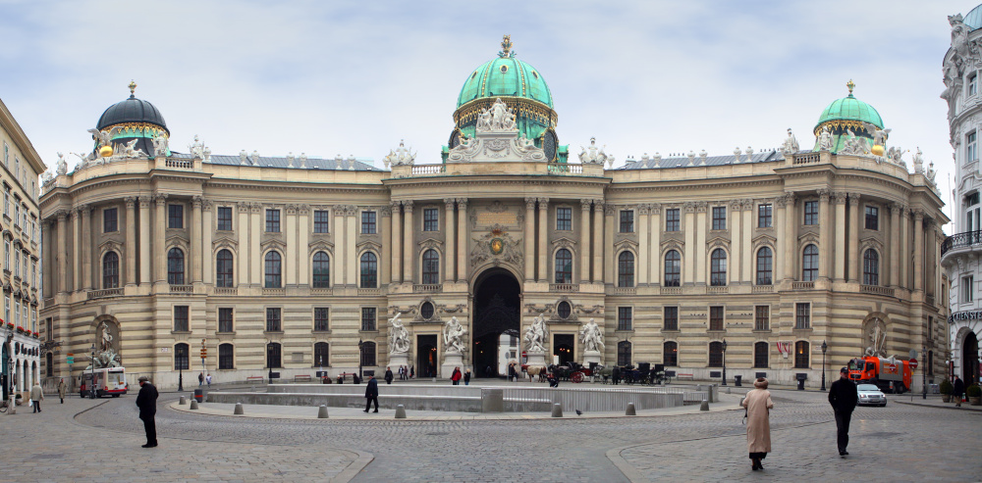
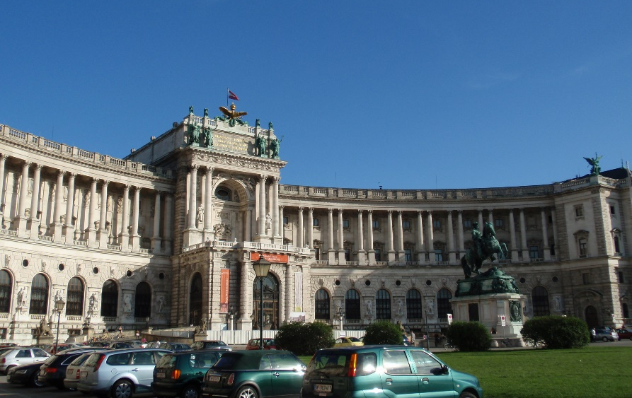
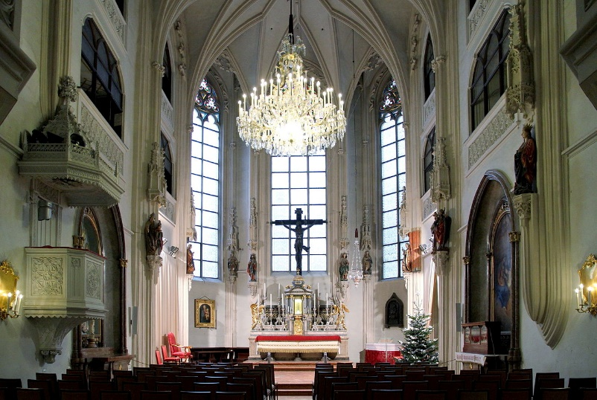
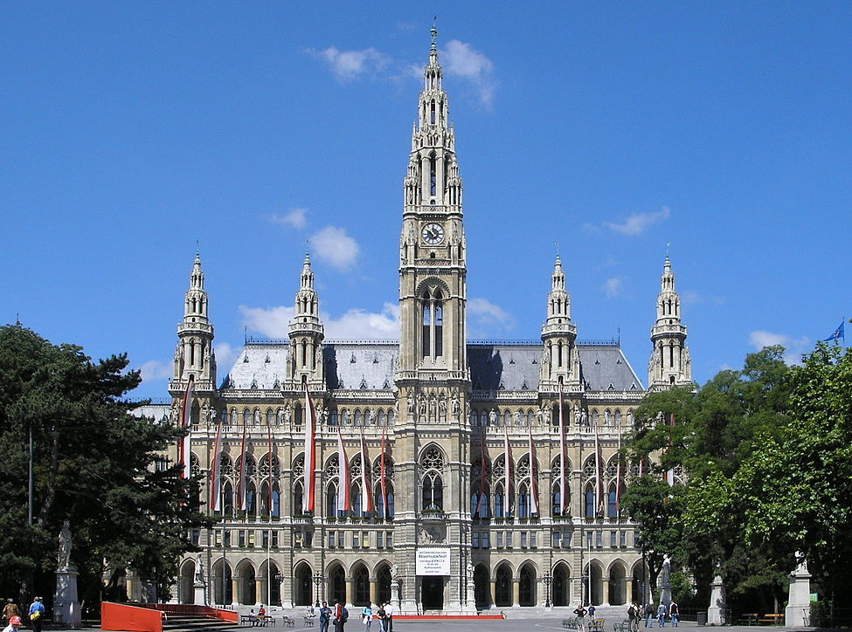
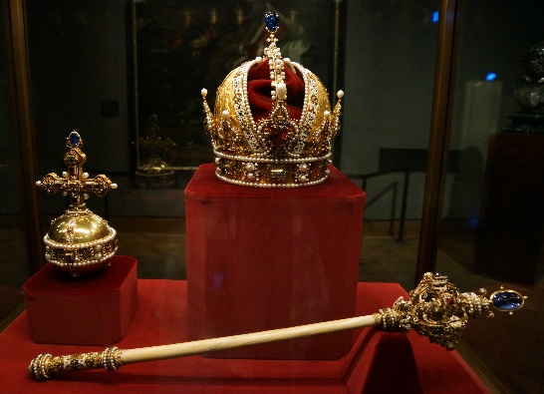
Historic Centre of Vienna
Ringstraße – Town Hall (Rathaus), Hofburg Palace (13c, imperial palace, principal winter residence of Habsburgs), Imperial Chapel (Hofkapelle/Burgkapelle), Austrian National Library (Hofbibliothek), Imperial Treasury (Schatzkammer)
Hofbibliotek
Hofburg
Rathaus

Slide 11
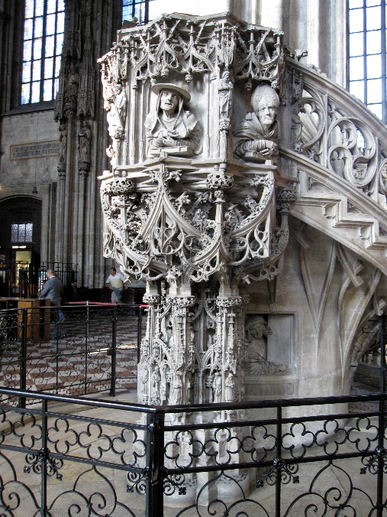
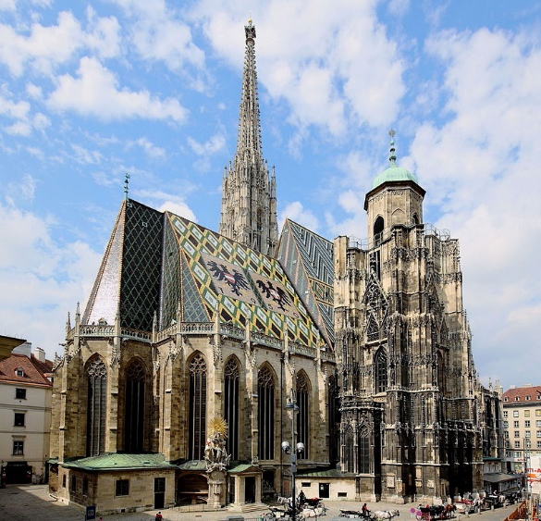
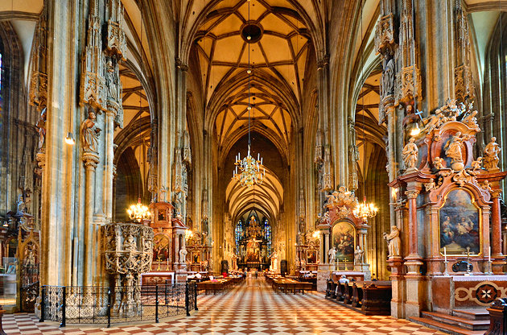
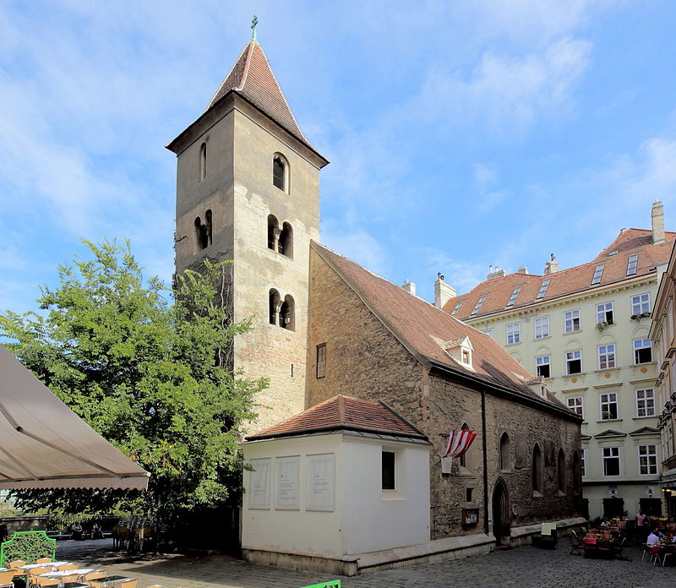
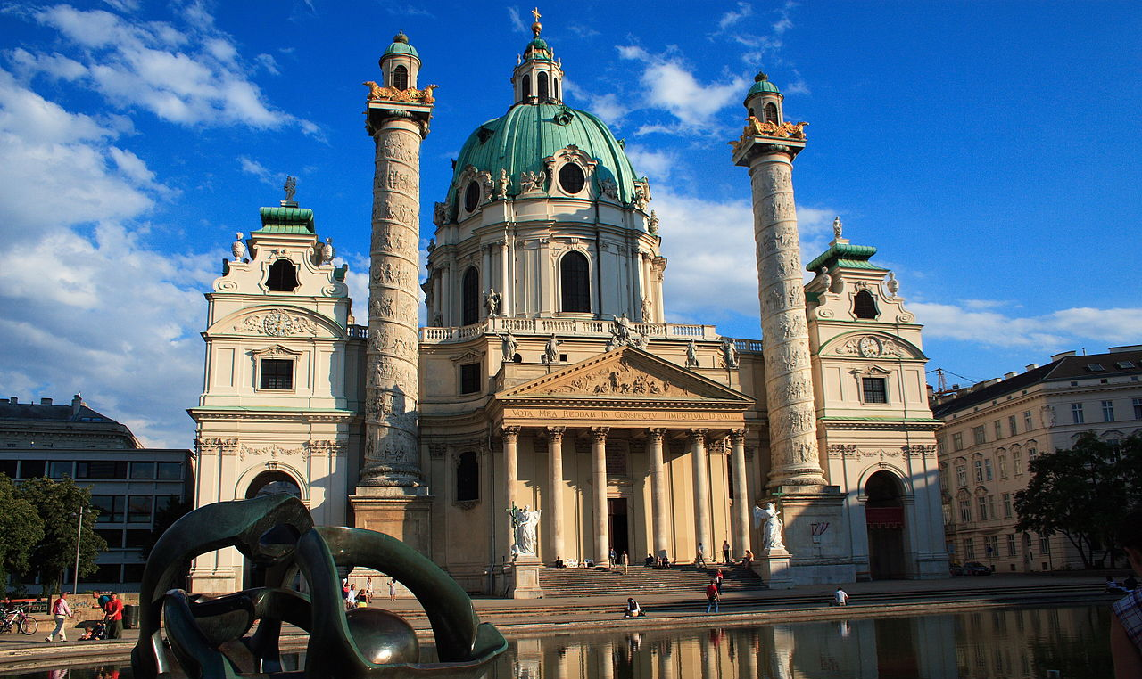
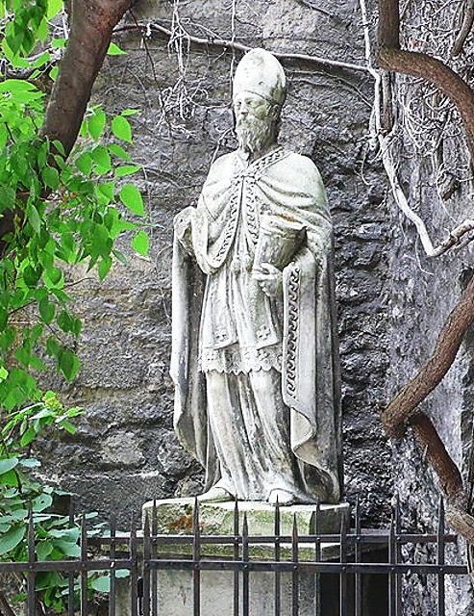
Historic Centre of Vienna
Cathedral of Saint Stephen (Stephansdom) – seat of Archbishop, symbol of the city (14c)
Church of Saint Rupert (Ruprechtskirche) – Saint Rupert of Salzburg (patron saint of salt merchants of Vienna, oldest – 8/9c), Karlskirche (18c)

Slide 12
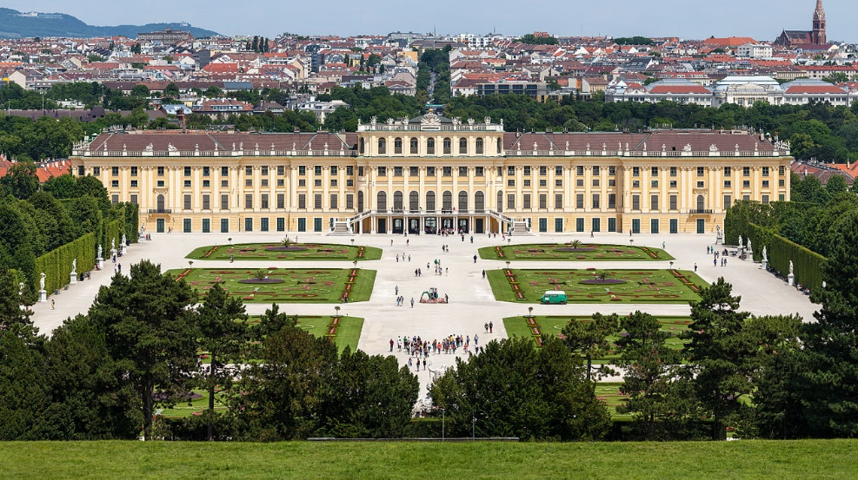
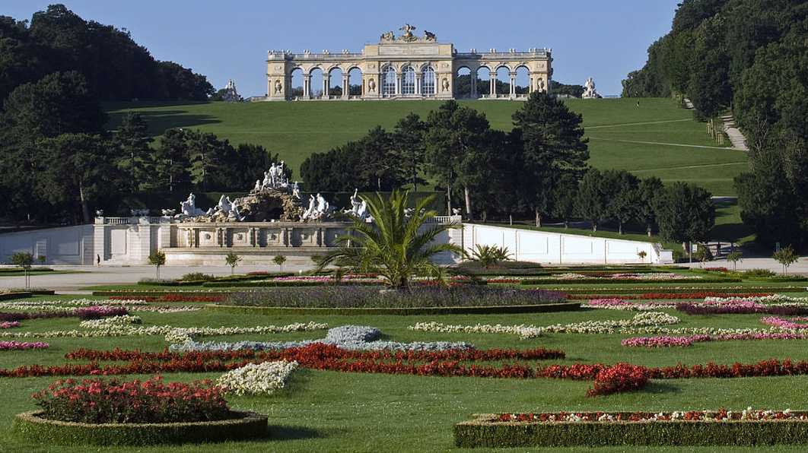
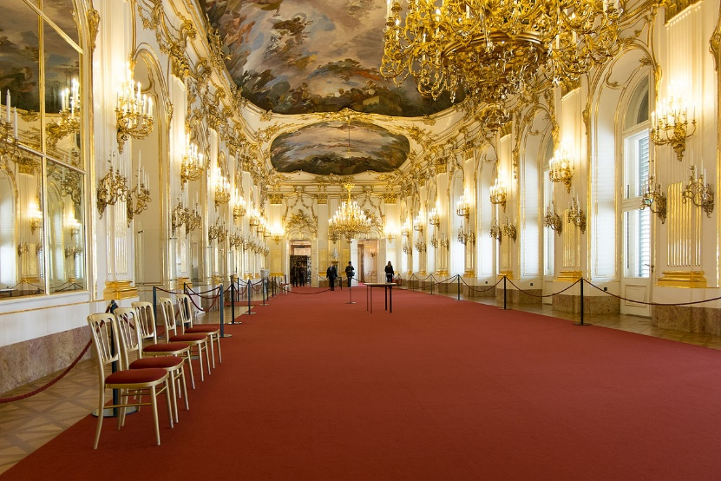
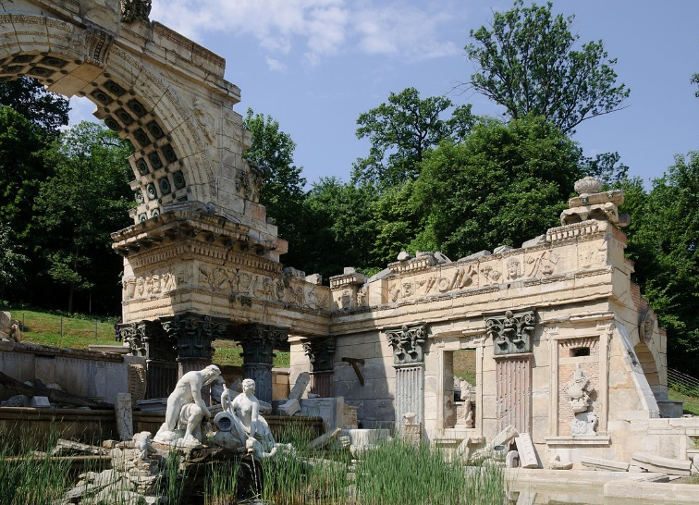
Palace and Gardens of Schönbrunn
Former imperial summer residence of Habsburg emperors (from 17c until 1918, 1,441-rooms)
Baroque Palace (designed & built by Johann Bernhard Fischer von Erlach & later by Nicolaus Pacassi)
French garden (sculptures, maze, orangery, palm house, botanical garden), English garden
Tiergarten – imperial menagerie (1752 – oldest ZOO in the world)

Slide 13
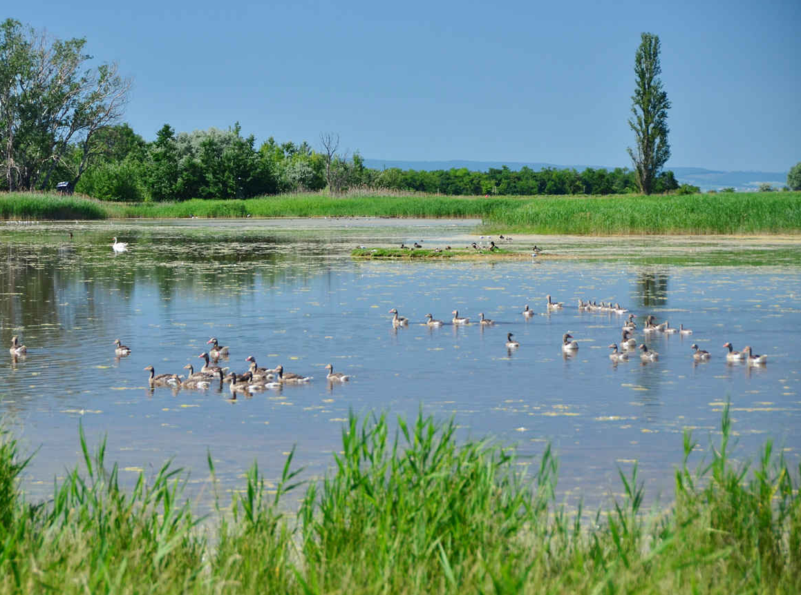
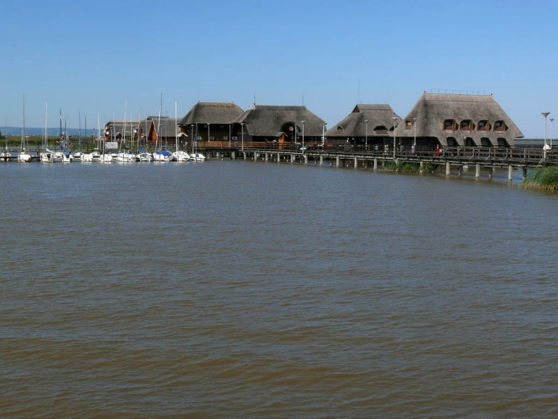
Fertö / Neusiedlersee Cultural Landscape
Lake Neusiedel (Fertö in Hungarian) – second largest Endorheic lake in Central Europe (retains water & allows no outflow to external bodies of water, converges into lakes or swamps, permanent or seasonal)
Covers 315 km² (75 on Hungarian side), no more than 1.8 m deep, surrounded by reeds (resting place for migratory birds)
Rural architecture of villages & several 18-19c palaces

Slide 14
Semmering Railway
1848 – 1854, 41 km of high rugged mountains (buildings designed for leisure activities along the way)
Tunnels, viaducts & other works still fully functional as part of South Railway
ʽFirst true mountain railwayʼ in the world (very difficult terrain & considerable altitude)

Slide 15
City of Graz – Historic Centre and Schloss Eggenberg
Residence of Inner Austrian line of Habsburg (14c)
Cultural borderland between Central Europe, Italy & the Balkan → absorbed various influences
Old Town, Castle Eggenberg (Alte Galerie, landscape park with Lapidarium of Roman stonework)

Slide 16
Primeval Beech Forests of the Carpathians and the Ancient Beech Forests of Germany
Outstanding examples of ongoing post-glacial biological & ecological evolution of ecosystems
Pure stands of European beech across variety of environmental conditions (all altitudinal zones from seashore up to forest line in mountains)
Primeval Beech Forests of the Carpathians
Ancient Beech Forests of Austria (Kalkalpen and Dürrenstein)

Slide 17
Frontiers of the roman empire – Danube lime
2 century AD to defend Roman Empire from the ‘barbarians’; Limes Romanus – 7,500 km
47 localities, most underground
Carnutum, Mautern, Traismauer, Tulln, Zeiselmauer…
Mautern

Slide 18
Great spa towns of europe
11 spas, 7 countries
Baden bei Wien
Belgium (Spa), France (Vichy), Germany (Bad Ems, Baden-BadenBad Kissingen), Italy (Montecatini Terme), UK (Bath), CR (KV, ML, FL)

Slide 19
Thank you for attention

