Slide 1
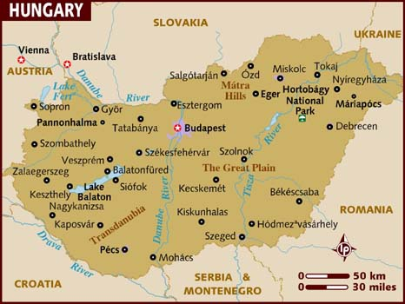
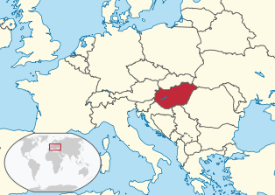
Hungary
Magyarország
Carpathian Basin
Slovakia to the north, Ukraine & Romania to the east, Serbia & Croatia to the south, Slovenia to the south-west, Austria to the west
93,000 km², 9.9 million people
Budapest
10.6 million foreign tourists

Slide 2
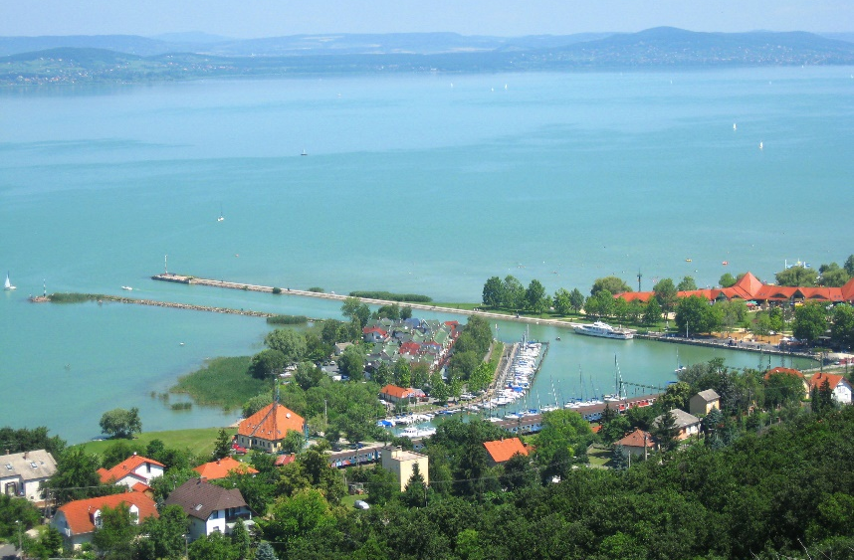
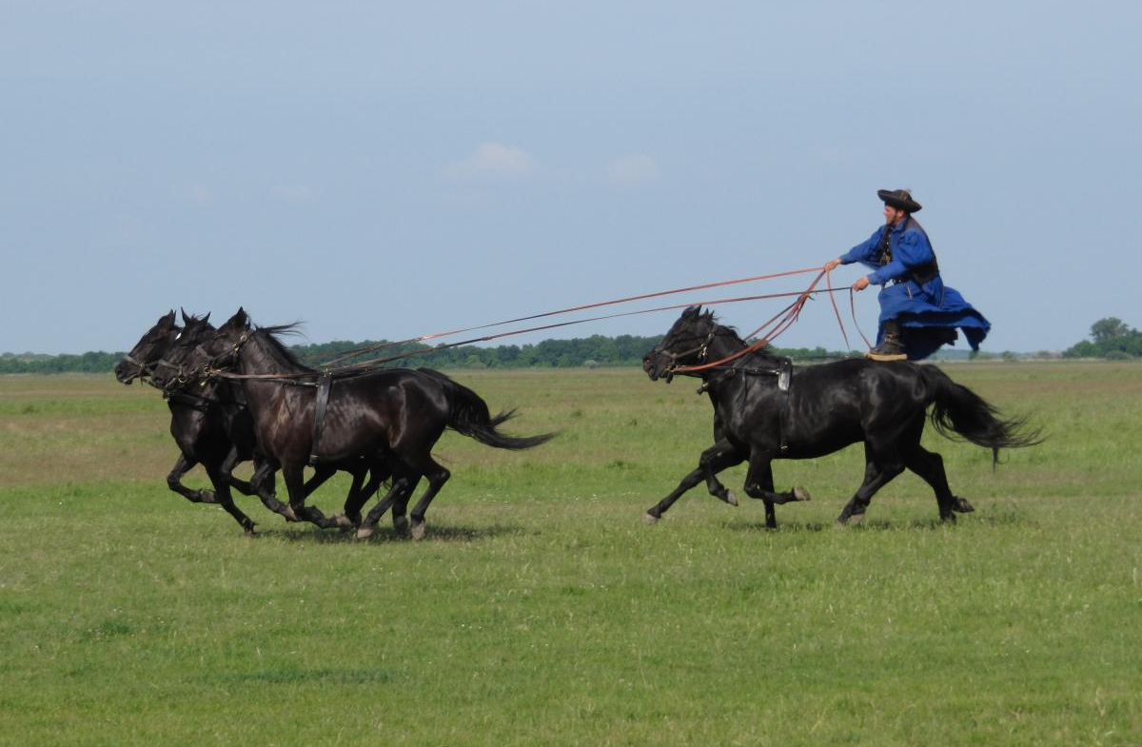
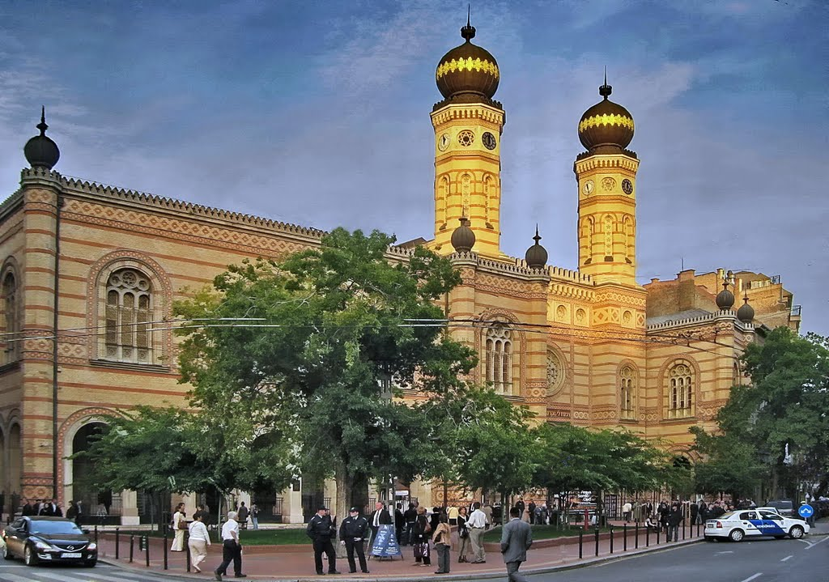
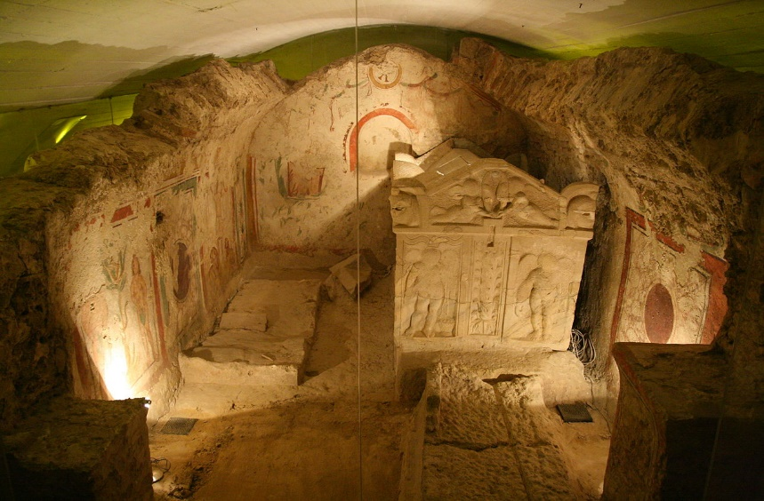
tourist attractions
Lake Balaton – largest fresh water lake in Central Europe
Hortobágy – largest natural grasslands in Europe
Great Synagogue in Budapest – largest synagogue in Europe (1859, Moorish Revival style)
Pécs – largest Early Christian Necropolis outside Italy

Slide 3
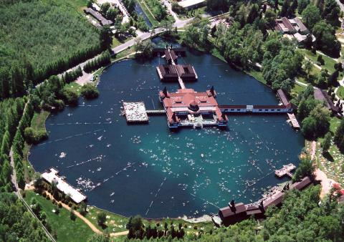
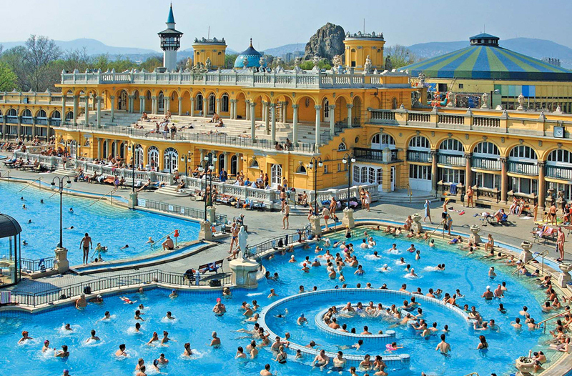
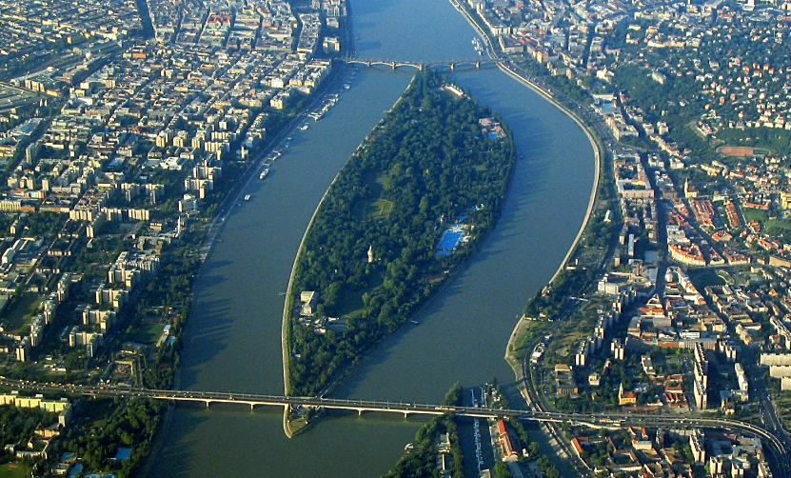
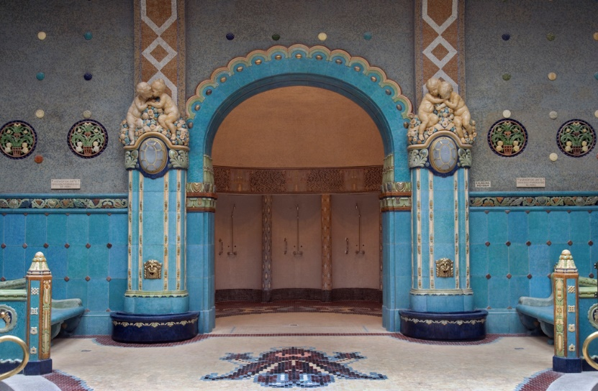
Thermal waters
Largest thermal water cave system (hundreds of therapeutic mineral springs), Lake Héviz (largest thermal lake in Europe), app 1,500 thermal springs (100 just in Capital area), app 450 public baths
Romans – remains of bath complexes (Óbuda = Old Buda, part of Budapest)
Turkish Invasion – spa culture revived (bathhouses Király or Rudas Baths still functioning)
19 century – deep drilling & medical science (Margaret Island, Gellért, Lukács & Széchenyi Bath)
Széchenyi Thermal Bath – largest spa complex in Europe
Gellert Bath

Slide 4
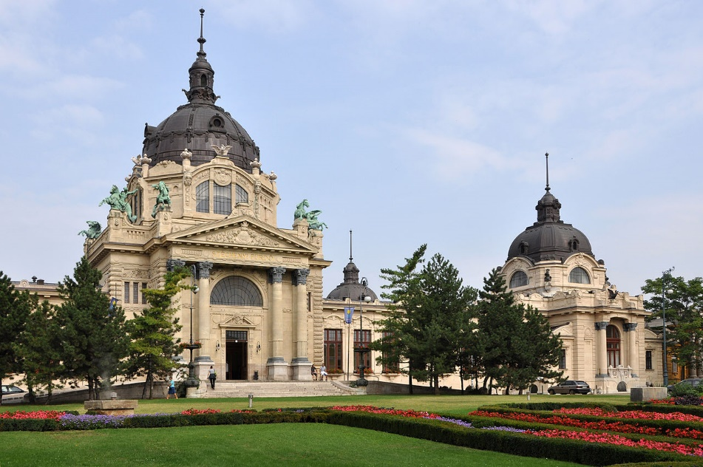
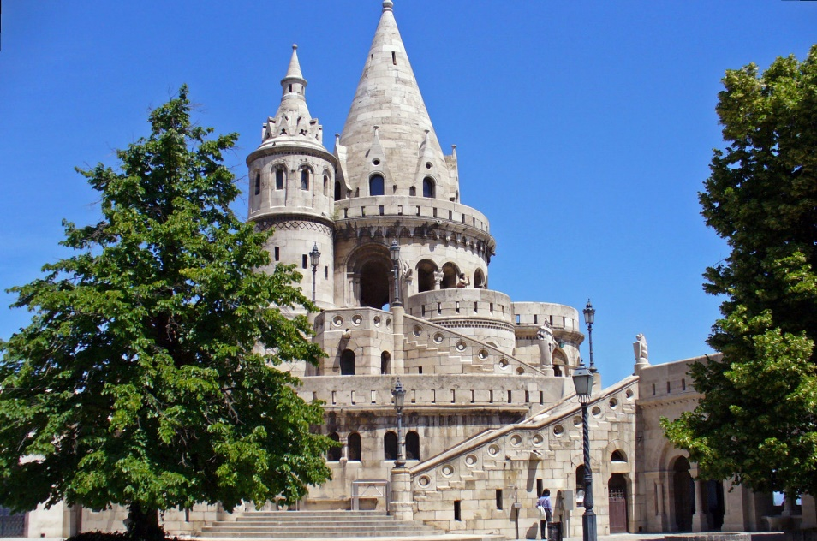
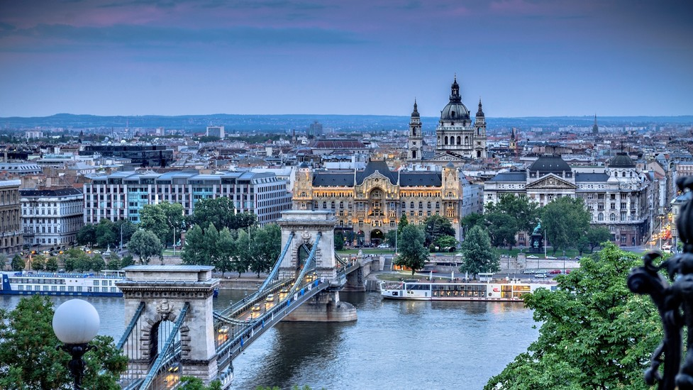
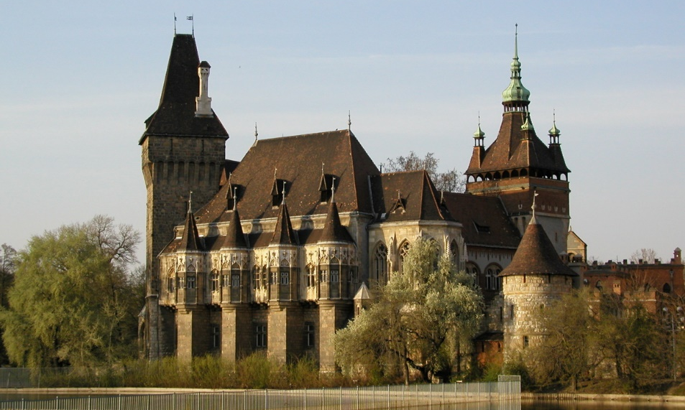
Unesco world heritage sites
Seven cultural sites, one natural site
One transboundary with Austria, one with Slovakia

Slide 5
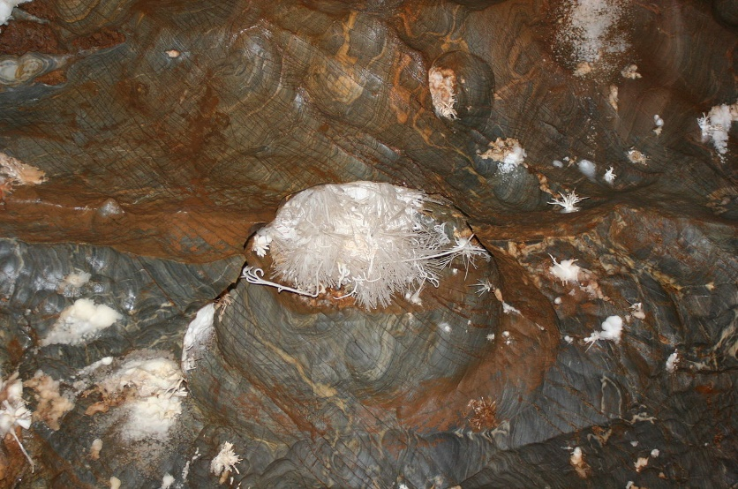
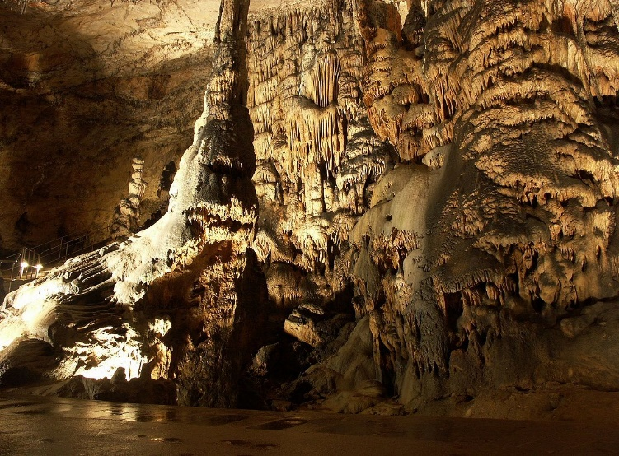
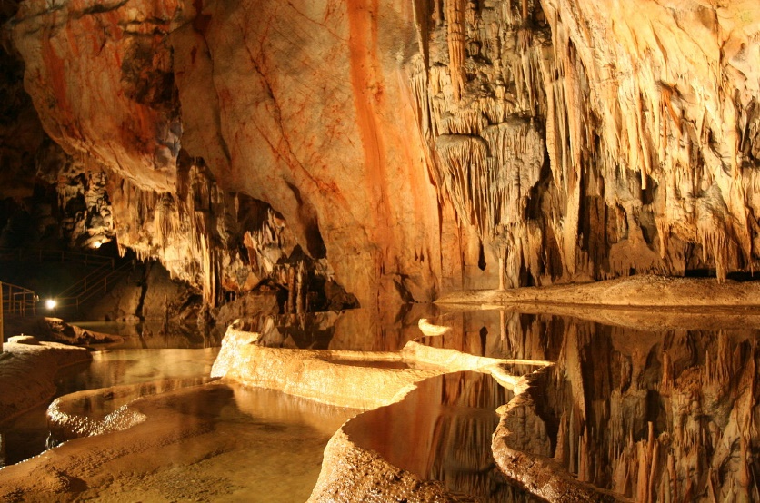
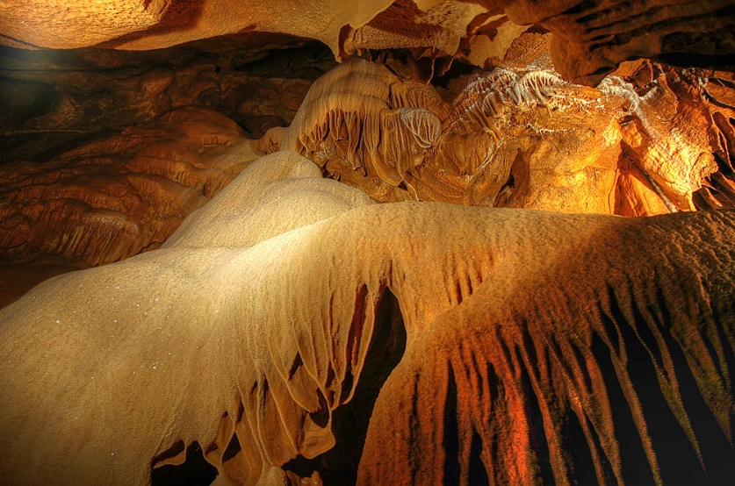
Caves of Aggtelek Karst and Slovak Karst
712 caves, 560 km² (along the border of Hungary & Slovakia)
Aggtelek, Szendrö-Rudabánya Hill & Esztramos Hill
Baralda Cave – largest stalactite cave of Europe (18 km long + 8 km in Slovakia)
Extremely rare combination of tropical & glacial climatic effects

Slide 6
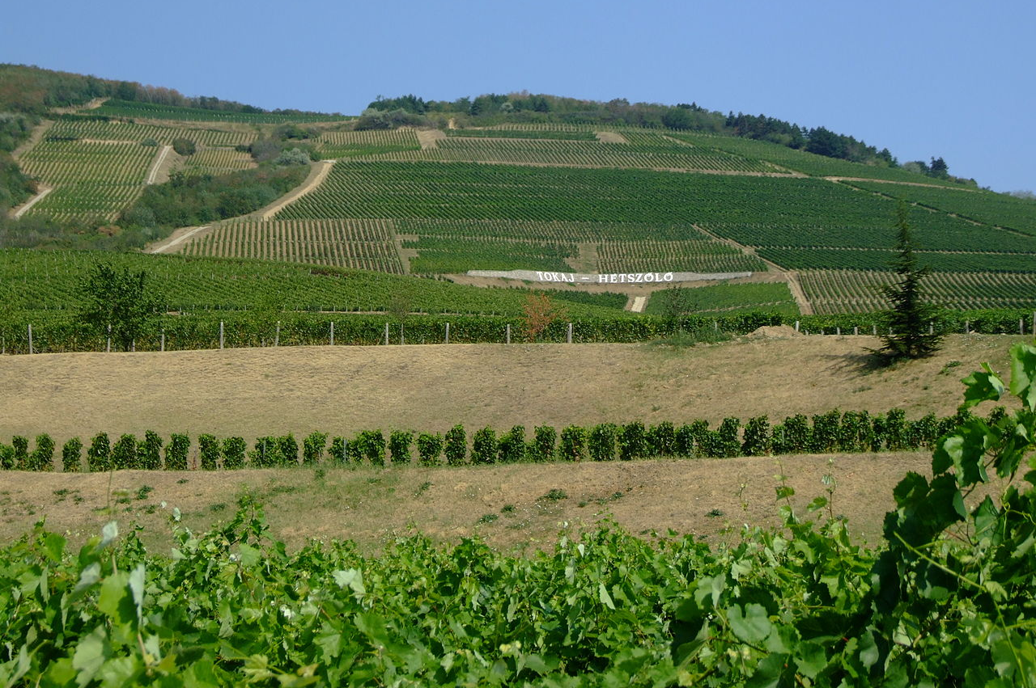
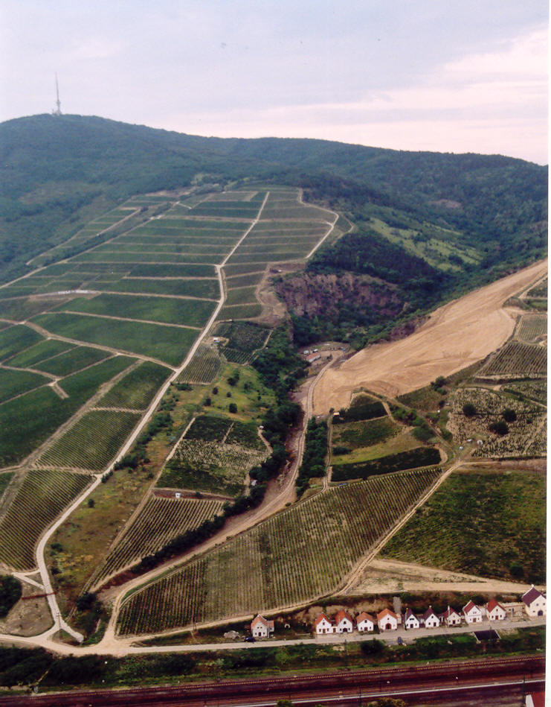
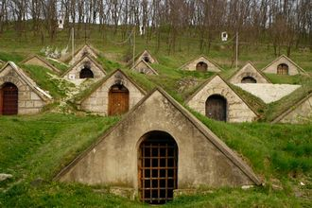
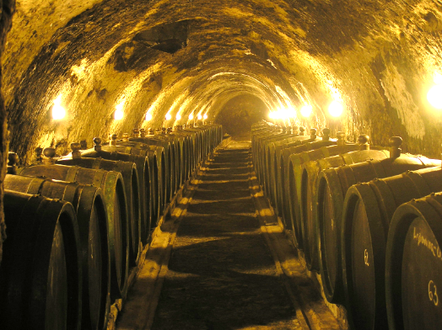
Tokaj Wine Region Historic Cultural Landscape
Historical wine region in north-eastern Hungary (& south-eastern Slovakia)
27 villages, app 112 km² of classified vineyards
Introduced with Celts (i.e. BC) or with Romans (3c AD), existence documented since 16c

Slide 7
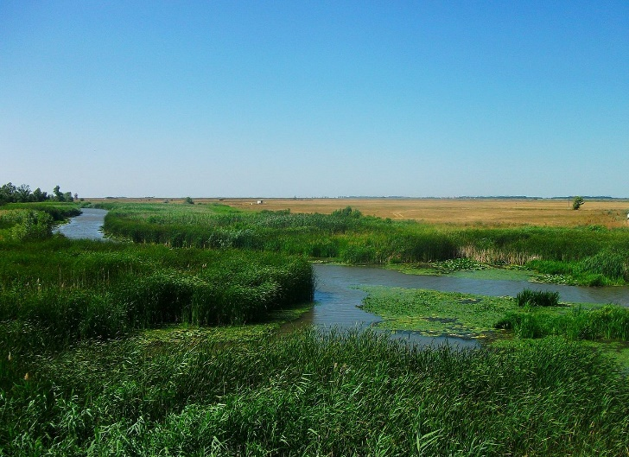
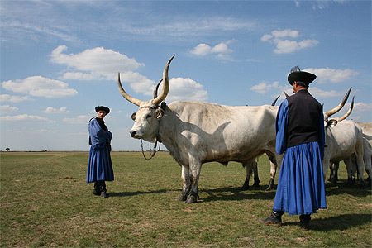
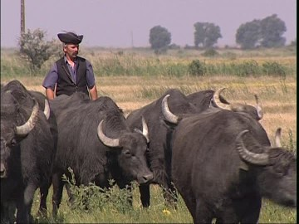
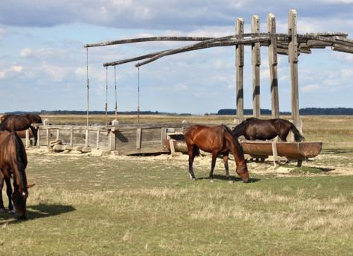
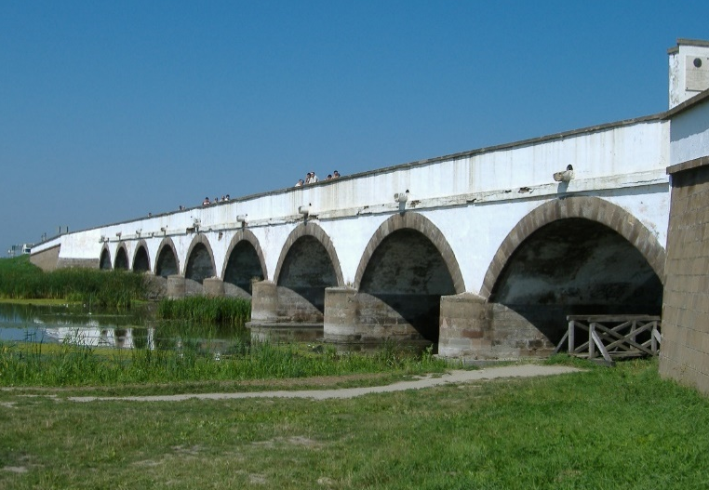
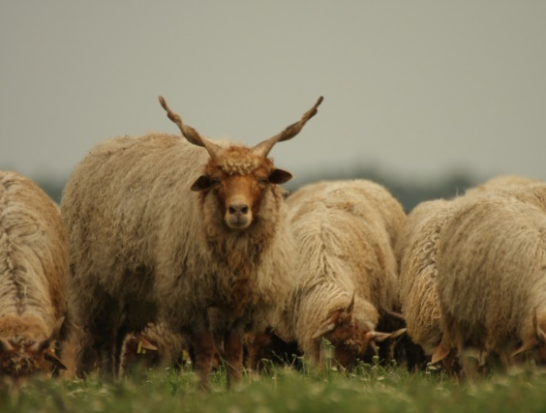
Hortobágy National Park – the Puszta
Vast area of plains & wetlands (800 km² NP), largest semi-natural grassland in Europe
Steppe (grassy plain), Hungarian Grey cattle, Racka sheep, Water Buffalo & horses (herdsmen)
Stopover site for migrating Common Cranes, Dotterels & Lesser White-fronted Geese
T-shaped sweep wells, occasional mirage of trees, Nine-holed Bridge (stone bridge, 167 m)
Traditional forms of land use (grazing of domestic animals for more than two millennia)

Slide 8
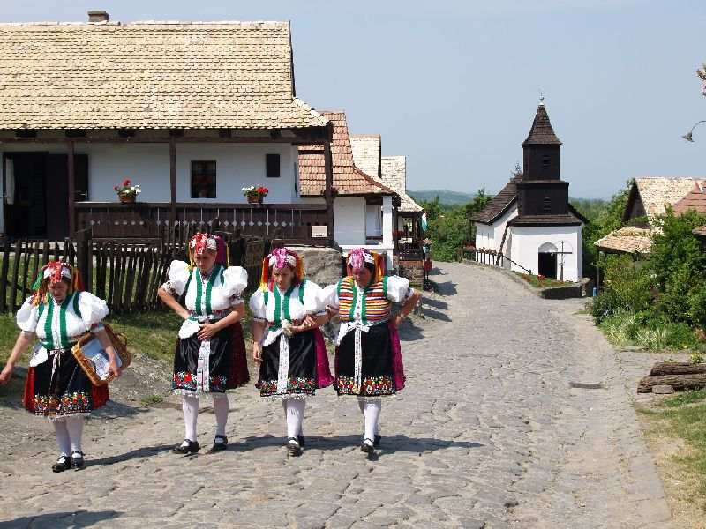
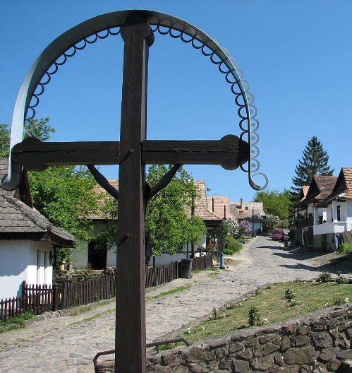
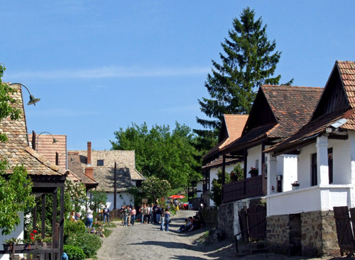
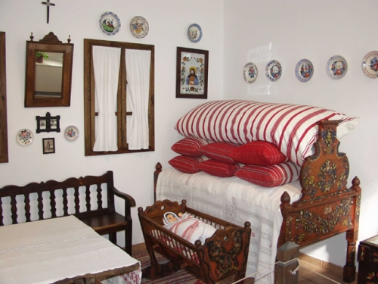
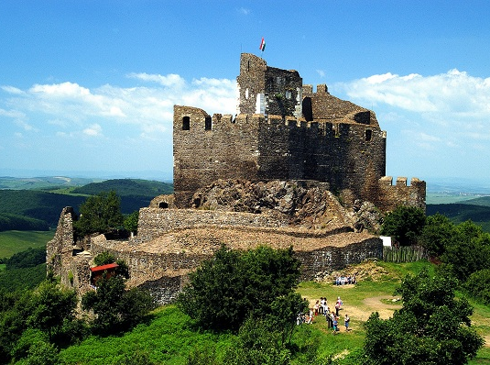
Old Village of HOLLÓKÖ and its Surroundings
Palóc ethnographic village, Hollókö = ‘Raven-stone’, Palóc people (probably descendants of Cumans, Turkic nomadic people)
Cserhát Mountains valley surrounded by low peaks below 13-c castle
Castle & village abandoned, present village grew up below (1683, end of Ottoman period)
55 village houses, ruins of Castle & surrounding area

Slide 9
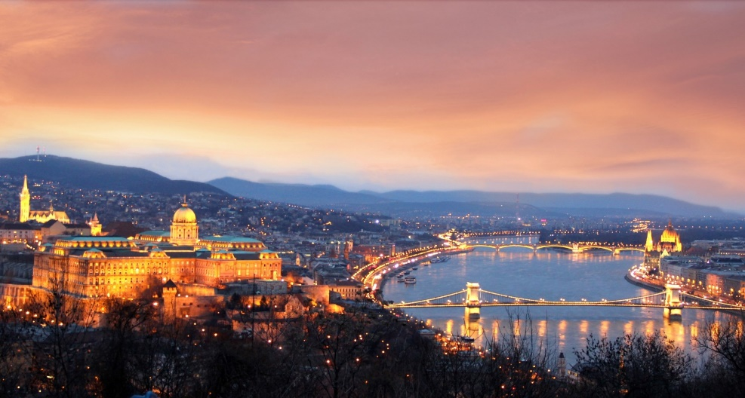
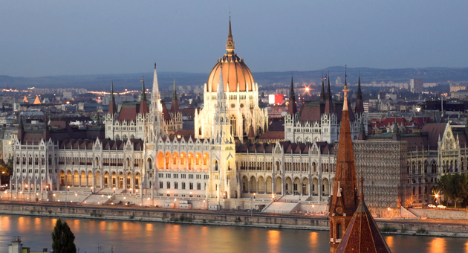
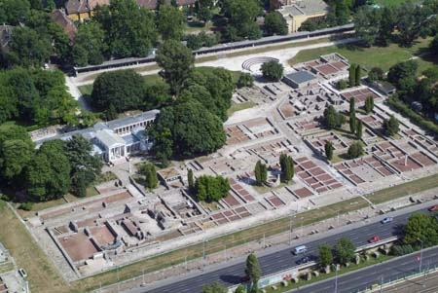
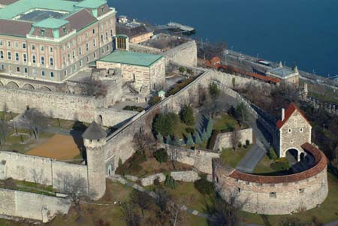
Budapest, including the Banks of the Danube, the Buda Castle Quarter and Andrássy Avenue
Buda (promontory on the right bank of the river Danube) & Pest (on the plain on the left bank)
Celtic settlement, Romans – colony called Aquincum (capital of Lower Pannonia, museum)
Pest – first medieval urban centre (devastated by Tatars in 13c) →
Castle of Buda (stone walls) built on top of Buda hills → palace complex of Hungarian kings (14c)

Slide 10
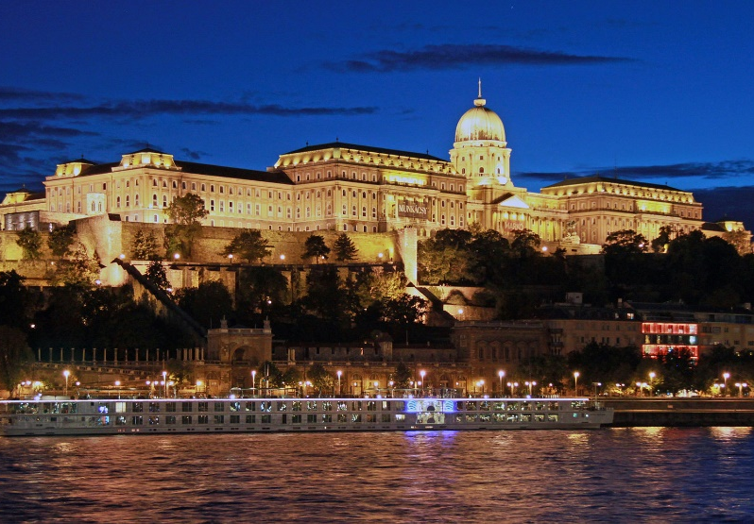
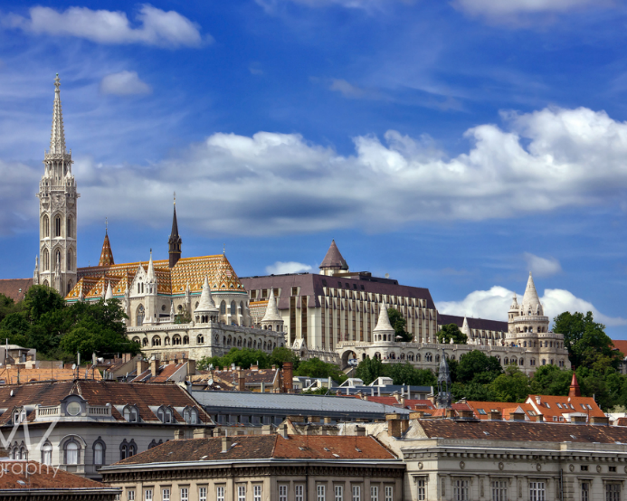
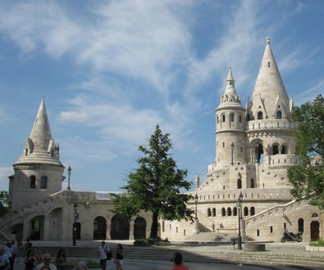
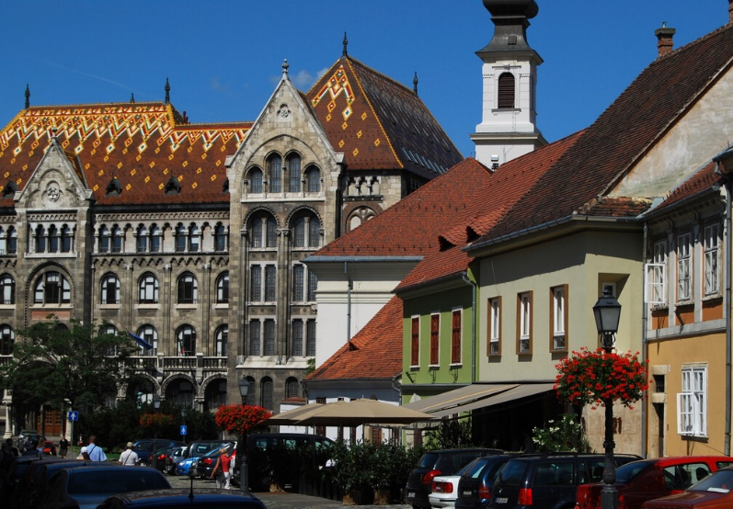
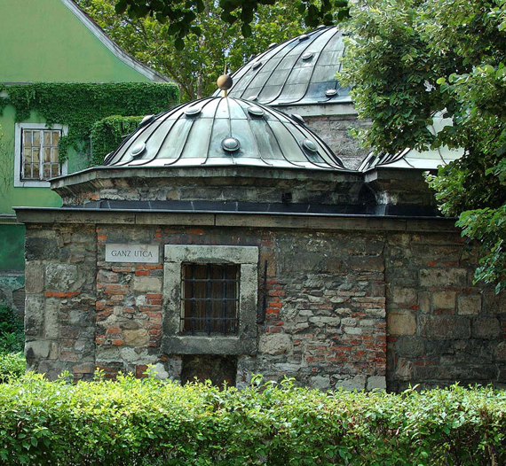
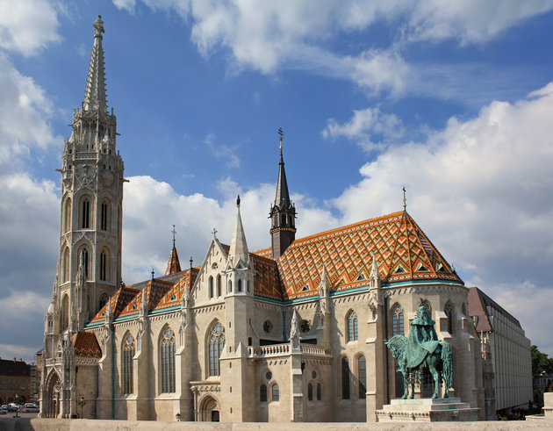
Budapest, including the Banks of the Danube, the Buda Castle Quarter and Andrássy Avenue
Castle District – medieval, Baroque & 19c houses, churches & public buildings
Matthias Church (11c), Fisherman Bastion (7 towers = 7 Magyar tribes, Neo-Romanesque & Neo-Gothic)
Turkish occupation (16c, 140 years) – built many bathing facilities (Rudas or Kirali Baths still in use)

Slide 11
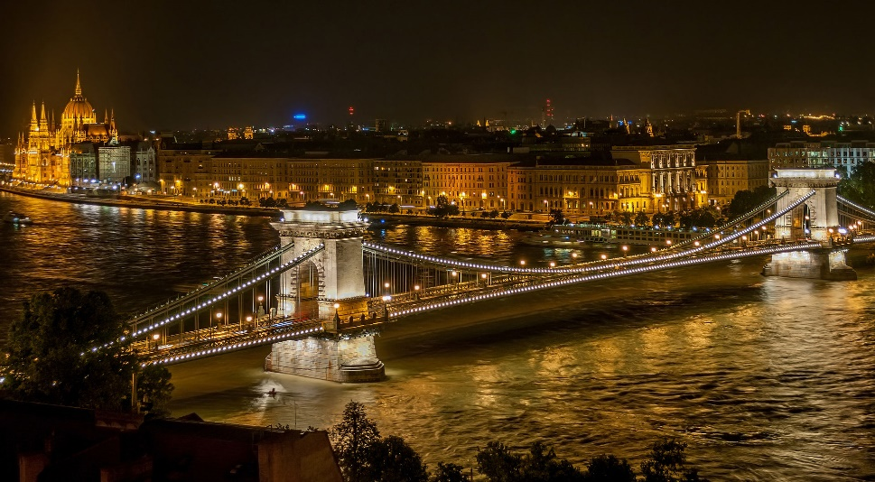
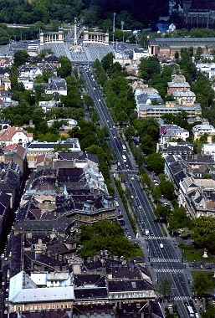
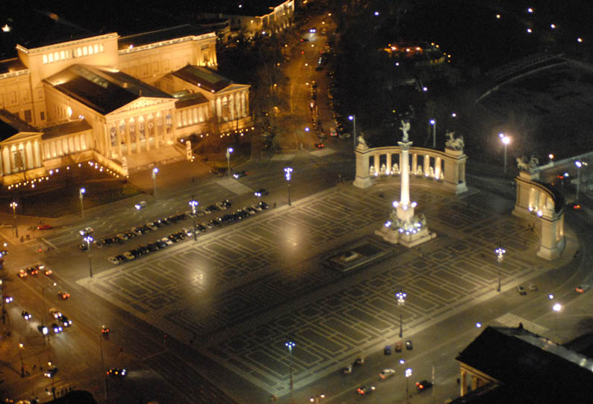
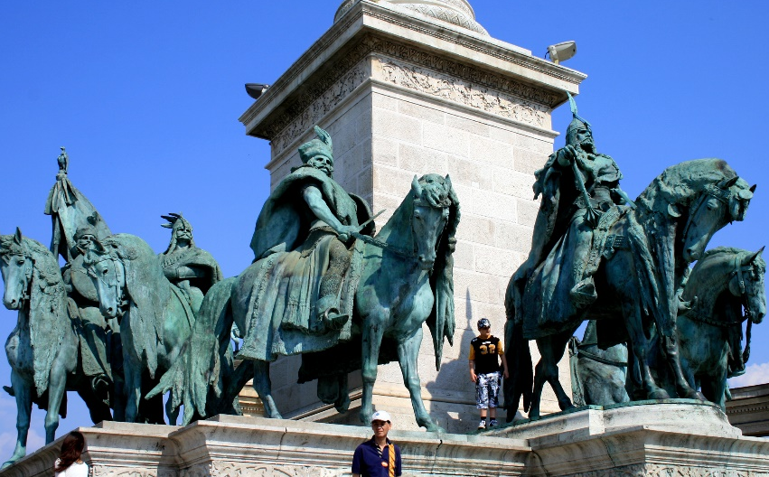
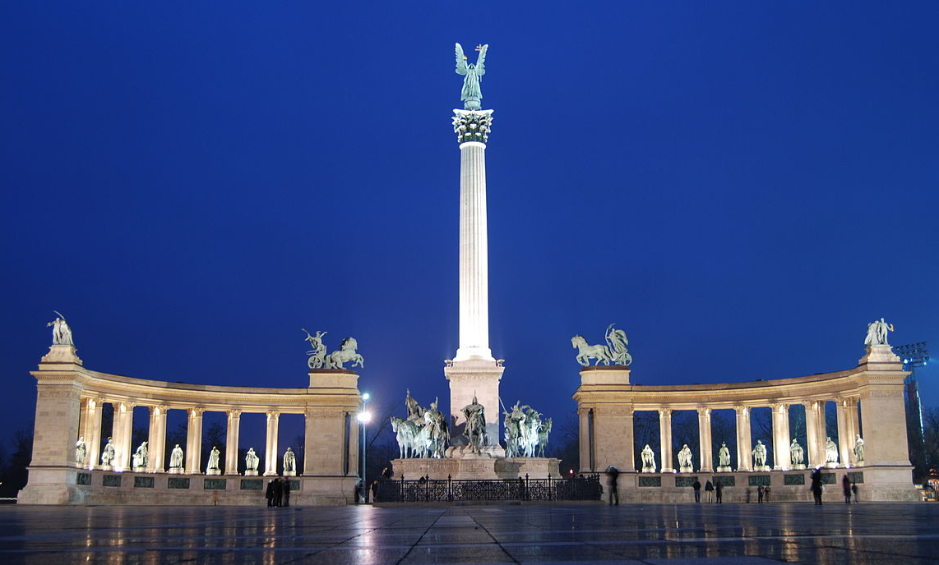
Budapest, including the Banks of the Danube, the Buda Castle Quarter and Andrássy Avenue
First documented use of combined name Buda-Pest – 1831
Széchenyi Chain Bridge (1849) – suspension bridge, spans the Danube & symbolises reunification
Andrássy Avenue (Andrássy út, Pest, 1872) – lined with Neo-Renaissance mansions
Square of Heroes (Hösök tere, 1900) – end of Andrássy Avenue, statue complex (leaders of 7 tribes that founded Hungary in 9c & other outstanding figures of Hungarian history), Millennium Memorial

Slide 12
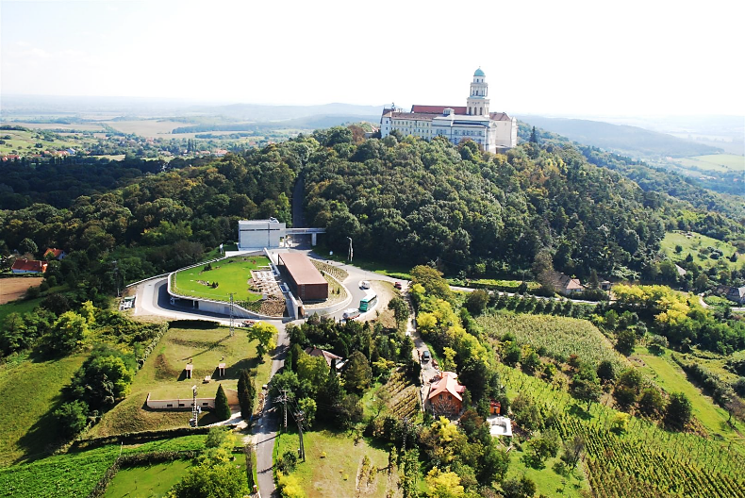
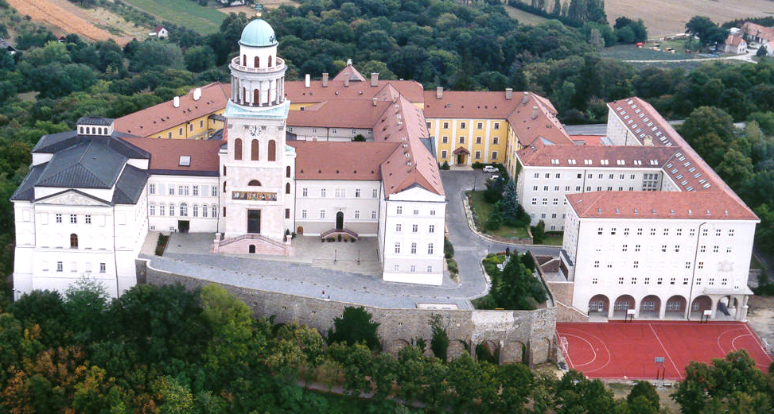
Millenary Benedictine Abbey of Pannonhalma and its Natural Environment
Pannonhalma Archabbey, top of Mount of Saint Martin (996, one of oldest monuments in Hungary)
Second largest territorial abbey in the world after Monte Cassino
Succession of architectural styles of monastic buildings (oldest dating from 1224)
Basilica with the crypt (13c), Cloisters, Library (360,000, oldest document 1055), Baroque Refectory
Surrounded by Arboretum (Botanical Garden with rare tree & bush species) & vineyard

Slide 13
Fertö / Neusiedlersee Cultural Landscape
Lake Neusiedel (Fertö in Hungarian) – second largest Endorheic lake in Central Europe (retains water & allows no outflow to external bodies of water, converges into lakes or swamps, permanent or seasonal)
Covers 315 km² (75 on Hungarian side), no more than 1.8 m deep, surrounded by reeds (resting place for migratory birds)
Rural architecture of villages & several 18-19c palaces

Slide 14
Early Christian Necropolis of Pécs (Sopianae)
Sopinae – Roman wine-producing colony in Pannonia (2c, Pécs area)
Capital of Valeria province (one part of Pannonia) & significant Christian centre (by 4c)
Series of decorated tombs (underground burial chambers with memorial chapels above the ground)
Richly decorated with murals depicting Christian themes

Slide 15
Thank you for attention

