Slide 1
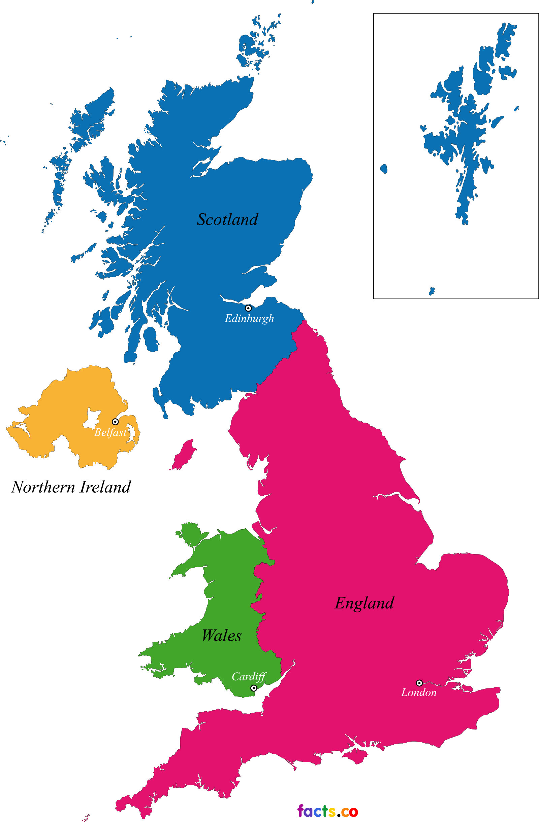
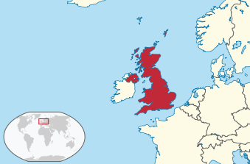
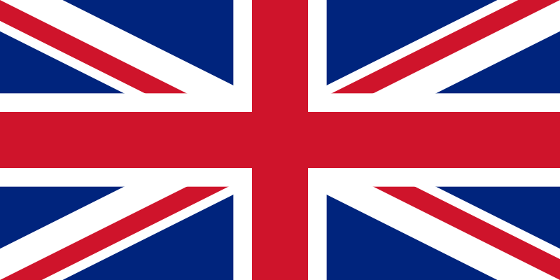
Great Britain
the United kingdom of great Britain and northern Ireland
Off the north-western coast of the Continent
Great Britain, north-eastern part of Ireland & many smaller islands
Ireland to the south; Atlantic to the north-west, North Sea to the east, English Channel to the south & Celtic Sea to the south-west; Irish Sea between Great Britain & Ireland
Crown dependencies – Guernsey, Jersey & Isle of Man
Overseas Territories – Bermuda, Virgin Islands, Cayman Islands, Falkland Islands, Gibraltar, Montserrat, Saint Helena (app 260,000 people)
242,500 km², 64.5 million people
London, Queen Elizabeth II (since 1952)
31 million foreign tourists

Slide 2
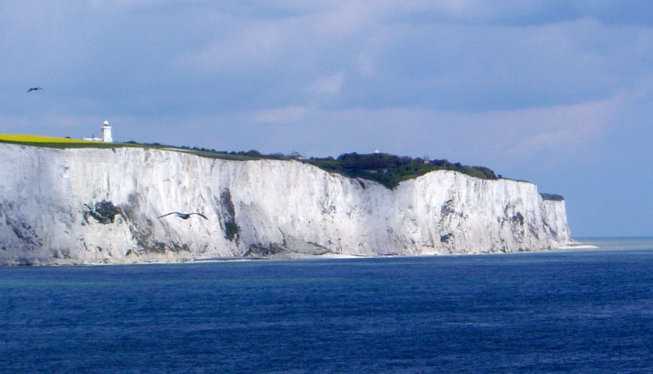
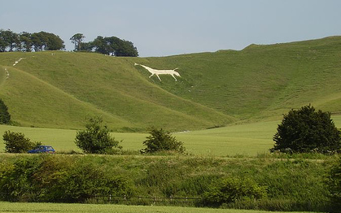
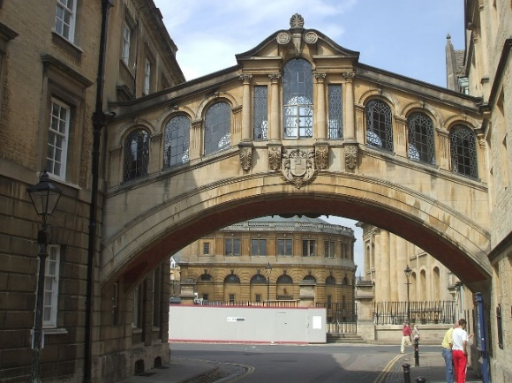
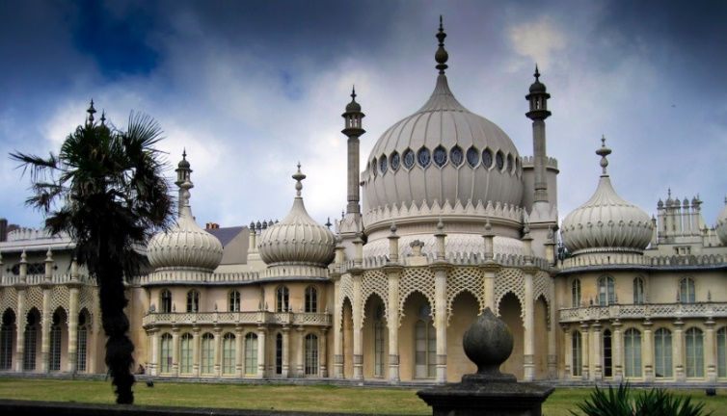
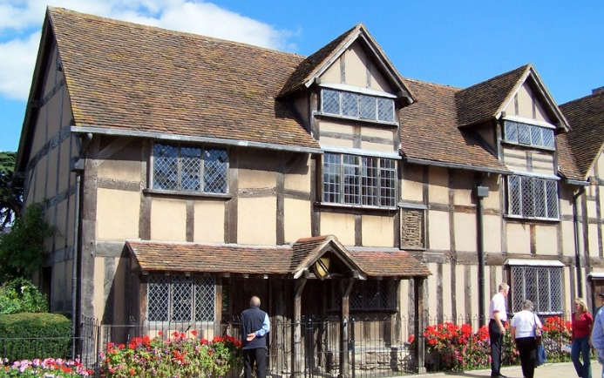
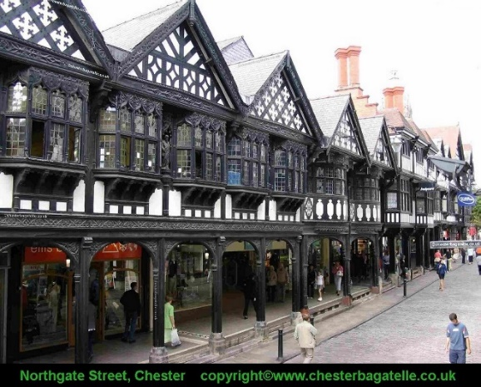
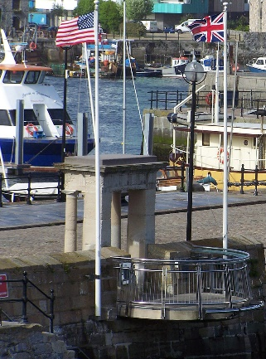
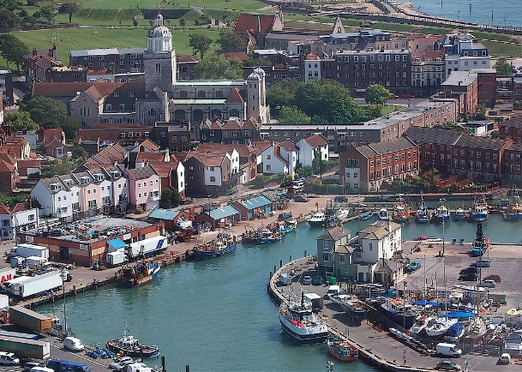
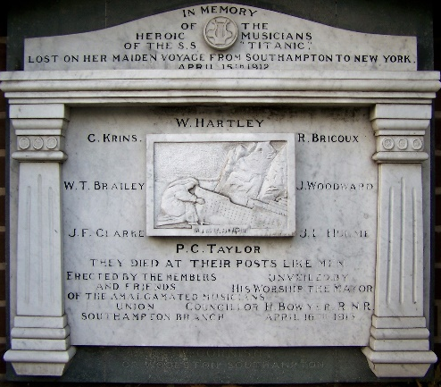
Portsmouth
England – iconic sites
Plymouth (Pilgrims – Mayflower Steps), Portsmouth (HMS Victory), Southampton (RMS Titanic, D-Day)
Dover
Cherhill White Horse
Oxford
Stratford
Cambridge
Chester

Slide 3
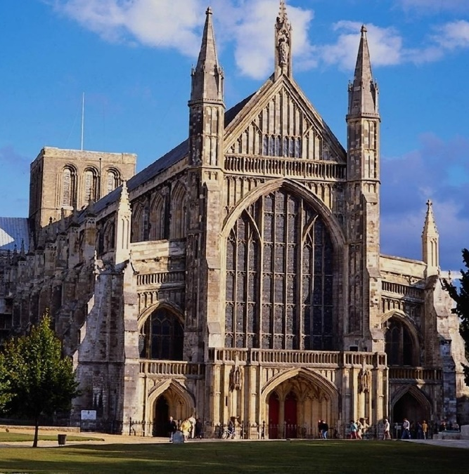
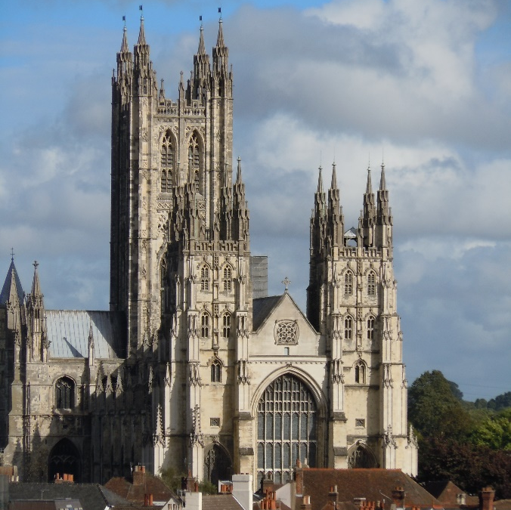
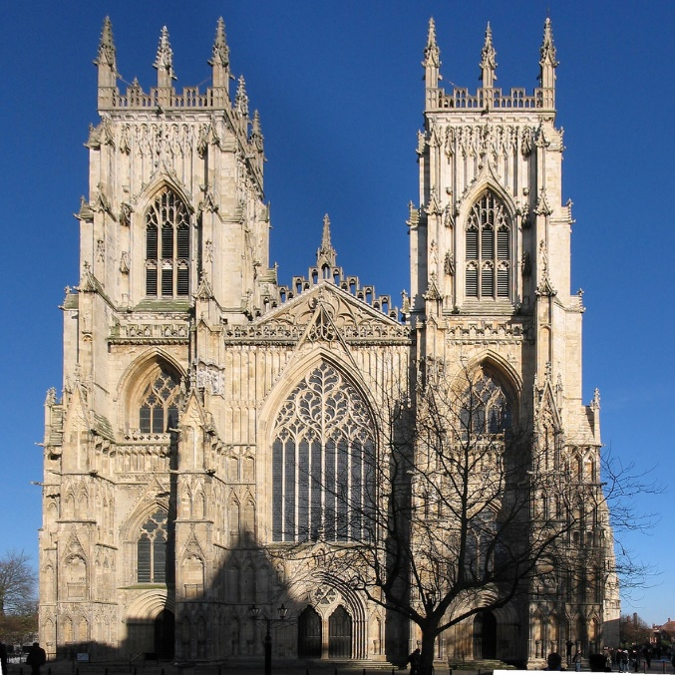
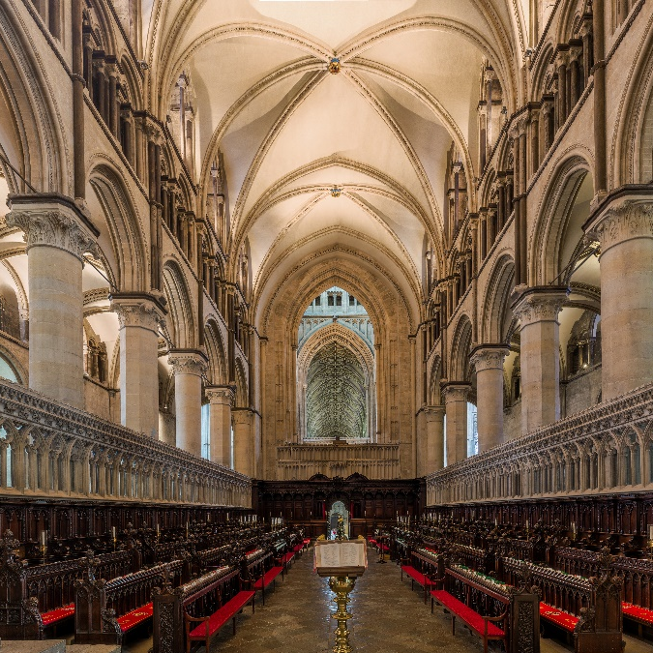
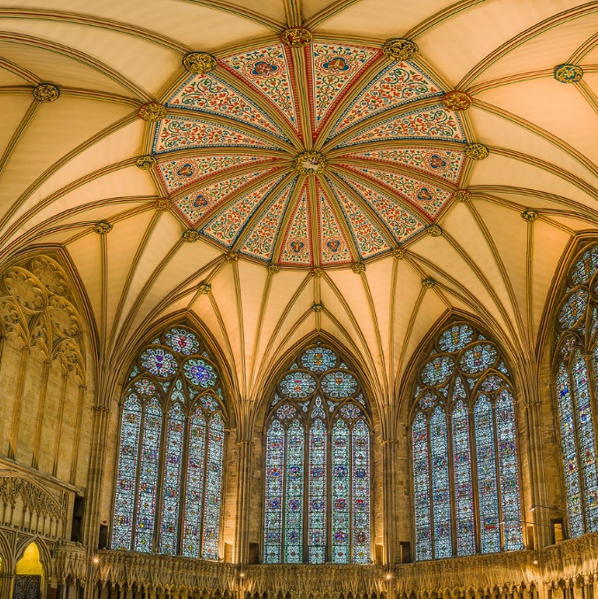
England – cathedrals
Winchester (7c)
Canterbury (11c)
York (11c)

Slide 4
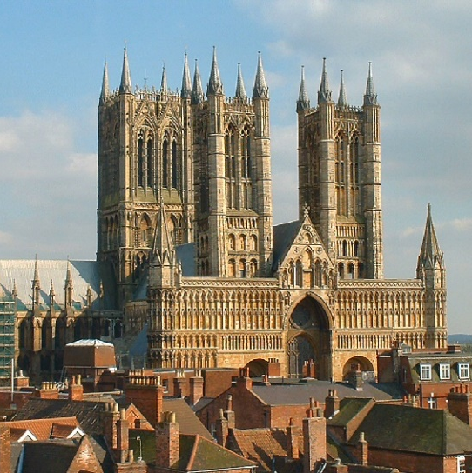
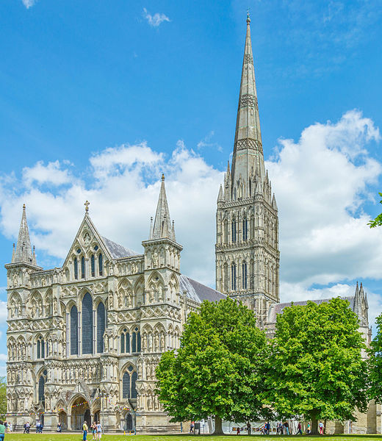
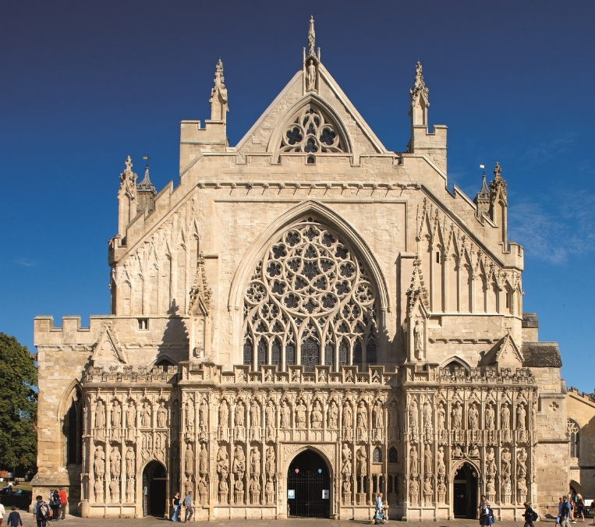
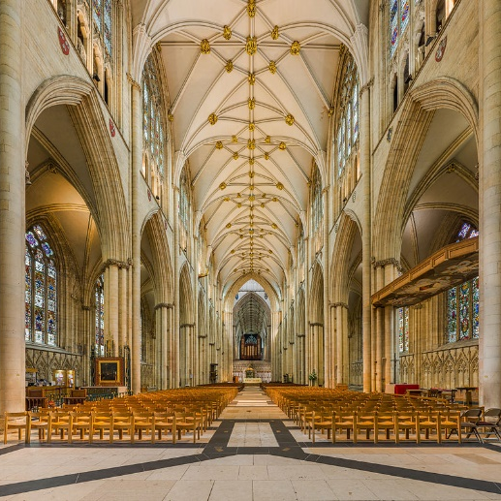
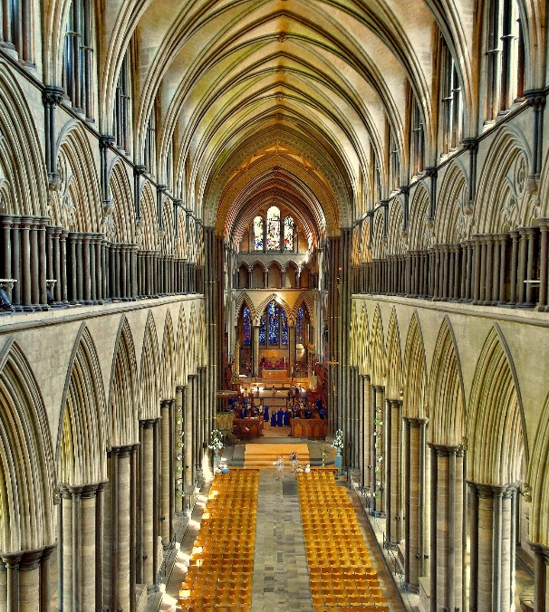
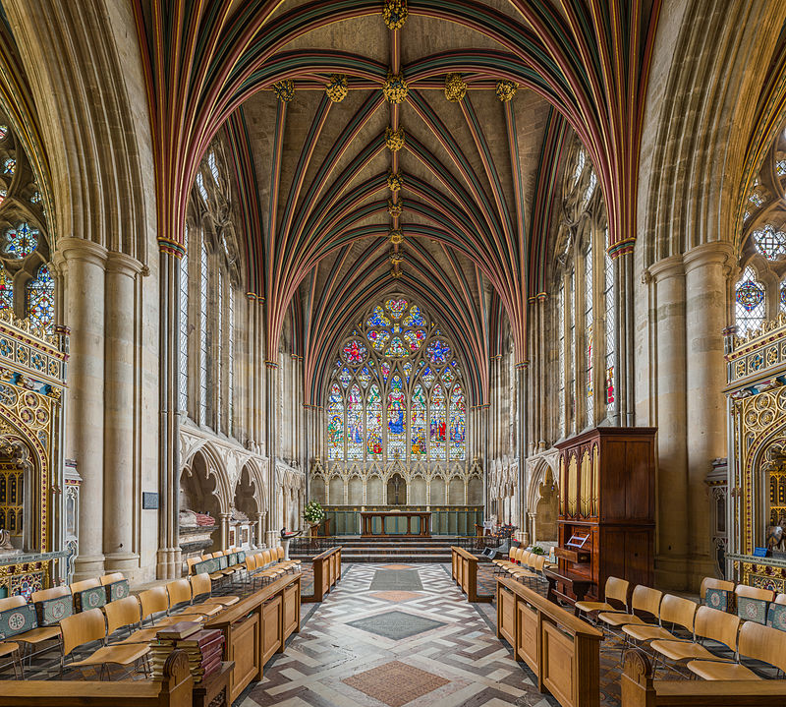
England – cathedrals
Lincoln (11c)
Salisbury (13c)
Exeter (14c)

Slide 5
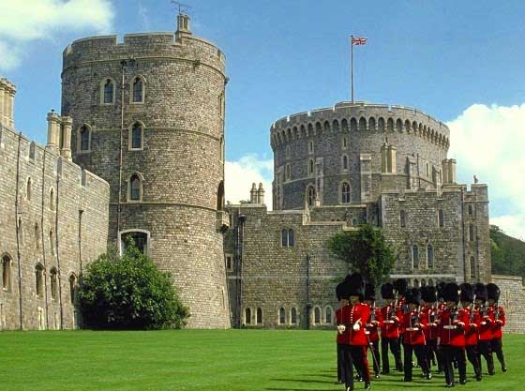
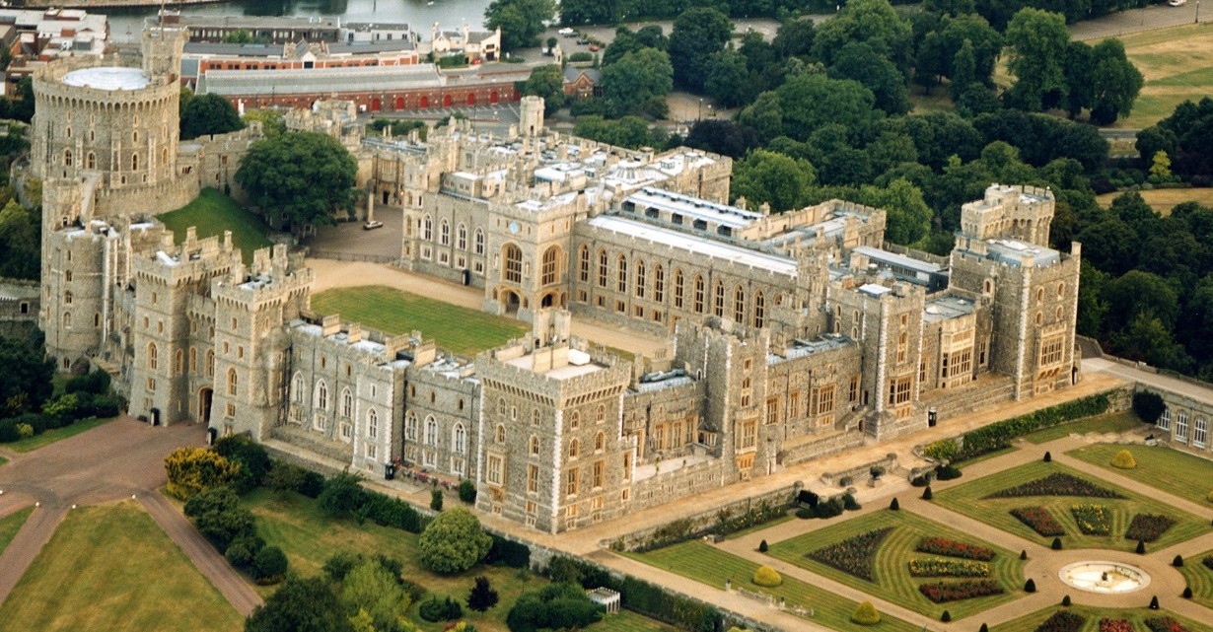
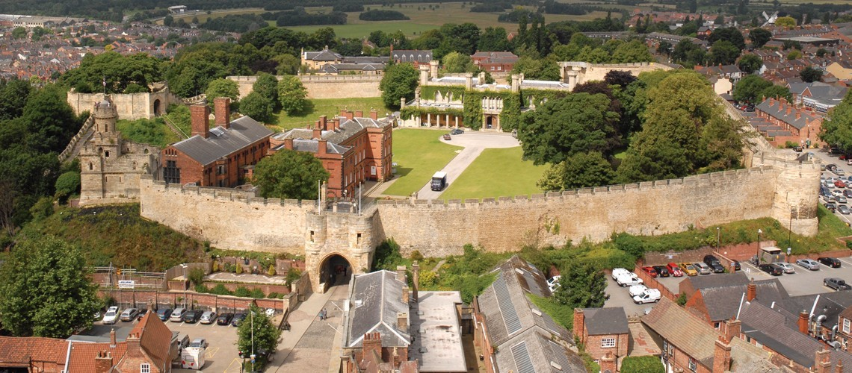
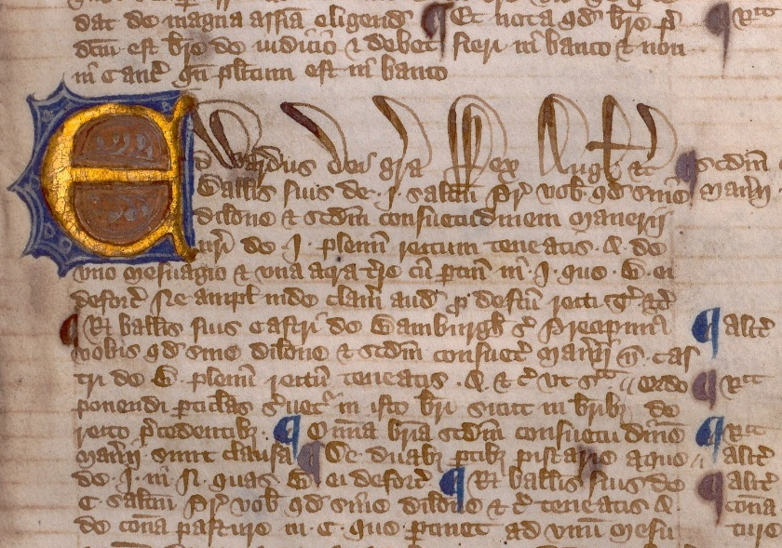
England – castles
Windsor
Lincoln (copy of Magna Carta)

Slide 6
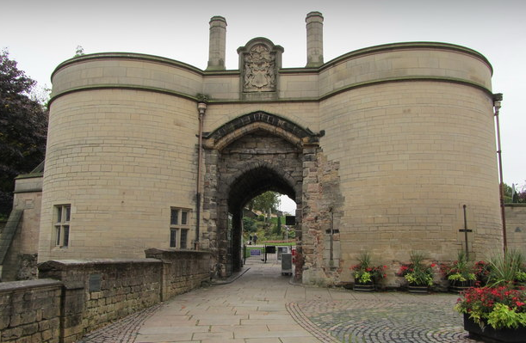
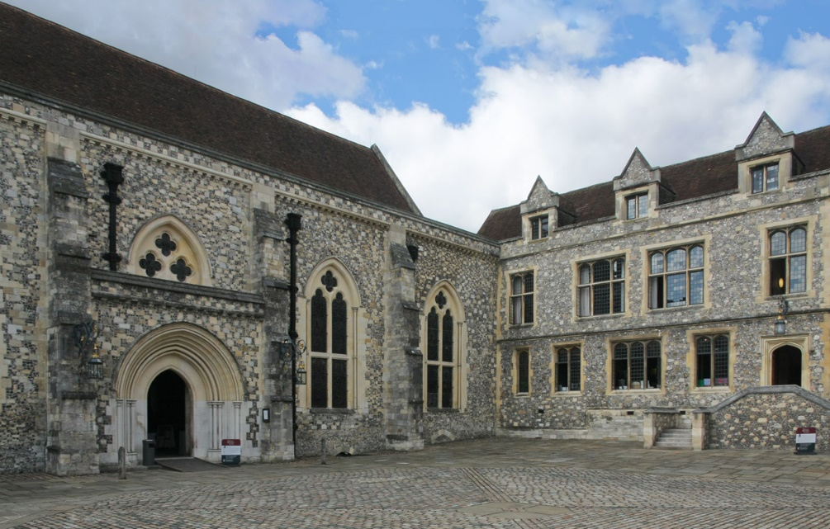
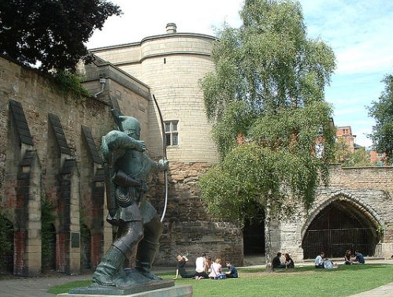
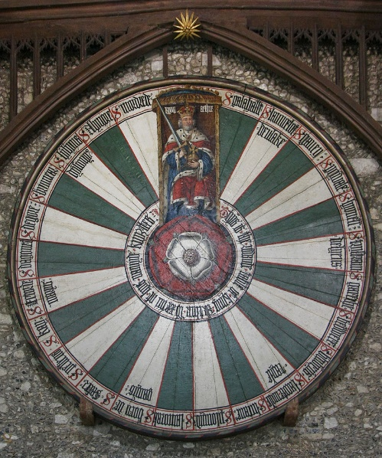
England – castles
Nottingham (Robin Hood)
Winchester (depiction of the Round Table of King Arthur)

Slide 7
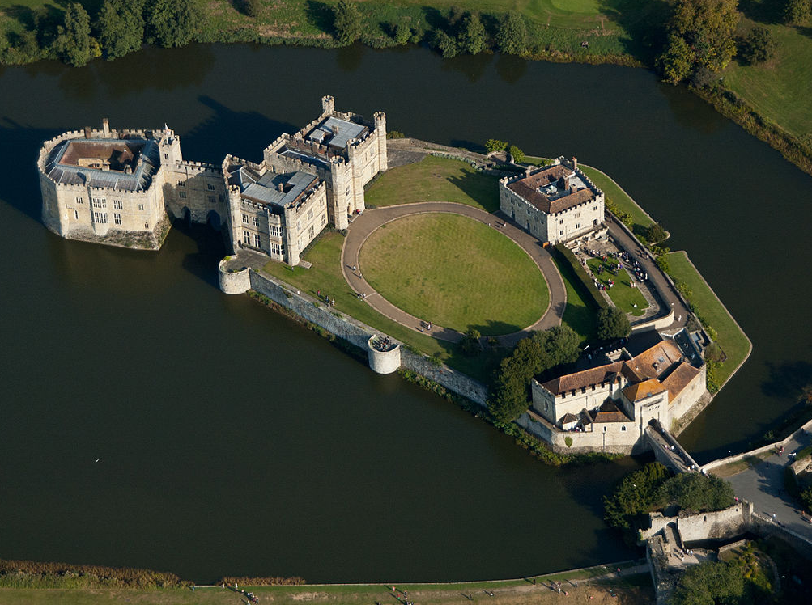
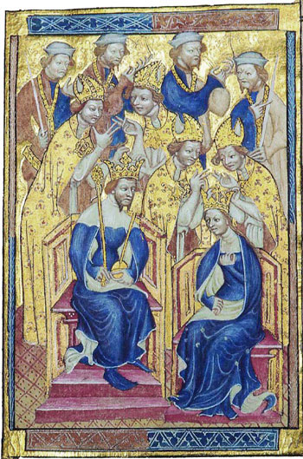
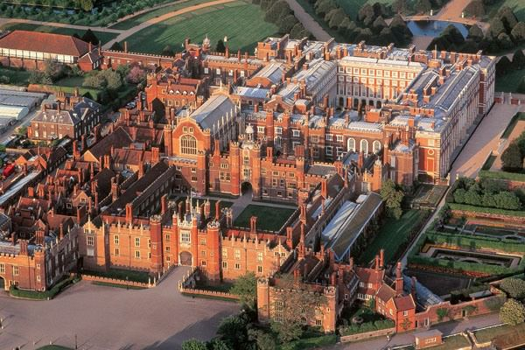
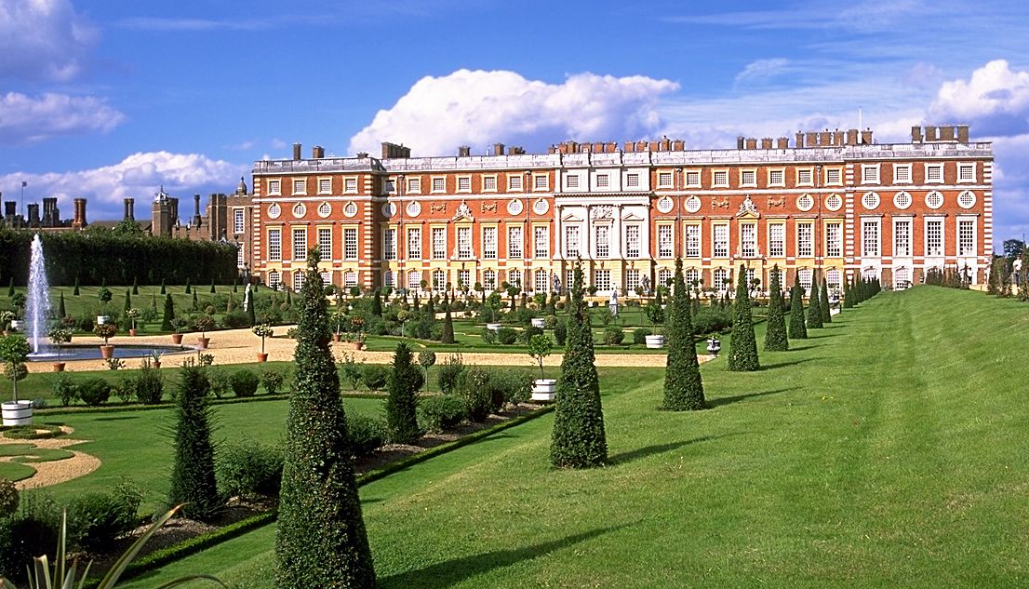
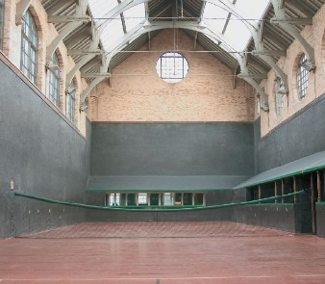
England – castles
Leeds Castle (Anne of Bohemia spent the winter of 1381 on her way to be married to Richard II)
Hampton Court (gardens, maze & Royal Tennis Court – 16 century)

Slide 8
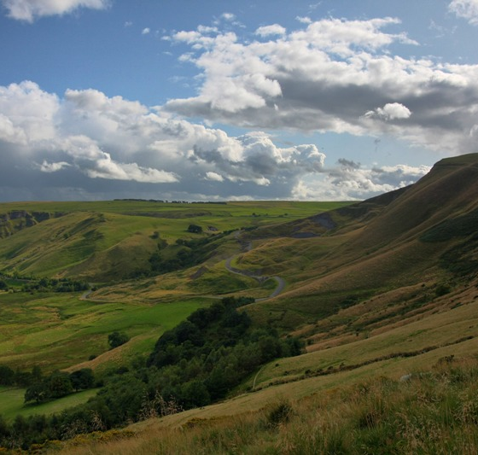
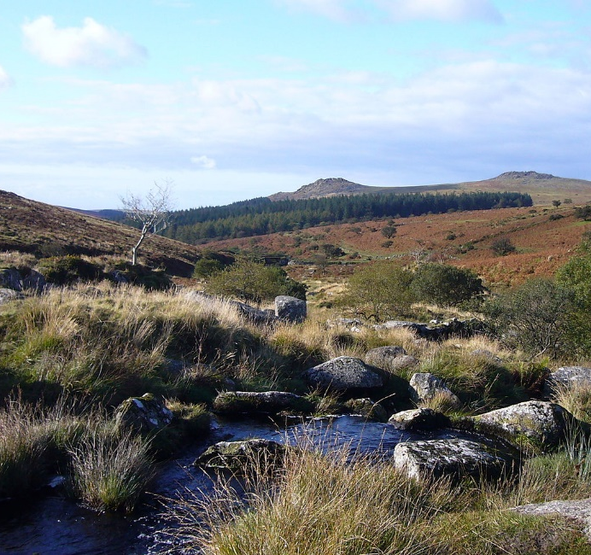
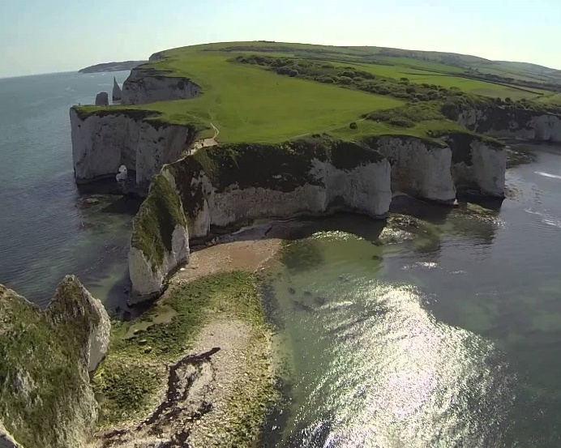
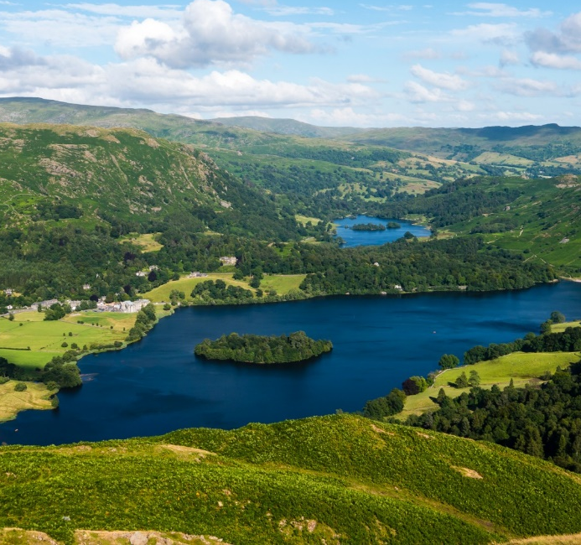
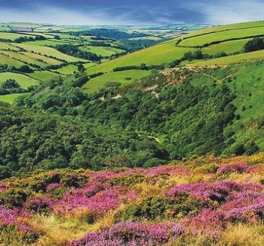
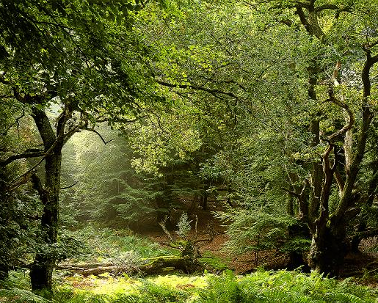
England – national parks
Peak District
Dartmoor
Jurassic Coast
Lake District
Exmoor
New Forest

Slide 9
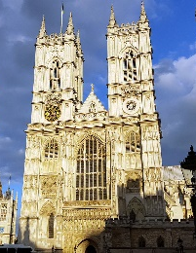
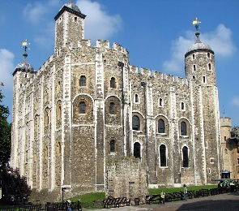
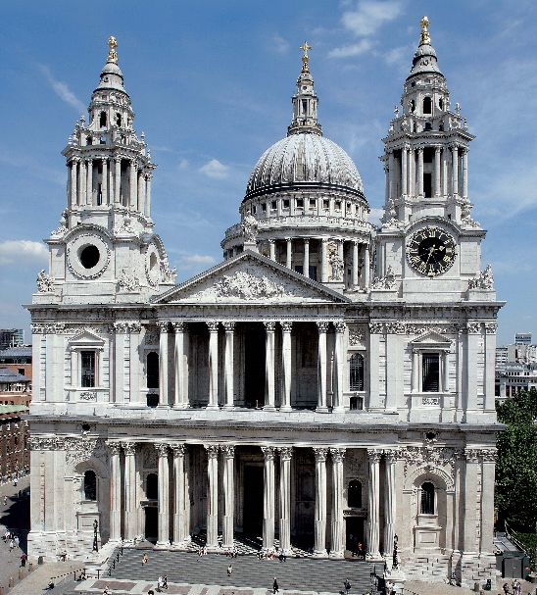
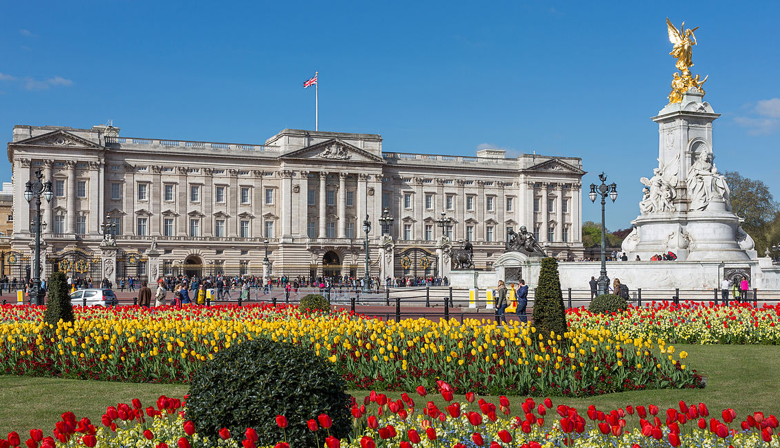
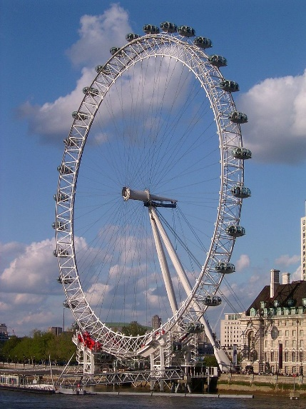
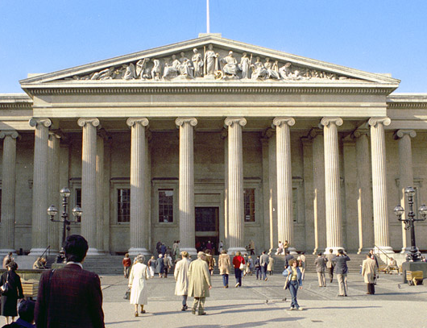
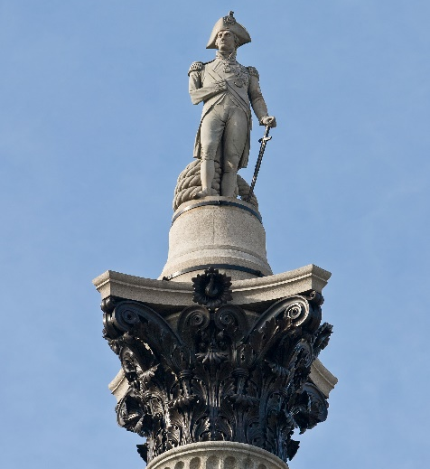
London
Founded by Romans – Londonium in 43 AD

Slide 10
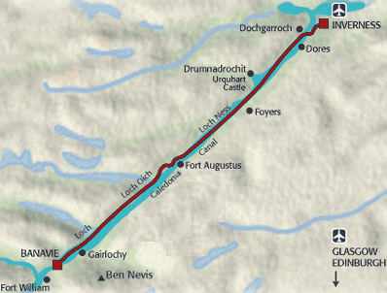
scotland
Clean, unspoilt country – Scottish Highlands (Ben Nevis), Loch Ness & Lomond
Caledonian Canal – connects Inverness with Corpach (97 km, 1/3 man-made)
Thousands historic sites (stone circles, standing stones, burial chambers, Bronze, Iron & Stone Age remains)

Slide 11
scotland
Historic castles, houses, battlegrounds, ruins
Golf (St Andrew), fishing (salmon) & hunting (deer, grouse)
Scotch whisky – tours around distilleries

Slide 12
scotland
Edinburg – Edinburgh Castle, Palace of Holyrood, Royal Mile, Arthur’s Seat (remnant of volcano)
Stirling – “Gateway to the Highlands” (between highland & lowland Scotland), Stirling Castle & Wallace National Monument

Slide 13
wales

Slide 14
Wales – national parks
Brecon Beacons
Snowdonia
Pembrokeshire Coast

Slide 15
Wales – castles
Caernarfon
Beaumaris
Conwy
Harlech
Pembroke

Slide 16
Northern Ireland
Carrick-a-Rede Rope Bridge

Slide 17
Northern Ireland
Over two hundred monastic houses
Londonderry – only remaining completely walled city in Ireland
Old Bushmill Distillery – oldest licenced whiskey distillery in the world
Dunluce Castle

Slide 18
Unesco world heritage sites
23 cultural sites, four natural sites, one of cultural-natural character
17 in England, four in Scotland, three in Wales, one in Northern Ireland, Bermuda, Pitcairn Islands & Saint Helena

Slide 19
Heart of Neolithic Orkney (Scotland)
Four sites, 5,000 years BP
Skara Brae (settlement with stone built houses connected by narrow roofed passages)
Maes Howe (large chambered tomb)
Stones of Stenness (four surviving standing stones & surrounding ditch)
Ring of Brodgar (36 surviving stones)

Slide 20
St kilda
Volcanic archipelago off the west coast of Scotland, no permanent residents since 1930
Towering black cliffs (430 metres) with steep grass-green slopes
One million seabirds at the breeding season (incl rare & endangered species)
Evidence of two millennia of human occupation (stone huts & houses, field systems)
Stac Levenish
Atlantic puffin
Feral Soay sheep

Slide 21
Forth bridge
Railway bridge – spans the estuary of the Forth River, opened in 1890
Earliest great multi-span cantilever bridge in the world & one of the longest (2,529 metres)

Slide 22
Old and new town of Edinburgh
Old Town – along ridge from the Castle on Castle Rock (remnant of volcano) to Palace of Holyrood
Medieval narrow closes, merchant & noble houses (up to six storeys)
Castle
Hollyrood
Saint Giles
Arthur’s Seat
Old Town

Slide 23
Old and new town of Edinburgh
New Town – Neo-Classical, glacial plain to the north of Old Town, large green spaces (18c onwards)
Waverley Valley with Princes Street Gardens

Slide 24
New Lanark
Small 18 century village
Early 19 century – philanthropist & Utopian idealist Robert Owen bought the site →
Turned it into model industrial community
Cotton mill buildings, spacious workers’ housing, public facilities, educational institute & school

Slide 25
giant’s causeway and causeway coast
(northern Ireland)
40,000 massive black basalt columns projecting out of the sea (volcanic activity 50-60 million years BP)
Tops of columns form stepping stones leading from the cliff foot & disappear under the sea
Most hexagonal (some with four, five, seven or eight sides; tallest about 12 metres, 28 metres thick in places)

Slide 26
Frontiers of the roman empire
2 century AD to defend Roman Empire from the ‘barbarians’
Limes Romanus – 5,000 km (from the Atlantic across Europe to Black Sea, Red Sea & across North Africa)
Remnants of walls, ditches, forts, fortresses, watchtowers & civilian settlements
118 km long Hadrian’s Wall (Hadrian, 122 AD), 60 km long Antonine’s Wall (Antonius Pius, 142 AD)

Slide 27
Durham castle and cathedral (England)
Castle – stronghold & residence of Prince-Bishops of Durham, 11 century (William the Conqueror)
Protected northern boundaries of England
Cathedral – within the Castle, 11/12 centuries to house the relics of Saint Cuthbert (evangeliser of Northumbria, 634-687 AD) & Venerable Bede (672/3-735 AD)
Largest & finest example of Norman architecture in England

Slide 28
Studley royal park incl ruins of fountains abbey
Was one of largest & richest Cistercian abbeys in Britain (12 century)
Landscape created around the ruins of the Abbey (18 & 19 centuries)
Gardens, canals, ponds, cascades, lawns, hedges…

Slide 29
saltaire
Exceptionally complete & well-preserved industrial village (2 half of 19 century)
Founded by mill-owner Titus Salt as model village for his workers
Textile mills, public buildings & workers’ housing, urban plan survives intact
Church

Slide 30
Derwent valley mills
Series of 18 & 19 century cotton mills, industrial landscape (high historical & technological significance)
1721 – construction of Silk Mill in Derby, 1770s – two water-powered spinning mills at Cromford→
Modern factory system established & developed
Industrial establishments in rural landscape → required housing & facilities for mill workers

Slide 31
Ironbridge gorge
Ironbridge – symbol of Industrial Revolution, remains of mines, pit mounds, foundries, factories, workshops, warehouses, iron workers’ housing, infrastructure
Iron Bridge – erected 1779, spans deep valley, first bridge in the world built from iron

Slide 32
Blenheim palace
Palace presented by English nation to John Churchill, the first Duke of Marlborough (for his victory over French & Bavarian troops in 1704)
Built between 1705-1722, within large landscape park

Slide 33
City of bath
Romans – 1 century AD, used natural hot springs as thermal spa (Aquae Sulis)
18 century – developed into spa city, Neo-classical Palladian buildings (crescents , terraces & squares)
Preserved Roman structures – Temple of Sulis Minerva & baths complex

Slide 34
Stonehenge, avebury and associated sites
Avebury – largest Neolithic stone circle in the world (3700 – 1600 BC)
Stonehenge – most sophisticated (2 different kinds of stones – Bluestones & Sarsens, 40 tons, 240 km)
Purpose? astronomic, ceremonial, mortuary?

Slide 35
Stonehenge, avebury and associated sites
Silbury Hill (largest prehistoric mound in Europe)
Beckhampton Avenue (curving avenue of stones)
West Kennet Avenue (avenue of two parallel lines of stones)
Adam & Eve

Slide 36
Dorset and east devon coast
Cliffs stretch for 155 kilometres along the Channel coast
Provide almost continuous sequence of rock formations spanning the Mesozoic Era
Called Jurassic Coast (fossils provide continuous record of life on land & in the sea since 185 million years BP)

Slide 37
Cornwall and west devon mining landscape
Landscapes radically reshaped during 18 & 19 centuries by deep mining (copper & tin)
Remains of mines, engine houses, foundries, smallholdings, ports, canals, railways & tram roads
Ancillary industries & new towns & villages
Pit
Wheelpit

Slide 38
Royal botanic gardens, kew
Designed by Charles Bridgeman, William Kent, Capability Brown & William Chambers, 1759
Historic landscape gardens, used to study botany & ecology
Botanic collections (conserved plants, living plants & documents)
Arboretum, bonsai, cacti, orchid, magnolia & fern collections, rose, azalea, lilac, grass, bamboo & rock gardens

Slide 39
Tower of london
White Tower – typical example of Norman military architecture
William the Conqueror to protect London & emphasise his power, 1066
Tower of London – built around White Tower (royal buildings, 11-16 centuries)
Royal palace, prison (Anne Boleyn, Catherine Howard, Mary Stuart, Sir Walter Raleigh)

Slide 40
Palace of westminster and westminster abbey
Westminster Abbey – William the Conqueror (11 century)
Coronation of all English & British monarchs, most of them married & buried

Slide 41
Palace of westminster and westminster abbey
Westminster Palace – home to British Parliament (1840s, on medieval remains)
Church of Saint Margaret – Gothic (11 century, parish church of the Palace)

Slide 42
Maritime Greenwich
Symbolises English artistic & scientific effort of 17 & 18 centuries
Queen’s House – Inigo Jones, first Palladian building in England
Royal Hospital for Seamen – now Royal Naval College (Christopher Wren, Baroque)
Old Royal Observatory – base-line for the world time zone system, marks the Prime Meridian
Royal Observatory

Slide 43
Canterbury Cathedral, St Augustine’s Abbey and St Martin’s Church
Canterbury – seat of the archbishops of the Church of England for nearly five centuries
Cathedral – mixture Romanesque & Gothic styles (11 century, Thomas Becket – 1170 → pilgrimage site)
Church of Saint Martin – oldest church in England
Ruins of the Abbey of Saint Augustine (introduction of Christianity to the Anglo-Saxons)

Slide 44
Castles and Town Walls of King Edward
in Gwynedd (Wales)
Edward I (1272–1307) – series of castles (pacifying local population & establishing English colonies in Wales)
Four castles – Beaumaris, Conwy, Caernarfon & Harlech
Fortified towns at Conwy & Caernarfon – 13/14 century military architecture
Conwy
Harlech
Caernarfon
Beaumaris

Slide 45
Pontcysyllte Aqueduct and Canal (Wales)
18 km navigable Aqueduct – to carry the Llangollen Canal over the Valley of the River Dee
Completed during Industrial Revolution – early 19 century
Pioneering masterpiece of engineering & monumental metal architecture
Use of both cast & wrought iron, longest & highest aqueduct in Britain

Slide 46
Blaenavon Industrial Landscape
19 century – Wales was leading producer of iron & coal in the world
Blaenavon – landscape created by industrial processes associated with production of iron & coal
Coal & ore mines, quarries, furnaces, railway system, public buildings & workers’ housing

Slide 47
Historic Town of St George and Related Fortifications (Bermuda)
St George – oldest English town in the New World (1612)
Outstanding example of planned urban settlements established in the New World
Associated fortifications illustrate development of English military engineering (17-20 century)

Slide 48
Gough and Inaccessible Islands (south Atlantic)
Two extraordinary uninhabited oceanic islands, almost untouched (number of endemic species)
Cliffs – one of largest colonies of sea birds (Rockhopper Penguins, Fur & Elephant Seals; whales, dolphins)
Gough
Inaccesile

Slide 49
Henderson Island (Pitcairn island, Pacific)
Uninhabited raised coral atoll, almost untouched by human presence
Provides ideal conditions for studying dynamics of evolution & natural selection
Ten plant & four land birds native to the island, home to large breeding seabird colonies

Slide 50
Thank you for attention

