Slide 1
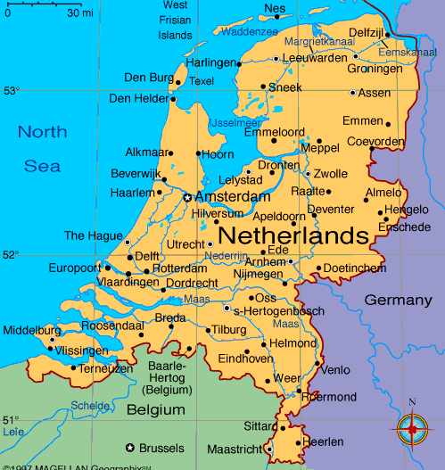
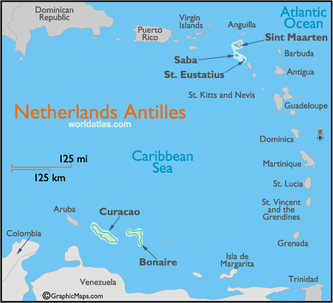
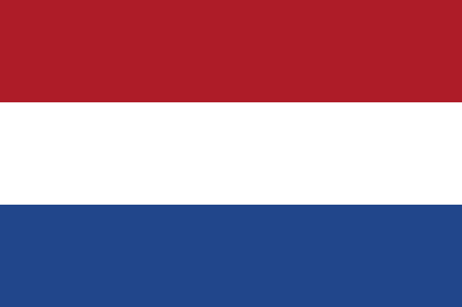
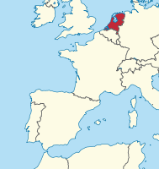
Netherlands
Nederland or Koninkrijk der Nederlanden
Four constituent countries – Netherlands, Aruba, Curaçao & Saint Martin (in the Caribbean)
Netherlands = European & Caribbean Netherlands (municipalities of Bonaire, Saba & Sint Eustatius)
The North Sea to the north & west, Belgium to the south, Germany to the east
41,500 km² , 17 million people
Amsterdam – capital & largest city, The Hague – seat of government; Willem-Alexander
  Trilateral Benelux economic union
  International courts – Permanent Court of Arbitration, International Court of Justice, International Criminal Tribunal for the Former Yugoslavia, International Criminal Court & Special Tribunal for Lebanon
  The Hague – first four + EU criminal intelligence agency Europol
13 million foreign tourists

Slide 2
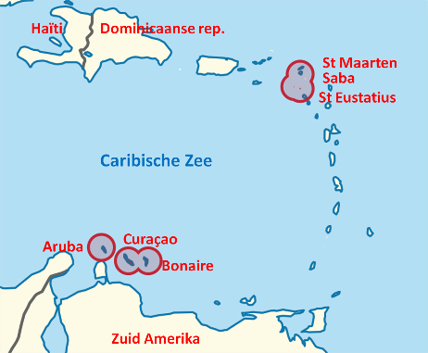
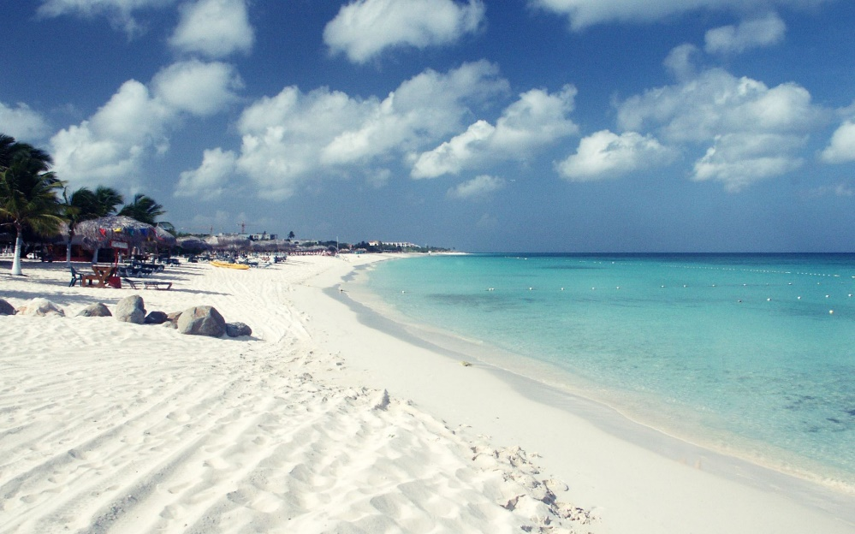
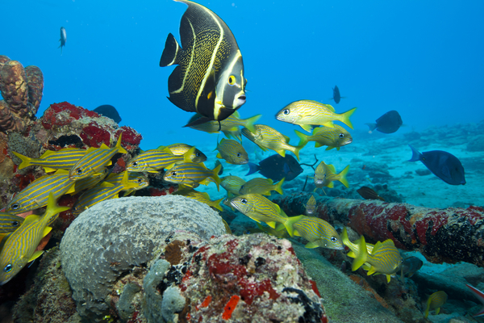
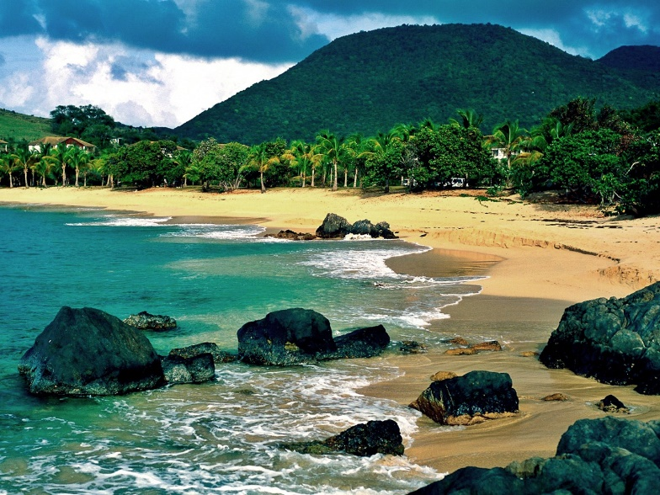
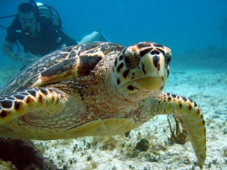
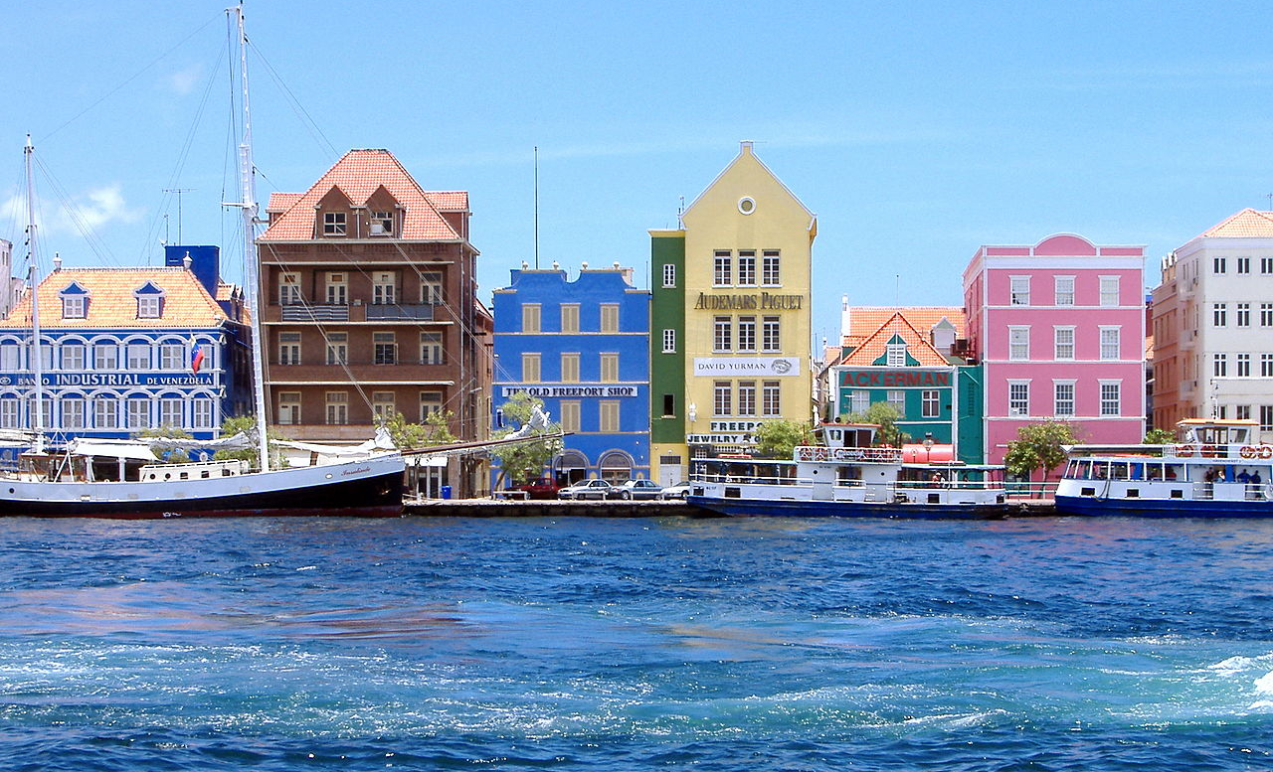
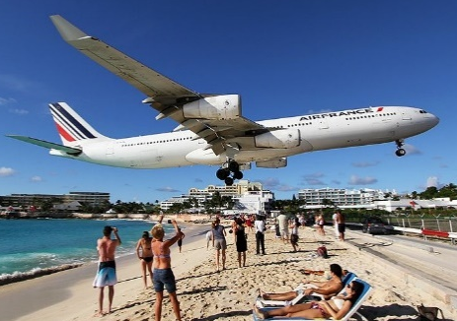
Tourist attractions
Four constituent countries – Netherlands + Aruba, Curaçao & Saint Martin (in the Caribbean)
Excellent conditions for snorkelling & scuba diving at coral reefs
Sint Maarten
Curacao

Slide 3
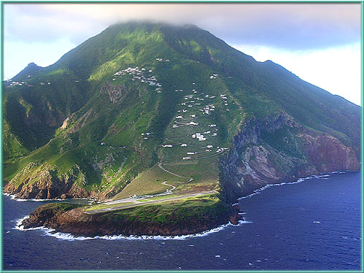
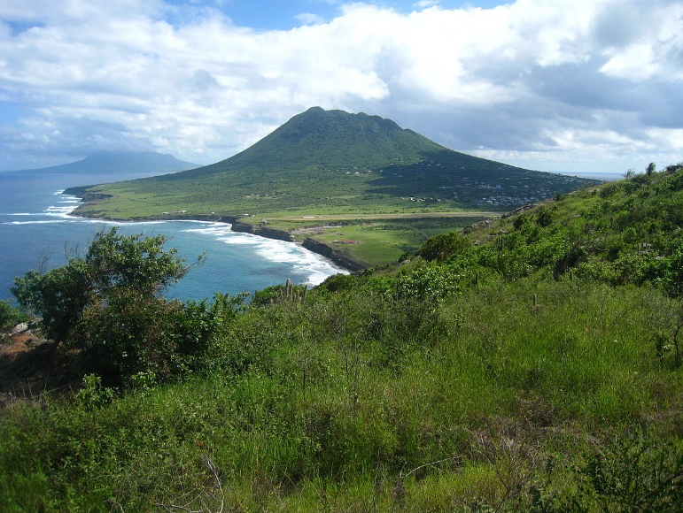
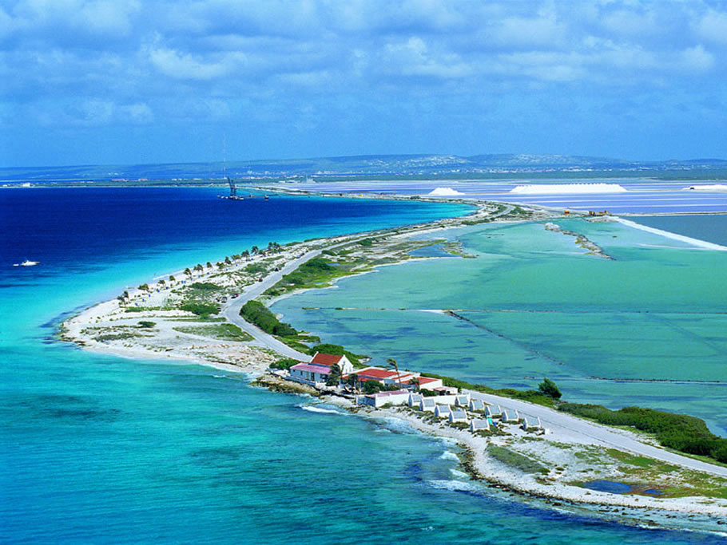
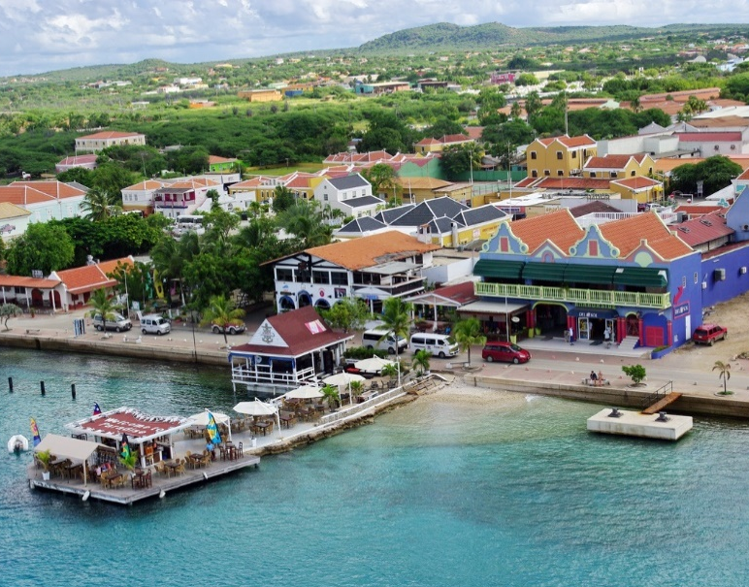
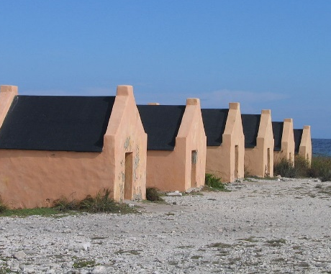
Tourist attractions
Netherlands = European mainland & Caribbean Netherlands (Bonaire, Saba & Sint Eustatius)
Bonaire – of mixed volcanic & coral origin, Saba & Sint Eustatius – hilly islands of volcanic origin
Saba
Sint Eustatius
Slave huts
Bonaire

Slide 4
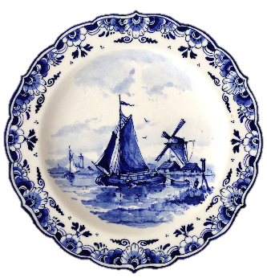
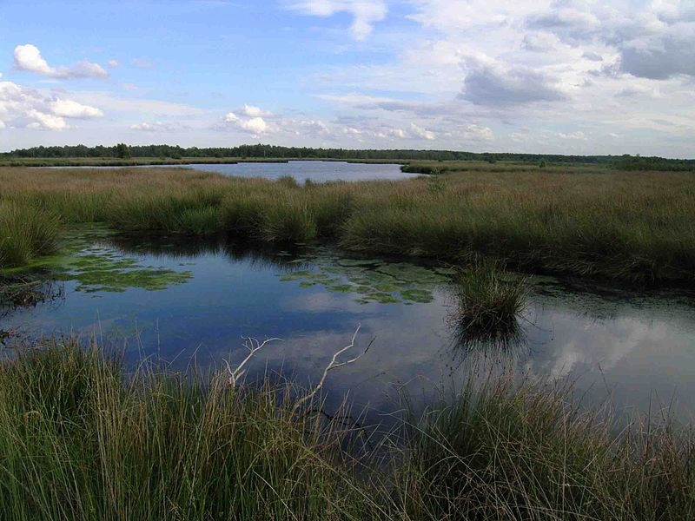
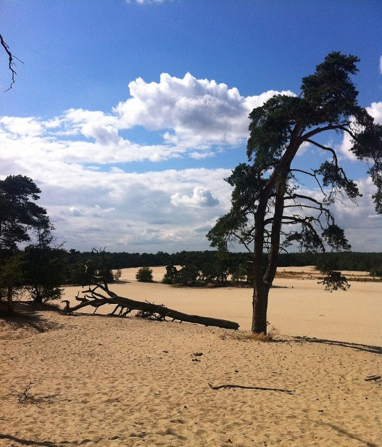
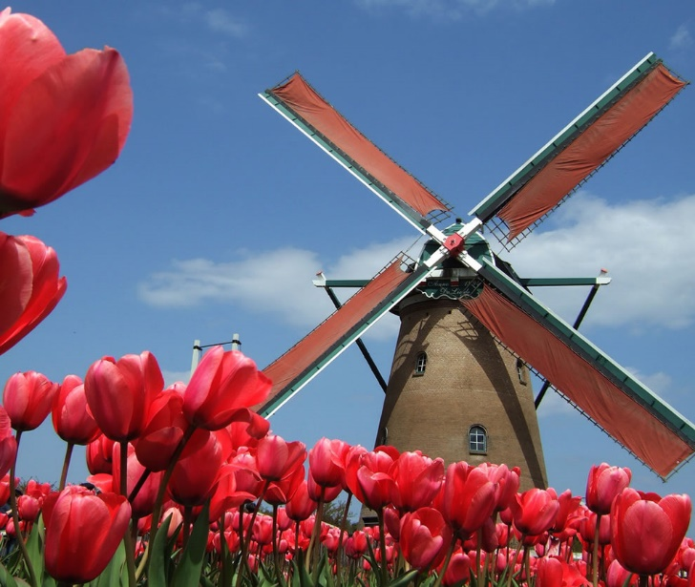
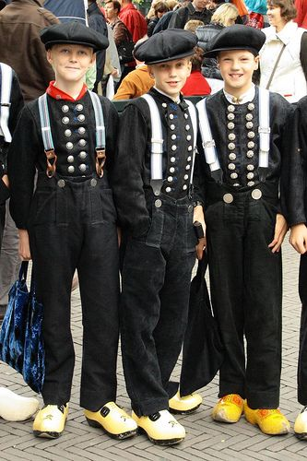
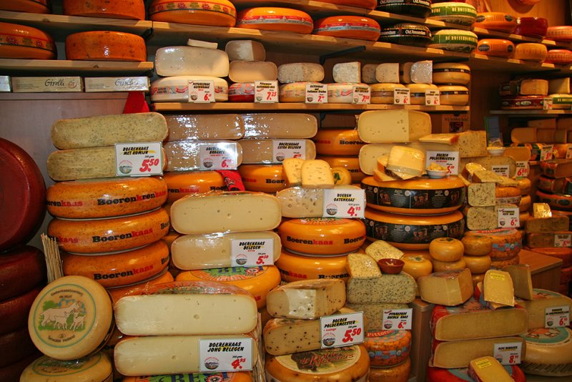
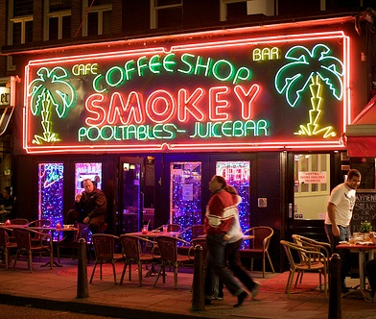
Tourist attractions
20 national parks, hundreds of nature reserves – lakes, heathlands, woods, dunes
Windmills, tulips, wooden shoes, cheese, Delftware pottery, cannabis
De Groote Peel NP
Loonse en Drunense Duiden NP

Slide 5
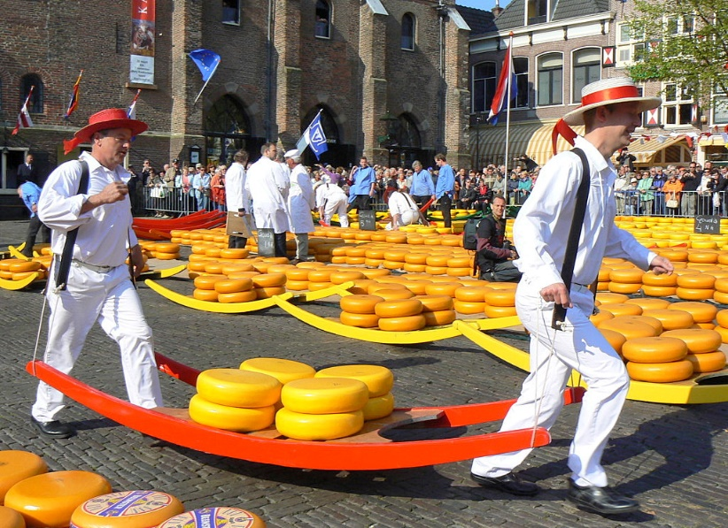
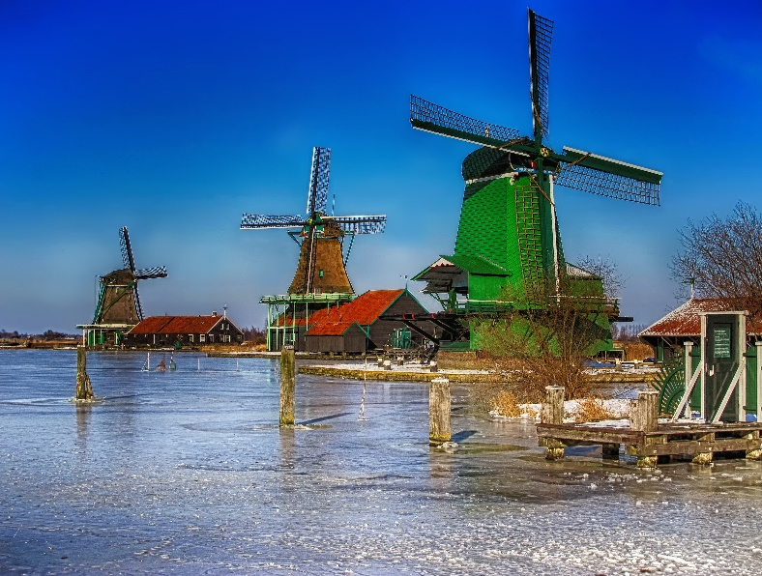
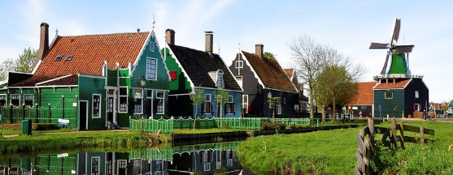
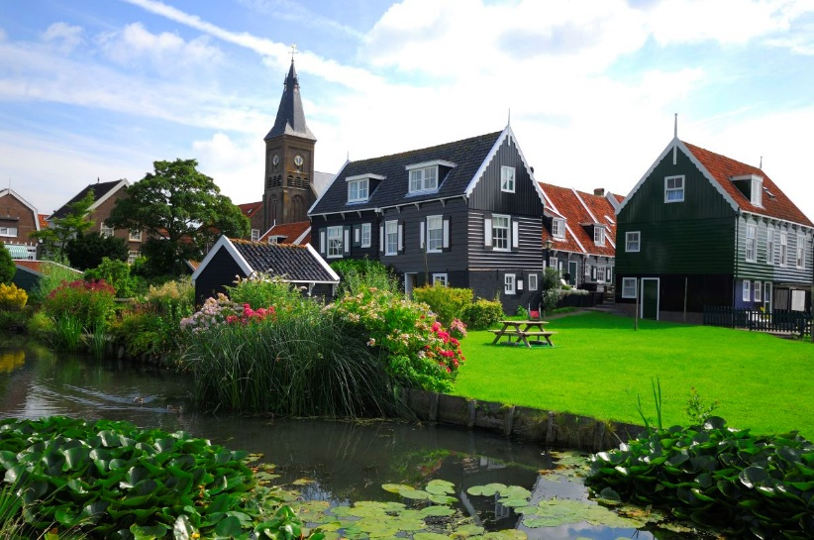
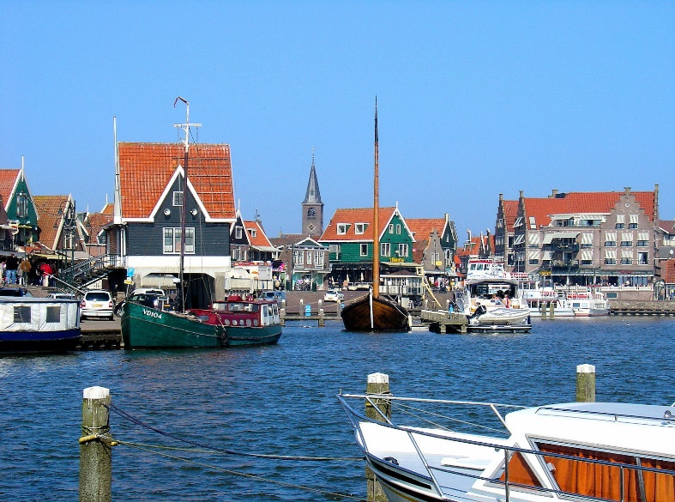
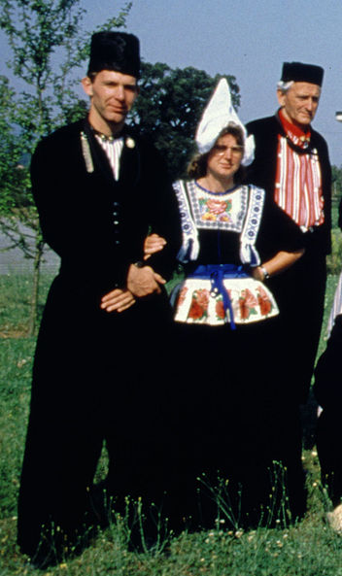
Tourist attractions
Zaanse Schans – historic windmills & houses (anchor point of the European Route of Industrial Heritage)
Volendam – old fishing boats & traditional costumes still worn
Marken – picturesque colourful wooden houses
Alkmaar – old centre & traditional cheese market
Zaanse Schans
Marken
Volendam

Slide 6
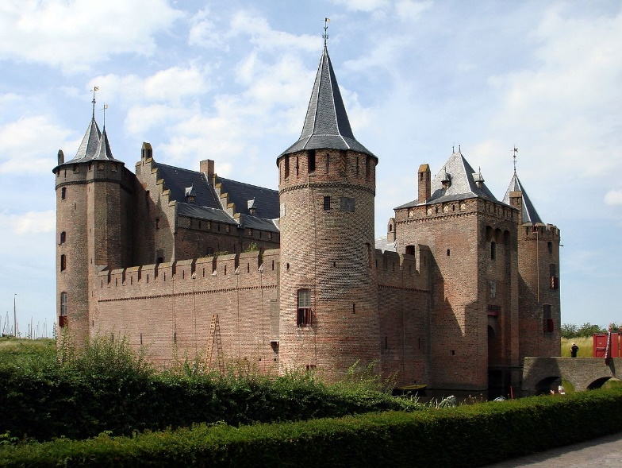
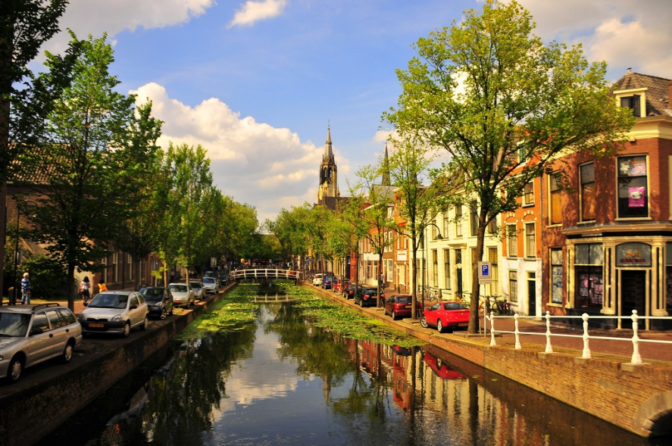
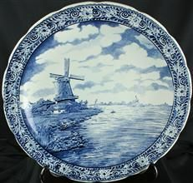
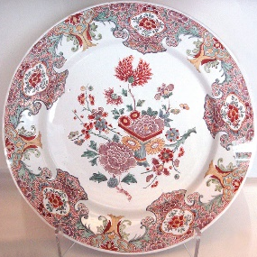
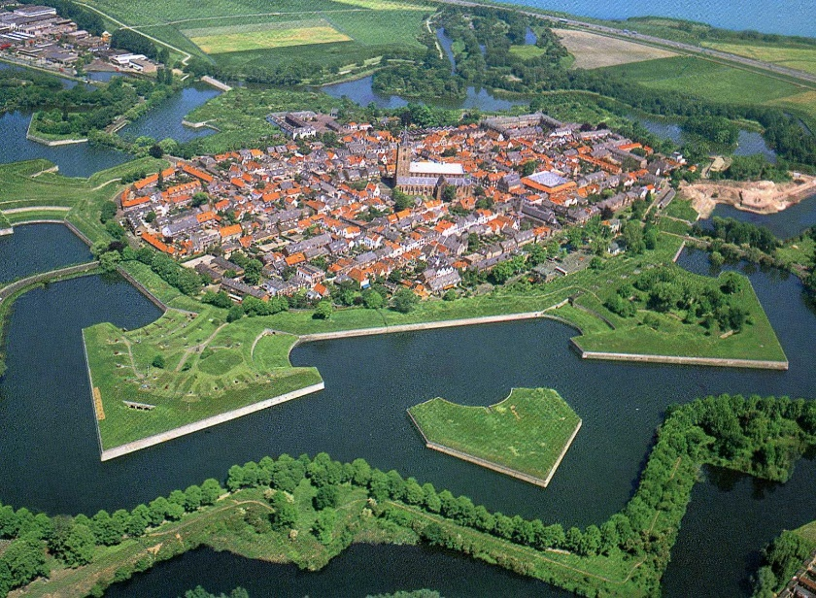
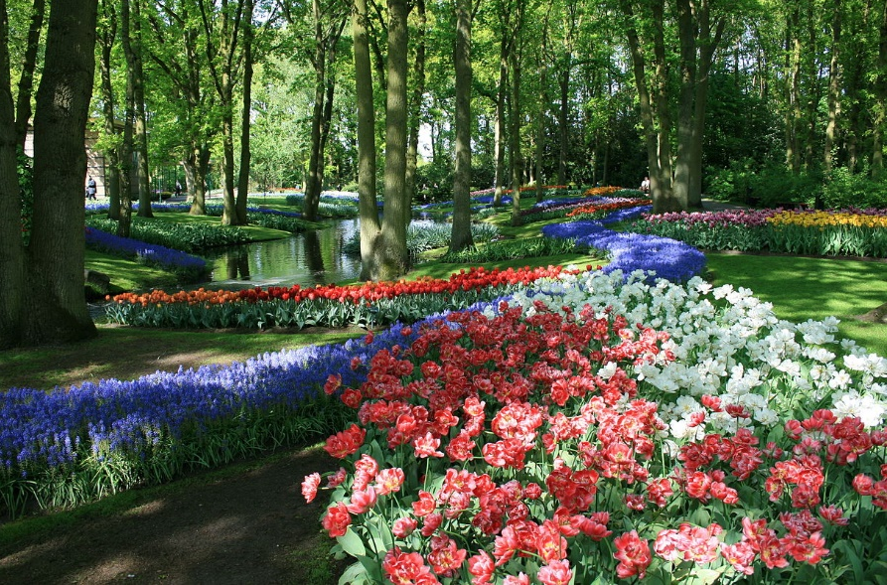
Tourist attractions
Delft – historic town centre with canals, Delft Blue pottery.
Naarden – well-preserved example of star fort with fortification walls & moat
Lisse – Kitchen Garden (Keukenhof), one of largest flower gardens in the world (7 mil flower bulbs)
Muiden 13c

Slide 7
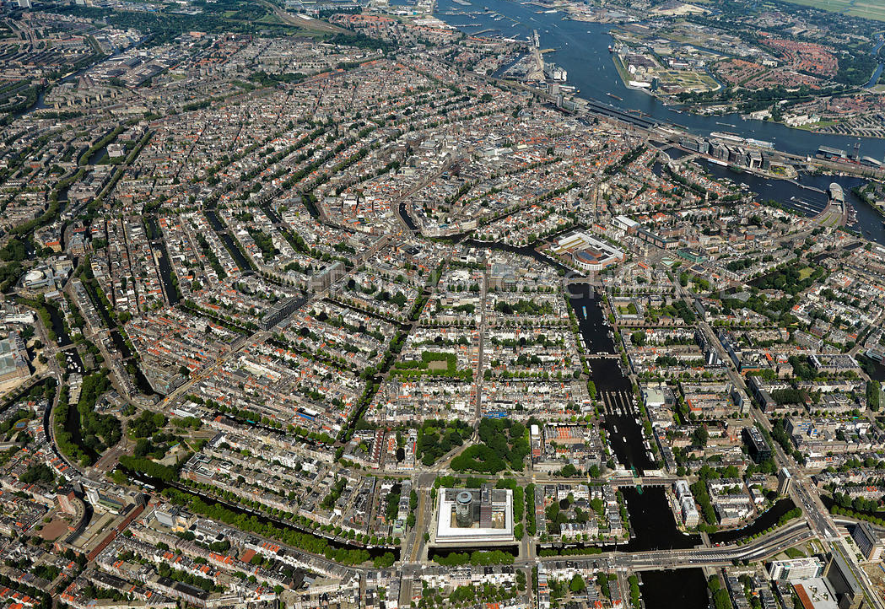
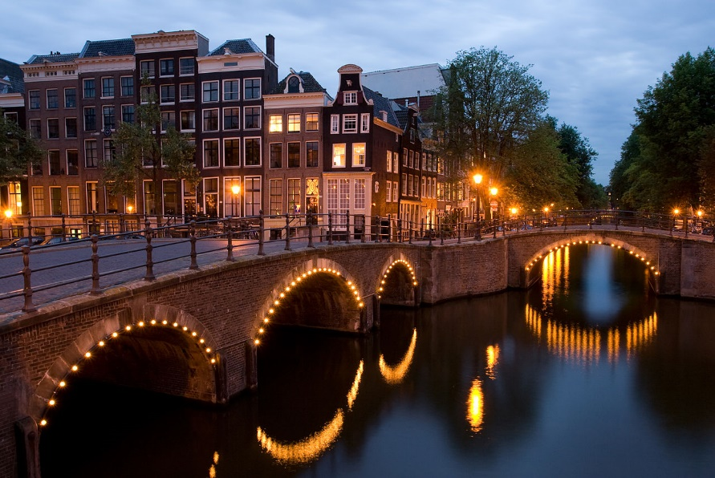
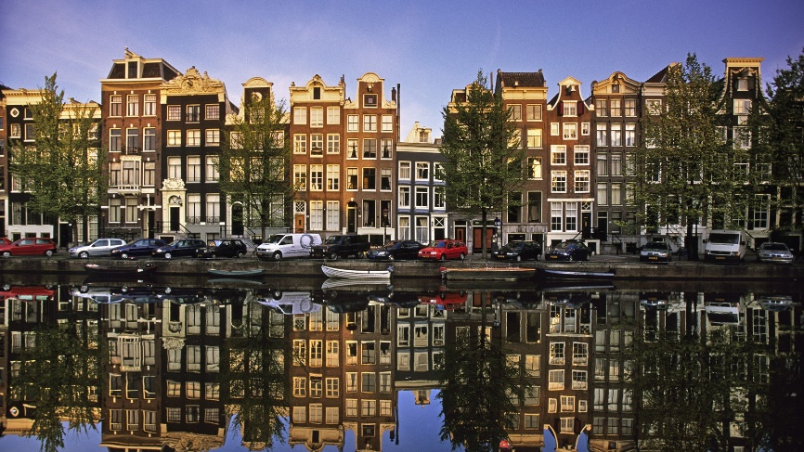
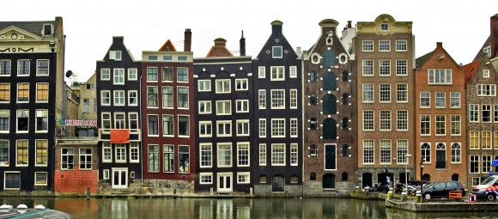
amsterdam
17-century canals in the heart of the city

Slide 8
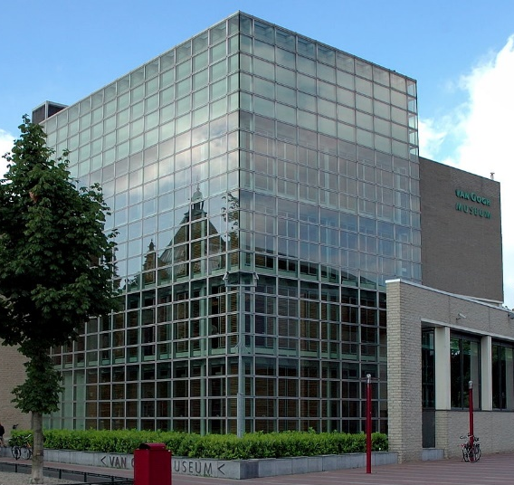
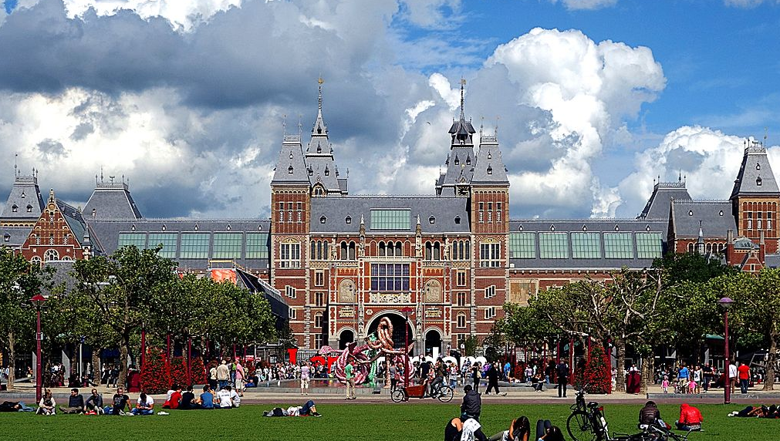
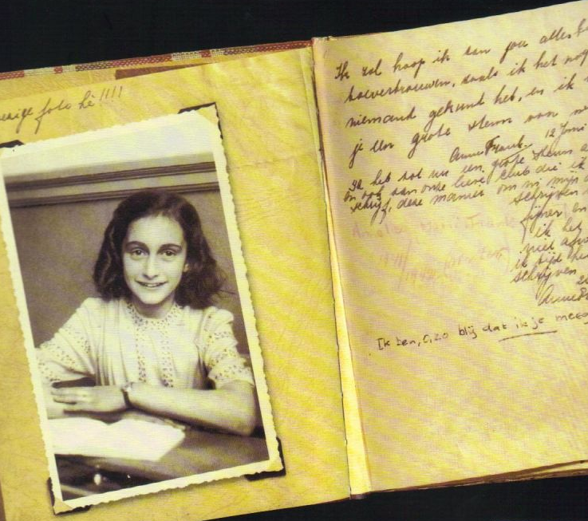
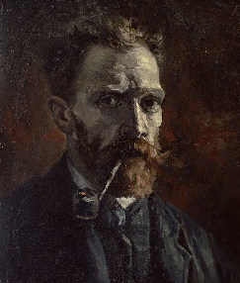
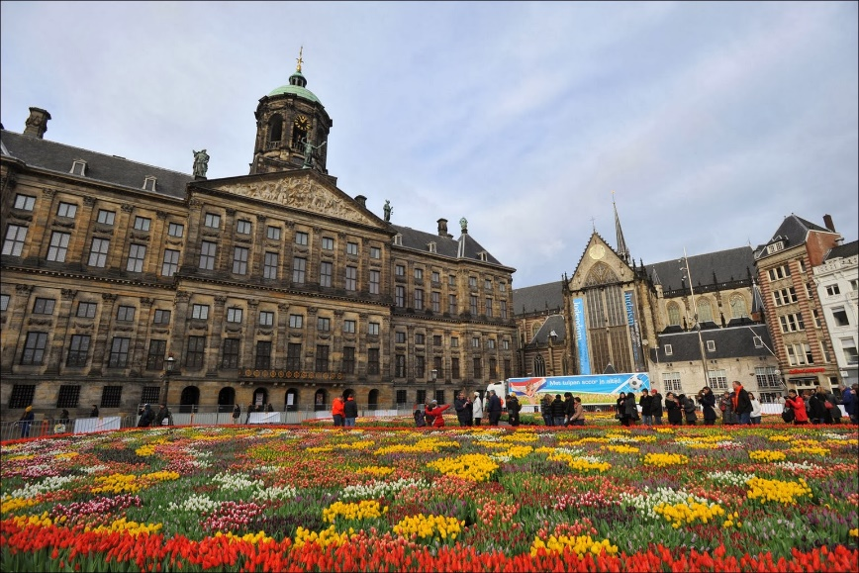
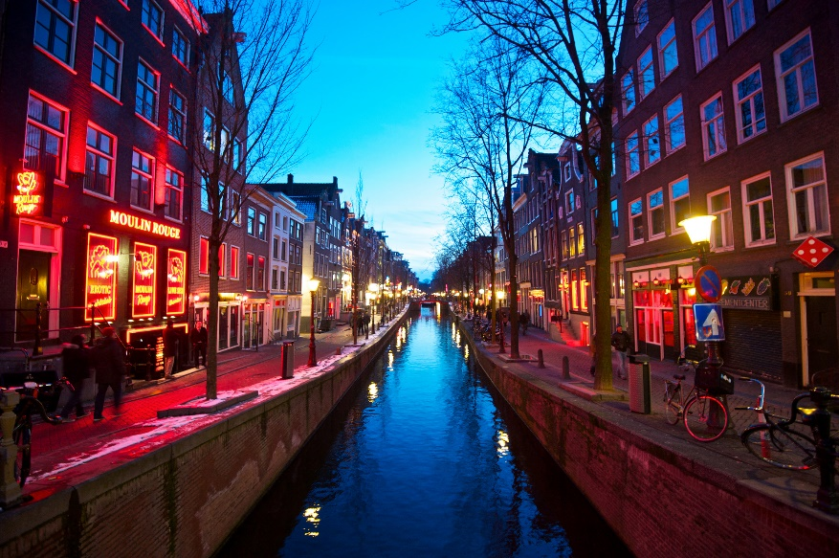
amsterdam
Van Gogh Museum, State Museum (Rijksmuseum), Anne Frank House
National Tulip Day – every January
De Wallen – red light district
Van Gogh Museum
State Museum
Anne Frank House
National Tulip Day
De Wallen

Slide 9
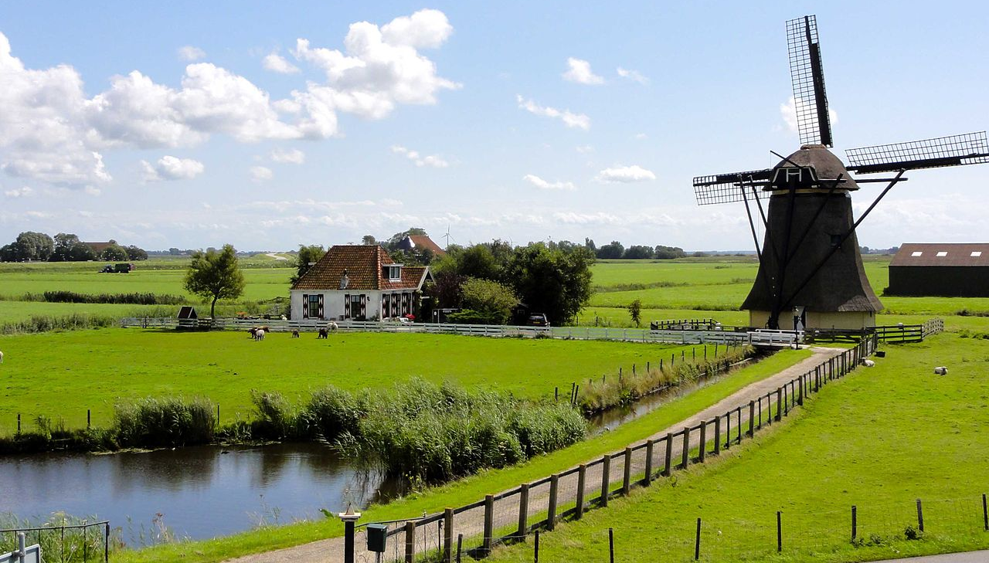
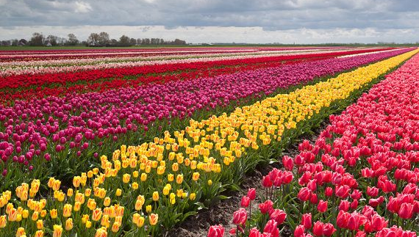
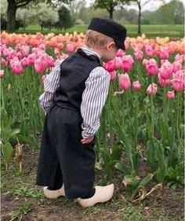

Unesco world heritage sites
Nine cultural sites, one natural site
Nine are on the European Mainland, one in Curaçao
One transboundary with Germany & Denmark

Slide 10
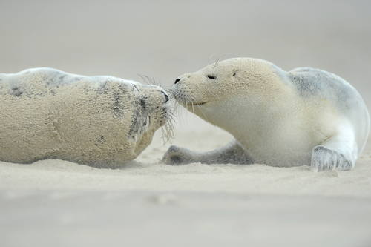
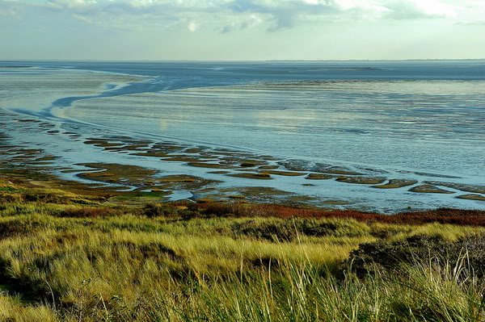






Wadden sea
Largest unbroken system of intertidal sand & mud flats in the world (10,000 km²)
Between north-western coast of Europe & Frisian Islands (Wadden Sea Islands)
From Den Helder (Netherlands), past river estuaries (Germany) to Skallingen (Denmark), 500 km
Shallow body of water with tidal flats and wetlands, rich in biodiversity & transitional habitats
Tidal channels, sandy shoals, sea-grass meadows, mussel beds, mudflats, marshes, beaches, dunes
Numerous plant & animal species (seals, harbour porpoise, migratory birds)

Slide 11




Ir. D. F. Woudagemaal
(D. F. Wouda Steam Pumping Station)
Largest steam-powered pumping station ever built (situated at Lemmer)
Opened (by Queen Wilhelmina) in 1920, to pump excess water out of Friesland,
1967 converted from coal to run on heavy fuel oil

Slide 12




Schokland and Surroundings
Peninsula, by 15 c had become island, Zuider Zee (shallow bay of the North Sea) thread of floods
1825 –flood → massive destruction → island evacuated & permanent settlement ended in 1859
1942 – Noordoostpolder reclaimed from the sea (the Zuider Zee was drained)→ lost status of island
slightly elevated part above polder, outlines of island visible, parts of the wall of the waterfront
Schokland – symbol of struggle of people against the sea (has lasted 6,000 years & still continues

Slide 13






Droogmakerij de Beemster
(Beemster Polder)
First polder in Netherlands, reclaimed from Lake Beemster – water extracted by windmills
1609-1612 – to acquire new agricultural land & space for country residences + to fight flooding
Intact geometric pattern of fields, roads, canals, dykes & settlements + canals parallel roads
Religious, residential, farm & industrial buildings along the roads (17-19 centuries)
Five forts – part of the Defence Line of Amsterdam (built 1880-1920)

Slide 14






Dutch water defence lines
Defence Line of Amsterdam; new dutch waterline
Amsterdam: 1880-1920, 135 km, 42 armed forts (10-15 km from the centre) & lowlands (easily flooded in time of war); buildings within 1 km of line – made of wood (could be burnt)
New Line: 1815-1940, 85 km, 3 forts, 6 fortified towns, 2 castles, canals, etc.
Based on flooding of land designed to give depth of app 30 cm (insufficient for boats to navigate)

Slide 15






Seventeenth-Century Canal Ring Area of Amsterdam inside the Singelgracht
App 100 km of canals, 90 islands & 1,500 bridges; 4 main concentric half-circles of canals
Singelgracht – outer canal for purposes of defence & water management
Grachtengordel = 3 main canals (Herengracht, Keizersgracht & Prinsengracht)
Interconnecting canals (primarily for transportation of goods)
Prinsen
Heren
Singel
Keizers

Slide 16




Rietveld Schröderhuis (Rietveld Schröder House)
Family house in Utrecht – Dutch architect Gerrit Thomas Rietveld (1924)
Example of De Stijl architecture (The Style, Dutch artistic movement also known as neoplasticism)
Interior – changeable open zone, sliding & revolving panels (allow flexible spatial arrangement)

Slide 17





Mill Network at Kinderdijk-Elshout
Kinderdijk – village situated in the Alblasserwaard polder at confluence of rivers Lek & Noord
System of 19 windmills built around 1740 – to drain the polder
Typical features of drainage technology (dykes, reservoirs, pumping stations & administrative buildings)

Slide 18




Van Nellefabriek
1920s – banks of canal in the Spaanse Polder industrial zone
Complex of factories with facades of steel & glass, curtain wall principle
‘Ideal factory’ open to the outside, working spaces evolved to provide pleasant working conditions

Slide 19




Historic Area of Willemstad,
Inner City & Harbour (Curaçao)
Willemstad – capital city of Curaçao, established as trading settlement at natural harbour (1634)
Several historic districts reflecting different areas of colonial town planning & development
Colourful buildings – local tradition from 1817 when white lime exterior was prohibited
Punda
Otrobanda
Pietermaai
Scharloo

Slide 20





Colonies of benevolence
Transnational – with Belgium; experiment in social reform aimed to reduce poverty (small farms for families; larger centralised farms with dormitories for beggars, orphans, etc.; peak – 11,000 people)
Frederiksoord, Wilhelminaoord and Veenhuizen in the Netherlands + Wortel in Belgium

Slide 21




Lower Germanic limes
Frontiers of the roman empire
Between Germania inferior (Roman province) and Germania Magna
Not fortified limes BUT river border guarded by a chain of castra

Slide 22
Thank you for attention

