Slide 1
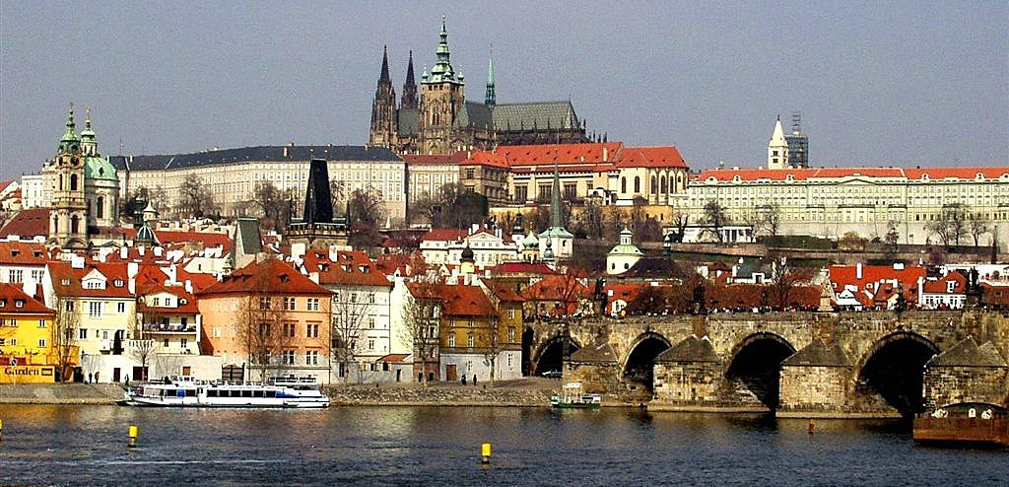
ARCHAEOLOGICAL HERITAGE
Historically – one of five main fine arts (painting, sculpture, architecture, music & poetry) created primarily for aesthetic and intellectual purposes and judged for its beauty
Nowadays – one of applied arts, practical considerations of use are essential

Slide 2
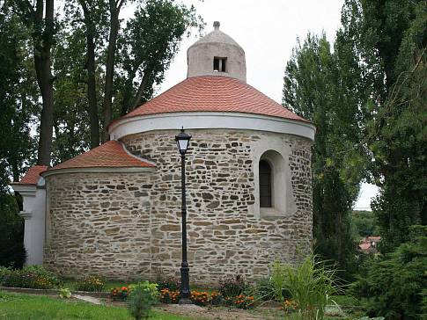
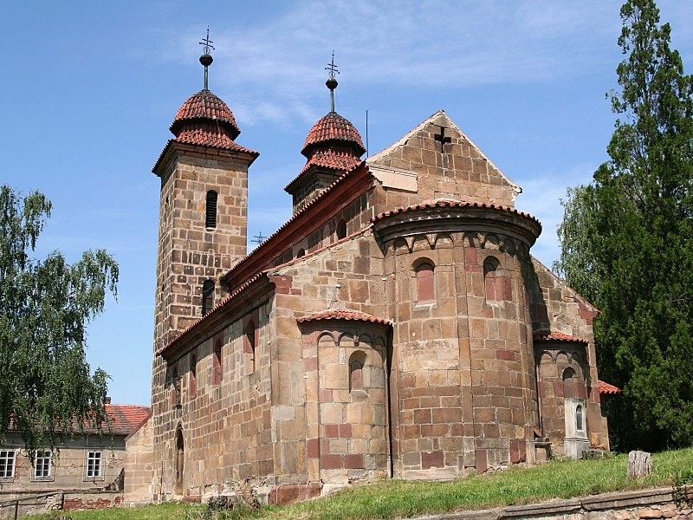
MAIN STYLES
Romanesque style – end of 9 century – first half of 13 century
  First stone structures (churches, monasteries, castles, town houses & fortifications)
  Semi-arch & barrel vault
  Ecclesiastic structures – rotundas (small round churches) & basilicas (large churches)

Slide 3
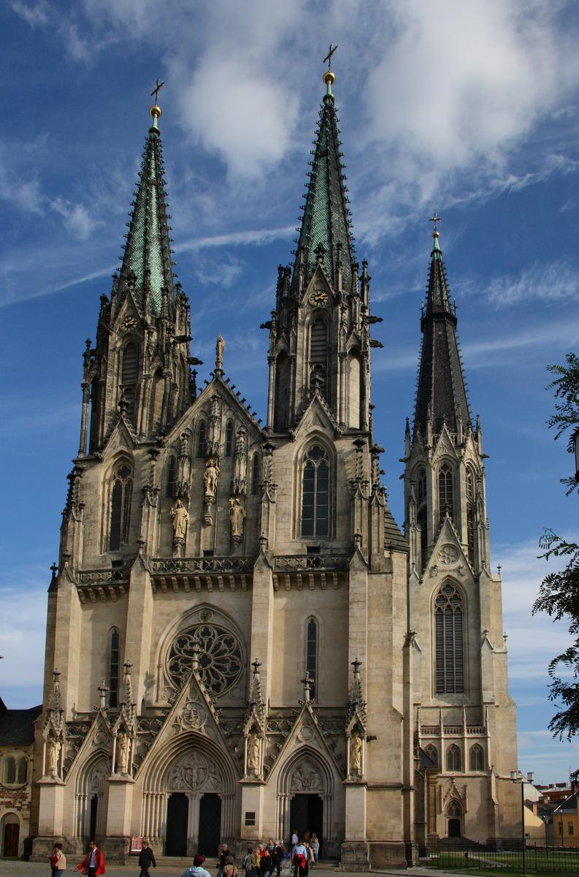
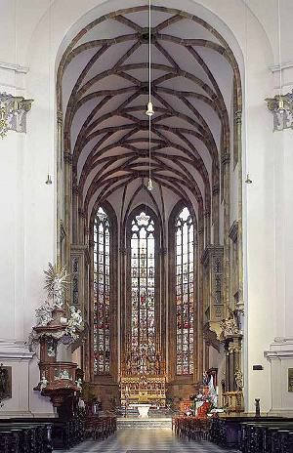
MAIN STYLES
Gothic style – (12 century) first half of 13 century – early 16 century
Broken (cross, rib) vault and pillars/columns
Cathedrals (tall ecclesiastical structures), castles & bridges
  Early Gothic – Přemyslid Gothic (13 to early 14 century, Ottokar II of Bohemia)
  High Gothic – Luxembourg Gothic (14 to early 15 century, Charles IV, Wenceslas IV)
  Late Gothic – Jagiellonian Gothic (15 to 1526, Wladislaus and Ludwig)
Peter Parler & Benedikt Rejt/Ried

Slide 4
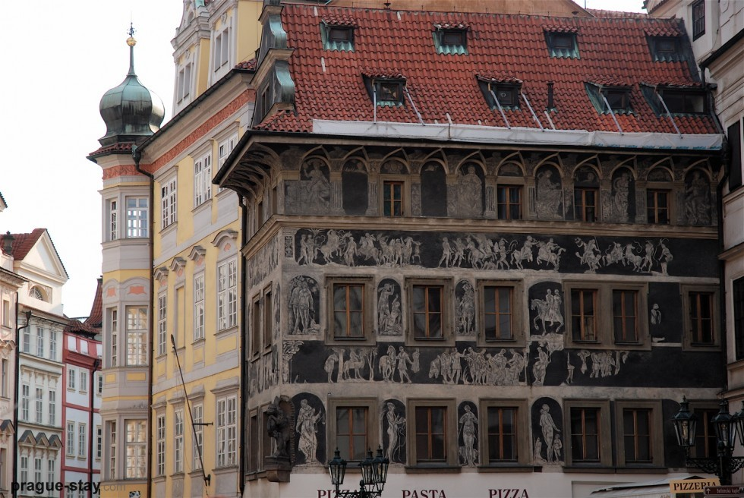
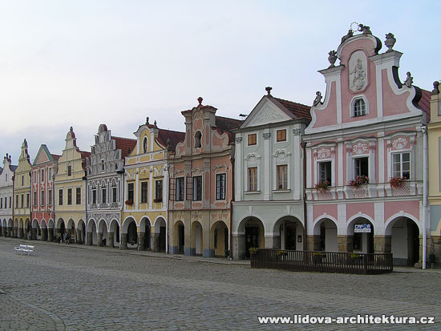
MAIN STYLES
Renaissance – (early 15 century) late-15 century – first half of 17 century (result of Hussite Wars)
Coexisted with Gothic style in Bohemia & Moravia until late-16 century (e.g. residential part of palace Renaissance but its chapel with Gothic elements)
Revival & development of classical antiquity culture
Bricks, facades decorated with sgraffito (figural or ornamental, inspired by the Bible or ancient mythology), decorated house gables, arcaded courtyards, barrel vault, columns & pilasters
Chateaux (comfortable homes for nobility) were built

Slide 5
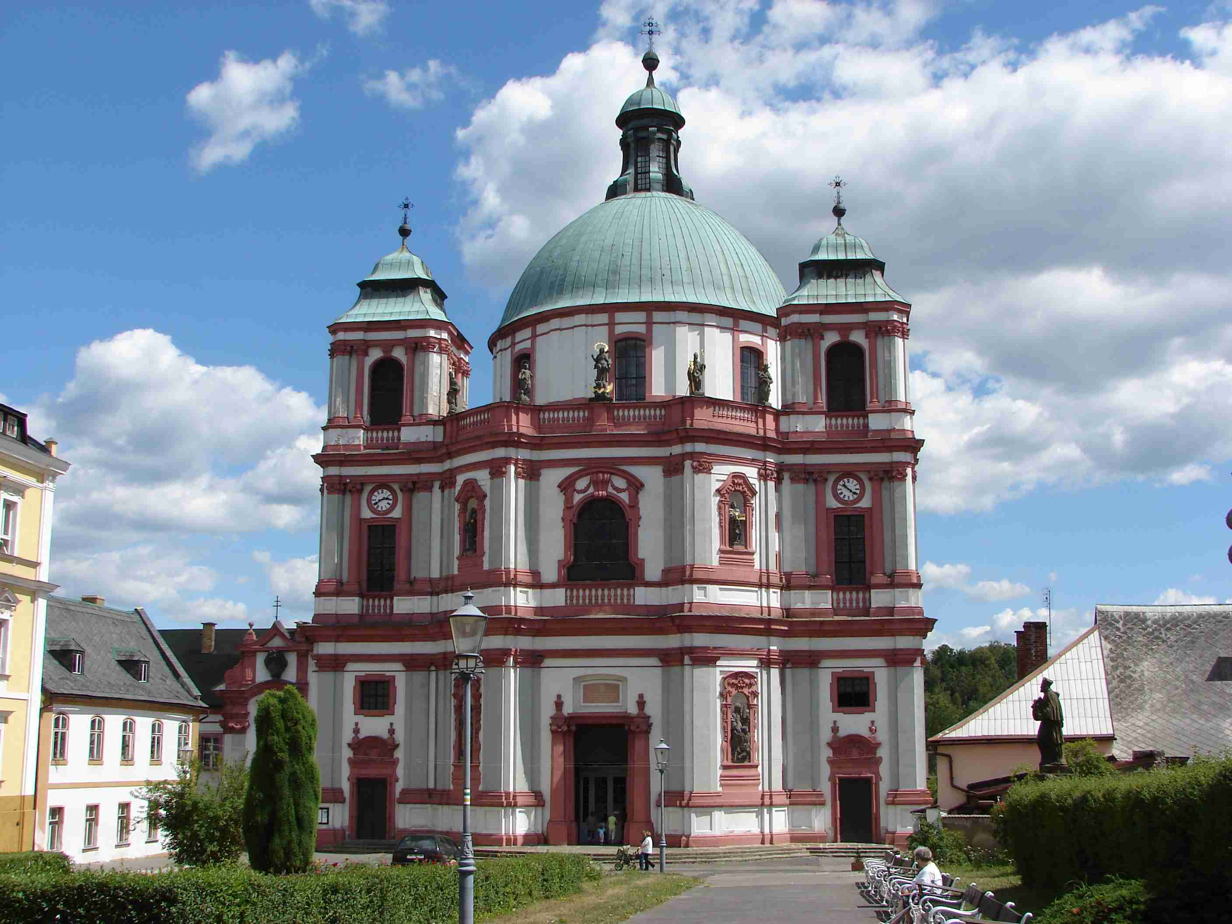
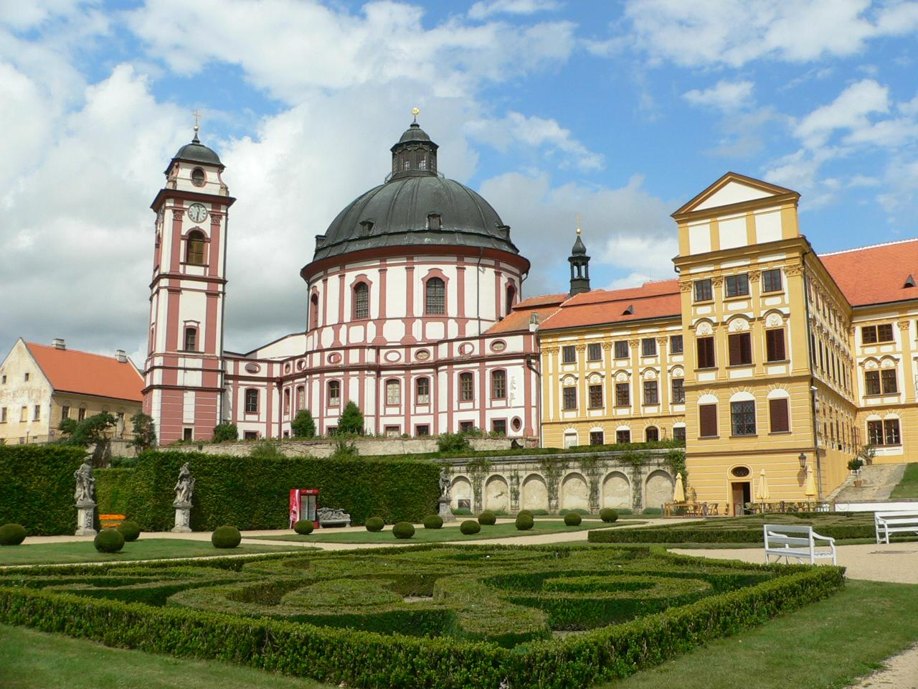
MAIN STYLES
Baroque style – (late-16 century) 17 to 18 century
Expressed the triumph of Catholic Church & absolutist state, churches & grand palaces
Rich shapes, domes, colonnades, monumental staircases, expensive materials, statues, rich interiors, painted decoration, contrast of light & dark, extensiveness & extraordinariness
Christoph & Killian Ignaz Dientzenhofers, Johann Blasius Santini-Aichel

Slide 6
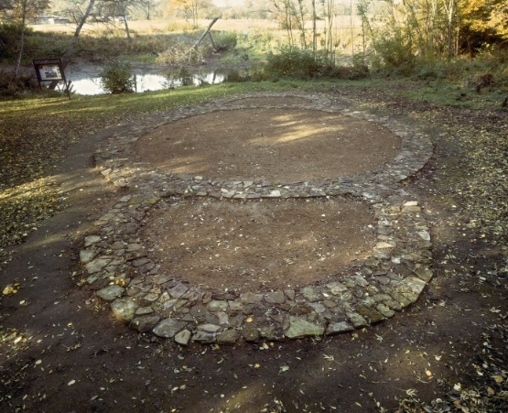
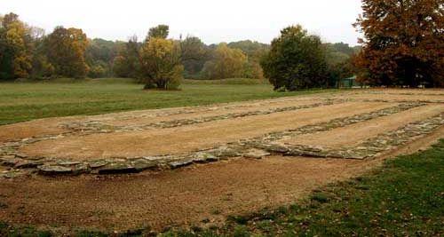
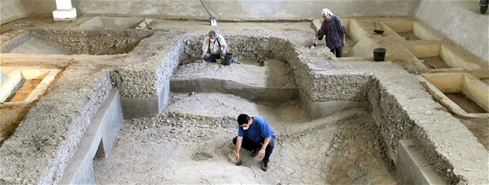
GREAT MORAVIA (Pre-Romanesque)
Earliest architectural monuments on our territory
Churches made of stone, plastered, roofed with burned tiles
Well-defended fortified settlements (elevated positions & lower areas)
Large hill forts, wooden palisades, stone walls (in some cases – moats)
Elite buildings in the centre & crafts in the outer enclosures
Buildings of timber, religious & residential parts of stone
  Localities with central functions – huge fortified agglomerations (Mikulčice, Staré Město-Uherské Hradiště & Nitra)
  Fortified regional administrative centres
  Forts with primary guarding & defence function
  Forts used in the case of danger
Mikulčice – palace & 12 churches (around 800), Pohansko
Staré Město – stone churches
Three-nave basilica (35 m x 9 m), rotunda without apses, rotunda with two apses, tetraconchic rotunda, i.e. with four apses (all in Mikulčice), one-nave churches & rotundas with one apse
Churches decorated by fresco paintings
Open air museum in Modrá (near Uherské Hradiště)
Current dating of several churches precedes the Byzantine mission

Slide 7
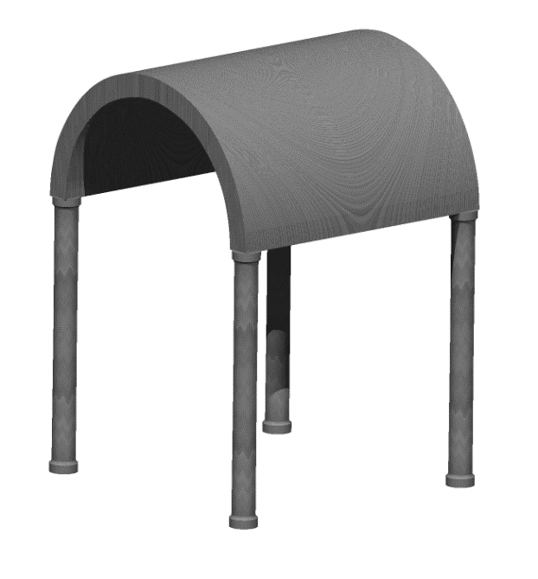
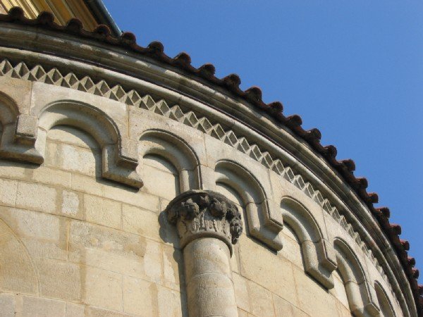
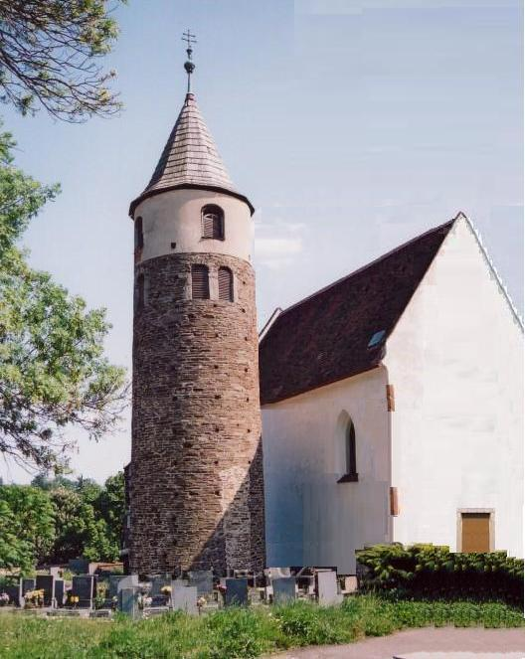
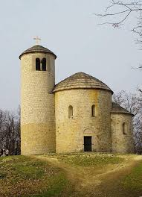
Romanesque style
Started developing after 1000 & culminated in first half of 13 century
Marked by massiveness & relatively little diversity
Windows & door openings are small with semi-circular arches
Characteristic features – arch frieze beneath main cornice, thick walls, round arches, sturdy pillars, groin vaults, large towers
Overall appearance – simplicity
  obloučkový vlys, římsa

Slide 8
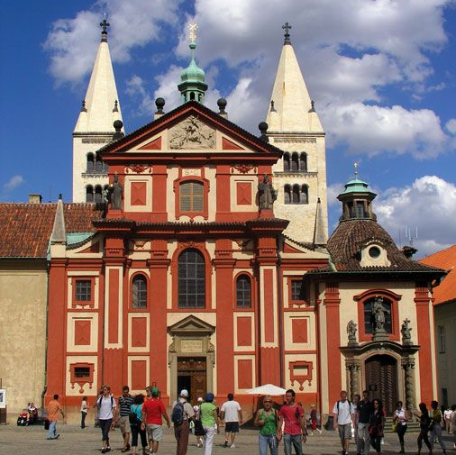
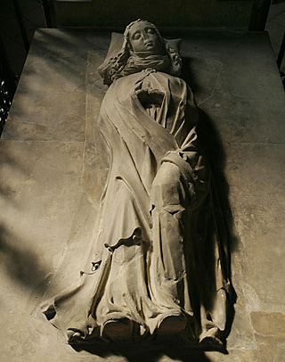
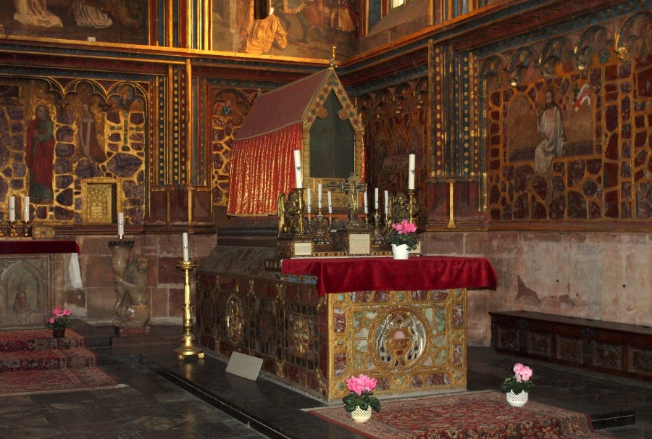
Romanesque style
Many castles (most substantially altered, many in ruins)
Greatly outnumbered by churches – from tiny chapels to large churches & monasteries
Most significant – great abbey churches (many still stand)
Basilica of Saint George (Vratislaus I, 920, oldest surviving church within Prague castle)
  First Bohemian Monastery (Benedictine, 973), Gothic chapel with tomb of Saint Ludmila
Rotunda of Saint Vitus (Prince Wenceslas, app 930)
  Arm of Saint Vitus, Saint Wenceslas buried, Saint Adalbert (tomb of Saint Wenceslas incorporated into Romanesque basilica 1060-1096)
  Saint Wenceslas Chapel built above his grave

Slide 9
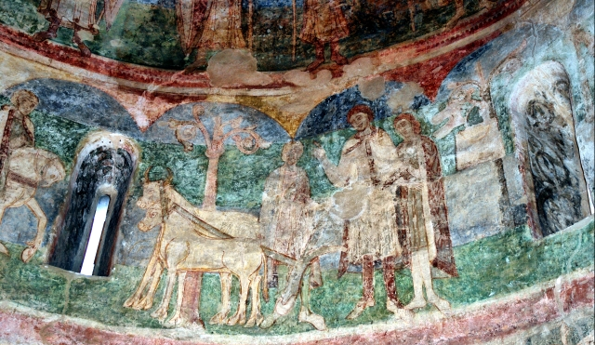
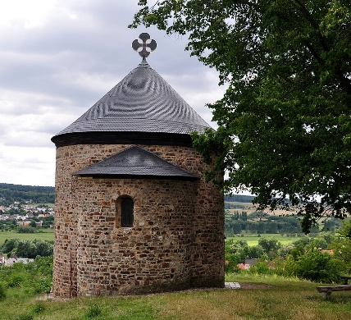
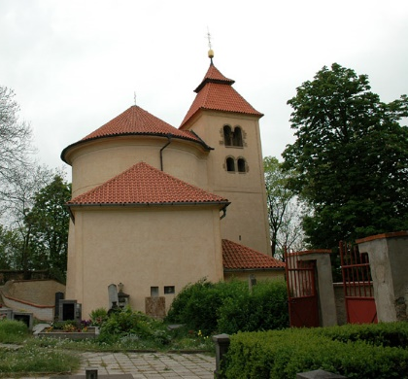
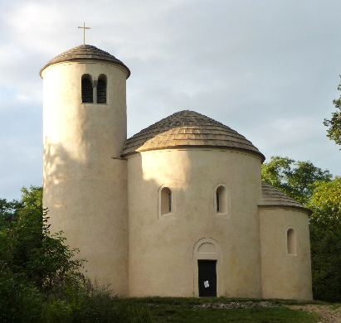
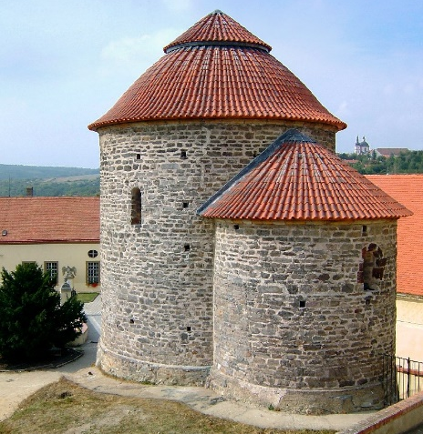
Romanesque style
Rotunda of Saints Peter and Paul (Budeč, 895, oldest preserved)
Rotunda of Saints Peter and Paul (Starý Plzenec, 976)
Rotunda of Saint Catherine (Znojmo, app 1100)
  11-century frescoes
  Biblical scenes & life of Přemyslids
Rotunda of Saint George (Říp Mountain, 1126)*
* Originally dedicated to Saint Adalbert – reconstructed & extended (founded app 1039 , relicts of Sint Adalbert brought to Prague)

Slide 10
Monastic Orders
Benedictines – end of 10 century → built monasteries, usually with three-nave basilica
  Břevnov Monastery – 993, Romanesque crypt survived
  Kladruby Monastery – 1115, three-nave Basilica of Virgin Mary (Baroque adaptation)
12 century – Premonstratensians, Cistercians, Order of Malta*
Premonstratensians
  Strahov Monastery, Doksany Convent – 1140
  Monastery in Louka (Znojmo) – 1190 (plundered by Hussites in 1425)
Commandry of the Order of Knights of Saint John of Jerusalem – 1150s-60s
Form of fortified castle, ramparts, three-nave basilica, hospital, convent, parish school, bathhouse, brewery
Cistercians
  Sedlec Monastery – 1142
  Plasy Monastery – 1144
Basilica of Saint Procopius (Třebíč) – 1240-1280, part of Benedictine monastery
  * Sovereign Military Hospitaller Order of Saint John of Jerusalem of Rhodes and of Malta or Sovereign Military Order of Malta

Slide 11
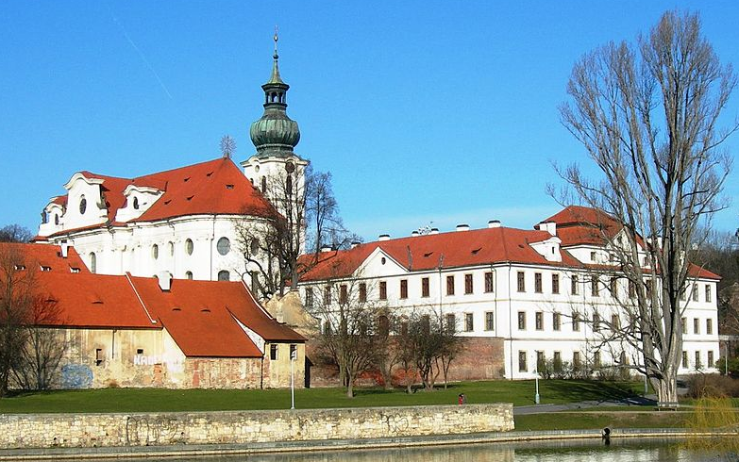
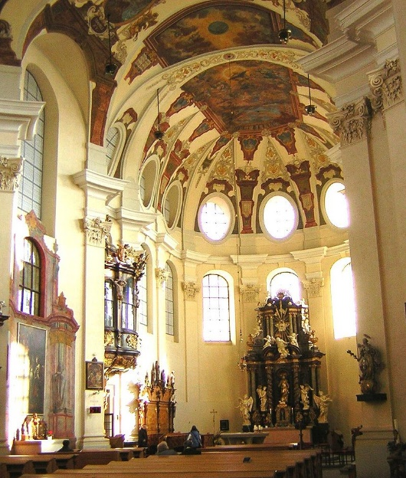
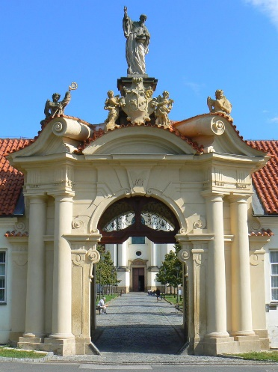
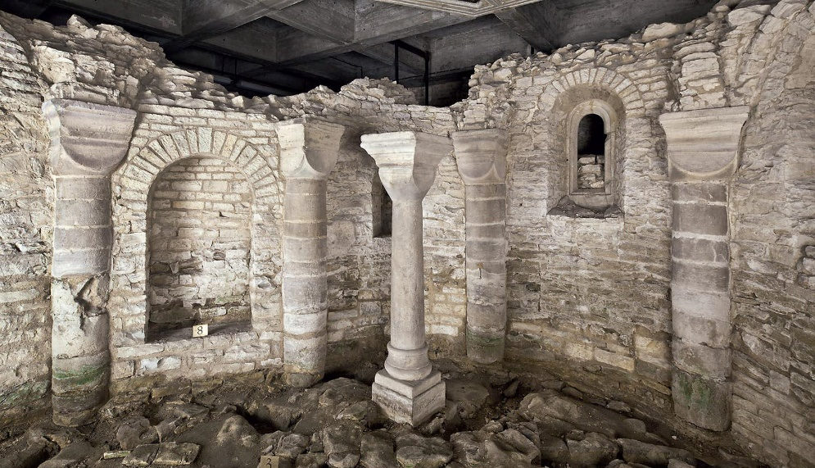
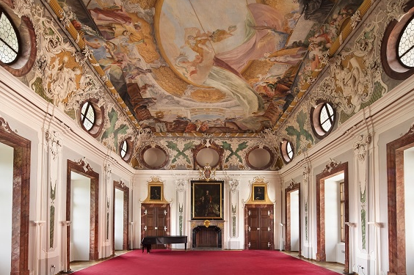
Monasteries
Benedictine Břevnov Monastery – 993, Romanesque crypt survived

Slide 12
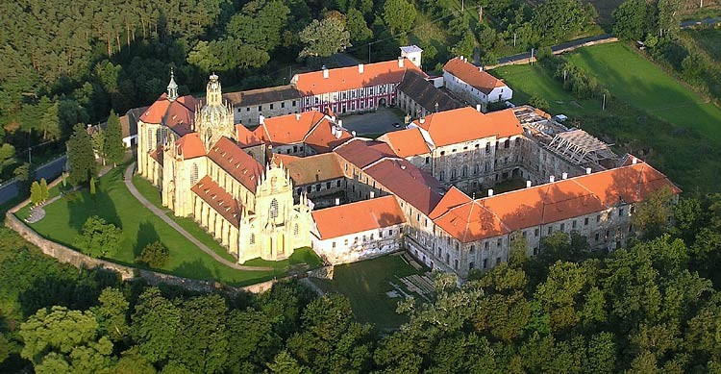
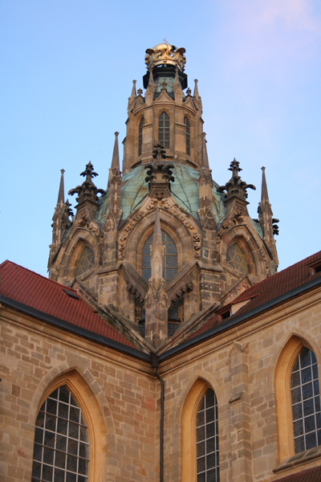
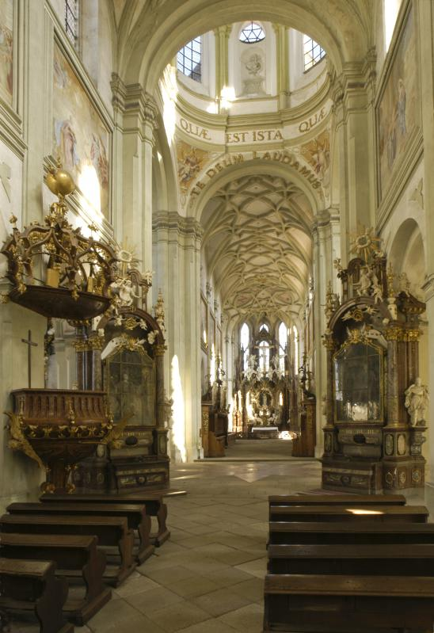
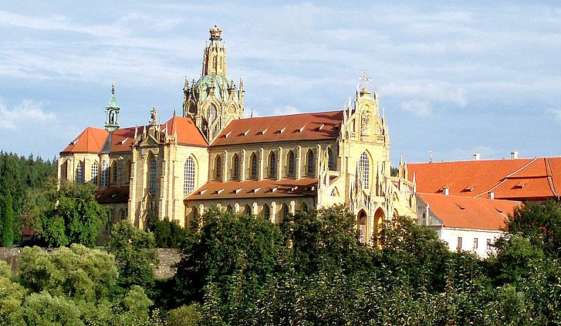
Monasteries
Benedictine Kladruby Monastery – 1115, three-nave Basilica of Virgin Mary (Baroque adaptation by Santini)

Slide 13
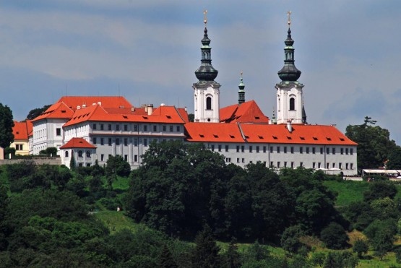
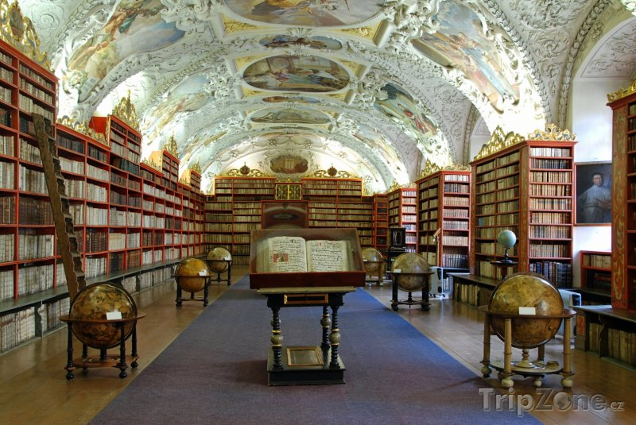
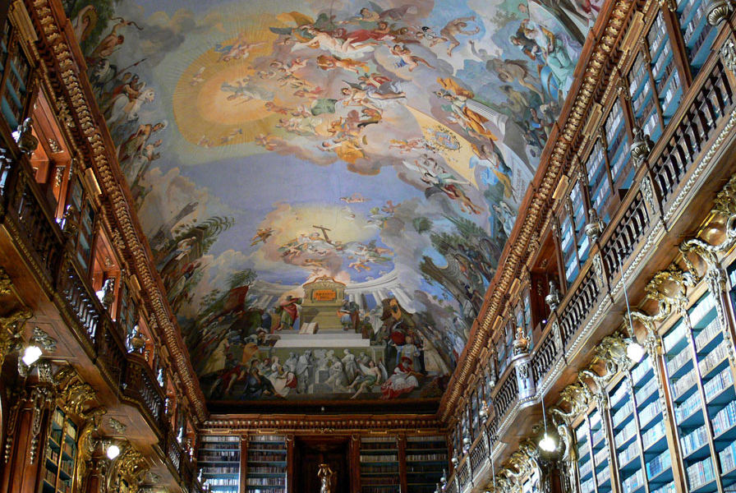
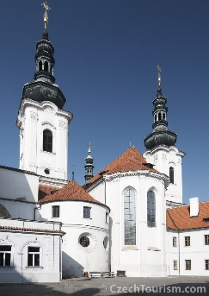
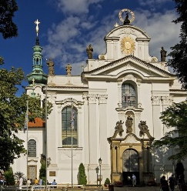
Monasteries
Premonstratensian Strahov Monastery – 1140
Theological Hall
Basilica of the Assumption of Our Lady
Philosophical Hall
200,000 books, 3,000 manuscripts, 1,500 incunabula, 860 Strahovský evangeliář

Slide 14
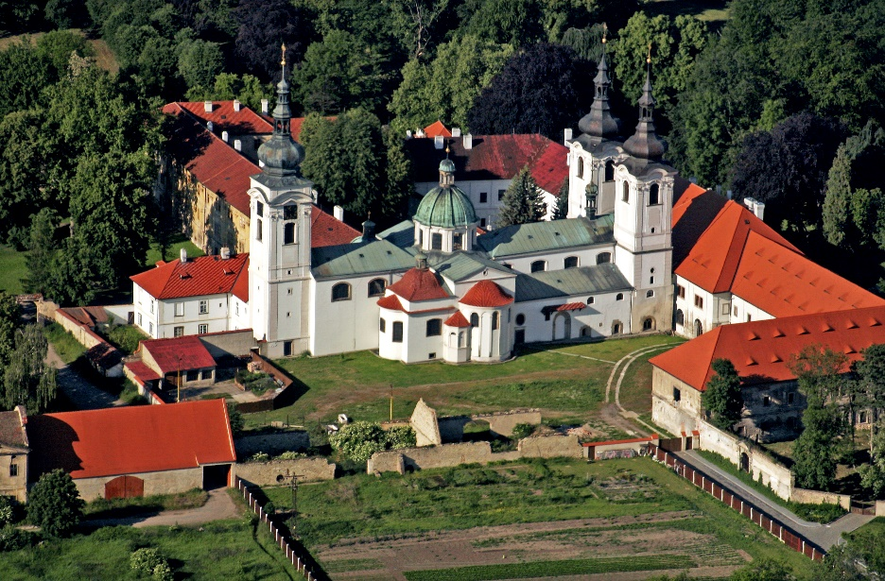
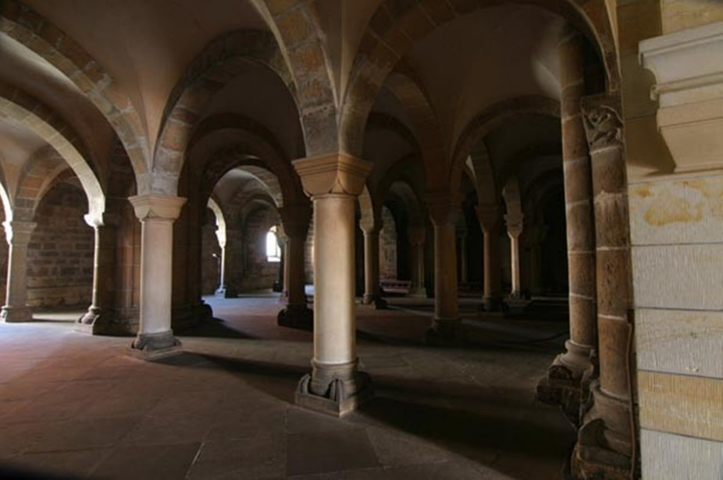
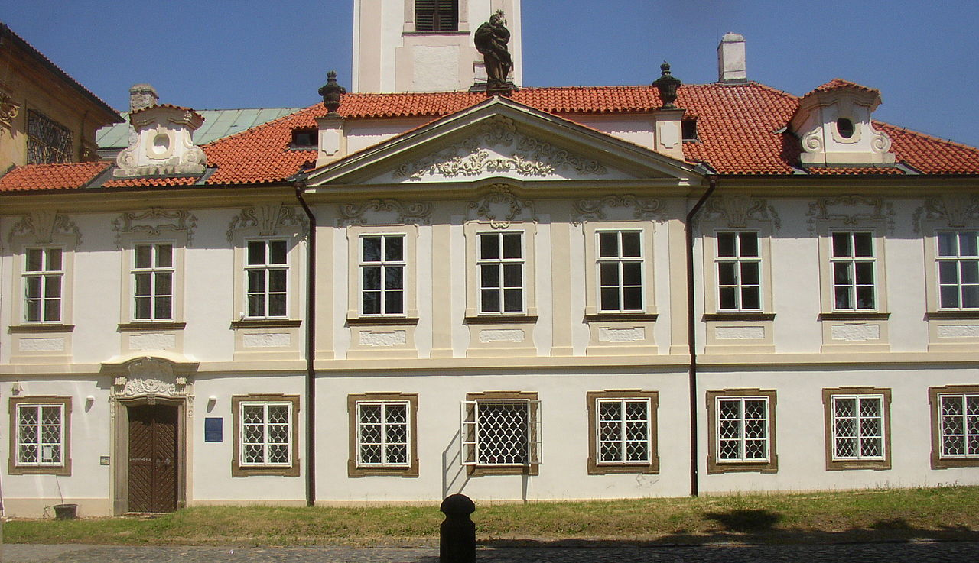
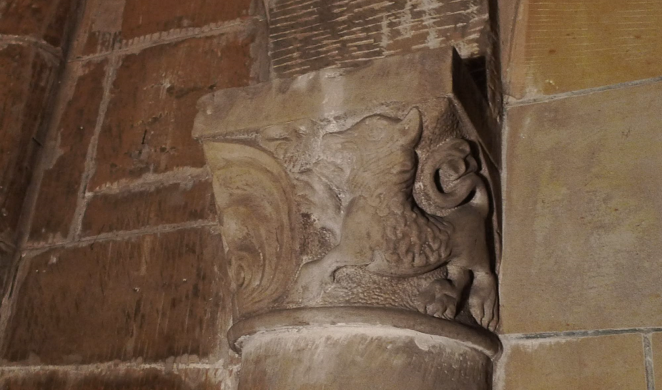
Monasteries
Premonstratensian Doksany Convent – 1140, Romanesque crypt,

Slide 15
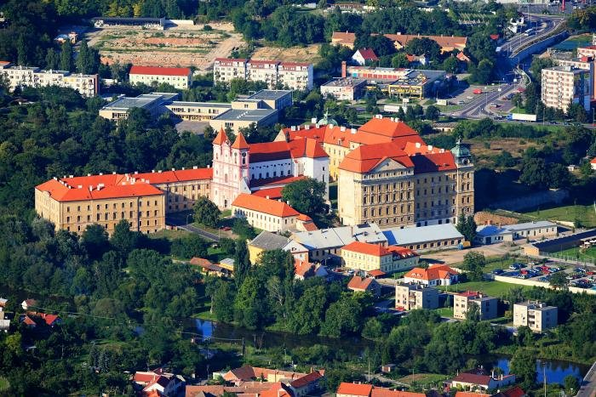
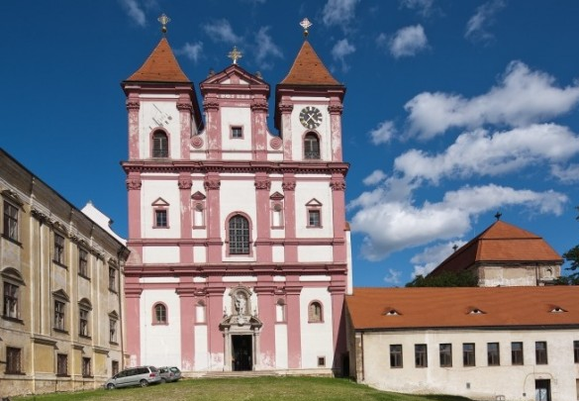
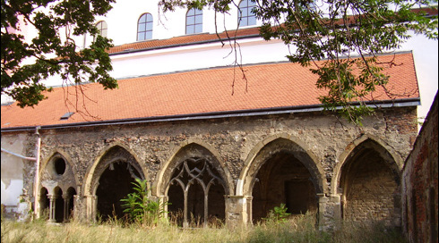
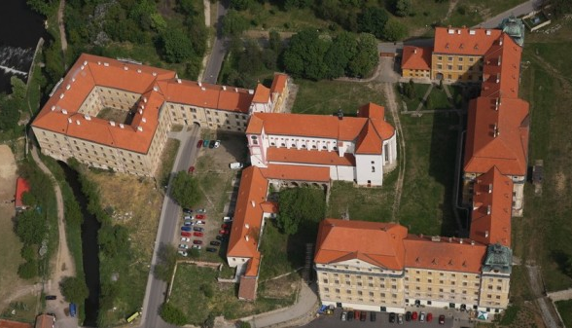
Monasteries
Premonstratensian Monastery in Louka (Znojmo) – 1190 (plundered by Hussites in 1425)

Slide 16
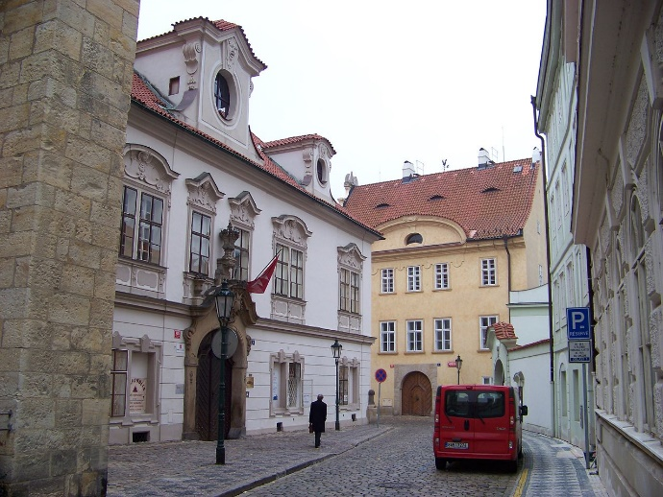
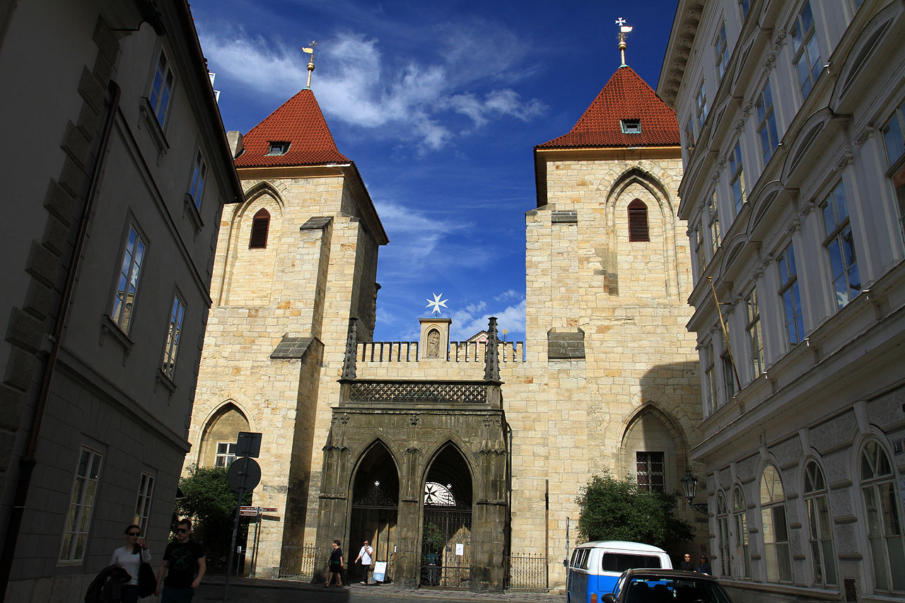
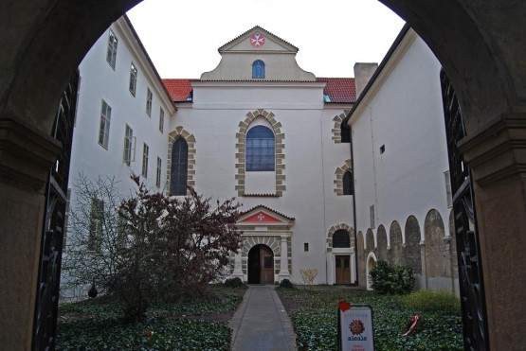
Monasteries
Commandry of the Order of Knights of Saint John of Jerusalem* – 1150s-60s
Form of fortified castle, ramparts, three-nave basilica, hospital, convent, parish school, bathhouse, brewery
  * Sovereign Military Hospitaller Order of Saint John of Jerusalem of Rhodes and of Malta or Sovereign Military Order of Malta

Slide 17
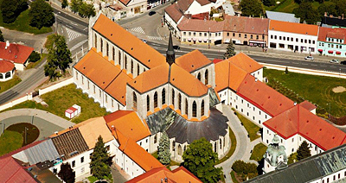



Monasteries
Cistercian Sedlec Monastery – 1142 (burnt by Hussites in 1421, Church of the Assumption of Virgin Mary and John the Baptist – one of first High Gothic buildings)

Slide 18






Monasteries
Cistercian Plasy Monastery – 1144 (Baroque rebuilding by Santini & K. I. Dienzenhofer)
  On swamp land → 5,100 oak piles

Slide 19



Monasteries
Basilica of Saint Procopius (Třebíč) – 1240-1280, part of Benedictine monastery

Slide 20




Castles
Castle Přimda – ruin of the oldest known stone castle on our territory
  Wladislaus I in 1121 (oldest mention – Chronica Boëmorum, Cosmas of Prague)
Zdík Palace (Přemyslid Palace)
  Bishop of Olomouc Jindřich Zdík in 1130s (torso, part of Castle complex on Wenceslas Hillock)
  Wenceslas III, last male Přemyslid (1306)
Cheb Castle – Romanesque Pfalz* (for Friedrich Barbarossa app 1180)
  Romanesque-Gothic Chapel of Saints Erhard & Ursula (lower floor Romanesque, upper early Gothic)
Gothic St John the Baptist
  * Empire castles/palaces, Emperor moved with his court around Empire, pfalzes provided him necessary conveniences

Slide 21




GOTHIC style
Originated in 12 century & lasted into 16 century (Czech Lands – first half of 13 century)
Built from stone, marked by verticality, slenderness pointing upwards (aspiration to the God)
Pointed arch, ribbed vault, clustered columns, flying buttress, towers & spires
Doorways, windows, arcades & galleries – pointed arches
Vertical mouldings around doors, figurative sculpture, plastic details (figural, animal & plant)
Windows with stained glass (scenes from Bible or life of Christ, representing saints or patrons), rose windows (round, large, above portal), pinnacles, gargoyles (in form of grotesque)
Numerous cathedrals, abbeys & churches
Castles, palaces, town halls, guild halls, universities, city walls & bridges

Slide 22






EARLY GOTHIC – PŘEMYSLID GOTHIC
Convent of Saint Agnes – 1231, oldest in Prague, Princess Agnes of Bohemia (Poor Clares)
  13 to early 14 century 1526, Ottokar II of Bohemia

Slide 23




EARLY GOTHIC – PŘEMYSLID GOTHIC
Premonstratensian Abbey in Teplá – 1193 (1232 consecrated)
  Second largest library (after Strahov), 100,000 volumes

Slide 24





EARLY GOTHIC – PŘEMYSLID GOTHIC
Cistercian Monastery in Osek – unique Chapter Hall
Romanesque stone reading pulpit

Slide 25





EARLY GOTHIC – PŘEMYSLID GOTHIC
Cistercian Convent Porta Coeli – 1233, first in Moravia (Předklášteří u Tišnova)

Slide 26





EARLY GOTHIC – PŘEMYSLID GOTHIC
Cistercian Monastery Zlatá Koruna (1263)
Thorn from the Crist Crrown

Slide 27





EARLY GOTHIC – PŘEMYSLID GOTHIC
Cistercian Monastery Vyšší Brod (1259, Chapter hall from 1285)
  Third largest library in Bohemia (70,000), Záviš Cross (piece of wood)

Slide 28





EARLY GOTHIC – PŘEMYSLID GOTHIC
Basilica of Saint Procopius – unique mixture of Romanesque & Gothic style (in mature forms)
Stone Bridge in Písek – oldest bridge (110 m, 6.25 m, 6 pillars, 7 arches, Baroque statues & cross)
Old New Synagogue (Jewish Quarter) – twin-nave synagogue (one of oldest & oldest still active)

Slide 29






EARLY GOTHIC – PŘEMYSLID GOTHIC
Zvíkov Castle – court with arcades in 2 levels, Chapel of Saint Wenceslas (mural decorations)
Bezděz Castle (beautiful chapel) – example of an unaltered castle of 13 century
Křivoklát, Špilberk, Veveří, Buchlov & Hulvaldy

Slide 30


HIGH GOTHIC – LUXEMBOURG GOTHIC
Church of the Assumption of Virgin Mary and Saint John the Baptist (Sedlec app 1300)
Church of Cistercian Monastery in Zbraslav (destroyed during Hussite Wars)
Saint Vitus Cathedral – 1344, Matthias of Arras, Peter Parler
  Net (rib) vault in main nave – one of first in Europe
  Chapel of Saint Wenceslas
Charles Bridge, Old Town Bridge Tower – Petr Parler
Karlštejn Castle (1348–1357, decorated until 1367)
  Chapel of the Holy Cross – precious stones, 129 panel paintings of saints (Master Theodoric), golden ceiling (resembles sky with stars, sun & moon), holy relics & Crown jewels
  14 to early 15 century, Charles IV, Wenceslas IV; heyday of High Gothic was stopped by outbreak of Hussite Wars in 1419

Slide 31




SAINT VITUS CATHEDRAL
1344, Matthias of Arras, Peter Parler
Net (rib) vault in main nave – one of first in Europe, Chapel of Saint Wenceslas
Cathedral of St Vitus, St Wenceslas and St Adalbert

Slide 32



KARLŠTEJN CASTLE
1348 – 1357, decorated until 1367, Matyas of Arras, Chapel of the Holy Cross

Slide 33





HIGH GOTHIC – LUXEMBOURG GOTHIC
Hall church – thin tall columns supporting vault, nave & side aisles of app equal height*
Saint Giles in Třeboň, Saint Vitus in Soběslav (two-nave churches)
Saint Vitus in Český Krumlov (three-nave) – net vault in main nave
  St Vitus Soběslav
  St Giles
  St Vitus Krumlov
* Often under single huge roof, windowed side walls typically spanning full height of interior

Slide 34


HIGH GOTHIC – LUXEMBOURG GOTHIC
Točník Castle – above already existing Žebrák Castle (after large fire that destroyed it)

Slide 35



LATE GOTHIC – JAGIELLONIAN GOTHIC
Many churches, monasteries & castles burnt down
Fortification system of Hussite Tábor (probably the only precious architectural work of that time)
During wars & many years after – not enough money to build any precious buildings
Church of Our Lady before Týn – main Hussite church (Parler, 14 c, Rejsek, 1510s)
Lesser Town Gate of Charles Bridge (higher tower, expense of King George after 1464)
  15 century to 1526, Wladislaus and Ludwig, Jagiellonian Gothic may be regarded as early phase of Renaissance style in Bohemia

Slide 36




LATE GOTHIC – JAGIELLONIAN GOTHIC
Gothic style started to mix with Renaissance elements
Vladislav Hall (Benedikt Rejt, largest secular vaulted space, without inner supporting columns)
Gunpowder Gate (Matěj Rejsek, inspired by the Old Town Bridge Tower)
Church of Saint Barbara (Benedikt Rejt, completed by Matěj Rejsek)

Slide 37



RENAISSANCE STYLE
Between early 15 & early 17 centuries (Czech Lands – late 15c, coexisted with Gothic until late 16c)
Revival & development of certain elements of ancient Greek & Roman architecture
Emphasis on symmetry, geometry & regularity of parts → neat arrangements of columns, pilasters & lintels + square, symmetrical layout
Features – attic, joint windows in common frame, semi-circular arches & vaults, arcades, hemispherical domes, niches, aedicules, paintings, frescoes & sgrafitti (figural, ornamental)
Regular repetition of openings on each floor
External walls – brick, rendered with stone laid in straight courses, topped by cornice

Slide 38







RENAISSANCE STYLE
Earliest elements – portals of Moravská Třebová & Tovačov Castles
Vladislav Hall – rectangular windows (earliest Renaissance elements, one bears date 1493)
Louis’ Wing of the Royal Palace – oldest Renaissance residential building in Bohemia
Royal Summer Palace (Belvedere) – relief decorations, arcades supporting large balcony
Star Villa – summer palace for royal family (White Mountain, shape of a six-pointed star)

Slide 39




RENAISSANCE STYLE
Great fire (1541) → many civic houses rebuilt in aristocratic residences
Schwarzenberg Palace, Martinic Palace & Palace of the lords of Hradec
(all with sgraffito facades)

Slide 40





RENAISSANCE CHATEAUX
Elegant arcade courtyards, geometrically arranged gardens, fountains & statues (emphasis on comfort)
  Telč
  Litomyšl
  Kratochvíle
  Český Krumlov

Slide 41





RENAISSANCE CHATEAUX
  Opočno
  Jindřichův Hradec
  Velké Losiny
  Nelahozeves

Slide 42




RENAISSANCE TOWNS
  Český Krumlov
  Pardubice
  Telč

Slide 43






RENAISSANCE TOWNS
  Jindřichův Hradec
  Český Krumlov
  Prachatice
  Slavonice

Slide 44




RENAISSANCE TOWN HALLS
  Litoměřice
  Prostějov
  Nymburk
  Stříbro

Slide 45




  Malá Strana
RENAISSANCE TOWN HALLS
  Plzeň
  Malá Strana
  Hradčany
  Český Krumlov

Slide 46




SACRAL ARCHITECTURE
Hussite Wars (1419–1434) many monasteries destroyed, lost goods, church institutions did not have resources → Renaissance ecclesiastical architecture rarer than Gothic & Baroque
Churches often combine Renaissance architecture with Gothic elements
Catholic Holy Trinity Church (Opočno, 1567) – three naves, Gothic groin vault supported by 10 Renaissance Corinthian columns
Catholic Church of Saint Rochus (Hradčany, 1600s) – rectangle with bevelled corners (oval impression), three apses, barrel vault

Slide 47






SACRAL ARCHITECTURE
Pinkas Synagogue – oldest parts late Gothic elements (rib vaulting, tracery)
High Synagogue – valuable Renaissance interior

Slide 48



TRANSITIONAL PERIOD – MANNERIST STYLE
During reign of Rudolph II – Prague one of most important centres of Mannerism (late Renaissance art foreseeing early Baroque)
Italian Chapel of the Assumption of Virgin Mary – one of first religious buildings without Gothic elements (elliptical ground plan → sometimes considered one of earliest Baroque)
New Royal Palace – rebuilt & extended (Giovanni Maria Philippi), some parts preserved →
Matthias Gate (before 1614, impression & monumentality – considered one of first Baroque)
Spanish Hall
  Turn of 16 and 17 century, Rudolph II, Matthias

Slide 49





BAROQUE STYLE
End of 16 & first half of 18 century (Czech Lands – 17c, churches & chapels mostly Baroque)
Expressed wealth & power of Catholic Church, by mid-17 century – grand palaces
Early Baroque – straight lines, rectangularity on facades, ground plans of buildings
Top Baroque – curves, mutually penetrating cylinders & other bodies, domes, colonnades, monumental staircases & statues, expensive materials (gold, marble), rich interiors, splendid painted decoration, contrast of light & dark, extensiveness & extraordinariness

Slide 50



EARLY BAROQUE
Church of Our Lady Victorious (Lesser Town, first Baroque church in Prague)
Church of the Holy Saviour (Old Town, Kostel u Salvátora, Carlo Lugano)
  1620s to 1680s

Slide 51



EARLY BAROQUE
Church of Saint Ignatius (Charles Square, Carlo Lugano)
Church of Saint Francis Seraph/of Assisi (Old Town, Jean Baptiste Mathey)
  1620s to 1680s

Slide 52






EARLY BAROQUE
Clementinum (Carlo Lugano)
  1620s to 1680s

Slide 53




EARLY BAROQUE
Wallenstein Palace (first Baroque palace in Prague, Giovanni Pieroni & Andrea Spezza)
Černín Palace (Francesco Carrati)
  1620s to 1680s

Slide 54




EARLY BAROQUE
Troja Palace (Jean Baptiste Mathey)

Slide 55





EARLY BAROQUE
Residence of Olomouc Archbishops in Kroměříž (Filiberto Lucchese, Giovanni Pietro Tencalla)
  1620s to 1680s

Slide 56





EARLY BAROQUE
Humprecht Chateau (Bohemian Paradise, Sobotka, elliptical ground floor Carlo Lugano )
  1620s to 1680s

Slide 57




HIGH BAROQUE
Christoph Dientzenhofer, Killian Ignaz Dientzenhofer → “radical Baroque” – characterized by curvature of walls & intersection of oval spaces
Church of Saint Nicolas (Lesser Town, 1702-1715 & 1737-1751)
Giovanni Battista Allipardi – Kuks, Opočno, Lobkowitz Palace, Hrzán Palace (Old Town)
  Hrzán Palace
  around 1690 to the mid-18 century

Slide 58



HIGH BAROQUE
František Maxmilián Kaňka – Karlova Koruna Chateau
  around 1690 to the mid-18 century

Slide 59




HIGH BAROQUE
Johann Bernhard Fischer von Erlach – Clam-Gallas Palace, Vranov nad Dyjí Chateau (Baroque rebuilding)
  around 1690 to the mid-18 century

Slide 60




HIGH BAROQUE
Holy Trinity Column in Olomouc
  Greatest Baroque sculptural group in our country
  Wenzel Render, 1714-1754)
  around 1690 to the mid-18 century

Slide 61



BAROQUE GOTHIC
Unique feature of Czech High Baroque – connects Radical Baroque with Gothic elements
Johann Blasius Santini-Aichel – creator & main representative
  Pilgrimage Church of Saint John of Nepomuk (most significant structure, 1720s)
  Monastery Church of the Assumption of Virgin Mary and Saint John the Baptist in Sedlec
  Convent of Cistercian Monastery in Plasy
  Monastery Church of Assumption of Virgin Mary, St Wolfgang and St Benedict Kladruby
  Monastery Church of Nativity of Virgin Mary in Želiv
  Pilgrimage Church of Virgin Mary in Křtiny
  Church of St Wenceslas in Zvole
  Church of St Peter and Paul in Rajhrad
  Karlova Koruna Chateau
  around 1690 to the mid-18 century

Slide 62





JOHANN BLASIUS SANTINI-AICHEL
Pilgrimage Church of Saint John of Nepomuk

Slide 63


JOHANN BLASIUS SANTINI-AICHEL
Monastery Church of Nativity of Virgin Mary in Želiv

Slide 64




JOHANN BLASIUS SANTINI-AICHEL
Pilgrimage Church of Virgin Mary in Křtiny
  65 m long, 35 m wide, central cupola 35 m tall, 33 windows

Slide 65



JOHANN BLASIUS SANTINI-AICHEL
Church of St Wenceslas in Zvole

Slide 66



JOHANN BLASIUS SANTINI-AICHEL
Church of St Peter and Paul in Rajhrad

Slide 67





LATE BAROQUE & ROCOCO
Late Baroque paved way for Rococo (very similar to Baroque, differs by its ornamental decoration)
Archbishop’s Palace & Goltz-Kinsky Palace (Baroque architecture with Rococo elements)
  1740 – 1780 (during the reign of the Queen Maria Theresa)

Slide 68




LATE BAROQUE & ROCOCO
Nové Hrady Chateau (one of few Rococo structures, Little Schönbrunn or Bohemian Versailles)
  1740 – 1780 (during the reign of the Queen Maria Theresa)

Slide 69




(NEO-)CLASSICISM
Classicism inspired by ancient Greece & Rome (several waves)
Emphasis on symmetry, proportion, geometry & regularity of parts
Flat facades, triangle gables, columns & modest decorations
1750s – originated, 1780s – became the style of royal courts, 1790s – spread to rich burghers, 1800s-1820s – termed Empire style – Chateau Kačina
Second half of 19 century – style of urban development
  (1750s) 1780s – end of 19 century

Slide 70




(NEO-)CLASSICISM
Estates Theatre in Prague
Mahen Theatre in Brno
  (1750s) 1780s – end of 19 century

Slide 71



(NEO-)CLASSICISM
Second half of 19 century – style of urban development
Whole towns & quarters – Terezín, Smíchov, Vinohrady, Karlín, Žižkov, centre of Brno
  Brno
  (1750s) 1780s – end of 19 century

Slide 72






REVIVAL ARCHITECTURAL STYLES (HISTORISM)
Many churches restored to their presumed medieval appearance & new buildings constructed
Neo-Romanesque architecture – applied mainly in churches, chapels & synagogues
Synagogues in Krnov, Břeclav or Český Krumlov
  19 century

Slide 73



NEO-GOTHIC STYLE
Basilica of Saints Peter and Paul (Vyšehrad), Church of Saint Nicolas (Ludgeřovice), Schwarzenberg Vault (Domanín)
  19 century

Slide 74



NEO-GOTHIC STYLE
Bouzov Castle, Hluboká nad Vltavou or Lednice Castle (both Tudor Gothic)
  19 century

Slide 75



NEO-RENAISSANCE STYLE
Neo-Renaissance – Rudolfinum, National Theatre & National Museum
  19 century

Slide 76




REVIVAL ARCHITECTURAL STYLES (HISTORISM)
Antonín Dvořák Theatre (Ostrava), Church of Virgin Mary (Mariánské Hory), Kramář Villa & Straka Academy (Prague)
  19 century

Slide 77




ART NOUVEAU
Features – paintings, stuccoes, mosaics, marble facings, metal elements & coloured glass
Municipal House – Prague, Osvald Polívka
Prague Main Railway Station – Josef Fanta
  19/20 century

Slide 78


MODERNISM
Emphasised single geometrical shapes & flat roofs
Main architects in Bohemia – Jan Kotěra & Josef Gočár
One of best examples – Kotěra’s Villa (Vinohrady)
  1905 to 1914

Slide 79


CUBISM
From Latin term cubus – based on presumption that cube is fundamental shape of all bodies
Buildings decorated with plastic fronts
Black Madonna House – Celetná Street in Prague, Josef Gočár
  1900s to 1920s

Slide 80



DECORATIVISM – ARCH STYLE
Second stage of cubism, accentuates decor & ornamentalism
Facades decorated by various geometrical shapes, mainly arches
Legiobanka – best example, Prague, Josef Gočár
  Obloučkový sloh, 1920s

Slide 81


CONSTRUCTIVISM & FUNCTIONALISM
Constructivism makes construction visible in final realisation of object
Functionalism emphasises function (practical utilisation in accordance with purpose it was built for)
Both mostly penetrate or overlap each other
New materials – reinforced concrete & glass
Outer parts – plastered or lined with ceramics, also made of burnt bricks
General Pension Institute – Prague, Josef Havlíček & Karel Honzík
  1920s & 1930s

Slide 82
Thank you for attention

