Slide 1
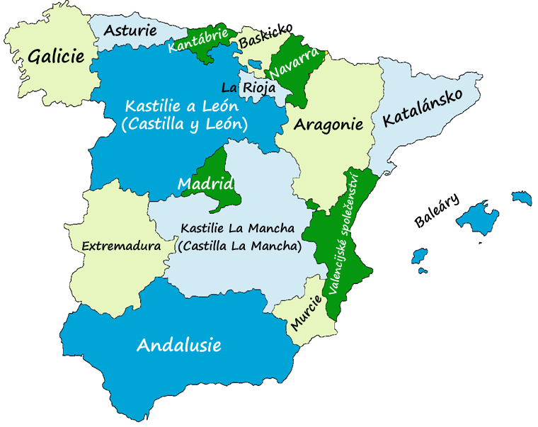
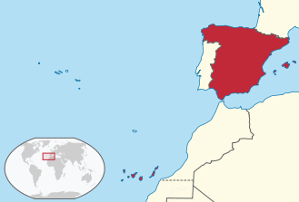
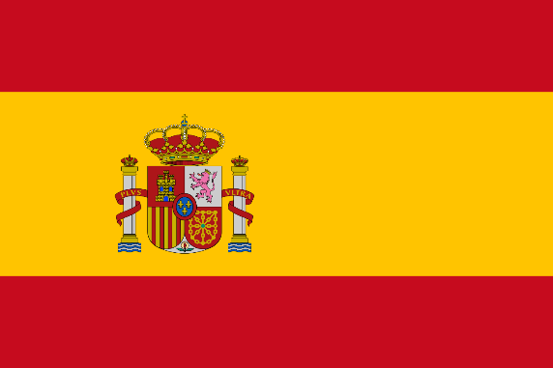
spain
España or Reino de España
Iberian Peninsula
Mediterranean to the south & east, Gibraltar to the south, France & Andorra to the north; Atlantic to the north & west, Portugal to the west
Balearic Islands in Mediterranean, Canary Islands in Atlantic, Ceuta & Melilla (autonomous cities in North Africa, border Morocco), town of Llívia (Spanish exclave in France)
506,000 km², 46.5 million people
Madrid, King Juan Carlos I
61 million foreign tourists

Slide 2
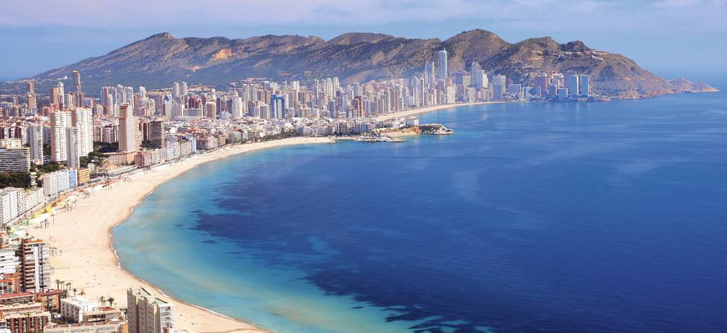
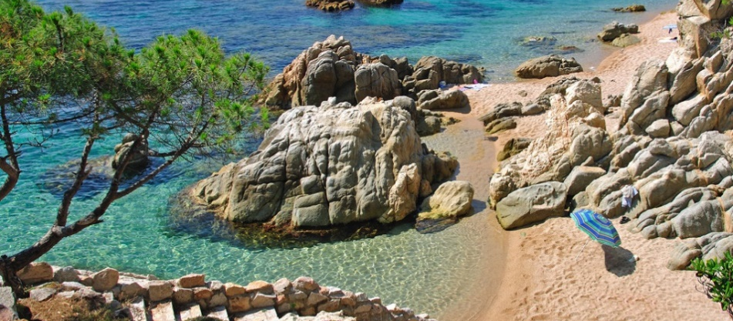
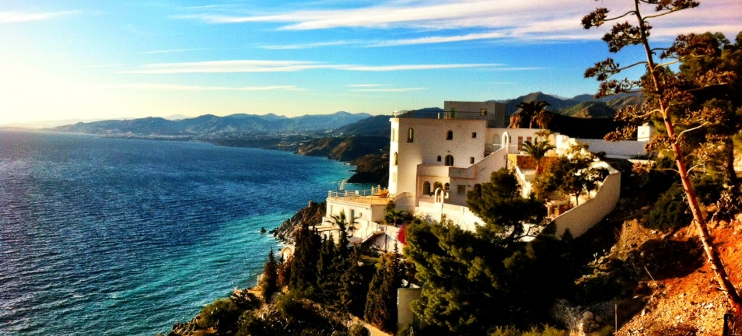
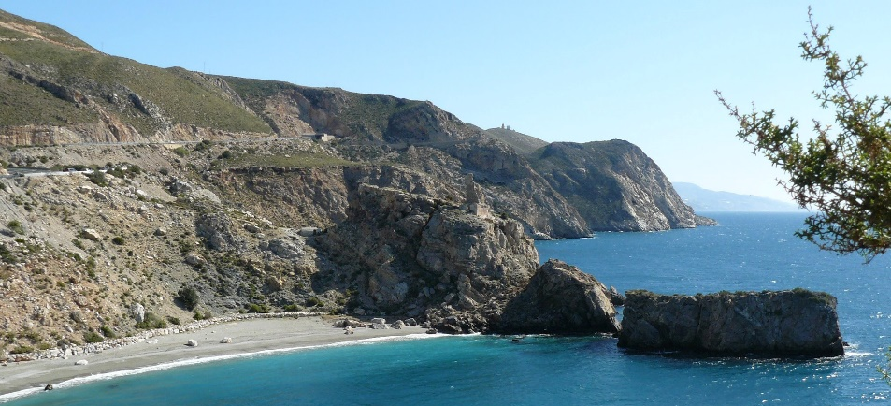
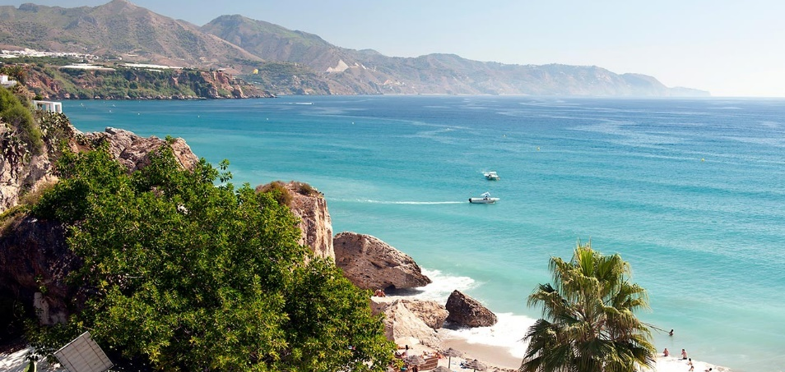
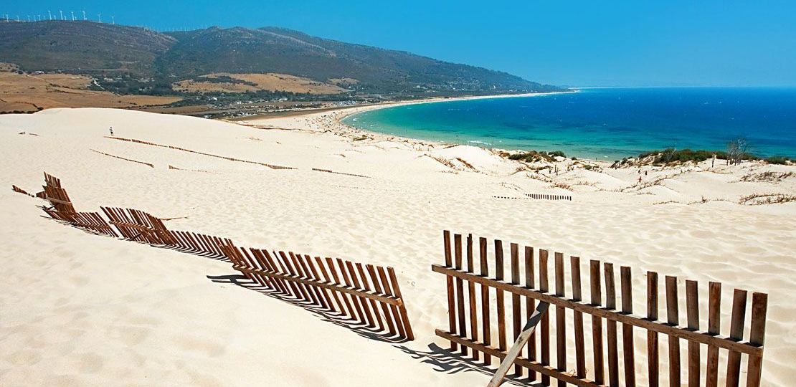
Summer tourism
Mild climate during the whole year → beaches
Costa Blanca (White Coast)
Costa Brava (Wild Coast)
Costa Tropical
Costa del Sol (Coast of Sun)
Costa de la Luz (Coast of Light)

Slide 3
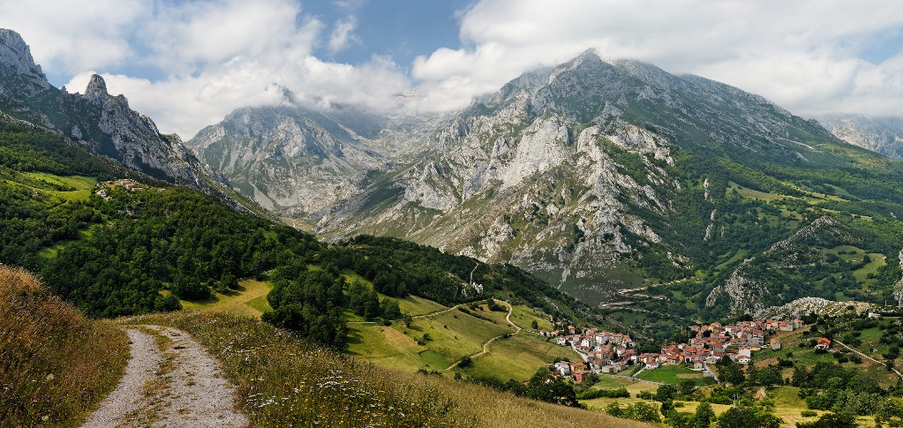
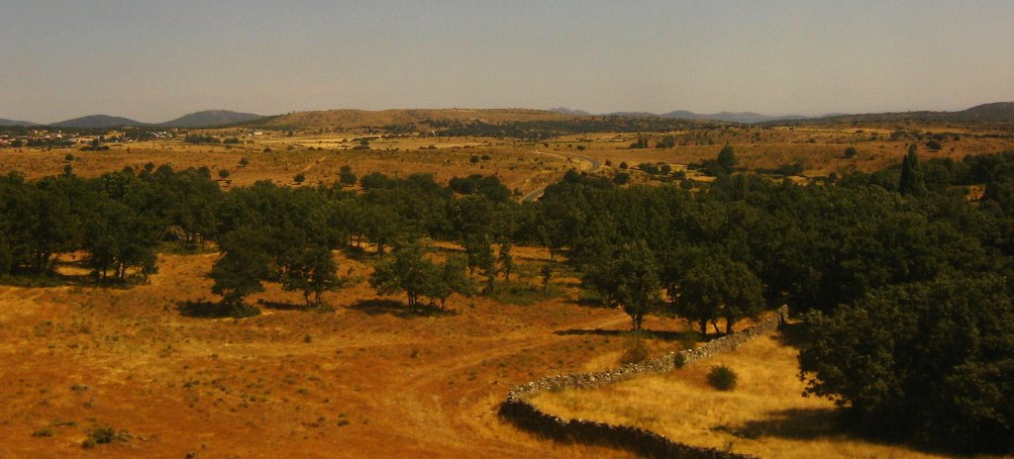
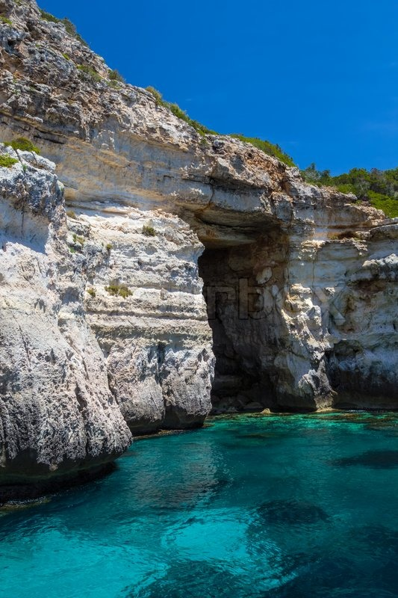
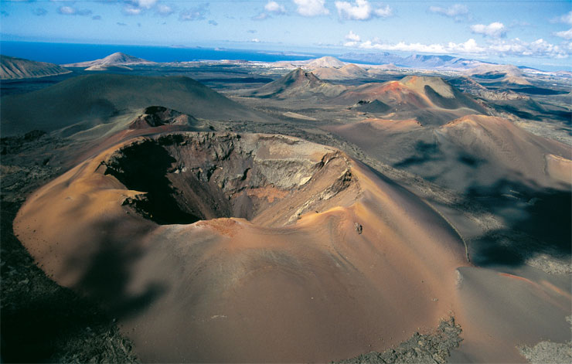
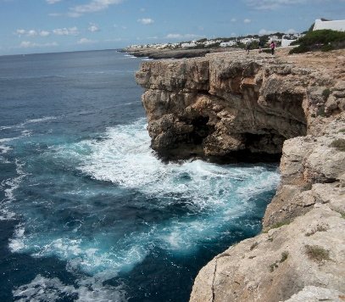
Nature & rural tourism
Mostly mountainous
Inner Plateau (Meseta Central, 45 per cent)
Cliffs, beaches, bays, capes & coves
Balearic Islands, Volcanic Canary Islands
Canary Islands

Slide 4
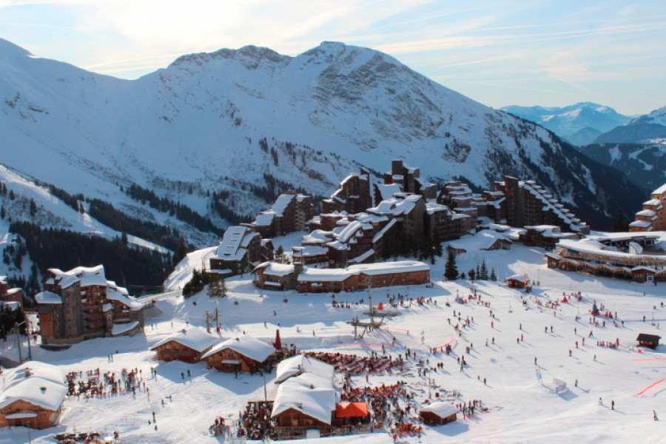
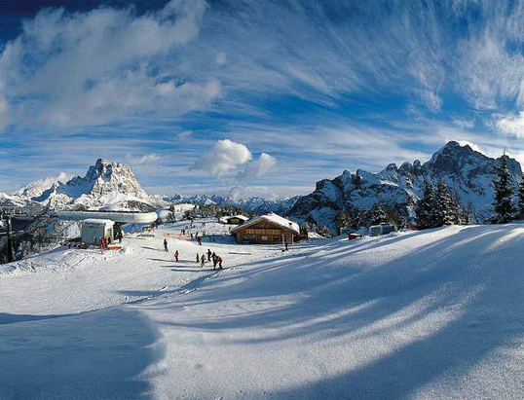
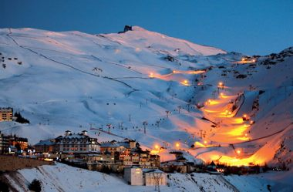
Winter tourism
High mountains & excellent ski resorts
Pyrénées, Central System (Sistema Central), Iberian System (Sistema Ibérico) & Sierra Nevada

Slide 5
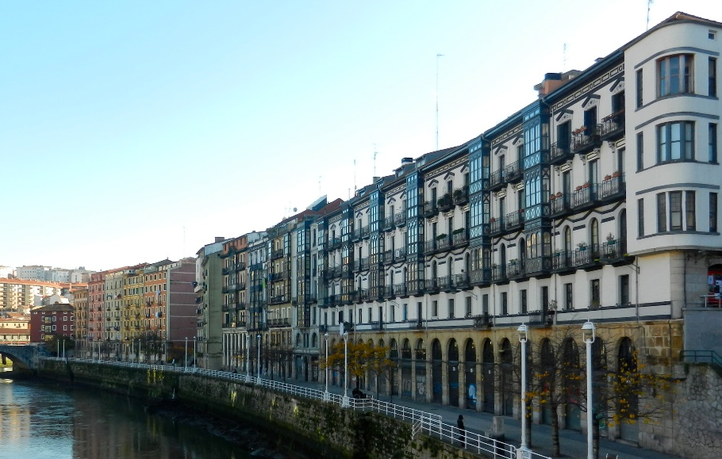
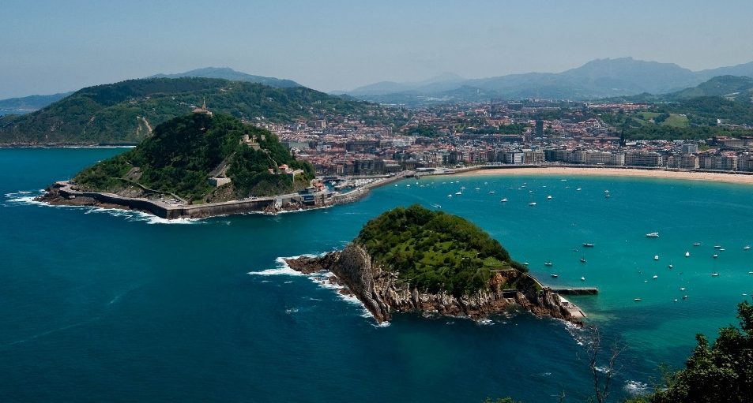
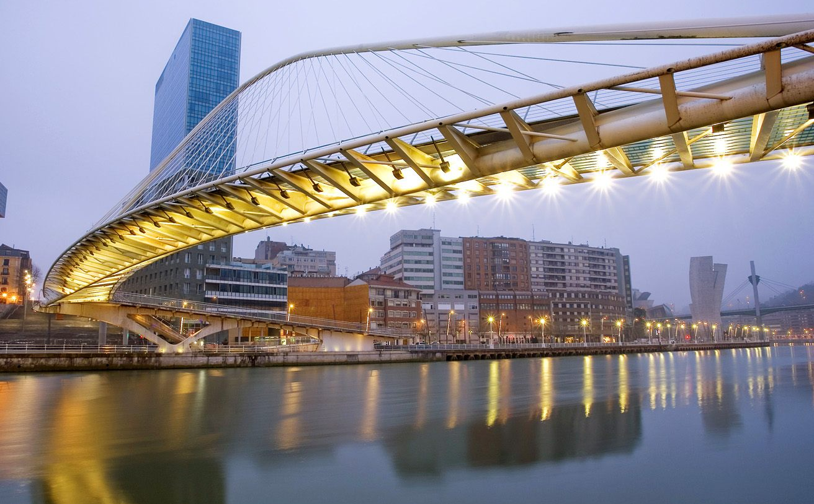
Cultural tourism
Crossroads of several civilisations, number of historical cities & towns
Madrid (1992), Salamanca (2002), Santiago (2000), Barcelona, Seville, Granada Oviedo, Bilbao
European Capital of Culture – San Sebastián (2016)
Thirteen UNESCO cities

Slide 6
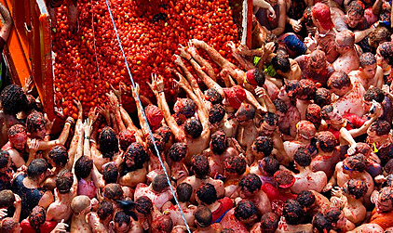
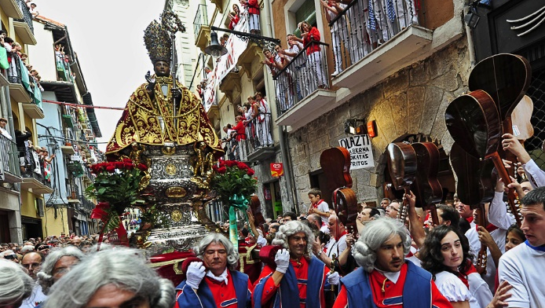
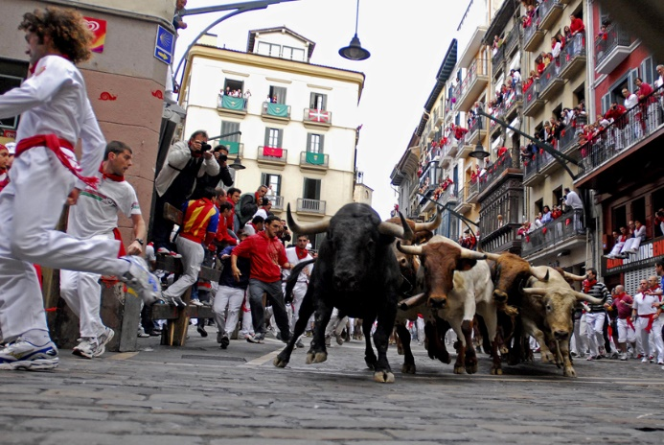
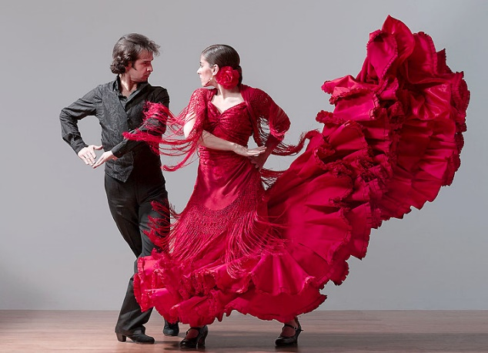
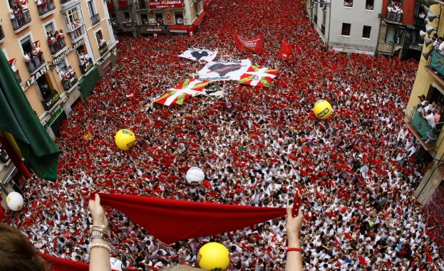
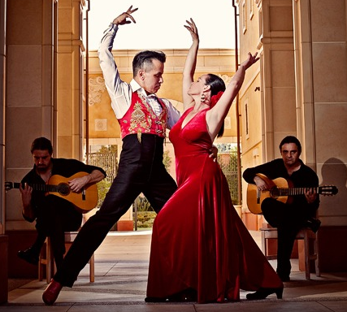
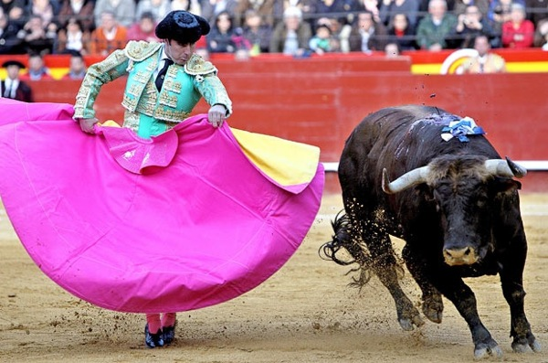
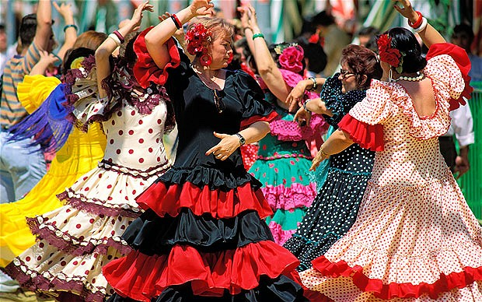
festivals
Many festivals – patron saints, legends, local customs & folklore
San Fermín in Pamplona – encierro (running of the bulls)
7-14 July, 8:00 am

Slide 7
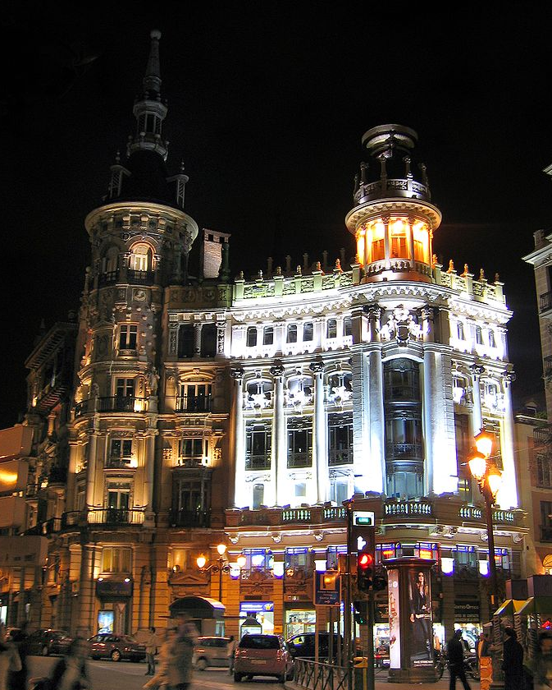
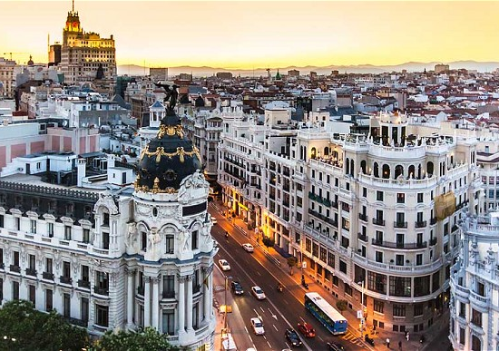
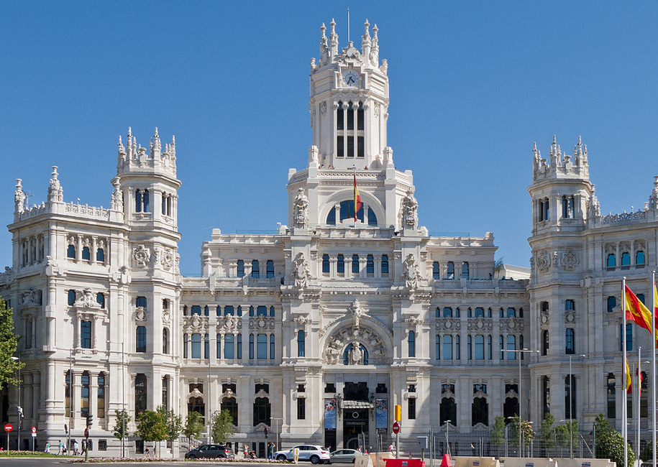
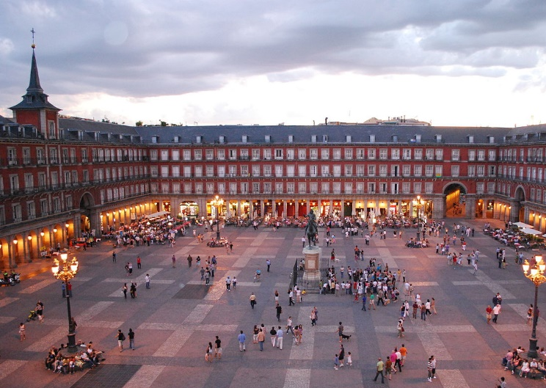
madrid
Saint Jerome
Romans (200 BC), Visigoths, Muslis (9 c), Christians (1085)
El Prado – museum & art gallery
Royal Palace of Madrid (Baroque)
Convent of Las Descalzas Reales
Canalejas Square
City Centre
City Hall
Plaza Mayor
Bridge of Toledo
Longoria Palace

Slide 8
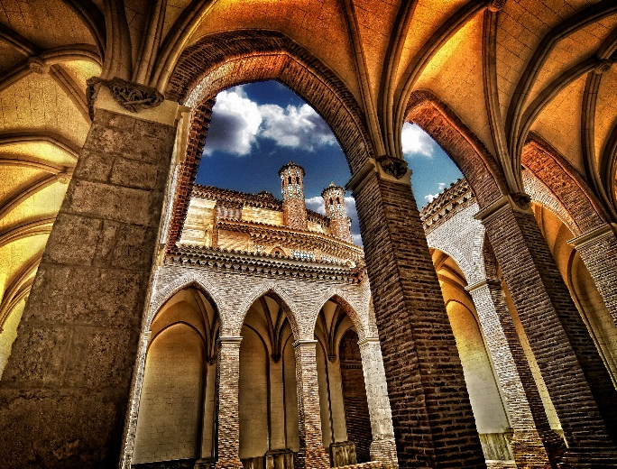
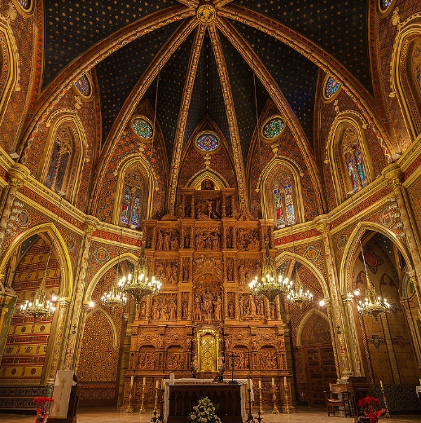
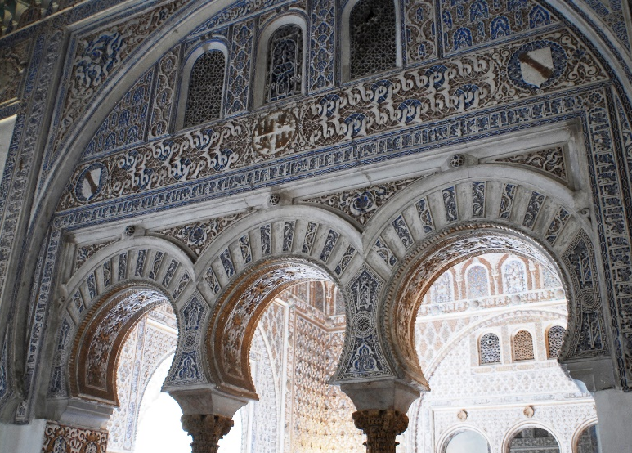
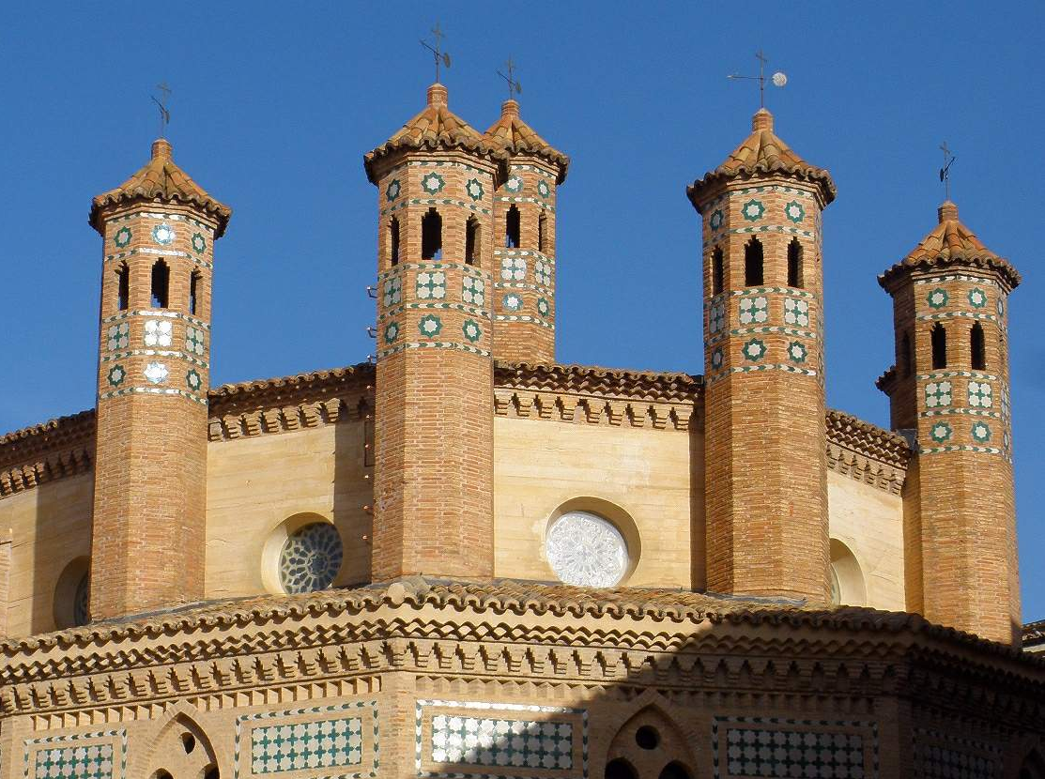
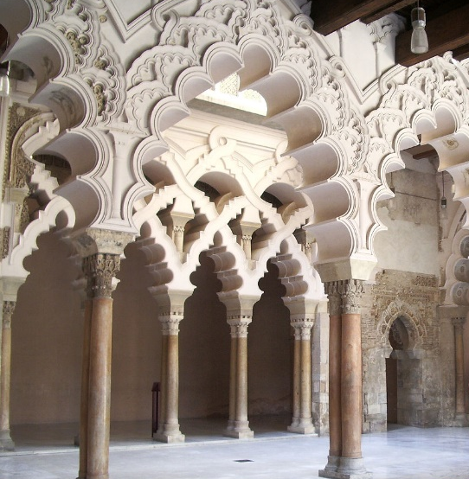
Unesco world heritage sites
39 cultural sites, three natural sites
Two of cultural-natural character
One transboundary with Portugal, two with France, one with Slovenia

Slide 9
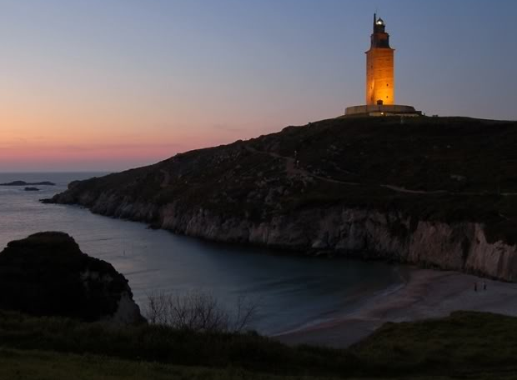
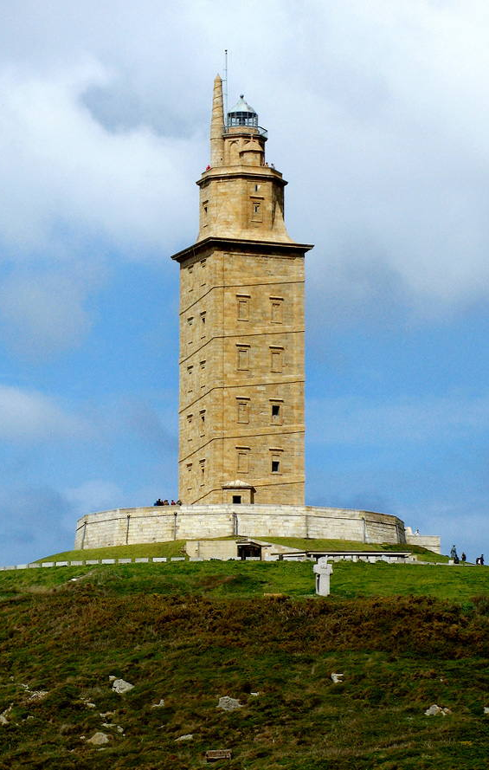
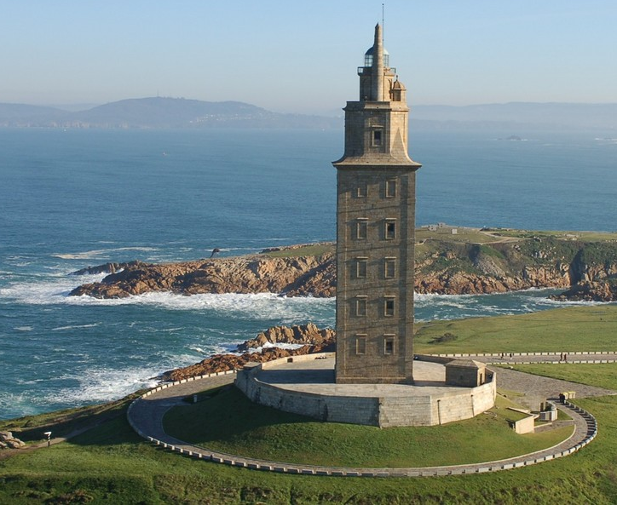
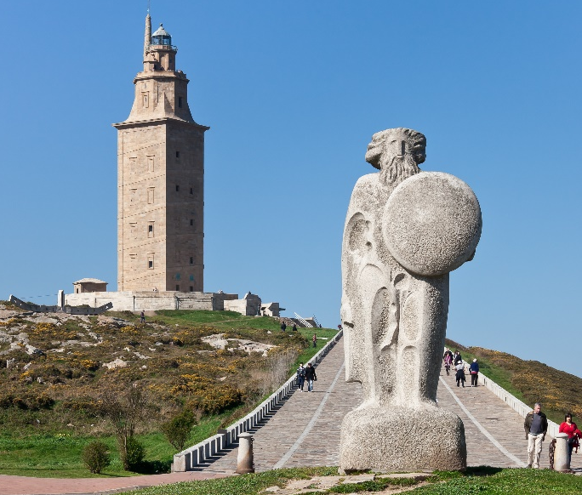
Tower of Hercules
Lighthouse at entrance to La Coruña harbour
Late 1 century (Romans)
34 metre high Tower on 57 metre high rock
21 metres added (18 century)

Slide 10
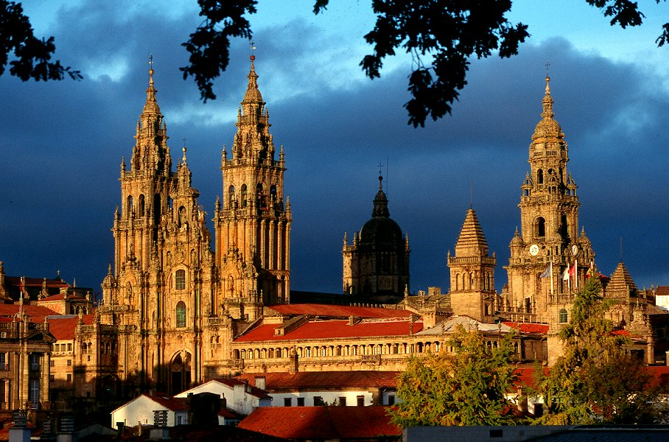
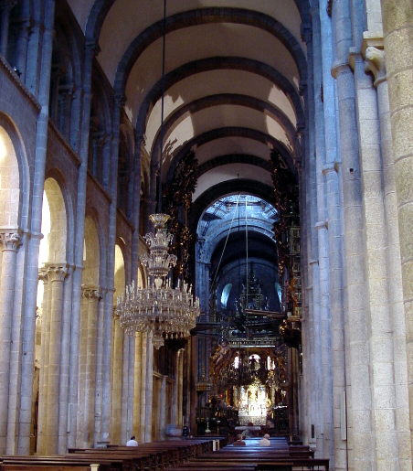
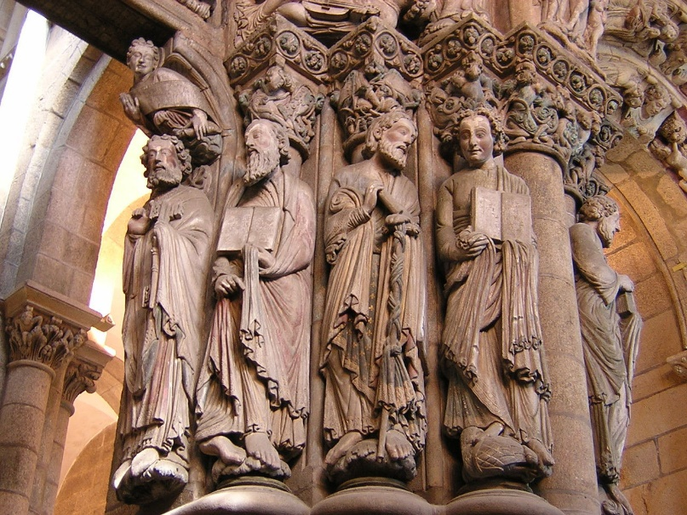
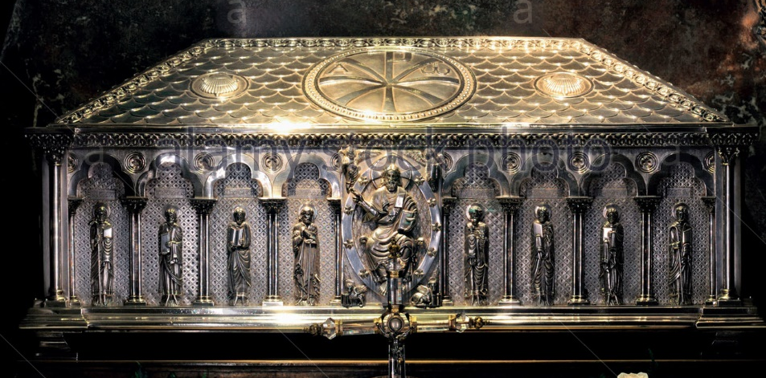
Santiago de Compostela
Pilgrimage site in north-west Spain
Cathedral – burial place of the apostle James

Slide 11
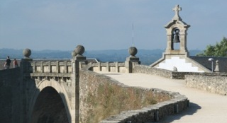
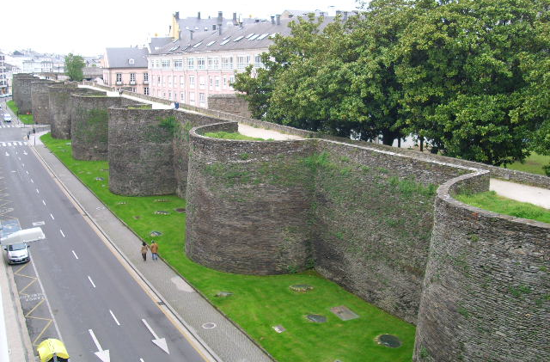
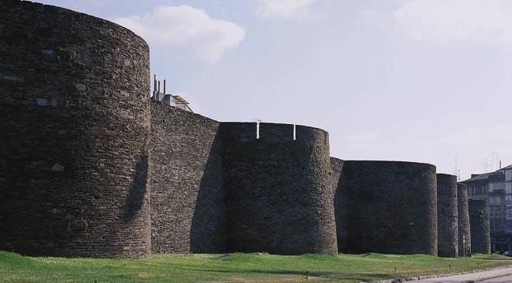
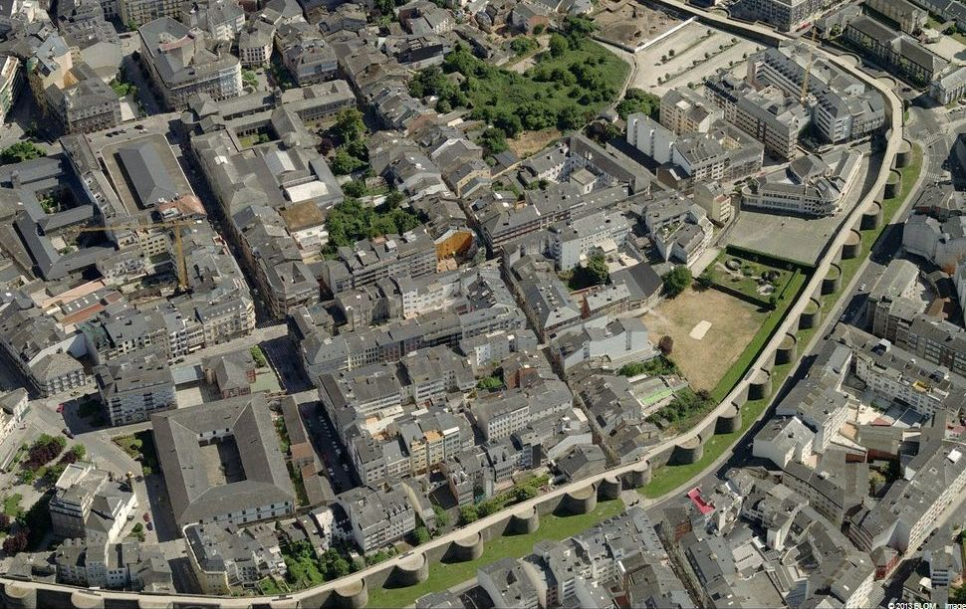
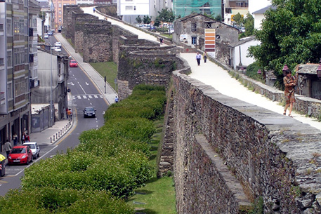
Roman Walls of Lugo
Defended the Roman town of Lucus (3 century)
Entire circuit survives intact

Slide 12
Las Médulas
Most important gold mine in Roman Empire (1 century AD)
Hydraulic mining
(undermining mountain with large quantities of water)

Slide 13
Routes of Santiago de Compostela: Camino Francés and Routes of Northern Spain
Network of four Christian pilgrimage routes
(extension of the Route of Santiago de Compostela)
1,500 kilometres of the Basque Country
Needs of pilgrims
(cathedrals, churches, hospitals, hostels, bridges)

Slide 14
Monuments of Oviedo and the Kingdom of the Asturias
Kingdom remained the only Christian region of Spain in the 9 century
Developed its own style of Pre-Romanesque art & architecture
Church of Santa María del Naranco
Church of Cámara Santa
Church of San Miguel de Lillo
Church of San Julián de los Prados
Church of Santa Cristina de Lena

Slide 15
Cave of Altamira and Paleolithic Cave Art of Northern Spain
Peak of Paleolithic cave art (35,000 to 11,000 BC)
Document creativity of humans
Testimony to cultural tradition

Slide 16
Vizcaya Bridge
Overlaps the mouth of Ibaizabal bay (west of Bilbao)
Basque architect Alberto de Palacio, 1893
45 metre high, spans 160 metres, twisted steel ropes
First in the world to carry people & traffic on high suspended gondola

Slide 17
Archaeological Site of Atapuerca
Caves in Atapuerca Mountains
Rich fossil remains of the earliest human beings in Europe
Dating from nearly one million years ago
Pit of Bones – largest collection of hominid fossils in the world

Slide 18
Burgos Cathedral
Cathedral of Our Lady, Gothic (13-16 centuries) → entire history of Gothic art
Architecture & unique collection of works of art
Paintings, altarpiece, stained-glass windows

Slide 19
San Millán Yuso and Suso Monasteries
Suso Monastery founded by Saint Millán (mid-6 century), soon became a place of pilgrimage
Glosas Emilianenses – first written in Spanish & Basque
→birthplace of written and spoken Spanish
Yuso Monastery below Suso (16 c)

Slide 20
Pyrénées – Mont Perdu
Spans the borders of France & Spain, Mount Perdu (3,352 metres)
Two of European largest & deepest canyons (Spain)
Three major cirque walls (France)

Slide 21
Catalan Romanesque Churches
of the Vall de Boí
Vall de Boí – small & narrow valley, Edge of the Pyrénées
Steep mountains with grazing lands on higher slopes
Each village – Romanesque church (murals, statues & altars)
Unique for tall, square bell towers

Slide 22
Works of Antoni Gaudí (1852–1926)
Seven properties in Modernist style
In or near Barcelona
Very personal style (gardens, sculpture & decorative arts
* Eusebi Güell assigned the works to Gaudí
Park Güell
Casa Batlló
Casa Vicens
Güell Palace
Casa Mila
Crypt in Colonia Güell
La Sagrada Familia

Slide 23
Palau de la Música Catalana and Hospital de Sant Pau, Barcelona
Art Nouveau, Lluís Domènech i Montaner , (early 20 century)
Steel-framed structures full of light & space

Slide 24
Archaeological Ensemble of Tárraco
Tárraco (Tarragona) – centre of all the Roman Iberian provinces
Most of remains fragmentary, many preserved beneath more recent buildings
Remains of the walls, Aqueduct, amphitheatre & circus
El Pont del Diable

Slide 25
Poblet Monastery
Founded by Cistercians in 1151 , lands conquered from Moors
One of the largest monasteries in Spain
Fortified royal residence
Pantheon of the kings of Catalonia & Aragon

Slide 26
La Lonja de la Seda de Valencia
La Lonja de la Seda = Silk Exchange in English
Group of buildings (1482-1533), late Gothic
Demonstrates the power & wealth of Valencia
(important Mediterranean & European merchant city)

Slide 27
Rock Art of the Mediterranean Basin on the Iberian Peninsula
Over 750 examples of prehistoric rock art
From geometric shapes to scenes of men hunting animals
The corpus of mural paintings – largest in Europe

Slide 28
Mudejar Architecture of Aragon
Developed in 12 century, influenced by Islamic tradition, applied until early 17 century
Refined & inventive use of brick & glazed tiles, especially in belfries
4 churches in Teruel, 2 churches & remains of Zaragora palace & 3 other churches in surroundings

Slide 29
Historic Walled Town of Cuenca
Built by Moors (Caliphate of Cordoba, 8 century)
Conquered by Castilians (12 century)
Royal town & bishopric
Cathedral – first Gothic in Spain
Casas colgadas (houses hanging over edge of cliff)

Slide 30
University and Historic Precinct of Alcalá de Henares
Founded by Cardinal Jiménez de Cisneros (16 century)
First planned university city in the world
Birthplace of Miguel de Cervantes
University
Laredo Palace
Plaza de Cervantes
Archbishop Palace

Slide 31
Aranjuez Cultural Landscape
Relationships between nature & human activities, winding watercourses & geometric landscape design
Royal Palace (16-mid-18 centuries)
Extensive pleasure gardens

Slide 32
Historic City of Toledo
Founded by Romans
Capital of Visigothic Kingdom
Fortress of Emirate of Cordoba (in Muslim Spain)
Outpost of Christian kingdoms fighting Moors
Temporarily capital of Spain (16 century)
Combines Christian, Muslim & Jewish influence
Puerta de Bisagra (Muslim)
Roman circus

Slide 33
Monastery and Site of the Escurial, Madrid
The Escurial Monastery (16 century)
On a plan in the form of a grill
(instrument of the martyrdom of Saint Lawrence)
Cloister, seminary, church
Residence of the King of Spain

Slide 34
Old Town of Segovia and its Aqueduct
Alcázar palace (11 century)
Gothic cathedral (16 century)
Roman aqueduct (about 50 AD)
Remarkably well preserved
Two tiers of arches

Slide 35
Old Town of Ávila with its Extra-Muros Churches
Founded in 11 century, protected Spanish territories from Moors
Birthplace of Saint Teresa
Gothic cathedral & defensive wall (11 c)
82 semi-circular towers & nine gates
San Vicente

Slide 36
Old City of Salamanca
Conquered by Carthaginians (3 c), then ruled by Romans, later by Moors (until 11 c)
University of Salamanca – 1218, oldest in Spain
University

Slide 37
Prehistoric Rock Art Sites in Siega Verde and the Côa Valley (Spain)
On the banks of the rivers Agueda and Côa
Continuous human settlement from the Palaeolithic Age
Hundreds of panels with thousands of animal figures
Around 640 in Siega Verde, 5,000 in Côa Valley
Carved over several millennia

Slide 38
Old Town of Cáceres
Blend of Roman, Islamic, Northern Gothic & Italian Renaissance styles
About 30 towers (Muslim), Torre del Bujaco

Slide 39
Royal Monastery of Santa María de Guadalupe
Statue of Virgin Mary found on the bank of Guadalupe River (13 century)
apparently hidden there by local inhabitants from Moorish invaders in 714
Chapel built on the site → developed into Royal Monastery

Slide 40
Archaeological Ensemble of Mérida
Founded in 25 BC – colony called Emerita Augusta (veterans of the army of Augustus)
Capital of Lusitania province
Preserves most Roman monuments in Spain
Bridge over the Guadiana River (longest of all Roman bridges)
Forum including the triumphal Arch of Trajan
Amphitheatre, theatre, Circus Maximus

Slide 41
Heritage of Mercury.
Almadén (Spain) and Idrija (Slovenia)
Mining sites of Almadén – mercury (quicksilver) extracted since antiquity
(Idrija – mercury first found in 1490 AD)
Retamar Castle, religious buildings & traditional dwellings
Together – two largest mercury mines operational until recent times

Slide 42
Historic Centre of Cordoba
Greatest glory – after the Moorish conquest (8 century)
300 mosques & innumerable palaces & public buildings
(to rival Constantinople, Damascus & Baghdad)
Catholic church (7 century) converted into a mosque →
Great Mosque → Roman Catholic cathedral (13 century)
Alcázar de los Reyes Cristianos
Torre Fortaleza de la Calahorra
Alcázar

Slide 43
Cathedral, Alcázar and Archivo de Indias in Seville
Testimony to civilisation of Almohads (ruled Spain until the Reconquest) & of Christian Andalusia
Alcázar Palace complex (previous Moorish Palace, 12-17 century)
Five-nave Cathedral (15 century, tomb of Columbus)
Giralda minaret (masterpiece of Almohad architecture)
General Archive of the Indies (documents relating to colonisation of Americas)

Slide 44
Doñana National Park
Andalusia, right bank of Guadalquivir & its delta on the Atlantic
Lagoons, marshlands, dunes, scrub woodland & maquis
Threatened bird species, wintering – 500,000 water fowl

Slide 45
Alhambra, Generalife and Albayzín, Granada
Alhambra & Albaycín – medieval part of Granada (on two neighbouring hills above modern town)
Generalife – palace & gardens (former residence of emirs)

Slide 46
Renaissance Monumental Ensembles of
Úbeda and Baeza
Urban shape dates back to Moorish 9 century & to Reconquest in 13 century
16 century – Renaissance renovation
Úbeda
Baeza

Slide 47
Palmeral of Elche
Orchards of date palms with elaborate ancient irrigation systems, laid in 10 century
Palmeral (palm groves) – Arab agricultural practices (North Africa) → on European continent

Slide 48
Ibiza, Biodiversity and Culture
Fortified Upper Town (Alta Vila) – Renaissance military architecture
Archaeological sites at Sa Caleta (settlement) & Puig des Molins (necropolis)

Slide 49
Cultural Landscape of the Serra de Tramuntana
Mountain range on north-western coast of Majorca
Transformed by millennia of agricultural activities

Slide 50
San Cristóbal de La Laguna (Canary islands)
Original unplanned Upper Town
Lower Town – first ideal city-territory according to philosophical principles
Large number of churches & convents

Slide 51
Teide National Park (tenerife)
Mount Teide stratovolcano (highest Spanish peak – 3,718 metres)
Rises 7,500 m above the ocean floor
Spectacular environment
‘Sea of clouds’ forms its impressive background

Slide 52
Garajonay National Park
Island of La Gomera (Canary Islands archipelago)
Approximately 70 per cent covered by laurel forest
(vegetation from Tertiary period that disappeared from mainland Europe)

Slide 53
Thank you for attention

