Slide 1
First years of democracy
Prof. Radosław Domke

Slide 2
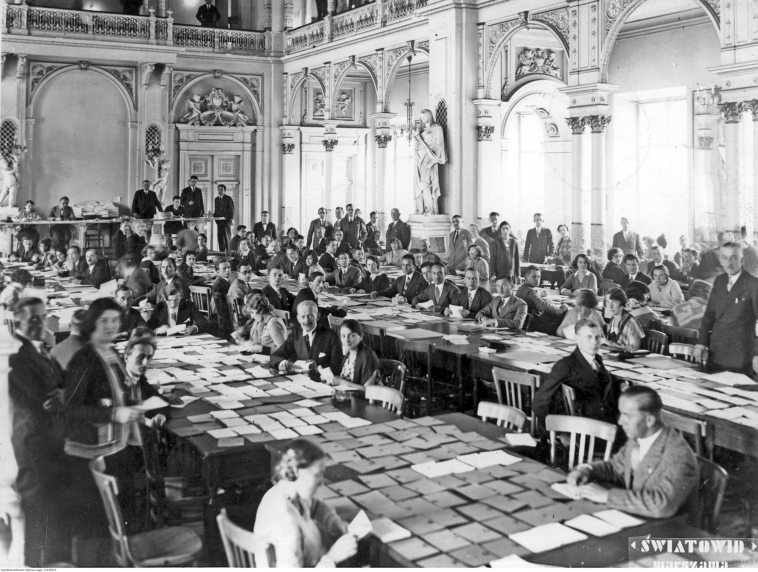
Elections to legislative Sejm (1919)

Slide 3
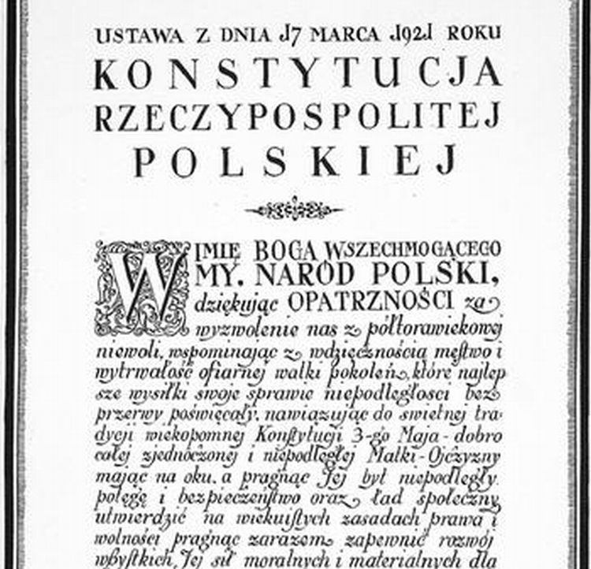
The March constitution (1921)

Slide 4
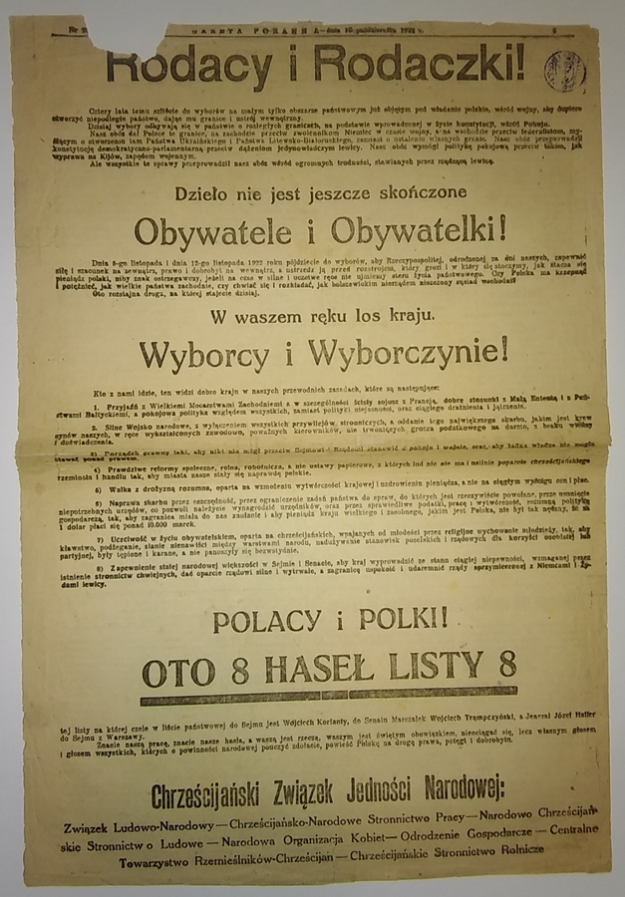
Parliament Elections (1922)

Slide 5
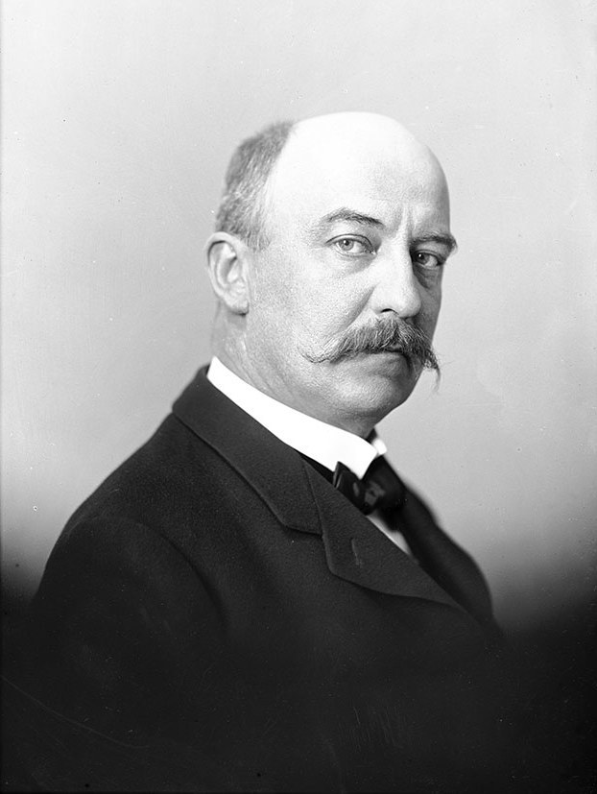
Gabriel Narutowicz (1922)

Slide 6
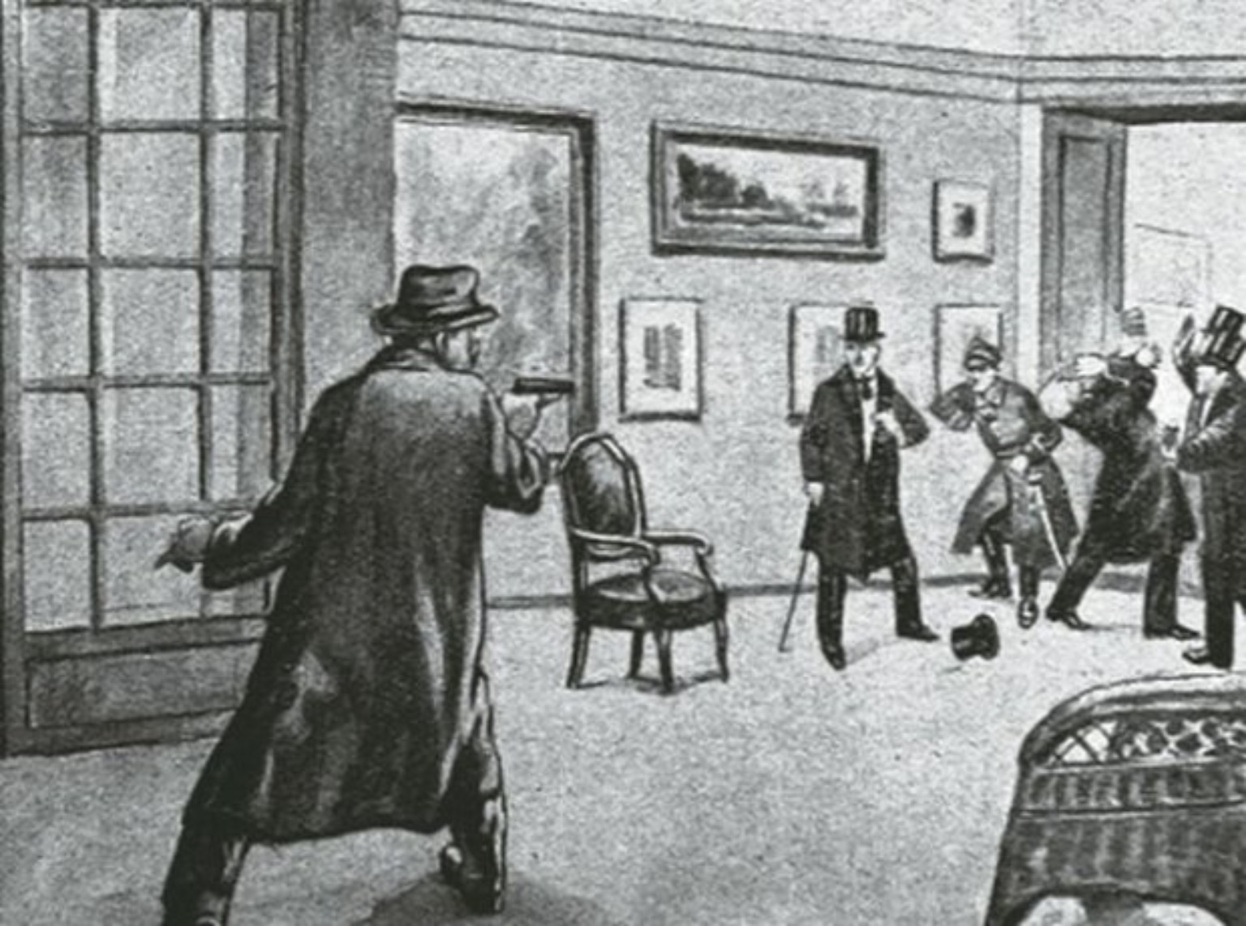
Killing the president

Slide 7
Political options:
Right –wing
Left – wing
Communists
People's parties/ Peasent party parties

Slide 8
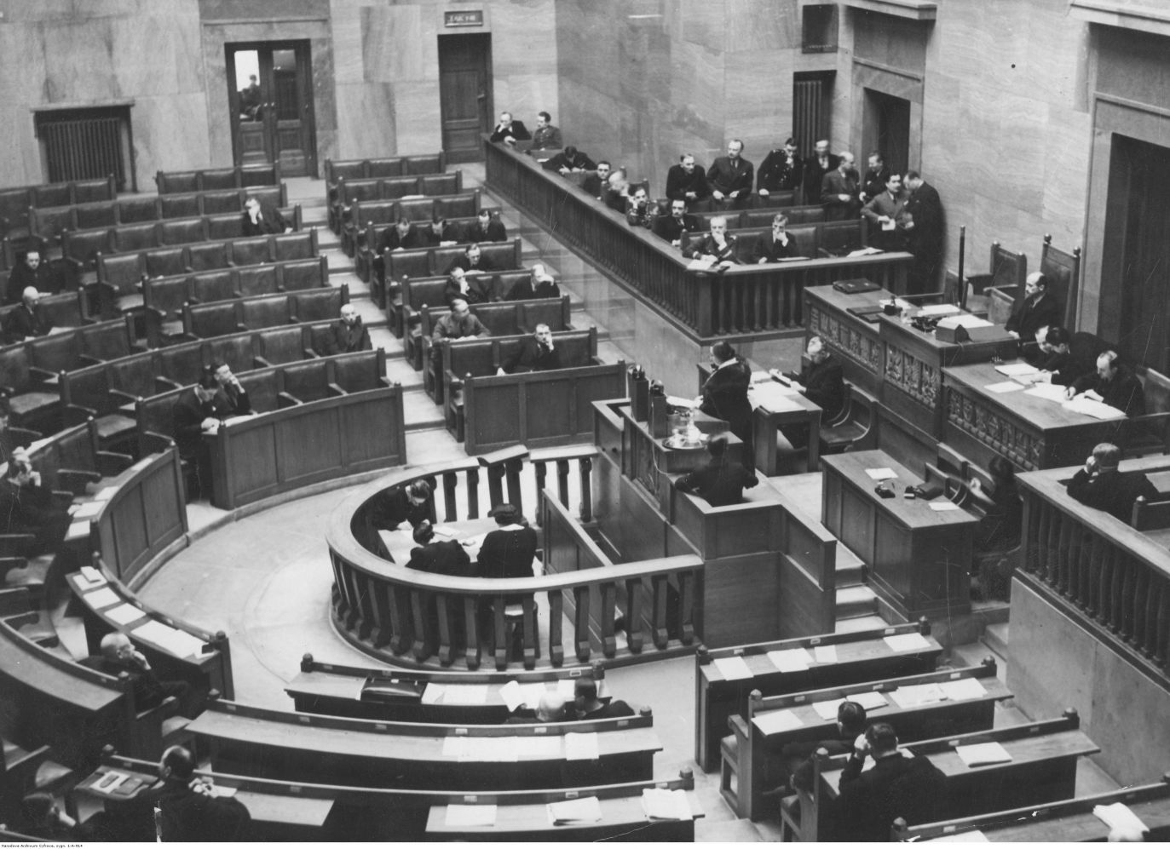
Parliament (1922-1926)

Slide 9
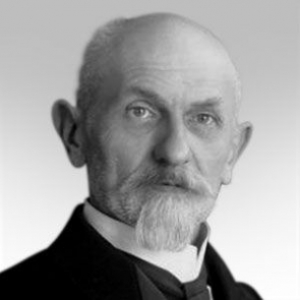
Stanislaw Wojciechowski (1922-1926)

Slide 10
Rules of Chieno-Piast
Pact of Right Wing (nationalists) + Conservatives + rich Farmers

Slide 11
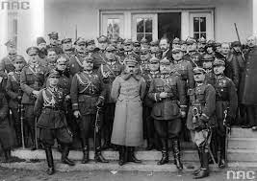
PiŁsudski camp

Slide 12
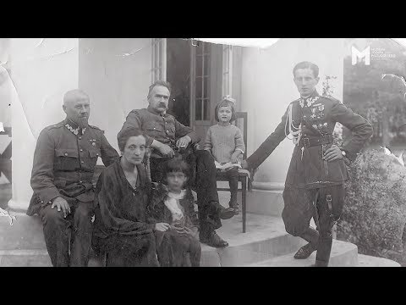
Lonely man from Sulejówek

Slide 13
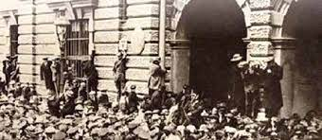
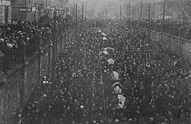
Strikes and Riots

Slide 14
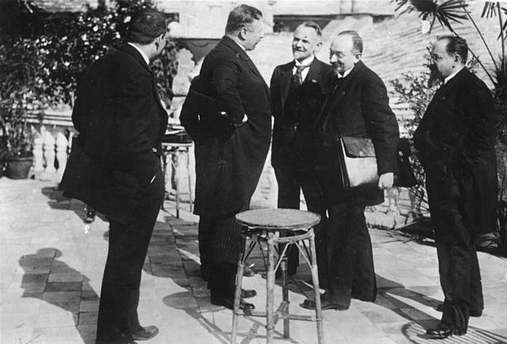
Rapallo (1922)

Slide 15
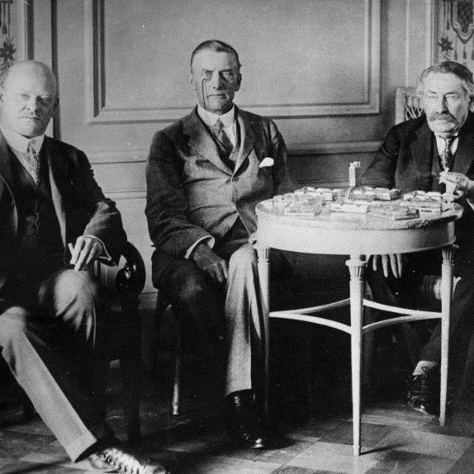
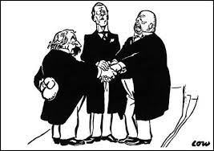
Locarno treaty (1922)

Slide 16
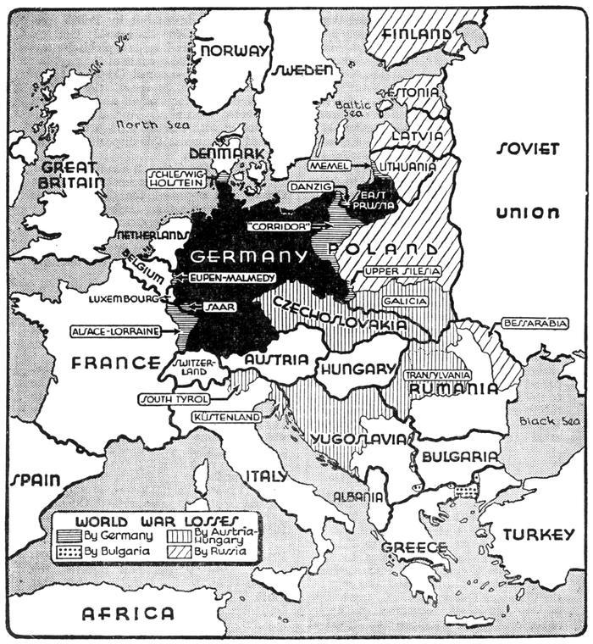
Unsecure bondaries after Locarno

Slide 17
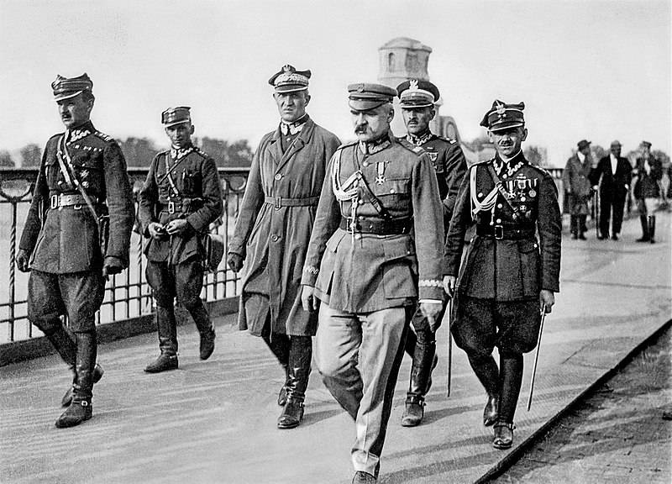
May coup

Slide 18
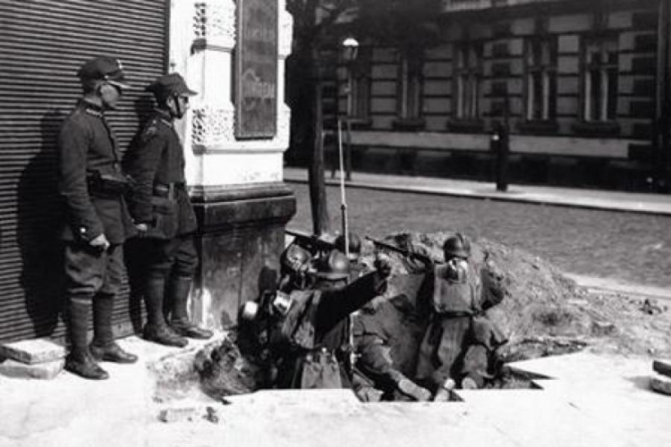
Fights in warsaw, may 1926

Slide 19
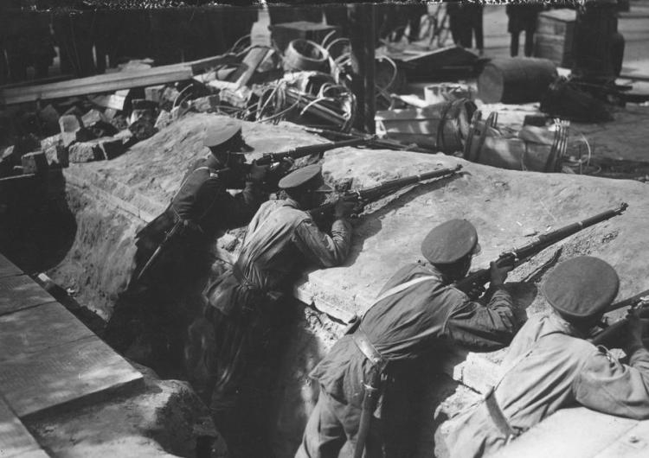

Slide 20
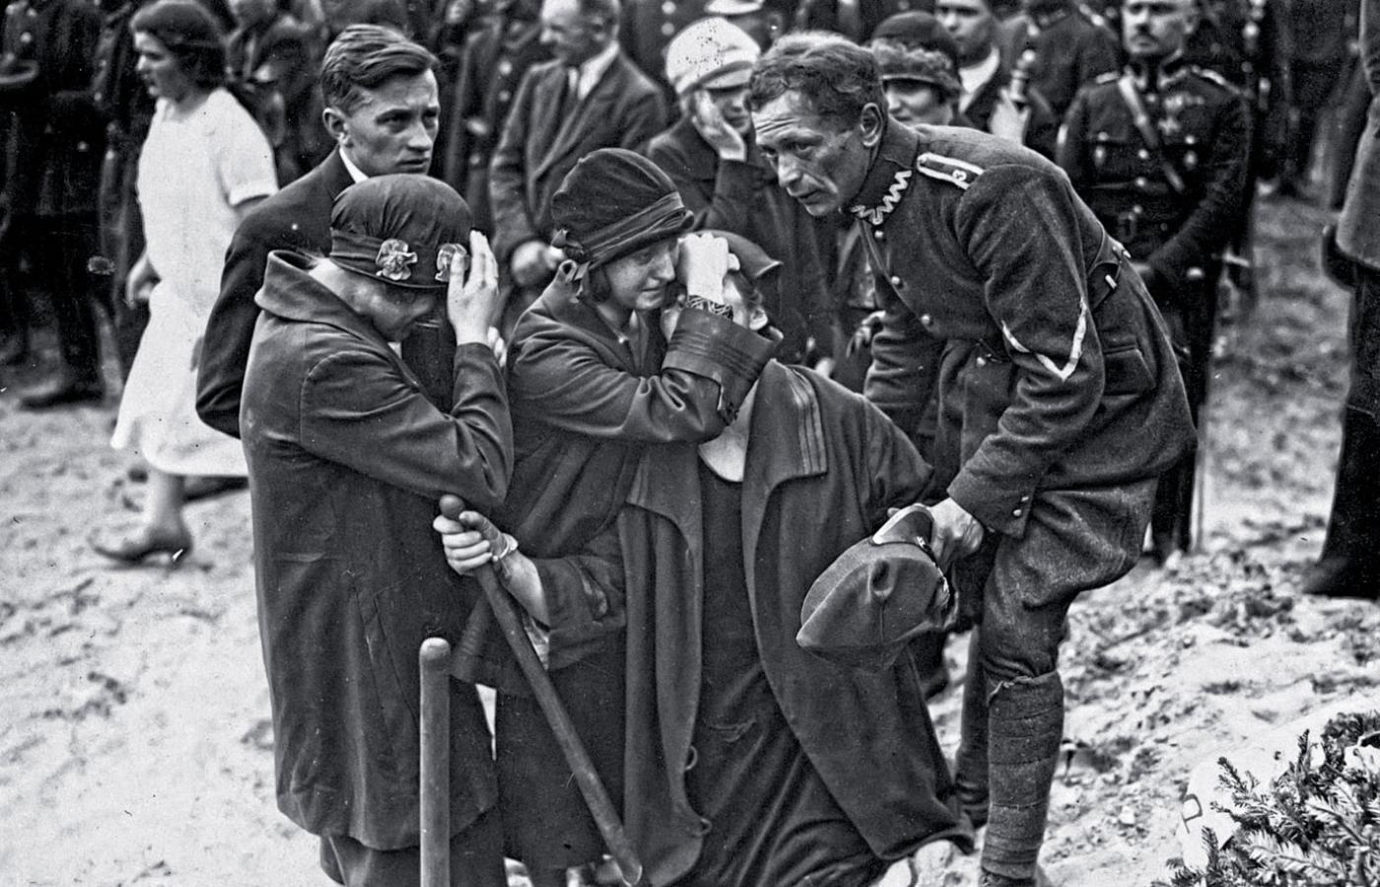

Slide 21
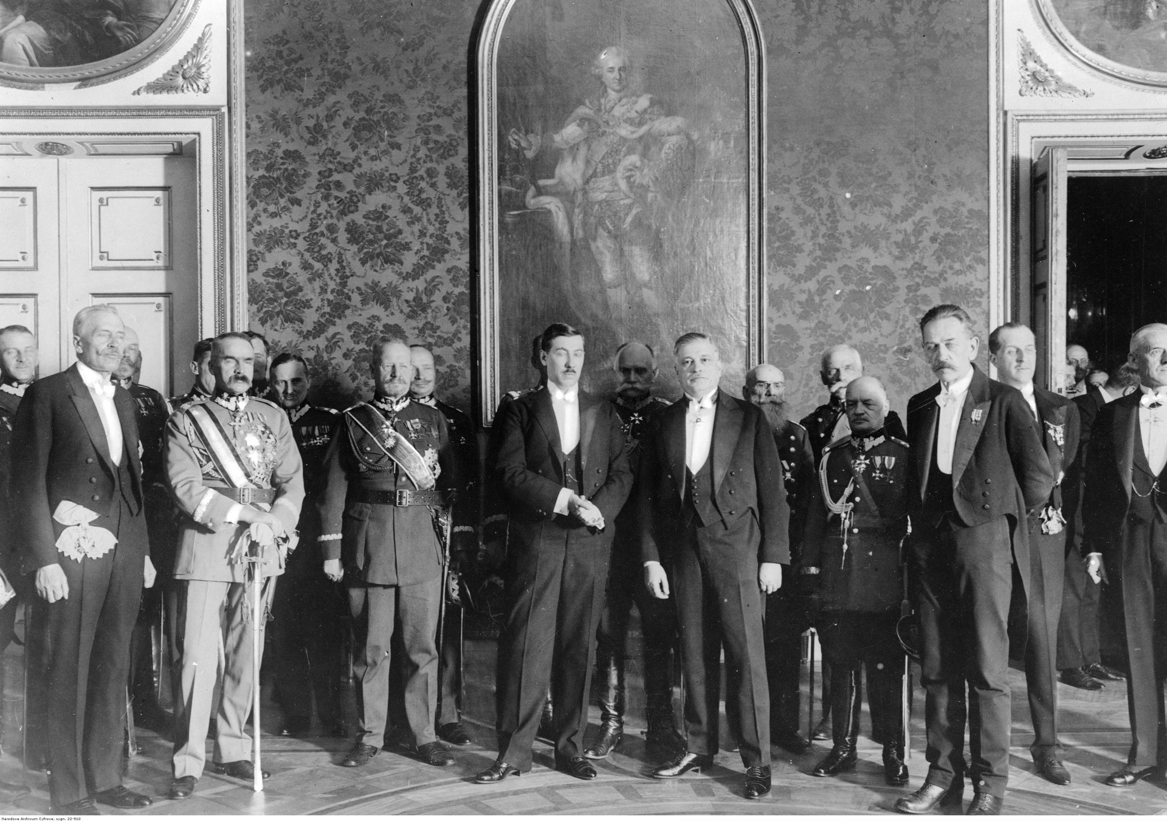
The August Novelization

Slide 22
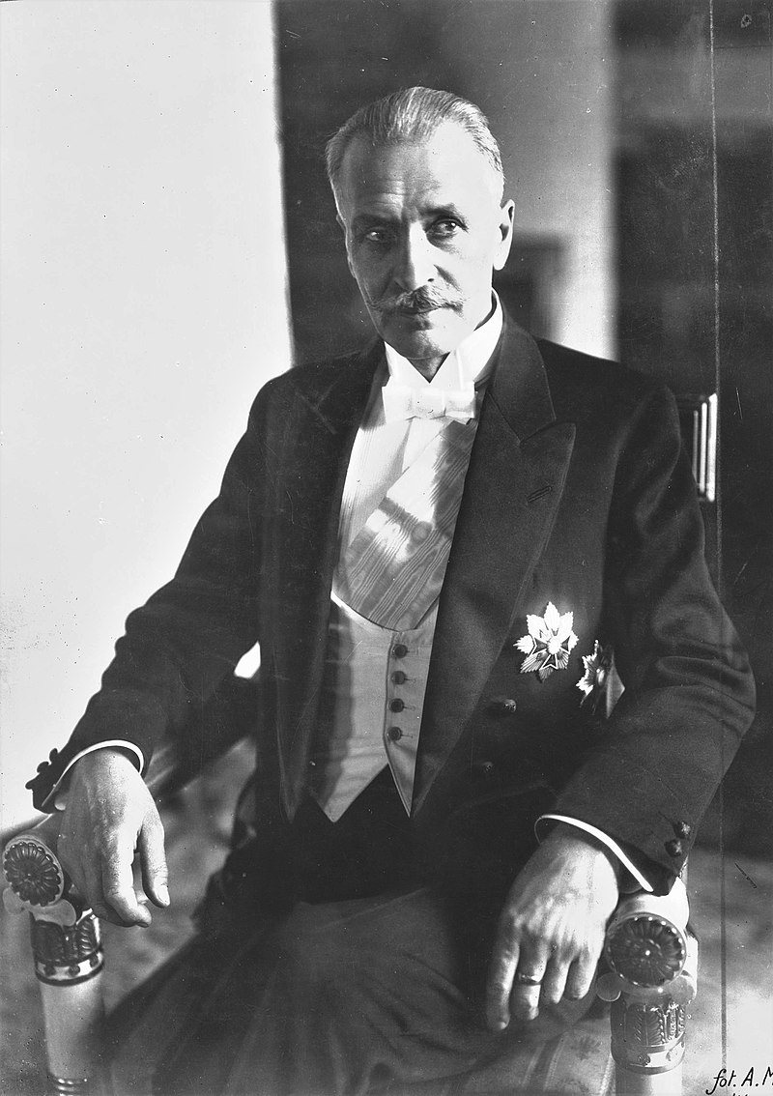
Ignacy
MoŚcicki
(1926-
1939)

Slide 23
Foreign policy

Slide 24
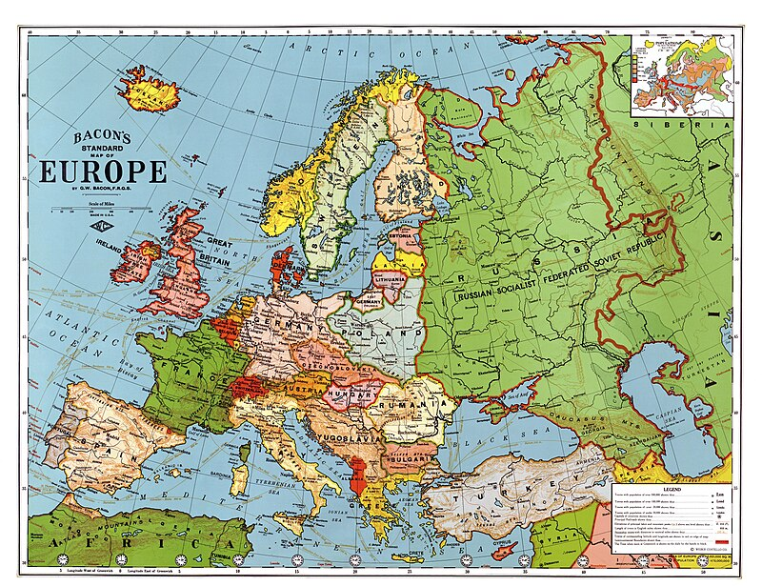

Slide 25
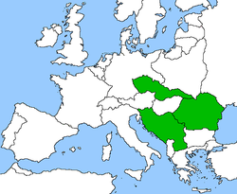
The Little entente

Slide 26
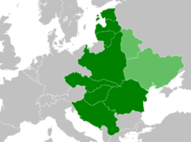
Intermare – lost chance

Slide 27
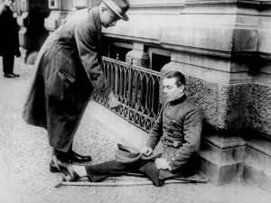
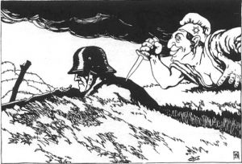
Weimar Republic

Slide 28
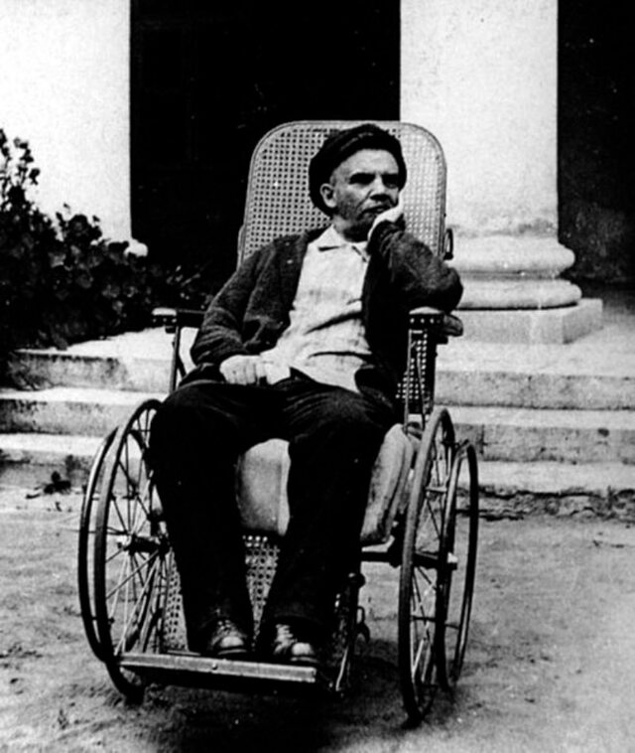
Beginning of USSR

Slide 29
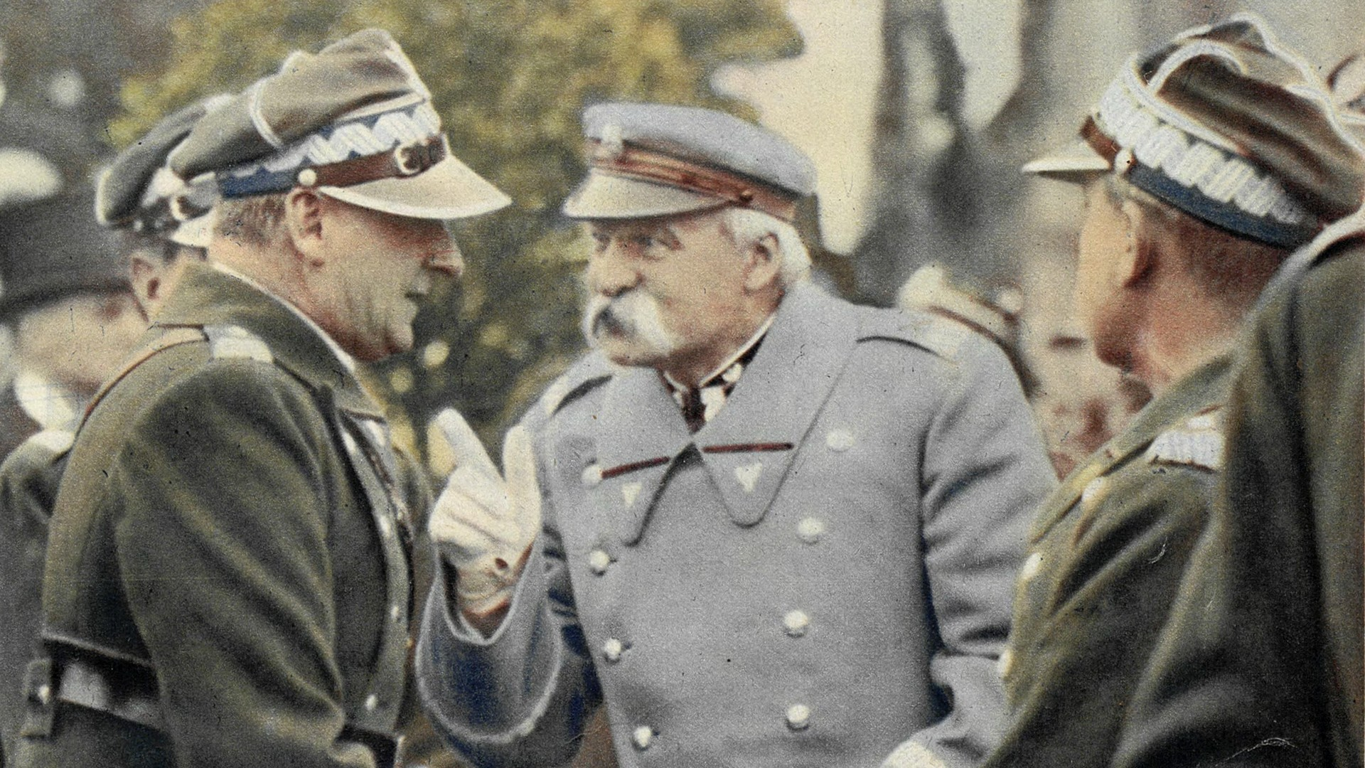
Preventive war – another last Chance?

Slide 30
Realpolitik
Between Germany and Russia (USSR)
Pact with Romania and France (later with UK)

Slide 31
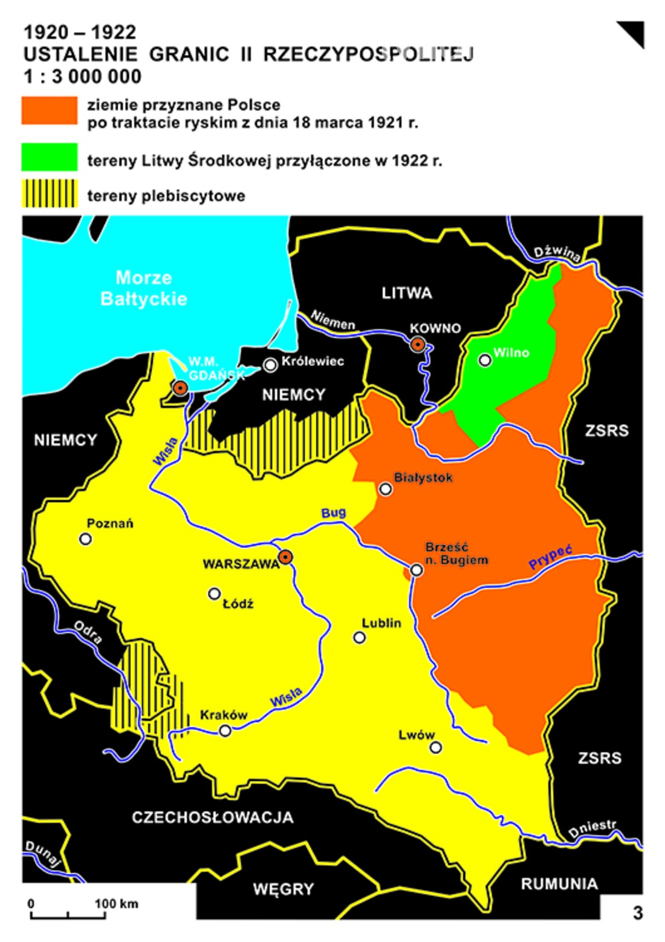

Slide 32
statistics

Slide 33
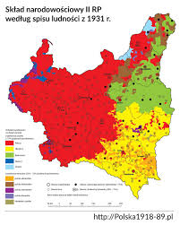
Nationality

Slide 34
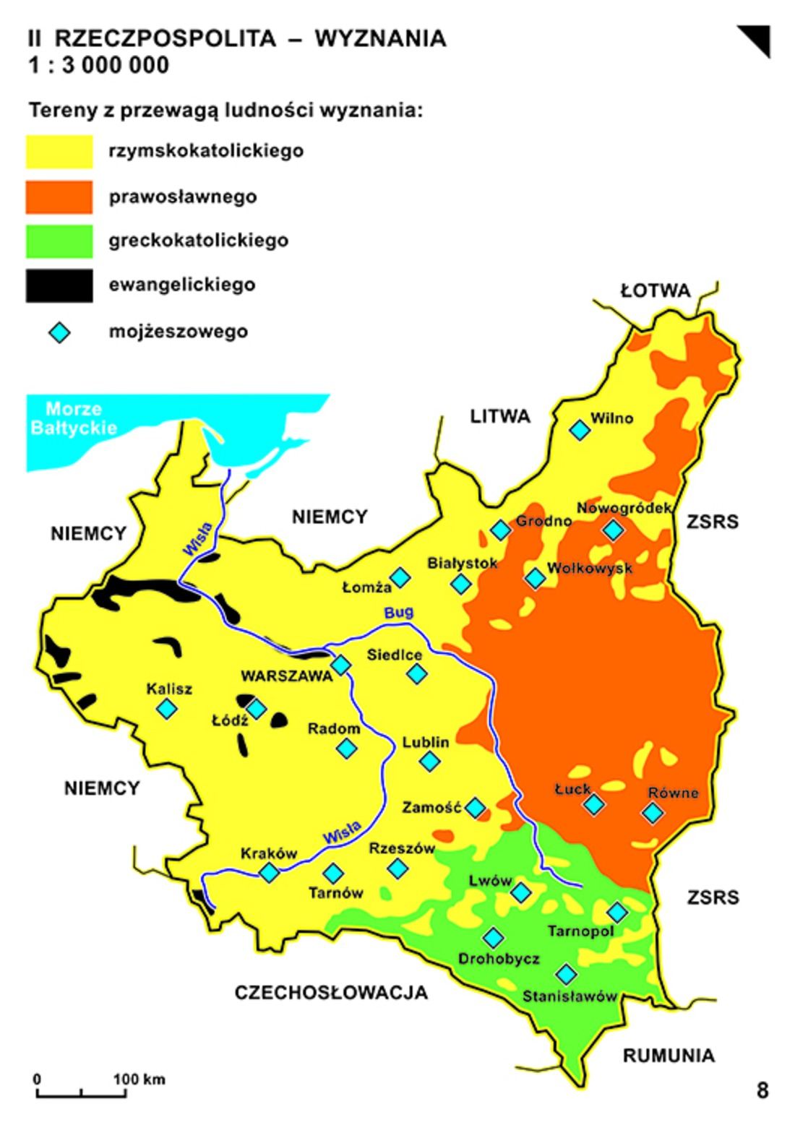
Religion

Slide 35
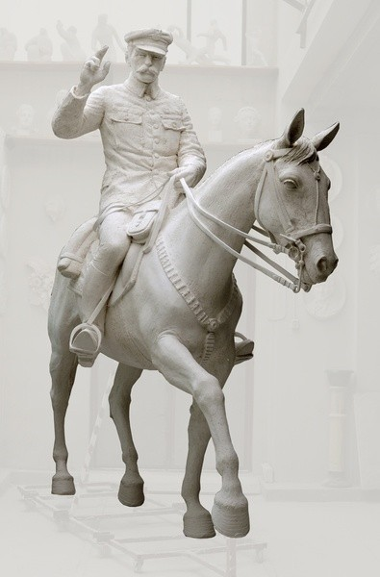
Thanks for listening

