Slide 1
The rules of „Sanacja” camp. 1926-1930 and 1930-1935
Radosław Domke

Slide 2
The first period (1926-1930)

Slide 3
Consequences of the May Coup (1926).
Consequences of the May Coup (1926).
Establishment of the Non-Party Bloc for Cooperation with the Government.
Rules of colonels. Center-left opposition (Centrolew).
Wybory Brzeskie (Polish legislative election).

Slide 4
Establishment of the Non-Party Bloc for Cooperation with the Government (BBWR)
a political grouping of supporters of J. Piłsudski's rule, created in January 1928, bringing together conservatives, groups from PPS, NPR, peasant parties and national minority parties. The BBWR program was limited to condemning the parliamentary system existing in Poland before the May Coup in 1926, demanding a reduction in the influence of opposition political parties, and announced the strengthening of executive power and the independence of the president from the legislative chambers.

Slide 5
Establishment of the Non-Party Bloc for Cooperation with the Government (BBWR)
In the 1928 Sejm elections, the BBWR, together with smaller pro-government lists, received 133 parliamentary seats (30.0%), to the senate 49 seats (44.1%). In 1930, after the early dissolution of parliament and in open conflict with the opposition (Centrolew, Brest), BBWR obtained 249 seats (56.1%), to the senate 77 seats (69.4%) and created the strongest political grouping in the Sejm.

Slide 6
Center-left opposition (Centrolew).
the common name of the alliance of parliamentary political clubs of 6 parties of the center and the parliamentary left (ChD, NPR, PSL "Piast", PPS, PSL "Wyzwolenie", Stronnictwo Chłopskie) concluded on September 14, 1929 in order to consolidate the anti-government opposition under the banner of parliamentary democracy in Poland.

Slide 7
Center-left opposition (Centrolew).
On June 29, 1930, the Centrolew parties organized the Congress for the Defense of People's Rights and Freedoms in Krakow under the slogans of "removing J. Piłsudski's dictatorship" and establishing a constitutional government based on public trust. Centrolew was looking for public support. For September 14, he prepared mass rallies and demonstrations in 21 cities (there were clashes with the police, people were killed and injured).

Slide 8
Center-left opposition (Centrolew).
On August, the president dissolved the parliament, and on the night of September, the arrests of Centrolew's main activists began. W. Kiernik, W. Korfanty, K. Popiel, A. Pragier, W. Witos, were imprisoned in Brześć nad Bugiem (Brest trial). In the elections on November 16, the Centrolew parties presented a list called the Union for the Defense of People's Law and Freedom. Pressure from the state administration and the lack of strong public support did not allow for gaining an advantage in parliament (79 parliamentary and 13 senatorial seats). At the beginning of 1931, as a result of the electoral defeat and internal political discord, Centrolew disintegrated.

Slide 9
Wybory Brzeskie (Polish legislative election in 1930).
in order to deal with this danger, the Sanation authorities resorted to radical measures. In 1930, Centrolew's leaders were unexpectedly arrested and accused of acting to the detriment of the state. Show trials took place in Brest. Shortly thereafter, parliament was dissolved and new elections were called. Of course, they took place in the shadow of Brest and their trials, and the authorities did everything to further destroy the opposition and win the elections.

Slide 10
The second period (1930-1935)

Slide 11
Bereza Kartuska (1934)
The camp in Bereza Kartuska, founded in 1934, had the official name of the retreat place. It was established shortly after the successful assassination of the then Minister of Internal Affairs Bolesław Pieracki. Polish nationalists were suspected of the minister's murder and they were the first to be sent to Bereza. Soon, communists from the Communist Party of Poland (KPP) working for the Soviet Union, oppositionists from the Polish Socialist Party (PPS) and the People's Party (SL), and the real perpetrators of Pieracki's murder - Ukrainian nationalists from the Organization of Ukrainian Nationalists (OUN) - began to arrive there.

Slide 12
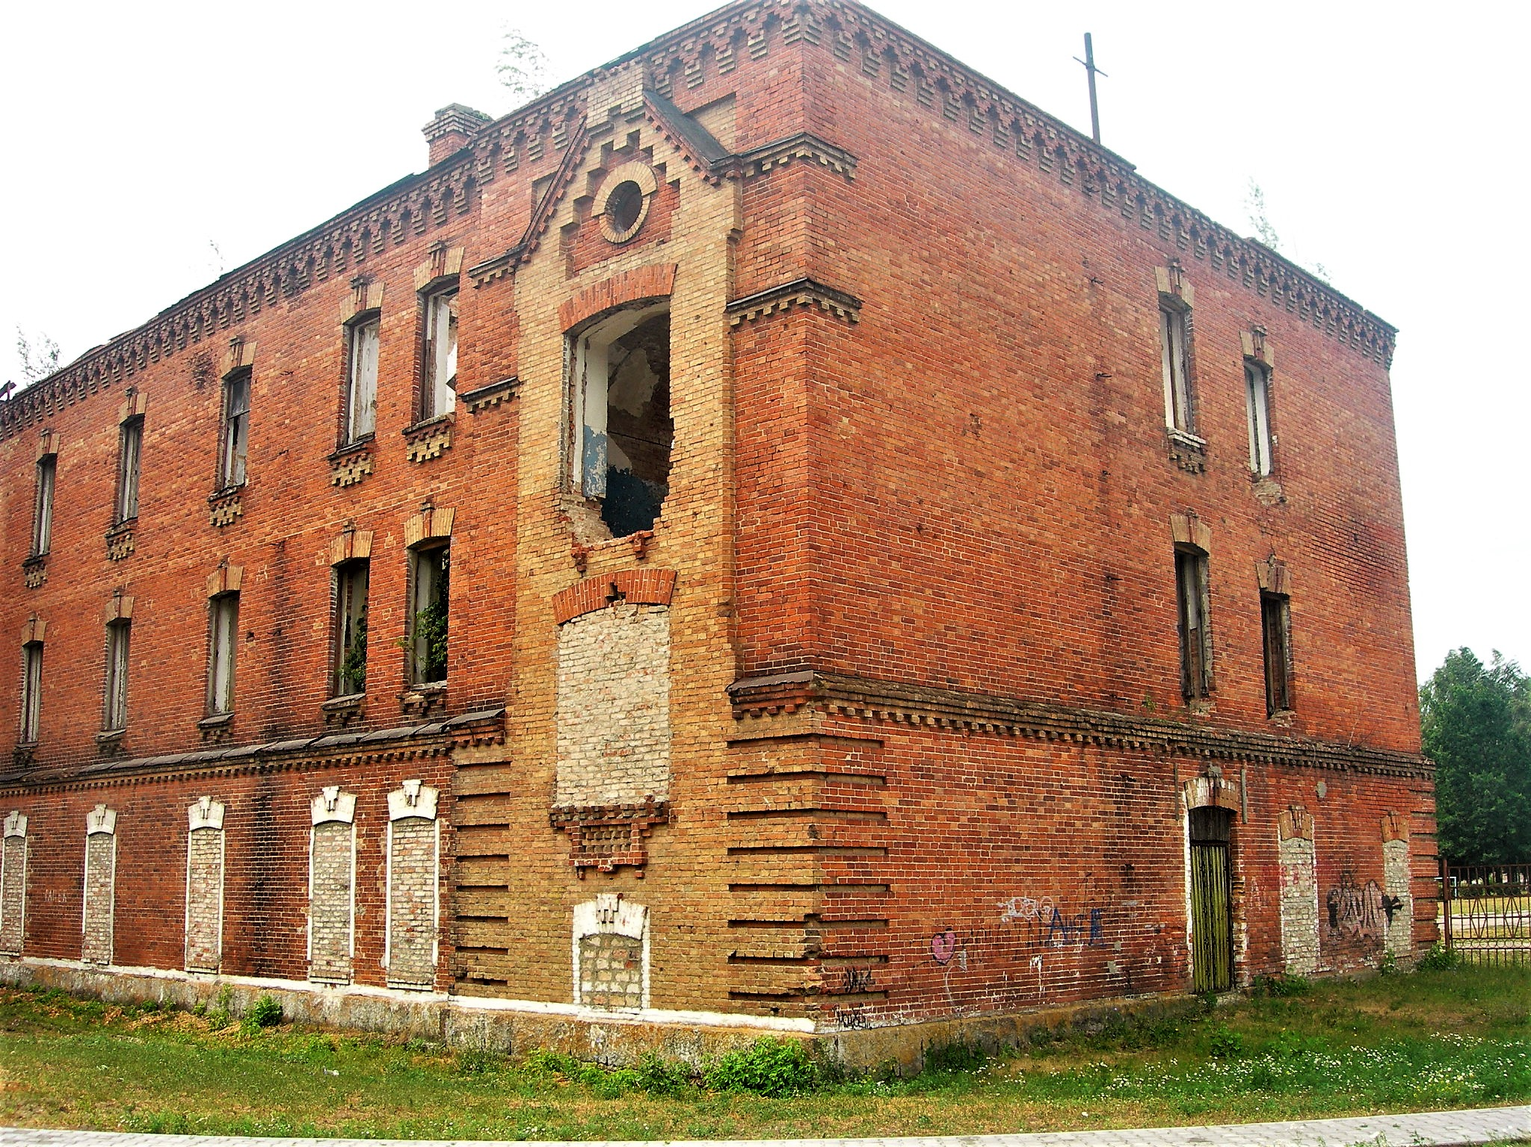

Slide 13
Bereza Kartuska (1934)
In addition to political prisoners, Bereza received economic speculators (hated "snatchers" who inflated the prices of hard-to-find products), counterfeiters and other criminals - especially recidivists. However, criminal offenders, as they were more familiar with this type of places, quickly became official prisoners and informers of the prison service. The establishment of the camp in Bereza Kartuska was a kind of ordering of the dictatorship's repressive actions.

Slide 14
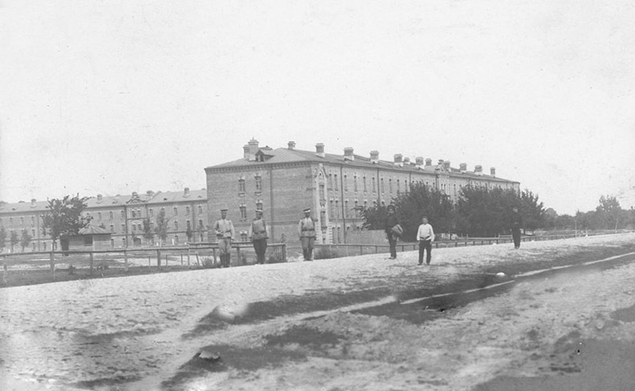

Slide 15
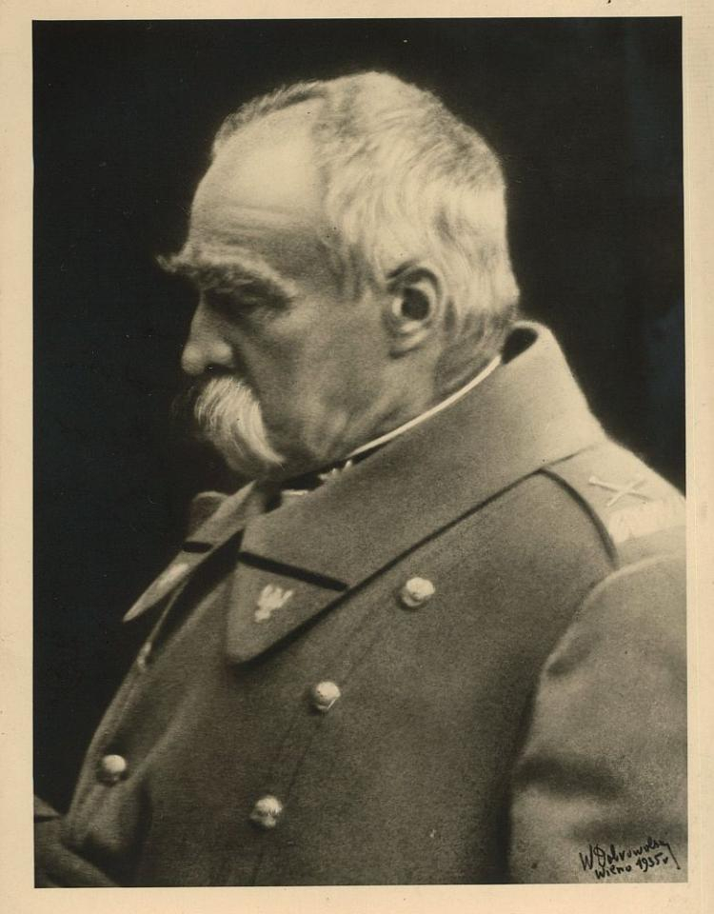
Last years of marshal Piłsudski

Slide 16
Lonelyness
Mental deseace
Loneliness
Project of the chosens electors (merit list)

Slide 17
Mental disease
Cancer, sclerosis, paranoia
Piłsudski was becoming unpredictable. Those around him had to endure outbursts of uncontrolled rage, the causes of which were completely incomprehensible. Lepecki's memories and Hrynkiewicz's diary reveal a terrifying picture of the slow disintegration of personality. It was one of the most closely guarded secrets of the ruling camp. The fact that Piłsudski was aging rapidly could not be hidden, of course. The physical changes were simply visible. However, the public could not find out about the changes taking place in the psyche.

Slide 18
Mental disease
These periods of mental indisposition were interspersed with periods of complete mental clarity. Perhaps this was the most tragic thing for those around him - helplessly watching the fight he was fighting with himself and in which he could not win. But it wasn't always just passive observation. Sometimes it was the immediate surroundings that became threatened.

Slide 19
loneliness
It is characteristic that the more he rose above his colleagues, the more lonely he was. Already in his Belweder times, after 1918, he mainly played solitaire - it is, after all, a single-player card game. This is a contribution to the evolution of his personality.

Slide 20
Pro-german policy?
Treaty with USSR – 1932
Treaty with Germany – 1934

Slide 21
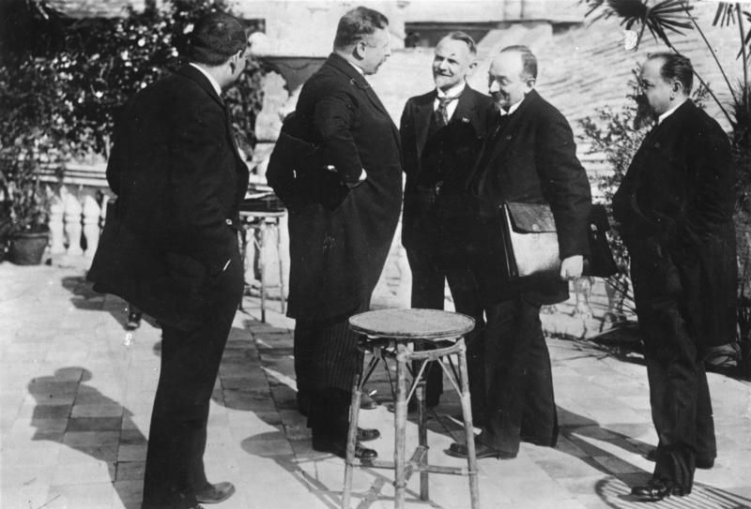

Slide 22
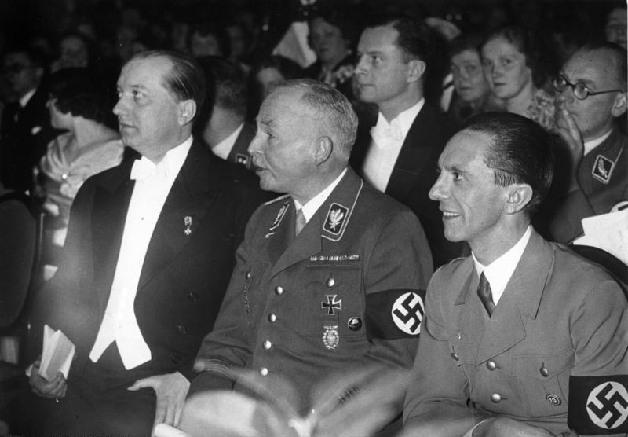

Slide 23
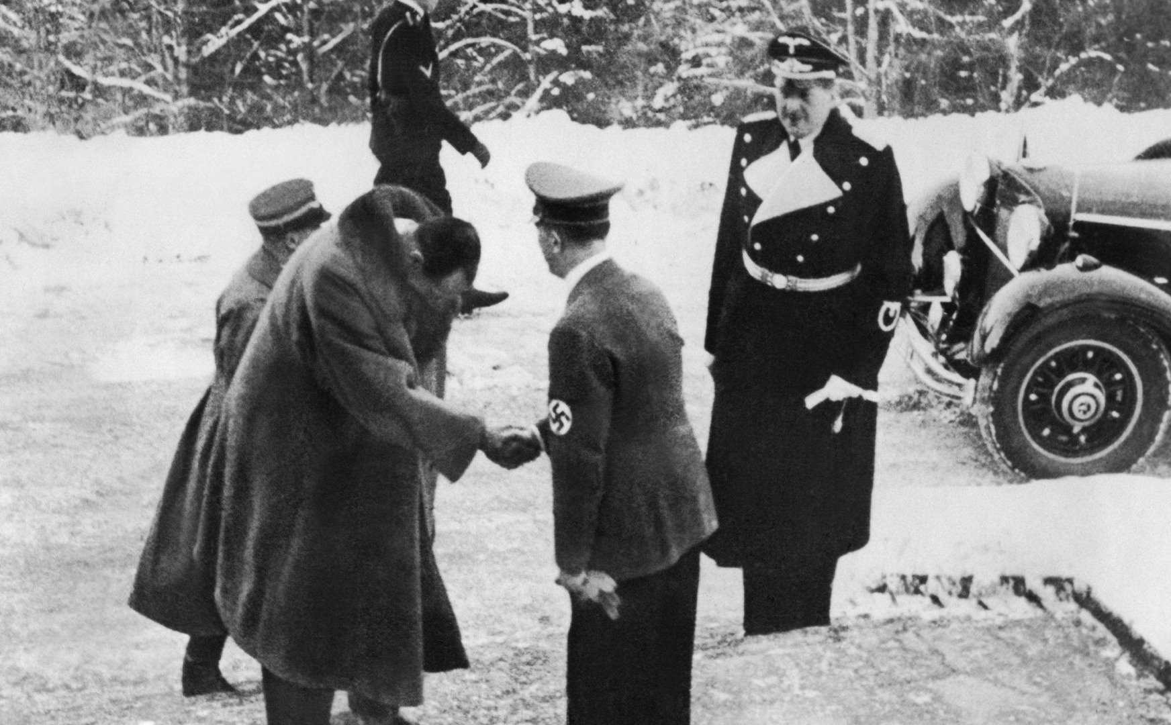

Slide 24
The April Constitution of Poland (Polish: Ustawa konstytucyjna 23 IV 1935 or Konstytucja kwietniowa)
brought an amendment to the March constitution. Its basic idea was to strengthen the executive power - the president and the government, at the expense of the Sejm and Senate. This was done by granting the president special legislative powers.

Slide 25
president
Responsible to "God and history", elected for a 7-year term, elected by the Assembly of Electors. He appointed 1/3 of the Senate and could dissolve the Sejm and the Senate. He had a set of prerogatives where he did not need the government's countersignature. The decrees had the status of a law. He could have stopped bills.

Slide 26
Prime Minister
The increased role of the Prime Minister, he set the general principles of the state's policy. Appointed and dismissed by the president.

Slide 27
Parliament
The Sejm is elected in general elections, the Senate is elected in 1/3 by the president, and the rest in elections. Subordinated to the president, who could suspend and convene him at will, as well as block laws. 5-year term of office. Very limited parliamentary immunity.

Slide 28
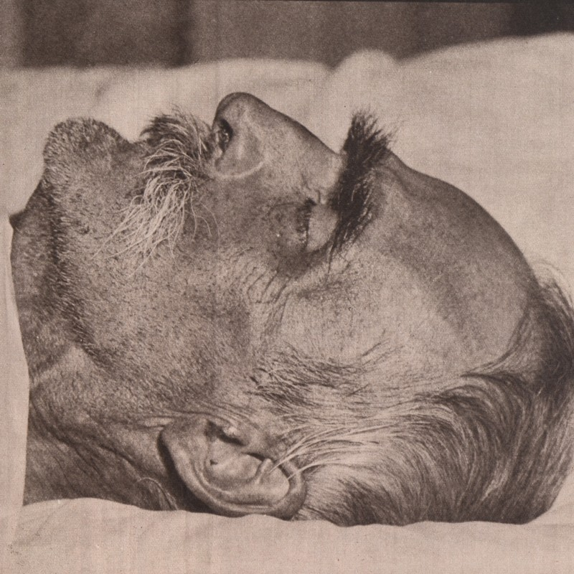
Death of Józef Pilsudski and funeral

Slide 29
Legacy of Piłsudski in the camp
Marshal wanted an authocratic country but he did not give precise clues for it

Slide 30
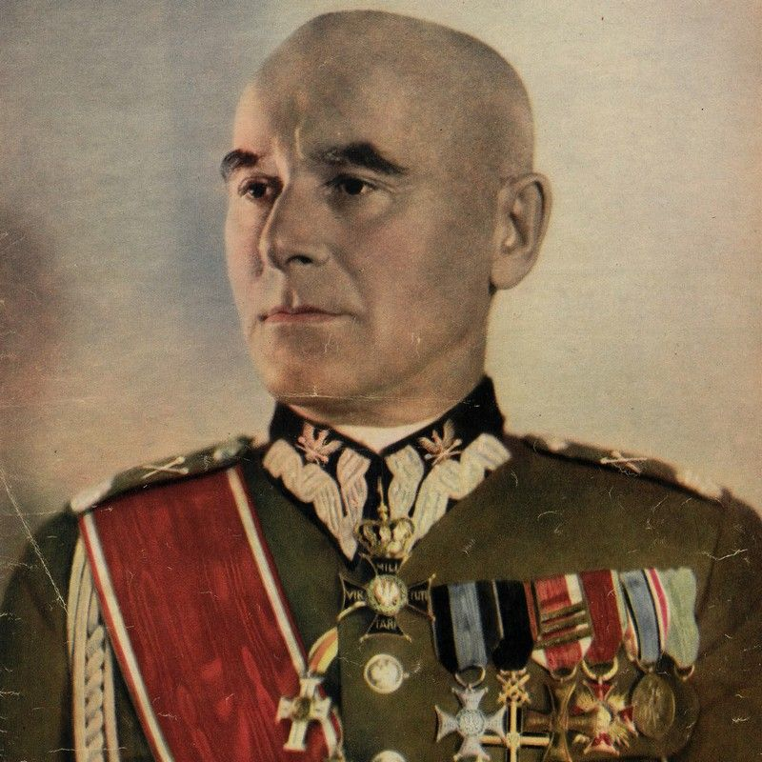
Edward Rydz-Śmigły

Slide 31
Edward Rydz-Śmigły
During the May Coup in 1926, he supported Marshal Piłsudski by sending him some of the Vilnius garrison units to Warsaw. In October 1926, he was appointed Army Inspector in Warsaw.
After Piłsudski's death on May 12, 1935, based on the decree of President Ignacy Mościcki, he took over the position of Inspector General of the Armed Forces, which gave him enormous powers.

Slide 32
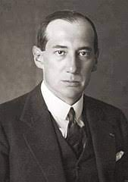
Józef Beck

Slide 33
Józef Beck
From November 1932 to the end of September 1939, he served as the head of the Ministry of Foreign Affairs, replacing August Zaleski. In the years 1935-1939 he also sat in the Senate.
As a minister, he remained faithful to Marshal Piłsudski's belief that Poland should maintain balance in relations with Moscow and Berlin. Like him, he was an opponent of the Republic of Poland's participation in collective agreements, which, in his opinion, limited the freedom of Polish politics.
While leading diplomacy, he signed, among others: in 1934, the Polish-German declaration of non-violence.

Slide 34
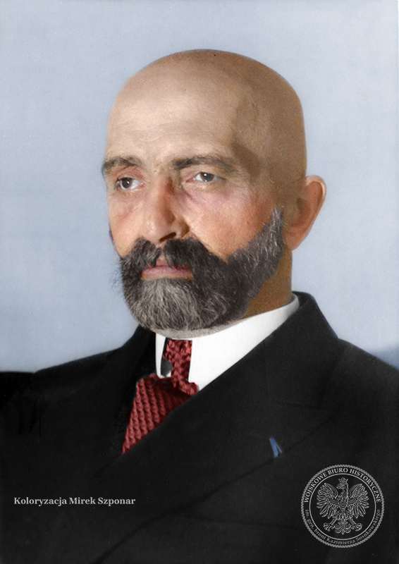
Walery Sławek

Slide 35
Walery Sławek
After the May coup, he returned to active military service, serving from 1927 as an officer for special orders of the Inspector General of the Armed Forces, Marshal Piłsudski. At the end of March 1928, he retired again. Then he became a member of the Cabinet of the Prime Minister in the government of Kazimierz Bartel. He was the author of the concept of establishing the Non-partisan Bloc for Cooperation with the Government and its president in the years 1928-1935. From 1928 to 1938 he was a member of the Sejm. During this period, he served as prime minister three times: from March 29 to August 23, 1930, from December 4, 1930 to May 26, 1931 and from March 28 to October 12, 1935. He was one of the main creators of the April Constitution of 1935.

Slide 36
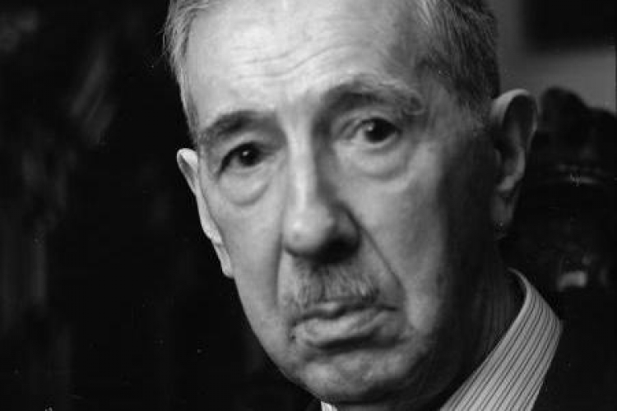
Eugeniusz Kwiatkowski

Slide 37
Eugeniusz Kwiatkowski
He began his political career after the May coup in 1926, when Prime Minister Kazimierz Bartel appointed him as Minister of Industry and Trade. While performing this function, he contributed to the creation and implementation of the idea of ​​building a port in Gdynia and a nitrogen compounds factory in Mościce near Tarnów.
He also supported the development of maritime trade and the creation of the High Seas Fishing Fleet.
In 1928, he became an MP from the Nonpartisan Bloc for Cooperation with the Government.
In the years 1931-1935, he became the director of the State Nitrogen Compound Factories in Chorzów and Mościce, from which he resigned in 1935, accepting the portfolio of deputy prime minister and minister of treasury in the offices of Marian Zyndram-Kościałkowski and Felicjan Sławoj Składkowski.

Slide 38
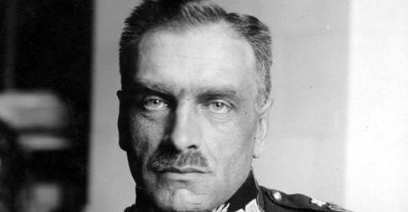
Felicjan Sławoj-Składkowski

Slide 39
Felicjan Sławoj-Składkowski
In the years 1926-29 and 1930-31, Składkowski was the Minister of Internal Affairs. In 1936, he was promoted to major general. In the same year, you can use the services of the Minister of Internal Affairs.

Slide 40
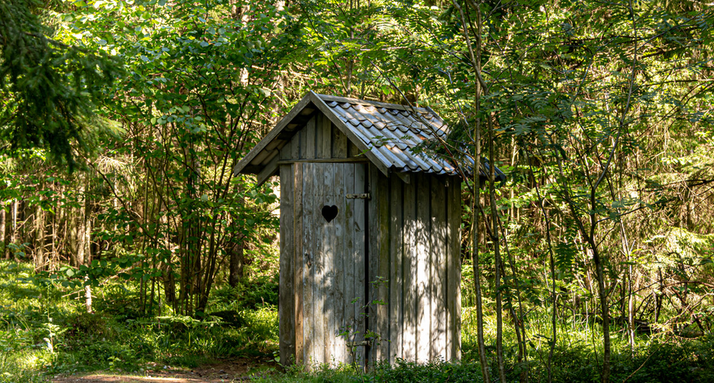
„sławojka”

Slide 41
Thank you

