Slide 1
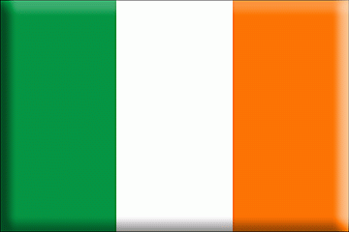
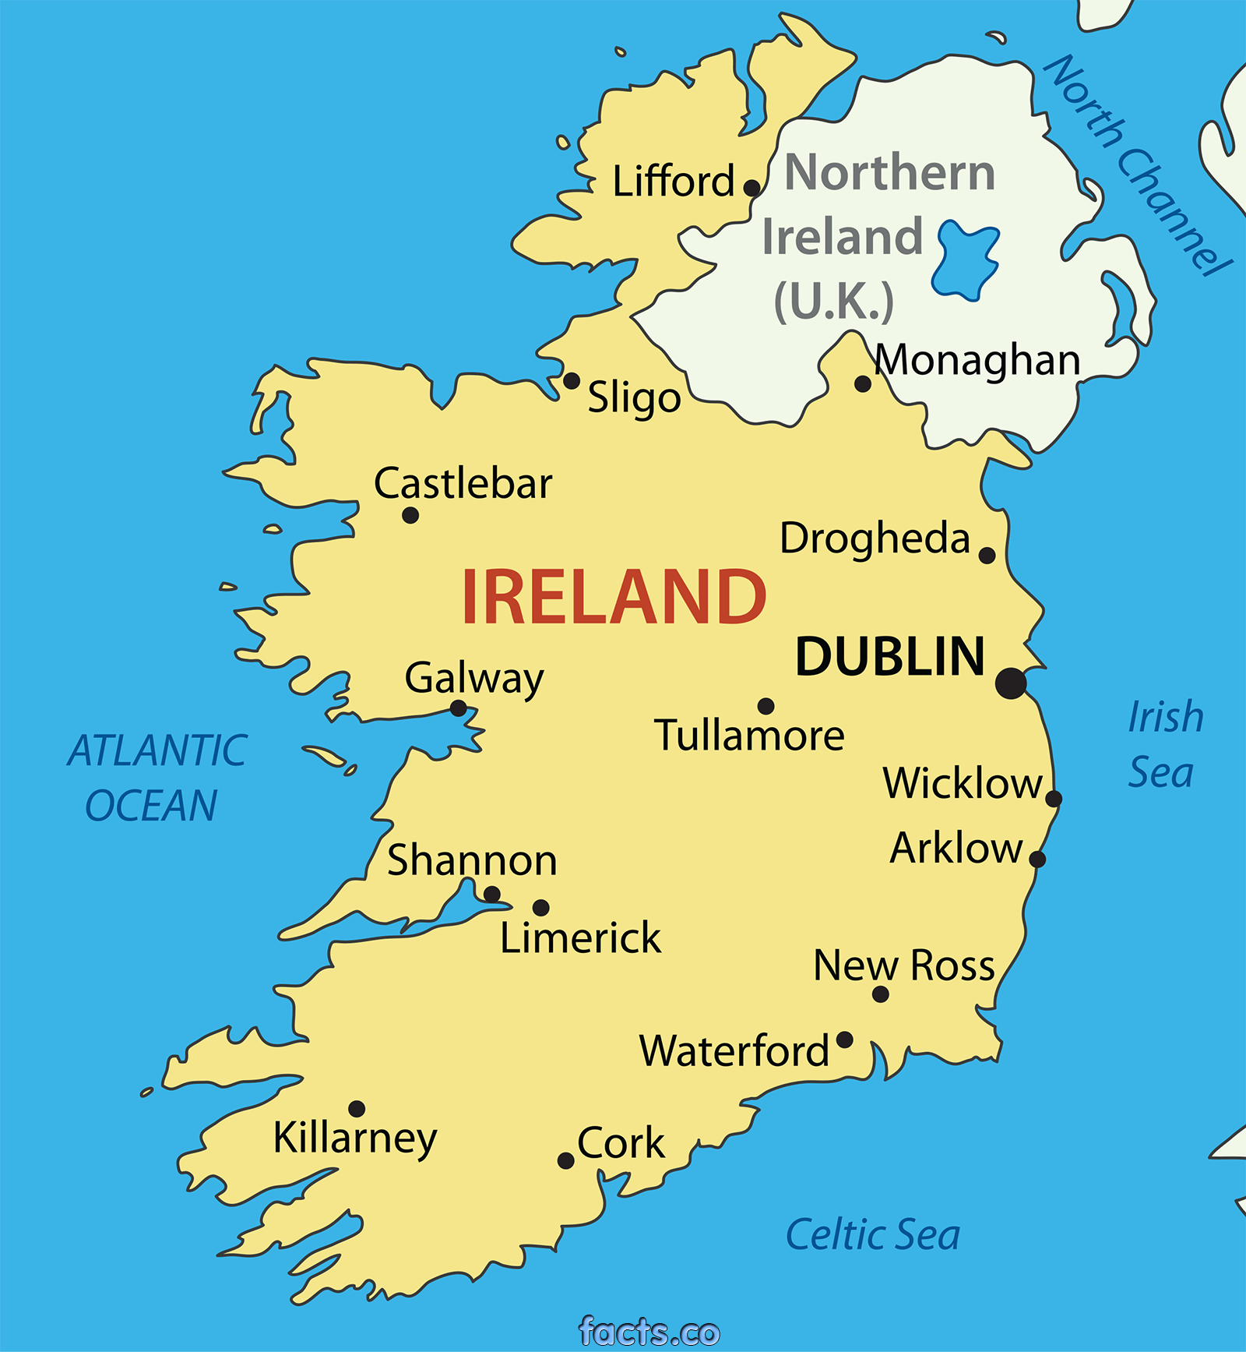
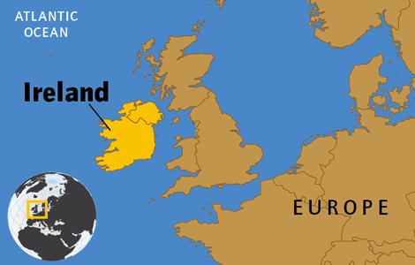
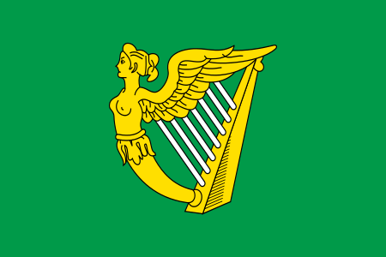
ireland
Éire or Poblacht na hÉireann
About five-sixths of the island of Ireland
Northern Ireland to the north & east, Atlantic to the north & west, Celtic Sea to the south, Saint George’s Channel to the south-east & Irish Sea to the east
70,280 km², 4.6 million people
Dublin
7.5 million foreign tourists

Slide 2
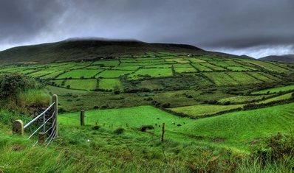
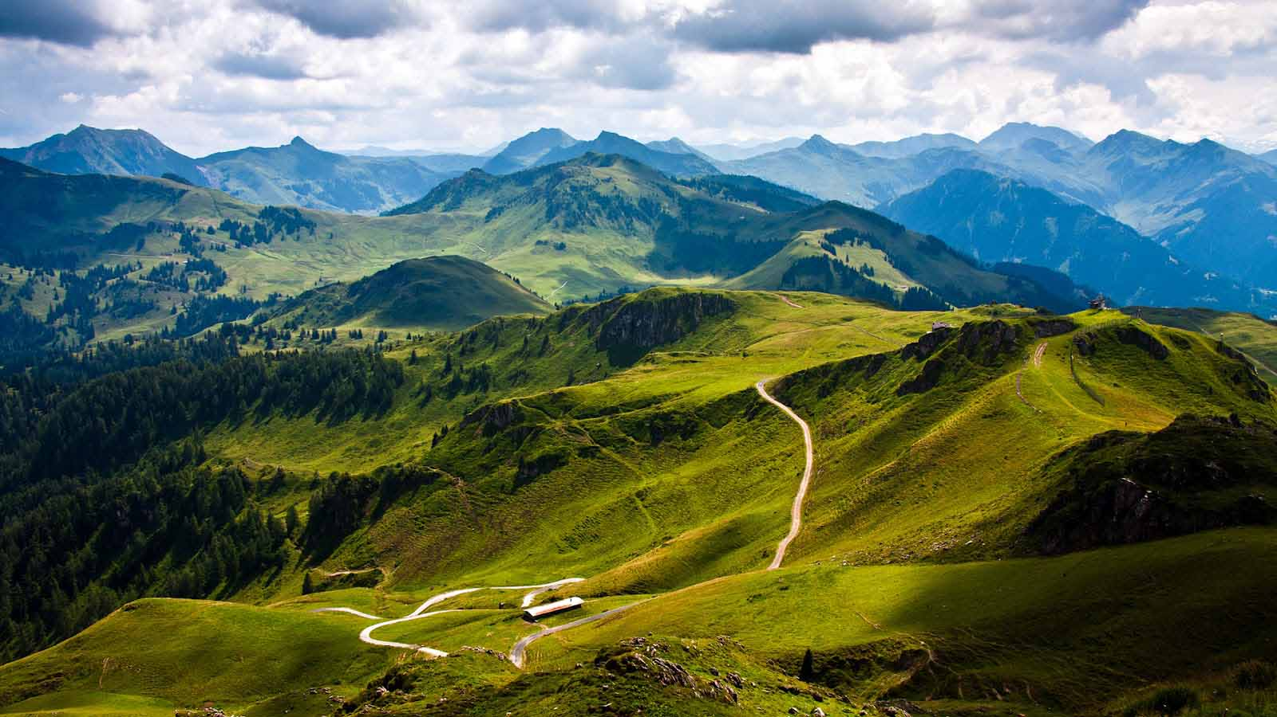
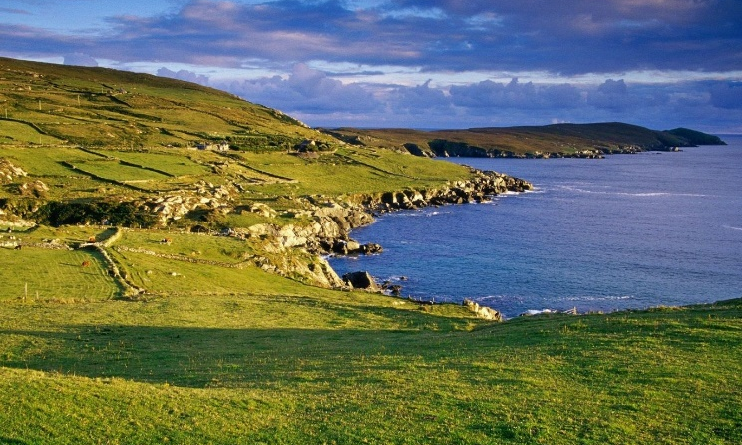
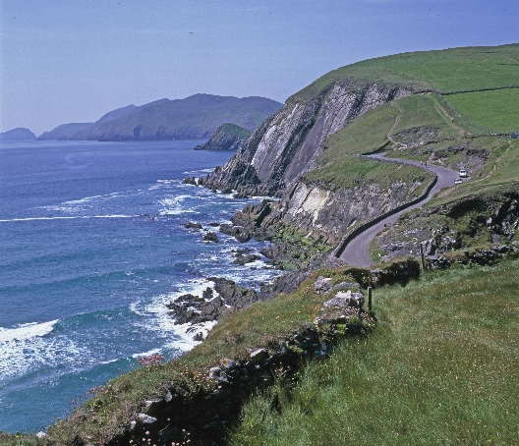
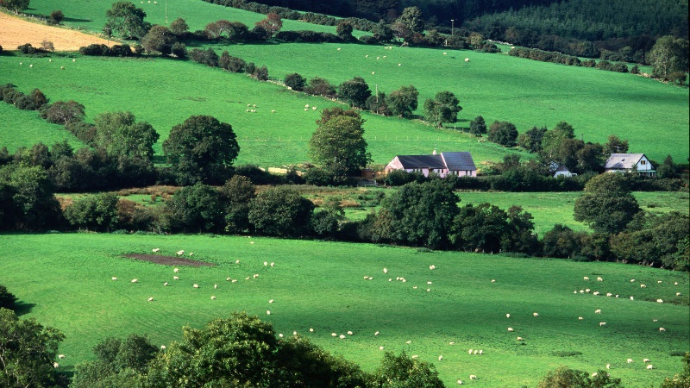
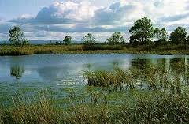
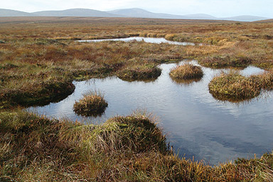
nature
Emerald Island – rural greenery & natural beauty
West – hills, mountains & rugged cliffs (islands, peninsulas, headlands & bays)
Centre – lowlands covered with areas of bogland & lakes

Slide 3
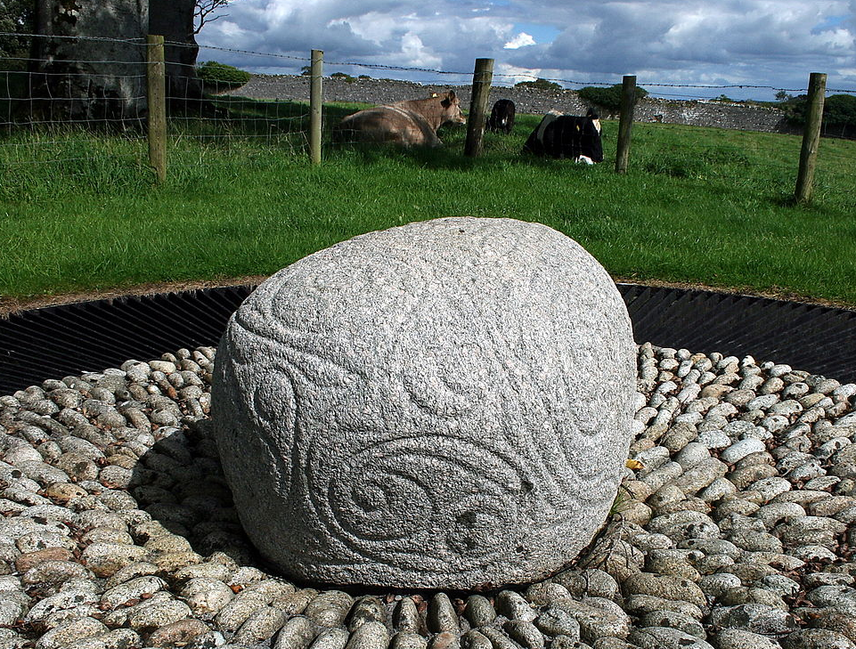
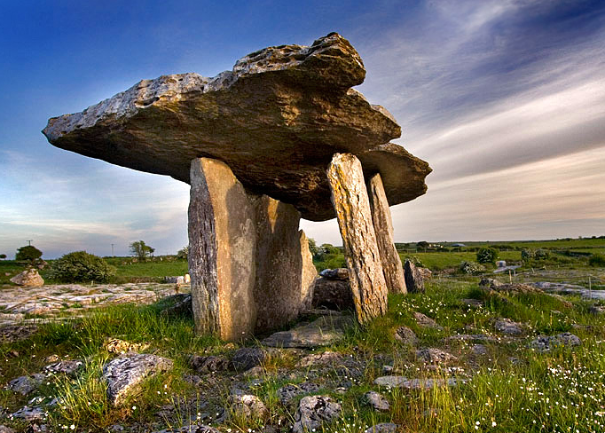
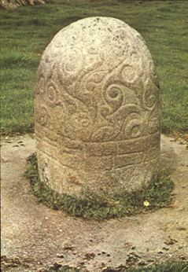
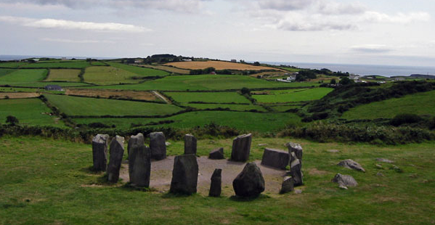
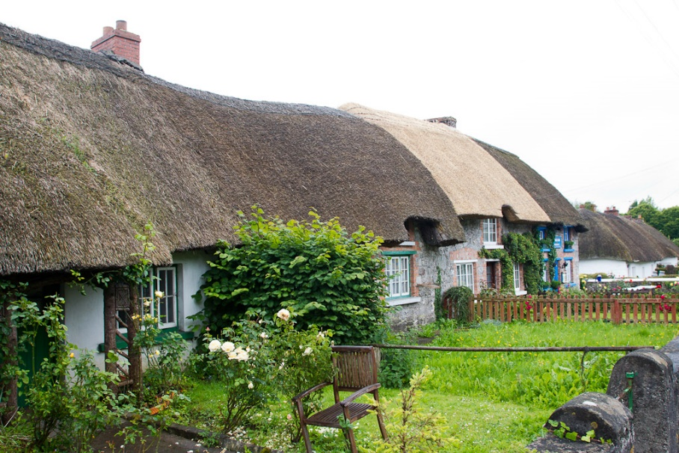
Tourist attractions
Wealth of structures from Neolithic period
Thatched-roof cottages (roof built with dry vegetation – straw, heather)
Castlestrange stone (granite boulder decorated with flowing spirals, 500BC)
Poulnabrone dolmen (portal tomb)
Turoe stone (granite, decorated Celtic style)
Dromberg stone circle

Slide 4
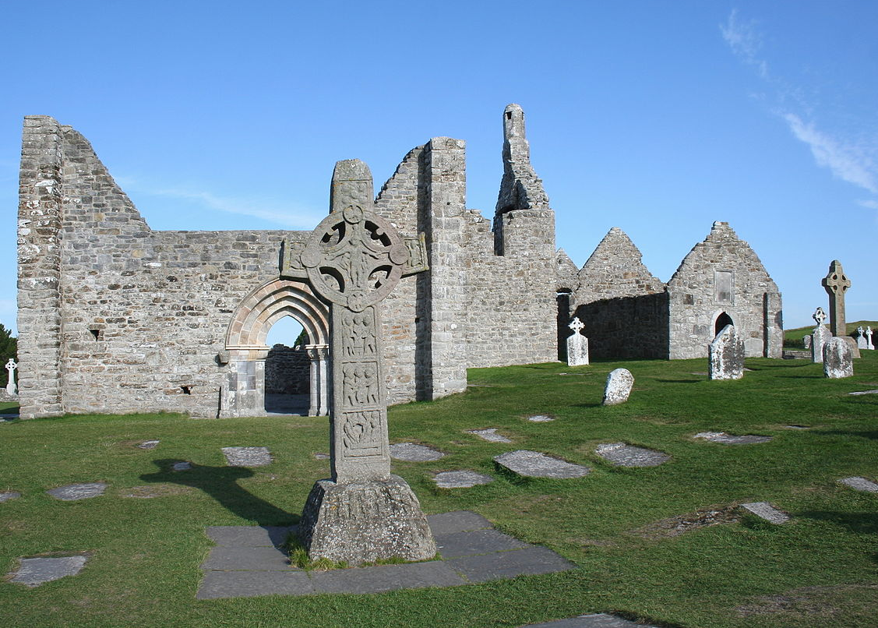
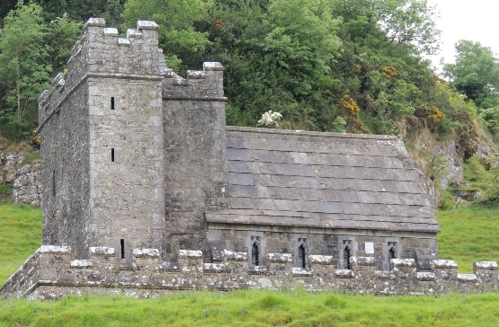
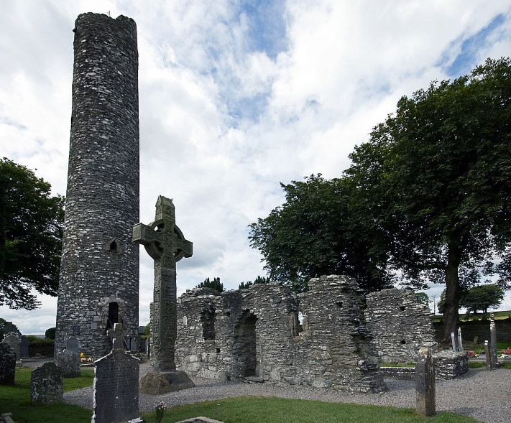
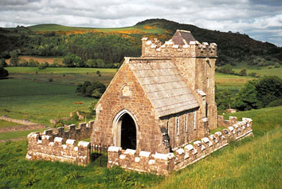
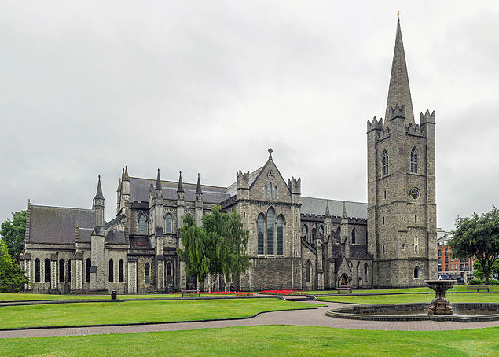
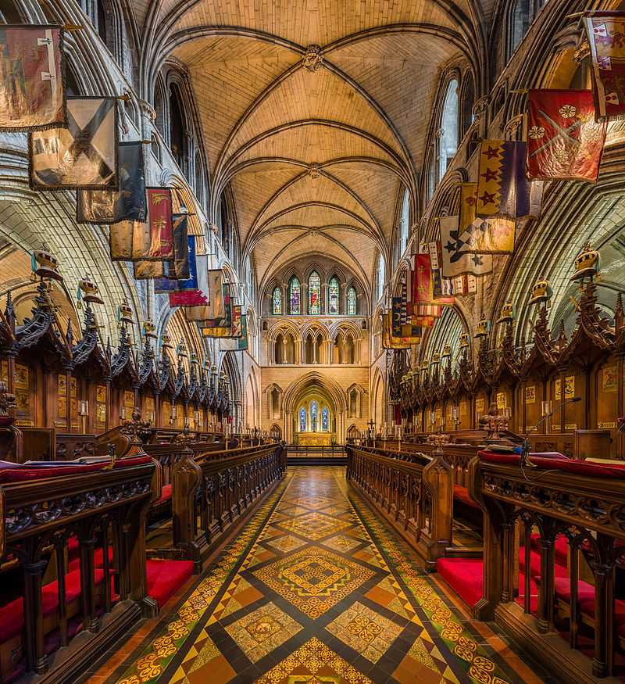
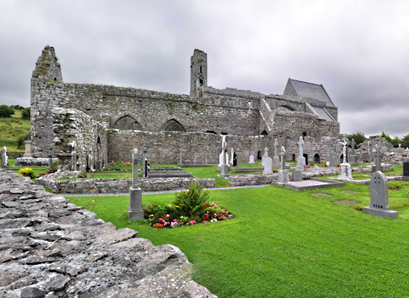
Tourist attractions
Christianity – monastic houses
Franciscans – numerous abbeys
Gothic cathedrals – Saint Patrick’s in Dublin
Clonmacnoise (6 c)
Monasterboice (5 c)
Saint Patric

Slide 5
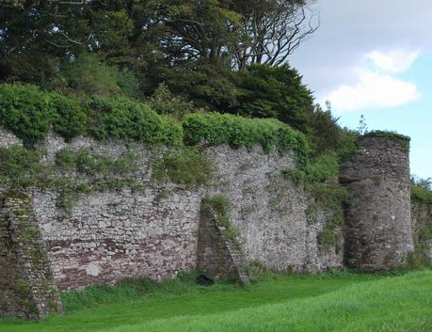
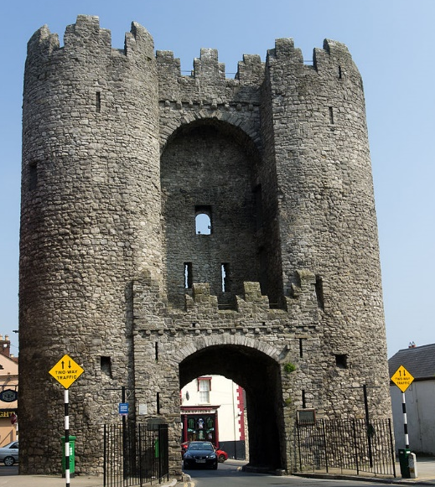
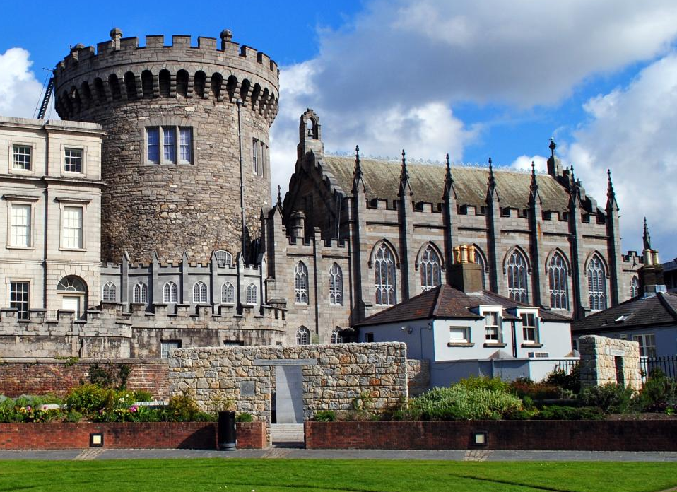
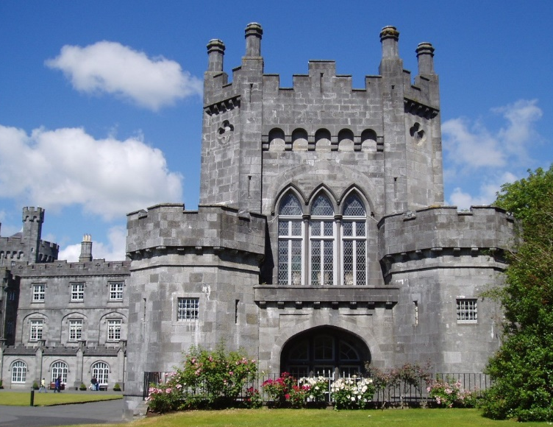
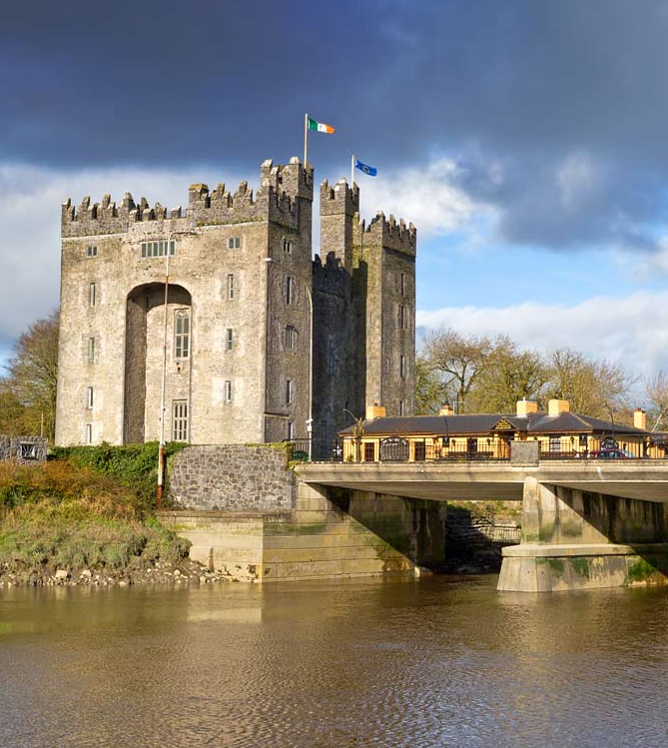
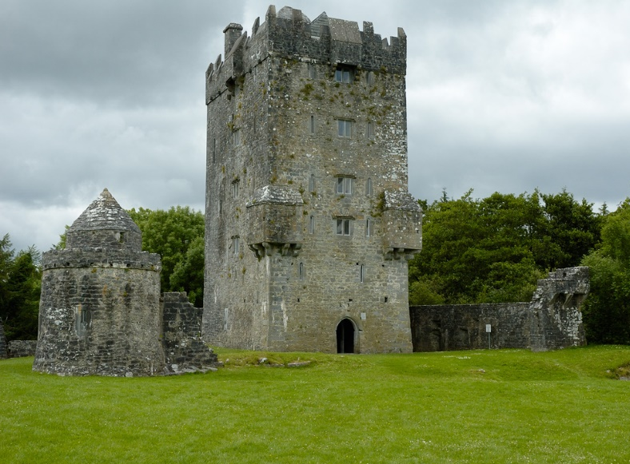
Tourist attractions
Surviving walled trading towns (Normans) – Drogheda & Youghal
Castles built by Normans – Dublin & Kilkenny
Tower houses – Bunratty castle (Gaelic & Norman aristocracy)
Youghal
Drogheda
Dublin
Kilkenny
Bunratty
Aughnanure

Slide 6
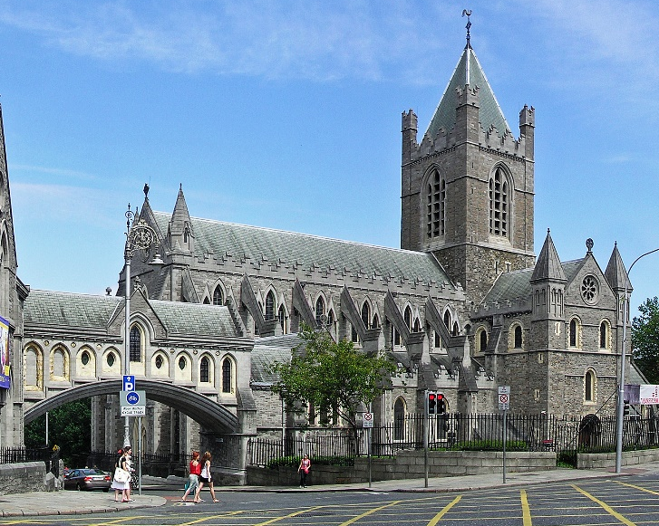
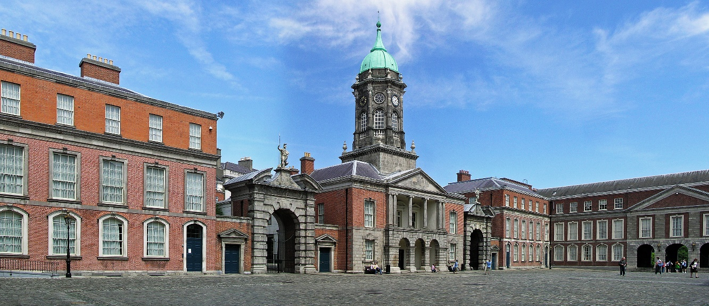
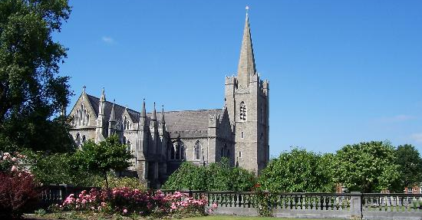
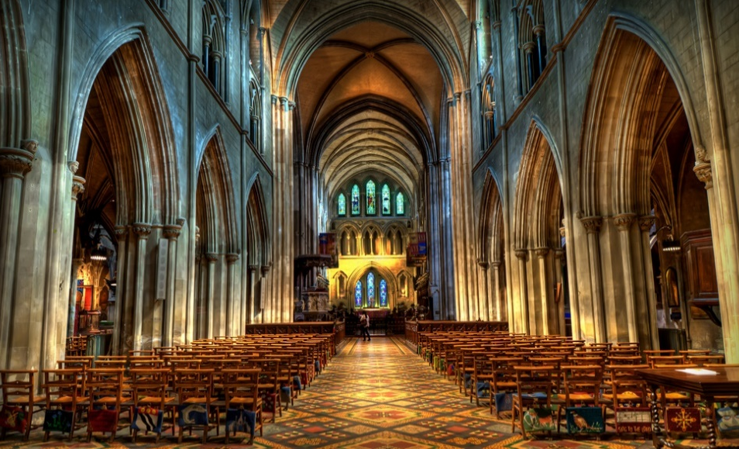
Dublin
Vikings – 840s, gained by British – 1171, from 1800 Irish strived to gain independence, won in 1922
Christ Church Cathedral (11 century), Cathedral of Saint Patrick (1191)
Dublin Castle – massive stronghold (1204, Normans)

Slide 7
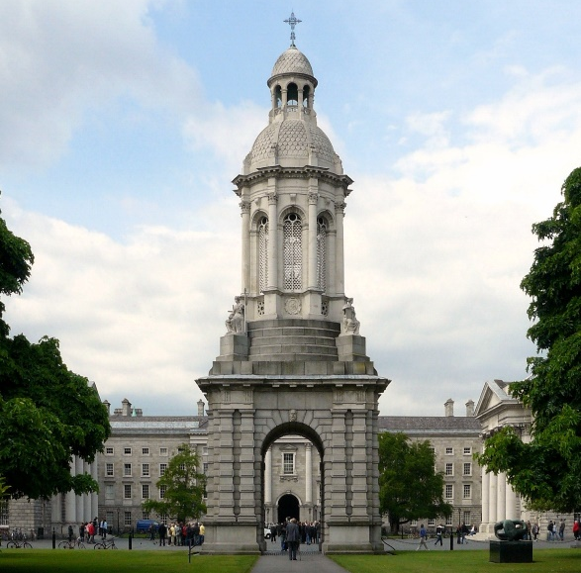
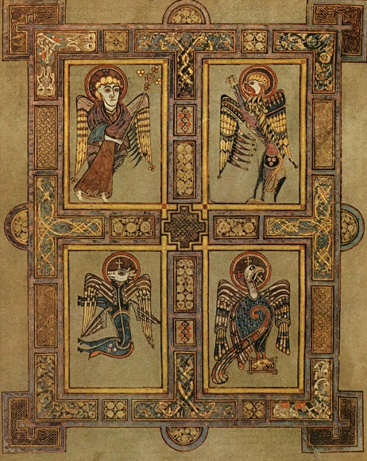
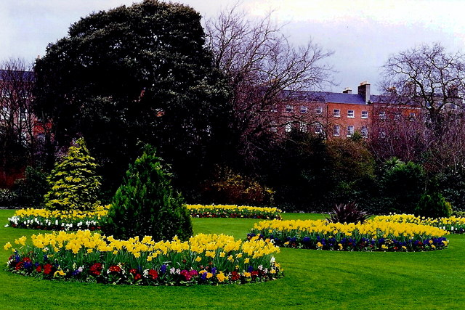
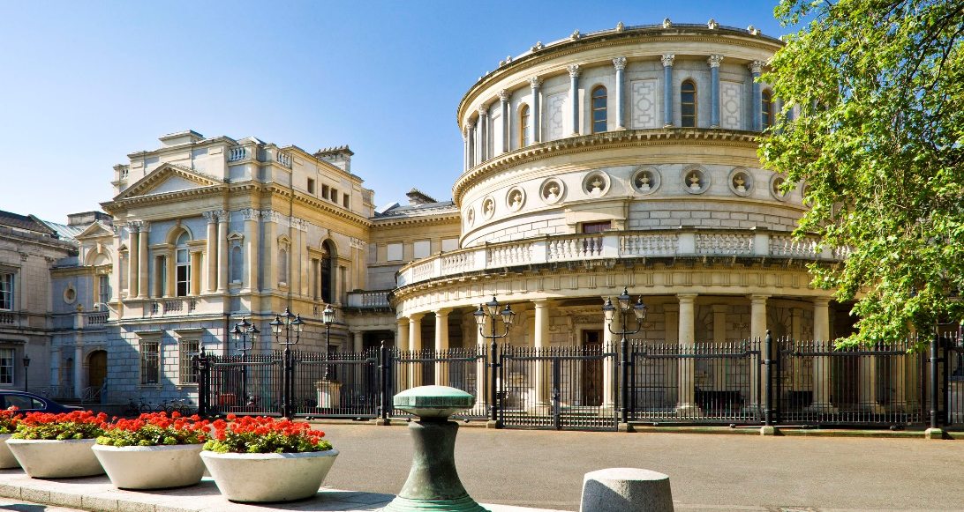
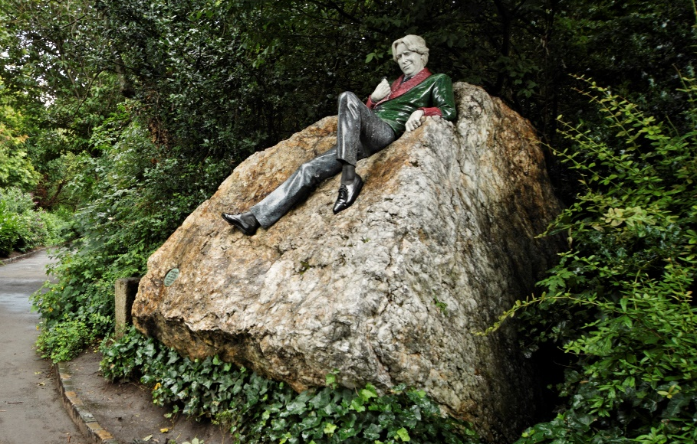
Dublin
Trinity College – Book of Kells (illustrated manuscript, Irish monks, app 800)
Merrion Square – Georgian garden square (Oscar Wilde)
National Museum (all archaeological objects found in Ireland)

Slide 8
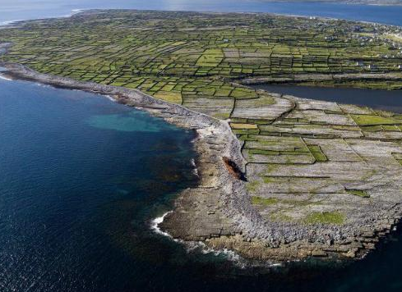
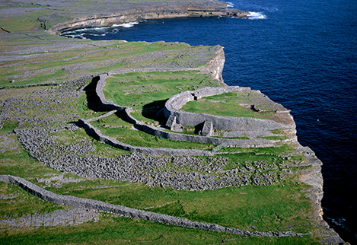
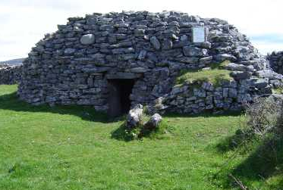
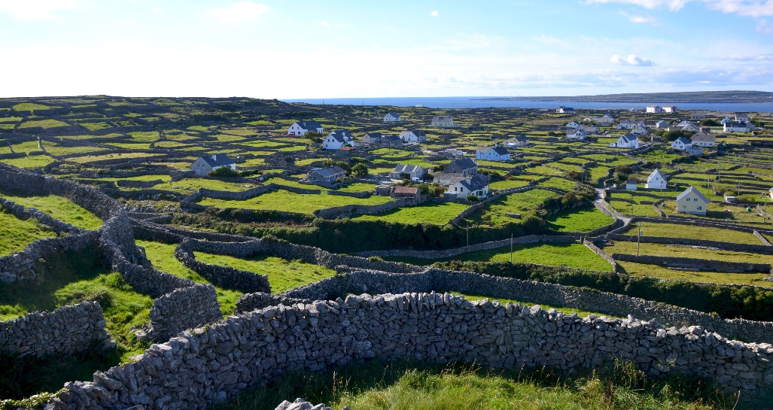
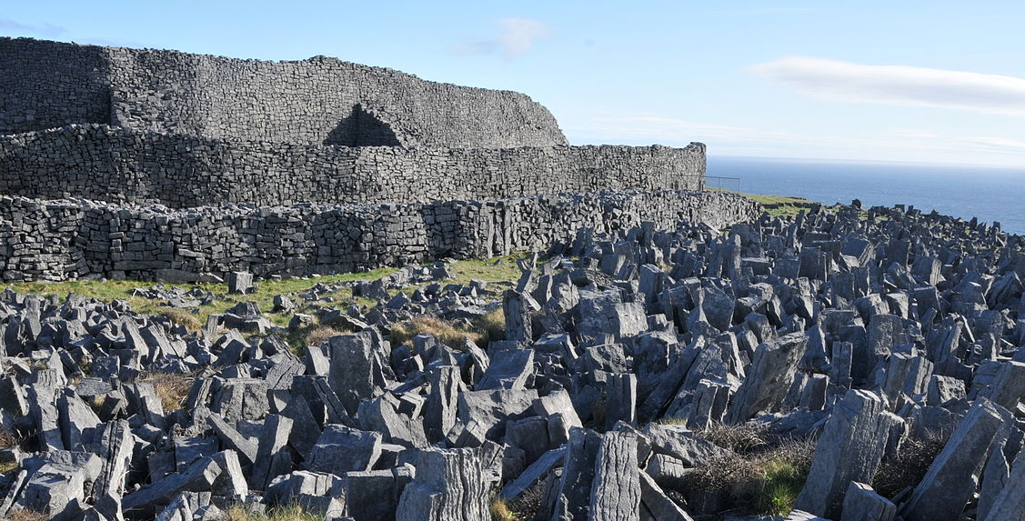
Aran islands
Archipelago of three small islands, largest Inis Mór – 12 by 3 kilometres
Unfertile, rocky → digging dirt from cracks & composting seaweed (greenery to lifeless rock)
Stone forts of Aengus & of Aonghasa, stone walls crisscross islands (1,600 kilometres, livestock)
Scattered with early clocháns (dry-stone beehive huts from the early-Christian period)
Fort of Aengus
Fort of Aonghasa

Slide 9
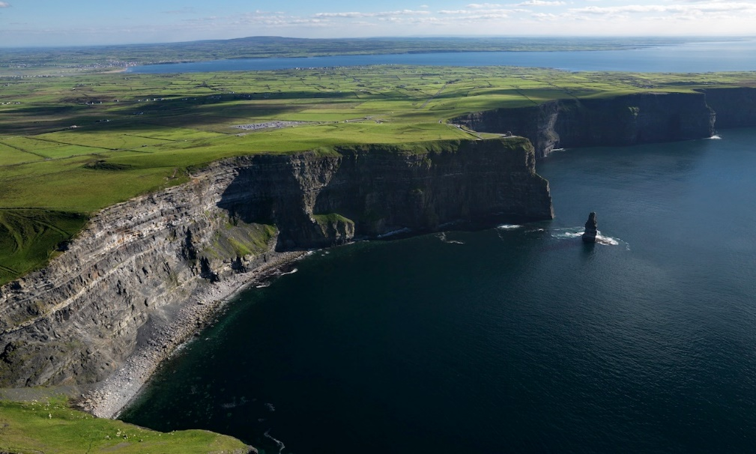
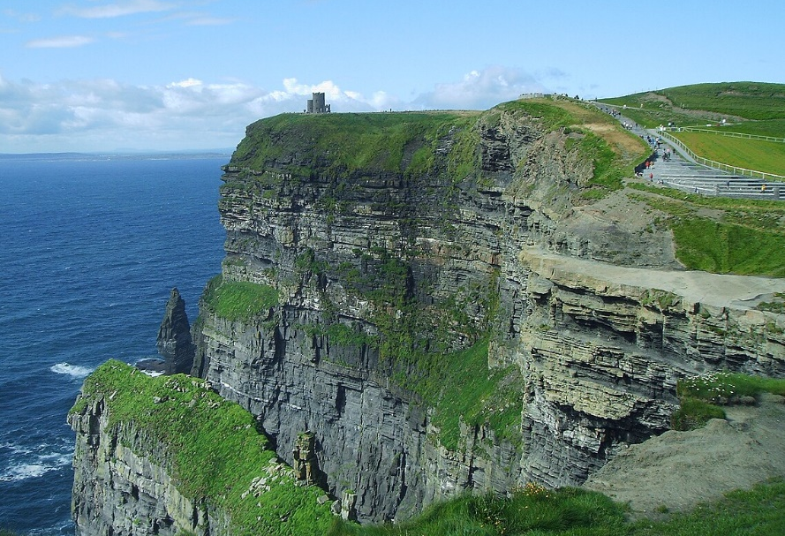
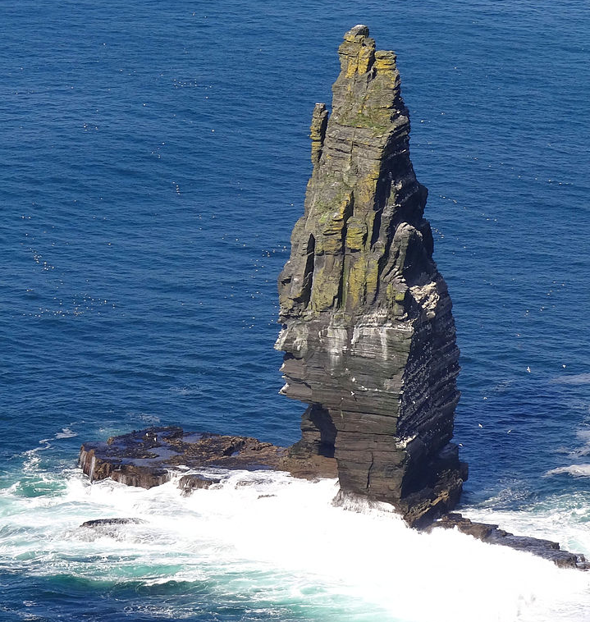
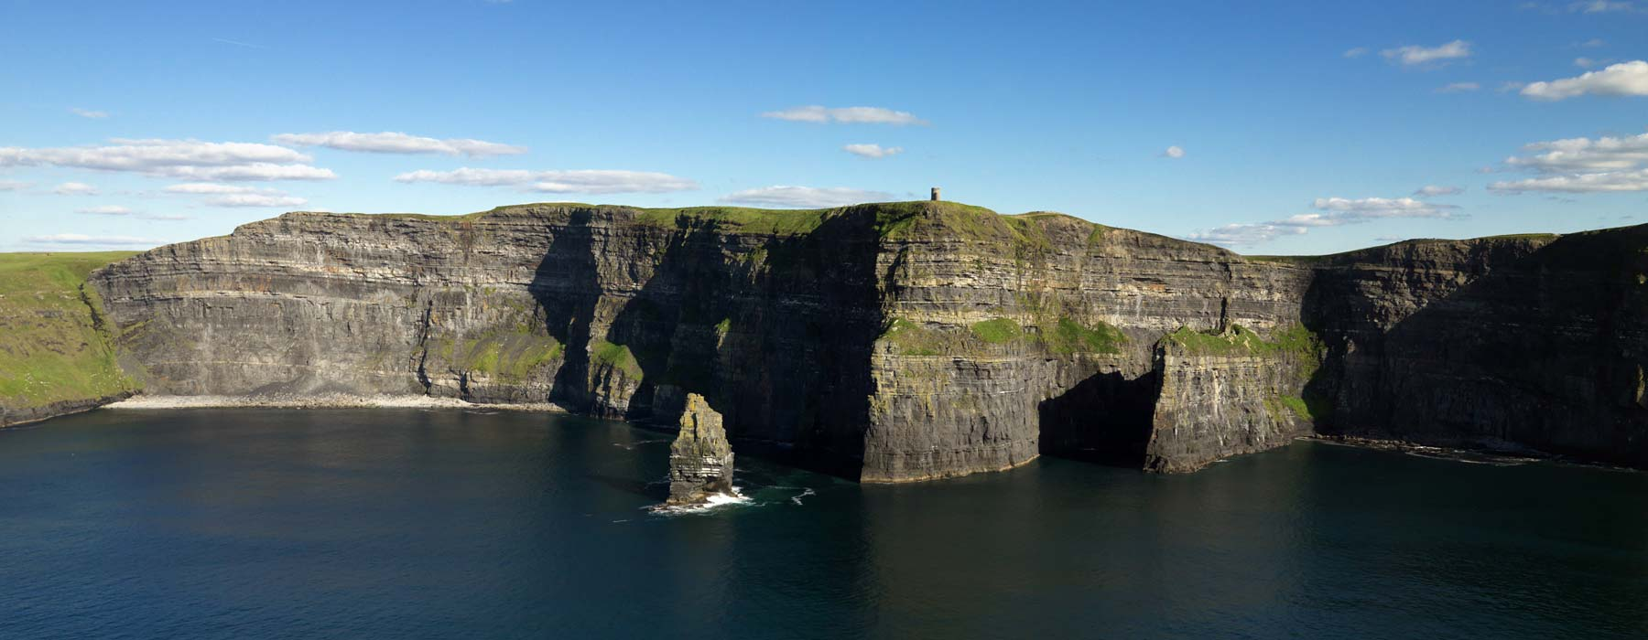
Cliffs of moher

Slide 10
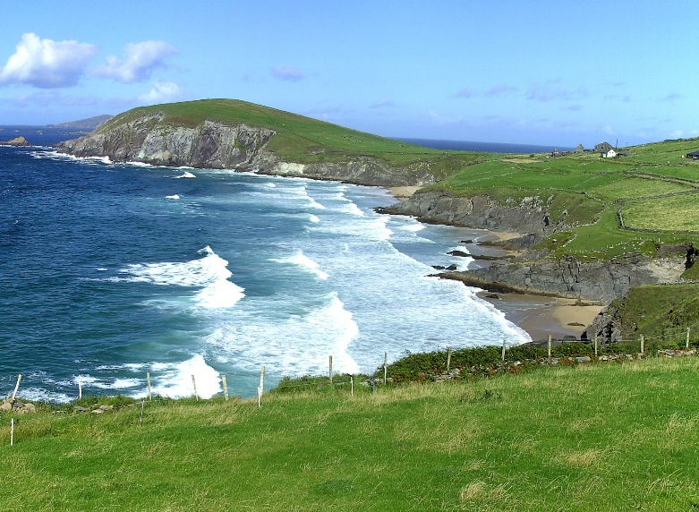
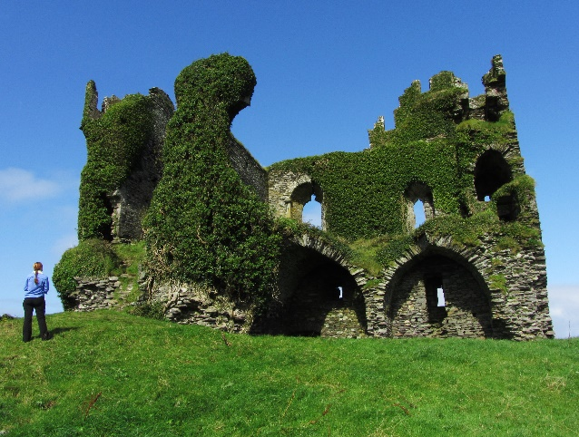
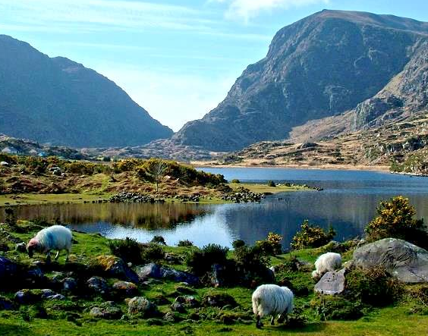




Ring of kerry
Typical Irish landscape with stunning scenery
Dramatic coastline, windswept cliffs, unspoilt beaches, blue lakes, green hills, rich flora & fauna
Ancient monuments, romantic castles, outstanding gardens, colourful towns & villages

Slide 11





Blarney castle
Originally timber house, replaced by stone fortification (12 century), destroyed (1440s)
Medieval stronghold (15 century, abandoned in 1690)
Romantic partial ruin, some rooms & battlements accessible
Extensive gardens incl poisonous garden (poisonous plants – mandrake, opium, cannabis)

Slide 12





Unesco world heritage sites
Only two sites
Both of cultural character

Slide 13





Brú na Bóinne (Palace of the Boyne)
Complexes of Megalithic sites (Neolithic period, 35 century BC)
Burial mounds, chamber tombs, standing stones, hedges & other prehistoric enclosures
App 90 recorded monuments & unknown quantity of yet unrecorded sites
  Significant collections of megalithic art; social, economic, religious & funerary functions

Slide 14




Sceilig Mhichíl (Skellig Michael or Great Skellig)
Larger of two Skellig Islands, pyramidal rock (12 km west off the south-west coast)
Monastery on steep sides of rocky island (7 century)

Slide 15
Thank you for attention

