Slide 1
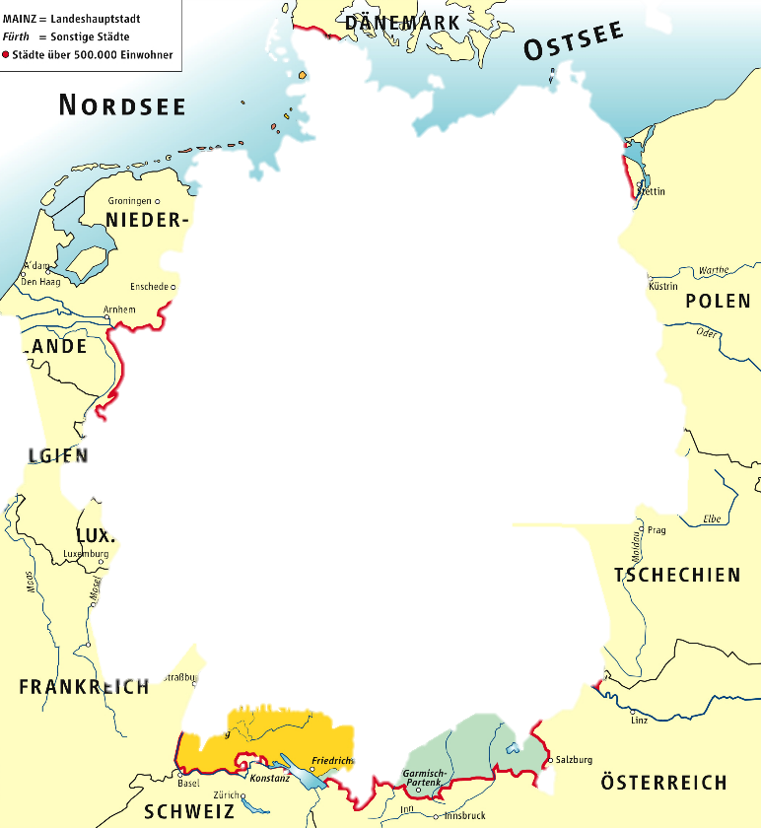
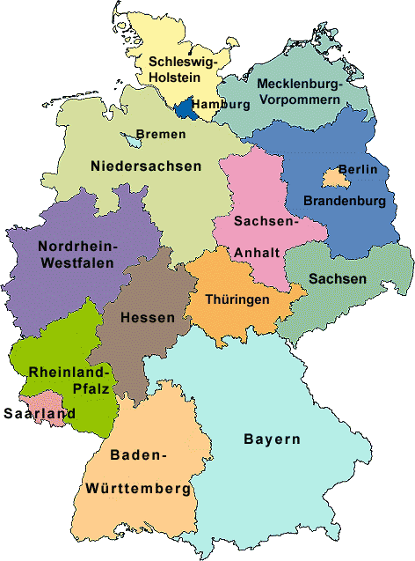
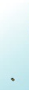
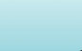
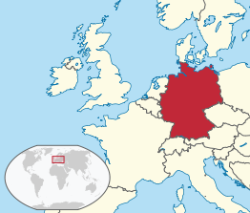
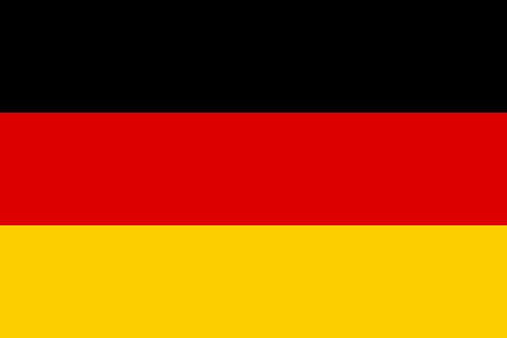
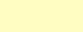

Germany
Deutschland or Bundesrepublik Deutschland
North Sea, Denmark & the Baltic Sea to the north, Poland & the Czech Republic to the east, Austria & Switzerland to the south, France, Luxembourg, Belgium & the Netherlands to the west
357,000 km², 81 million people
Berlin
16 states (Bundesländer), three of them are city-states, i.e. Berlin, Bremen & Hamburg
31.5 million foreign tourists

Slide 2
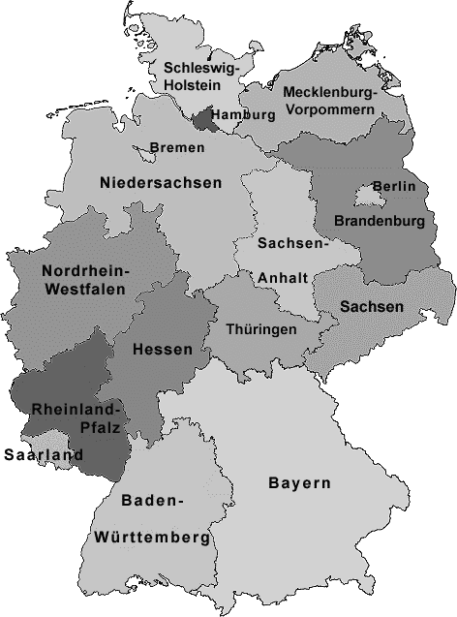
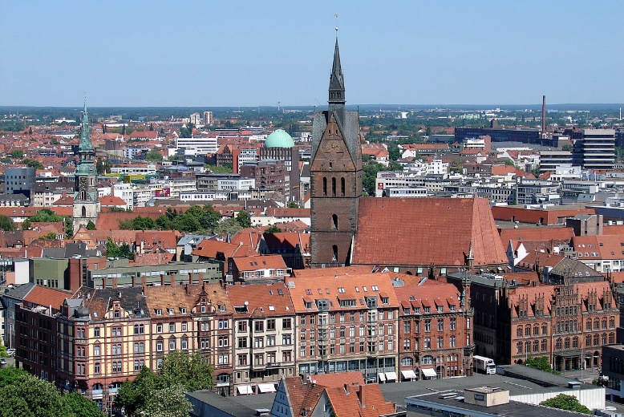
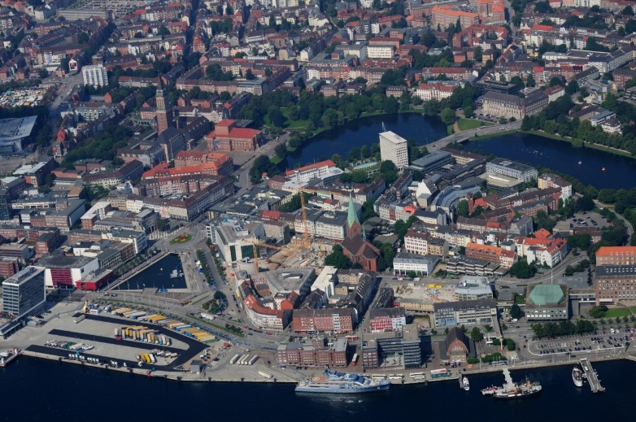
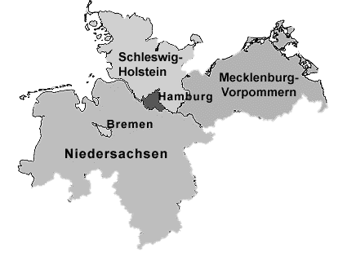
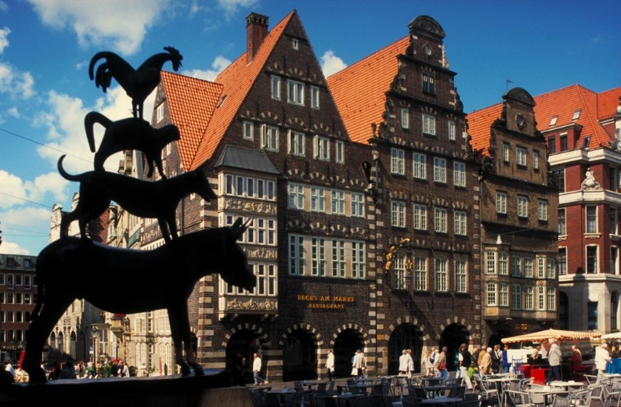
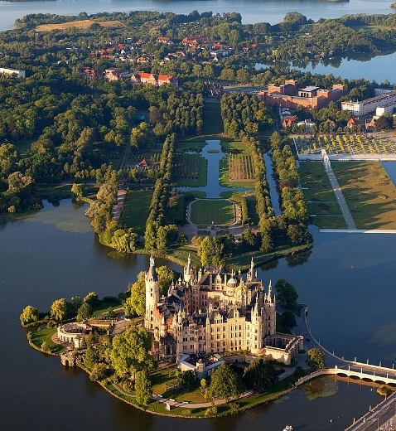
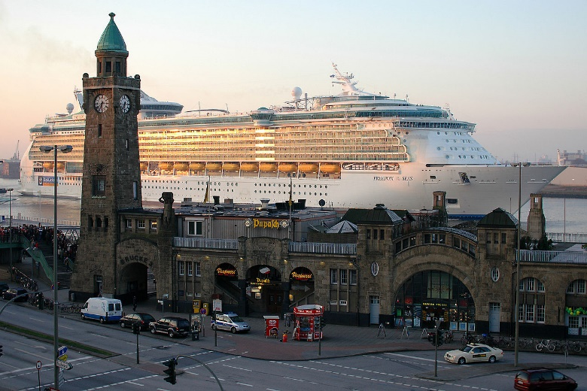
Northern Germany
Lower Saxony (Niedersachsen, Hanover), Schleswig-Holstein (Kiel), Mecklenburg-Western Pomerania (Mecklenburg-Vorpommern, Schwerin), Bremen & Hamburg
Flat landscape of North German Plain, hills & coastline of the North & Baltic Sea (Ostseeküste) & islands (Rügen & Usedom)
Hanover
Kiel
Bremen
Schwerin
Hamburg

Slide 3
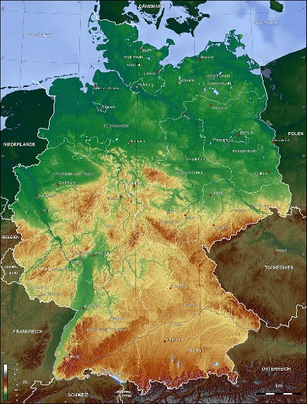
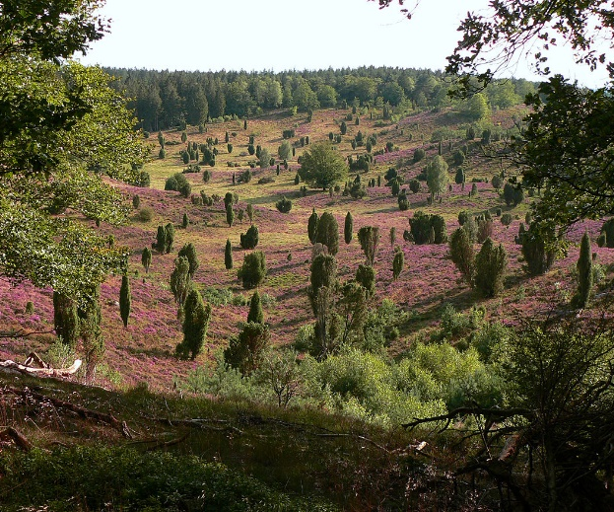
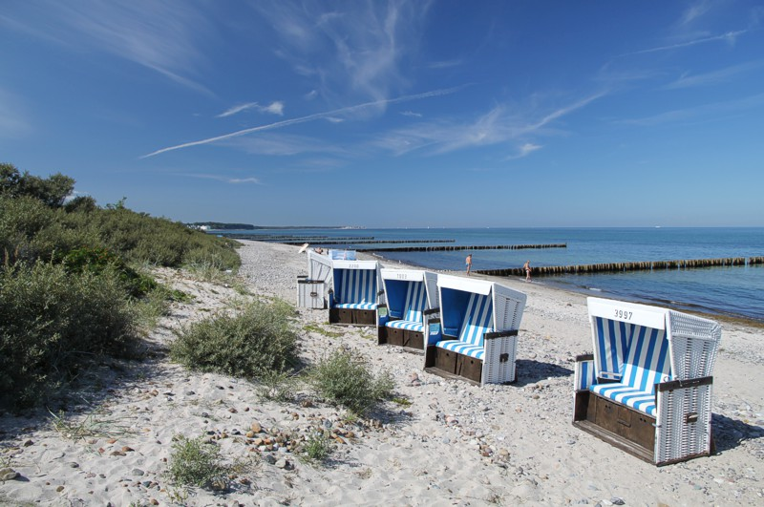
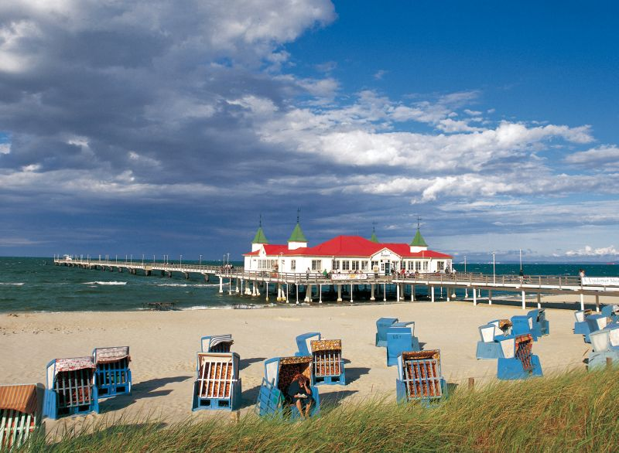
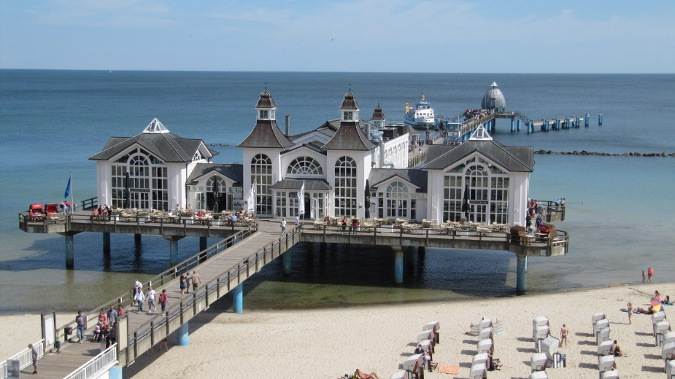
Northern Germany
Lower Saxony (Niedersachsen, Hanover), Schleswig-Holstein (Kiel), Mecklenburg-Western Pomerania (Mecklenburg-Vorpommern, Schwerin), Bremen & Hamburg
Flat landscape of North German Plain, hills & coastline of the North & Baltic Sea (Ostseeküste) & islands (Rügen & Usedom)
Lower Saxony
Ostseeküste
Usedom
Rügen

Slide 4
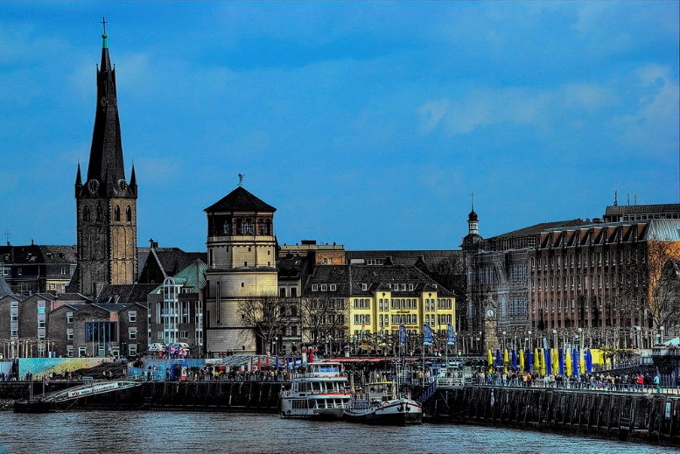
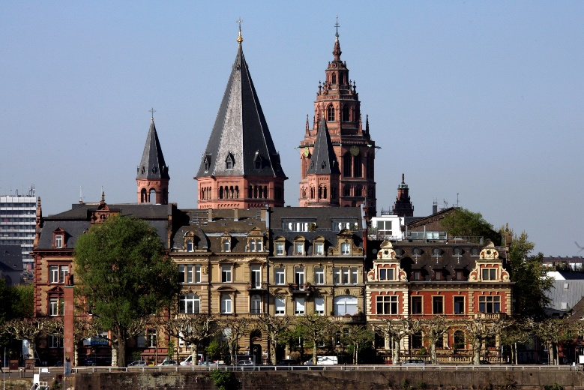
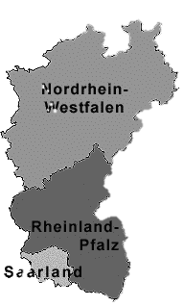
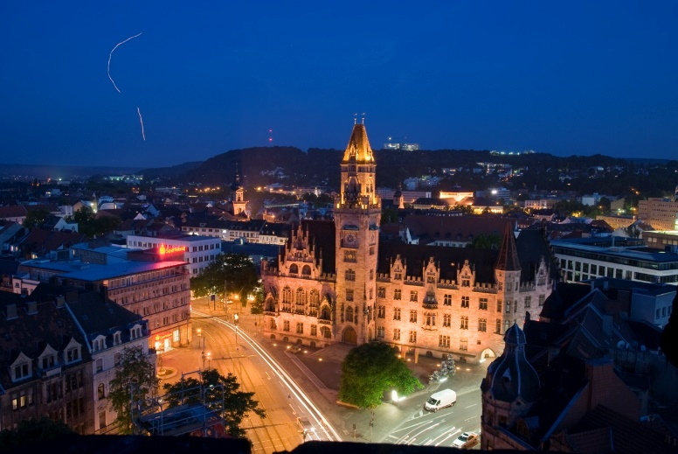
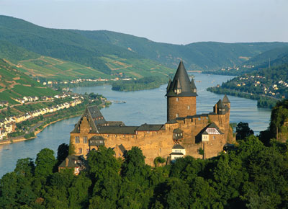
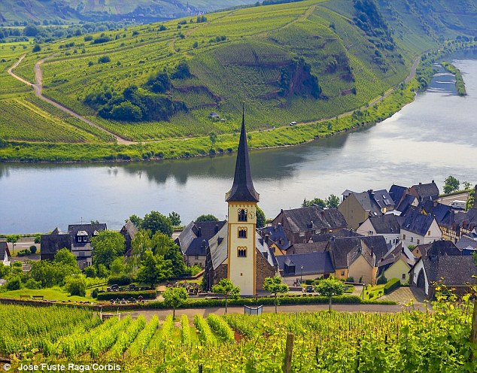
Western Germany
North Rhine-Westphalia (Nordrhein-Westfalen, Düsseldorf), Rhineland-Palatinate (Rheinland-Pfalz, Mainz) & Saarland (Saarbrücken)
Rhine Valley & Moselle Valley (wine country & fruit growing)
Düsseldorf
Mainz
Saarbrücken
Rhine Valley
Moselle Valley

Slide 5
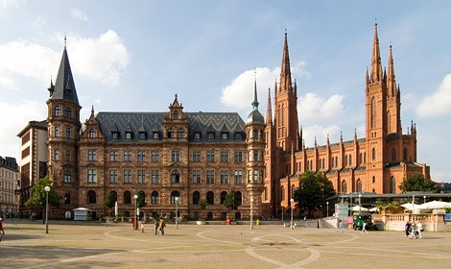
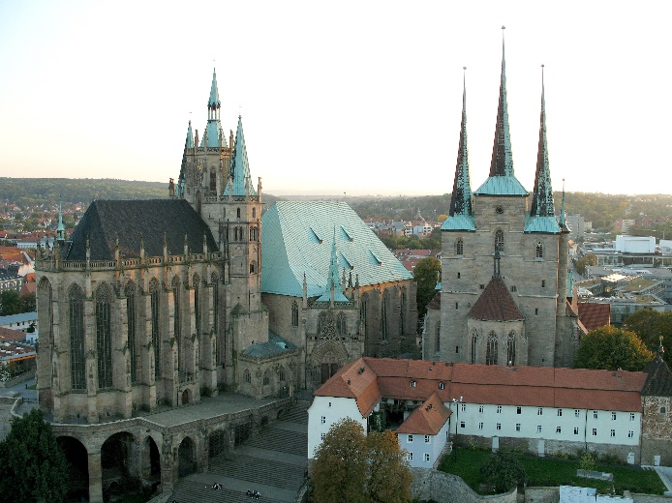
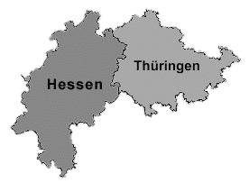
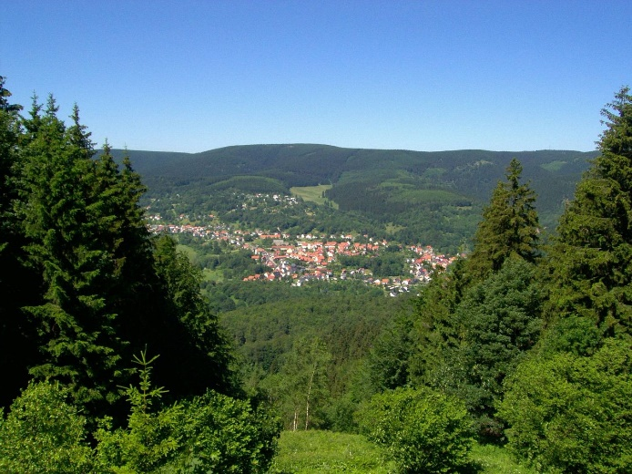
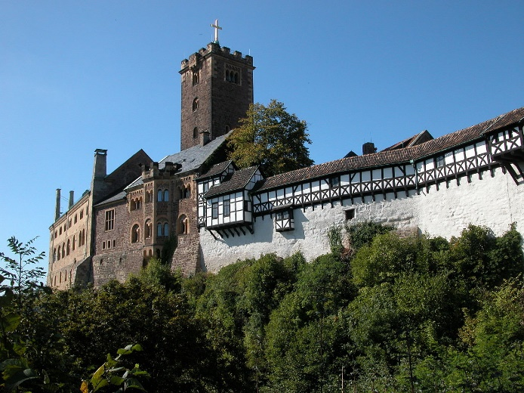
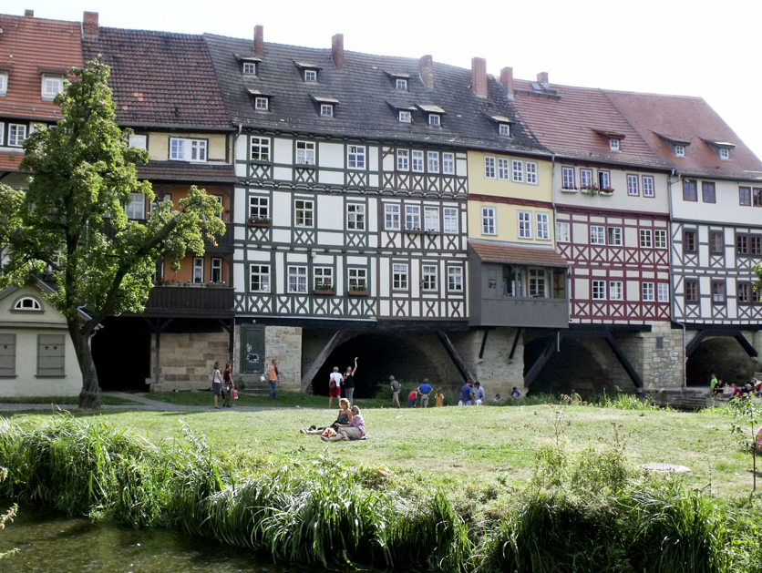
Central Germany
Hesse (Hessen, Wiesbaden) & Thuringia (Thüringen, Erfurt)
Hilly rural areas (green heart of Germany, fields & forests), ancient Thuringian Forest (range of rounded mountains), Großer Beerberg (982 metres) & Wartburg Castle
Wiesbaden
Erfurt
Erfurt

Slide 6
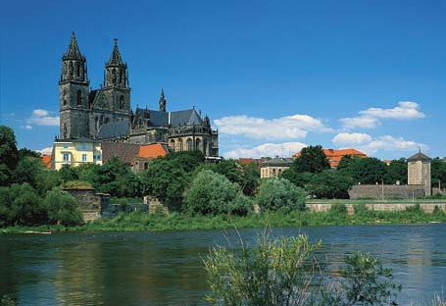
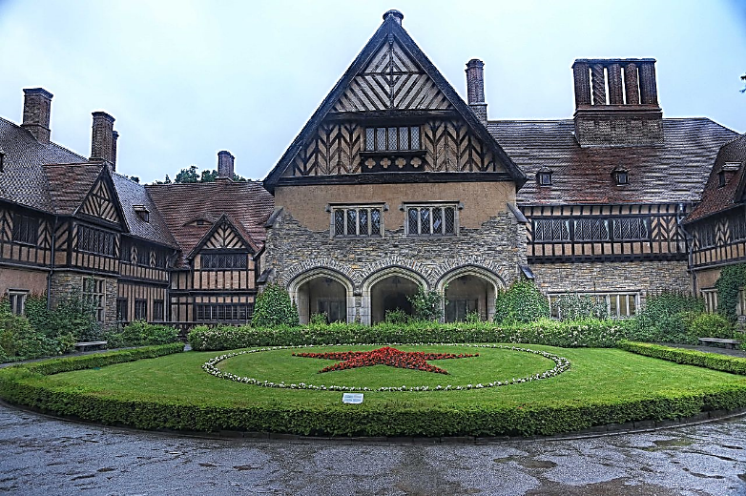
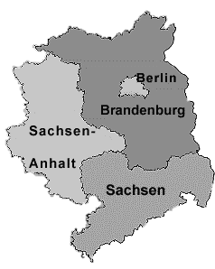
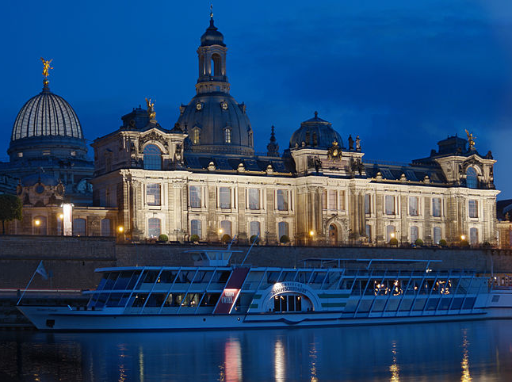
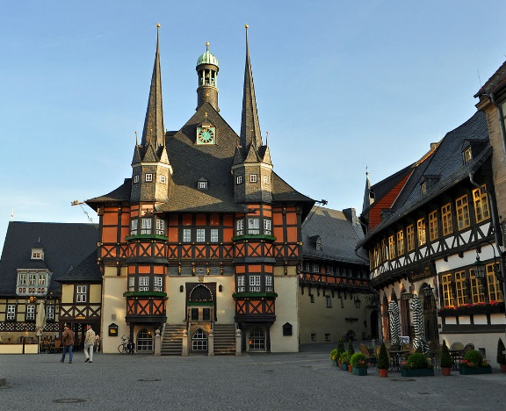
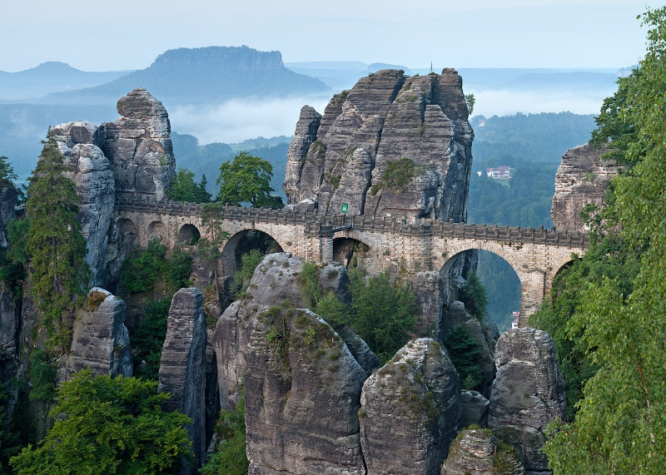
Eastern Germany
Saxony-Anhalt (Sachsen-Anhalt, Magdeburg), Brandenburg (Potsdam), Saxony (Sachsen, Dresden) & Berlin
Harz (low mountain range famous for historic silver mines), Saxon Switzerland
Magdeburg
Cecilienhof (Potsdam Conference)
Dresden
Saxon Switzerland
Wernigerode

Slide 7
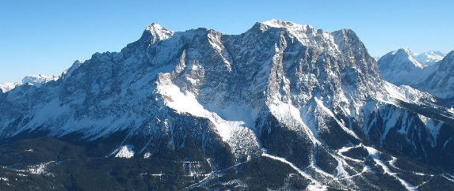
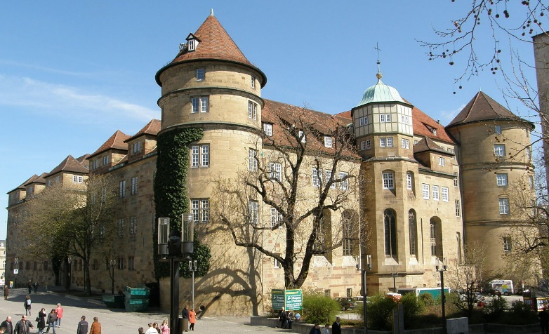
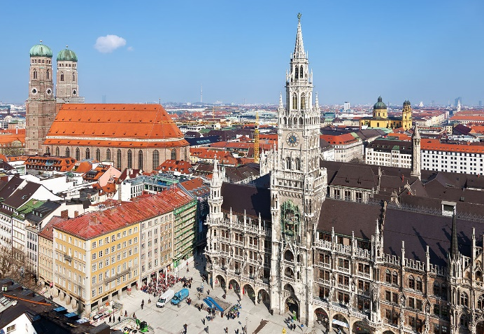
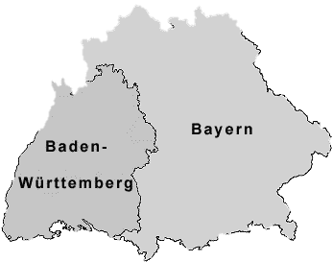
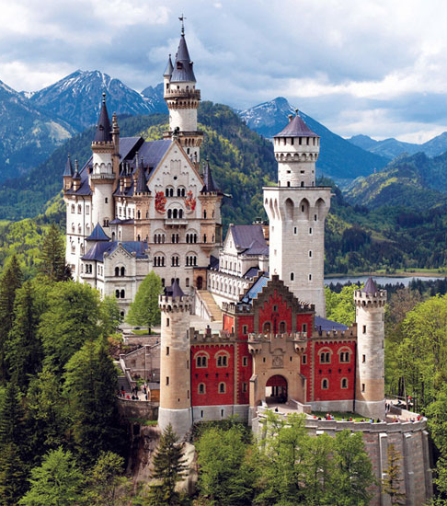
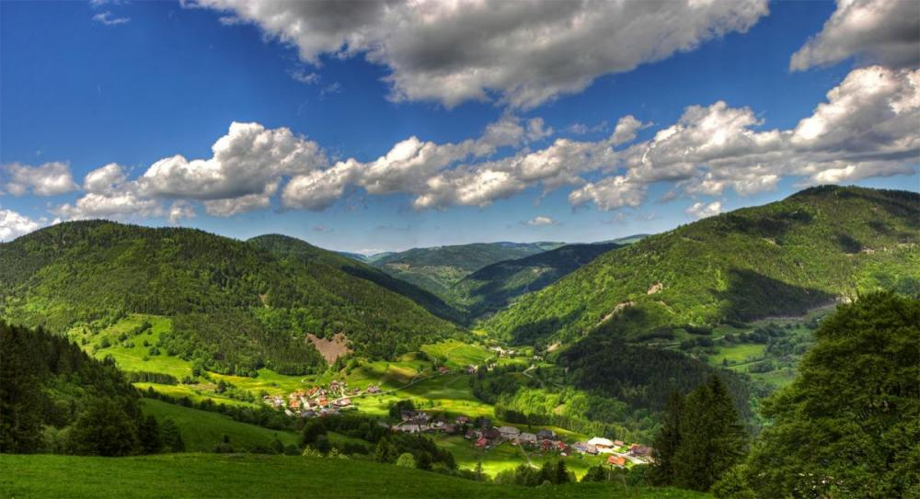
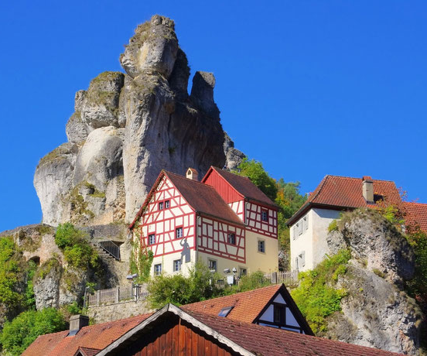
Southern Germany
Baden-Württemberg (Stuttgart) & Bavaria (Bayern, Munich)
Black Forest (Schwarzwald), Franconian Switzerland (Fränkische Schweiz), Franconian Lake District, Bavarian Forest, Bavarian Alps (Bayerische Alpen, Zugspitze 2,962 m) & Lake Constance (Bodensee), Neuschwanstein Castle (19c, Neo-Romanesque)
Stuttgart
Munich
Fränkische Schweiz
Schwarzwald

Slide 8
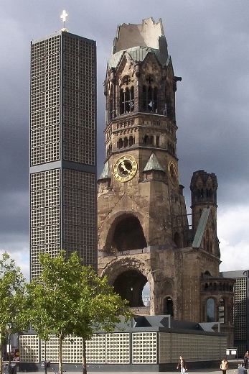
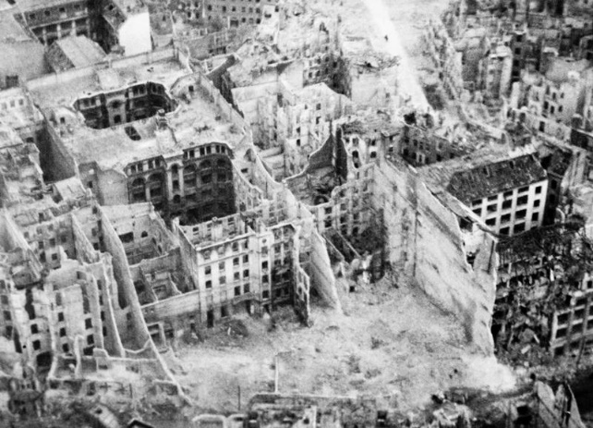
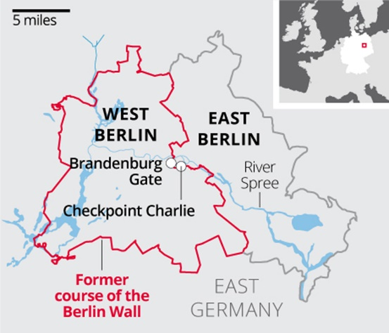
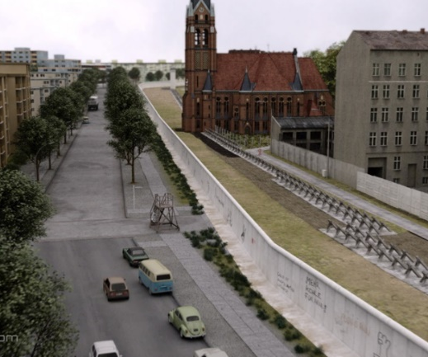
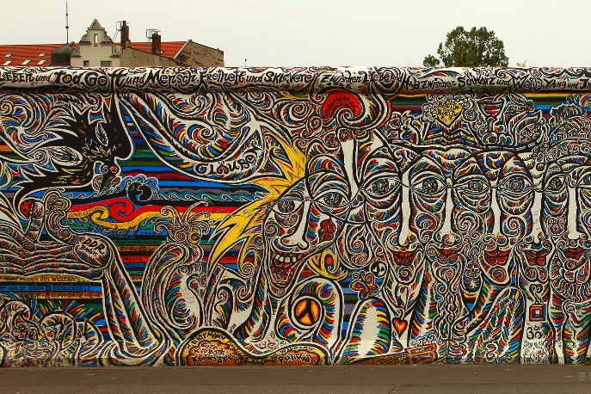
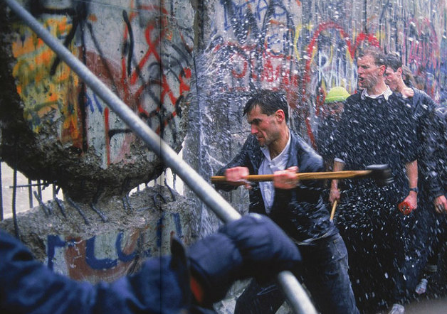

Berlin
Banks of rivers Spree & Havel (crossing of two important historic trade routes, first documented in 13c)
Capital of Brandenburg, Kingdom of Prussia, German Empire, Weimar Republic & Third Reich
Large parts destroyed in 1943-45 air raids & during Battle of Berlin
After War – East Berlin & West Berlin (West German exclave, Berlin Wall, 1961–1989, 1990 reunification )
Kaiser Wilhelm Memorial

Slide 9




Berlin
City Hall (Rotes Rathaus, 1860s)
Brandenburg Gate (18c triumphal arch)
Reichstag (seat of Parliament)
Charlottenburg Palace (17c, extensive gardens)

Slide 10






Berlin
Unter den Linden
  Embassies (British, Hungarian, or Russian)
  State Opera, Cathedral of Saint Hedwig, Humboldt University
  Palace Bridge (Schlossbrücke, connects Unter den Linden with Museum Island)

Slide 11







Dresden
Home to many Saxon princes & kings (many buildings & art collections testify to their extreme wealth)
¾ of historical centre destroyed by allied bombing in 1945
Church of Our Lady (Frauenkirche) – severely damaged, remained in ruins for many years
Topped with gold cupola donated from the UK, historic centre was also rebuilt
Fürstenzug

Slide 12







Nuremberg
Typical German city
Old Town (restored after bombing)
Imperial Castle (Kaiserburg) – important residence of Holy Roman Emperors
Documentation Centre & Courtroom 600 (venue of Nuremberg Trials)

Slide 13




Unesco world heritage sites
49 cultural sites, three natural sites
One transboundary with Denmark & Netherlands, one with Poland, one with UK, one with Slovakia & Ukraine, one with Austria, France, Italy, Slovenia & Switzerland

Slide 14








Wadden sea
Largest unbroken system of intertidal sand & mud flats in the world (10,000 km²)
Between north-western coast of Europe & Frisian Islands (Wadden Sea Islands)
From Den Helder (Netherlands), past river estuaries (Germany) to Skallingen (Denmark), 500 km
Shallow body of water with tidal flats and wetlands, rich in biodiversity & transitional habitats
Tidal channels, sandy shoals, sea-grass meadows, mussel beds, mudflats, marshes, beaches, dunes
Numerous plant & animal species (seals, harbour porpoise, migratory birds)

Slide 15






Historic Centres of Stralsund and Wismar
On Baltic coast, founded in 13c, major trading centres of Hanseatic League in 14-15c
17 & 18c – became Swedish administrative & defensive centres for German territories
Buildings of Brick Gothic – using fired brick (bricks shaped in different decorative forms)
Stralsund – several brick cathedrals, Town Hall, houses for residential, commercial & crafts use
Wismar – preserved medieval harbour basin
Stralsund
Wismar

Slide 16







Hanseatic City of Lübeck
Leading city of Hanseatic League (commercial & defensive confederation of merchant guilds & their market towns that hold monopoly over trade of Baltic & North Sea), founded in 12c & prospered until 16c
Old Town – medieval appearance with old buildings & narrow streets
Cathedral (13c), Church of Virgin Mary (Marienkirche, 13c), Hospital of the Holy Spirit (Heilig-Geist-Hospital, 13c), Holstentor & Burgtor (15c), Salzspeicher (salt stored before shipment to Baltic ports, 16-18c)
Saint Mary
Town Hall
Hospital
Holstentor

Slide 17






Speicherstadt and Kontorhaus District with Chilehaus
Two urban areas in the centre of port city of Hamburg
Speicherstadt – on group of narrow islands in the Elbe (1885-1927, historic ensemble of port warehouses)
15 huge warehouse blocks, ancillary buildings & connecting network of streets, canals & bridges
Kontorhaus district – 8 very large office complexes (1920s-1940s, to house port-related businesses)
Modernist Chilehaus office building – one of most outstanding complexes within the district
Kontorhaus

Slide 18





Town Hall and Roland on the Marketplace of Bremen
Old Town Hall – Gothic style, 15c (after Bremen joined Hanseatic League)
Large windows, high gable, decoration of facade (17c, statues representing emperor & prince electors)
Ground floor – one large hall with oak pillars, upper floor – main festivity hall, underground –wine cellar (one hall with stone pillars)
Statue of Roland – symbol of market rights & privileges of free, imperial city of Bremen (5.5 m, 1404)

Slide 19






Pergamon
Museumsinsel (Museum Island), Berlin
Five museums on Museum Island (1824-1930, collections trace development of civilizations through ages)
Old Museum (Altes Museum, collections of antiquities), New Museum (Neues Museum, Egyptian, Prehistory & Early History, bust of Nefertiti, 2009), Old National Gallery (Alte Nationgalerie), Bode Museum (sculptures, late Antique & Byzantine art), Pergamon Museum (reconstructed monumental buildings – Pergamon Altar, Market Gate of Miletus, Ishtar Gate of Babylon)
Bode
Pergamon Altar
Galery
Markttor Milet

Slide 20







Berlin Modernism Housing Estates
Siedlungen - 6 housing estates, testify innovative housing policies (Weimar Republic – 1910-1933)
Building reform movement (to improve housing & living conditions for people with low incomes)
Novel approaches to town planning, architecture & garden design (technical & aesthetic innovations)
Tuschkastensiedlung (Paintbox Estate), Siedlung Schillerpark, Hufeisensiedlung (Horseshoe Estate), Wohnstadt Carl Legien, Weiße Stadt (White City), Ringsiedlung (Ring Estate)
Paintbox
Schillerpark
Horseshoe
White City
Ring Estate
Carl Legien
Ring Estate

Slide 21








Palaces and Parks of Potsdam & Berlin
Potsdam to Berlin-Zehlendorf, 5 km² of parks & 150 buildings (banks of River Havel & Lake Glienicke), region of rivers, lakes, & hills, ensemble of architecture & landscape gardening, 1730-1916
Potsdam – residence of Prussian kings (1918), New Garden, Park of Babelsberg & other grounds
Sanssouci, New & Linstedt Palace, Charlottenhof, Alexandrowka (Russian colony), Bornstedt (artificial Italian village), Klein-Glienicke (artificial Swiss village), etc.
New Garden
Park Babelsberg
Babelsberg Palace
Sanssousi
Cecilienhof Palace
Charlottenhof Palace &Park

Slide 22






.
Muskauer Park / Park Muzakowski
Extensive landscape park, Lusatian Neisse valley (5.6 km², border between Poland & Germany, 1815-1844)
Blends with surrounding farmed landscape (use of local plants to enrich qualities of existing landscape)
Extends into town of Muskau – green passages created urban parks; extraordinary simplicity
Also features reconstructed castle, bridges, forested areas & arboretum

Slide 23








Wittenberg
Luther Memorials in Eisleben and Wittenberg
Places associated with lives of Martin Luther & his fellow-reformer Melanchthon
Wittenberg – Luther’s room & Melanchthon’s house
Castle church (where Luther posted his “95 Theses” in 1517 that launched the Reformation)
Eisleben – house where Luther was born (1483) & died (1546)
Melanchthon’s house
Luther’s house
Wittenberg – Castle church
Luther
Melanchthon

Slide 24







Garden Kingdom of Dessau-Wörlitz
Landscape design & planning of Enlightenment (18 century)
English landscaped parks & gardens, modified areas of agricultural land
Wörlitz, Lusium & Georgium Castles (1770-1780s), Riesigk, Wörlitz & Vockerode Churches (1800s)
Wörlitz
Luisium
Georgium

Slide 25






Collegiate Church, Castle and Old Town of Quedlinburg
Coronation of Henry I (876-936, first German King from Saxonian dynasty) → capital of East Franconian German Empire (“metropolis of the Reich” of first German state), flourishing trading town (Middle Ages)
Originated from castle village & several separate settlements
Town wall (1330), timber-framed medieval buildings, Church of Saint Servatius (basilica floor plan, 11/12c, crypt with cross vaults, capitals, tombs & murals)
Castle & Church

Slide 26








Mines of Rammelsberg, Historic Town of Goslar and Upper Harz Water Management System
Rammelsberg – large mining & metallurgical complex for non-ferrous metals in Europe (silver, copper, lead & tin, existed since ancient times), in continuous use since Middle Ages
Upper Harz mining water management system – developed over 800 years (to help extracting ore)
Complex system of artificial ponds, channels, tunnels & underground drains
Goslar –Hanseatic League, historic centre (perfectly preserved, 1,500 timber-framed houses, 15-19c)

Slide 27








St Mary’s Cathedral and St Michael’s Church at Hildesheim
Benedictine abbey Church of Saint Michael – one of key medieval monuments of art (1010-1020)
Symmetrical plan with two apses (Ottonian Romanesque), wooden ceiling, painted stucco-work, bronze doors & Bernward bronze column (1020, spiral decor – scenes from New Testament)
Cathedral of Saint Mary – rebuilt after 1046 fire, original crypt, nave, bronze doors (1015, events from the book of Genesis & life of Christ)
Saint Michael
Saint Mary

Slide 28


Fagus Factory in Alfeld
Ten-building complex, built around 1910, design of Walter Gropius
Serves all stages of manufacture, storage & dispatch used by shoe industry (still operational)
Innovative use of walls of vast glass panels combined with reduced load-bearing structure

Slide 29






Carolingian Westwork and Civitas Corvey
Imperial Abbey of Corvey – Benedictine abbey (840s-1792, dissolved, converted into prince-bishopric)
1803 – secularised → some buildings rebuilt into palace, abbey church rebuilt Baroque
Westwork (west front) of abbey – two bare-stone towers (only standing structure from Carolingian era, fortified monastery district – preserved as archaeological remains)

Slide 30







Bergpark Wilhelmshöhe
Landscape park in Kassel (2.4 km² – largest European hillside park, started 1696 & took about 150 years)
Baroque style of French garden, later re-arranged into English landscape park
Stretches up to Karlsberg Mountain, Hercules monument on the top, water runs down in 350-m long Grand Cascade (from Hercules monument to Wilhelmshöhe Castle)
System of channels & waterways feeds series of waterfalls, rapids, Grand Fountain, lake & ponds

Slide 31






Wartburg Castle
Fortress of the Landgraves of Thuringia
Hovering app 400 metres above countryside, forest surroundings, in many ways “the ideal castle”
Some original sections & ornamentation from 12c, current appearance – 19c reconstructions
Symbol of the nation past & present

Slide 32







Dowager Palace
Classical Weimar
18/19c – attracted many writers & scholars (Goethe & Schiller) → remarkable cultural flowering →
Reflected in high quality of many buildings & parks in the surrounding area
12 buildings & ensembles – landscape Park on the Ilm + Roman House, Goethe House & Garden, Church of Saints Peter and Paul (Herderkirche, 1525), Goethe House & Schiller House (1700s), Dowager’s Palace, Duchess Anna Amalia Library (over mil books, 2,000 medieval & early modern manuscripts), Belvedere Castle & Park (Orangery), Ettersburg Castle & Park, Tiefurt Castle & Park, Historic Cemetery with Princes’ Tomb (burial chapel Fürstengruft) & tombs of Goethe & Schiller
Schiller’s house
Goethe garden house
Roman house
Belvedere
Fürstengruft

Slide 33






Bauhaus and its Sites in Weimar and Dessau
1919-1933 – Bauhaus School (based first in Weimar, then in Dessau) – new architectural & aesthetic concepts & practices
Professors (Gropius, Meyer, Moholy-Nagy & Kandinsky) – Modern Movement (shaped architecture of 20c, new materials – reinforced concrete, glass, steel + methods – skeleton construction, glass facades)
Former Art School, Applied Art School & Haus am Horn (Weimar), Bauhaus Building & 7 Masters Houses (Dessau)

Slide 34




Zollverein Coal Mine Industrial Complex in Essen
Complete infrastructure of historical coal-mining site + some 20c buildings
Evidence of evolution & decline of industry over past 150 years

Slide 35









Cologne Cathedral
1248-1880, in several stages, kept absolute fidelity to original plans
High Gothic five-aisled basilica (144.5 metre long), prominent transept (87 m wide) & tower (157 m)
High altar, carved oak choir stalls (1300s), painted choir screens (1330s), 14 statues on pillars in choir (1300), stained-glass windows, tombs 12 archbishops (976-1612)
Gero Crucifix (10c) in Chapel of the Holy Cross & Shrine of the Magi (largest reliquary in Europe)

Slide 36






Castles of Augustusburg and Falkenlust at Brühl
Augustusburg – built by Clemens August of Bavaria, Prince-Elector & archbishop of Cologne (1725, on foundations of medieval castle)
3 brick wings (rough-cast rendering) & 2 adjoining orangeries (south oratory, north service buildings)
Large English park & ornamental garden (flowerbeds, 4 fountains, Mirror Pool with fountain & cascade)
Falkenlust hunting lodge – small rural building
Augustusburg
Falkenlust

Slide 37








Aachen Cathedral
Palatine Chapel of the Emperor Charlemagne – core of Cathedral (octagonal plan roofed with cupola, 790-815, Charlemagne buried – 814)
Gothic choir & series of chapels added (marble columns , bronze doors, mosaic, open-arched windows)
Cathedral Treasury – Cross of Lothar (1000, from gold, inlaid with precious stones), reliquary-bust of Charlemagne (silver & gold), sarcophagus containing the body of Charlemagne (marble)

Slide 38







Upper Middle Rhine Valley
65 km long stretch of Middle Rhine Valley with castles, historic towns & terraced vineyards
Associated with history & legend, strong influence on writers, artists & composers
Important trade route since prehistoric times, string of small settlements along the banks
Increasing wealth → core region of Holy Roman Empire → many castles bulit → Thirty Years’ War → many in ruins (40 hill top castles & fortresses, Burg Katz, Stolzenfels, Marksburg, Rheinstein, Stahleck)
Gutenfels
Stahleck
Rheinstein
Pfalzgrafenstein
Kaub
Stolzenfels
Marksburg
Bacharach

Slide 39









Roman Monuments, Cathedral of St Peter and Church of Our Lady in Trier
Roman colony on Moselle River (from 1c), great trading centre, one of capitals of Tetrarchy (3c)
Seat of prefects of Gaul, Germania, Britannia & Hispania, seat of vice-emperor of Western Empire
1 & 2c – Moselle Bridge, Barbara Baths, Porta Nigra (fortification & palace → two-storey church – 11c)
4c – Imperial Baths, Aula Palatina (Basilica of Constantine, 70 m long throne hall of Emperor Constantine)
Cathedral of Saint Peter (4c, when Constantine made Christianity tolerated & supported religion in his Empire, unites elements of all the periods – classical, medieval & modern times, relic of the Holy Robe of Jesus said to be worn at his crucifixion), Church of Our Lady (Liebfrauenkirche, 13c)
Römerbrücke
Porta Nigra
Imperial Baths
Constantine Basilica
Cathedral
Liebfrauenkirche

Slide 40





Völklingen Ironworks
Symbol of human achievement during First & Second Industrial Revolutions (19 & beg of 20c)
Appearance from 1930s, gone out of production 1986

Slide 41









Messel Pit Fossil Site
Richest site in the world for understanding living environment of the Eocene (57-36 mil years ago)
Discovered through mining activities around 1900, serious scientific excavation started 1970
Area preserved → subject of important paleontological research → unique information about early stages of evolution of mammals (fossils rich in quantity & diversity, over 1000 species of plants & animals – full skeletons, feathers, skin, hair & stomach contents of animals)

Slide 42







Abbey and Altenmünster of Lorsch
Former Imperial Abbey, one of most renowned monasteries of Carolingian Empire
Ruined but among most important pre-Romanesque buildings in Germany
Its chronicle – fundamental document for early medieval German history (in Lorscher Codex, 1170s)
Königshalle or Aula Regia – entrance hall, 9c, sculptures & paintings

Slide 43









Speyer Cathedral
Basilica with four towers & two domes & biggest Romanesque church in the world
Found as flat-ceiling basilica (Conrad II, 1030), rebuilt as first & largest vaulted church in Europe (11c), first with gallery that encircles the whole building, arcades added during renovations
Burial place of German emperors for almost 300 years
Size & richness of sculptures – one of most significant Romanesque monuments in Europe

Slide 44






Maulbronn Monastery Complex
Most complete & best-preserved medieval monastic complex north of the Alps
Cistercian Monastery – 1147, fortified walls, main buildings – 12-16c
Main monastery church (12c), hospital, chapel, refectories, cellar, auditorium, cloisters, hall, forge, bakery, inn & mill (13c), most fortifications (14c)

Slide 45






Würzburg Residence with the Court Gardens and Residence Square
Baroque palace – one of largest & most beautiful in Germany, surrounded by wonderful gardens (under support of prince-bishops Lothar Franz & Friedrich Carl von Schönborn, 18c)
One of most brilliant courts of Europe, sculptors & stucco-workers from Italy, Flanders & Munich

Slide 46








Town of Bamberg
Early medieval plan & many surviving ecclesiastical & secular buildings of medieval period
Henry II, Duke of Bavaria, became King of Germany in 1007 → Bamberg seat of bishopric
Old Town Hall (14c, middle of Regnitz, accessible by two bridges), Cathedral (11c, 4 grand towers), Old Palace (bishop residence, 16-17c), Klein-Venedig (Little Venice, fishermen’s houses, along Regnitz, 19c)
Smoked Rauchbier, 9 breweries, most famous – Schlenkerla (brewery & tavern)
Cathedral
Altes Rathaus
Old Palace
Klein-Venedig

Slide 47




Margravial Opera House Bayreuth
Masterpiece of Baroque theatre architecture (1745-1750)
Court opera house located not within palace but as urban element in public space
Internal layout & design of foyer & stage area incl all original materials & decoration preserved
Bell-shaped auditorium of tiered loges built of wood, lined with decoratively painted canvas

Slide 48






Old town of Regensburg with Stadtamhof
Exceptional example of medieval trading centre (Roman, Romanesque & Gothic buildings)
Meeting place of Imperial Assemblies, seat of Imperial Diet general assemblies (until 19c, remains of 2 imperial Palatine palaces from 9c)
Patrician towers, Old Bridge (12c), Old Chapel (Alte Kapelle, 9c), Lower Monastery (Niedermünster, 9c), Higher Monastery (Obermünster, 1010), Cathedral (Dom, 1275-1634), Church of Saint James (12c), abbey church of Saint Emmeram (13c, 1809 – converted into palace for the prince of Thurn and Taxis)
Saint Emmeram
Old Chapel

Slide 49




Pilgrimage Church of Wies
Alpine valley in Bavaria, oval plan, 1745-1754, architect Dominikus Zimmermann
Pilgrimage church – perfect masterpiece of Bavarian Rococo art
Unique feature – harmony between art & countryside

Slide 50






Monastic Island of Reichenau
Lake Constance, preserves traces of Benedictine monastery (724)
Centre of remarkable spiritual, intellectual & artistic influence
Churches of Virgin Mary and Marcus, of Saints Peter and Paul, of Saint George (9-11c, elements of Carolingian, Ottonian & Salian architecture)
Monumental Ottonian murals of miracles of Christ in Saint George (10c)
St Peter & Paul
Saint George
Virgin Mary & Marcus

Slide 51







Frontiers of the roman empire
2 century AD to defend Roman Empire from the ‘barbarians’
Limes Romanus – 5,000 km (from the Atlantic across Europe to Black Sea, Red Sea & across North Africa)
Saalburg Roman Fortress near Bad Homburg
Remnants of walls, ditches, forts, fortresses, watchtowers & civilian settlements
118 km long Hadrian’s Wall (Hadrian, 122 AD), 60 km long Antonine’s Wall (Antonius Pius, 142 AD)
Antonine
Hadrianic

Slide 52


Frontiers of the roman empire
Upper Germania-Rhaetian Limes – between the rivers Rhine & Danube (Germania Superior, Rhaetia)
Danube Limes – along the River Danube (Regensburg, Straubing & Passau)
Lower German Limes – along the River Rhine
Danube Limes

Slide 53



Frontiers – the lower german limes

Slide 54



Primeval Beech Forests of the Carpathians and the Ancient Beech Forests of Germany
Outstanding examples of ongoing post-glacial biological & ecological evolution of ecosystems
Pure stands of European beech across variety of environmental conditions (all altitudinal zones from seashore up to forest line in mountains)
Primeval Beech Forests of the Carpathians (293 km² of Slovakian & Ukrainian beech forests)
Ancient Beech Forests of Germany (five forests totalling 44 km²)

Slide 55


Prehistoric Pile dwellings around the Alps
Serial property of 111 small individual sites
Germany 18 sites, Austria (5), France (11), Italy (19), Slovenia (2) & Switzerland (56)
Remains of prehistoric pile-dwelling (stilt house) settlements
Built from around 5000 to 500 BC on the edges of lakes, rivers & wetlands
Well-preserved & culturally rich archaeological sites (study of early agrarian societies in the region)

Slide 56



The architectural works of le corbusier
… an Outstanding Contribution to the Modern Movement
Franco-Swiss architect; 17 projects in different countries (Argentina, Belgium, France, Switzerland, India, Japan)
Stuttgart – Maisons de la Weissenhof-Siedlung (21 bldngs, Mies van der Rohe – in charge of the project)

Slide 57






Caves and ice age art in the Swabian jura
Six caves, southern Germany, used as shelter about 33,000 to 43,000 years ago
Carved statuettes (female, cave lions, mammoths, horses, etc.), musical instruments, tools, etc.

Slide 58







Archaeological border complex of hedeby and the danevirke
Hedeby – remains of trading town – traces of roads, buildings, cemeteries and harbour (Viking Era, 1-2 millennia BC)
Danevirke – line of fortification

Slide 59







Naumburg cathedral
Dom of St Peter and St Paul
1028-1044, Romanesque style; Gothic additions; 16 century – became Protestant
West choir – donor portrait statues of 12 cathedral founders (Stifterfiguren)

Slide 60






Erzgebirge/krušnohoŘí mining region
Serial property, CR 5 sites, Germany 22 sites
Mines, mining landscapes, technical monuments, mining towns, etc.
Lengefeld
Marienberg
Schneeberg
Grünthal

Slide 61






Water management system of augsburg
Augsburg & surrounding area, testimony to importance & history of water management
22 technical-architectural cultural objects – flowing water canals, waterworks, water tower, waterworks, wells & 10 historic hydroelectric power plants

Slide 62



The great spa towns of europe
Serial property of 11 spas
Bad Ems, Baden-Baden, Bad Kissingen
Baden-Baden
Bad Ems
Bad Kissingen

Slide 63








Mathildenhöhe darmstadt
Darmstadt Artists’ Colony – group of Jugendstil artists & buildings in Mathildenhöhe where they lived & worked
1899-1944, Art Nouveau; Josef Maria Olbrich House

Slide 64





sHum sites of speyer, worms and mainz
Serial property – ShUM stands for initials of Hebrew names of Speyer, Worms & Mainz
Speyer Jewry-Court, synagogue, remains of religious school & underground mikveh (ritual bath); Mainz – Old Jewish Cemetery; Worms Synagogue (post-war reconstruction of 12-century synagogue), community hall (Rashi House), 12-century mikveh & Old Jewish Cemetery

Slide 65






Jewish –medieval heritage of erfurt
Old Synagogue, Mikveh & Stone House
Illustrate life of local Jewish community & its coexistence with Christian majority
End of 11 and mid-14 century

Slide 66






Moravian Church Settlements
Four towns in four countries (Denmark, Germany, USA)
Herrnhut
Architectural character based on ideals of the Moravian Church adapted to local conditions
Active congregation present → living Moravian heritage
Vogtshof
Widowʼs House

Slide 67






Schwerin Residence Ensemble
19 c – Grand Duchy of Mecklenburg-Schwerin
38 elements – Residence Palace, manor houses, cultural & sacred buildings
Neo-Renaissance, Neo-Baroque, Neo-Classical with influences from the Italian Renaissance

Slide 68
Thank you for attention

