Slide 1

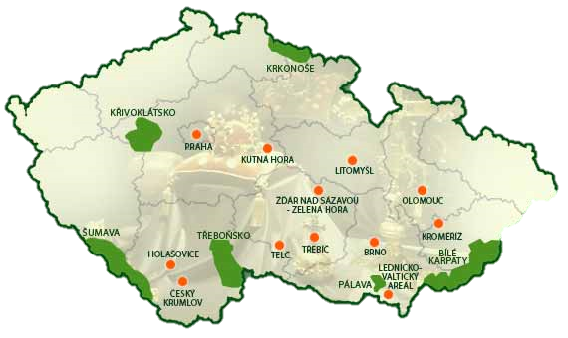

CZECH UNESCO HERITAGE
Praha
Český Krumlov
Telč
Žďár nad Sázavou
Kutná Hora
Lednice-Valtice
Holašovice
Kroměříž
Litomyšl
Olomouc
Brno
Třebíč

Slide 2
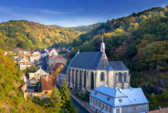
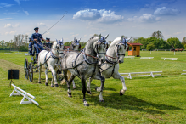
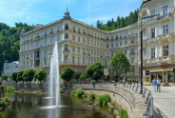
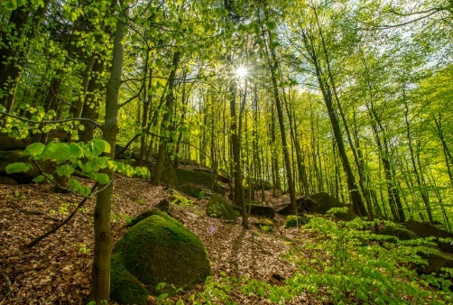
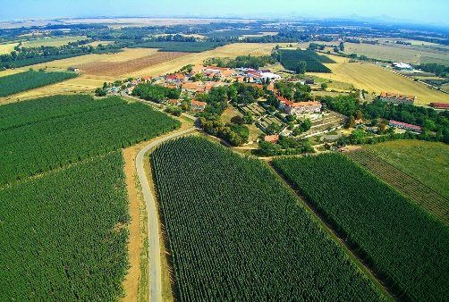
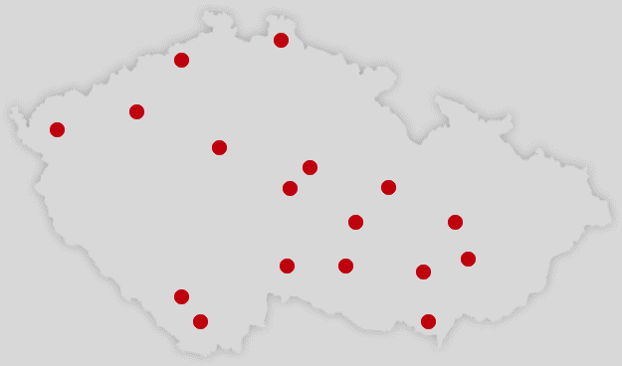
CZECH UNESCO HERITAGE
Erzgebirge
Kladruby
Lázeňská města
Jizerskohorské bučiny
Žatec

Slide 3

About UNESCO
United Nations Educational, Scientific and Cultural Organization
16 November, 1972 – General Conference of UNESCO adopted Convention Concerning the Protection of the World Cultural and Natural Heritage →
List of World Heritage sites
Place of outstanding cultural or natural importance to the common heritage of humanity (forest, mountain, lake, dessert, monument, building, complex, city)
Aim – protection of the sites for the future
1990 – Czechoslovakia joined
2024 – 1,223 sites: 952 cultural, 231 natural, 40 mixed, in 168 states
Italy – 60 inscriptions, China – 59, Germany – 54, France – 53, Spain – 50, India – 43, Mexico – 35
Czech Republic – 17 sites + 9 intangible

Slide 4
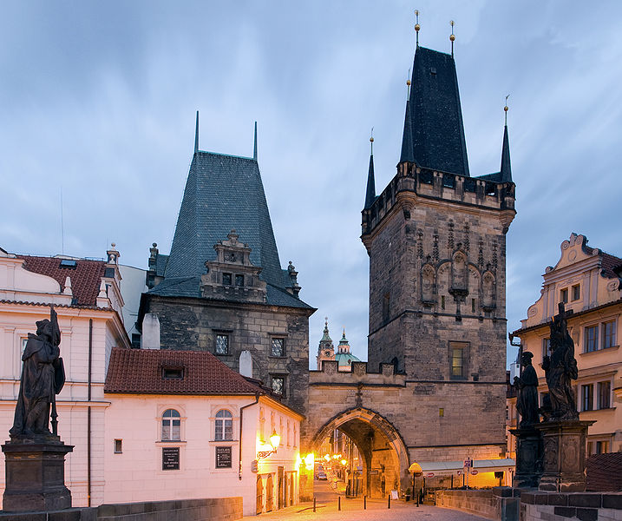
PRAGUE

Slide 5
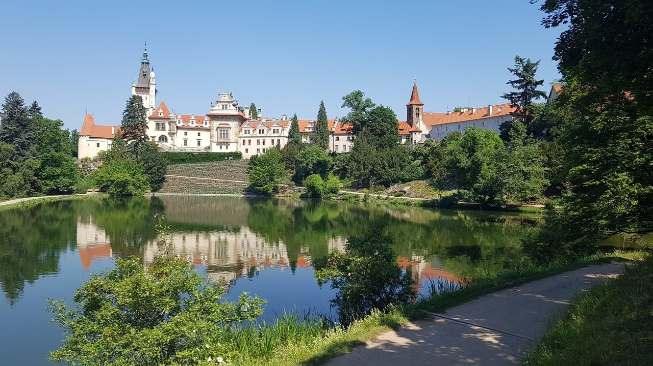
PRŮHONICE

Slide 6
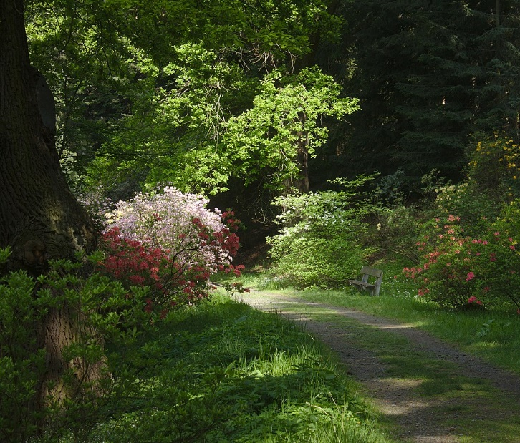
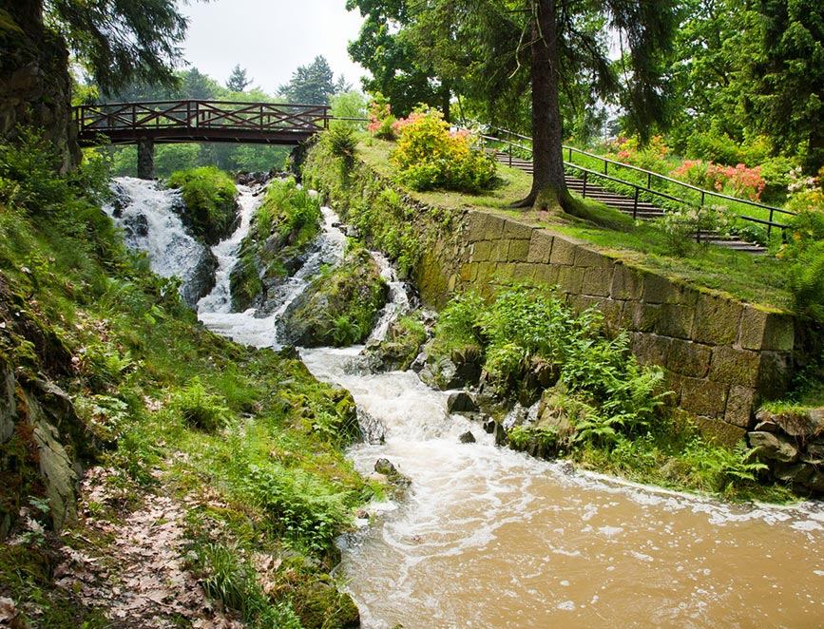
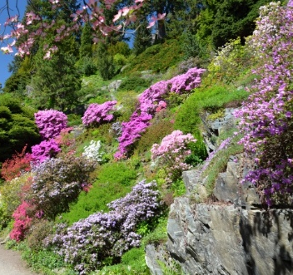
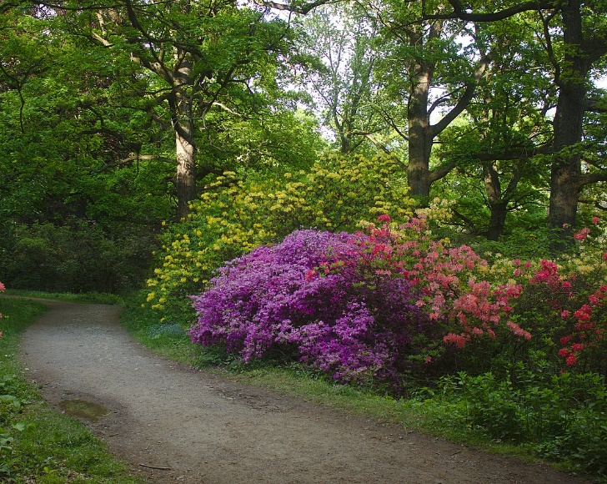
PRŮHONICE
Natural landscape park, valley of the Botič stream
1885, Count Arnošt Emanuel Silva-Tarouca
Significant collection of plants – aesthetic & scientific value
Ponds, forests, woody plants, rhododendrons, azaleas, alpinium; original & new flora

Slide 7
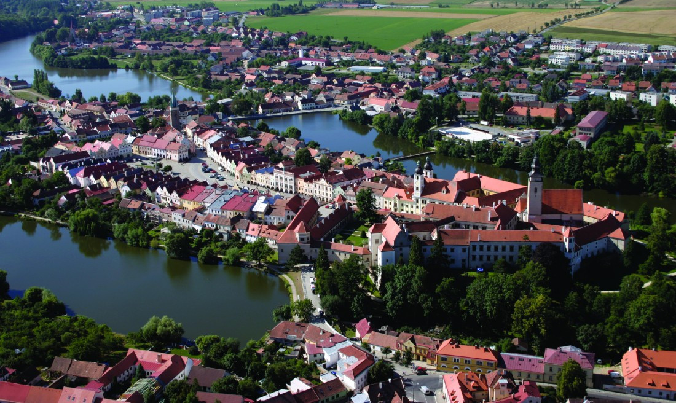
TELČ

Slide 8
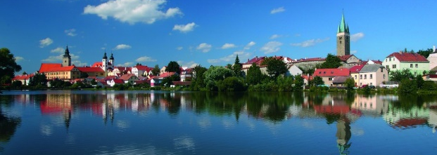
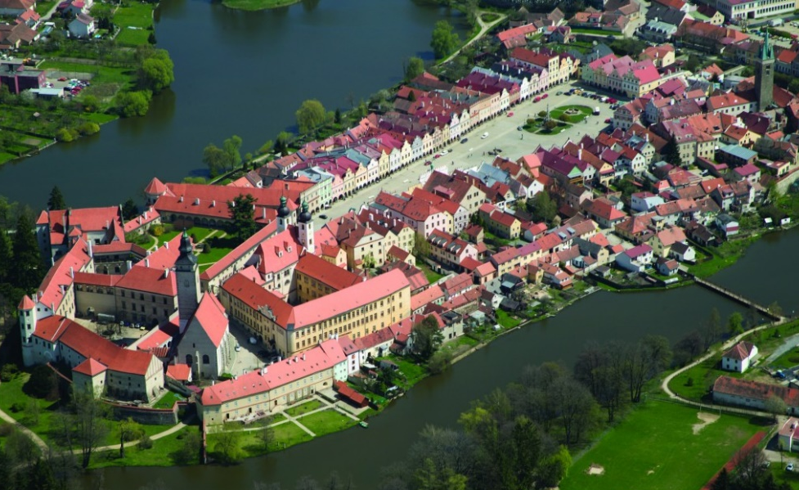
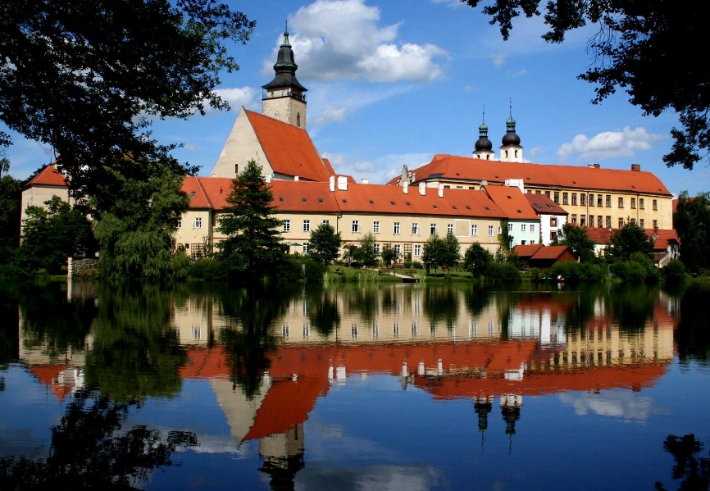
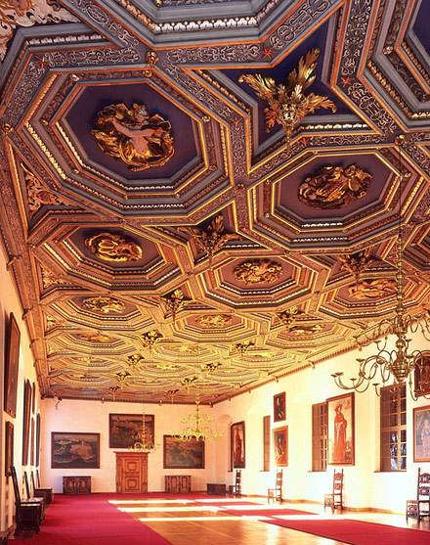
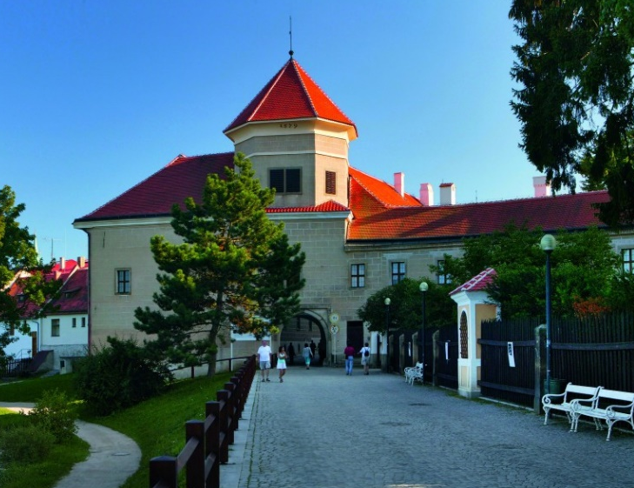
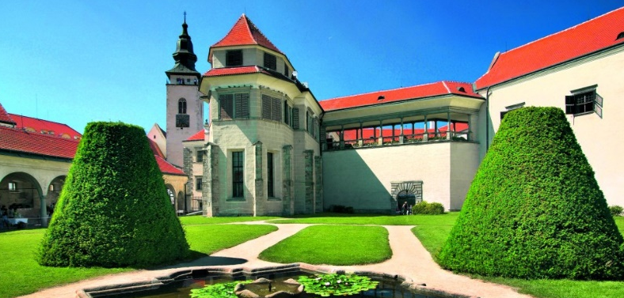
TELČ
Royal water fort (14 century)
Walls & network of ponds → Moravian Venice
Renaissance castle & English park

Slide 9
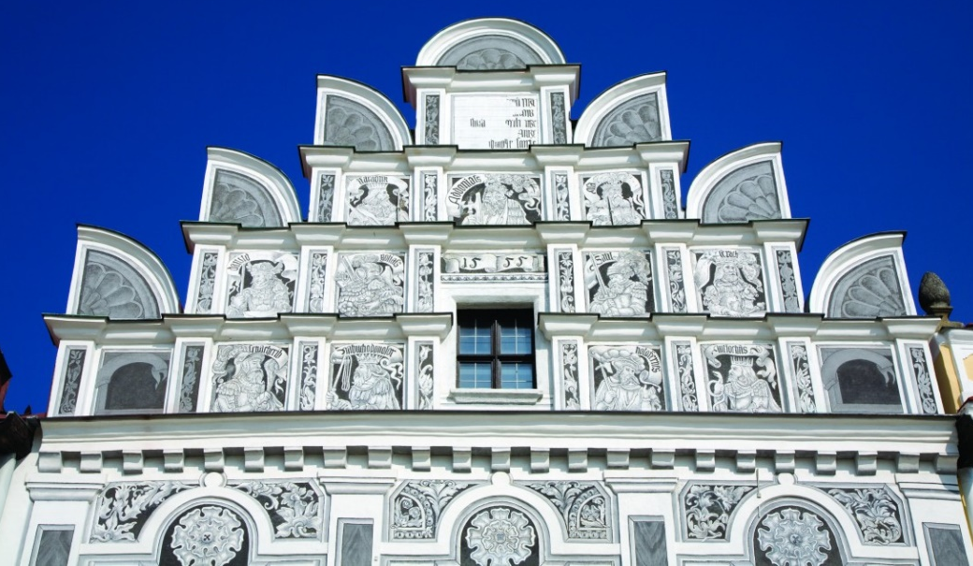
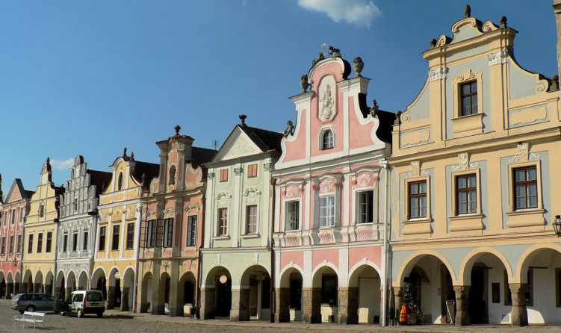
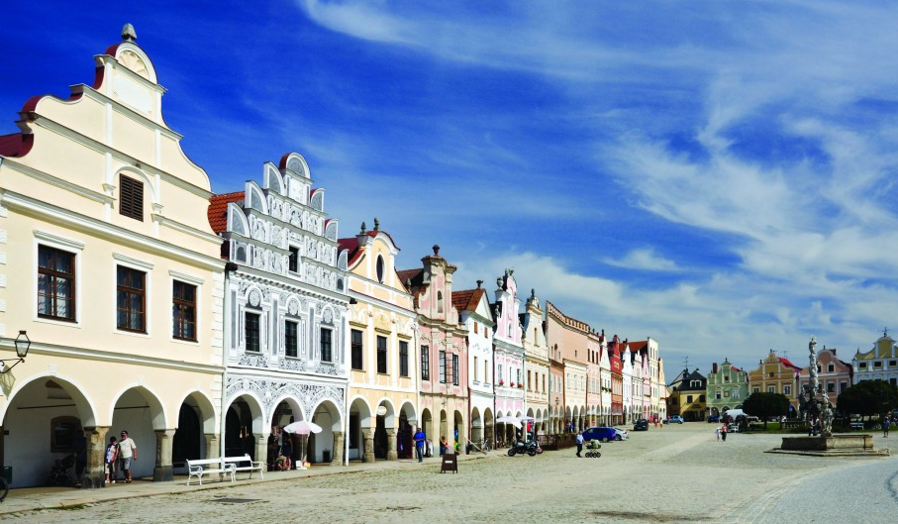
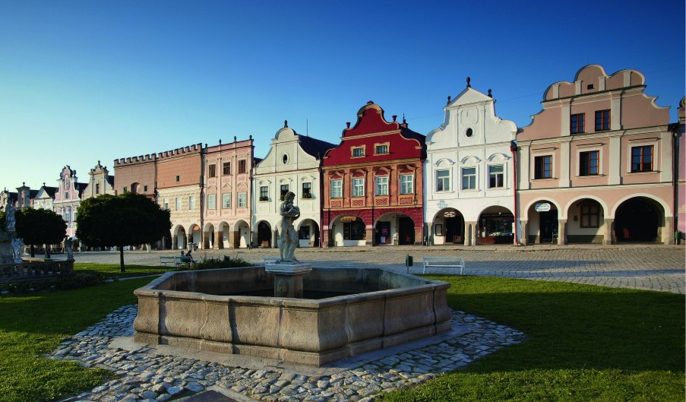
TELČ

Slide 10
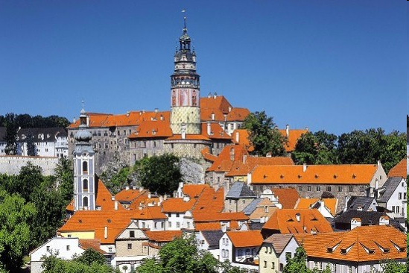
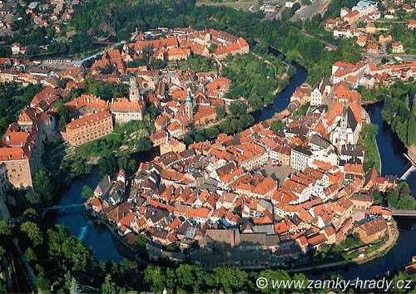
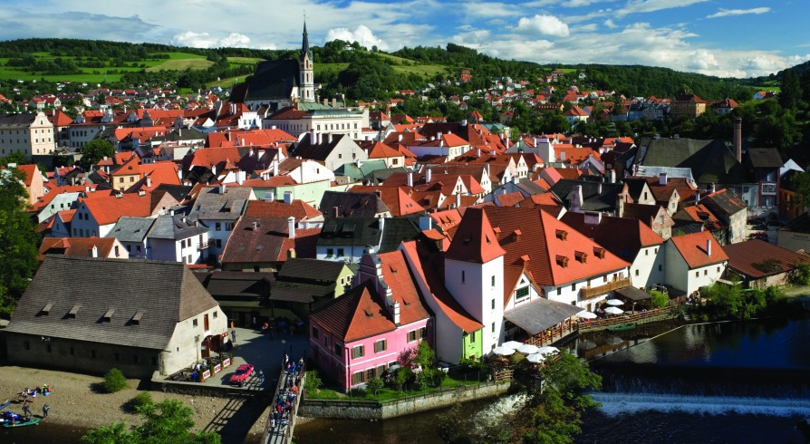
ČESKÝ KRUMLOV
Core of the town within a horseshoe bend of the Vltava river
Important craft & trade centre
Castle complex (13 century)
Unique medieval town (preserved intact)

Slide 11
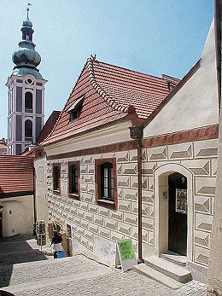
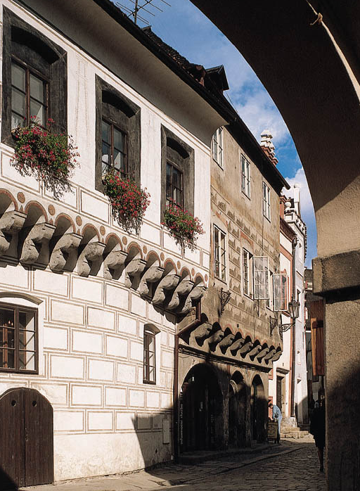
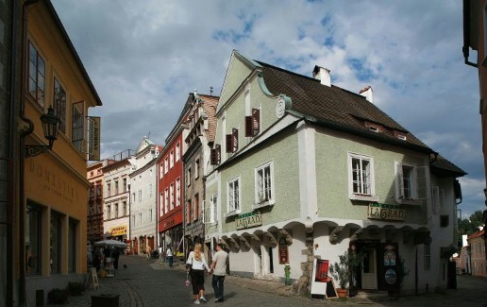
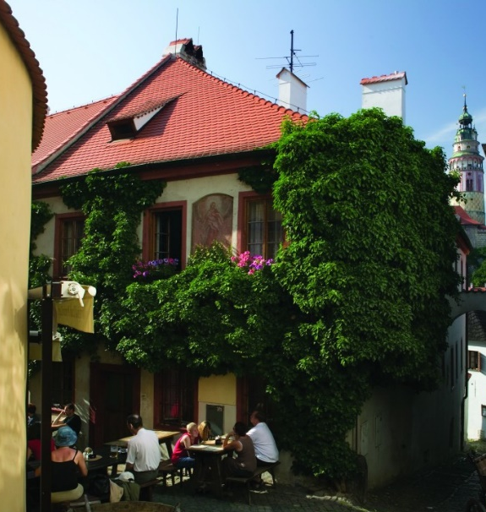
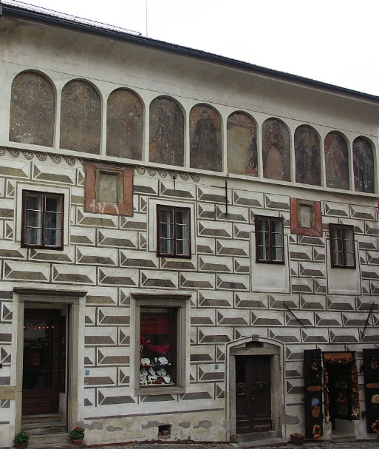
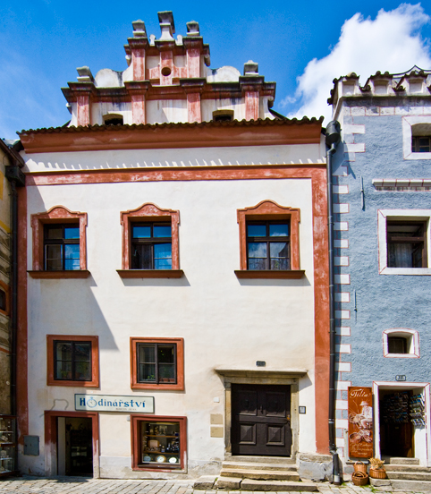
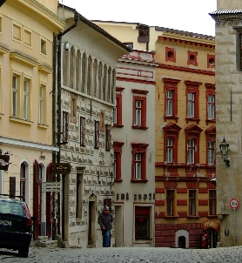
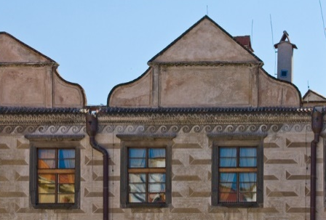
ČESKÝ KRUMLOV
Two main historic areas
Latrán – area below castle
  Burgher houses from Gothic onwards
  Facades, internal layouts & decorative detail, esp. carved wooden ceilings
  Renaissance armoury

Slide 12
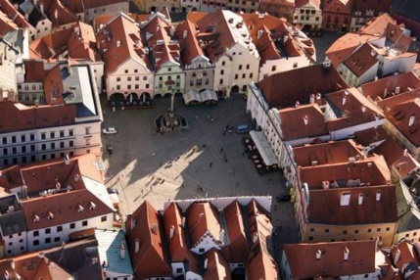
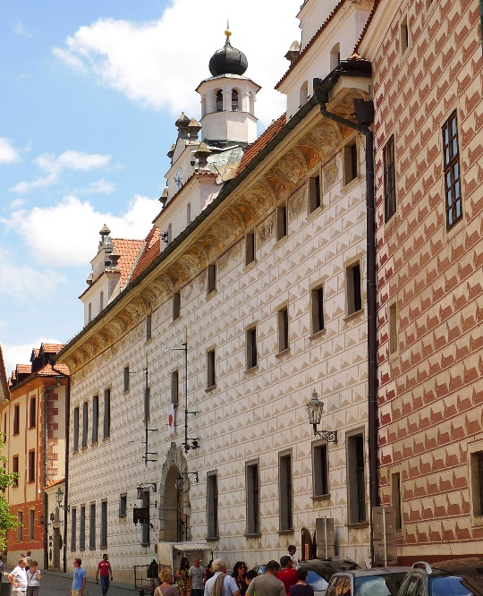
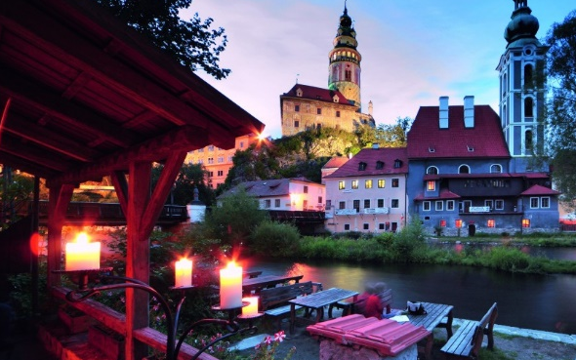
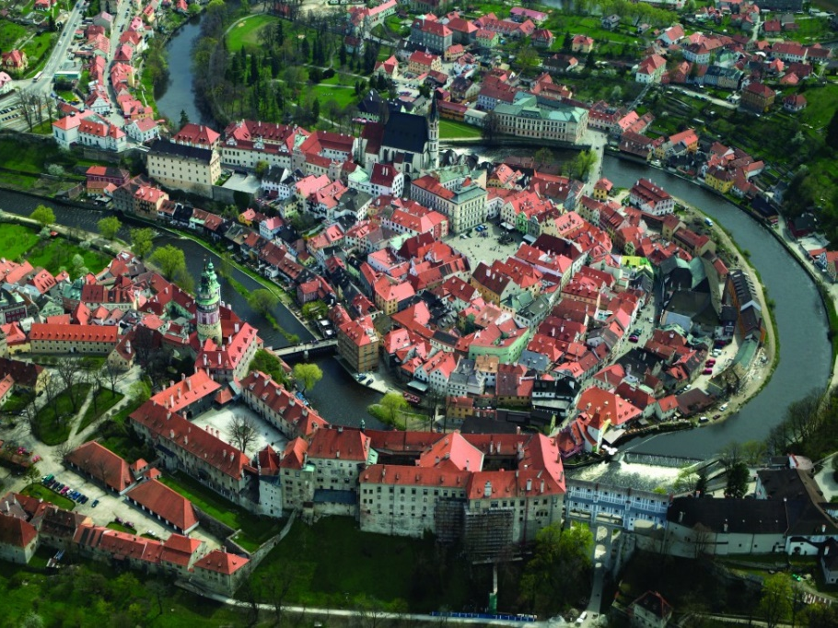
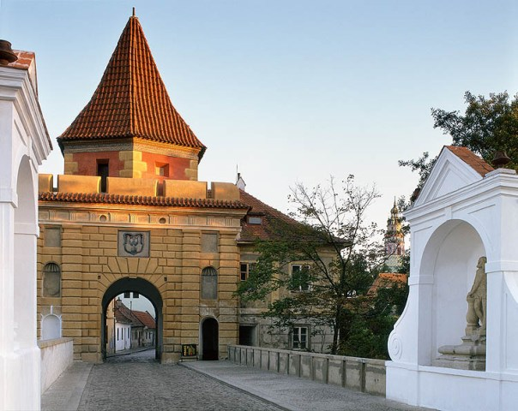
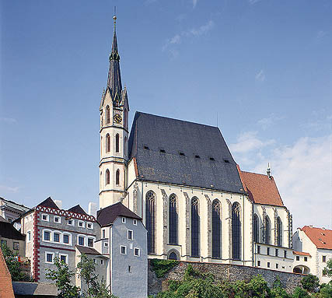
ČESKÝ KRUMLOV
Town proper
  Regular street layout, streets radiating from central square & circular intra-rampart road
  Church of St Vitus – Gothic (15 century)
  Renaissance Jesuit College & Baroque seminary
  Remains of fortifications, esp. Budĕjovická Gate (Renaissance)

Slide 13
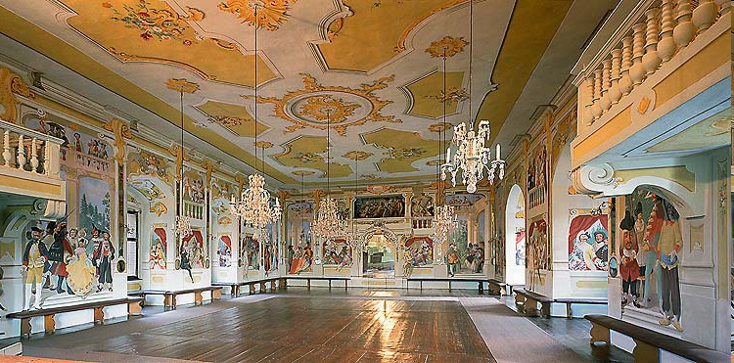
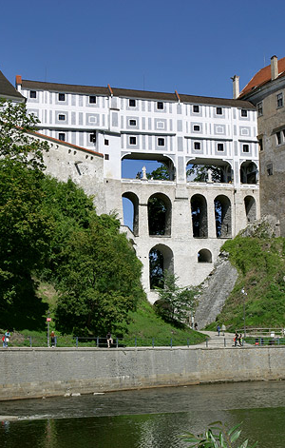
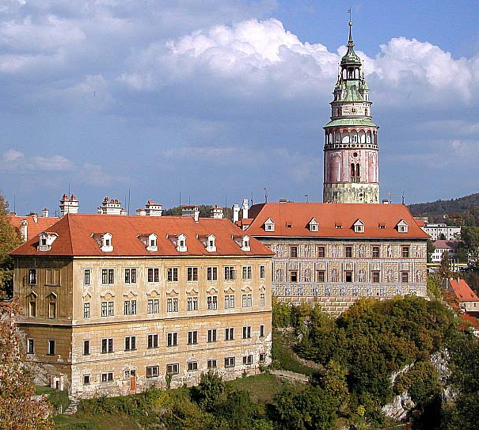
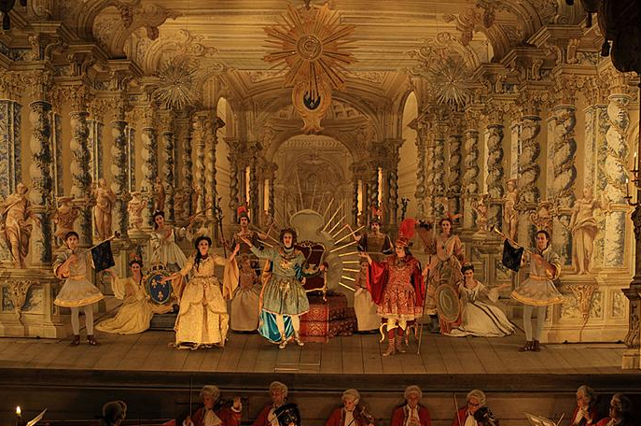
ČESKÝ KRUMLOV
  Hrádek – core of the Castle, round tower, Gothic (13 century)
  Rebuilt – many parts, Renaissance & Baroque elements
Seat of Rožmberk family for 300 years
Passed to Schwarzenberg family
  Extensive bridge over deep gap in rock
  Baroque theatre (1766)

Slide 14
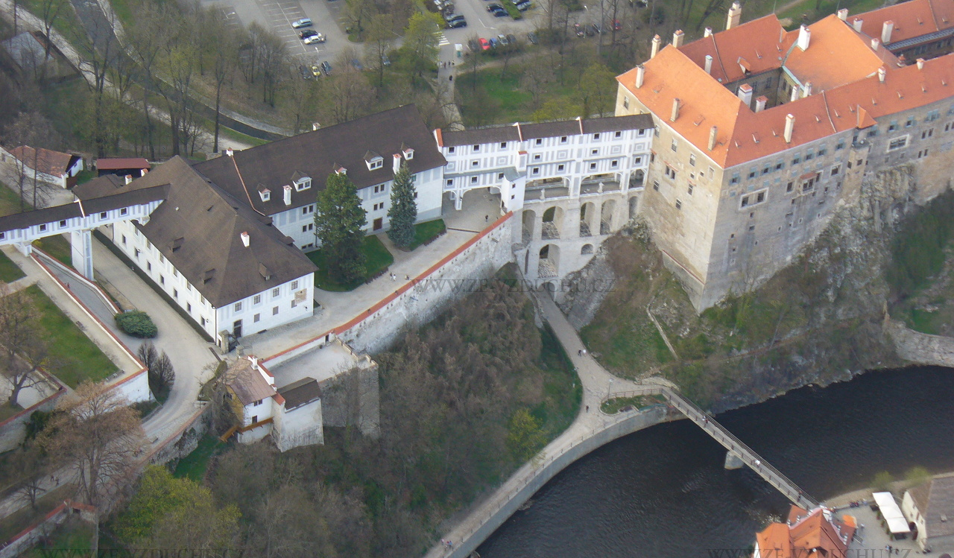
ČESKÝ KRUMLOV

Slide 15
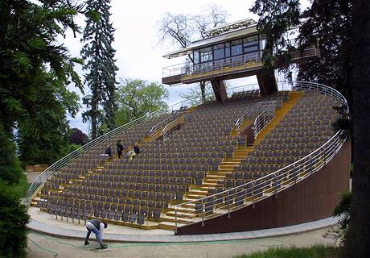
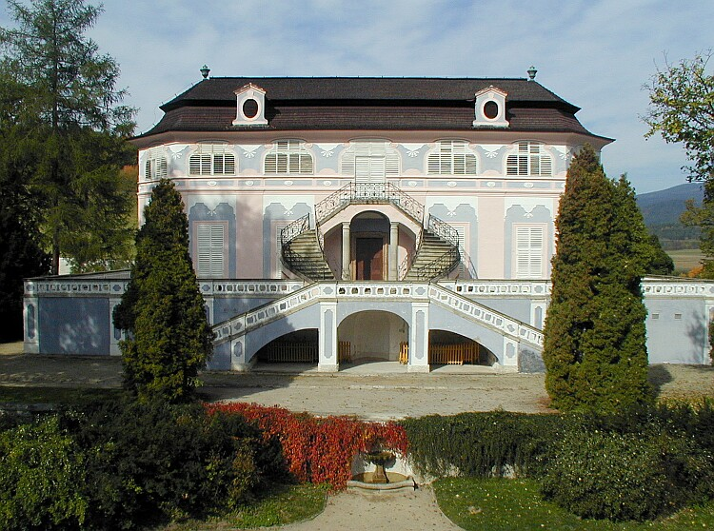
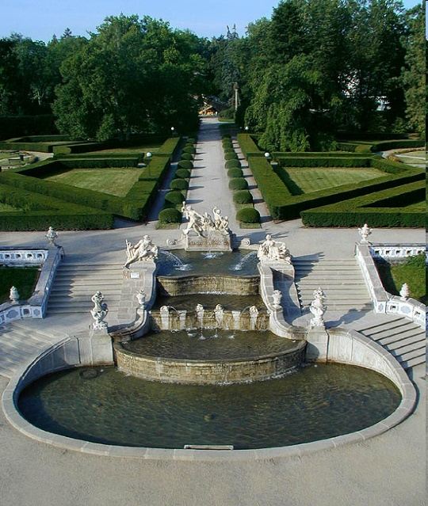
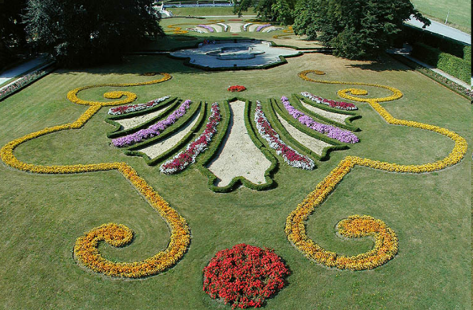
ČESKÝ KRUMLOV
  Garden
  Theatre with revolving auditorium
  Bellaire summer palace
  Winter riding school

Slide 16




ŽĎÁR NAD SÁZAVOU
Jan Blažej Santini (18 century)
Five-pointed star-shaped plan
Legend about martyr
Between Neo-Gothic & Baroque style
Original altars – Santini
Nepomuk (main) & Evangelists (side)
Five chapels, five gates

Slide 17



ŽĎÁR NAD SÁZAVOU

Slide 18







KUTNÁ HORA
Silver mines (10 century)
Royal city (14 century)
Medieval centre
Italian Court – central mint – Prague groschen (1300)
Stone House & patrician houses
Stone House
Italian Court

Slide 19






KUTNÁ HORA
Cathedral of St Barbara – Gothic (Parléř)
Church of St James

Slide 20






KUTNÁ HORA
Cathedral of Our Lady – Baroque (Jan Blažej Santini)
Church of All Saints – Ossuary (black death & wars 40 – 70,000)

Slide 21


LEDNICE – VALTICE
Largest artificially created area in Europe (200 km²)
„Garden of Europe“ or „Garden of Paradise“
Dukes of Liechtenstein (17 – 20 century)
Karl I – Valtice (main residence), Lednice (summer)
Connected by avenues, paths & parks (English)
Rivers, canals & ponds; pavilions
Wide range of native & exotic tree species
Mlýnský, Prostřední & Hlohovecký ponds – Englische Anlagen (smaller parks on English model)
Pohansko Manor – Empire hunting castle, exposition, site of important hill fort of Great Moravia (massive ramparts still visible (2 km), excavations of court of ruler, church, several houses & burial ground)

Slide 22







LEDNICE – VALTICE
Lednice – Baroque & Neo-Gothic

Slide 23





LEDNICE – VALTICE
Johnʼs Castle
Temple of Diana
Minaret
Temple of Three Graces

Slide 24




LEDNICE – VALTICE
Hunting Lodge
Border House
Fishpond Manor
Apollo Temple

Slide 25






LEDNICE – VALTICE
Valtice – Renaissance & Baroque, Wine cellars
Nesyt Pond

Slide 26



LEDNICE – VALTICE

Slide 27






HOLAŠOVICE
Traditional rural settlement
Ground plan dating to Middle Ages
23 farmhouses facing central village square 120 – barns, stables, cowhouses, granaries
Exceptionally complete & preserved
18 to 19 centuries
Chapel St John of Nepomuk
South Bohemian Folk Baroque

Slide 28




HOLAŠOVICE

Slide 29



KROMĚŘÍŽ
Early medieval market village (1110)
15 century – Thurzo – castle, pleasure garden
Karl Liechtenstein (1664)
Baroque princely residence & gardens

Slide 30





KROMĚŘÍŽ
Baroque Archbishop Palace
Picture gallery
Library

Slide 31






KROMĚŘÍŽ
Podzámecká & Flower garden
Colonnade, Maze
Wine cellars

Slide 32






LITOMYŠL
Renaissance Arcade Castle (16 century)
Graffiti
Neo-classical theatre (1796)
Constructed entirely of wood, original painted decoration of auditorium, stage decorations & machinery have survived intact
Range of ancillary buildings

Slide 33








LITOMYŠL
On road between Moravia & Bohemia
Bedřich Smetana – birthplace

Slide 34




OLOMOUC
Holy Trinity Column
Sculptural group of saints
largest in central Europe
35 meters high
European Baroque (1716-1754)
Václav Render, Ondřej Zahner

Slide 35








OLOMOUC
Second oldest & largest town reserve
St Wenceslas cathedral (1306)
25 fountains

Slide 36

OLOMOUC

Slide 37



BRNO
First masterpiece of modern architecture
Fourth in the world
Modern Movement – Functionalism
Ludwig Mies van der Rohe, 1928-1930
Designed the house & furniture
Fritz and Greta Tugendhat, Jewish, 1938

Slide 38






BRNO
No paintings or decorative items, no fixed walls
Onyx wall, rare tropical woods
Electrically operated steel-frame windows
Central heating, air-conditioning system

Slide 39




TŘEBÍČ
Co-existence of Jewish & Christian cultures from Middle Ages to 20 century
Jewish Quarter – evidence of cultural traditions of Jewish diaspora
1920s – area merged with Třebíč
Jewish residents deported, none left at present

Slide 40





TŘEBÍČ

Slide 41




TŘEBÍČ
Old Synagogue (1639) – now Hussite Church
New Synagogue (18 century) – museum
Cemetery – 4,000 stones, 15 & 19 century

Slide 42

TŘEBÍČ

Slide 43





TŘEBÍČ
Basilica of St Prokopius (13 century)
  part of Dominican monastery (1101)
  16 century rebuilt & renovated → castle (Baroque)
Romanesque, Gothic & Baroque elements

Slide 44



TŘEBÍČ
Benedictine Monastery – 1101 (it has not been preserved, it is not known where exactly it stood)
Built again – 13 century (cellars & ground floor)
15 century → fortress (walls, bastions, towers)
16 century → Renaissance chateau

Slide 45


ERZGEBIRGE /KRUŠNOHOŘÍ
Together Czech Republic (5) & Germany/Saxony (22)
Jáchymov, Abertamy – Boží Dar – Horní Blatná, Krupka, Mědník, Red Tower of Death
Iron & silver ores (12 century) → unique mining monuments (above & below ground)
Mining landscape Erzgebirge /Krušnohoří – 2019

Slide 46





ERZGEBIRGE /KRUŠNOHOŘÍ
Historical old town (1516)
Surroundings – evidence of mining
Silver ores; 1840 – uranium ores
(1898: Sklodowská-Curie – radium, polonium)
1906 – first radon spa in the world
Jáchymov

Slide 47




ERZGEBIRGE /KRUŠNOHOŘÍ
Horní Blatná – mine Vlčí jáma
Boží Dar (spoil heaps after tin panning)
Důl Mauritius (Arbetramy)
Abertamy (dumps of uranium mine)
Abertamy – Boží Dar – Horní Blatná

Slide 48



ERZGEBIRGE /KRUŠNOHOŘÍ
Red Tower of Death
Mědník
Vykmanov u Ostrova – uranium crashing plant
Krupka
Mining landscape Erzgebirge /Krušnohoří – 2019

Slide 49




ERZGEBIRGE /KRUŠNOHOŘÍ
Krupka
Mrtvé jezero (Boží Dar)
Blatenský moat
Royal mint
Mining landscape Erzgebirge /Krušnohoří – 2019

Slide 50

KLADRUBY NAD LABEM
Stud farm grounds & surrounding countryside; oldest stud farm in the world (1579)
Old Kladruber horse (white horse; fundamental herd – NCM)
NATIONAL STUD FARM – 2019

Slide 51

KLADRUBY NAD LABEM
NÁRODNÍ HŘEBČÍN – 2019

Slide 52




KLADRUBY NAD LABEM
NATIONAL STUD FARM – 2019

Slide 53

THE GREAT SPA TOWNS OF EUROPE
Together with Belgium, France, Italy, Germany, Austria & the United Kingdom
11 cities in 7 countries that have developed around natural mineral water springs
Evidence of international European spa culture (early 18 century – 1930s)
Wide range of leisure activities → reflected in the form of cities and their architecture
Sets of spa buildings – spa houses, spring pavilions, drinking halls, colonnades, social houses, casinos, theatres, etc.
Combination of spa and medical treatments
Integration into landscapes, parks, gardens, promenades
West Bohemian Spa Triangle – 2021

Slide 54



THE GREAT SPA TOWNS OF EUROPE
Baden-Baden
Bad Ems
Bad Kissingen
Germany

Slide 55

THE GREAT SPA TOWNS OF EUROPE
Spa – Belgium

Slide 56


THE GREAT SPA TOWNS OF EUROPE
Vichy – France

Slide 57


THE GREAT SPA TOWNS OF EUROPE
Montecatini Terme – Italy

Slide 58


THE GREAT SPA TOWNS OF EUROPE
Baden bei Wien - Austria

Slide 59

THE GREAT SPA TOWNS OF EUROPE
Bath – England

Slide 60


THE GREAT SPA TOWNS OF EUROPE
West Bohemian Spa Triangle – 2021

Slide 61


THE GREAT SPA TOWNS OF EUROPE
West Bohemian Spa Triangle – 2021

Slide 62


THE GREAT SPA TOWNS OF EUROPE
West Bohemian Spa Triangle – 2021

Slide 63

JIZERA MOUNTAINS BEECH FORESTS
94 separate locations across 18 countries; 2007 – Slovakia & Ukraine
2011, 2017, 2021 – Albania, Austria, Belgium, Bosnia and Herzegovina, Bulgaria, Croatia, France, Germany, Italy, Poland, Romania, North Macedonia, Slovenia, Spain, Switzerland
Preserved beech forests demonstrating the process of postglacial expansion of European beech
Primeval Beech Forests of the Carpathians and Other Regions of Europe – 2021 (2007)

Slide 64




JIZERA MOUNTAINS BEECH FORESTS
Primeval Beech Forests of the Carpathians and Other Regions of Europe – 2021 (2007)

Slide 65


ŽATEC REGION
landscape
historic centre of Žatec with industrial district from 19 c
Villages of Trnovany & Stekník, chateau Stekník
Žatec and the Landscape of Saaz Hops – 2023

Slide 66

ŽATEC REGION
landscape – more than 700-year old tradition, still continuing
  hop fields, buildings used for hop drying, packaging & storing
  historical transport network of roads, railways, Ohře & other water ways
Žatec and the Landscape of Saaz Hops – 2023

Slide 67






ŽATEC REGION
Žatec and the Landscape of Saaz Hops – 2023

Slide 68

ŽATEC
historic centre with industrial quarter from 19 century (buildings connected with hop processing & trading
Žatec and the Landscape of Saaz Hops – 2023

Slide 69





ŽATEC
Žatec and the Landscape of Saaz Hops – 2023

Slide 70




TRNOVANY & STEKNÍK
Trnovany – hop drying spaces
Žatec and the Landscape of Saaz Hops – 2023

Slide 71


Slovácko Verbuňk – 2005
South Moravia & Zlín regions (18 century)
Essential component of local customs, ceremonies & celebrations
Improvised dance performed by boys & men
From German Werbung – recruitment
Folk dance groups in of Slovácko region
Song performed, slow movements, faster dancing
No precise choreography but improvisation & individual expression including jumping contests
Great variety of figures & dance rhythms
Six different regional types
Evolved in 20 century & continue to change
International Folklore Festival in Strážnice
annual contest of best dancers

Slide 72




Slovácko Verbuňk – 2005

Slide 73



Shrovetide Mask Processions – 2010
MASOPUST
Eastern Bohemia
Town of Hlinsko & six nearby villages
Door-to-door procession & masks
End of winter, period before Christian Lent
Boys – red masks, married men – black
Accompanied by brass band
Stop at each house, four men perform a ritual dance
To secure rich harvest & prosperity
Receive treats & collect a fee
End – ʻKilling a Mareʼ, following – mare is revived with alcohol

Slide 74



Shrovetide Mask Processions – 2010

Slide 75


Ride of the Kings – 2011
Towns Hluk & Kunovice, villages Skoronice & Vlčnov
Spring – part of Pentecost tradition
Ceremonial procession – ride of group of young men
Chanters followed by pageboys with unsheathed sabres who guard the King, rest of royal cavalcade
King – young boy, face partially covered, holding rose in his mouth
King & pageboys dressed in womenʼs ceremonial costumes
Ride on decorated horses stops to chant short rhymes
Chanters receive donations for performance
Evening – celebration at Kingʼs house, small feast, music & dancing

Slide 76



Ride of the Kings – 2011

Slide 77


Falconry – 2012
Traditional activity of keeping & training falcons & other raptors to take quarry in its natural state (4,000 years)
Amateurs & professionals of all ages & genders
Strong relationship & spiritual bond of falconers & their birds
Bread, train, handle & fly the falcons
Common value, traditions & practices (methods of training, caring for birds, bonding process & equipment)
Traditional dress, food, songs, music & dance

Slide 78

Falconry – 2012

Slide 79


Pupetry in Slovakia and Czechia – 2016
professional & folk/amateur performing art
practice bearers – performers, playwrights, puppet & costume makers, stage designers (carving, painting, puppet costumes creating, decorations painting)

Slide 80



Blueprint/Modrotisk – 2018
textile printing technology (18 c)
family workshops, hand-crafted blocks up to 300 year old, regionally-inspired patterns, Christian motifs
blocs print dye-resistant paste that prevent cloth from indigo dyeing (remains white)
folk costumes – Wallachia & Horácko region
19 c – workshops in every town; Olešnice, Strážnice

Slide 81


Blueprint/Modrotisk – 2018

Slide 82



Handmade production of Christmas tree decorations – 2020
Traditional production of Christmas decorations in Giant Mountains area

Slide 83




Timber rafting – 2022
craftsman techniques in raft construction (600 m long, 50 m wide, 2 m high)
raft navigation on the river
distinctive customs, rafting songs & slang; water & ecosystem protection

Slide 84







Knowledge, craft & skills of handmade glass production – 2023
traditional techniques – glass blowing, work at burner
cold techniques – cutting, engrawing & gilding of glass; fashion jewellery

Slide 85
Man and the Biosphere Programme
Run by UNESCO, started 1971
World Network of Biosphere Reserves
Aim – balanced relationship between mankind & nature, sustainable development
Biosphere Reserve – ecosystem with plants & animals of unusual scientific & natural interest
Sustainable use of natural resources
  Křivoklátsko – 1977
  Třeboň Basin – 1977
  Lower Morava – 2003 (former Pálava – 1986, extended & renamed 2003)
  Šumava – 1990
  Krkonoše – 1992
  Bílé Karpaty – 1996

Slide 86







Man and the Biosphere Programme

Slide 87

THANK YOU FOR YOUR ATTENTION

