Slide 1
DEAD INTERNET THEORY
Sabina Balintová

Slide 2
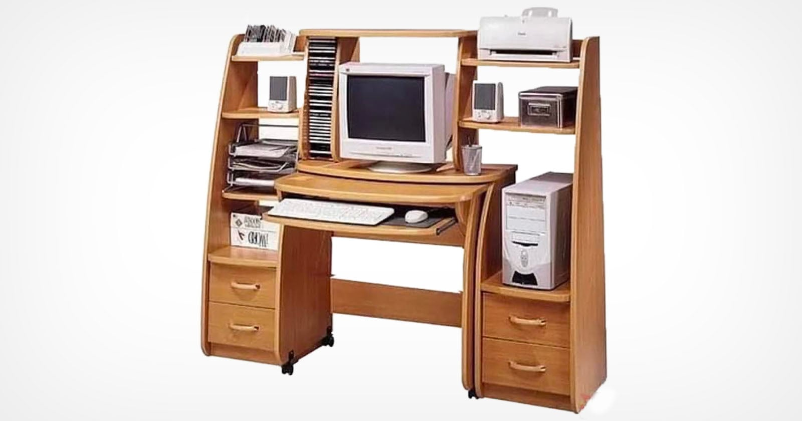
''15 years ago, the internet was an escape from the real world. Now, the real world is an escape from the internet.''
Is this true?

Slide 3

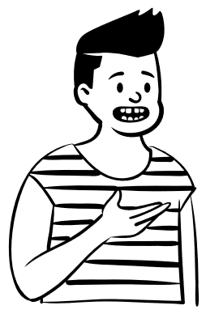

INTERNET

Slide 4

INTERNET​
1969-2016​

Slide 5

WHAT KIND OF THEORY?
Most online activity is fake
Real people post less
AI is writing a lot of the internet
Big tech companies control the flow
Studies estimate 40–50% of all internet traffic is automated (eg. spam bots).

Slide 6
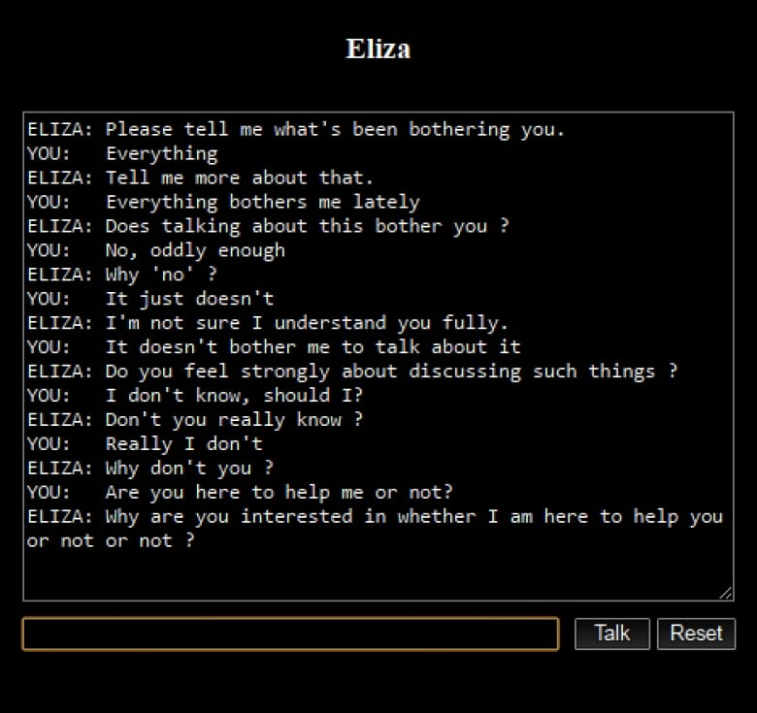
WHAT DO YOU THINK IS A ''BOT ACTIVITY''?​
ANY action on the internet that is performed automatically by software, not by a real human​

Slide 7
BOTS CAN BE HELPFUL BUT ALSO VERY DANGEROUS...

Slide 8
NICE
Search Engine Crawlers
Monitoring Bots
Authorized Data Collection Bots
Archiving Bots
Productivity Bots
NOT SO NICE
Spambots
Unauthorized Scraper Bots
Fake Engagement Bots
Credential Stuffing Bots
Shopping/Ticket Bots

Slide 9

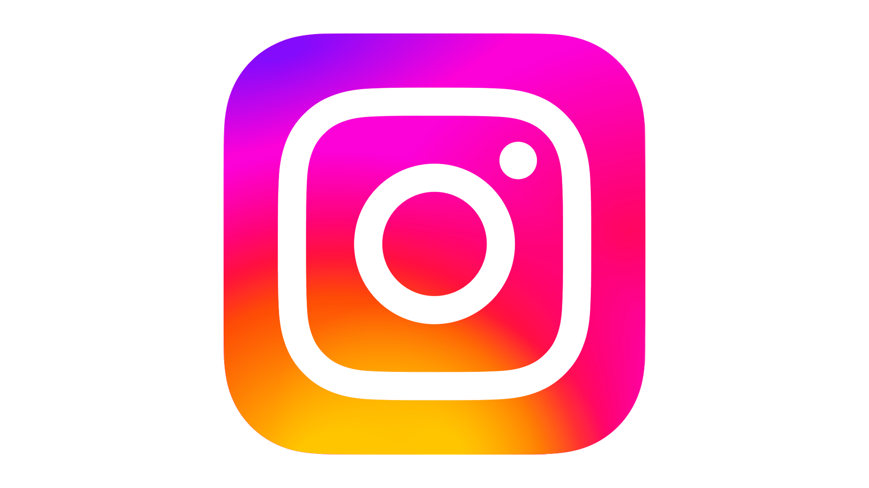

FAKE ENGAGEMENT BOTS

Slide 10
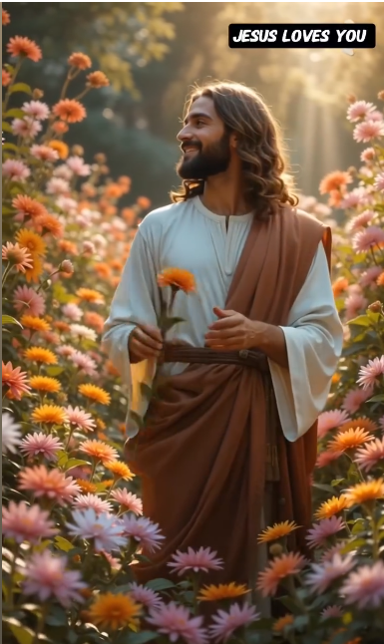
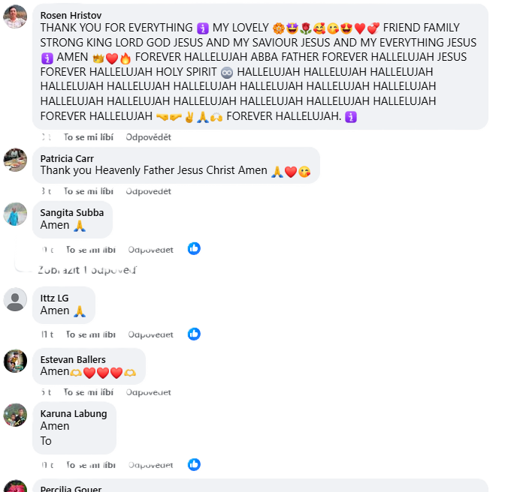
FAKE ENGAGEMENT BOTS
Over 800 million + fake accounts on facebook (4-5% activity)
Phishing
Manipulation
Generating "life-like content"

Slide 11
Source
https://fraudblocker.com/articles/facebook-spam-bots-how-to-get-rid-of-annoying-bots-2
https://www.bing.com/search?pglt=299&q=google+obrazky&cvid=70f717beb88a47a48a9b78106325f8ce&gs_lcrp=EgRlZGdlKgkIABBFGDsY-QcyCQgAEEUYOxj5BzIGCAEQABhAMgYIAhAAGEAyBggDEEUYOTIGCAQQRRg7MgYIBRAAGEAyBggGEEUYOzIGCAcQRRg8MgYICBBFGDzSAQgxNDcxajBqMagCALACAA&FORM=ANNTA1&PC=U531

Slide 12
THANK YOU FOR YOUR ATTENTION

