Slide 1
Crime Prevention Video
https://www.youtube.com/watch?v=TN8Ymq-Kllc

Slide 2
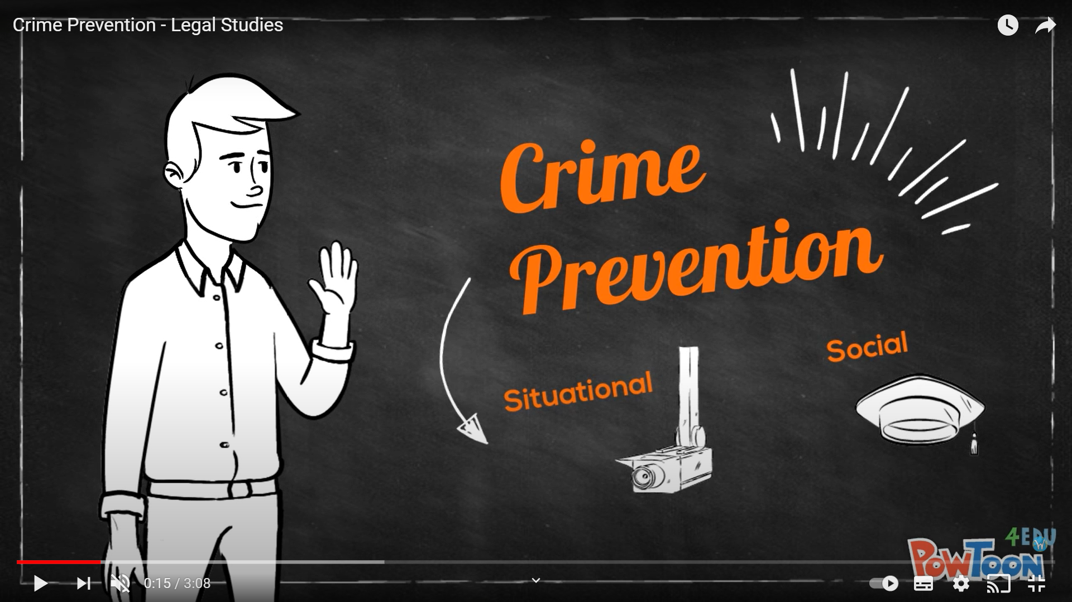

Slide 3
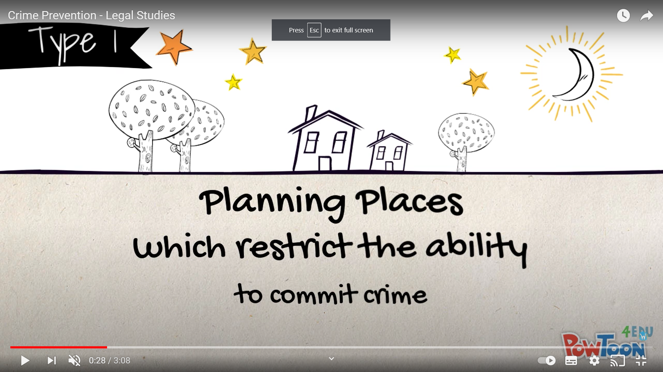
Situational Crime Prevention

Slide 4
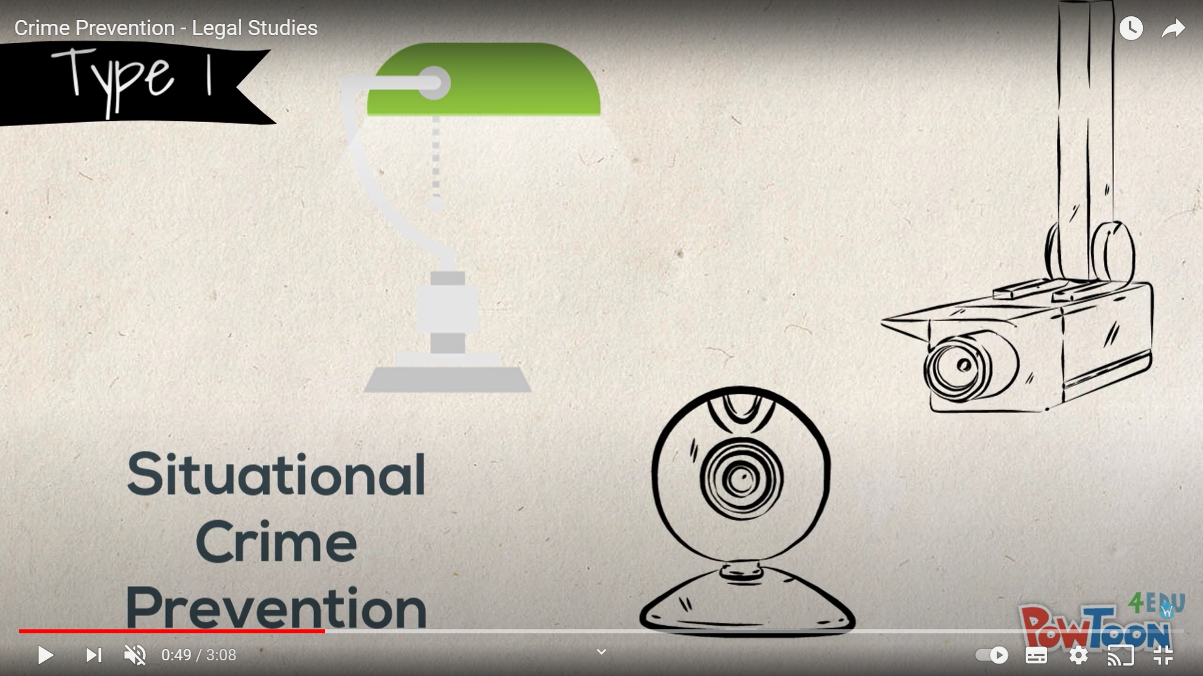
Situational Crime Prevention

Slide 5
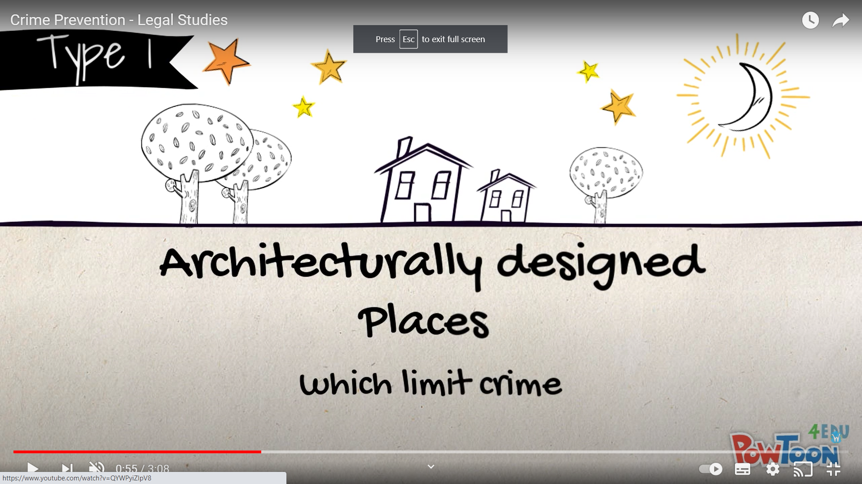
Situational Crime Prevention

Slide 6
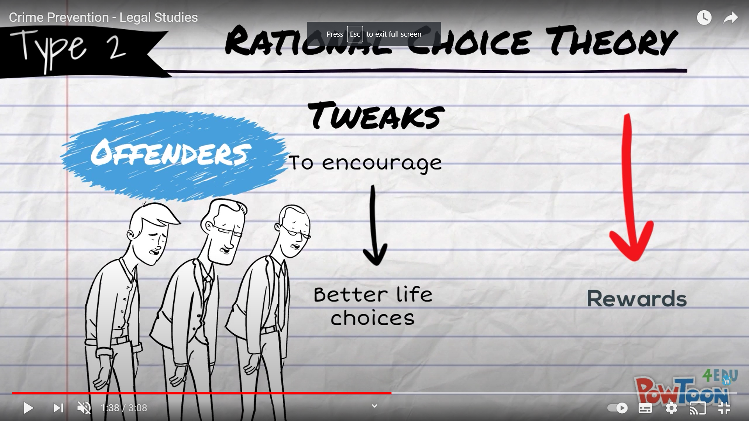
Situational Crime Prevention

Slide 7
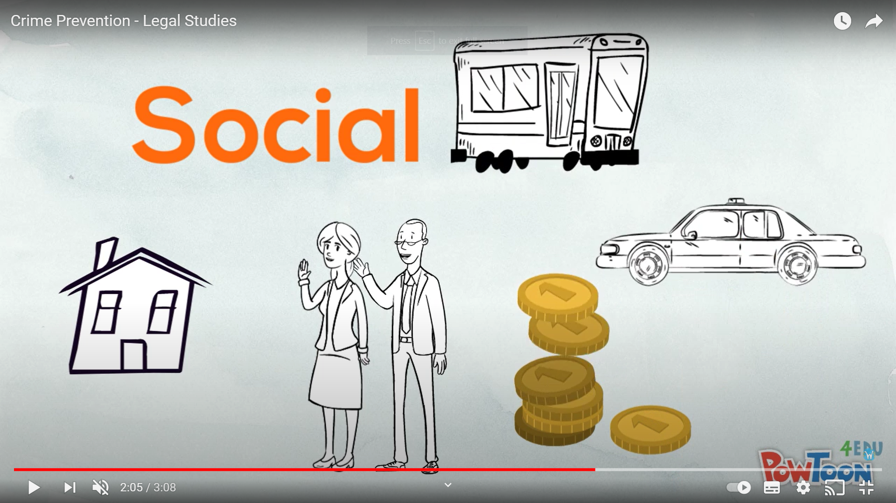
Social Crime Prevention

Slide 8
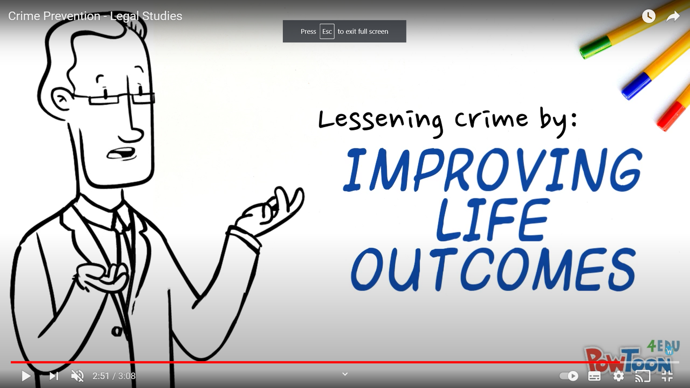
Social Crime Prevention

Slide 9
How to improve life outcomes:
          Home environment
          Parenting
          Education (Attending school)
          Socioeconomic conditions
          Relationship with the police

