Slide 1
UNZSOP07 English for Pediatric Nursing 2 UOLP055 English for Dental Hygiene 2
Markéta Skalná, PhD
marketa.skalna@fvp.slu.cz
Seminář 2 / 4

Slide 2
Podmínka splnění předmětu - zápočet
Podmínkou udělení zápočtu je:
1) účast na výuce (viz sylabus předmětu) – 80% (možnost 1x absence, další absence s lékařským potvrzením o nemoci, hospitalizaci)
2) Seminární prezentace – vypracování prezentace formou PPT na jedno z témat probíraných ve výuce, také viz. sylabus, její přednes na závěrečné hodině 4.4. 2023
V případě absence na poslední hodině nebo v případě více absencí na přednáškách budou stanoveny požadavky navíc individuálně (AJ text na A4)

Slide 3
Obsah předmětu (témata prezentací)
1. Injuries in children – specifické kapitoly, 3 studenti
2. Emergency and First Aid for children of different age – 2 studenti
3. Specific medical care (small kids, obese, mental diseases) – 3 studenti
4. Communication with family members – 3 studenti
5. Multicultural approach (ethnic specifics) – 3 studenti
6. Reflection on healthy lifestyle
7. Medical system in Czech Republic and abroad – 3 studenti
8. Student's presentations

Slide 4
Obsah předmětu (témata prezentací) – dent.hyg
1. Communication with patient in dental care (procedure, education)
2. Dental care equipment (instruments, brushes, shower, flosses, home care)
3. Oral Health
4. Orthodontics
5. Medical technique and imagining in dentistry
6. Multicultural approach (ethnic specifics), Pediatric patient
7. Student's presentations

Slide 5
Obsah semináře 28.3.
PS:
Specific medical care (small kids, obese, mental diseases)
Communication with family members
Multicultural approach (ethnic specifics)
DH:
Specific medical care for pediatric patients in dental hygiene
Dental care equipment (instruments, brushes, shower, flosses, home care)
Orthodontics

Slide 6
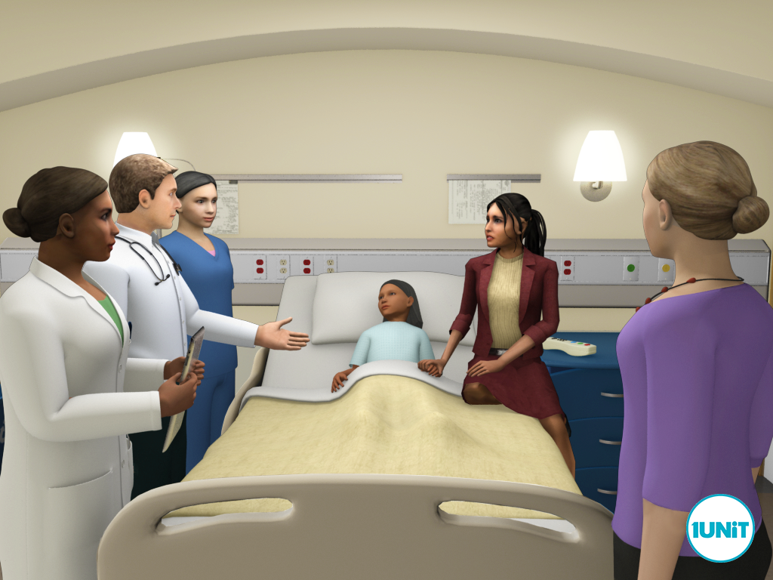
Specific medical care - pediatric patients
means infants, children, adolescents, and young adults up to the age of 15 / 18 / 21
neonates (0-28 days of life)
infants (28 days -12 months)
toddlers (1-3 years)
preschoolers (3-5 years)
school aged children (6-10 years)
adolescents (11-18 years)
young adults (18-21)
Specifics in care differs according to child’s age and developmental level
Prenatal and birth history
Developmental history
Social history of family
Immunization history

Slide 7
KEY POINTS IN OBTAINING THE HISTORY
to establish a warm, caring atmosphere and be nonconfrontational
to greet everyone in the room in a polite manner, friendly
to wash your hands before and after your exam the patient
getting down to the child’s eye level upon entering the room (and not towering over them) is also important, especially when examining toddlers and preschoolers
distraction is a valuable tool
be extra honest - if something is going to hurt, tell the child that in a calm, age-appropriate fashion - do not lie, or else you will lose credibility
remember that the birth history and the impact that this has on the child’s growth and development are key differences between a pediatric and adult patient
Age group specifics in physical examination
Infants under 6 months of age who tend to not have stranger anxiety are best examined on the exam table
For infants older than 6 months and anxious toddlers who are leery of strangers, the exam may be more comfortable if sitting on their parent/caregiver’s lap.
While children over 3 years of age tend to be generally more cooperative during the exam without being held, they may like to play with the equipment beforehand (i.e., allowing patients to hold the stethoscope or otoscope before using it on them).
Examination of children aged 5 to 12 years old and adolescents are easier to perform because they also tend to cooperate more.

Slide 8
KEY POINTS IN OBTAINING THE HISTORY – what to ask for
present illness – use SOCRATES for more specifics, health state immediately before the illness
Birth History:
Prenatal: Health of mother during pregnancy (medical supervision, vitamins, drugs, diet, infections, complications)
Natal: Duration of pregnancy, birth weight, type of delivery, presentation, sedation and anesthesia, state of infant at birth (apgar, lenght of hospitalization)
Neonatal: congenital anomalies or birth injuries, jaundice, transfusion, sepsis, or other neonatal problems, if the baby had any difficulty in sucking, any rashes, excessive weight loss, or feeding difficulties
Developmental History (grow):
motor (gross and fine) and social (interaction with others), major milestones achieved (i.e., age smiled, sat, crawled, walked, first words). Parent/caregiver has any concerns about infant’s development?
gross motor (e.g., head control, sitting, pulling to stand, walking)
fine motor (e.g., raking, pincer grasp)
social (e.g., social smile, smiling, interaction with toys)
cognitive (e.g., object permanence, school performance)
note any formal developmental screening when appropriate and also if infant/child is receiving services for any delay

Slide 9
KEY POINTS IN OBTAINING THE HISTORY – what to ask for (DH an PS)
Nutrition History
Breast or formula: Type, duration, major formula changes, difficulties.
Be specific about how much milk or formula the baby receives, intervals
Vitamin supplements: type, when started, amount, duration
“Solid” foods: When introduced, how taken, types
For older child, ask about diet, meals/snacks per day, and types of foods consumed.
Appetite: Food likes and dislikes, idiosyncrasies or allergies, reaction of child to eating. An idea of child’s usual daily intake is important.
DH: time of eruption of first tooth, care at home, dental care, problems
Work in pairs – ask for the illness, history and denvelopment, use points in previous slides

Slide 10
Specific in verbal communication - pediatric patients
Be honest when explaining the procedure to a child, during the procedure, explain what is occurring, especially sensory aspects such as smells, feelings, etc. (eg a change in position, technique, equipment or staff)
Use clear and simple language that is tailored to the child’s developmental level
Use affirmative terms (eg “Keep your arm nice and relaxed”) and avoid negative terms (eg “Don’t move”, “Sting”) and qualifiers (eg “This will hurt a little”). Also be aware of communication devices for children with special needs
Ensure the child is positioned comfortably where they are able to see, hear and/or touch their carer during the procedure
Try to have one person at a time talk to the child

Slide 11
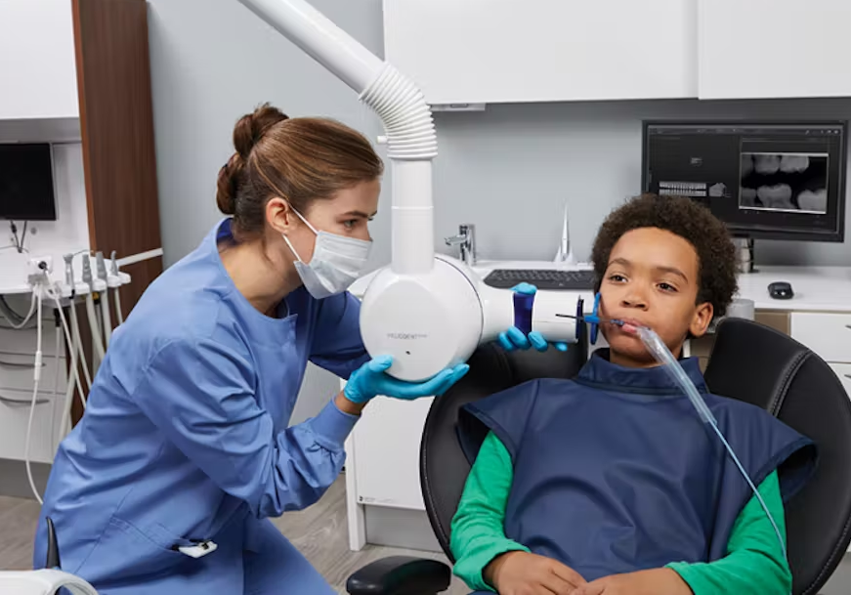
https://etactics.com/blog/pediatric-patient-parent-communication-tips - video od 1 minuty
Work in pairs – play a situation during examination of kid, use tips and vocabulary for the age

Slide 12
Children with obesity - reading
Childhood obesity has resulted in the rise of type 2 diabetes—and the complications that go along with it.
Diseases that mainly affect adults, such as atherosclerotic heart disease, stroke, renal insufficiency, and chronic renal failure, are also on the rise in obese children
Other health issues prevalent in overweight/obese children include hypertension, obstructive sleep apnea, joint problems, gastroesophageal reflux, fatty liver disease, gallstones, and social and psychological problems.
If children don't learn to manage their weight in their youth, they often grow up to become obese adults with myriad health problems.
Healthcare professionals must advocate for all children, working with families to improve their lifestyles.
Helping children to make healthier food choices must begin at home.
Developing activities to involve the entire family will enable children to get the exercise their growing bodies need.
Proper nutrition and bone building exercise are essential for optimum development and growth.

Slide 13
Costumized communication in mental disorders
Tips for Communicating With people suffering mental problems
Maintain a positive communicative tone
Avoid speaking slowly (it does not help and can make the patient angry)
Simplify sentences
Use direct, concrete, actionable language
Use repetition or paraphrase sentences to facilitate comprehension
Use visual aids such as pictures and diagrams to help understanding the key points.
Ask open-ended questions and listen to answers.
Monitor and control your nonverbal behavior
Include patient in the conversation even if their companion is in the room.
Strike an appropriate balance between respecting patients’ autonomy and stimulating their active participation in health care.

Slide 14
Communication with family members
Describe situation, diagnosis, procedures, prognosis as clear as possible
Remember to protect patient confidentiality (ask the patient what information you can be given to family or friends)
Active listening to family member needs, worries
Provide emotional support
Prevent misunderstandings
Ask for feedback
Invite them to ask questions
Connect them to additional support
https://www.youtube.com/watch?v=kBuljGaFjP8 - souhrn

Slide 15
Obsah semináře 28.3. – individuální část
PS:
Specific medical care (small kids, obese, mental diseases)
Communication with family members
Multicultural approach (ethnic specifics)
DH:
Specific medical care for pediatric patients in dental hygiene
Dental care equipment (instruments, brushes, shower, flosses, home care)
Orthodontics

Slide 16
DH, VS: Multicultural approach

Slide 17
Multicultural approach (ethnic specifics – culture, religion)
Potential cultural conflicts between healthcare staff and patient may arise from different attitudes to time, personal space, body language and value systems
Some patients avoid eye contact with medical staff, especially of the opposite sex
When talking to a culturally different patient, use non-verbal ways of communication - "body language"
Use a translator when giving accurate professional information
Obtaining accurate information about the principles of their life will ensure that spiritual needs, privacy and modesty are respected
To protect patient confidentiality, it is best to avoid translators from the patients' circle of family and friends
Speak slowly, clearly, address the patient directly, and formulate short sentences
Always make sure that the patient understands the recommendations of the medical team and accepts the proposed treatment plan

Slide 18
VIETNAMESE
official language – vietnamese, there is no formal and nonformal addressing
Vietnam people are nodding during interview, it doesn mean that they understand
Family is on first place, they consult everything with parents
Laughter - can show uncertainty
Direct look in to the eyes is impolite
Traditional greeting - handshake and clear squeeze of the hand
When sitting, it is not recommended to leg over the leg, which expresses superiority Crossed hands on the chest are a sign of exasperation
They believe that sleep has healing power The results of the examination and the planned interventions must be explained slowly and clearly
Respect for privacy and for shame are important during a hospital stay

Slide 19
VIETNAMESE
In prevention, they use various forms of relaxation
Vietnamese actively take care of their health, eat healthy, play sports
Personal hygiene is very important for them, they prefer to do it themselves. If they can't, they prefer to be helped by a family member of the same sex
They like warm, soft food (e.g. pure broth with vegetables and rice), few salts They drink a lot, especially tea or water of room temperature, tea without lemon and without sugar, diluted with water Most Vietnamese do not tolerate lactose!
In the period of illness, they eat rice porridge, a lot of vegetables and fruits
They take food as a medicine, according to somatic problems they also choose a specific diet During hospitalization, the family brings the sick person his favorite food
They do not accept anything cold through the mouth!
Play a situation – old Vietnamese man coming to ambulance with pain in leg after he felt on street, he is with his wife, the leg is dirty and bleeding, fractured bone is visible

Slide 20
UKRAINIANS
The official language is Ukrainian
Ukrainians are welcoming and communicative
They are very straightforward and say everything as they feel directly The central element of non-verbal communication is a face-to-face look, thereby expressing trust and respect for the other person Greeting by shaking hands is practiced during the meeting and farewell, but only men shake hands
Ukrainian society is more patriarchal, the family is the fundamental value of society
Ukrainian patients are usually very disciplined, they willingly adapt and understand the regime rules of the department
Problems can ocure due to ignorance of the language of the majority of society and thus misunderstanding of the information provided They eat mostly very healthy, preferring fish, vegetables

Slide 21
ROMA(NY)
The common language is Romani
In particular, they need an extended family for their lives Roma culture is not homogeneous, subject to local influences and is very diverse in different areas The way of non-verbal and verbal communication is very lively, emotional, loud They don't like prolonged eye contact Health information should be communicated to the patient and his family Illness is not just a matter for the individual If a Roma is hospitalized, the whole extended family goes to visit him, often outside the visiting hours, which can lead to conflicts with medical staff Pain manifests itself both verbally and mimicly, they cry loudly, sigh, complain, cry, they are very emotional and loud Roma feel a great fear of pain and death, even if their state of health is not serious

Slide 22
ROMA(NY)
They suffer from obesity and smoking Most visit their general practitioner; prevention at specialized doctors (gynecologists, dentists, ophthalmologists) neglect
In general, Romani people do not like hospitals because there is a high incidence of disease, bacteria and death
In the period of illness, the Roma have a weak will and are unable to be persistent or patient patients
They perceive health professionals as someone who is to blame for the problem because he has drawn attention to it
When hospitalized, it is quite difficult for health professionals to take care of them, because Romani people do not trust them Communication with the family of the hospitalized person can also be a problem Romani people routinely follow a treatment regimen only until the painful symptoms disappear and, if the problems subside, they stop taking medication and ignore the advice of health professionals
They do not observe the use and timing of medicines
Play a situation: Roma man coming to surgery. He is afrait of the pain after surgery and hospitlaization.

Slide 23
ARAB(IC) CULTURE
Privacy is very important Both women and men do not want physical contact and revealing themselves in the presence of the opposite sex
Arab patient should be treated by same-sex medical staff
If possible, place the patient in a separate room Medical personnel should limit physical contact to the minimum necessary and, if necessary, inform the patient of its purpose Do not touch the patient's head, if so with great "caution" When inform about the state of health of an Arab woman, her husband must be informed (or her father) about all nursing and treatment activities
Provide information about the daily schedule of the department and postpone the treatment activity until after prayer In addition, they should have created conditions for washing the rectum after using the toilet, also for lying patients

Slide 24
ARAB(IC) CULTURE
Arabs divide food into allowed and forbidden All about diet should be personally discussed with the patient, they should know the composition of the foo, family should be able to provide meals prepared at home - if it is not possible to provide equivalent components in the hospital diet In case of disability or immobilization of the right hand, help eat food by feeding the Arab with your right hand
If the need to break the fast is part of the treatment program and successful cure, the patient should be informed and also his family
Patients do not break fasting if it is drugs absorbed through the skin, also treatment administered by injection Fasting is broken when applying drugs to the ears or nose, administering suppositories and globules, and when applying inhalation drugs Arabs do not take medication in the form of gel capsules due to the presence of gelatin and alcohol-based drugs Avoid puncture of the peripheral vein on the patient's left hand
Play a situation: Muslim woman is coming for planned operation of lung cancer. She should be hospitalized and prepared for operation, his husband is coming with her. Make admission to hospital and to the room, answer the questions and make room customized (according to religion)

Slide 25
JEWS
Jewish teaching forbids physical contact between adults without family ties Women (also men) do not want physical contact and detection in the presence of the opposite sex - the patient should be treated by medical staff of the same sex (doctor, nurse, physiotherapist)
Medical personnel should limit physical contact to the minimum necessary, if contact is necessary inform the patient of its purpose Gentle handling and touching of the head and forehead ! (these parts are used for daily prayer) When transmitting information about the state of health of a Jewish woman, it is necessary to inform her husband or father about all nursing and healing activities
A very important aspect in care is the recognition of the patient's privacy (If possible, a separate room)
It is necessary to provide these patients with conditions for prayer. The Jews pray 3x a day and turn to the exit when praying, and during prayer they do not wish to be disturbed
Play a situation: Jewis woman coming for dental hygiene, explain how it works, need of using glasses, try to be gentle to touching of the head, forehead and face

Slide 26
JEWS
Jews are obliged to visit the sick in the hospital with some exceptions Visitors can perform special rituals - they often light candles because they are convinced that evil spirits are afraid of light
"Ritual impurity" is caused by the discharge of semen, menstruation, childbirth The state of „ritual purification“ is achieved by repeated washing Hygienic hand washing is carried out shortly after waking up, before and after each meal, and after using the toilet
Before prayer and before the beginning of the Sabbath, they follow the ritual washing
Jews divide food into permitted and forbidden; everything around diet should be personally discussed with the patient The rules for preparing meals are very strict; separate dishes must be used for preparation, which will not come into contact with foods that are forbidden by religion
The family should be able to provide meals prepared at home - if it is not possible to provide equivalent components in the hospital diet

Slide 27
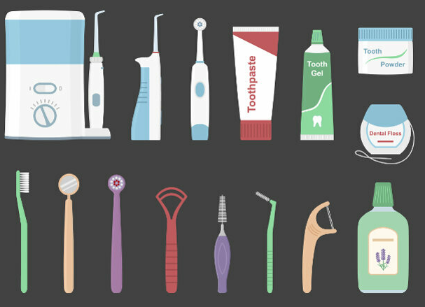
Dental care equipment – home care
Student work: Give english word to each instrument, use vocabulary if needed

Slide 28
Dental care equipment – dental hygienist
https://www.hygieneedge.com/hygiene-tools
Dental Air Polishing Systems - high-pressure air to propel special powders at a patient’s teeth
Dental Hygiene Handpieces - provide a smooth and comfortable polishing of the patient's teeth
Dental Prophy angles - used to apply prophy paste to a patient's teeth during a routine hygiene appointment
Dental Ultrasonic Scalers - piezoelectric or magnetostrictive technology, dental ultrasonic scalers rapidly vibrate an inserted tip to effectively remove calculus, debris and stains
Mirror - allows to see your teeth at multiple angles, are small, rounded mirror
Probes - look like hooks and are used to check gum health and measure pocket depths around a tooth
Scaler - is what actually scrapes away plaque and tartar from teeth.
Curette - scrapes tartar from underneath the gums. It has a rounded, spoon-shaped end with a hole in it, and this allows the hygienist to remove dental calculus, which is a hard deposit at the base of the teeth.
Polisher - tool is what is used at the end of cleaning to make teeth shiny and bright. This removes surface level stains and makes teeth smooth after being scaled.
Suction - to remove saliva from the mouth while teeth are cleaned. This eliminates the need to spit over a sink and helps keep teeth dry when necessary, such as during a filling procedure.

Slide 29
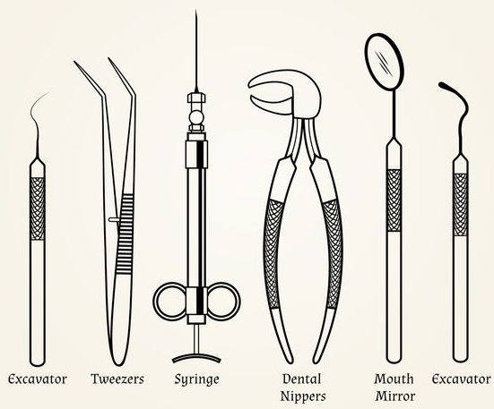
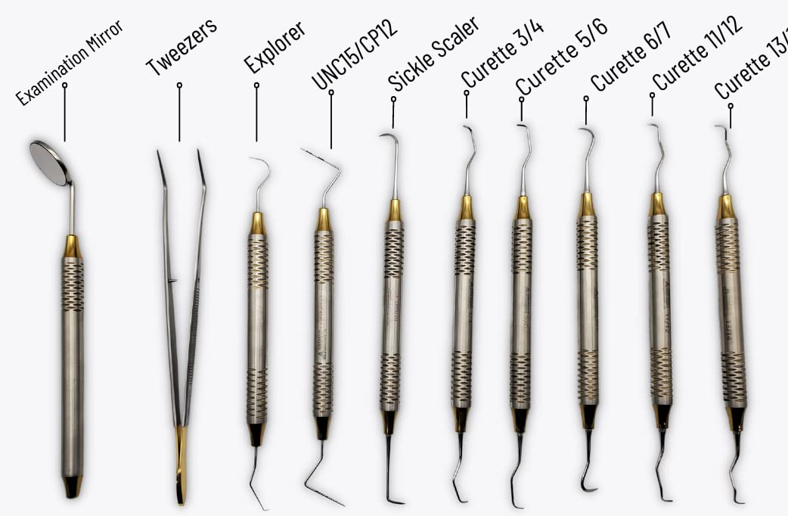
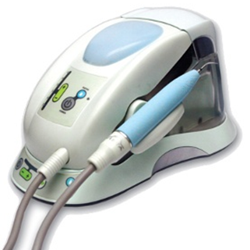
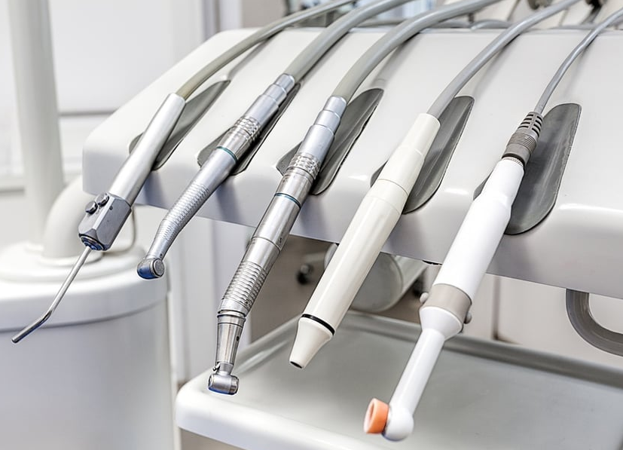
Dental care equipment – dental hygienist

Slide 30
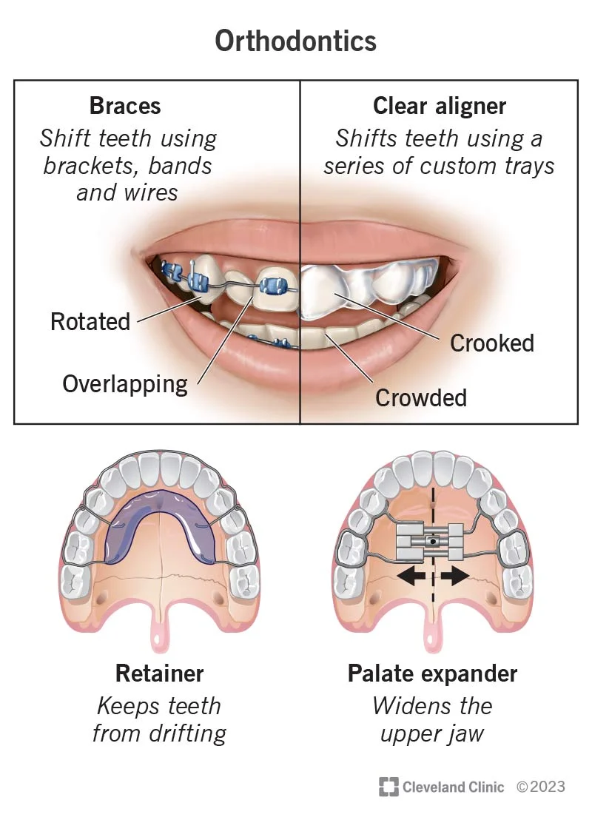
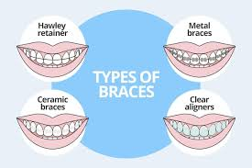
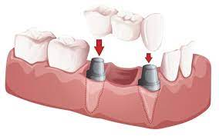
Orthodontics
Orthodontics is a dental specialty focused on aligning patients bite and straightening the teeth
Orthodontist is need for crooked, overlapped, twisted or gapped teeth.
Braces or clear aligners
Removable retainers
Dental bridge
Veneers
Dental crown

Slide 31
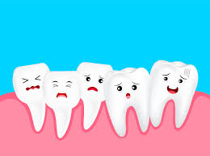
Thank you for atention

