Slide 1
UNZSOP07 English for Pediatric Nursing 2
UOLP055 English for Dental Hygiene 2
Markéta Skalná, PhD
marketa.skalna@fvp.slu.cz
Seminář 1 / 3

Slide 2
Podmínka splnění předmětu - zápočet
Podmínkou udělení zápočtu je:
1) účast na výuce (viz sylabus předmětu) – 80%
(možnost 1x absence, další absence s lékařským potvrzením o nemoci, hospitalizaci)
2) Seminární prezentace – vypracování prezentace formou PPT na jedno z témat probíraných ve výuce, také viz. sylabus, její přednes na závěrečné hodině 4.4. 2023
V případě absence na poslední hodině nebo v případě více absencí na přednáškách budou stanoveny požadavky navíc individuálně (AJ text na A4)

Slide 3
Obsah předmětu (témata prezentací)
1. Injuries in children – specifické kapitoly, 3 studenti
2. Emergency and First Aid for children of different age – 2 studenti
3. Specific medical care (small kids, obese, mental diseases) – 3 studenti
4. Communication with family members – 3 studenti
5. Multicultural approach (ethnic specifics) – 3 studenti
6. Reflection on healthy lifestyle
7. Medical system in Czech Republic and abroad – 3 studenti
8. Student's presentations

Slide 4
Obsah předmětu (témata prezentací) – dent.hyg
1. Communication with patient in dental care (procedure, education)
2. Dental care equipment (instruments, brushes, shower, flosses, home care)
3. Oral Health
4. Orthodontics
5. Medical technique and imagining in dentistry
6. Multicultural approach (ethnic specifics), Pediatric patient
7. Student's presentations

Slide 5
Obsah semináře
PS:
Injuries in children – specifické kapitoly, 3 studenti
Emergency and First Aid for children of different age – 2 studenti
DH: self-study – make a short presentation (max 10 slide):
Specific of medical care for pediatric patients in dental hygiene
Oral Health in children

Slide 6
PS: Obsah semináře 1
Communication in ambulance – opakování
Communication basics – SOKRATES
Injuries
Emergency and first aid

Slide 7
Communication with patients in ambulance – příklad konverzace
https://www.youtube.com/watch?v=44SL8i8h0dg -návštěva lékaře, fráze, basic obss
Please come in, I am a nurse / this is a doctor Jméno
Nationality? Citizenship (stát. občanství)? Passport Number?
Permanent or temporary address/residence? Are you insured?
Please show me your health insurence card/travel insurance. After treatment wait for an account, pay
Are there any serious diseases in your family such as cancer, diabetes, high blood pressure, ischaemic heart disease, tuberculosis, heart defect, allergies to some drugs/to disinfection/to some food ..
Does she/he have had any serious disease? undergone some surgery? use drugs? What?
Do you know her/his blood group? When did she/he eat/drink last?
What is a matter? What is a problem? What is bringigng you? What is troubling/bothered you?
I will examine you. Please get undressed/strip to the waist/strip from waist down/you can dressed
Sit down/lay down/stand up/open your mouth and say A. Nausea? Vomiting?
Where it hurts? What do you feel? Hurts, aches/itches/pusches/burns/stitches, squeezes
I will write you a prescription for… you pick it up in a pharmacy. See you soon..

Slide 8
General communication skills - reading
demonstrating these skills will ensure your consultation remains patient-centred and not checklist-like (just because you’re running through a checklist in your head doesn’t mean this has to be obvious to the patient)
Some general communication skills which apply to all patient consultations include:
Demonstrating empathy in response to patient problems: both verbal and non-verbal
Active listening: through body language and verbal responses to what the patient has said
An appropriate level of eye contact throughout the consultation
Open, relaxed, yet professional body language (e.g. uncrossed legs and arms, leaning slightly forward in the chair)
Making sure not to interrupt the patient throughout the consultation
Establishing rapport (e.g. asking the patient how they are and offering them a seat)
Explaining to the patient what you have discussed so far and what you plan to discuss next
Summarizing at regular intervals

Slide 9

Communication – SOCRATES https://geekymedics.com/gynaecology-history-taking/
Site
Ask about the location of the symptom:
“Where is the pain?”
“Can you point to where you experience the pain?”
Onset
Clarify how and when the symptom developed:
“Did the pain come on suddenly or gradually?”
“When did the pain first start?”
“How long have you been experiencing the pain?”
Character
Ask about the specific characteristics of the symptom:
“How would you describe the pain?” (e.g. dull ache, throbbing, sharp)
“Is the pain constant or does it come and go?”
Radiation
Ask if the symptom moves anywhere else:
“Does the pain spread elsewhere?” (e.g. shoulder tip pain in ectopic pregnancy)

Slide 10
Communication - SOCRATES
Associated symptoms
Ask if there are other symptoms which are associated with the primary symptom:
“Are there any other symptoms that seem associated with the pain?” (e.g. patients presenting with an ectopic pregnancy may have associated nausea and vomiting)
Time course
Clarify how the symptom has changed over time:
“How has the pain changed over time?”
Ask if the symptom has any relationship to the menstrual cycle:
“Have you noticed if this symptom is worse at a particular time in the month?”
Exacerbating or relieving factors
Ask if anything makes the symptom worse or better:
“Does anything make the pain worse?” (e.g. patients with symphysis pubis dysfunction may find going up or down the stairs makes things worse)
“Does anything make the pain better?” (e.g. patients with gastro-oesophageal reflux may find that antacid medication helps with their symptoms)
Severity
Assess the severity of the symptom by asking the patient to grade it on a scale of 0-10:
“On a scale of 0-10, how severe is the pain, if 0 is no pain and 10 is the worst pain you’ve ever experienced?”
Ask the patient if the symptom is having a significant impact on their day to day life:
“How is the pain impacting your daily life?”

Slide 11
Communication on admission – work in pairs
Ilnesses and treatments: https://agendaweb.org/vocabulary/health-illness-worksheets-resources.html
Make a conversation with foreign patient coming to the ambulance/hospital:
check his personal details
shortly ask about anamnesis, family history
ask about the problems and its details according to SOKRATES
try to use your communication skills as much as possible (do your best)
write down the notes for short summary about the patient and his problem
change roles (one is a patient, second is nurse)
the problém of patient and symptoms are illusory
Summary:
There is a patient from XX country, sex, age, … I have performed….
Examination shown because of…. And I found ….

Slide 12
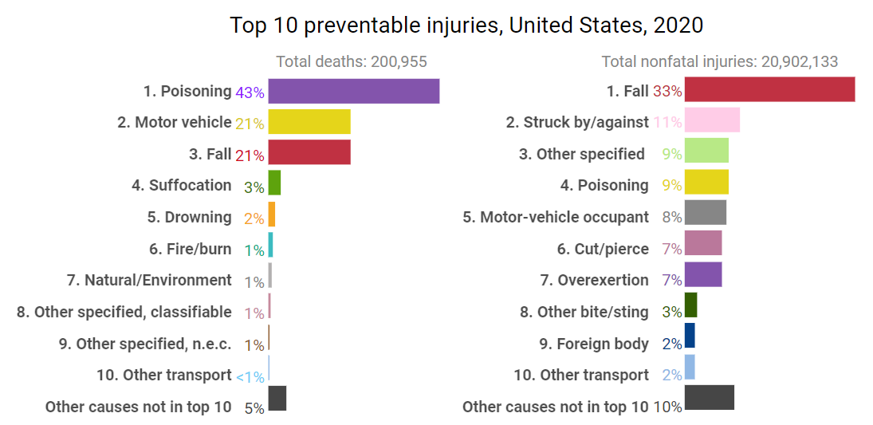
Injuries - Top 10 causes of death in USA
https://injuryfacts.nsc.org/all-injuries/deaths-by-demographics/top-10-preventable-injuries/
The top three leading causes of preventable injury-related death: poisoning, motor vehicle, and falls – account for over 86% of all preventable deaths. Next suffocation (udušení), drowning (utopení), fire and burns and natural or environmental disasters—accounts for more than 5% of the total.
In contrast, nonfatal emergency department visits are dominated by fall-related injuries, struck by or against, other specified cause and poisoning are often injury-related emergency department visits
Only 3 injury causes are in the top 10 for both deaths and nonfatal injuries: Poisoning, Motor vehicle, Falls

Slide 13
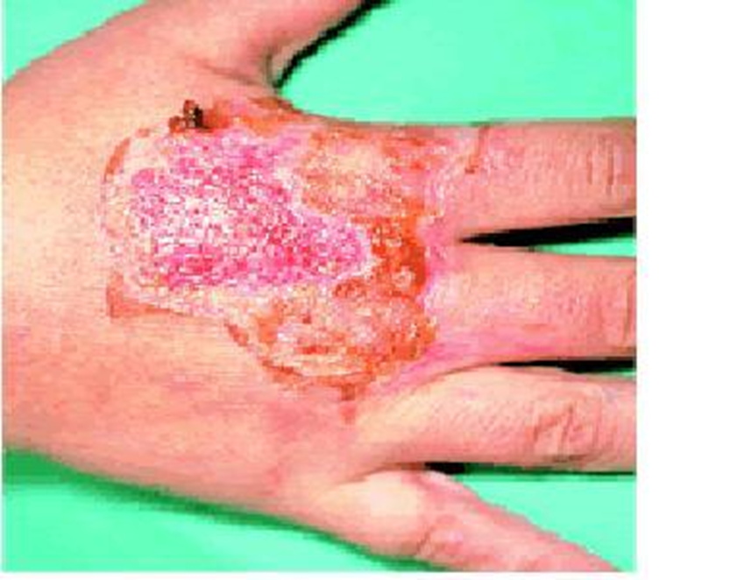
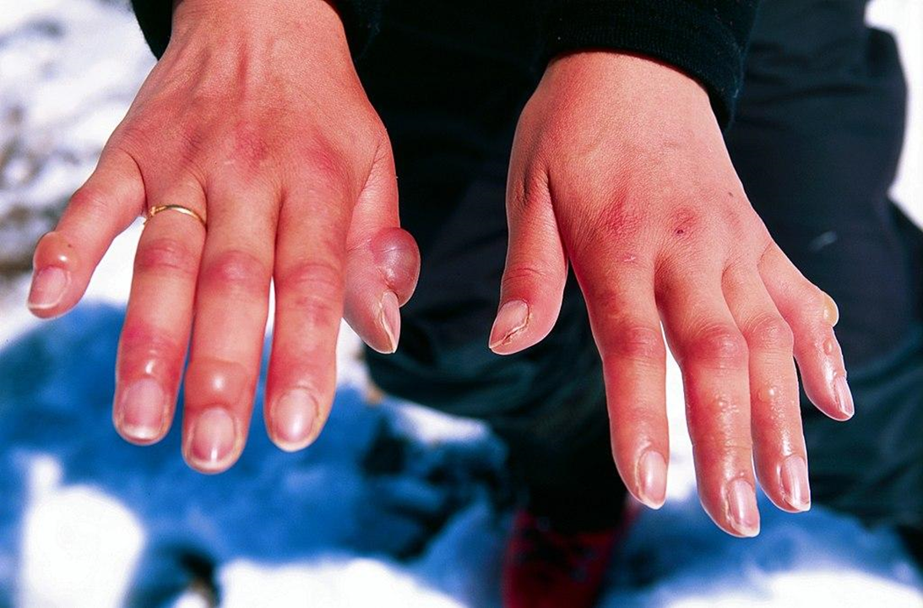
Definition of Injury - reading
an injury or accident is a sudden event affecting the organism from the outside and damaging it
a wound is a condition where the continuity of the skin, mucous membrane or surface of an organ is disrupted
the medical synonym for injury is the word trauma
more serious injuries can be fatal or have other permanent consequences
Superficial wounds: chemical injuries – etching, heat and cold injuries (burns, frostbite)

Slide 14
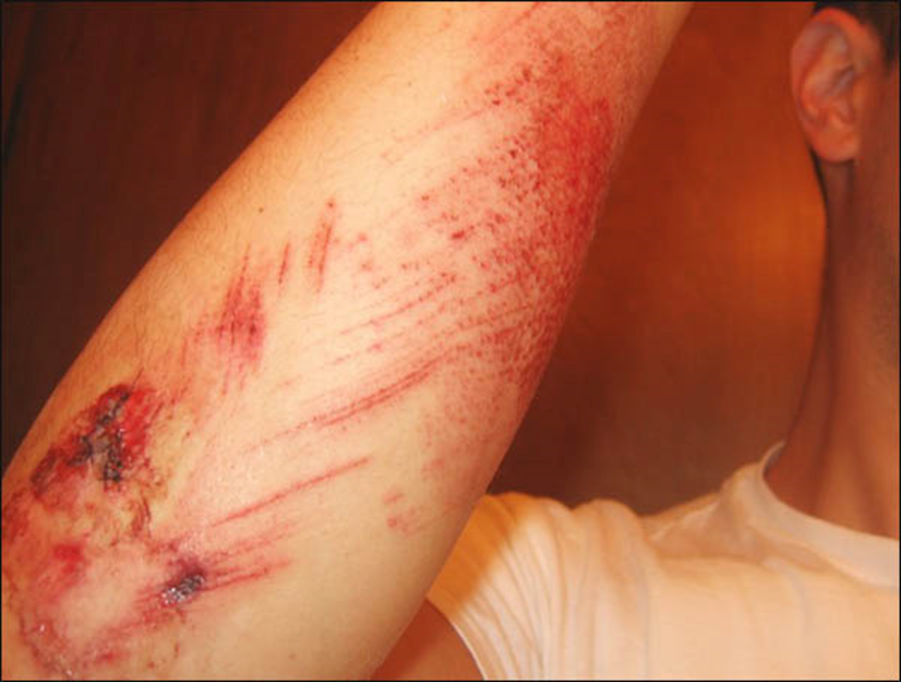
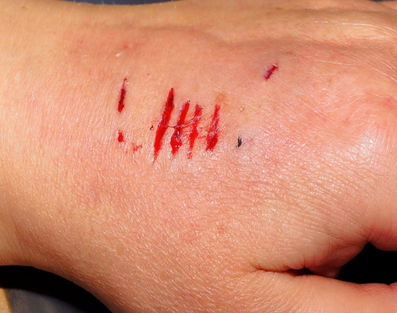
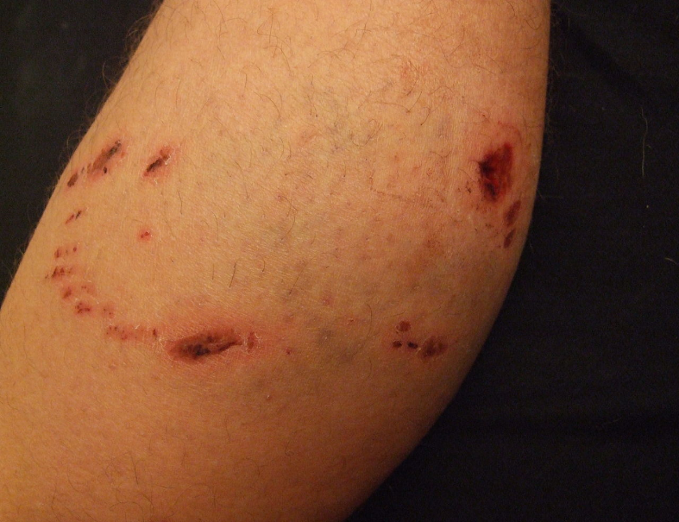
Injury - deep wounds
wound - violation of the integrity of the body's tissues
sharp force trauma - sharp object, hurts and bleeds a lot
sucking wound - impact of a sharp object, deeper wound, greater tissue loss
stab wound - penetrates deeply
gunshot wound - shot, gunshot
bite wound - often bruised and infected
blunt force trauma – laceration or/and contused wound

Slide 15
Causes of injuries
traffic injuries - usually multiple injuries and polytrauma, often multiple persons injured simultaneously, high mortality and disability rates
work injuries - limb injuries, falls from height, crush syndrome, electrocutions, burns, etc.
agricultural injuries - lost limb injuries, crush syndrome, typically extrication in inaccessible terrain
domestic injuries - usually falls from low height, injuries when working with various appliances
sports injuries - mostly limb injuries, tendon ruptures, jumping into water - spinal and spinal cord injuries
criminal injuries - blunt trauma, stab and gunshot wounds, possibly blast syndrome

Slide 16
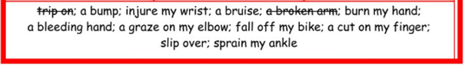
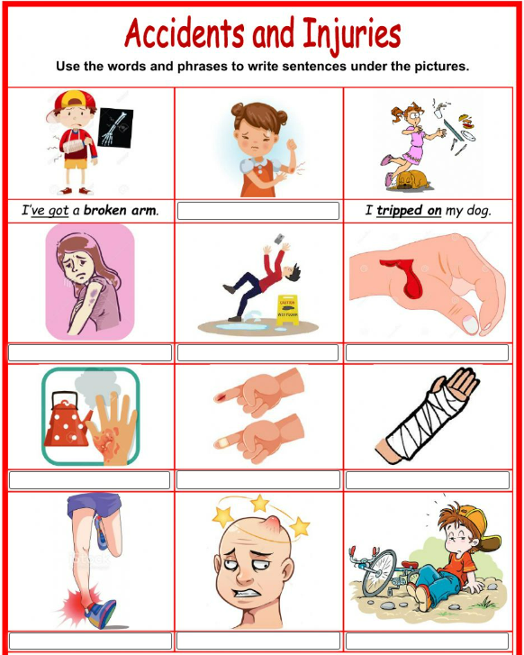
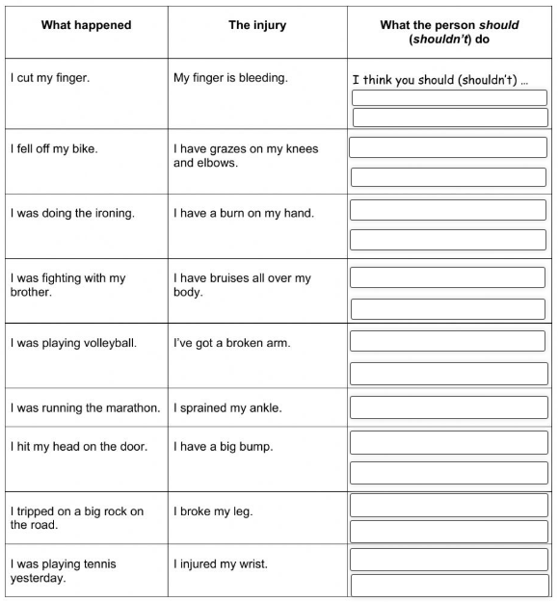
Injuries – describe the problem

Slide 17

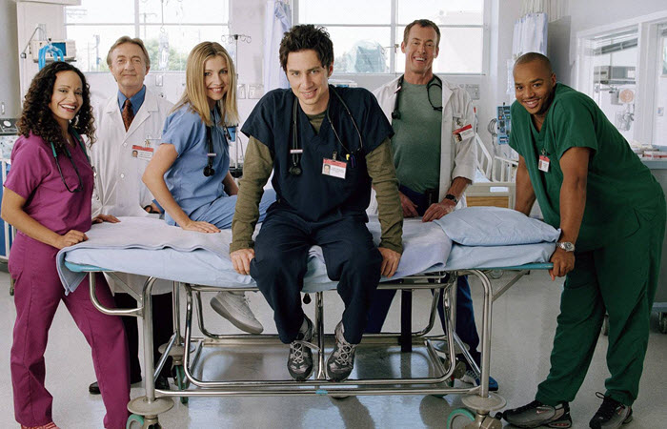

Emergency and First Aid
Native English Speaking in Injury + doctor
https://www.youtube.com/watch?v=-Sh3u80oGZY
Firts Aid Kit
https://www.youtube.com/watch?v=-wuQYoRtzNI
Mistakes in FirstAid
https://www.youtube.com/watch?v=2ynlaWUwMsA&t=70s

Slide 18
First Aid - reading
People should know how to behave in various life-threatening situations and how to provide first aid.
When an accident happens we should keep calm and act without panic.
Emergency First Aid when applied properly and in time can save a man´s life.
ASSES: First, asses the situation. Is danger still present? Decide what has happened, ask the affected person or any witnesses how the accident occured.
MAKE SAFE: Make sure that it is safe to approach the scene of an accident and the casualty.
GIVE AID: When giving emergency aid, do not try to do too much.
Always treat the unconscious first, then those who are bleeding and finally those with broken bones and other injuries.
Never give an affected person anything to eat, drink or smoke.
GET HELP: Use a bystander to help you. Summon help by using the 155 or 112
The provision of first aid for an injured person in the Czech Republic is given by law.
Failure to provide is punishable.

Slide 19
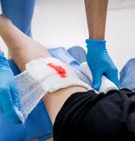
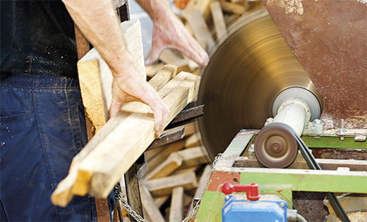
BLEEDING
In case of large cuts when bleeding occurs apply pressure directly on the bleeding part with a pad, e.g., a clean cloth. /Your fingers will do if necessary.)
If possible, lift the wounded part into the air.
Apply a dressing and bandage firmly.
If the blood seeps through the dressing, put another bandage over the top of the original.
Do not remove the dressing once in place.
Call for medical help.
Venous haemorrhage - blood dark red, from the wound flows slowly
Arterial haemorrhage - blood bright red, squirting out of the wound
Capillary - minor bleeding from small blood vessels
Mixed haemorrhage

Slide 20
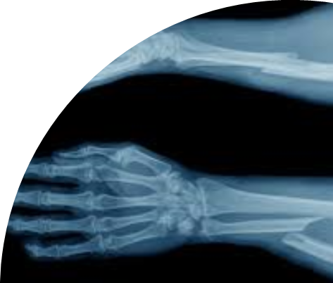
BROKEN BONES (FRACTURES)
Fractures are usually closed or open
Features of broken bones are as follows:
Pain at or near the fracture
The casualty cannot move the part normally
Tenderness, swelling and perhaps, later on, bruising
Odd shape or strange angle.
Do not move the injured person unless he is in danger of further injury.
Support and steady the injured part. Use rolled up blankets, coats, bags etc. to support the injury.
If it is an open fracture, cover lightly with a clean dressing.
Do not put pressure on it. To control any bleeding gently press the sides of the wound together.
Do not give the injured person anything to eat, drink or smoke. Arrange transport to hospital.

Slide 21
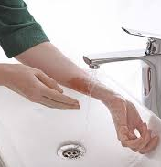
BURNS AND SCALDS
Burns result from dry heat, scalding from moist or wet heat.
Burns may be superficial (very tender and with red skin), may be blistered or dee with waxy, pale or even charred skin.
Place the area under cold, slowly running water or immerse in cold water for at least 10 minutes, or longer if the pain persists.
Remove any rings, watches, tight clothing etc. before the area starts to swell.
Do not remove any clothing that is stuck to the skin.
Seek medical help.
Never apply fats, creams, ointments or sticking plasters.
Do not interfere with blisters.

Slide 22
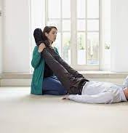
FAINTING
The casualty feels weak and lightheaded and falls to the ground. The pulse is usually slow or weak.
If the affected person feels faint sit him down his head between his knees.
Loosen tight clothing from around his chest, neck and waist.
If the affected person has fallen to the ground leave him there but raise his legs in the air.
Watch the airway, breathing and pulse and be prepared to resuscitate.

Slide 23
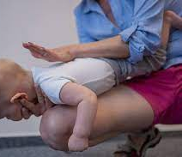
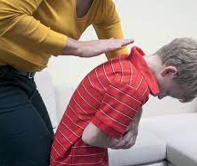
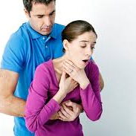
CHOKING
Open the airway and remove any visible obstruction such as false teeth or food.
Encourage coughing.
Bend the casualty forwards. Slap sharply between the shoulder blades up to four times.
If the affected person stops breathing, follow resuscitation.
If a baby or child is choking, tip them over your knee so that the head is lower than the stomach.
Give a series of 4 firm back slaps.

Slide 24
RESUSCITATION
Open the airway: Lift the jaw and tilt the head to open the airway. Remove any object from inside the mouth.
Check breathing: Look to see it the chest is rising and falling. Listen for the noise of breathing, feel for his breath against your cheek. If the casualty is breathing turn him into the recovery position.
Cirkulation – check the pulse: Find the pulse in the neck by placing your fingers to the side and pressing gently down.
If pulse and breathing are both present, turn the affected person into the recovery position on his side, taking care to protect his face.
His head should remain tilted with the jaw forward to maintain the open airway.
Check that the person cannot roll forwards or back wards.

Slide 25
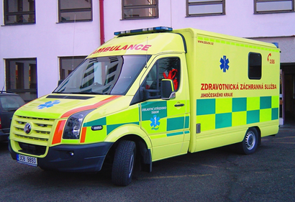
IF THERE IS A PULSE BUT NO BREATHING - start artificial ventilation
Pinch person´s nose firmly
Take a deep breath and seal your lips around the casualty´s lips.
Blow into his mouth watching the chest rise.
Let the chest fall completely.
When breathing starts, turn casualty into the recovery position.
IF THERE IS NO PULSE AND NO BREATHING - shout for help
Phone for an ambulance, then start chest compressions combined with ventilations.
Give 2 breaths artificial ventilation. Place the palm of one hand. Place the other hand over the top, interlocking fingers. Keeping your arms straight, press down 4-5 cms.
Do this 30x times at a rate of 100 per minute.
Repeat cycle 2 breaths to 30 compressions.
If condition improves, recheck pulse. Place person in recovery position.
When can we stop cardiopulmonary resuscitation:
If we are exhausted and do not have the strength to continue resuscitating
If we are in danger
When emergency emergency arrives and takes over cardiopulmonary resuscitation

Slide 26
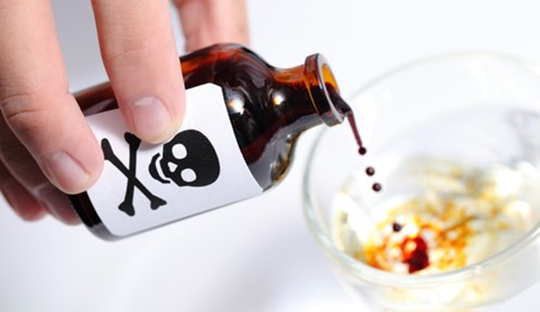
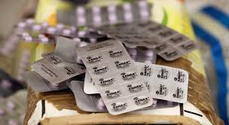
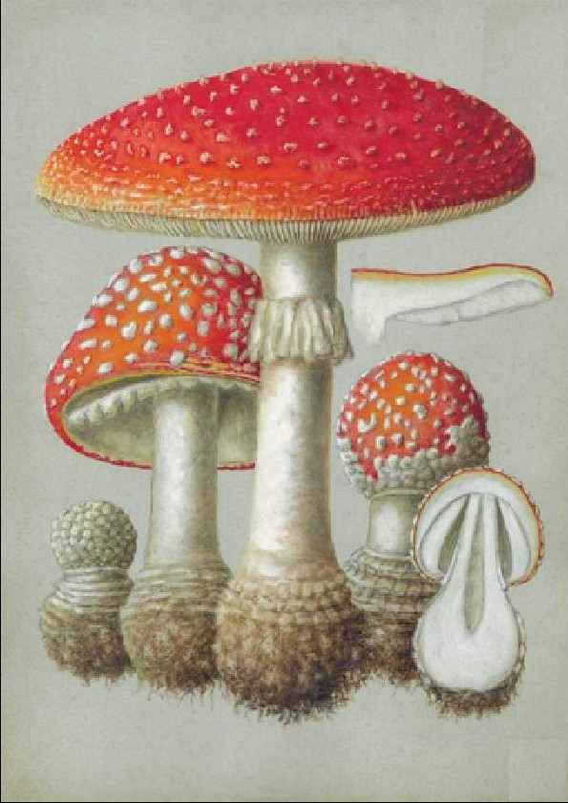
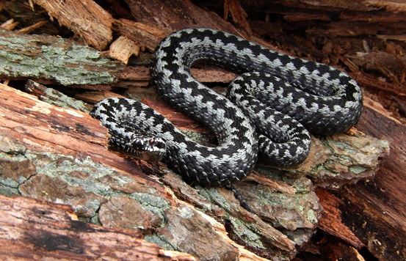
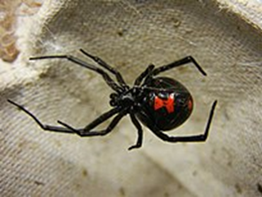
Poisoning
occur consciously or unconsciously
Most often poisoning with drugs, food, chemicals, poisons of animals
Drug poisoning
The most common poisoning
Danger in young children !!! do not leave medication freely !!!
Food poisoning
poisonous mushrooms, poisonous plants
Chemical poisoning
are very dangerous
carefully hide from children
do not confuse packaging
Animal poisoning
bites by poisonous snakes, bites by poisonous spiders

Slide 27
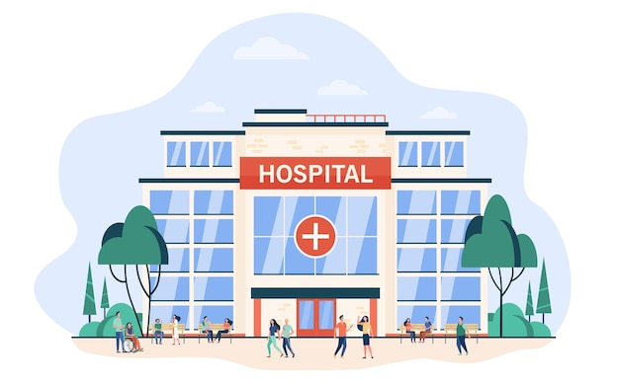

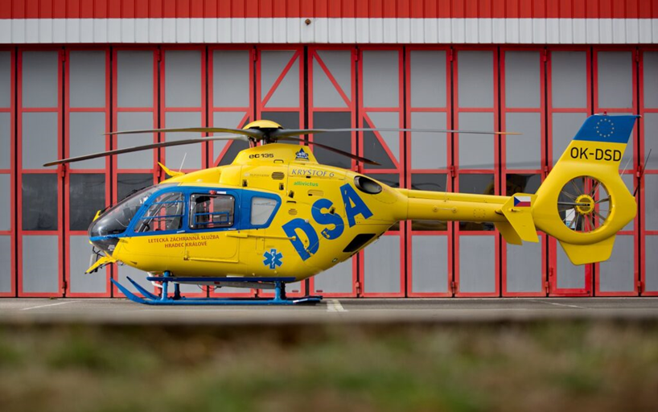
The most important thing is that the patient is transported to a medical facility as soon as possible.

