Slide 1
Grafická tvorba s AI -prompty a príklady použitia
Mgr. Lucia Drotárová, PhD.

Slide 2
Lego výrobok
A Lego product photography of a cute rat eating a piece of a gingerbread cottage in Christmas style, made entirely with Lego bricks. The scene should be carefully constructed with Lego, showcasing the intricate details of the gingerbread cottage and the rat. The rat should be depicted as playfully nibbling on a piece of the cottage, with the Christmas theme evident in the background. The composition should resemble professional product photography, highlighting the creativity and craftsmanship of the Lego construction.

Slide 3
fisheye lens ultra wide shot
A fisheye lens ultra wide shot of a cute rat sitting on the bed of a Lego cargo truck, with a Christmas-themed background. The rat is in a playful motion pose, perhaps interacting with gifts under a Christmas tree, embodying the joy and playfulness of the season. The scene is captured with a colorful palette, giving the image a vibrant and lively feel. The style should be raw, with a high level of detail and clarity, as if taken with a fisheye lens, providing an expansive view of the festive setup --ar 16:9 --style raw --s 100 --v 6.0

Slide 4
„trompe-l'oeil details“
A pencil sketch of a cute rat coming to life from the paper, as if it were chewing its way out through a classic rat hole in the wall. The drawing should feature trompe-l'oeil details, making it appear as if the rat is realistically emerging from the paper. The rat should be depicted in a playful and endearing manner, with its features and actions conveying a sense of liveliness and curiosity. The sketch should capture the essence of the rat coming to life, with the illusion of the paper being torn or chewed through.

Slide 5
Video game/comic style
An illustration in a video game/comic style with a darker tone. In the center of the image, there's a rat dressed in a black robe with a hood, holding a scythe, representing death, the black death. The rat stands on barren, trampled ground with no vegetation, scattered with a few stones. In the background, a dark castle looms in the distance. The scene is dimly lit by candles, enhancing the ominous and eerie atmosphere.

Slide 6
Graffiti, street art
A graffiti street art on a multi-story residential building with balconies. The wall is painted with a scene where, from the top balcony, a cat has knocked over a Christmas tree. The cat is now fleeing the scene, while the Christmas tree, gifts, and ornaments are depicted falling down towards the lower levels of the building. The graffiti art should capture the dynamic and humorous moment of the Christmas tree tumbling down, with vibrant colors and a lively street art style. The overall atmosphere should be playful and festive, embodying the spirit of Christmas in an urban setting.

Slide 7
Blueprint manuscript
A blueprint manuscript of a Christmas potato salad with mayonnaise, representing the idea of a unique, regional recipe. The blueprint should have an architectural or technical drawing style, showing the 'construction' of the salad with various ingredients. It should include layers or sections for potatoes, mayonnaise, and other common ingredients, with annotations or notes suggesting possible variations or regional preferences. The drawing should capture the essence of a playful debate over the perfect recipe, embodying the spirit of a traditional Christmas dish with a creative twist.

Slide 8
Dagerotypia (technika staršia než fotografie)
A shocking daguerreotype of a giant bat caught by two men, who are poor miners in an old mine. The image is styled as a daguerreotype from the year 1850, giving it the appearance of a dirty, old picture. It should be in a vintage color black monochrome palette to enhance the historical and mysterious feel of the image. The scene should capture the sense of an astonishing discovery in the 19th century, with the miners appearing amazed or frightened by the giant bat --style raw --ar 16:9

Slide 9
powerful action shot
A powerful action shot depicting dynamic movement and intense emotion. This image is designed to be a poster for an action-packed movie or game. It could include an explosive scene with characters running, jumping, or shooting, all captured in the midst of thrilling action. The style should be dramatic and vivid, with a focus on the raw energy and excitement of the moment.

Slide 10
Čierne siluety, vhodné ako logo
Create an image featuring black silhouettes of various rats in dynamic poses that reflect typical rat behaviors such as playing, jumping, standing on hind legs, or resting. Include the text 'Must Love Rats' in an elegant font that complements the imagery. The design should convey admiration and love for rats, suitable for print or as a logo for a community of rat enthusiasts.

Slide 11
Steampunk
A steampunk castle on the side of a hill, with various steampunk vehicles around, bathed in sunlight. The image should be portrayed with a sense of both expansive and profound depth, blending hues of light gold and dark cyan to create an epic landscape. The style should evoke the feeling of a painter's brush, capturing the unique and imaginative essence of steampunk architecture and technology. The castle and surrounding vehicles should be intricately detailed, showcasing the inventive and mechanical aspects of steampunk --ar 16:9

Slide 12
Kaleidoskop
A kaleidoscopic view, kaleidoscopic visions of a cute rat, where reality shatters and reshapes into kaleidoscopic designs of cream and rusty brown colors. The image should feature stunning patterns that fracture and reform, creating a mesmerizing and artistic representation of the rat. The style should be raw, focusing on the intricate and repetitive patterns characteristic of a kaleidoscope, with an emphasis on the chosen color scheme --style raw --ar 1:1

Slide 13
Popisujte očakávané vyznenie
An image of a female orc looking at her phone with a puzzled expression, as if she doesn't understand what she's seeing. The orc should be depicted as strong and imposing, in line with the typical orcish traits of strength and resilience. Her expression should convey confusion or bewilderment, without being disrespectful. The scene should capture this humorous moment, showing the contrast between the orc's formidable appearance and her struggle with modern technology.

Slide 14
Sketchbook
In the style of a sketchbook, this image captures a beautiful female mechanic in a steampunk world, portrayed in full body. The artwork features a mix of bold dark lines and loose lines, creating a dark, gritty, and realistic sketch on paper. The character is adorned with arcane symbols and runes, emphasizing a dark theme. The composition is crafted to perfection, adhering to the golden ratio, resulting in a masterpiece of the highest quality with sharp focus. The anatomy of the character is flawlessly depicted, showcasing a better hand and perfect anatomy, surrounded by a rough sketch atmosphere.

Slide 15
Double exposure – dvojitá expozícia
The image showcases the silhouette of a Nordic queen, her outline filled with a lush forest scene, employing the technique of double exposure. The silhouette features crisp lines, standing out against a monochrome background. This artistic composition merges the majesty of a queen with the natural beauty of a dense forest, creating a striking visual metaphor. The monochrome scheme enhances the contrast and focuses on the intricate details within the queen's silhouette, offering a unique and captivating depiction.

Slide 16
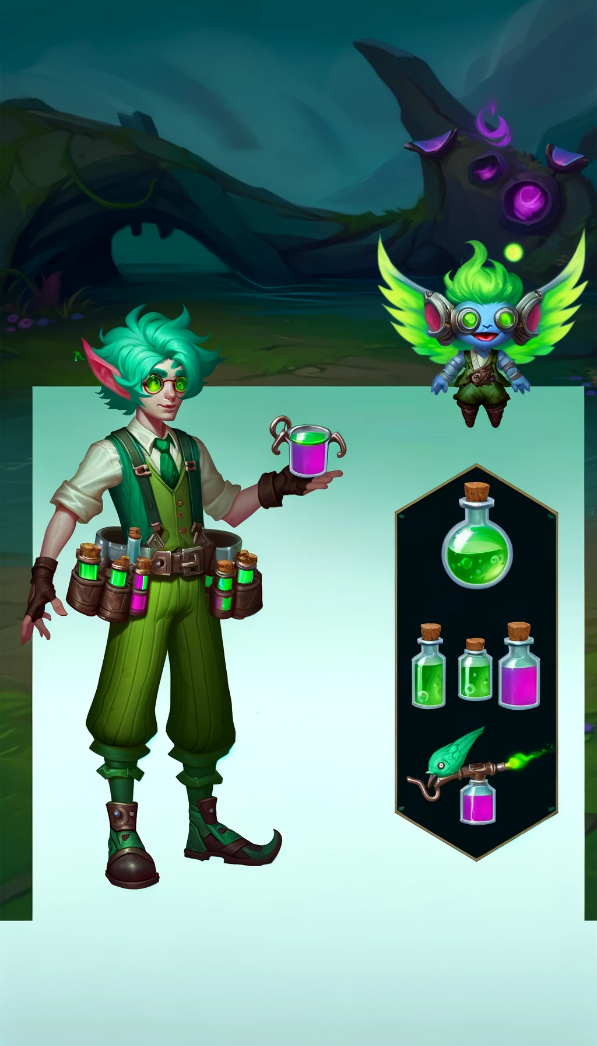
Vyskúšajte si... Tvorbu postavy do obľúbenej hry!
Neberte prvý výsledok, upravujte prompty ďalej, pridávajte detaily.
Toto je napríklad pokus č. 3 (po pridaní krajiny pôvodu), staršia varianta je vpravo.
Uhádnete hru, typ postavy, región pôvodu?

Slide 17
O autorke
Mgr. Lucia Drotárová, PhD., je psychológ, zaoberá sa sociálnou psychológiou, gerontopsychológiou a v poslednej dobe novými možnosťami pre pomáhajúce profesie v súvislosti s digitálnou transformáciou.
Učí na Slezskej univerzite v Opave.
Je členkou univerzitnej skupiny pre zavádzanie AI do výuky.
Je autorkou Plug-Inu Thesis Mentor (Silesian University) pre chatGPT4, digitálneho asistenta pre pomoc s tvorbou bakalárskych prác študentov oboru Sociální patologie a prevence.
Všetky obrázky uvedené v prezentácii pripravila pomocou AI DALL-E

