Slide 1
Drug Abuse
Ing. Pavla Melecká
Odborný anglický jazyk 1
Zima 2020

Slide 2
Source
National Institute on Drug Abuse
(NIDA ) USA
    It is the lead federal agency supporting scientific research on drug use and its consequences.

Slide 3
1. Reasons why adolescents take drugs
To fit in: Many teens use drugs “because others are doing it”—or they think others are doing it—and they fear not being accepted in a social circle that includes drug-using peers.
To feel good: Abused drugs interact with the neurochemistry of the brain to produce feelings of pleasure. The intensity of this euphoria differs by the type of drug and how it is used.
To feel better: Some adolescents suffer from depression, social anxiety, stress-related disorders, and physical pain. Using drugs may be an attempt to lessen these feelings of distress. Stress especially plays a significant role in starting and continuing drug use as well as returning to drug use (relapsing) for those recovering from an addiction.

Slide 4
1. Reasons why adolescents take drugs
4. To do better: Ours is a very competitive society, in which the pressure to perform athletically and academically can be intense. Some adolescents may turn to certain drugs like illegal or prescription stimulants because they think those substances will enhance or improve their performance.
5. To experiment: Adolescents are often motivated to seek new experiences, particularly those they perceive as thrilling or daring.

Slide 5
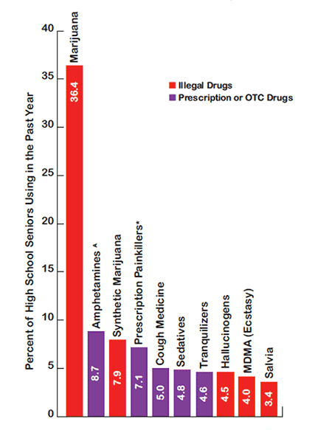
2. Drugs most frequently used by adolescents

Slide 6
2. Drugs most frequently used by adolescents
Alcohol and tobacco are the drugs most commonly abused by adolescents, followed by marijuana.
The next most popular substances differ between age groups”
  Young adolescents tend to favor inhalant substances
  Older teens are more likely to use synthetic marijuana (“K2” or “Spice”) and prescription medications (particularly opioid pain relievers like Vicodin® and stimulants like Adderall^{®)}.

Slide 7
Inhalants
Various household products have fumes that are sometimes breathed to obtain a brief, typically alcohol-like high
E. g. , cleaning fluids, glues, lighter fluid, aerosol sprays, and office supplies (markers and correction fluid)

Slide 8
Inhalants
Although the high from inhalants typically wears off quickly, immediate health consequences of inhalant abuse may be severe: In addition to nausea or vomiting, users risk suffocation and heart failure—called "sudden sniffing death."
Serious long-term consequences include liver and kidney damage, hearing loss, bone marrow damage, and brain damage.
Although addiction to inhalants is not very common, it can occur with repeated abuse.

Slide 9
Inhalants
Early abuse of inhalants may also be a warning sign for later abuse of other drugs.
One study found that youth who used inhalants before age 14 were twice as likely to later use opiate drugs.
So it is important for parents to safeguard household products and be alert to signs that their younger teens may be abusing these substances.

Slide 10
Marijuana
Contrary to common belief, marijuana is addictive. Estimates from research suggest that about 9 percent of users become addicted to marijuana; this number increases among those who start young (to about 17 percent, or 1 in 6) and among daily users (to 25–50 percent)
Long-term marijuana users who try to quit report withdrawal symptoms including irritability, sleeplessness, decreased appetite, anxiety, and drug craving, all of which can make it difficult to stay off the drug.

Slide 11
3. Addiction
Addiction occurs when repeated use of drugs changes how a person’s brain functions over time.
Becoming addicted: The transition from voluntary to compulsive drug use reflects changes in the brain’s natural inhibition and reward centers that keep a person from exerting control over the impulse to use drugs even when there are negative consequences

Slide 12
4. Risk factors for becoming addicted to drugs
Stressful early life experiences such as being abused or suffering other forms of trauma (Adolescents with a history of physical and/or sexual abuse are more likely to be diagnosed with substance use disorders)
genetic vulnerability
prenatal exposure to alcohol or other drugs
lack of parental supervision or monitoring
association with drug-using peers

Slide 13
5. Signs of drug use in adolescents
If an adolescent starts behaving differently for no apparent reason—such as acting withdrawn, frequently tired or depressed, or hostile—it could be a sign he or she is developing a drug-related problem. Parents and others may overlook such signs, believing them to be a normal part of puberty.

Slide 14
5. Signs of drug use in adolescents
Other signs:
a change in peer group
carelessness with grooming
decline in academic performance
missing classes or skipping school
loss of interest in favorite activities
changes in eating or sleeping habits
deteriorating relationships with family members and friends

Slide 15
6. Drug addiction treatment
Based on the consensus of drug treatment experts, the American Society of Addiction Medicine (ASAM) has developed guidelines for determining the appropriate intensity and length of treatment for adolescents with substance abuse problems, based on an assessment involving six areas:
  Level of intoxication and potential for withdrawal
  Presence of other medical conditions
  Presence of other emotional, behavioral, or cognitive conditions
  Readiness or motivation to change
  Risk of relapse or continued drug use
  Recovery environment (e.g., family, peers, school, legal system)

Slide 16
6. Drug addiction treatment
Because no single treatment is appropriate for every adolescent, treatments must be tailored for the individual.
treatment must be long enough and strong enough to be effective
  providing lower than the recommended level of care or a shorter length of treatment than recommended will increase the risk of relapse and could cause the patient and his or her family members to lose hope in the treatment because they will see it as ineffective.

Slide 17
7. Settings for adolescent drug abuse treatment
  Outpatient/Intensive Outpatient
It´s the most common type of the treatment
When delivered by well-trained clinicians, it can be highly effective
Outpatient treatment is traditionally recommended for adolescents with less severe addictions, few additional mental health problems, and a supportive living environment
It varies in the type and intensity of services offered and may be delivered on an individual basis or in a group format
Low- or moderate-intensity outpatient care is generally delivered once or twice a week
Intensive outpatient services are delivered more frequently, typically more than twice a week for at least 3 hours per day.

Slide 18
7. Settings for adolescent drug abuse treatment
2. Partial Hospitalization
It´s a higher level of care called also day treatment.
Suitable for adolescents with more severe substance use disorders but who can still be safely managed in their home living environment
This setting offers adolescents the opportunity to participate in treatment 4–6 hours a day at least 5 days a week while living at home.

Slide 19
7. Settings for adolescent drug abuse treatment
3. Residential/Inpatient Treatment
It´s a resource-intense high level of care, generally for adolescents with severe levels of addiction whose mental health and medical needs and addictive behaviors require a 24-hour structured environment to make recovery possible.
These adolescents may have complex psychiatric or medical problems or family issues that interfere with their ability to avoid substance use.

Slide 20
7. Settings for adolescent drug abuse treatment
3. Residential/Inpatient Treatment
A well-known long-term residential treatment model is the therapeutic community (TC).
TCs use a combination of techniques to “resocialize” the adolescent and enlist all the members of the community, including residents and staff, as active participants in treatment.
Treatment focuses on building personal and social responsibility and developing new coping skills.
Such programs offer a range of family services and may require family participation if the TC is sufficiently close to where the family lives.

Slide 21
Drug abuse prevention
VIDEO:
https://www.youtube.com/watch?v=LunoLU3XFKc

