Slide 1
UNZSRP067 General nursing studies 1
Markéta Skalná
Seminář 3

Slide 2
Obsah Semináře 1
Ambulance conversation – what is a matter?
Patient admission in ambulance
Patient admition for hospitalization (to room)
Basic observations (obss)
Situations during hospitalization

Slide 3

Communication with patients in ambulance:
What is a matter? What is a problem? What is bringigng you? What is troubling/bothered you?
https://www.youtube.com/watch?v=2PCgztYXnxk - all situations PLAY IT !

Slide 4
Admission in ambulance – data and anamnesis

Slide 5
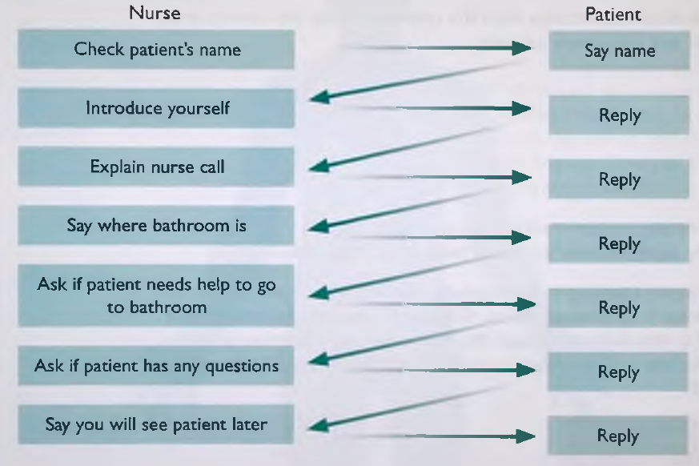
Patient admission in hospital – hospitalization in the room
In pairs, practise welcoming a patient on admission. Student A, you are the nurse; Student B, you are the patient. Change roles, do again.
Listen to a conversation between Stephen, the Ward Nurse, and Mr Connolly, a patient. Mark the following statements. True (T) or False (F) in column 1.1.
1 The nurse knows the patient’s name.
2 The nurse introduces himself to the patient.
3 The nurse explains the nurse call button.
4 The nurse checks if the patient can walk to the bathroom.
5 The nurse is in a hurry. Listening 02 2
Checking a patient's identity (ID) bracelet Listening 04 4
Stephen continues talking to Mr Connolly. Listen to the conversation and answer the following questions.
1 What does Stephen need to do?
2 What is Mr Connolly allergic to?
3 What colour identity (ID) bracelet does Mr Connolly need?

Slide 6
Communication with patient in basic observations
https://www.youtube.com/watch?v=bjOp_6-HvHM
Communication focus: giving instructions to a patient.
Listen to the conversation and tick ✓ the instructions you hear.
1 Can you stand on the scales, please? □
2 Can you open your mouth, please? □
3 Can you bend your leg, please? □
4 Can you turn your head to one side for me, please? □
5 Can you bend your arm, please? □
6 Can you roll up your sleeve, please? □
7 Can you put your arm out straight? □ Listening 06 6
8 Can you hold out your hand, please? □ Next try in pairs

Slide 7
Situations during hospitalization
Examinations také place from 8 to 11 o clock
I will change your bed, it is necesarry. I will turn you o your side.
I change you into clean clothes. Raise your hands. Bathrobe. Replace/change laundry
I wash you on the bed, cut your nails, remove polish from nails before surgery, cream you
We need to position you to prevent bedsores. Keep legs up.
I will feed you. Can you feed yourself? Is it disgusting to you? You are allowed only tea.
Do you suffer from urine leakage/ pain while urinating. I will give you a bowl to the bed.
Doctor recommended bladder catheterisation/ insert catheter through urethra. Annoying.
We transfer you in the department..
Dont have a free bed elsewehere, Im sorry.
Tomorow you will be released to home care. Does anyone care of you?
Who will accompany you home? Discharge report. Take all you things with you. Here is

Slide 8

Patient‘s admission
Nikola kratinová

Slide 9


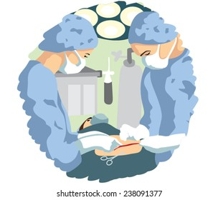
WHY?
Reasons, why patients are receiving
Change in health
Deterioration of health
Acute case
An accident
Childbirth
Planned interventions

Slide 10
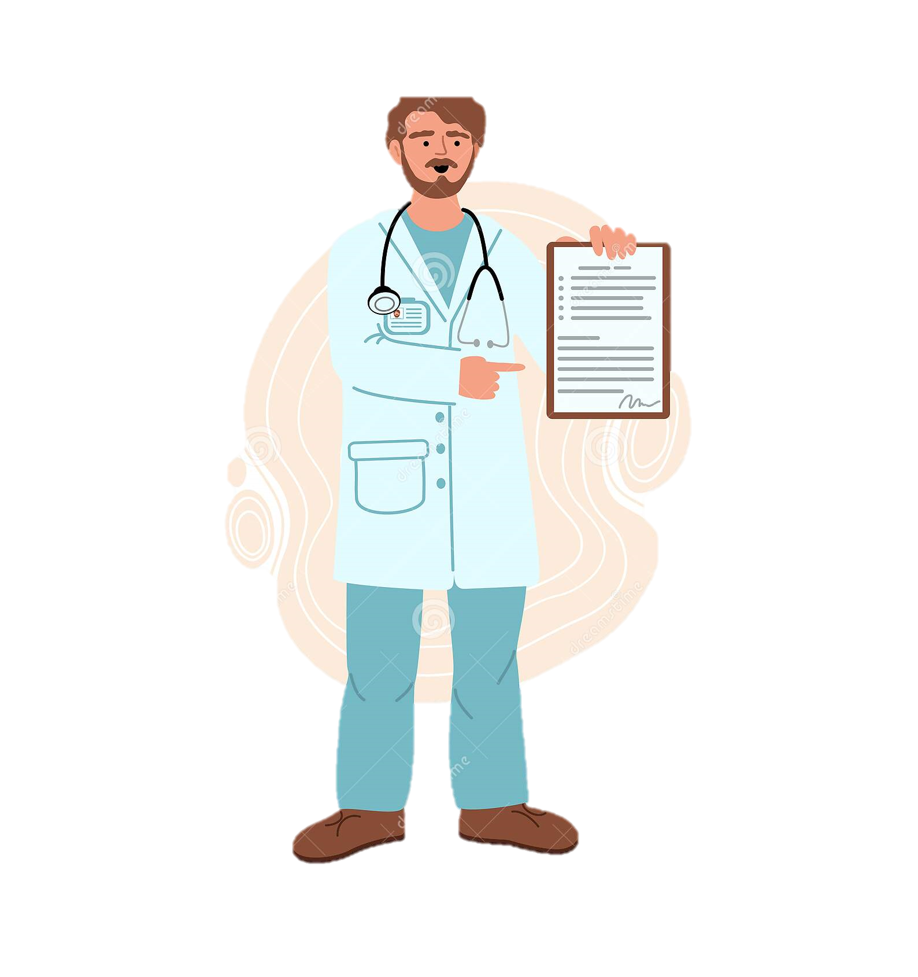
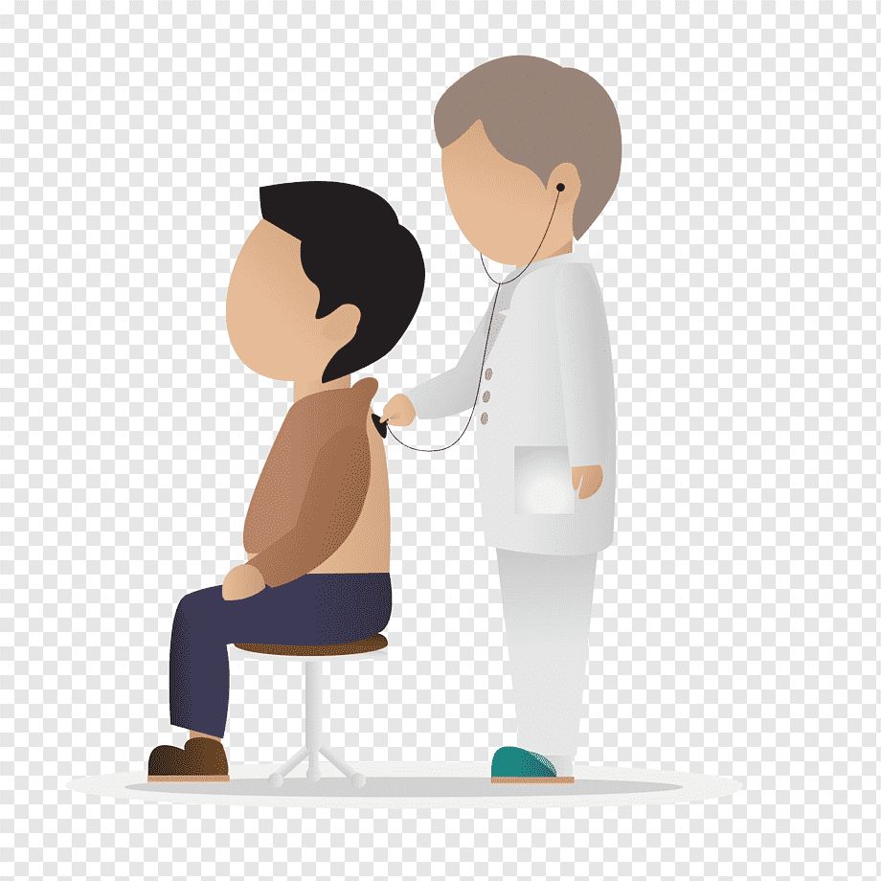

Types of Admission
Acute admission
Planned admission
Without recommedation from doctor
The client‘s health is in threat of life or has changed for the worse
Admitted at the urgent
The client is ordered for an operation or examination
Commes on the recommendation of practitioner doctor or specialist
Admitted at the outpatient clinic or at the central reception

Slide 11

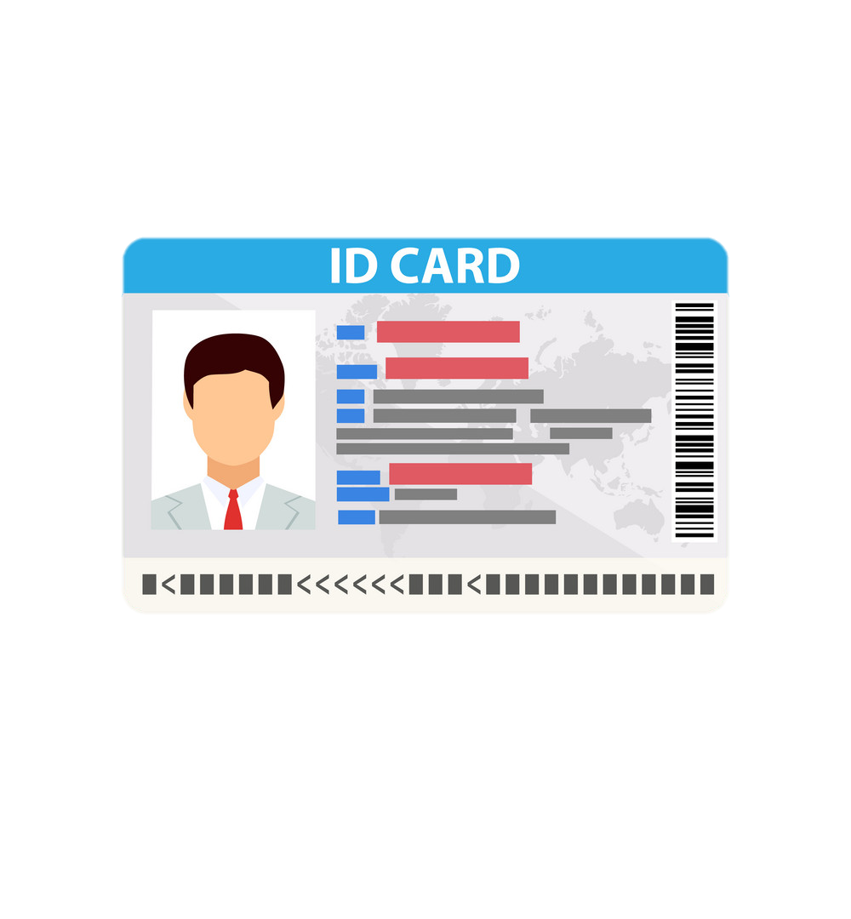
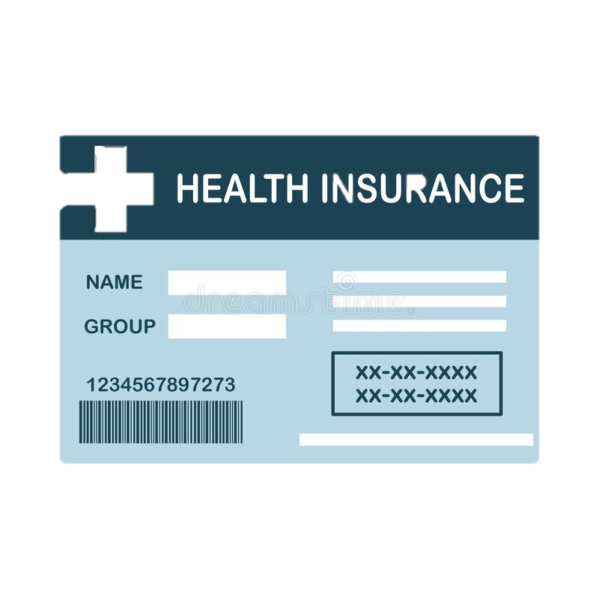
What should the client with him?
Insurance card
Identity card
Doctor‘s recommendation
Results of laboratory examination
For children informed consent signed by a parent

Slide 12
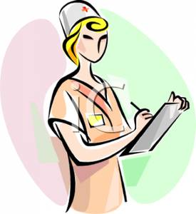

Medical documentation
Medical documentation consists of daily record, informed consents, nursing documentation, examination results, medical record and decourse
NURSING DOCUMENTATION-includes daily record, evaluation scales, temperature tables, pain table, ressure ulcer evaluation, consciousness
DECOURSE-record of teh course of the diseases and treatment

Slide 13
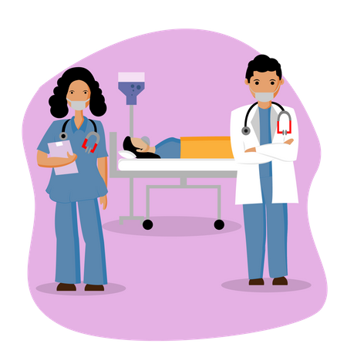
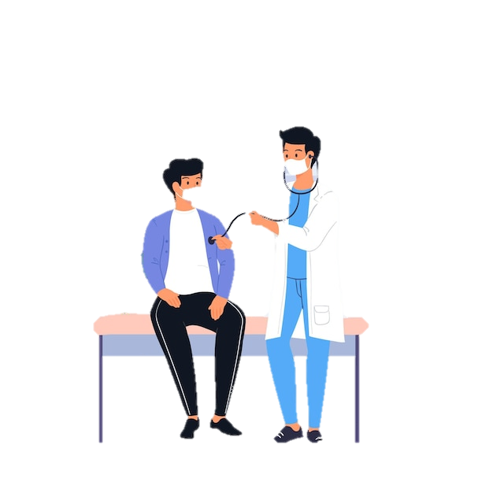
FORms
Informed consent
Nursing anamnesis
Assessment of the general condition
Record in the register of hospitalized in the hospital
Wardrobe list and record of valuables storage

Slide 14
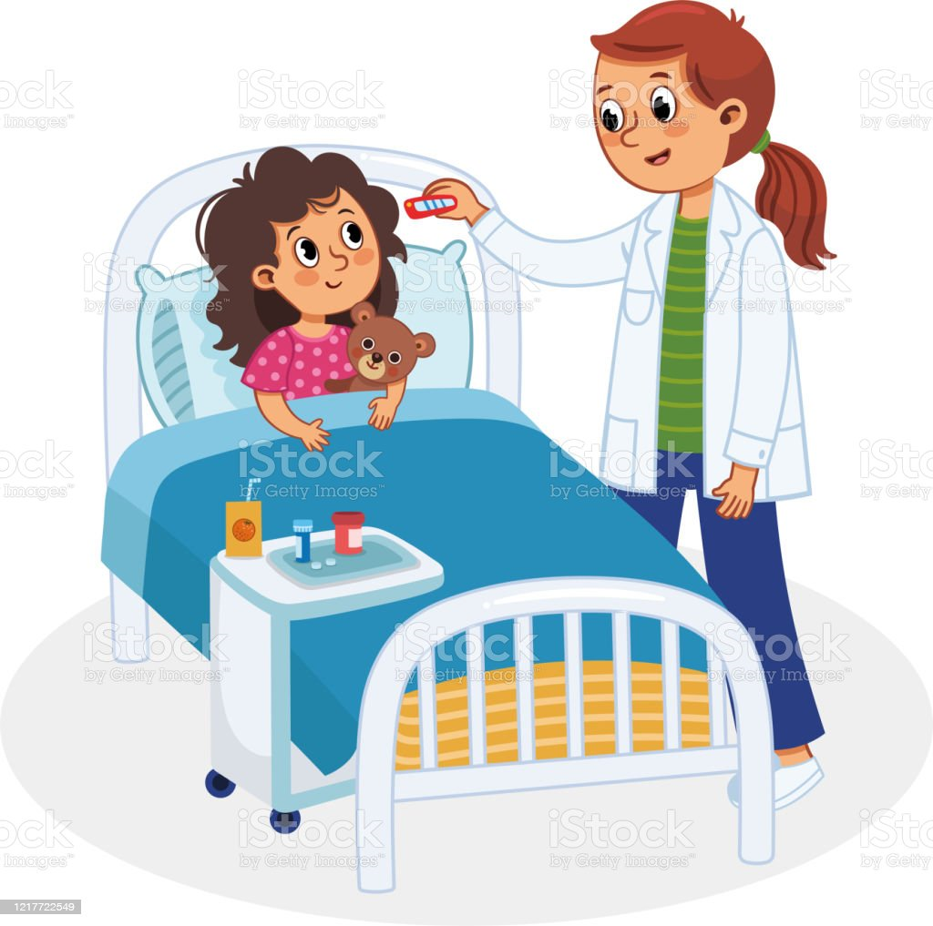


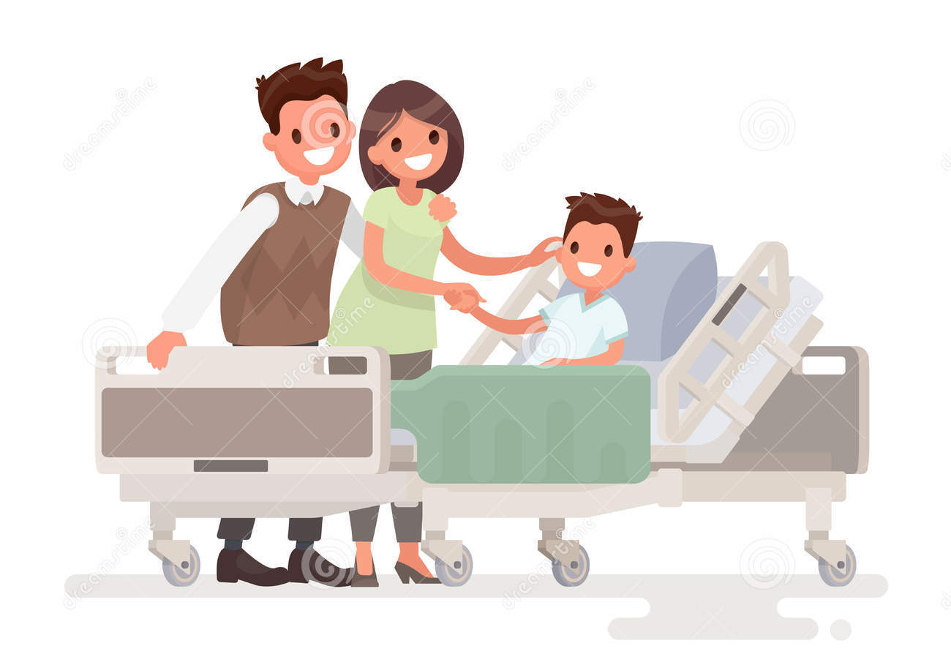

What is necessary for children?
Habits
Salutation
Favorite toy
Boarding
Hygiene
Visiting hours
Hospital rules

