Slide 1
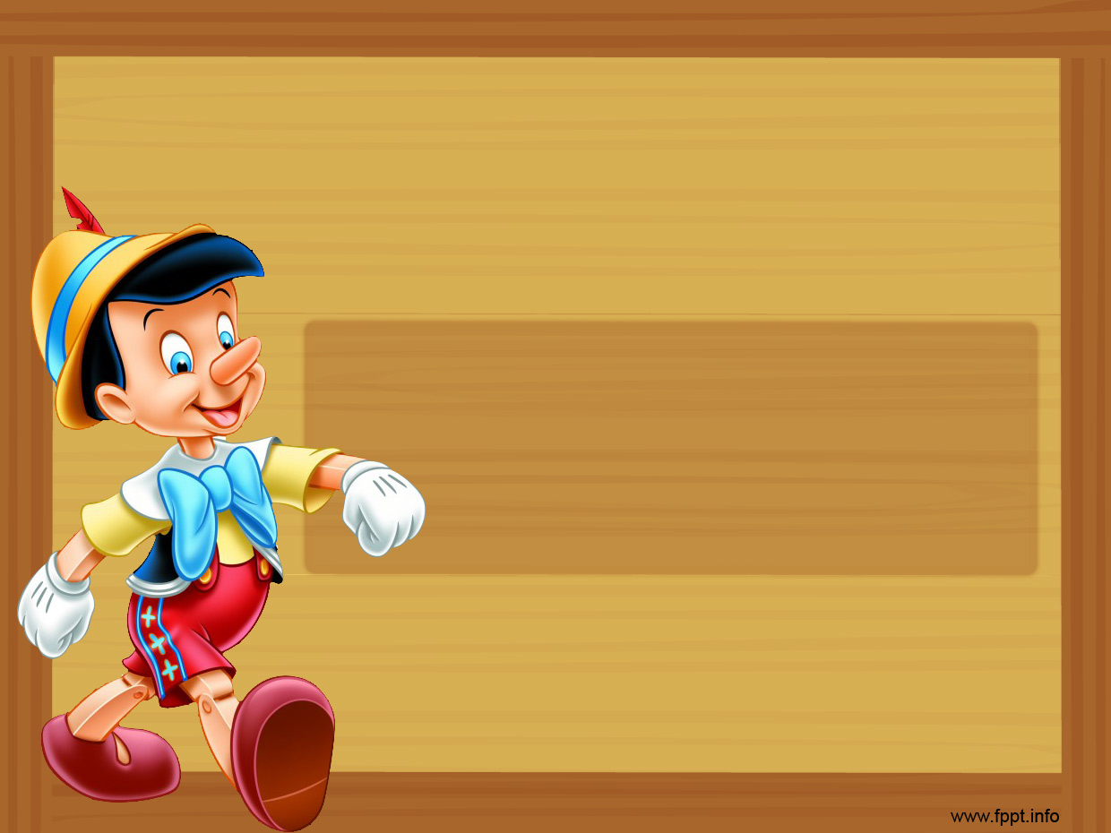

Grammar Lesson
Articles
a , an , the
Teacher Silvino Sieben
1st grade of HS

Slide 2
a
We use “a” before countable nouns (singular) for the first time:
We use “a” with words beginning with a consonant ( b, c, d, f , g … ):
a book
a baby

Slide 3
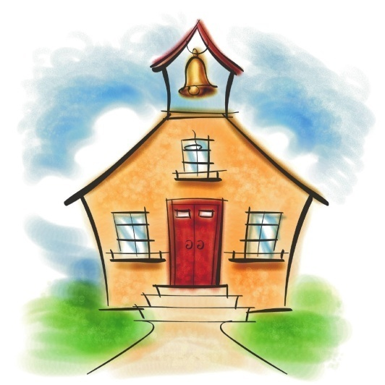
a
We also use”a” before “u” when it is pronounced like the word “you” and before “eu”:
a university
a European country

Slide 4
an
We use “an” before words beginning with vowels (a, e, i, o u):
an axe
an igloo
an octopus
an umbrella
an elephant

Slide 5
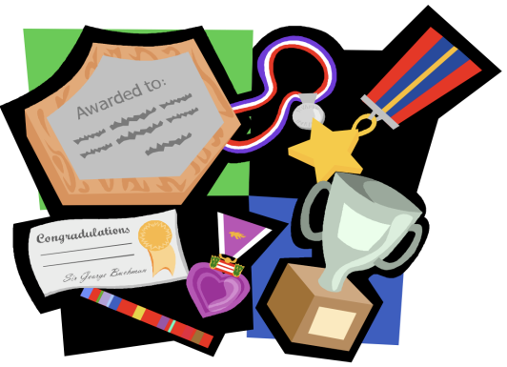
an
We use “an” before words that start with a silent “h”:
60
minutes
an honour
an hour

Slide 6
the
We use “the” to refer to a specific person, thing or object that has been mentioned before or that is clear from the context.
(not new information)
I see a dog. The dog is eating.

Slide 7
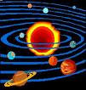
the
We also use “the” when there is only one of something:
the earth, the world, the moon, the sun, the sky, the stars, the air

Slide 8
the
“The” is also used in the following cases:
Before musical instruments:
the piano, the violin, the guitar

Slide 9
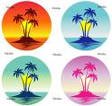

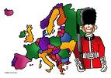


the
Before mountain groups, rivers, island groups, seas, deserts:
the United Kingdom,
the United States of America
the Philipines
the Himalayas
the Pacific Ocean
the Nile
the Sahara Desert

Slide 10

the
Before the superlative form of an adjective:
the strongest , the biggest , the best…
Before ordinal numbers:
the twenty- fifth of December

Slide 11



zero article
People’s personal names , People’s titles
Streets, squares, parks, parts of town
Mr Brown, Miss Chan,
Mary, John
Oxford Road,
Victoria Park
Continents, countries, towns
North America, Canada, Toronto

Slide 12




zero article
Days of the week, years, holidays, months, seasons
Monday, April, spring, Easter, 2009
Sports
Meals
Languages
table tennis,
football, golf
breakfast, lunch, dinner
English, French

