Slide 1
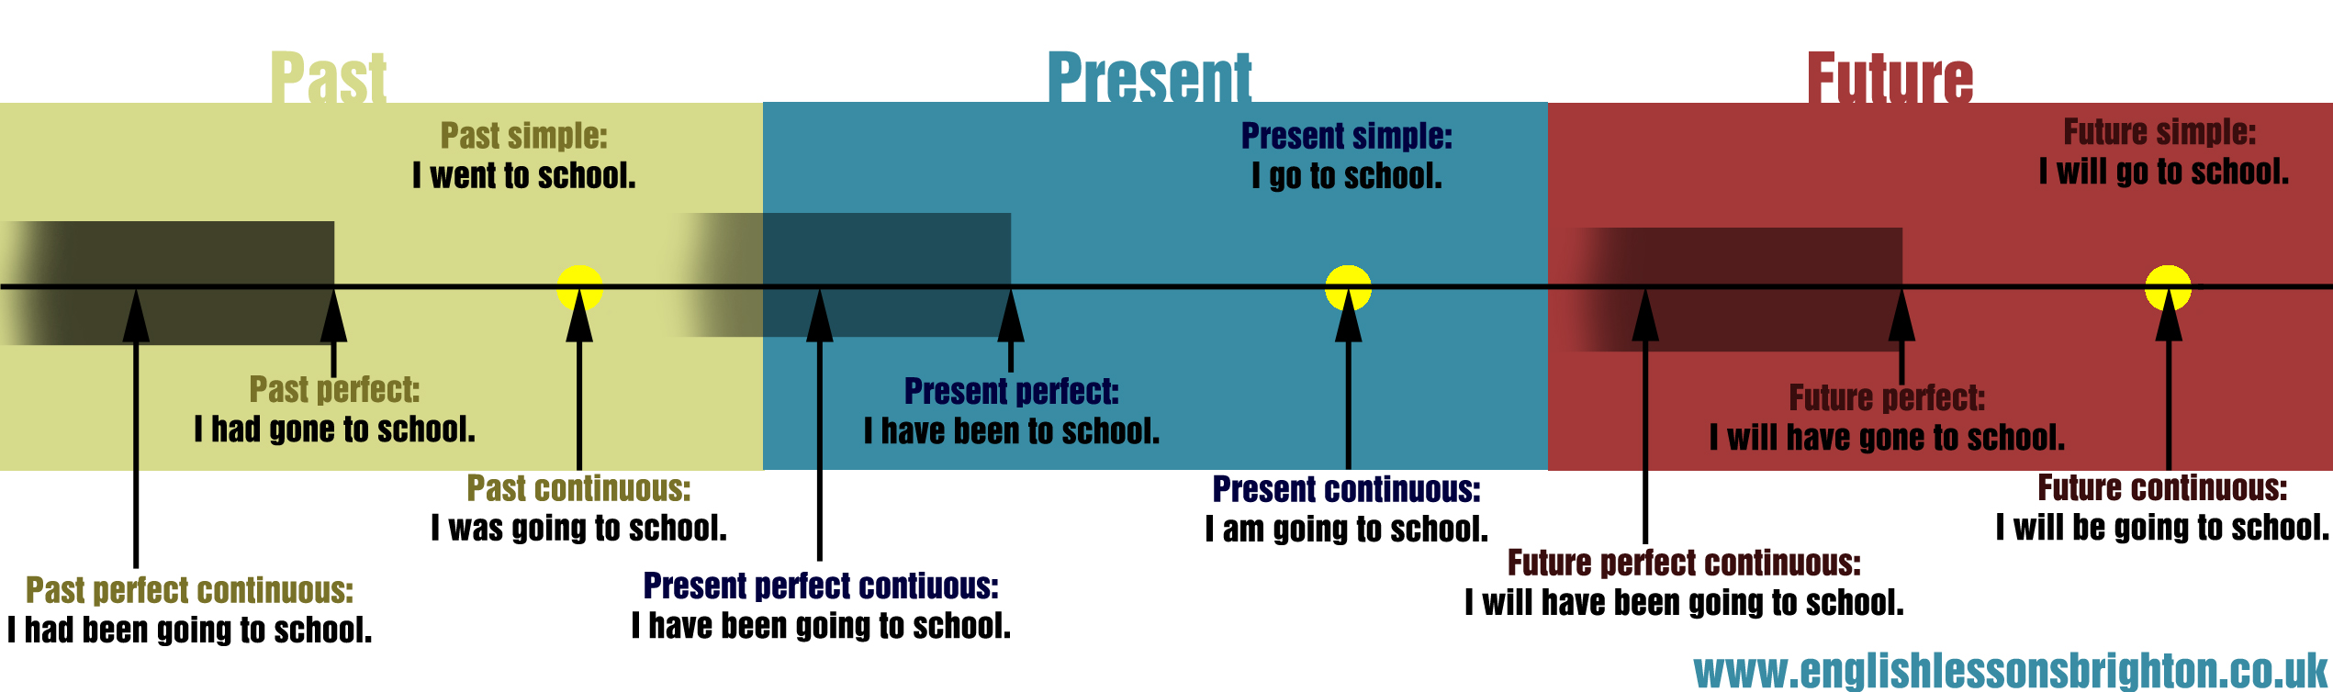

English Tenses

Slide 2

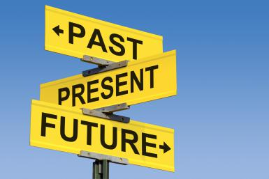
English Tenses
A. Issues of Terminology – The 12 Tense System in English
A. Present
Present Simple
Present Continuous
Present Perfect Simple
Present Perfect Continuous
B. Past
Past Simple
Past Continuous
Past Perfect Simple
Past Perfect Continuous
C. Future
Future Simple
Future Continuous
Future Perfect Simple
Future Perfect Continuous
This classification is based on time reference.

Slide 3
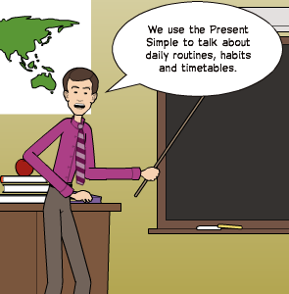
English Tenses
A. Issues of Terminology – The 12 Tense System in English
A. Simple
Simple Present
Simple Present Perfect
Simple Past
Simple Past Perfect
Simple Future
Simple Future Perfect
B. Continuous
Continuous Present
Continuous Present Perfect
Continuous Past
Continuous Past Perfect
Continuous Future
Continuous Future Perfect
This classification is based on difference in aspect.

Slide 4
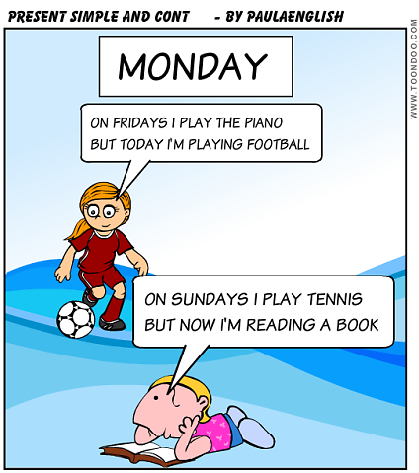
English Tenses
The Present Tense Forms
Present Time
Present time is seen as the time of speaking or timing, or as ‘time around now’, or as the more general, permanent time relating to truths and general facts.
References to present time are most typically indicated in the verb phrase through the simple and progressive forms of the present tense.

Slide 5
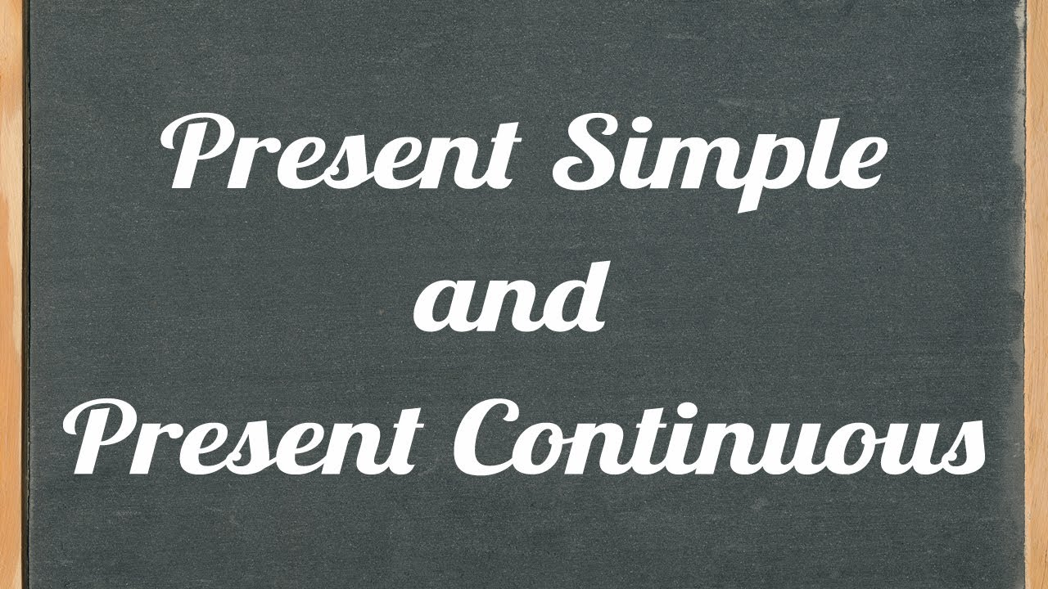

Slide 6
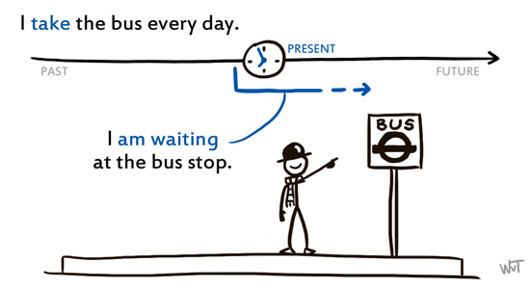
English Tenses
Present Tense Forms – Present Simple & Present Progressive
1. Simple Present
Structure:
Present tense form of lexical V (-s/-es/-ies)+ do/does (in questions/negatives)
2. Present Progressive
Structure:
Present tense form of Be + lexical V-ing form

Slide 7
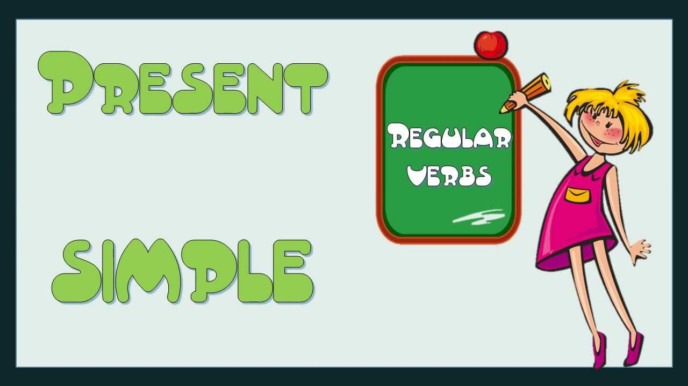
English Tenses
Present Tense Forms – Simple Present
1. Simple Present
Affirmative
I/you/we/you/they eat an apple every day.
He/she/It eats an apple every day.
Question
Do I/you/we/you/they eat an apple every day?
Does He/she/It eat an apple every day?
Negation
I/you/we/you/they don’t eat an apple every day.
He/she/It doesn’t eat an apple every day

Slide 8
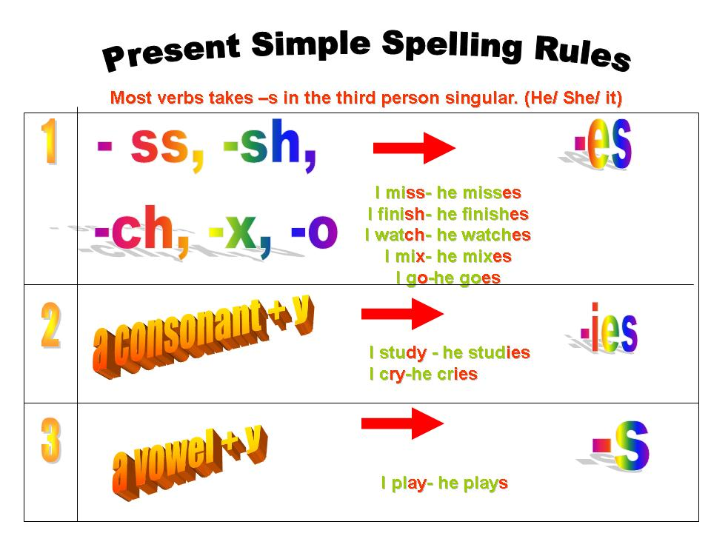

Slide 9
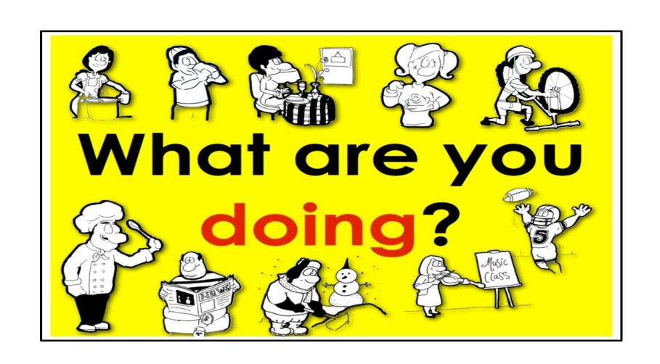
English Tenses
Present Tense Forms (Present Progressive)
2. Present Continuous
Affirmative
I am /you/we/you/they are eating an apple every day.
He/she/It is eating an apple every day.
Question
Am I/Are you/we/you/they eating an apple every day?
Is He/she/It eating an apple every day?
Negation
I am not (‘m not) you are not (aren’t)/we/you/they eating an apple every day.
He/she/It is not (isn’t) eating an apple every day

Slide 10
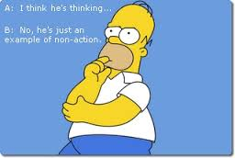
English Tenses
Present Tense Forms (Present Progressive)
Some verbs in English are only very rarely used in Continuous tenses. These include verbs that describe:
Mental states and processes: e.g. believe, know, think
Responses of the senses: e.g. smell, taste
Emotional responses: e.g. adore, admire, detest, hate, like
Ongoing process: have to need want.
Permanent qualities of characteristics: consist, contain, belong
Some of these verbs can form Continuous but their meaning change.
e.g. I am seeing my doctor this afternoon. (i.e. I have an arranged appointment)
I can see the kite flying high. (I have the ability to see).

Slide 11
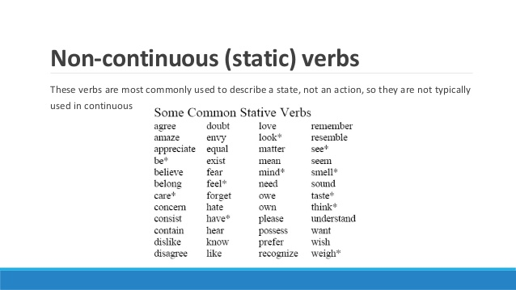

Slide 12
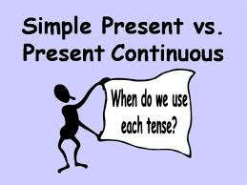
English Tenses
Present Tenses Meaning (Simple Present)
A. Simple Present
For permanent states of affairs
e.g. I speak four languages and I live in L.A.
For general truths
e.g. 2 plus 2 makes 4
The sun rises from the East and sets in the West.
For habitual actions with adverbs of frequency and time adverbials
e.g. I usually drive to work every day.
For future actions (when used in itineraries)
e.g. My train leaves at 8 ‘clock tomorrow morning.

Slide 13
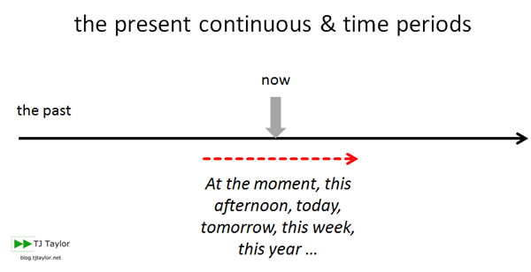
English Tenses
Present Tenses Meaning (Present Progressive)
B. Present Continuous
For actions that are happening now, at the time of speaking.
(now, at the moment).
e.g. I am writing my essay now as I will not be able to do it tomorrow.
-For preplanned actions (‘is going to’) (with any future phrase)
e.g. I am going to go to the US next month to visit my brother and his family.

Slide 14
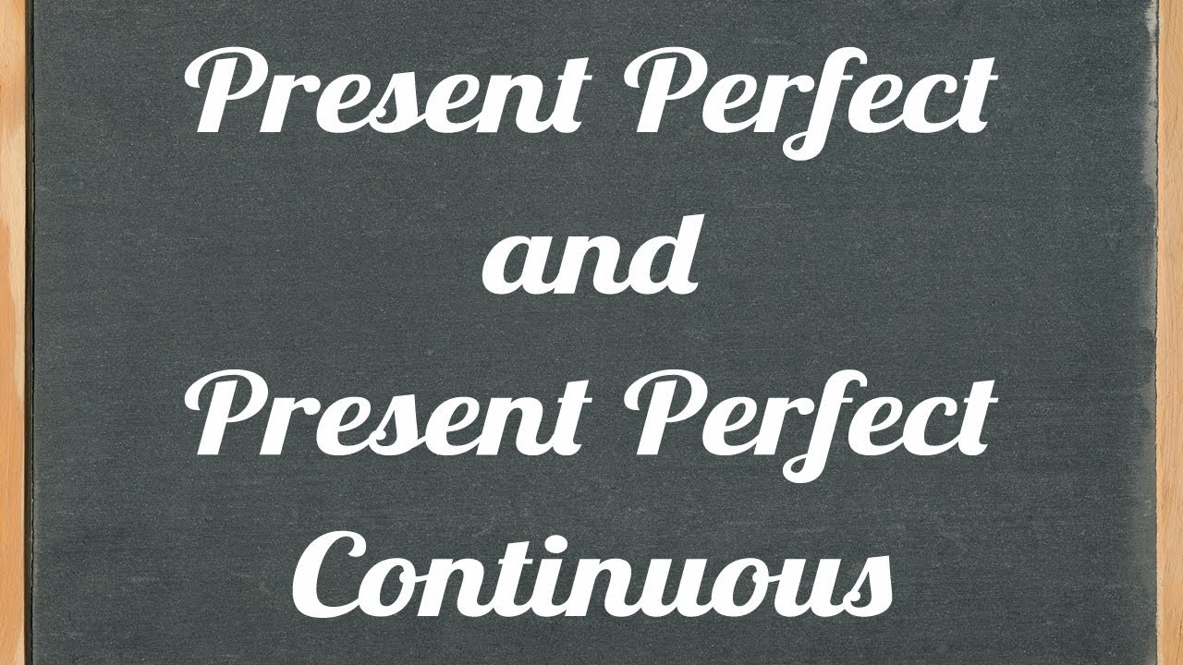

Slide 15
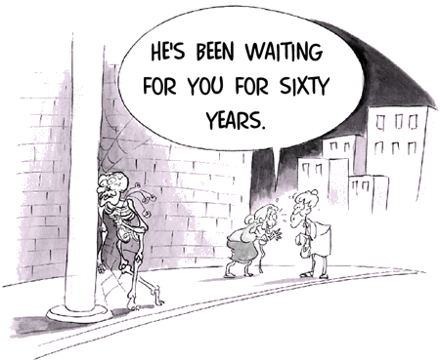
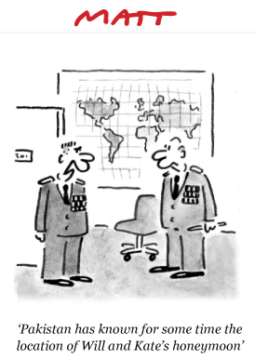
English Tenses
Present Tense Forms (Simple Present Perfect & Continuous)
1. Simple Present Perfect
Structure:
Have/has + Past Participle of the Verb
Past participle for regular verbs + ed and for irregular verbs
(See verb formation in the Simple Past)
2. Present Perfect Continuous
Structure:
Have/has + been + V-ing

Slide 16
English Tenses
Present Tense Forms – Simple Present Perfect
3. Simple Present Perfect
Affirmative
I/you/we/you/they have eaten an apple every day.
He/she/It has eaten an apple every day.
Question
Have I/you/we/you/they eaten an apple every day?
Has He/she/It eaten an apple every day?
Negation
I/you/we/you/they have not (haven’t) eaten an apple every day.
He/she/It hasn’t eaten an apple every day.

Slide 17
English Tenses
Present Tense Forms – Present Perfect Continuous
3. Present Perfect Continuous
Affirmative
I/you/we/you/they have been eating an apple every day.
He/she/It has been eating an apple every day.
Question
Have I/you/we/you/they been eating an apple every day?
Has He/she/It been eating an apple every day?
Negation
I/you/we/you/they have not (haven’t) been eating an apple every day.
He/she/It has not (hasn’t) been eating an apple every day?

Slide 18
English Tenses
Present Tense Meaning – Simple Present Perfect
3. Simple Present Prefect
For actions that have been completed in the past and we do not know when exactly. (cf. Simple Past)
e.g. I have read this book and as far I can remember it is very interesting.
To denote when an action started with since and for how long it lasted with for.
e.g. I haven’t seen him since last May and so I don’t know what he‘s been up to.
I have had headaches for quite a long time, and to be honest I’m a little bit worried.
- Most frequently used adverbs: recently, lately, already, and yet (in negative sentences)

Slide 19
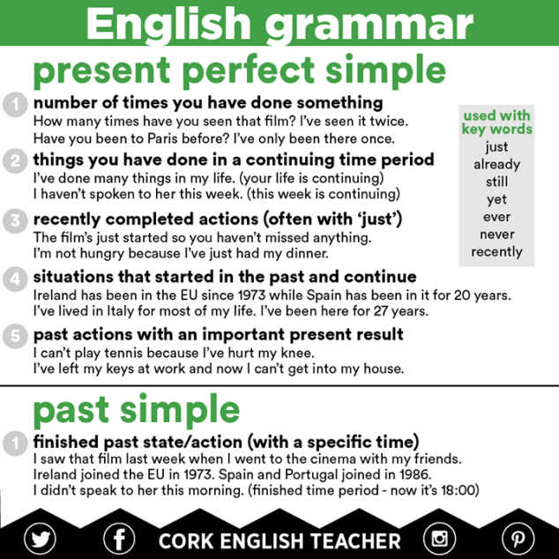
English Tenses
Present Tense Meaning – Simple Present Perfect vs. Simple Past

Slide 20
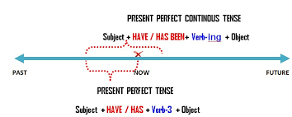
English Tenses
Present Tense Meaning – Present Perfect Continuous
4. Present Prefect Continuous
The most usual use of the tense is to emphasise continuity of action, i.e. that something has been happening for quite a time and then it stopped short.
e.g. It was a rather boring day as it has been raining all morning and hasn’t stopped until not.

