Slide 1

THE JOB INTERVIEW

Slide 2

What is the job interview?
Job interview
reprezentative/company
the candidate a job.
It represents the second phase of the selection process for employment. The invitations to the interview reveals that the documents submitted (CV, letter of intent) were well written, efficient and discussion with potential employers can play a key role in obtaining an employment.

Slide 3
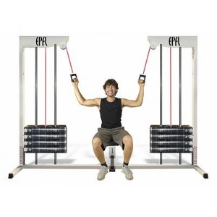
Preparation of the interview
The interview preparation requires special attention because it is an unique opportunity for the candidate to present himself to the employer in detail and in the best way possible. Why is it necessary to prepare for the interview? To allow the candidate to successful answer all questions and to reduce the stress and uncertainty that may occur before the interview.

Slide 4

File of the interview
CV in Europass format printing
At least one letter of recommendation
Materials to support your presentation

Slide 5
Presentation at interview
Personal presentation is very important because most people who do interviews will draw conclusions about you in the first minutes of the meeting and there will be not a second chance to produce a good first impression.
good first impression
attire
punctuality
non-verbal communication

Slide 6

Interview
Personal interview, face-to-face
The candidate is received by a responsible recruitment consultant or a boss in a company recruitment. This type of interview is the most used, it is considered as a classic interview and generally it lasts one hour.

Slide 7

Successive interviews
Being considered a marathon, you may encounter one day with all the people involved in the recruitment process. It's the classic case when you have three interviews with human resources officer with direct supervisor and company director. This type of interview is encountered especially in large companies.

Slide 8

Interview in front of a group of interlocutors
It is used in the recruitment process for a swift election or in the second stage of the interview for to know your supervisor and his boss directly (e.g. head of product and marketing manager) or the whole team.

Slide 9
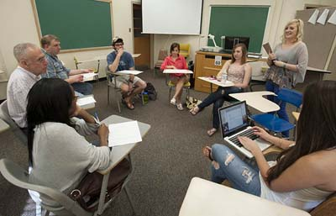
The group interview
This type of job interview is practice increasingly less, but the focus is on him especially when recruiting graduates for commercial stations.
The most important tip to be able to hover over a job interview is to know to adjust according to interlocutor.

Slide 10

The structure of an interview
1. Introduction: it establishes eye contact with the interviewer, it adopts a warm smile and adopted a relaxed position.
2. Questions: the employer usually start the discussion
3. Central questions: targeting skills and knowledge asked by the post.
You can discuss specific cases
It presents a situation and asks you to examine possible implication
It addresses questions situational
Question from speciality area
Questions about the firm
General questions

Slide 11


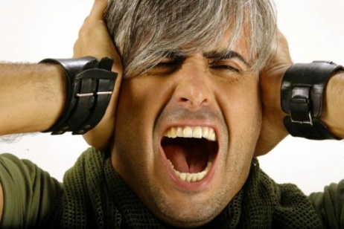
Common mistakes in a job interview
You are late
You are wearing inappropriate
You are cranky

Slide 12
No smoking, no gum, no drinks
Research failed (not enough documentation)
You lose yourself
You speak too much
Fail to form a bond between you and the target job
Not asking questions - or ask too many
Speak ill of someone
Questions of salary and / or benefits too soon
Ask no job

