Slide 1
International negotiating
Steps of the process and culture specifics

Slide 2
International negotiating
Definition – bargaining process between two or more parties with its own goals, needs, and views, to reach an agreement
Specifics -
Partners with different culture background
Language
Relationship building
Rules of negotiating typical for a culture
Body language

Slide 3
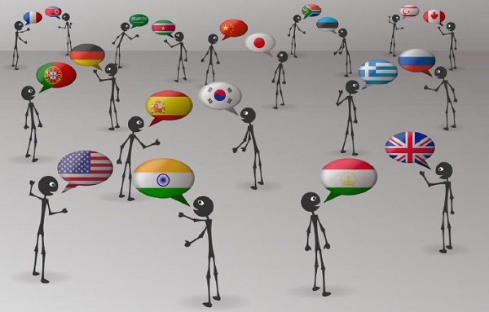
Steps
1 Preparation
2 Relationship building
3 Agreeing
4 Bidding
5 Bargaining
6 Concluding

Slide 4
Step 1 Preparation
Goals: What do you want to get out of the negotiation?
Alternatives: If you don’t reach agreement with him or her, what alternatives do you have?
The relationship: What is the history of the relationship? Will there be any hidden issues that may influence the negotiation?
Expected outcomes: What outcome will people be expecting from this negotiation?
The consequences: What are the consequences for you of winning or losing this negotiation?
Power: Who has power in the relationship?

Slide 5
Step 2 Relationship building
Establishing good atmosphere
Keeping up conversation and showing interest
Different cultures – various emphasis
on relationship building
Example: Middle Eastern countries x Finland (no small talks, relationship building afterwards in a restaurant or sauna)

Slide 6
Step 3 Agreeing procedure
Agreeing on objectives and procedure-mutually beneficial agreements
Different reactions – the Japanese and the Americans
Am. culture – most info in words
Jap. culture – unspoken ways, context, and silence

Slide 7
Language input - questioning
Using lead questions – listeners have time to prepare themselves
Could we move on to………..?
Checking understanding
Does that mean you need …........?
Example: buyers from different cultures ask about different things –
Germans – technical features
British – benefits to customers

Slide 8
Step 4 Bidding - suggestions
Putting forward proposals – the main part of negotiation
We propose that ……
A better solution would be……
It could be a good idea to ……
Alternatively, we could ……
Our proposal is to ……

Slide 9
Step 5 Bargaining
Further offers connected to certain conditions
If you accepted, we could ……
We could fund st…, if there was ……
We would have no objection provided that the details were worked out together.
I am afraid we could not accept that.

Slide 10
Step 6 Concluding
Summarizing what has been said
I could summarize……
As we agreed, you will……
There are some outstanding points.
By our next meeting you will have to……
Is there anything else you would like to add?

Slide 11
Business cards
Handing over at the beginning – the Japanese – unfamiliar names, and the status and role in the team
In other cultures – more common to exchange business cards at the end of the meeting
Japan, China – special rituals

Slide 12
Controversial topics
Avoiding traditional taboo topics –
religion and politics
Posssible – information gathering questions – who, what, how?
Why? – may contain criticism
Example: How is your president elected?
X Why is your president elected for a long term?

Slide 13
Collectivism x individualism
Coll. cultures –
group harmony – Japan, Indonesia, Portugal, Venezuela, focus on family
Ind. cultures –
individual performance and individual reward – the USA, Italy, GB

Slide 14
Different attitudes to time
Polychronic c. – a high tolerance for interruptions – phones and people coming with questions, time is flexible – Spain, Italy, Greece
Monochronic c. – devote blocks of time to a certain task, low tolerance for interruptions, emphasis on schedules and deadlines– Britain, Germany, the USA

Slide 15
Gift giving
Giving gifts can be seen as a way of helping negotiation or it may be interpreted as corruption and bribery.
Gifts acceptable everywhere – company gifts – e.g.inscribed pens
Other gifts or services could lead to problems
Rituals – East Asia

Slide 16
Using mediator
Difficult situations
facilitating responses to questions that have been refused or ignored
better defining the interests and goals of each side to the other
persuading partners
changing the manner of negotiating - all parties in one room or in separate rooms to continue negotiations

Slide 17
USA culture or Japanese culture?
Quiet, patient and respectful. Modesty and self-control are valued.
To be strong is highly valued.
Face-saving is very important to preserve honour and dignity.
Interactions with the others are mostly unemotional.
Always ready to argue their point of view. Arguments are based on facts.

Slide 18
Intercultural tests
1.Compared to people from most other cultures, US Americans appreciate arguments based on:
A. emotion
B. logic and reasoning
C. statistics and empirical evidence

Slide 19
Intercultural tests
2.The concept of “losing face” – a person’s image or value in the eyes of other people – is important in China and this is why the Chinese
A. like to do business with small, unknown companies
B. don’t like to give business to friends or relatives because it creates a bad image
C. don’t say “no” directly, even if it’s really what they are trying to communicate

Slide 20
Intercultural tests
3 .Match the country with the percentage of women on Executive Boards of companies included in
US 21,1 (1st)
Greece 6.5 ?
Japan 3.8?
Norway 0.4?

Slide 21
Intercultural tests
4. Do not compliment an Arab’s personal possession because he or she might:
A. think you are envious
B. feel that you’re being condescending
C. feel obliged to offer it to you
D. consider it bad luck

Slide 22
Intercultural tests
5 .In Japan, it is considered bad manners to write on:
A. a napkin
B. someone’s business card
C. a printed meeting agenda
D. a newspaper

Slide 23
https://www.youtube.com/watch?v=1FeM6kp9Q80

Slide 24
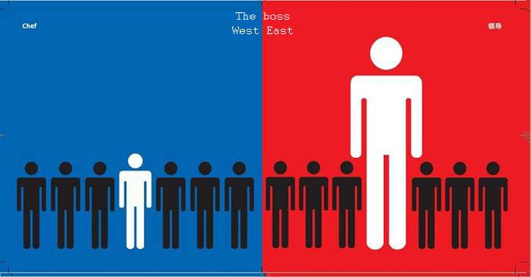

Slide 26
