Slide 1
Stereotypes, prejudice and
discrimination

Slide 2
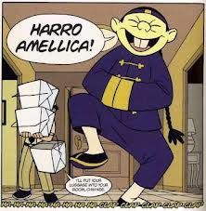

Slide 3
Generalizations
It is possible to make generalizations about cultures, but not about individuals
No.of people
Most people
Some individuals
Some individuals
values

Slide 4
Barriers - communication
Misinterpretation
Misunderstanding
Bad intercultural training and poor language skills
Generalizations leading to stereotype , prejudice and discrimination

Slide 5
A critical incident – an example of misinterpretation
A Japanese businessman is negotiating with a Norwegian partner. The Japanese says that the deal will be very difficult. The Norwegian asks how her company can help to solve the problem. The Japanese is puzzled by the question.
What happened?

Slide 6
Explanation
For the Japanese, his statement that the deal will be difficult mans that it will not be possible at all. He expressed it indirectly because he must be polite and wants to avoid losing face.
The Norwegian was not aware of this and thought that there were some problems that could be solved.

Slide 7
Stereotype
A FIXED IDEA
or image that many people have about a particular type of person or thing, but which is not true in reality.
It is based on generalizations

Slide 8
HUMAN MENTAL PROGRAMMING (Hofstede)
Individual issues
human nature
Values, attitude, beliefs
personality
culture
Universal and inherited characteristics

Slide 9
PREJUDICE AND DISCRIMINATION
Prejudice - a negative judgement or opinion formed about a group without knowledge of the facts
The Czech Republic – Romas (gypsies), the Vietnamese
Discrimination - treating people in a less favourable way because they are members of a particular group –
Examples – history - ???

Slide 10
Ethnic prejudice
Universal character –all over the world – they are fixed and taken over by generations – families with lower social status and lower level of education – age of 5-6
Holland – research – children 10-17 – attitude to ethnic minorities (Verkuyten, Thijs)
Result – the most negative attitude – Turks and Moroccians

Slide 11
Ethnic prejudice
East of Finland – Joensuu – Russian border
Kindergarten –prejudice to small children with Russian background
Reason – family – prejudice – history
War with the Russians – part of Karelia

Slide 12
How to eliminate prejudice?
Contact hypothesis (Allport) – reduction of prejudice – in contact among ethnic groups
People of the same status working on a common goal
Italy – foreigners from Africa in Italian teams – research –
1st group- students – Italians and Africans
2nd group- hospital staff - Italians and Africans
Result – workers in hospital – more positive attitude – difficult tasks

Slide 13
Relationship between Czechs and Germans
Stereotypes on both sides
Common historical development
German stereotype – Slavonic nations – easy to control
Arrrogant attitude of Germans toward the Czechs – WW2 - German aggression

Slide 14
Czechs seen by the Germans
POSITIVE
NEGATIVE
hospitable
friendly
ready to help
joyful
polite
nationalistic
drinking alcohol
untidy
envious
lazy

Slide 15
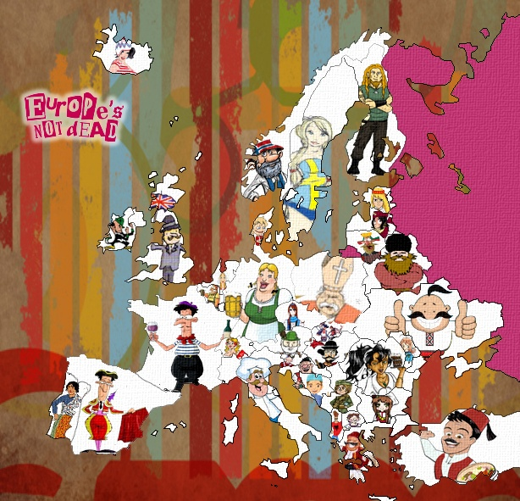

Slide 16
Prejudice
Https://www.youtube.com/watch?v=tODZxVattjc
Discrimination
https://www.youtube.com/watch?v=_TbvuqRMUO4
Funny misunderstanding
https://www.youtube.com/watch?v=EeRqIC1sPz0

Slide 17
Discussion questions
What kind of ethnic prejudice do you have in your cultures?
Make a national self-stereotype.
People think we are…………………….

