Slide 1
Název prezentace
Název projektu | Rozvoj vzdělávání na Slezské univerzitě v Opavě
Registrační číslo projektu | CZ.02.2.69/0.0./0.0/16_015/0002400
Prezentace předmětu:
Marketing of services
Vyučující:
Ing. Michal Stoklasa, Ph.D.
Ing. Martin Klepek, Ph.D.

Slide 2
Quality and service innovation
The aim of this presentation is to explain notion of the quality in services through understanding of the SERVQUAL model
.
Martin Klepek
Garant předmětu
Michal Stoklasa
Přednášející

Slide 3
Quality and service innovation
Defining quality in services
Servqual model
Improving services
Benchmarking
Service Blueprint
.
Lecture structure

Slide 4
Introduction
The service quality of a firm is tested at each service encounter.
If employees are bored, cannot answer simple questions, or are visiting each other while customers are waiting, customers will think twice about doing business there again.
Notes:
Kotler & Keller (2016, p. 441)

Slide 5
Defining service quality
Being an intangible concept, defining service quality poses a lot of problems. It is very difficult to quantify the abstract elements of service quality, which are highly idiosyncratic and customer-specific.
However, the most commonly accepted definition of service quality is: Service quality is the delivery of excellent or superior service relative to customer expectations.
Notes:
Urbánek (2014)

Slide 6
Defining service quality
This is the simplest way to understand service quality, although this definition is far from being adequate.
In general terms, quality is defined as ‘conformance to standards’. Therefore, when service measures up to some predefined parameters of performance, it is said to be of higher quality.
The real issue is in identifying these parameters of performance and then measuring the service in relation to these parameters.
Notes:
Urbánek (2014)

Slide 7
Defining service quality
For example, for some person, waiting for 15 minutes at a bank counter is ‘OK’, while it may be ‘too much’ for another. If a teller disposes off the customer in 10 minutes, the first customer would be very delighted, but the second customer will be protesting for the delay. The problem for the banker would lie in establishing the ‘normal’ time, which a customer should wait at the counter.
Notes:
Urbánek (2014)

Slide 8
GAP Model
Quality can be viewed from two perspectives - internal and external.
Internal quality is based on conformance to specifications.
External quality is based on relative customer-perceived quality.
The important point is that quality must be seen from the customer’s viewpoint, not the company’s.
Notes:
Urbánek (2014)

Slide 9
GAP Model
It is essential that quality is measured from the customer’s perspective, not from what managers within a company think their customers’ views are!
There are biases!
Notes:
Urbánek (2014)

Slide 10
GAP Model - biases
Management may not know what specific purchase criteria users consider important.
For example, customers frequently identify key purchase criteria not identified by management.
Even when the criteria are correctly identified, management may misjudge the relative importance of individual criteria.
Notes:
Urbánek (2014)

Slide 11
GAP Model - biases
Management may misjudge how users perceive the performance of competitive products on specific performance criteria.
These differences in perception of performance may exist for the most basic of criteria.
Notes:
Urbánek (2014)

Slide 12
GAP Model - biases
Management may fail to recognize that user needs have evolved in response to competitive product developments, technological advances, or other market or environmental influences.
Notes:
Urbánek (2014)

Slide 13
GAP Model - biases
Management may fail to recognize that user needs have evolved in response to competitive product developments, technological advances, or other market or environmental influences.
Notes:
Urbánek (2014)

Slide 14
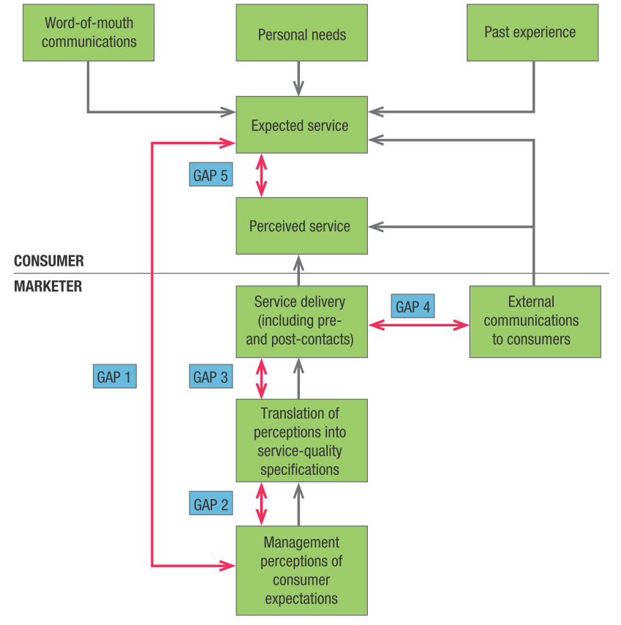
GAP Model
Source: Kotler & Keller (2016)

Slide 15
GAP Model
Source: Urbánek (2014)

Slide 16
GAP 1
The first gap is the difference between consumer expectations and management perceptions of consumer expectations.
Research shows that financial service organizations often treat issues of privacy and confidentiality as relatively unimportant, whilst consumers considered them very important.
Notes:
Urbánek (2014)

Slide 17
GAP 2
The second gap is the difference between the management perceptions of consumer expectations and service quality specifications.
Managers will set specifications for service quality based on what they believe the consumer requires.
However, this is not necessarily accurate. Hence, many service companies put much emphasis on technical quality, when in fact the quality issues associated with service delivery are perceived by clients as more important.
Notes:
Urbánek (2014)

Slide 18
GAP 3
The third gap is the difference between service quality specification and the service actually delivered.
This is of great importance to services where the delivery system relies heavily on people. It is extremely hard to ensure that quality specifications are met when a service involves immediate performance and delivery in the presence of the client
For example, it happens in most government offices in India that one or more dealing clerks are on leave or do not process the files, leading to delay in the decisions. This upsets the whole working of the office.
Notes:
Urbánek (2014)

Slide 19
GAP 4
The fourth gap is the difference between service delivery intention and what is communicated about the service to customers. This establishes an expectation within the customer which may not be met. Often this is result of inadequate communication by the service provider
Indian Railways is a good example to show this gap. Late arrival of trains is more of a routine than being an exception. Even the clerk at the reception is unable to tell the exact time of delay. No officer of the railways takes any responsibility for the delay.
Notes:
Urbánek (2014)

Slide 20
GAP 5
The fifth gap represents the difference between the actual performance and the customers’ perception of the service.
Subjective judgement of service quality will be affected by many factors, all of which may change the perception of the service, which has been delivered. Thus a guest in a hotel may receive excellent service throughout his stay, apart from poor checking out facilities.
But this last experience may damage his entire perception of the service, changing his overall estimation of the quality of the total service provided from good to poor.
Notes:
Urbánek (2014)

Slide 21
Improvement
Improving services
Improving service quality is an important activity, which needs to be followed.
Some of the commonly used techniques for improving service quality are Benchmarking and Service Blueprinting.
Notes:
Urbánek (2014)

Slide 22
Benchmarking
In order to evaluate service quality it is important to establish a firm’s performance relative to its competitors.
Benchmarking involves looking for the best ways to achieve competitive advantage.
It stems from the Japanese practice of ‘dantotsu’ which means striving to be ‘best of the best’.
Notes:
Urbánek (2014)

Slide 23
Service Blueprint
Service companies who wish to achieve high levels of service quality and customer satisfaction need to understand all the factors which may influence customer perception.
Blueprinting or service process analysis is a concept which breaks down the basic systems and structures of an organization in order to develop a greater understanding of the service process.
Notes:
Urbánek (2014)

Slide 24
Service Blueprint
The approach requires the identification of all of the points of contact between the customer and the service provider.
Possible breakdowns in the service encounter can then be identified.
These can then be acted upon and improved, thereby improving service quality.
Notes:
Urbánek (2014)

Slide 25
Improving services
Pioneers in conducting academic service research, Berry, Parasuraman, and Zeithaml offer 10 lessons they maintain are essential for improving service quality across service industries:
Listening, Reliability, Basic service, Service design, Recovery, Surprising customers, Fair play, Teamwork, Employee research, Servant Leadership.

Slide 26
Improving services
1. Listening—Service providers should understand what customers really want through continuous learning about the expectations and perceptions of customers and noncustomers (for instance, by means of a service-quality information system).
2. Reliability—Reliability is the single most important dimension of service quality and must be a service priority.
Notes:
Kotler & Keller (2016, p. 441)

Slide 27
Improving services
3. Basic service—Service companies must deliver the basics and do what they are supposed to do—keep promises, use common sense, listen to customers,
keep customers informed, and be determined to deliver value to customers.
4. Service design—Service providers should take a holistic view of the service while managing its many details.
Notes:
Kotler & Keller (2016, p. 441)

Slide 28
Improving services
5. Recovery—To satisfy customers who encounter a service problem, service companies should encourage customers to complain (and make it easy for them
to do so), respond quickly and personally, and develop a problem-resolution system.
Notes:
Kotler & Keller (2016, p. 441)

Slide 29
Improving services
6. Surprising customers—Although reliability is the most important dimension in meeting customers’ service expectations, process dimensions such as
assurance, responsiveness, and empathy are most important in exceeding customer expectations, for example, by surprising them with uncommon swift-
ness, grace, courtesy, competence, commitment, and understanding.
Notes:
Kotler & Keller (2016, p. 441)

Slide 30
Improving services
7. Fair play—Service companies must make special efforts to be fair, and to demonstrate fairness, to customers and employees.
8. Teamwork—Teamwork is what enables large organizations to deliver service with care and attentiveness by improving employee motivation and capabilities.
Notes:
Kotler & Keller (2016, p. 441)

Slide 31
Improving services
9. Employee research—Marketers should conduct research with employees to reveal why service problems occur and what companies must do to solve problems.
10. Servant leadership—Quality service comes from inspired leadership throughout the organization; from excellent service-system design; from the effec-
tive use of information and technology; and from a slow-to-change, invisible, all-powerful, internal force called corporate culture.
Notes:
Kotler & Keller (2016, p. 441)

Slide 32
Incorporating self-service technologies
Consumers value convenience in services, and many person-to-person service interactions are being replaced by self-service technologies (SSTs) intended to provide that convenience. To traditional vending machines we can add automated teller machines (ATMs), self-pumping at gas stations, self-checkout at hotels, and a variety of activities on the Internet, such as ticket purchasing, investment trading, and customization of products.
Notes:
Kotler & Keller (2016, p. 443)

Slide 33
Incorporating self-service technologies
Chili’s is installing tabletop computer screens in its restaurants so customers can order directly and pay by credit card.
The restaurant found users of the service spend more per check, in part because they buy more desserts and coffee when the screen is present.
You can add an app like WaitAway to your cell phone and be contacted by text message when your table is ready at a restaurant—and monitor the length of the line in the process.
OpenTable lets you easily book the reservation ahead of time
Notes:
Kotler & Keller (2016, p. 443)

Slide 34
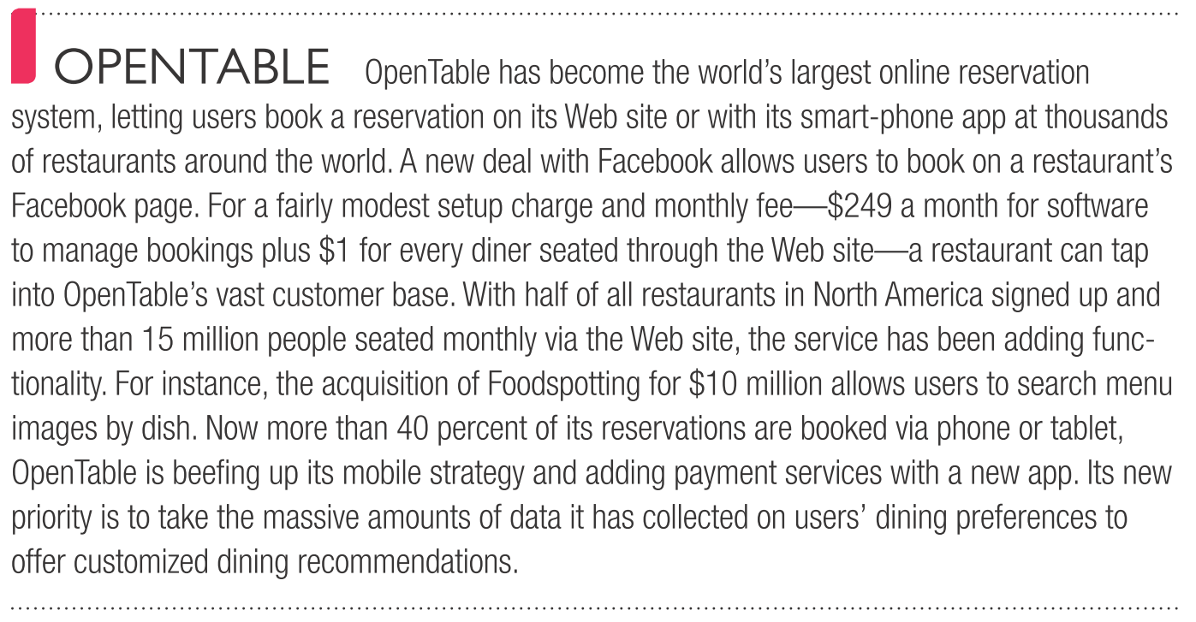
Example
Source: Kotler & Keller (2016)
Notes:
Kotler & Keller (2016)

Slide 35
Summary
In the present times, no marketer can ignore the importance of service quality. Merely providing the service is not source of competitive advantage because every marketer is providing the same.
In order to outsmart the competitors, it is important that ‘better’ service is provided to the customers.
We learned there is gap model called SERVQUAL which is suitable for general analysis of the quality of service.
There are also strategies to improve service quality: Listening, Reliability, Basic service, Service design, Recovery, Surprising customers, Fair play, Teamwork, Employee research, Servant Leadership.

