Slide 1


Název prezentace
Název projektu | Rozvoj vzdělávání na Slezské univerzitě v Opavě
Registrační číslo projektu | CZ.02.2.69/0.0./0.0/16_015/0002400
Prezentace předmětu:
Marketing of services
Vyučující:
Ing. Michal Stoklasa, Ph.D.
Ing. Martin Klepek, Ph.D.

Slide 2

Nature of services 2
The aim of this presentation is to describe the nature of services and its value for economy and potential for growth
.
Martin Klepek
Garant předmětu
Michal Stoklasa
Přednášející

Slide 3
Nature of services 2
Cervice classification in the history of thoughts.
Reasons for growth in services
Role of services in the economy
.
Lecture structure

Slide 4
Reasons for service growth
Consumer affluence
Due to the fast rise in the income of consumers, they are attracted towards the new areas like clubs, health clubs, domestic services, travel and tourism, entertainment, banking, investment, retailing, insurance, repairs, etc. and these are growing much faster than ever before. There is a significant change in the pattern of family expenditure.

Slide 5
CLASSIFICATION OF SERVICE
The service sector can best be characterized by its diversity.
Service organisations range in size from huge international corporations in such fields as airlines, banking, insurance, telecommunication, hotel chains, and freight transportation to a vast array of locally owned and operated small businesses, including restaurants, laundries, taxis, and numerus business to business services.
Franchised service outlets- in fields ranging from fast food to book keeping- combine the marketing characteristics of a large chain that offers a standardised product with local ownership and operation of a specific facility.

Slide 6
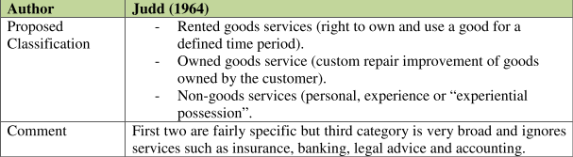
CLASSIFICATION OF SERVICE
Source: Urbánek (2014)

Slide 7
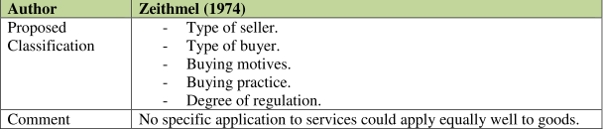
CLASSIFICATION OF SERVICE
Source: Urbánek (2014)

Slide 8
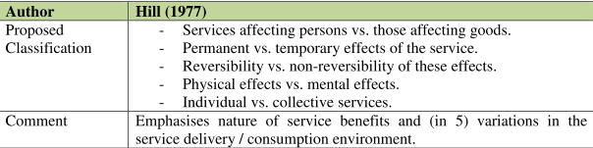
CLASSIFICATION OF SERVICE
Source: Urbánek (2014)

Slide 9
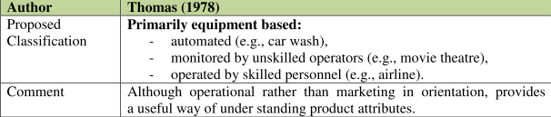
CLASSIFICATION OF SERVICE
Source: Urbánek (2014)

Slide 10
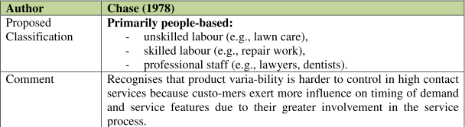
CLASSIFICATION OF SERVICE
Source: Urbánek (2014)

Slide 11
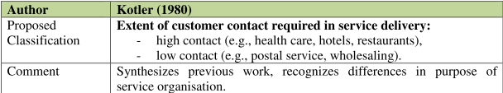
CLASSIFICATION OF SERVICE
Source: Urbánek (2014)

Slide 12
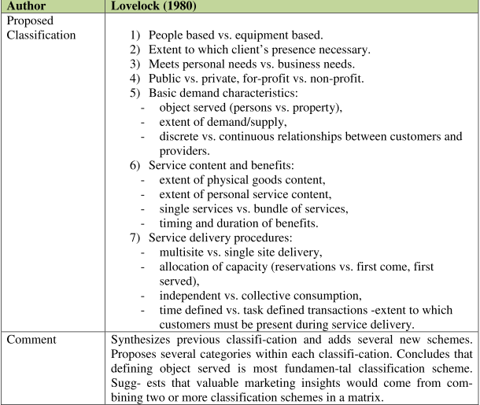
CLASSIFICATION OF SERVICE
Source: Urbánek (2014)

Slide 13
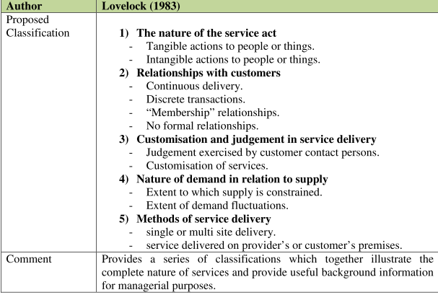
CLASSIFICATION OF SERVICE
Source: Urbánek (2014)

Slide 14
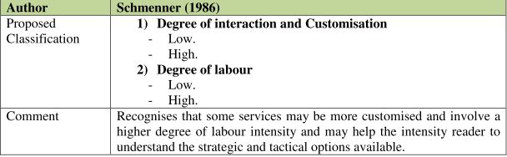
CLASSIFICATION OF SERVICE
Source: Urbánek (2014)

Slide 15
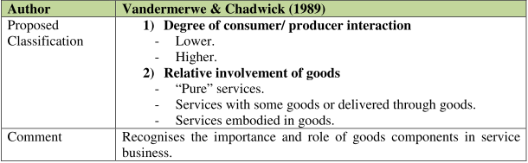
CLASSIFICATION OF SERVICE
Source: Urbánek (2014)

Slide 16
Service episodes
Service episodes are defined as an event or interaction that has a clear starting-point and an ending-point.
An episode can involve several interactions or acts.
For example, a consumer who has travelled with a particular airline on a number of routes can represent an episode. This episode can consist of a number of interactions or acts including check-in, boarding a plane, interacting with in-flight staff and so on.
Therefore it is possible to distinguish between different acts within an episode. The importance of each of these acts may vary in explaining episode satisfaction.
Notes:
Gilmore (2003)

Slide 17
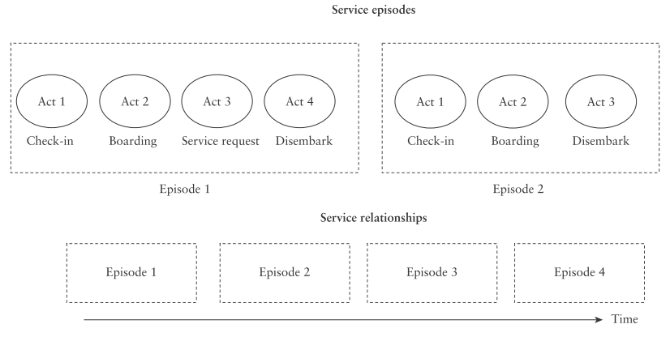
Service episodes
Source: Gilmore (2003)

Slide 18
CLASSIFICATION OF SERVICE
These classifications not only demonstrate the diversity of services but also suggest how important it is in a specific situation to carefully analyze the detailed nature of the service operation.
The general characteristics of services remain unchanged irrespective of the nature of service business where the customer is always a person or group of persons; the service is perceived more or less intangibly, some kind of interaction between the customer and some parts of the production system of the service provider-including personnel, technology, or both – always occurs, and some kind of input from the customer is always required in the process

Slide 19
Reasons for service growth
Working women
During the recent times a large number of women have come up in a variety of professions.
The work performance of women in most of services sector like bank, insurance, airlines, etc. is highly appreciable. In short, women are getting involved in almost all male dominated activities.
Due to increasing involvement of women in commercial activities, the services like domestic activities, fast food restaurants, marriage counselling, personal care, financial services, retailing, etc. have emerged in the recent times.

Slide 20
Reasons for service growth
Double income no kids (DINK)
Dinks are the working couples who have consciously postponed parenthood plans indefinitely or in an increasing number of cases, have decided not to have any children ever.
The dink culture is getting stronger and spreading wider day by day. The realisation that parenthood is likely to result in more commitments at home and demands on their time, thereby slowing down their career plans and ambitions, make them postpone their parenthood plans.
Whatsoever be their life style, they have double income and no kids, resulting in the emerging and enhancing of services like, entertainment, hotels and restaurants, career institutes, domestic services, travel resorts, personal care, ETA.

Slide 21
Reasons for service growth
Leisure time
People do get some time to travel and holiday, and therefore, there is a need for travel agencies, resorts, hotels and entertainment.
There are others who would like to utilise this time to improve their career prospects, and therefore, there is a need for adult education, distance learning, part time courses, etc.

Slide 22
Reasons for service growth
Greater life expectancy
According to the World Development Report and World Human Resource Index, the life expectancy of people has increased significantly all over the world barring few developing countries. It may be due to the advancement in the medical technology, and greater awareness about health and education. Greater life expectancy invites opportunities in services like hospitals, Nursing Homes, entertainment, leisure services, investment banking and so on.

Slide 23
Reasons for service growth
Product innovations
In the changing time the consumers have become more conscious of quality than cost.
They need high quality goods at par with international standards. Having this in mind the manufacturers have focused their attention on quality improvement, innovations, etc. In this process many more services have emerged on account of product innovation.
Some of them are servicing services, repairs, computer, training and development, education, etc.

Slide 24
Reasons for service growth
Product complexity
A large number of products are now being purchased in households which can be serviced only by specialised persons e.g. water purifiers, microwave oven, computers, etc., giving rise to the need for services.
The growing product complexities create greater demand for skilled specialists to provide maintenance for these complex products and brings out other services like expert advise, consultancy services, etc.

Slide 25
Reasons for service growth
New young youth
Every new generation has its own characteristics and enjoys a different life style.
There is a lot of difference between the generations in respect to their living conditions/ styles, maturity, thinking, attitudes, behaviour, beliefs, satisfactions, performance values and so on.
Today’s generation with all these changes provide more opportunities to services like entertainment, fast food, computers, travel, picnic resorts, educational institution, counselling, retailing, etc.

Slide 26
Reasons for service growth
Resource scarcity and ecology
As the natural resources are depleting and need for conservation is increasing, we have seen the coming up of service providers like pollution control agencies, car pools, water management, etc.

Slide 27
Reasons for service growth
Corporate crowd
The phenomena of globalisation, privatisation and liberalisation coupled with faster urbanization have created the corporate world crowd and its support services. This crowd is responsible in bringing the new services, and redefining the old ones. The services like hotels and restaurants, banking, insurance, travel and tourism, advertising, airlines, courier services, marketing research, health care, legal services, etc. will emerge and flourish more and more.

Slide 28
ROLE OF SERVICES IN ECONOMY
There is a growing market for services and increasing dominance of services in economies worldwide.
Services are a dominant force in countries around the world as can be seen in the global feature.
The tremendous growth and economic contributions of the service sector have drawn increasing attention to the issues and problems of service sector industries.

Slide 29
ROLE OF SERVICES IN ECONOMY
There was a time when it was believed that the industrial revolution was the only solution to the problems of poverty, unemployment and other ills of society.
Now, however, the service sector promises to fulfil the task.
Services touch the lives of every person every day whether it is in the field of food services, communication, leisure ser-vices, maintenance services, travel, amusement parks, to name only a few.

Slide 30
ROLE OF SERVICES IN ECONOMY
Services are increasingly being used by the corporate as well as the household sector.
This emphasis on services and its increasing use has not happened overnight - it started in the twentieth century especially after the end of World War II.
Due to large scale destruction during the war, a lot of economic activities had to be carried out to bring the war torn economies back on road. World War II marked as milestone in the explosive rise of service industries.

Slide 31
ROLE OF SERVICES IN ECONOMY
Throughout the second half of the twentieth century services industries have attained considerable growth in most western nations.
After Green Revolution and Industrial revolution, the next possible popular revolution will be in the field of service sector.
In Green revolution the man learnt to use, exploit and interact with nature (i.e., land and natural resources).

Slide 32
ROLE OF SERVICES IN ECONOMY
In Industrial revolution man learnt to use, exploit and interact with equipments and machines for development. In case of services, man is learning to use, exploit and interact with other man-made resources for development.

Slide 33
ROLE OF SERVICES IN ECONOMY
In the present day world the service sector is growing at a phenomenal rate and termed as ‘sunrise sector of the economy’.
Folowing table depicts the share of services in GDP as compared with agriculture and industry dividing the world in three groups; low income, middle income and high income.

Slide 34
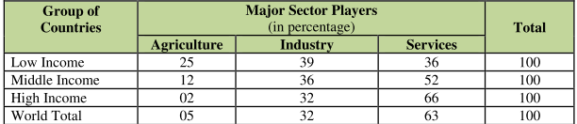
ROLE OF SERVICES IN ECONOMY
Source: Urbánek (2014)

Slide 35
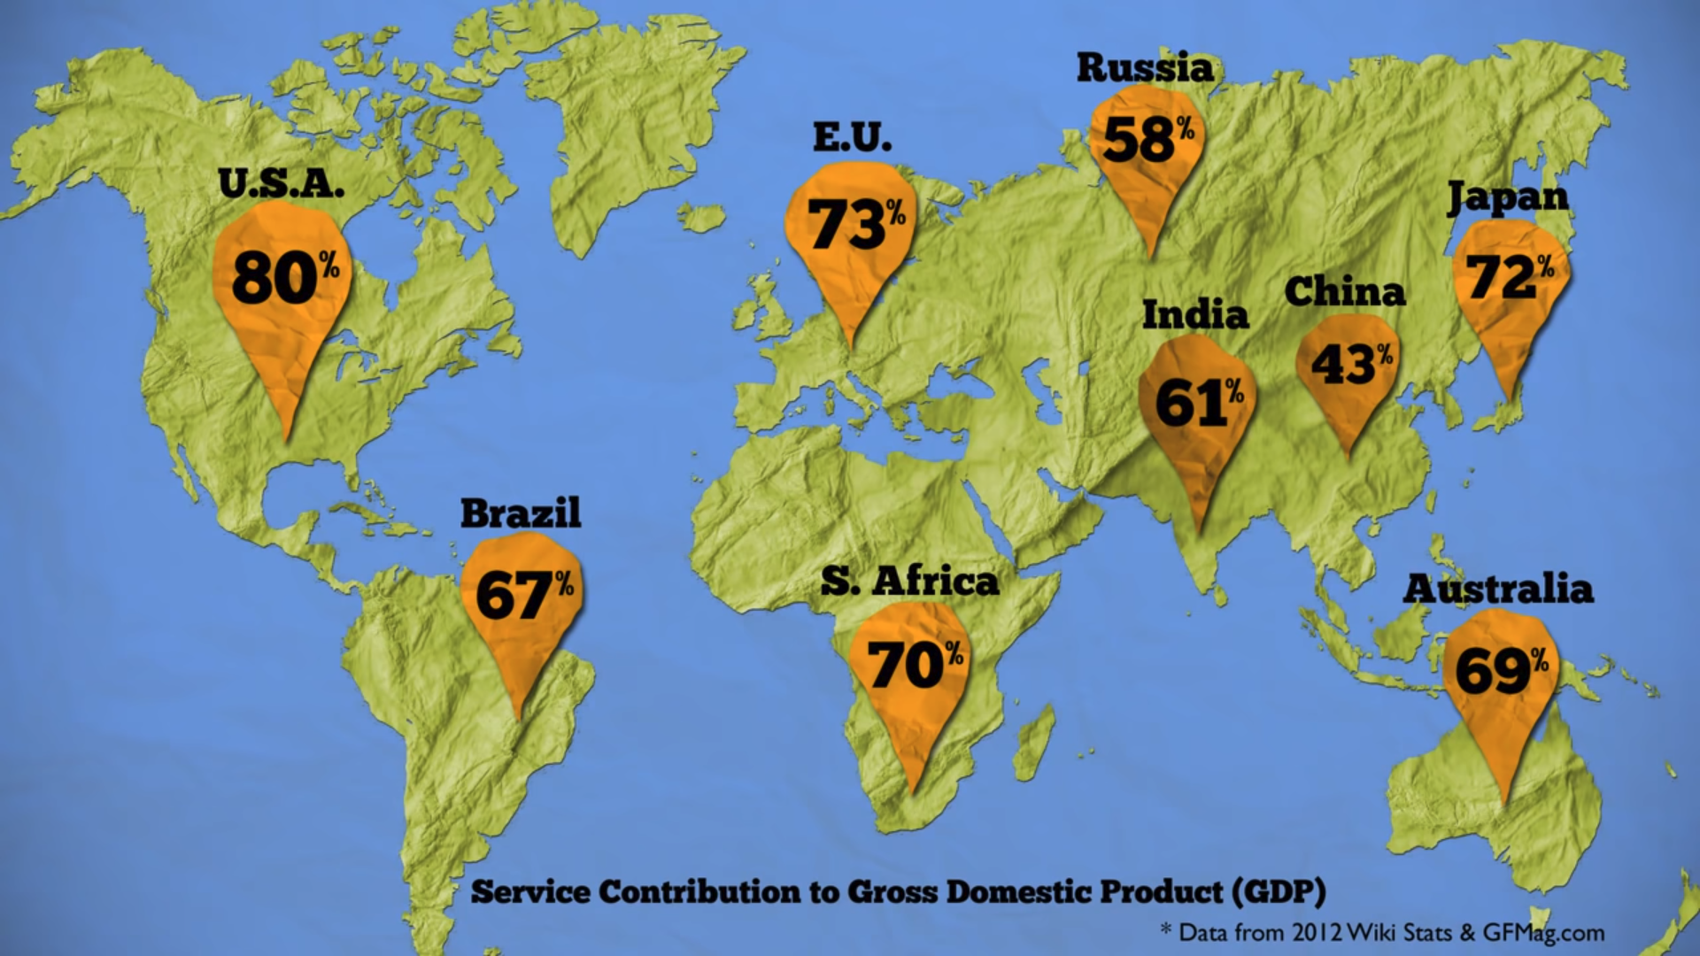
ROLE OF SERVICES IN ECONOMY

Slide 36
Summary
There is a growing market for services and increasing dominance of services in economies worldwide. We have discussed thi issue in this presentation.
Services are a dominant force in countries around the world as can be seen in the global feature.
The tremendous growth and economic contributions of the service sector have drawn increasing attention to the issues and problems of service sector industries.
There was a time when it was believed that the industrial revolution was the only solution to the problems of poverty, unemployment and other ills of society

