Slide 1
Název prezentace
Název projektu | Rozvoj vzdělávání na Slezské univerzitě v Opavě
Registrační číslo projektu | CZ.02.2.69/0.0./0.0/16_015/0002400
Prezentace předmětu:
Marketing of services
Vyučující:
Ing. Michal Stoklasa, Ph.D.
Ing. Martin Klepek, Ph.D.

Slide 2
CONSUMER BEHAVIOUR IN SERVICES
The aim of this presentation is to describe how consumers thing about services, how they percieve service providers
.
Martin Klepek
Garant předmětu
Michal Stoklasa
Přednášející

Slide 3
CONSUMER BEHAVIOUR IN SERVICES
Market segmentation
Factors influencing decision making:
Sitational
Psychological
Personal factors
.
Lecture structure

Slide 4
Customer behaviour
Every customer is different in some way by its ability of perception, attention, memories, previous experiences and cognitive capacity.
However we very often overlay with others creating segments on the market which are in similar (homogenous) characteristics.
We therefore perform market segmentation which is dividing market to smaller actionable parts based on some charactersitics.

Slide 5
Market Segmentation
McDonald sees market segmentation as „ process of dividing heterogenou market into specific homogenous groups. The segments this identied can then be targeted with specific setvices and distinctive marketing mix.“
In this way, customer needs can be met more effecvitvely which in turn opens up the prospect of building customer retentoon and loyalty.
Notes:
MC Donald – Planing for services

Slide 6
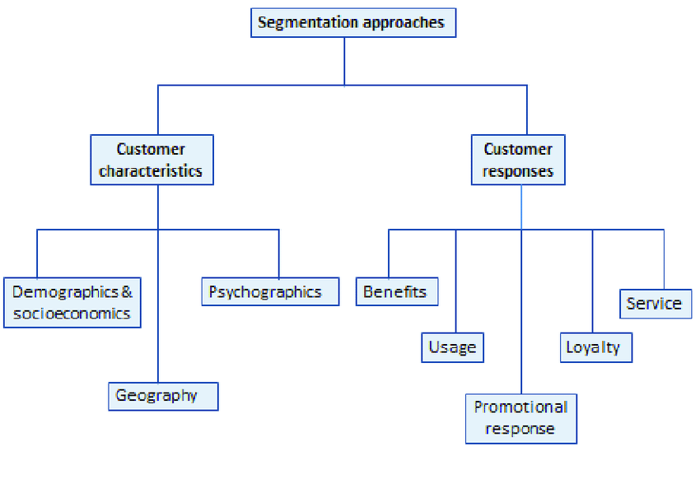
Market Segmentation
We know two main segmentation approaches:
Source: McDonald, Frow, Payne (2011)
Notes:
MC Donald – Planing for services

Slide 7
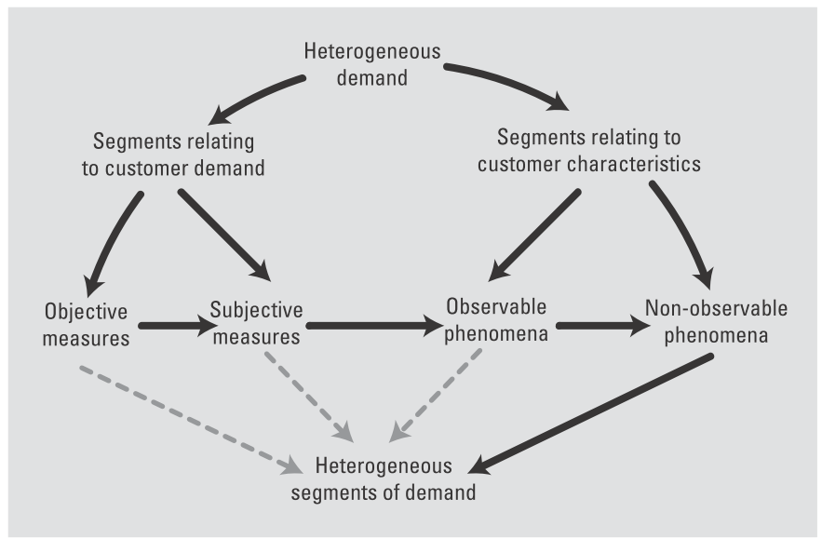
Segmentation strategies
Source: Ruskin-Brown (2005)
Notes:
MC Donald – Planing for services

Slide 8
Market Segmentation
Customer characteristics
Demographics and socioeconomics
Sex, age, family size, social class, ethic origins...
Psychographics
Lifestyle, behaviour
Geography
Home, work location
Notes:
MC Donald – Planing for services

Slide 9
Market Segmentation
Customer responses
Benefit
The reason why people buy a service
Usage
Heavy medium adn occasional users
Promotional response
How customers respond to various rypees of promotional activity
Notes:
MC Donald – Planing for services

Slide 10
Market Segmentation
Customer responses
Loyalty
Degree of loyalty – high medium and low
Service
Importance that particular customer groups attach to various elements of service
Notes:
MC Donald – Planing for services

Slide 11
Market Segmentation
Customer responses
Benefit
Source: McDonald, Frow, Payne (2011)
Notes:
MC Donald – Planing for services

Slide 12
Market Segmentation
Customer responses
Usage
Source: McDonald, Frow, Payne (2011)
Notes:
MC Donald – Planing for services

Slide 13
Market Segmentation
Customer responses
Promotional response
Source: McDonald, Frow, Payne (2011)
Notes:
MC Donald – Planing for services

Slide 14
Market Segmentation
Customer responses
Loyalty
Source: McDonald, Frow, Payne (2011)
Notes:
MC Donald – Planing for services

Slide 15
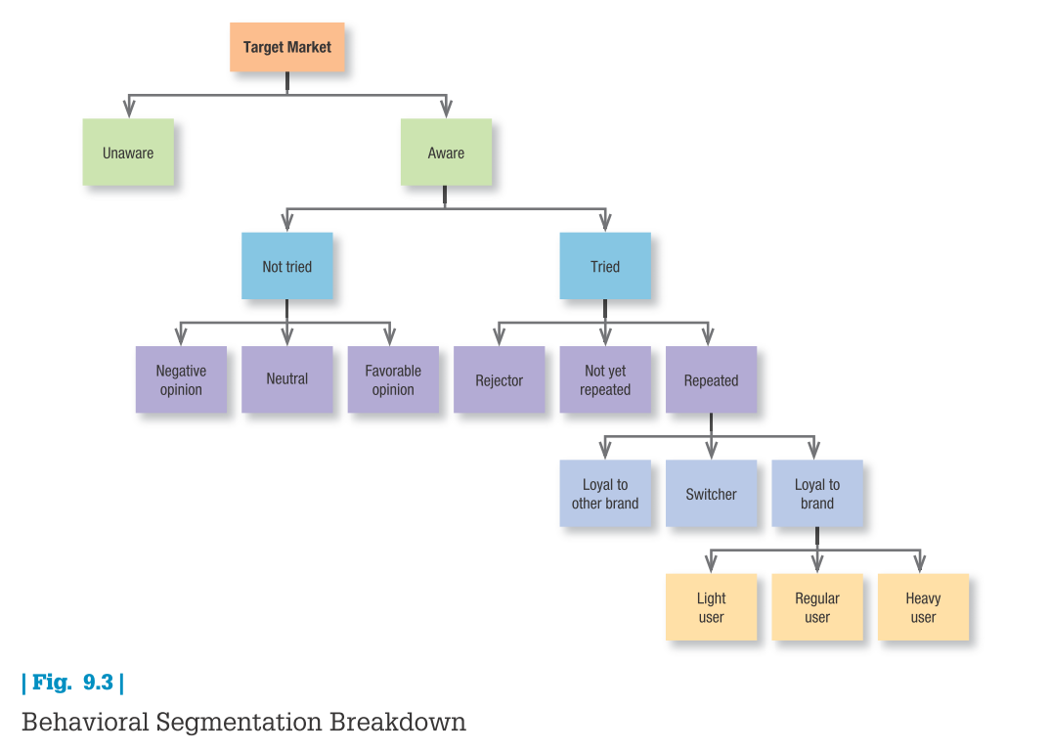
Market Segmentation
Source: Kotler & Keller (2016)
Notes:
MC Donald – Planing for services

Slide 16
Market Segmentation
Customer responses
Service
Source: McDonald, Frow, Payne (2011)
Notes:
MC Donald – Planing for services

Slide 17
Critical succes factor
Customer responses
Service
We have to improve seating arrangements
Maintain or increase service speed
Source: McDonald, Frow, Payne (2011)
Notes:
MC Donald – Planing for services

Slide 18
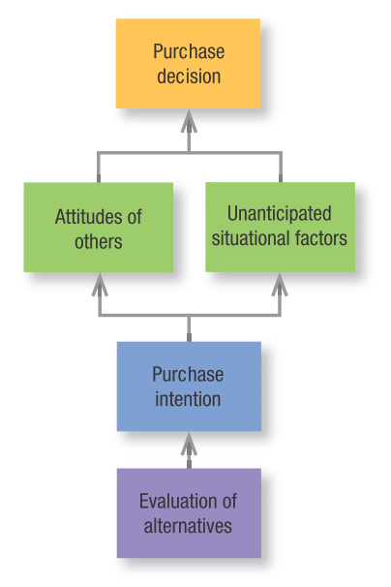
Intervining factors of consumer decisoons
Even if consumers form brand evaluations, two general factors can intervene between the purchase intention and the purchase decision.
The first factor is the attitudes of others. The influence on us of another person’s attitude depends on two things: (1) the intensity of the other person’s negative attitude toward our preferred alternative and (2) our motivation to comply with the other person’s wishes.
The more intense the other person’s negativism and the closer he or she is to us, the more we will adjust our purchase intention. The converse is also true.
Source: Kotler & Keller (2016)
Notes:
Kolter and Keller 2016

Slide 19
Intervining factors of consumer decisoons
The second factor is unanticipated situational factors that may erupt to change the purchase intention. Linda might lose her job before she purchases a laptop, some other purchase might become more urgent, or a store salesperson may turn her off.
Source: Kotler & Keller (2016)
Notes:
MC Donald – Planing for services

Slide 20
Intervining factors of consumer decisoons
Preferences and even purchase intentions are not completely reliable predictors of purchase behavior. A consumer’s decision to modify, postpone, or avoid a purchase decision is heavily influenced by one or more types of perceived risk:
Source: Kotler & Keller (2016)
Notes:
MC Donald – Planing for services

Slide 21
Factors influencing consumer behaviour
Sitational
Psychological
Personal factors

Slide 22
Situational factors
Socio-cultural factors - Buyers or consumers do not take buying decisions or the decision not to buy, in a vacuum. Rather, they are strongly influenced by cultural and social factors.

Slide 23
Situational factors
Cultural factors - Children acquire from their environment a set of beliefs values and customs which constitute culture. These beliefs, values and customs go deeper

Slide 24
Situational factors
Cultural factors - Children acquire from their environment a set of beliefs values and customs which constitute culture. These beliefs, values and customs go deeper and deeper as a person grows. Therefore, it is sometimes said that culture is learned as a part of social experience. The various sub-categories within a culture can be identified based on religion, age, gender, occupation, social class, geographical location, etc.

Slide 25
Situational factors
Reference groups - There are certain groups to which people look to guide their behaviour. These reference groups may guide the choice of a product but not necessarily the brand. Peer group and peer pressure has generally been observed to play an important role in the purchase of credit cards, cell phones, etc. The knowledge of reference group behaviour helps in not only offering substitutes but also in pricing and positioning them.

Slide 26
Situational factors
Family - The family is another major influence on consumer behaviour. Family consumption behaviour, to a large extent, depends on the family life cycle. The stages in family life cycle include bachelorhood, newly married, parenthood with growing or grown up children, post-parenthood and dissolution. Knowledge of these stages helps greatly in knowing the buying process. Often family members play a significant role in the purchase of a particular service.

Slide 27
Psychological factors
Perception - It is the process by which buyers select, organize and interpret information into a meaningful impression in their minds. Perception is also selective when only a small part is perceived out of the total of what is perceptible. Buyer’s perception of a particular service greatly influences buying behaviour.

Slide 28
Psychological factors
Attitude - An attitude is a learned predisposition to respond in a consistently favourable or unfavourable manner with respect to a market offer (i.e., a brand, a particular shop or retail outlet, an advertisement, etc.). Attitude is a dispositional term indicating that attitudes manifest themselves in behaviour only under certain conditions. Knowing a buyer’s attitude towards a product without knowing the personal goals is not likely to give a clear prediction of his behaviour.

Slide 29
Psychological factors
Motivation - Motivation is the driving force within individuals that compels them to action. This driving force is subconscious and the outcome of certain unfulfilled needs. Needs are basically of two types- first, the ‘innate needs’ are those needs with which an individual is born and they are mainly physiological.

Slide 30
Psychological factors
Motivation - They include all the factors required to sustain physical life e.g., food, water, shelter, clothing, etc. Secondly, the ‘acquired needs’ are those which a person acquires as he/she grows and these needs are mainly psychological, like love, fear, esteem, acceptance, etc.

Slide 31
Personal factors
Personality - Personality can be described as the psychological characteristics that determine how an individual will react to his or her environment.

Slide 32
Personal factors
Life style - Life style as distinct from social class or personality is nothing but a person’s pattern of living and is generally expressed in his/ her activities, interests and opinions. Life style suggests differences in the way people opt to spend on different products or services differently.

Slide 33
Personal factors
Demographic factors - Buyers demographic factors like age, gender, education, occupation, etc., also influence his/her purchase behaviour. In sum, knowledge on all such dimensions of the consumer will help in understanding his needs and wants and also help in integrating all these elements in service offer which the consumer wants.

Slide 34
Summary
We have discussed in this presentation that the primary objective of service producers and marketers is identical to that of all marketers: to develop and provide offerings that satisfy consumer needs and expectations, thereby ensuring their own economic survival. In other words, service marketers need to be able to close the customer gap between expectations and perceptions. To achieve this objective, service providers need to understand how consumers choose and evaluate their service offerings.

