Slide 1

INTERNATIONAL MARKETING ENVIRONMENT
Ing. Michal Stoklasa, Ph.D.
International Marketing/subject code

Slide 2
INTERNATIONAL MARKETING ENVIRONMENT
Outline of the lecture
International marketing environment.
Economic factors.
Technological environment.
Political and legal environment.
(There should also be Culture here, but we have it as separate lecture, next time!)

Slide 3
INTERNATIONAL MARKETING ENVIRONMENT
1. INTERNATIONAL MARKETING ENVIRONMENT
Companies that want to use intercultural approach need to analyze marketing environment, as it is the element that differs the most in foreign countries and influences the whole strategy of a company.
We can say that marketing environment is defined as the external and internal forces that influence an organization´s capability to undertake its business.
Market environment consists of three parts:
  Macro-environment.
  External micro-environment.
  Internal micro-environment.

Slide 4
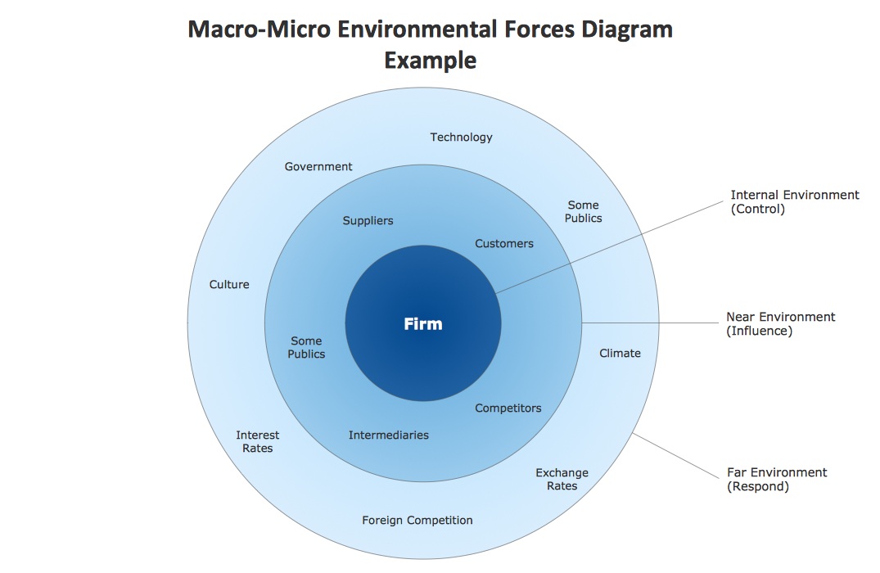
INTERNATIONAL MARKETING ENVIRONMENT
INTERNATIONAL MARKETING ENVIRONMENT
Companies that want to use intercultural approach need to

Slide 5
INTERNATIONAL MARKETING ENVIRONMENT
PARTS OF MARKETING ENVIRONMENT
Macro-environment consists of broad environmental issues that may affect not only the business performance but also the other actors in the micro-environment. Traditionally four forces - political/legal, economic, demographic, social/cultural and technological– have been the focus of attention, with the result that the term PEST analysis has been used to describe macro-environmental analysis.
External micro-environment consists of the actors in the firm´s immediate environment that affect its capabilities to operate effectively in its chosen markets. The key actors are customers, distributors, suppliers, competitors and publics. Analysis will consist of an analysis of issues relating to these actors and an overall analysis of market size, growth rates and trends.
Internal micro-environment comprises the internal business characteristics of the firm itself and its operations: sales, profitability, marketing organization etc.

Slide 6
INTERNATIONAL MARKETING ENVIRONMENT
PEST, PESTLE, STEEPLE OR?
PEST (Political and Legal, Economic, Social and Cultural, and Technological analysis) has been enhanced throughout its time on the market into PESTLE (Political, Economic, Social, and Technological Legal and Environmental analysis), then the model has recently been further extended to STEEPLE and STEEPLED (adding Ethics and demographic factors).
The growing importance of environmental or ecological factors in the first decade of the 21st century have given rise to green business and encouraged widespread use of an updated version of the PEST framework.
STEER analysis systematically considers Socio-cultural, Technological, Economic, Ecological, and Regulatory factors.

Slide 7
INTERNATIONAL MARKETING ENVIRONMENT
SO WHAT DO WE CHOOSE?
A number of analyses - analysis of the international macro environment - PEST. We settle for the original name, because all the other names are just marketing, the idea and content are the same only with differently named categories.
Political and legal - easily accessible data.
Economical - analyses carried out by many public institutions.
Socio-cultural – we can examine the trends, but there is no uniformity how to understand everything.
Technology - easily accessible data.
PEST name - just marketing (the other option is the newest STEER for Socio-cultural, Technological, Economic, Ecological and Regulatory factors).

Slide 8
INTERNATIONAL MARKETING ENVIRONMENT
PEST TIMEFRAME
In this case, timeframe refers to a point in time in which the analysis is done.
Usually when people do PEST, they look up info on web and say its done. But it only shows data for one point in time. Usually the data is also kinda old.
In real life we are interested not only in current data and current state of the market (NOW), but we are also interested in how we got to this point (PAST TRENDS), and where are we expecting things to evolve from now on (FUTURE TRENDS).
What does it mean? It means, that we are interested in past timeframe, current timeframe, and future timeframe.
How long does the timeframe need to be? It depends! Can be decades (e.g. 50 years) for very stable segments without turbulent development, can be years (e.g. 8 years), or can be months (e.g. 1 year) for very edgy things.

Slide 9
INTERNATIONAL MARKETING ENVIRONMENT
MACRO-ENVIRONMENT
Political/Legal | EU and national laws, codes of practice
Economic | economic growth, unemployment, interest and exchange rates, global economic trends (e.g. the growth of the Chinese and Indian economies)
Ecological/Physical | global warming, pollution, energy and other scarce resources, environmentally friendly ingredients and components, recycling and non-wasteful packaging
Demographic | changes in world population (demographic forces), age distribution and household structure
Social/Cultural | attitude and lifestyle changes, subcultures within and across national boundaries, consumerism
Technological | new product and process technologies, new materials

Slide 10
INTERNATIONAL MARKETING ENVIRONMENT
EXTERNAL MICRO-ENVIRONMENT
Market | size, growth rates, trends
Customers | who they are, their choice criteria, how, when and where they buy, perception of product, promotion, price and distribution, segmentation, benefits sought,
Competitors | major competitors, their objectives and strategies, strengths and weaknesses, size, market share and profitability, entry barriers to new competitors, trends
Distributors | channel attractiveness, distributor decision-making unit, decision-making process and choice criteria, strengths and weaknesses, power changes, physical distribution methods, trends
Suppliers | who they are and location, strengths and weaknesses, power changes, trends
Publics | financial public, government publics, media publics, citizen-action publics, non-profit organizations, general publics

Slide 11
INTERNATIONAL MARKETING ENVIRONMENT
TRENDS IN MACRO ENVIRONMENT
Demographic - our customer, aging, migration back from the cities, the decline in fertility, singles, families and households character, racial and national structure.
Economical - purchasing power, the global economic crisis, unemployment, disposable income, tax policy, exchange rate.
Legislative and political - instability, EU law.
Natural - ecology, energy prices, climate change.
Technology - shortening cycle, innovation.
Socio-cultural - universal global customs, social communities, life in debt, organic lifestyle, health and beauty, empowerment of women, terrorism, education.

Slide 12
INTERNATIONAL MARKETING ENVIRONMENT
2. ECONOMIC FACTORS – MOST IMPORTANT CRITERIA
Average wage.
Statistics of unemployment.
Inflation rate.
Consumer prices.
Work productivity.
Development of energy prices.
Exchange rates.
Investment.
Savings.
Taxes and duties.
Interest rate.
State budget balance.

Slide 13
INTERNATIONAL MARKETING ENVIRONMENT
THE ECONOMIC STRUCTURE OF COUNTRIES ACCORDING TO KOTLER
Economic system - (market or centrally planned).
Economic structure - the share of the sectors of industry, agriculture and services. Kotler distinguishes four types:
  a) Developed (industrialized) countries: main exporters of manufactured goods and investment capital. These economies trade with each other industrial goods, and also export it to other types of economies, in exchange for raw materials and semi-finished products.
  b) Developing economies: in these economies, the the industrial production is 10-20% of GDP. The country imports machinery and equipment, but also consumer goods for rich and a small middle class.
  c) Economies exporting raw materials: these countries have one or more of the natural resources, but in other respects they are poor.
  d) Subsistence economies: most of the population is employed in agriculture, little opportunity for exporters.

Slide 14
INTERNATIONAL MARKETING ENVIRONMENT
FOREIGN TRADE POLICY
A set of state activities, which purposefully influence foreign trade of the country. The degree of influence of commercial tools affects trade policy which can be largely protectionist or predominantly liberal.
The economic policy of the government (diverges with Central Bank? - saving vs. spending).
Foreign trade policy.
Exchange rate policy.
Policy towards foreign investors.

Slide 15
INTERNATIONAL MARKETING ENVIRONMENT
REASONS FOR PROTECTIONISM
Protecting new companies or industry.
Protection of the domestic market.
The need to keep the funds in domestic market.
Stimulation and accumulation of capital.
Maintaining the standard of living and real wages.
Conservation of natural resources.
Industrialization of less developed state.
Maintaining employment and reducing unemployment.
Defense of the country.
Enlarge the scope of business.
Retaliatory action and negotiation.

Slide 16
INTERNATIONAL MARKETING ENVIRONMENT
TARIFF INSTRUMENTS - DUTY
According to the purpose of duty: fiscal (revenue in the budget), defense (domestic production), prohibitive (prevent imports), protective (protection of specific sectors), retaliation, negotiation, differential (for the benefit of transport), contingent (temporary) preference (in the integration).
According to the movement of goods: import (most used), export (minimum) and transit (replaced by a highway sign).
According to the selection method: the ad valorem (%), specific (fixed amount), differentiated (depending on customs valuation), and mixed.

Slide 17
INTERNATIONAL MARKETING ENVIRONMENT
NON-TARIFF INSTRUMENTS
Import surcharge (% of customs value of goods).
Import deposit (then returned).
Quantitative restrictions (quotas).
Minimal price.
Countervailing duty (subsidized products).
Anti-dumping duties.
Technical barriers to trade (mostly!) - mandatory certificates, an administrative authorization procedure, changes in manufacturing processes, etc.

Slide 18
INTERNATIONAL MARKETING ENVIRONMENT
EXPORT PROMOTION INSTRUMENTS
Serve to promote domestic export.
Important for SMEs.
Most often - preferential export financing, risk insurance, providing information and advice.
Czech Export Bank, EGAP (Export Guarantee and Insurance Corporation).

Slide 19
INTERNATIONAL MARKETING ENVIRONMENT
EXCHANGE RATE POLICY
The system of fixed rates or floating rate system.
Variability rate - rate risk - the difficulty of calculations and planning - the need to hedge against exchange rate risk - increasing costs.
The need to spread the risk in different markets and different currencies.
Used hedging instruments - futures purchases and sales of currencies (forwards, futures, swaps, options).

Slide 20
INTERNATIONAL MARKETING ENVIRONMENT
GOVERNMENT POLICY TOWARDS FOREIGN INVESTORS
International capital flows are one of the largest manifestations of globalization.
Form - foreign investments and credits - direct investment.
Depending on how the country is developed - developed countries are trying to encourage inward investment - a stable economic environment and investment incentives.
Investment incentives - the tax on corporate income tax, subsidies for newly created jobs, retraining, zero import tariffs, investment-ready areas, etc.

Slide 21
INTERNATIONAL MARKETING ENVIRONMENT
MACROECONOMIC INDICATORS
Basic: GDP per capita, inflation rate, unemployment rate, GDP growth, the development of investment etc.
Natural environment: the size of the country, climate, water resources, topographical conditions, altitude, climate zone in which the country is etc.
Demographic Environment: data on demographic international environment represent another very important area of marketing analyzes. It identifies the country's population in numbers, including men, women, trends in the population development in the country, population density, the number of economically active population, the level and structure of education, health data etc.

Slide 22
INTERNATIONAL MARKETING ENVIRONMENT
IMPORTANT ECONOMIC CHARACTERISTICS FOR STARTUPS

Slide 23
INTERNATIONAL MARKETING ENVIRONMENT
3. TECHNOLOGICAL ENVIRONMENT
Technological environment contributed to globalization.
It provides information on the technical development of the country.
Expenditure on research (% of GDP), the level of spending on research and development in various sectors, the number of international patents, the number of researchers, computerization, penetration of smartphones, the number of Internet users and its speed etc.
Development of communication technologies - enables new forms of business - C2C, C2B.
The technical infrastructure of the country: determines the level and coverage of the country's telecommunications services and networks, the quality and structure of the transport network density and structure of the business and the level of financial services.

Slide 24
INTERNATIONAL MARKETING ENVIRONMENT
IMPORTANT TECHNOLOGICAL CHARACTERISTICS FOR STARTUPS

Slide 25
INTERNATIONAL MARKETING ENVIRONMENT
4. POLITICAL AND LEGAL ENVIRONMENT
Legal or also called legislative environment significantly affects the overall business activity and possibilities on the foreign market. Legal conditions are closely related to the political environment, which develops legislation and standards for businesses.
In this context it is important to have a clear game rules for companies that support the desired business activity and economic development.
An issue and a risk area in international marketing are different legal systems and standards in different countries.
Although a number of compatible rules in business law exists in the international environment, the ignorance of small differences and nuances in legal standards causes significant risks and failures

Slide 26
INTERNATIONAL MARKETING ENVIRONMENT
POLITICAL AND LEGAL ENVIRONMENT
Fundamental factor - needed stability.
We analyze: the political system, political stability, the membership of the country in regional integration groupings, political ties to other countries, the relationship with foreign firms, corrupt environment, the importance of interest groups (business and professional associations, consumer protection associations), lobbying, status of trade unions, regulation of foreign business entities (the possibility of checking ownership, buying property and land, repatriation of profits abroad, dispute resolution, employment conditions.

Slide 27
INTERNATIONAL MARKETING ENVIRONMENT
LEGAL ENVIRONMENT 1
Legislation and standards for business, therefore the legal environment is closely linked to the political environment.
On the one hand, there is a number of compatible rules in the international environment that facilitate commerce.
On the other hand, there are differing legal standards in various states causing considerable risks and failures.
International law vs. national law vs. acquis communitaire.
In international trade, we must distinguish between general economic laws of the country governing all economic entities within the state (pricing, business forms, loan terms, etc.) and the foreign economic policy measures and trade policy.
The legal standards, procedural norms, norms regulating property relations between participants in international trade.

Slide 28
INTERNATIONAL MARKETING ENVIRONMENT
LEGAL ENVIRONMENT 2
We have to understand if it is cognitive law or based on precedents or even heavily influenced by religion.
Continental law (codified) is based on a fixed written law, and based on Roman law. It is used in most countries of the world, e.g. in Germany, France, Spain, Mexico, etc.
And then we have areas using precedent law (Anglo-Saxon), which is based on tradition (precedent and customs) and depends less on written codes and statutes. It is used in Great Britain, USA, India, Australia (total of 26 states).

Slide 29
INTERNATIONAL MARKETING ENVIRONMENT
IMPORTANT POLITICO-LEGAL CHARACTERISTICS FOR STARTUPS

Slide 30
INTERNATIONAL MARKETING ENVIRONMENT
THE END
Thank you for your attention.
☺

