Slide 1

International Distribution Policy
Ing. Michal Stoklasa, Ph.D.
International Marketing/subject code

Slide 2
International Distribution Policy
Outline of the lecture
Distribution.
International distribution strategy.
Trends in international distribution.

Slide 3
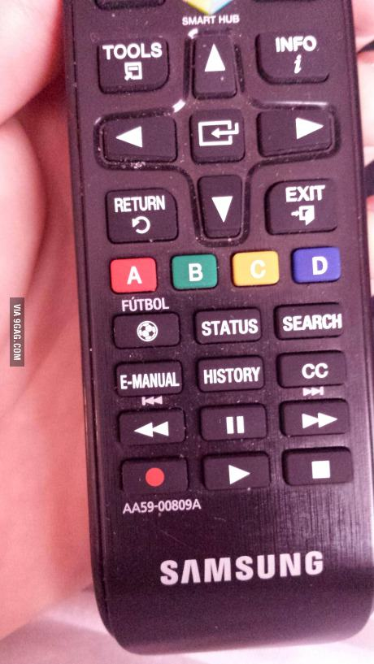
International Distribution Policy
I FOUND A FUN PIC OF PRODUCT ADAPTATION
Button on remote controler in Mexico.

Slide 4
International Distribution Policy
1. About distribution in general
It is far!
In every country people prefer a different style of shopping.
The aim of international distribution policy is to adapt supply to demand and ensure the smooth movement of goods from domestic manufacturer to the end consumer in the foreign market.
Building international distribution channels is very expensive, long and complicated process.
Distribution policy is the least flexible instrument of international marketing mix. Change of distribution policy will take effect only after a relatively long time and, moreover, is usually rather expensive and risky.
Distribution policy strongly influences all the other tools of the marketing mix.

Slide 5
International Distribution Policy
THE INFLUENCE OF INTERNATIONAL DISTRIBUTION
In the international product policy, it has an influence on the design and quality of products supplied, on the speed with which new products get to foreign markets, product mix and the particular size and packaging products.
Costs for building international distribution channels are reflected in the price of products where it constitutes a major part of the price paid by the final customer.
To some extent, distribution policy influences international communications policy, especially the level and quality of cooperation between business intermediaries.

Slide 6
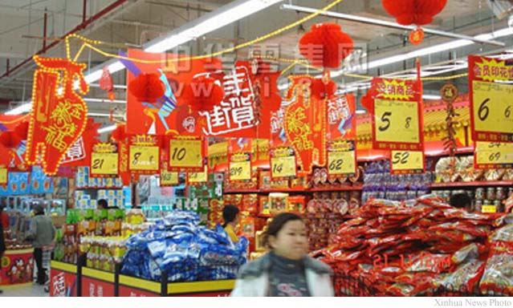
International Distribution Policy
DISTRIBUTION IN CHINA
The preferred way - marketplace or large shopping houses reminiscent of the marketplace.
Turnover during the "Spring Festival holiday" of about USD 90 bn. in 2015.

Slide 7
International Distribution Policy
2. INTERNATIONAL DISTRIBUTION STRATEGY
International distribution strategy is part of an overall international business strategy.
To be able to create a succesful international distribution strategy we have to decide:
  A: Distribution method.
  B: The density of the distribution network.
  C: Length of the distribution channel.
  D: Status and criteria for selecting participants for distribution.
  E: Method of management and coordination of the activities of participants in the distribution.
  F: Own physical transportation and storage of goods distributed, or logistics.

Slide 8
International Distribution Policy
A. DISTRIBUTION METHOD 1
Distribution channels provide essential links between manufacturers and customers. Method of international distribution of goods may in some cases coincide with the entry form on the international market. Selecting the method of distribution must be preceded by a careful analysis of the target market, its environment and conditions for the management and control of the distribution channel.
The structure of distribution channels is influenced by many factors, notably the degree of economic development of the country, the purchasing power of the population, the level of the country's infrastructure, the nature of the goods, specifics of movement of goods in international conditions (logistics) and capital of the exporting company.

Slide 9
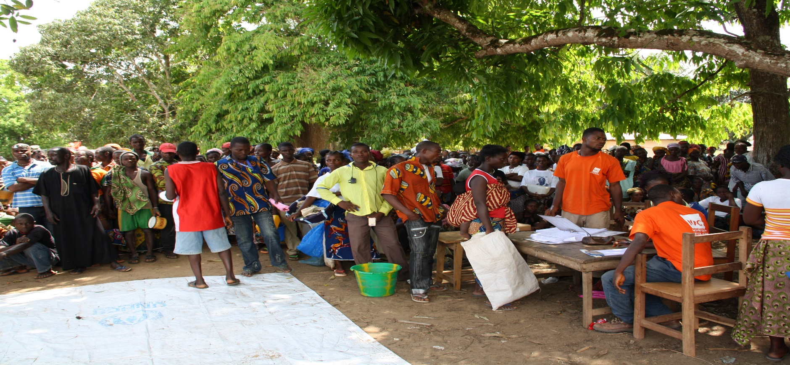
International Distribution Policy
Selling flour in Ethiopia

Slide 10
International Distribution Policy
DISTRIBUTION METHOD 2
Direct distribution: manufacturing company distributes its products abroad itself, with its own channels. (through its dealers, export department or through foreign trade branch). When direct distribution, manufacturer is in direct contact with customers, which is advantageous, but on the other hand bears any difficulties, claims and risks associated with export.
Indirect distribution: production company is deciding between numerous domestic and foreign entities who offer mediation of product distribution to customers. The intermediary buys the product and provides comprehensive marketing services. Or they don't buy the product (commercial representation, commission and agency relations, purchasing offices that look for and buy goods at the request of its clients, while not provide sales services). The facilitator has less freedom in decision-making.

Slide 11
International Distribution Policy
THE ADVANTAGES OF INDIRECT DISTRIBUTION
Providing know-how in the early stages of entering new market.
Saving costs (financial and personnel) to unexplored markets, small and distant.
Opportunity to get into customer awareness of brand name.
Test the acceptability of products on foreign markets at a low cost.
Ensure the immediate payment of goods, reducing the risks of international trade.
Organization of well-functioning distribution channels with an uncompetitive goods.
Ability to export products to new foreign markets, selling surplus stocks and raw materials.
In some cases, provide storage or other services.
For government contracts providing contacts and the adjustment of the company.

Slide 12
International Distribution Policy
THE DISADVANTAGES OF INDIRECT DISTRIBUTION
Indirect distribution reduces the producer's profit, mediator trading margin may be 5-30% of the product price.
Hinders direct communication with foreign participants, reduces feedback and control.
Mediator may conceal manufacturers expand sales opportunities in the form of licensing or investment, reasons are not to lose a client.
May harm the potential market where it performs poor service.
Limits the ability to provide effective support each product.
When the intermediary sells under its own name, it will be better known than the producer. When the manufacturer takes over exports it does not have an adequate understanding of the distribution and sales practices and contacts.
Instability of sales, in the case of wholesalers who can turn at any time to the competition.

Slide 13
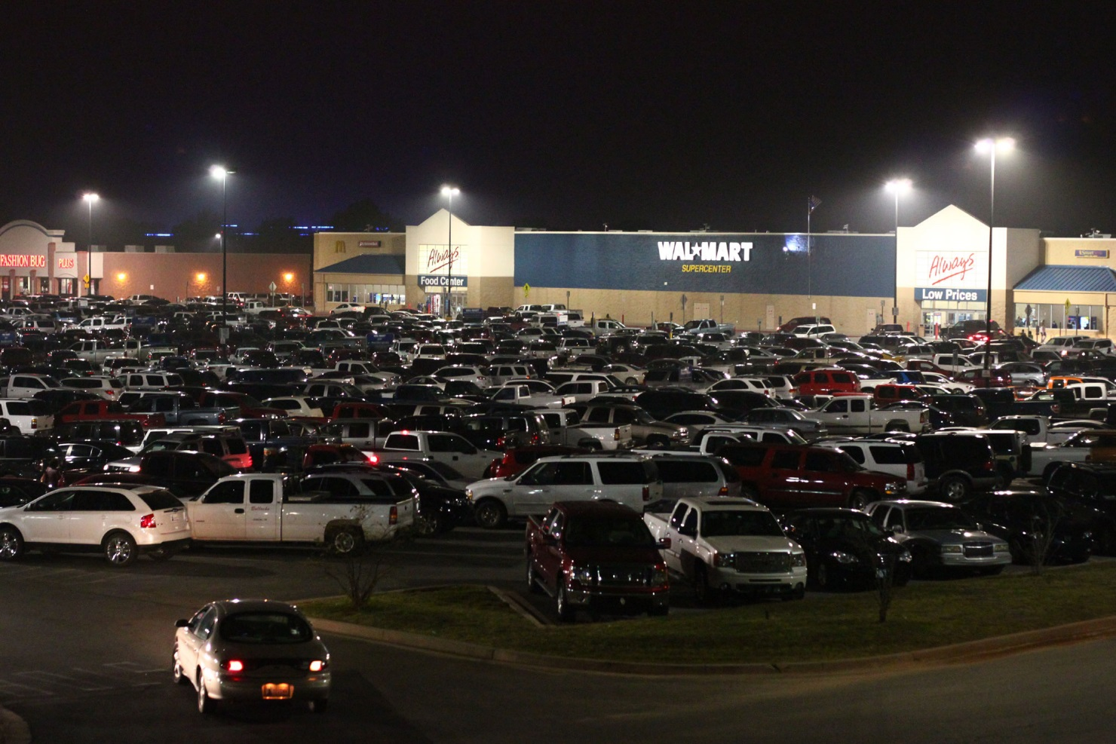
International Distribution Policy
Distribution in the USA
The bigger, the better.

Slide 14
International Distribution Policy
DIFFERENCES IN INTERNATIONAL DISTRIBUTION 1
A special type of intermediary called "Norazi agents" who specialize in suspicious transactions, such as smuggled goods, hazardous waste and weapons. Mediate importation of strategic goods to countries under international trade blockade (apples to Russia … but also guns, alcohol, drugs).
State agents - in some countries there is a state monopoly on the purchase of certain goods (Sweden and Norway have a monopoly on alcoholic beverages which can be purchased only in state stores). State may also through government agencies or state-authorized intermediaries buy goods for its own use (office equipment, computer purchases, for the army and police, etc.).

Slide 15
International Distribution Policy
B: THE DENSITY OF THE DISTRIBUTION NETWORK
The density of the distribution network is expressed as the number of elements in relation to a particular market and product. We distinguish intensive distribution (products of daily consumption), selective distribution (consumer durables), and exclusive distribution (luxury branded products).
The density of the distribution network is affected by:
  nature of the goods (intensive, selective, exclusive distribution)
  product life cycle stages,
  the purchasing habits of consumers,
  territorial factors (distance, traditions, legal restrictions)
  geographical distribution of market demand,
  potential sales volume (due to competition),
  control,
  requirements for special functions (service, counseling, etc.).

Slide 16
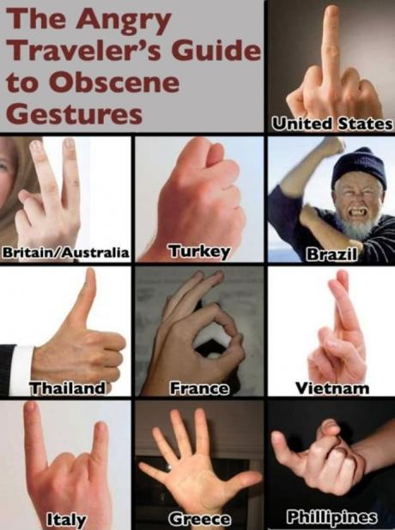
International Distribution Policy
Angry gestures

Slide 17
International Distribution Policy
C: LENGTH OF THE DISTRIBUTION CHANNEL
The length of distribution channels is determined by the number of distributors (intermediaries) in the distribution chain from the manufacturer to the end customer. Especially significant is the motivation for the realization of sales for each distribution channel element, not only economic (price) incentives, but also other tools such as advertising, sales promotion, personnel training, personal selling, etc.
The channel length is influenced by:
  density of the distribution network,
  the average quantity of goods supplied,
  expiration of goods,
  geographic characteristics of the country,
  consumer purchasing power.

Slide 18
International Distribution Policy
DISTRIBUTION CHANNEL LENGTH VS. WIDTH
For relationship of length and width of the distribution channel, the intensively and selectively distributed goods require more links in the chain. Exclusive distribution corresponds rather with the choice of direct distribution.
There is also a correlation between the length of the channels and the advancement of the country. Channels are usually shorter for the goods sold on the production markets, and for long-term goods with higher prices. It is true that the higher the volume of purchases, the shorter the distribution channel.
In many countries there are different types of wholesalers (in terms of service) who supply retailers. For a foreign company it is often advantageous to sell goods to one or two wholesalers, who take care of sales to the next levels, which is often characterized by a large number of small, scattered retailers.

Slide 19
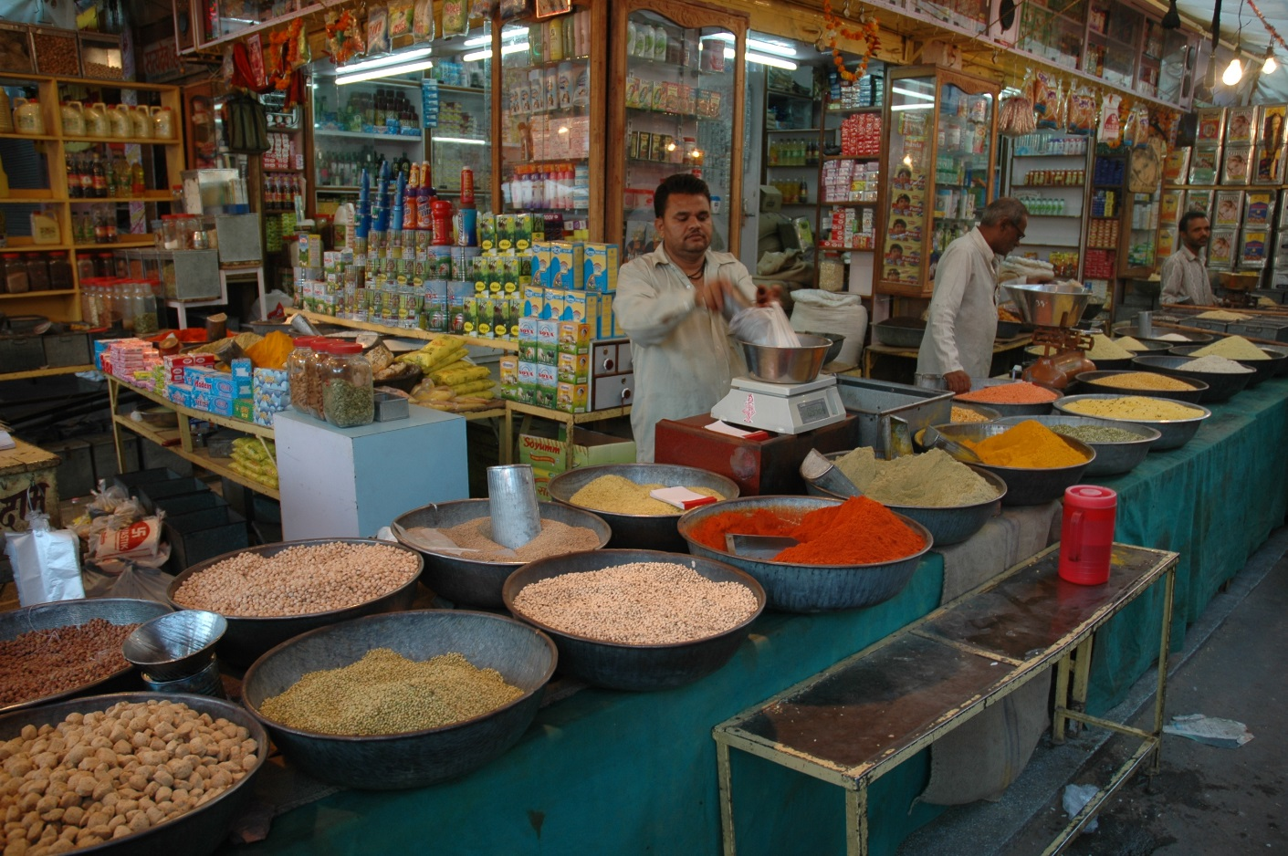
International Distribution Policy
Distribution in India
Retail is 12% of GDP, that is over 300 mld. USD, it employs over 10% of the work force, it has 12 mil. shops!

Slide 20
International Distribution Policy
ENTRY STRATEGIES INTO FOREIGN DISTRIBUTION CHANNEL
If the company has no own foreign distribution channels, it must secure the distribution of their products through foreign distribution channels. There are basically four ways:
  Complementary distribution (piggybacking goods of other manufacturers that do not compete, but complement its portfolio. Each of the participating manufacturers distribute goods under their own brand name.
  OEM system (Original Equipment Manufactures), in this case, the manufacturer enters the distribution channel under the brand name(s) of the seller. This method entails a risk of reputational damage for both parties.
  Joint venture with the distributor. This is a direct capital investment.
  A closed distribution channel strategy. Approach in this case assumes personal contacts to overcome mistrust.

Slide 21
International Distribution Policy
COSTS OF INTERNATIONAL DISTRIBUTION
The financial strength of the company entering into international business determines the method of distribution channels. The more company is financially stronger, it is easier for it to establish its own distribution channels or at least provide good control of the entire distribution process.
Distribution channel costs have 2 main parts – building the channel and maintaining it.
Maximum investment, as already mentioned, is needed to build own channel. The least profitable is to export directly to the retail network of a foreign country, the most profitable sales appear to be a distributor, which has built its own distribution channel.

Slide 22
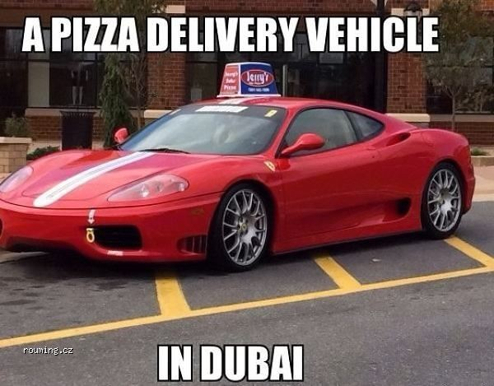
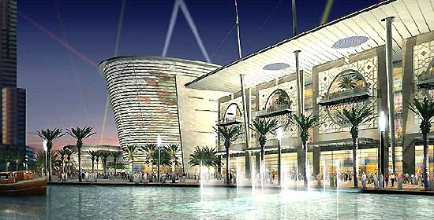
International Distribution Policy
Retail in Dubai

Slide 23
International Distribution Policy
D: STATUS AND CRITERIA FOR SELECTING PARTICIPANTS FOR DISTRIBUTION
Recommended factors for selection of distribution partner:
  objectives and strategies of distribution companies,
  size, capital of distribution partner,
  his reputation,
  geographic coverage and production areas of interest,
  compatibility of distributed products,
  experiences,
  sales network,
  physical equipment,
  willingness and possibility of stockholding, servicing, promotion,
  sales performance,
  communication,
  contacts with local authorities,
  general attitude.
When choosing distribution partner it is usual to assess the importance of each individual criteria and assess potential candidates. The resulting sum of points multiplied by the weights of the criteria will enable to determine the order of candidates.

Slide 24
International Distribution Policy
E: METHOD OF MANAGEMENT AND COORDINATION OF THE ACTIVITIES OF PARTICIPANTS
The motivation of intermediaries - mainly with financial rewards, material rewards and psychological motivation (recognition of performance), support for exporting companies and maintaining good relationships, including providing reports on the development of sales and market as a whole.
An important component of motivation is the amount of the (profit) margin, which depends on the level of economic development of the country, the nature of goods distributed, phase of its life cycle and range of services offered. Trading margins and commissions must meet the needs of intermediaries and distribution policy maker.
The problem is the coordination of individual members of the distribution channels. In each area there are strong players that try to more or less dictate terms to operators in other distribution channels. In developing countries - often one dominating company that is the exclusive distributor.

Slide 25
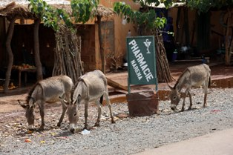
International Distribution Policy
Pharmacy in South America

Slide 26
International Distribution Policy
CONTROL OF DISTRIBUTION CHANNELS
Element that directly affects the quality of channel management is the control of distribution channels. Its focused on compliance with contractual terms, agreed prices, the minimum amount of sales volume, a form of sales, advertising, services and other conditions.
Monitoring (control) distributors in the environment of international marketing is harder than at home mainly because of the greater distance and also because of greater distribution channels length.
Easier control can be achieved in own distribution systems, or franchise, or with the careful selection of exclusive sales representatives. Controlling the movement of goods is done through barcode. Suitable is also personal visit that can evaluate the behavior of sales personnel (mystery shopping).

Slide 27
International Distribution Policy
ISSUES IN INTERNATIONAL DISTRIBUTION 1
Nonexistent distribution channels - in some countries there are no adequate distribution channels, or there are only parts of the channel. For example, channels suitable for the urban population do not cover rural areas. (Eastern Europe in the 90s)
Laws and regulations - can in many places restrict the producer in terms of control of distribution channels. For example, in EU countries is not possible under the laws prohibit transfers (i.e. re-exports) of goods within the EU, although it is one of the causes of "gray market" (the use of different price levels of the same goods in different countries). The only option for manufacturers is to put a clause into the distribution agreement of the movement ban.

Slide 28
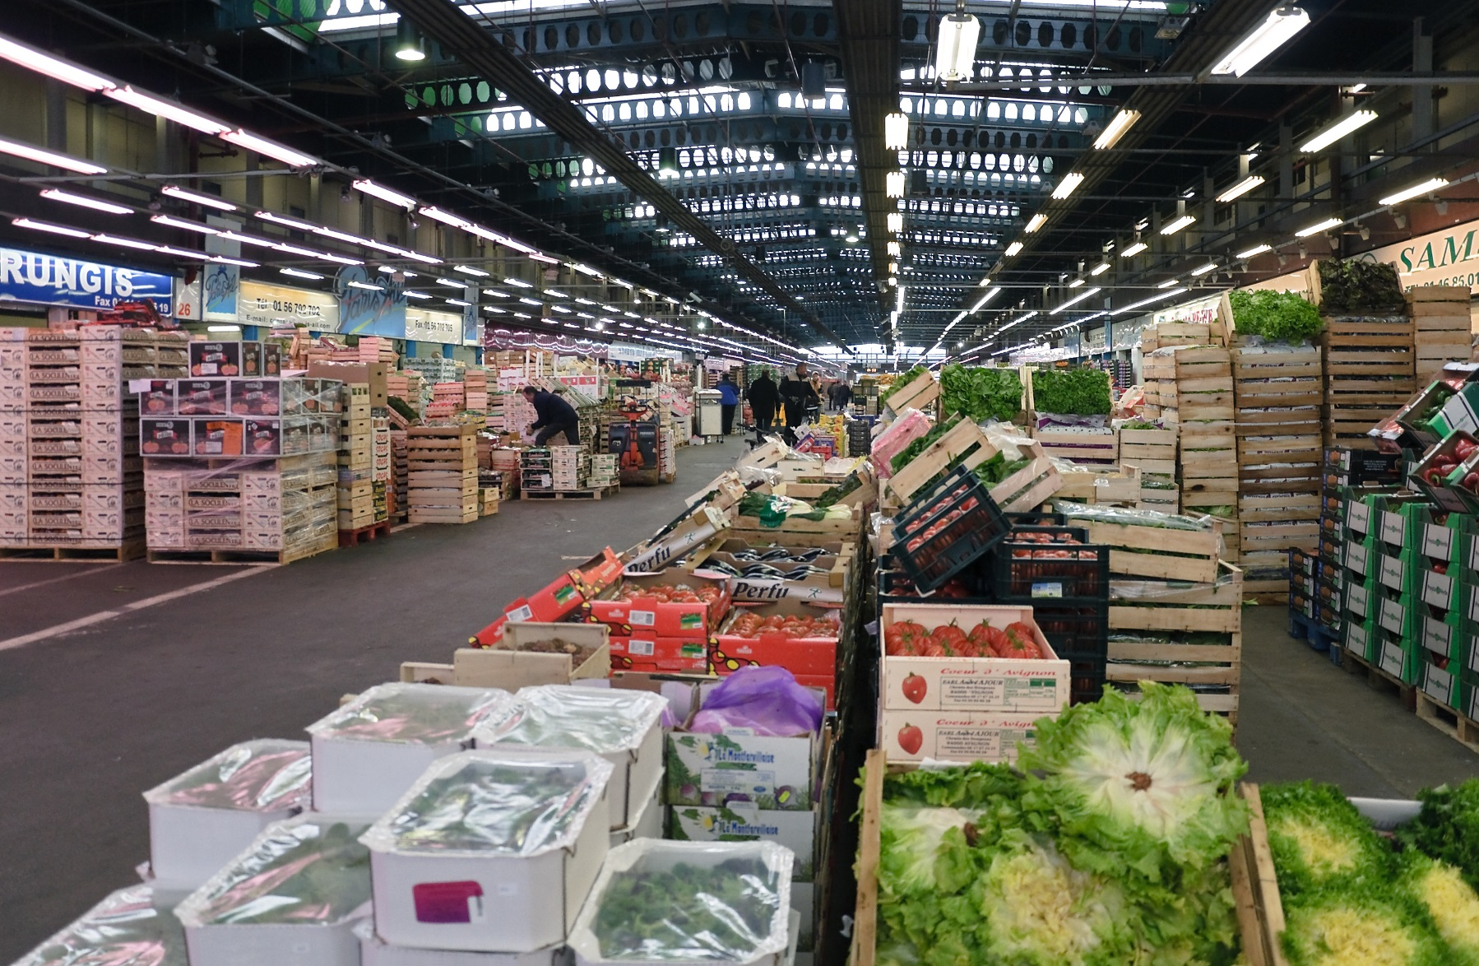
International Distribution Policy
Wholesale Retail

Slide 29
International Distribution Policy
ISSUES IN INTERNATIONAL DISTRIBUTION 2
Blocking the use of channels - some distribution channels may be inaccessible for exporters due to cartels and trade associations intermediaries. E.g. Czech crashed requirements of manufacturers and importers of drugs to distribute certain products outside pharmacies (petrol stations or at retail) due to strong opposition from the Association of Pharmacists. Retailers can only be supplied by a relatively small number of wholesalers with an exclusive contract. In a similar way, a new exporter can be completely cut off from access to the market.
Direct marketing - is the result of efforts to save distribution costs and bypass some of inefficient or blocked channels. Examples of successful companies in the field of direct marketing may be Amway or Avon, based on a system of multilevel marketing, i.e. direct offers to consumers. Another example are catalog sales, teleshopping and e-shopping.

Slide 30
International Distribution Policy
ISSUES IN INTERNATIONAL DISTRIBUTION 3
Storage - is in foreign markets connected with many inherent risks. These include high costs (especially in the case of a strong domestic currency), the risk of inflation, which has the effect of increasing prices of stored goods. In many cases, the exporter with the lack of equity tends to reduce the funds tied to stocks. This leads to reducing inventory and subsequent problems, especially when fluctuations in demand, and the threat of loss of market to competitors.
High bargaining power of distributor - is seen especially in countries where there is a small number of wholesalers supplying many retailers, or where the retail market is controlled by large multinational retail chains of hypermarkets and retail networks. Smaller exporters are forced to price and other concessions in order to get into these networks, or must rely on less efficient intermediary.

Slide 31
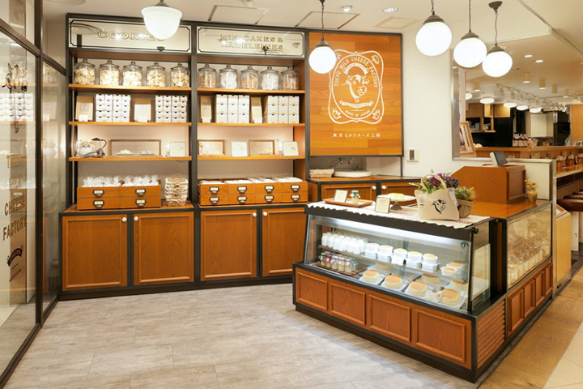
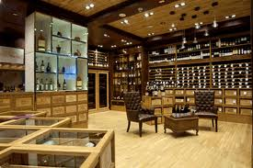
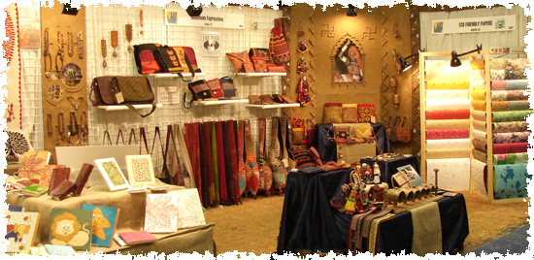
International Distribution Policy
SPECIFIC SHOPS – WINE, CHEESE, FAIR TRADE

Slide 32
International Distribution Policy
F: INTERNATIONAL LOGISTICS
Logistics is the physical distribution of goods among the members of the distribution channels to the consumer. In addition, it also includes transportation planning and control of the physical product flow. Transport is a key element of logistics. The aim of logistics is to transport the product so that the company can achieve a profit.
Logistics management is understand as management dealing with the traffic of products, inventory control, warehousing and order management process.
Well-functioning logistics system constitutes 15-35% of the total costs of the company. Logistics system is focused on achieving the greatest number of satisfied customers through realized deliveries in relation to orders.

Slide 33
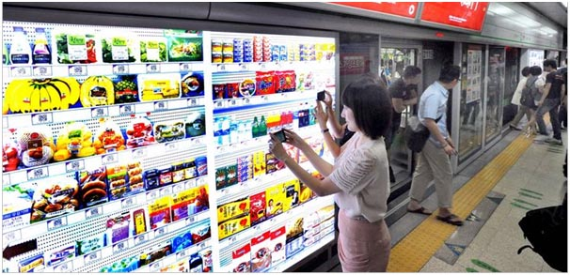
International Distribution Policy
QR SHOPS

Slide 34
International Distribution Policy
3. TRENDS IN INTERNATIONAL DISTRIBUTION 1
The process of internationalization – is the process of increasing involvement of enterprises in international markets.
The concentration process - is related to the process of internationalization, is evident especially in the retail and wholesale trades, and leads to the emergence of global trading companies (retail chains), and the creation of strategic business alliances.
Decisive influence shifts from producers to distributors - the main reasons for this phenomenon include the aforementioned processes of internationalization and concentration of distribution chains. Currently, the distribution chains increasingly determine what is produced and subsequently sold. Furthermore distributors pressures reduce prices of suppliers (manufacturers), improve the quality of supply.

Slide 35
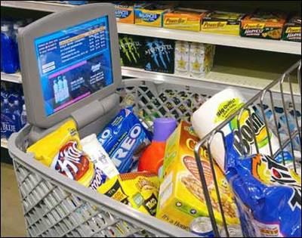
International Distribution Policy
RFID CHIPS
RFID – radio frequency identification technology.

Slide 36
International Distribution Policy
TRENDS IN INTERNATIONAL DISTRIBUTION 2
The diversification strategy of distribution intermediaries - this process leads trading companies to focus on designated type of activity, characterized by assortment, price level, sales method, the size of stores, range of services to a specific customer segment (hypermarkets, supermarkets, discount orientation, shop in the store - the use of high-capacity drives for rent, for example, sales of branded goods, refreshments, etc.). Diversification is also reflected in the development of own distribution brands (such as Tesco brand).
The role of wholesale organizations is assumed by a limited number of large distribution centers - the so-called modern form "Cross Dock" distribution centers, which assemble volume deliveries from producers practically "from car to car" and deliver without storing in warehouses directly to retail chains.

Slide 37
International Distribution Policy
TRENDS IN INTERNATIONAL DISTRIBUTION 3
Cooperation between business and suppliers - a strong position of distribution companies has led to various forms of cooperation with suppliers, where the main objective is to increase business efficiency for all stakeholders. Close cooperation must be based on the use of modern management tools, especially ECR systems and EDI.
Information technology - technological innovations of recent years allow distribution companies to greatly enhance the efficiency of its services.
Internet offers companies the possibility of direct communication with consumers and customers, but in relation to the classical distribution companies it is their competition.

Slide 38
International Distribution Policy
THE END
Thank you for your attention.
☺

