Slide 1

International Pricing Policy
Ing. Michal Stoklasa, Ph.D.
International Marketing/subject code

Slide 2
International Pricing Policy
Outline of the lecture
Price.
Factors affecting pricing.
International pricing strategies.
The process of price formation.

Slide 3

International Pricing Policy
BEFORE WE BEGIN …
The boring real life practice for pricing is … sitting at your computer analysing data about sales!

Slide 4
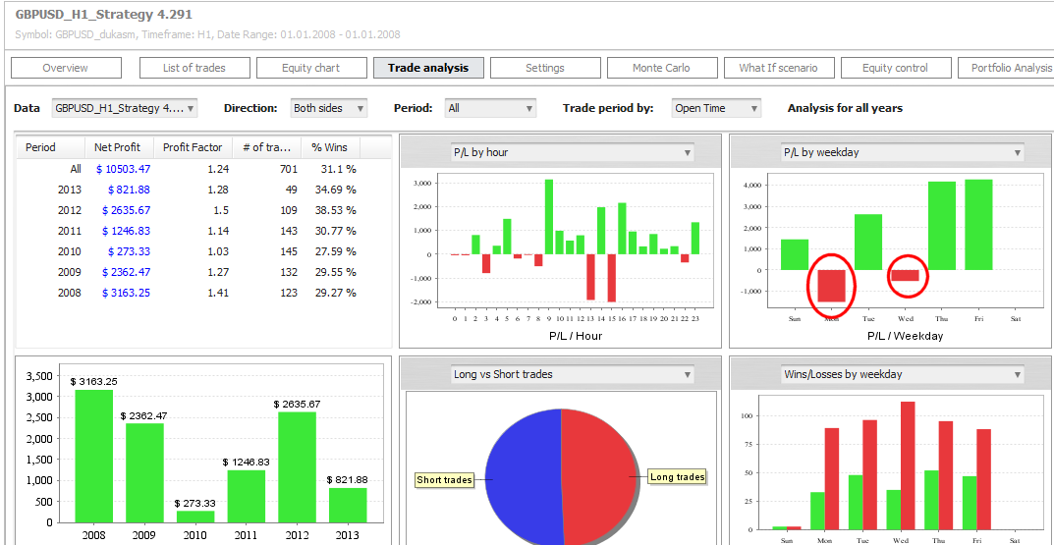
International Pricing Policy
WHAT-IF SCENARIOS
What-if scenarios are about what happens if something else happens.
Notes:
Source:http://www.strategyquant.com/doc/print-28.html

Slide 5
International Pricing Policy
… WE ARE ALSO BASING EVERYTHING ON CALCULATION EQUATION
Direct material (material immediately needed for production).
Direct wages (wages of workers producing the product).
Manufacturing overhead (overhead = joint production costs).
TOTAL 1 + 2 + 3: OWN COSTS OF PRODUCTION
Administrative overheads (common costs on the administrative apparatus).
Supply arrangement (et al. Supply costs for the enterprise).
TOTAL 4 + 5 + 6: OWN COSTS OF PERFORMANCE
Distribution costs / overheads (linked to sales - sales).
TOTAL 7 + 8: FULL OWN COSTS OF PERFORMANCE
Profit.
TOTAL 9 + 10: PRICE BEFORE TAX
VAT.
SUM 11 + 12: FINAL PRICE

Slide 6
International Pricing Policy
1. PRICE
International pricing policy is the only instrument of international marketing mix that has the opportunity to directly influence revenue and hence the overall profitability of the business.
The product price must reflect the value and quality that customers expect from the product.
In comparison with other instruments of international marketing mix price is very flexible tool, which allows to respond flexibly to all external and internal changes in the marketing environment of enterprise.

Slide 7
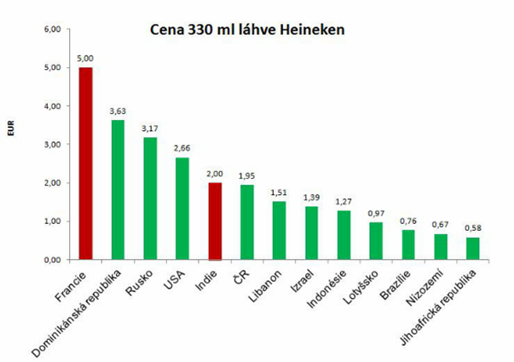
International Pricing Policy
PRICE OF HEINEKEN

Slide 8
International Pricing Policy
INTERNATIONAL PRICING POLICY
In managing international operations and when exporting goods or services, international manager is responsible for creating such a pricing policy, which will effectively support the implementation of international operations.
The marketer responsible for pricing policy must be able to orientate in the price of the market, competition and various government regulations, and his responsibility lies in determining and controlling the real price of the goods which are traded in different markets.
Every new market confronts the marketing manager with a new set of factors that influence their decisions, it is different duties, costs, behavior, competition, currency fluctuations and company marketing strategy.

Slide 9
International Pricing Policy
INTERNATIONAL DIFFERENCES 1
In Asian countries, the concept of time is focused more on the past (ancestors, values), in Latin American countries and southern European countries it is rather focused on the present, and in Western Europe as well as North America on the future (achieving goals).
Thumbs up means in America, and especially Brazil and the USA, "everything is fine", while in some Islamic countries it is a rough sexual sign.
"Everything OK" is in Western European countries showed by thumb and forefinger forming the "O". This sign means in Japan „now we can talk about money", in southern France, the opposite ("nothing, without value"), in some Latin American countries, Eastern Europe and Russia, it is indecent sexual sign.

Slide 10
International Pricing Policy
2. FACTORS AFFECTING PRICING 1
The factors influencing pricing are strongly affected by: the country in which the transaction is done, the product, diversity of conditions under which competition operates and other strategic factors.
The company has / doesn't have pricing policy under its control, not / allowing it to realize its intended marketing strategy.
Greater control over the company's final selling price improves the ability to achieve marketing goals.
Ability to control the cost worsens with the width of the production line and the number of countries that are involved in the transaction.

Slide 11
International Pricing Policy
FACTORS AFFECTING PRICING 2
Internal factors the company - company objectives, desired profitability and the sum of costs - production, distribution, transportation, product - life cycle phases, quality.
Market factors - changes in demand, consumer behavior, perception of price, competition.
Environmental factors - state fiscal policy, inflation, tariffs, exchange rate stability, taxes, price controls, dumping, gray markets etc.
Managerial decisions - (marketing pricing strategies). In the implementation of international pricing, there must be gradual analysis of individual groups of factors.

Slide 12
International Pricing Policy
ANALYSIS OF THE INTERNAL PRICING FACTORS 1
Analysis of the internal factors of the company includes critical review of other elements of the marketing mix: product, distribution and communication mix. The objective is to evaluate their own costs and the competitiveness of the product.
Product will inter alia determine the stage of the product life cycle, which is offered in various markets, further substitutability of the product, its place in the relevant product-line, brand, appearance, weight, dimensions, product packaging etc.
The objective is to evaluate their own costs and the competitiveness of the product.

Slide 13
International Pricing Policy
ANALYSIS OF THE INTERNAL PRICING FACTORS 2
Indispensable condition for the success of pricing policy is a good orientation in the whole issue of costs. Company must be able to identify a significant number of factors that affect the cost, depending on the nature of the market, the product and the immediate situation.
Intense competition in some world markets increases costs and reduces profits. Costs increase sometimes lengthy business negotiations. Therefore, the positive factor helping reduce costs is extensive experience of the relevant markets.
Limit (marginal) costs should be the lower limit of the price of goods.

Slide 14
International Pricing Policy
ANALYSIS OF THE INTERNAL PRICING FACTORS 3
For the production costs, the effort to reduce them extends not only to the own business, but also to subcontractors, under the so-called „partnership relation". Cooperating companies are mutually comparing their cost items and jointly considering that costs can be reduced by the same percentage on the principle of profit from the contract. This principle is increasingly applied particularly for complex products and investment units.
If the internal costs of production involve significant cost of purchased materials, it is sometimes useful to insert in the contract the price clause, by which the exporter enforces adjustment of the invoiced price if the price of inputs exceeds a certain limit (e.g. 5%) compared to state before signing a contract.

Slide 15
International Pricing Policy
ANALYSIS OF THE INTERNAL PRICING FACTORS 4
For material, we need to define according to which commodity exchange we will price and the date for the price fixation (shipping date or billing), and what is the share of total price.
Very important is the knowledge of the differences in the valuation of output at variable or total costs. Variable costs are rising with each produced (sold) unit, while fixed costs do not change with the change in production volume.
For international logistics costs, i.e. the costs of transportation, storage, insurance, etc., will the amount be influenced by the choice of delivery conditions - for example, by Incoterms 2012+.

Slide 16
International Pricing Policy
ANALYSIS OF THE INTERNAL PRICING FACTORS 5
The amount of the distribution cost is a function of the type of distribution, length of distribution channels, i.e. the number of distribution intermediaries. Consumer goods generally uses longer distribution channels and distributors overall margins are typically higher. In many countries, there are poorly developed distribution channels and marketing infrastructure.
Lack of price control and control of distribution routes can cause a phenomenon called parallel imports, or the emergence of gray markets.
In some countries, be careful that the duty (tax) is calculated off of the value of goods including freight, insurance and freight forwarding services.
If the company is unable to reduce costs, the price of the product can achieve such a level that it can be sold only to a select segment of customers with high resistance to the price.

Slide 17
International Pricing Policy
INTERNATIONAL DIFFERENCES 2
In North America, as well as in Arab countries, pauses between words are usually short, while in Japan pause may give the opposite meaning. Persistent silence is perceived as comfortable in Japan, while in India, Europe and North America it can cause confusion and embarrassment. Scandinavians, by Western standards, are more tolerant of silent pauses.
Laughter in most countries means happiness - in Japan it is often a sign of confusion, uncertainty and embarrassment.
When invited to dinner in some Asian countries and in Central America, it is customary to leave immediately after dinner. Not walking away means that we have not eaten enough (still hungry). In the Indian subcontinent, Europe, South America, and North American countries, it is considered rude, that the guest wanted only to eat, but did not want to be in the company of a host.

Slide 18
International Pricing Policy
ANALYSIS OF MARKET FACTORS 1
Competitor analysis – i.e. their state, level, number, size and nature of the competing firms.
Local competitors may have a different cost structure than large multinationals, it leads to the existence of different prices. If the main competitors are just these big companies that have their home base in the same country, then pricing strategies are similar.
Part of the competition analysis is to determine whether competing firms have signed a price agreement between them (such as cartel - illegal).

Slide 19
International Pricing Policy
ANALYSIS OF MARKET FACTORS 2
Customer analysis – i.e. the demand, purchasing power, income, price elasticity. The purchasing power of the population determines the upper price limit, which can not be easily exceeded.
The income level of the population determines the amount and structure of goods and services that can be applied in a given market.
Except the overall level of residents income, we will also be interested in the structure of consumer spending.
Price elasticity of demand will vary in individual countries and for different types of products. Industrial markets have usually lower price elasticity than consumer markets.

Slide 20
International Pricing Policy
ANALYSIS OF ENVIRONMENTAL FACTORS 1
The basic framework for the creation and implementation of pricing strategies on foreign markets is set by economic and legal environment. Particularly important is the fiscal policy of the state. The tax burden is a factor that affects not only the level of prices but also in the wider context of deciding what form of entry we choose.
In the area of imports, most developed countries apply mainly two basic taxes - value added tax (VAT) and excise tax. Excise tax is usually applied with respect to the society's so-called „superfluous" goods, such as cigarettes, alcohol, fuel and luxury goods.

Slide 21
International Pricing Policy
ANALYSIS OF ENVIRONMENTAL FACTORS 2
Many countries apply different tools that restrict free pricing.
The objective of price regulation may be to protect consumers or small businesses.
Sometimes this restriction may take the form of established maximum prices (rents, energy prices, medicines, etc.). Elsewhere, it is the determination of minimum prices, especially for large distribution companies, which are not allowed to sell goods at lower prices. Restrictions may include the determination of maximum profit, or a ban on the movement of prices (a tool to mitigate inflation).

Slide 22
International Pricing Policy
ANALYSIS OF ENVIRONMENTAL FACTORS 3
Export costs - other tools that directly affect prices in foreign markets are trade policy instruments that are used to protect domestic producers (customs duties, import duties, setting minimum prices for imported products, anti-dumping measures etc.).
Taxes, duties and administrative expenses – are affecting prices for final consumers, who bears the greatest burden (meaning its not affecting the company as much as consumers). Sometimes, however, the end consumer can benefit from the fact that producers seek to penetrate the foreign market and deliberately reduce their profitability.

Slide 23
International Pricing Policy
INTERNATIONAL DIFFERENCES 3
Arab countries, the Indian subcontinent, Japan, the Middle East, East Africa, Southeast Asia: to show the soles of the feet or touch someone with shoes is considered a major faux pas. You should never use your left hand while greeting or serve food at the table with left hand.
Arabic-speaking countries: to lay the Koran or religious literature on the floor is not allowed.
Scandinavia, Central and Eastern Europe, Japan, China, Hawaii, Turkey, India: it is unacceptable to enter someone's home with shoes on.
China: it is rude to give someone a watch as a gift. For "giving the watch" is a homonym for "burying the dead". It is also considered rude to start eating before the older start. Another faux pas at the dinner table is to eat a meal without a rice. It is perceived as a faux pas in Japan.

Slide 24
International Pricing Policy
DUMPING
Dumping sales could be explained as such a sale where the price of goods is lower than its production costs. Another approach characterizes dumping as selling goods in foreign markets at a price lower than what it is sold in the domestic market.
We distinguish between so-called „predatory dumping", which is intentionally selling goods in a foreign market at a loss. An unintentional dumping, which occurs due to timing differences between commercial transaction, sending and receiving the goods, including payment of the invoice, the price is lower due to changes in the exchange rate of the relevant currency or due to inflation.

Slide 25
International Pricing Policy
INFLATION
In countries with high inflation or with frequent changes in exchange conditions, it is necessary to combine the sales price with the cost of goods sold and the cost for the assortement replacement. If the price is lower then it is not suitable to export.
In the case of long-term contract or a several-month delays in payments for goods – we have to incorporated inflationary factors into the prices.
Exporter can not affect inflation and prices in the country, but may use various methods to compensate for inflationary pressures and price controls. Companies can offset the price with special services, raise transport prices, divide product into components and appreciate each part, or require the purchase of two products simultaneously, where one is valued at a higher price.

Slide 26
International Pricing Policy
EXCHANGE RATE FLUCTUATIONS
Freely floating exchange rates.
Regulated by the national bank and ECB.
Last years problems for Switzerland, Czech republic, Russia.
Signing contracts in the currency of the country of the seller or the buyer?
Another risk lies in changing the value of the currency of one country against another currency value. The problem increases if the company implements its foreign operations in multiple countries. If the company has long-term plans for permanent operations in foreign markets and wants to remain competitive, it must adapt its pricing strategy flexibly to changes in currency values.

Slide 27
International Pricing Policy
INTERNATIONAL DIFFERENCES 4
In Mediterranean countries of Europe, Latin America and sub-Saharan Africa it is normal, or at least widely tolerated, that a person may come half an hour late for a meeting, while in Germany and in the United States it would be considered very rude (the end of a business negotiations).
In Africa, the Arab cultures, and some countries in South America (not in Brazil), it is appropriate when meeting with a friend that you had not seen for a long time, to say that she had gained weight. This means that she looks physically healthier than ever before. This would be considered an insult in India, Europe, North America and Australia.

Slide 28
International Pricing Policy
3. INTERNATIONAL PRICING STRATEGIES
The basis is setting the price strategic goals.
Management, when making decisions about pricing strategies, bases its activities on analysis of all the previously mentioned factors, as well as the fundamental goals of the company.
Mostly it is a choice between short-term goals, focusing on short-term profits and long-term strategic interests.

Slide 29
International Pricing Policy
BASIC PRICING OBJECTIVES
Profit - price at which company covers full costs of production and will ensure the achievement of certain profit level (margin).
Maximizing profit - in this case, the company sets the price at such a level as to ensure maximum total revenue from sales in relation to the costs incurred.
Market share - profitability will be achieved based on the economy of scale for large production.
ROI - when deciding on the price of the product, the decisive factor is not the critical mass of sales, or the maximum amount of profit, but the return on investment for the production of this product with other alternative allocations to those investments.
Growth in sales volumes - short-term interest, which is usually associated with the sale of excess inventory (the after-Christmas sales and post-season).
Top quality product - is associated with a focus on quality strategy, as the main instrument in the competitive struggle.

Slide 30
International Pricing Policy
APPROACHE TO PRICING IN INTERNATIONAL MARKETING
Management may choose pricing in the international marketing based on the following three basic pricing strategies:
  standard (uniform) price on all markets of interest,
  dual price, which differentiates between domestic and export prices,
  market-differentiated (individual) price for each country.
The first two pricing strategies in international marketing are cost-pricing methods that are relatively easy to implement, easy to understand and cover all necessary expenses. But for the third strategy, pricing is based on a demand-oriented strategy and is therefore more consistent with the marketing concept.

Slide 31
International Pricing Policy
DIFFERENTIATED INDIVIDUAL PRICE STRATEGY
This strategy represents a pricing that fully respects dynamically different market environment in many foreign markets. The basis of pricing strategy is marginal cost, and prices can often change due to competition, exchange rates and other external environmental factors.
This pricing strategy can be applied in the case where the relevant markets, with different prices, are clearly separated from each other and are homogenous.
The advantage of individual pricing strategy is precisely the flexibility to change prices depending on any foreign market factors.
Disadvantages are the high requirements for ensuring enough information. Further, it may lead to the emergence of "gray markets" as well as the possibility to use so-called unethical transfer prices

Slide 32
International Pricing Policy
INTERNATIONAL DIFFERENCES 5
In Africa, it is a sign of respect to avoid eye contact (look into the ground) while talking to parents, elders, or someone of higher social status. In contrast, the same actions are signs of fraud or shame in North America and most of Europe.
In Africa, South America and the Mediterranean, loud laughter and talking in the streets and in public places is widely accepted. In some Asian cultures it is considered rude and can not be perceived as a sign of search for attention.
Central and Eastern Europe: it is appropriate to give someone a gloved hand (this does not apply to women).

Slide 33
International Pricing Policy
INTERNATIONAL PRICING STRATEGIES
Skimming strategy - is based on the application of intentionally high prices in a relatively short period of time, usually when introducing a completely new product on the world market. With the rise of competition, the company uses gradual reduction of prices.
Premium (prestigious) price strategy - long-term use of high price levels throughout the product lifecycle. The aim of this pricing strategy is to promote the prestige of the product and high quality to consumers, and build unique market position. Reducing this prize would be a big mistake because it could discourage consumers from buying with the loss of the symbol of prestige and a sense of exclusivity when using expensive products.

Slide 34
International Pricing Policy
INTERNATIONAL PRICING STRATEGIES
Market penetration pricing strategy - is based on the use of low prices. The strategy aims for market penetration, achieving a high market share, high turnover and the associated higher production and lower unit costs. The effectiveness of this strategy depends on a sufficient price elasticity of demand. The company also must have sufficient manufacturing and distribution capacity. The problem with this pricing strategy may become the retaliation of the competition, which could lead to price wars.

Slide 35
International Pricing Policy
INTERNATIONAL DIFFERENCES 6
France, Romania and Italy: it is inappropriate to ask people directly about their work or name. It is also inappropriate to bring chrysanthemums to anyone, except for funeral (chrysanthemums are generally associated with death in France, Italy and Romania).
Greece: showing the number five by a hand with outstretched fingers and palm facing to the recipient - is insulting gesture. The same gesture with the palm facing the opposite is not.
Korea: the need to bow when a person or greets or thanks elderly or people with higher social status. Writing someone's name in red symbolizes death. It is not appropriate to smoke or drink alcohol in the presence of an elder. Elderly has to approve first and the young must turn around.

Slide 36
International Pricing Policy
THE END
Thank you for your attention.
☺

