Slide 1

CENTERS OF WORLD ECONOMY
Ingrid Majerova
World Economy
EVS/XXX
LESSON IX

Slide 2

Outline of the lecture
History of the Centers
United States
Japan
European Union
Potencial Centers of World Economy

Slide 3
CENTERS OF THE WORLD ECONOMY
World center: economically developed country, or a higher type of integration, around which are, due to the close economic relations, grouped other countries
History:
  16th century – Portugal
  17th century – Spain
  18th a 19th century – England
World War II was an important factor that influenced the creation of the world economy in the 20th century:
  Europe was particularly affected by the First World War - loss of leadership in the global economy
  all continents were already affected by the Second World War - in terms of material damage and disruption of the economic and political system, however, the conflict hit more Europe and Japan than USA - USA exploited it and began their era of dominance, which persists to the present day

Slide 4
CENTERS OF THE WORLD ECONOMY
World centers
The development of the world economy after World War II led to the gradual formation of three crucial centers, namely the United States, Japan and the European Union (these three centers are sometimes referred to as the Triad)
Around the centers are grouped other countries, for which a large internal market of these centers is a significant outlet for produce and vice versa - thus creating a progressively wider macro-world economy
  other powerful economy are formed today, which affect the formation of macro-world economy in the future - there are especially China, India and Russia

Slide 5
CENTERS OF THE WORLD ECONOMY – UNITED STATES
United States
9 million 833 thousand Km2 and 328,239,523 inhabitants in 2019
Gross domestic product per capita (PPP) reached 65,112 USD in 2019 (11th place)
the U.S. produced 15.2% in 2018 of world GDP (22.9% in 2012)
considerable degree of self-sufficiency in fuel and raw material
in addition, the U.S. technological power (as selling of licenses), and military power

Slide 6
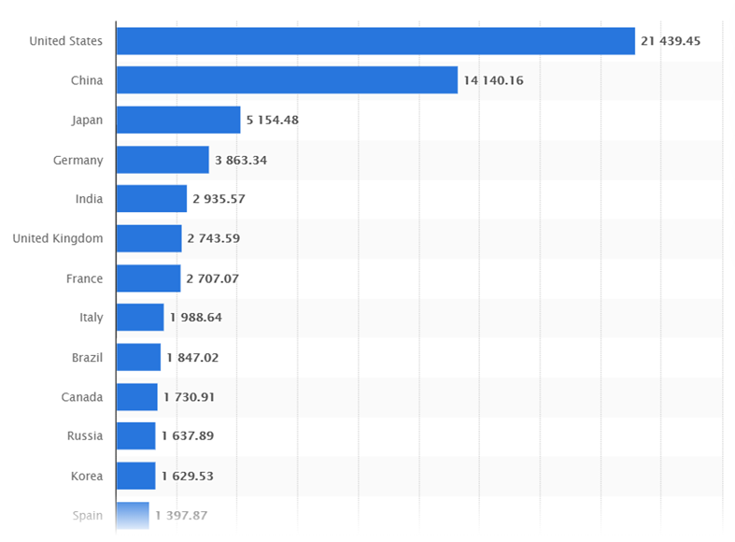
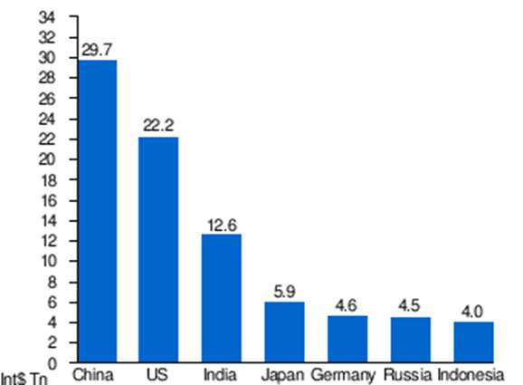
GDP of UNITED STATES – in billions USD and in PPP

Slide 7
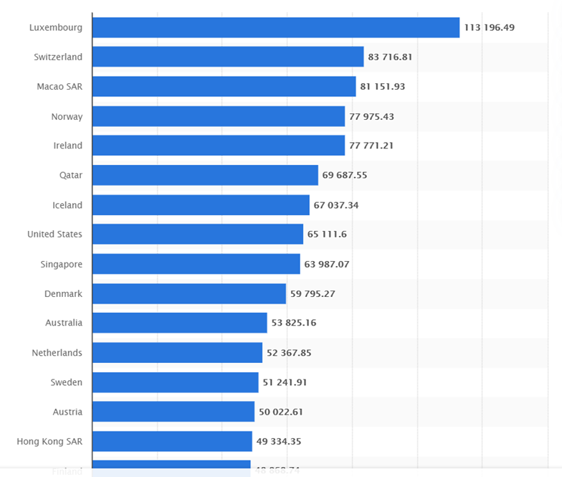
GDP per capita of UNITED STATES

Slide 8
CENTERS OF THE WORLD ECONOMY – UNITED STATES
The most important trading partner of the U.S. is Canada
Other important trading partners are China (506 billion USD), Mexico (465 billion USD) and Japan (199 billion USD) and Germany
USA has a problem with the deficit of current account
In addition to external debt (20,421,273 Million USD in 2019) represents a significant burden on the U.S. economy large internal/public debt (21.85 trillion USD in 2019), which represents more than 100% of produced GDP

Slide 9
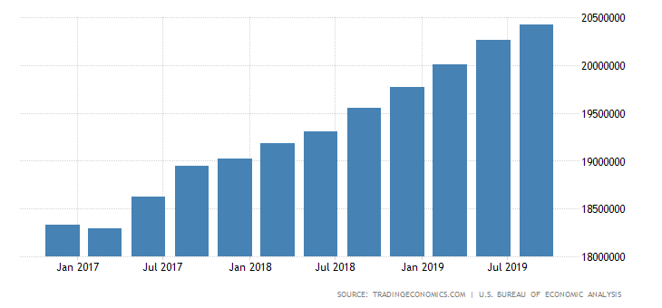
Development of External Dept of UNITED STATES

Slide 10
CENTERS OF THE WORLD ECONOMY – JAPAN
Japan
Covers an area of ​​377.975 thousand km2 and has 126.15 million inhabitants (in 2019):
Product per capita was 44,227 USD in 2019 (28th place)
Japan is extremely dependent on foreign trade and therefore on the international division of labor
Japan share of world GDP is 4.13% in 2019 (8.7% in 2012)
Japan is characterized by lack of food and raw material base and hence the emergency import dependence and vulnerability of the economy

Slide 11
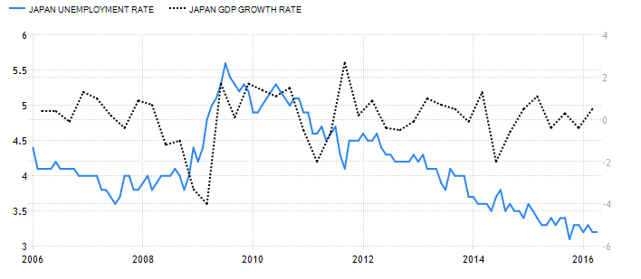
CENTERS OF THE WORLD ECONOMY – JAPAN
Japan

Slide 12
CENTERS OF THE WORLD ECONOMY – JAPAN
Japan
Japanese export increased by 17% of GDP in 2018, the trade balance is positive (60B USD)
In 2017 Japan exported $694B, making it the 4th largest exporter in the world. During the last five years the exports of Japan have decreased at an annualized rate of -2.9%, from $801B in 2012 to $694B in 2017.
The top export destinations of Japan are China (20%), the United States (18%), South Korea (7.8), Other Asia (4.7%) and Hong Kong (4.6%).
Its main exports are transportation equipment, motor vehicles, iron and steel products, semiconductors and auto parts

Slide 13
CENTERS OF THE WORLD ECONOMY – JAPAN
Japan
In 2017 Japan imported $632B, making it the 4th largest importer in the world. During the last five years the imports of Japan have decreased at an annualized rate of -4.6%, from $796B in 2012 to $632B in 2017.
Japan's main import markets is China (24.8 percent), the United States (10.5 percent), Australia (5.4 percent) and South Korea (4.1 percent)
Japan's main imports are machinery and equipment, fossil fuels, foodstuffs (in particular beef), chemicals, textiles and raw materials for its industries.

Slide 14
CENTERS OF THE WORLD ECONOMY – EUROPEAN UNION
The European Union
The second largest economic center - after enlargement in 2013 its whole area is ​​4.476 million km2
Population after several enlargements of the European Union and Brexit (now 27 members) currently exceed the 446,8 million people (in 2020)
The EU showed GDP/capita in average of 44.539 USD in 2019, ranking second place among economic centers
EU is a large internal market, is not dependent on imports of food and raw materials, however, is dependent mainly on oil and gas imports

Slide 15
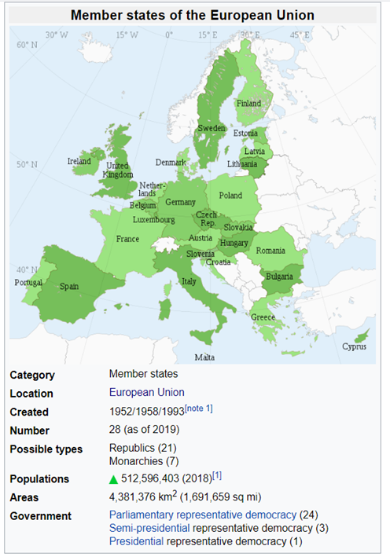
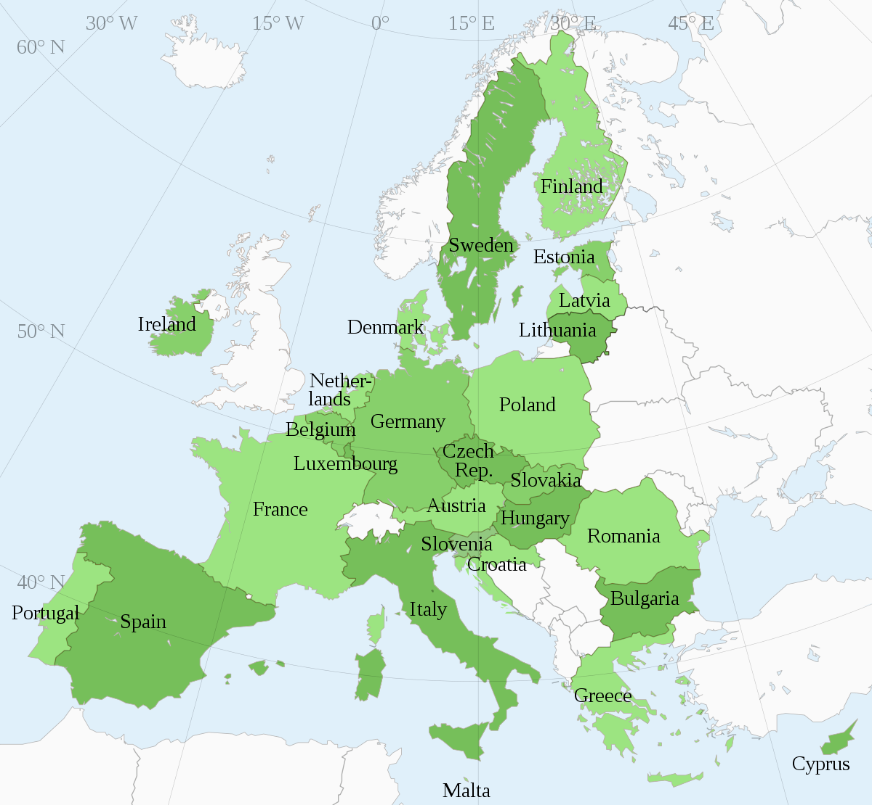
CENTERS OF THE WORLD ECONOMY – EUROPEAN UNION
The European Union Member States

Slide 16
CENTERS OF THE WORLD ECONOMY – EUROPEAN UNION
The European Union
EU is the world's largest importer and exporter (15% of world´s trade), followed by the U.S. and China
Largest EU trade partners are USA, a target of 20.5% of exports, then China (10.6%), Switzerland (8%) and Russia with 4.3%
Into the EU is imported most from China with 20%, USA (13.4%), Russia (7.7%) and Switzerland (5.5%)
The economy of the European Union is much more open than the rest of the centers and participates for more than 41 percentage points on global trade

Slide 17
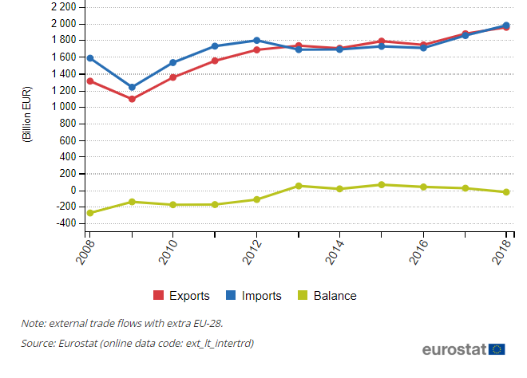
CENTERS OF THE WORLD ECONOMY – EUROPEAN UNION
The European Union – EXPORT AND IMPORTS

Slide 18
CENTERS OF THE WORLD ECONOMY – COMPARISON
Centers play a crucial role in world trade, where 57% of goods traded on world markets go through their foreign trade
Most of this share has EU with 25.8 percent, followed by the U.S. with 22.9 percent and Japan 8.7% (for comparison, the Chinese share is 9.1%)
All three world economic centers have modern economic structure, in which an important role plays the service sector (in the formation of GDP)
  United States have the highest share of this sector at 85%, followed by the EU with 72 percent and Japan with 70 percent share
  In contrast, Japan has the highest share of industrial production (28%), in the European Union is this share 26% and in the USA only 13%
  The share of the primary sector is the same in all centers, ranging about 2 percent

Slide 19
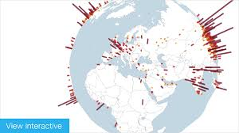
CENTERS OF THE WORLD ECONOMY – COMPARISON
Centers
there continues to consolidate the position of the United States of America in the years before the global financial crisis (2007-2009)
Macroeconomic conditions have changed in the post-crisis years
  The global financial and economic crisis caused in EU, Japan and the United States serious recession in 2009, followed by a slight recovery in the 2010 and 2011

Slide 20
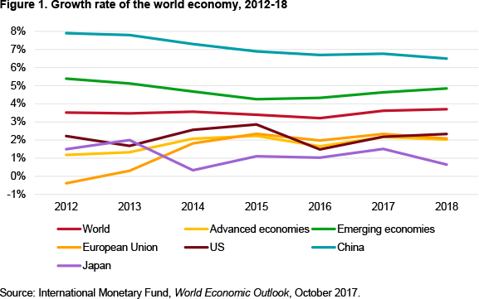
CENTERS OF THE WORLD ECONOMY – COMPARISON
Centers GROWTH RATE´S DEVELOPMENT

Slide 21
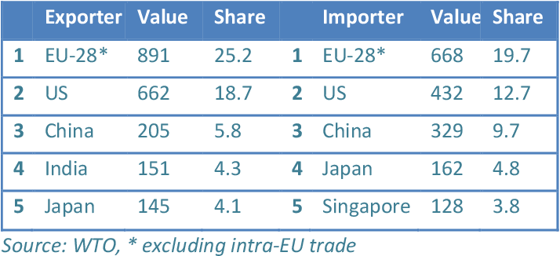
CENTERS OF THE WORLD ECONOMY – COMPARISON

Slide 22
POTENTIAL CENTERS OF THE WORLD ECONOMY – CHINA
CHINA
has 9.597 thousand km2 and mostly 1.5 billion people
Total GDP is the largest in the world - 27.309 trillion USD in 2019
Per capita GDP of China is growing in long-term average rate of 7-8%, which is significantly higher value than what triad shows
  at the beginning of the new millennium, the GDP growth rate was above 10 percent in the last three years, growth slowed down
despite high economic growth China belongs still among the developing economies - in terms of its economic levels measured by the GDP / capita (PPP), the value is 19,504 USD (73rd in the world) with comparison with 2012, when GDP/capita was 6190 USD (118th place in the world)

Slide 23
POTENTIAL CENTERS OF THE WORLD ECONOMY – CHINA
China
China's economy overtook British economy in 2005, the German economy in 2007 (third place in the world) and Japan in 2010
China is also the world's largest exporter and second-largest importer of goods
China has been the world's #1 manufacturer since 2010, after overtaking the US, which had been #1 for the previous hundred years, China has also been #2 in high-tech manufacturing since 2012
In 2019, China overtook the US as the home to the highest number of rich people in the world, according to the global wealth report by Credit Suisse

Slide 24
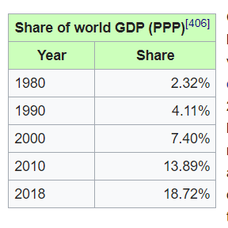
POTENTIAL CENTERS OF THE WORLD ECONOMY – CHINA
China
Is a major owner of US public debt, holding trillions of dollars worth of U.S. Treasury bonds.
Main export partners are US (20%), HongKong (11%), Japan (6.5%), Germany (4.5%), South Korea (4.1%)
Main import partners are countries of Asia (9.8%), South Korea (9.7%), Japan (8.8%), United States (8.7%) and Germany (6.2%)
The trade growth is 2.31% compared to a world growth of 3.50%
The share of world GDP is growing very fast

Slide 25
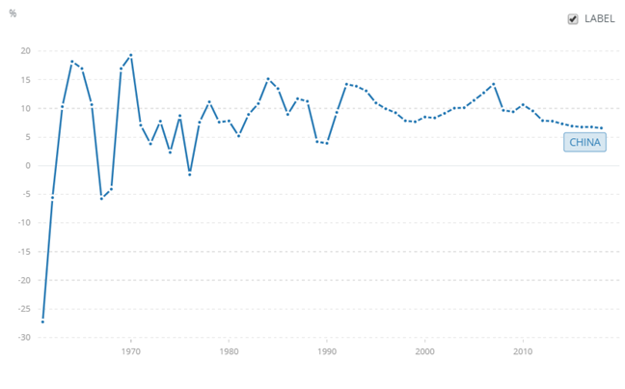
POTENTIAL CENTERS OF THE WORLD ECONOMY – CHINA
Development of GDP growth since 1961

Slide 26
POTENTIAL CENTERS OF THE WORLD ECONOMY – RUSSIA
Russia
Officially the Russian Federation, is the largest country in the world, with its area of ​​17,098,400 square kilometers occupies almost 12% of the world's land area
  Currently 146.8 million people live here (ninth most populous country in the world, 2% of the world population)
  GDP per capita reached value of 30,819 USD (in PPP) in the 2019 (49th place) in comparison of total GDP 4,5 trillion (6th place)
The current economic level of Russia is thus higher than economic level of China, but only one third in relation to the EU and a quarter in relation to the USA

Slide 27
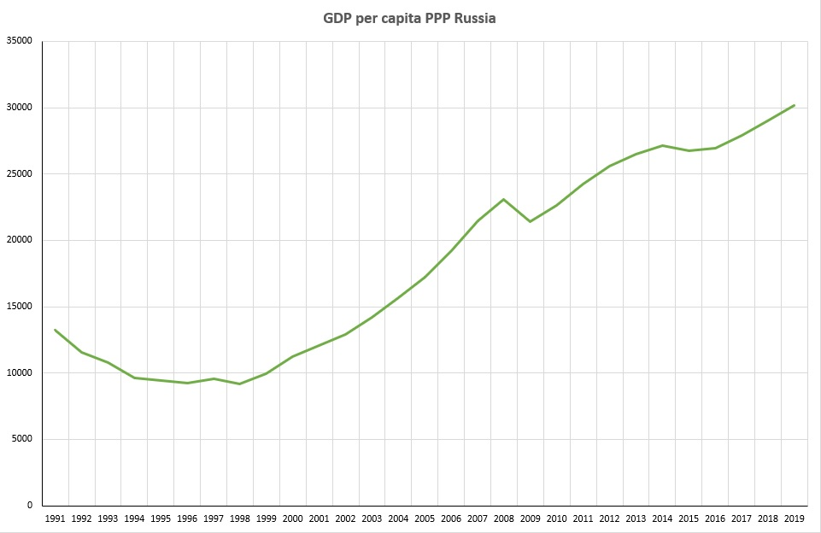
POTENTIAL CENTERS OF THE WORLD ECONOMY – RUSSIA

Slide 28
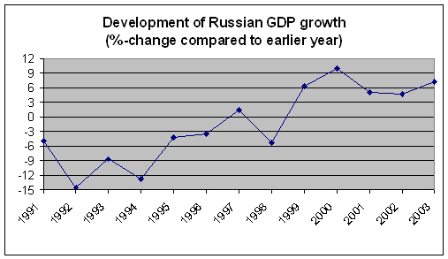
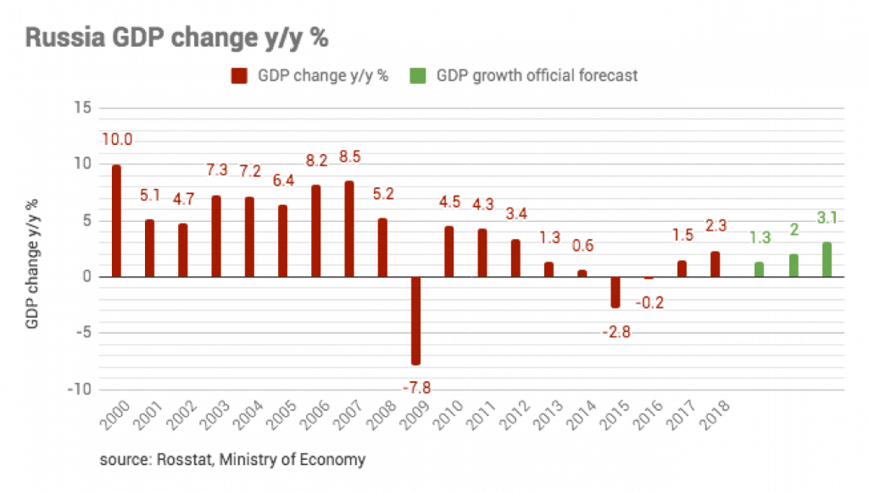
POTENTIAL CENTERS OF THE WORLD ECONOMY – RUSSIA

Slide 29
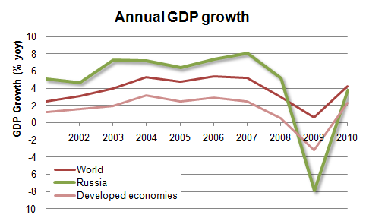
POTENTIAL CENTERS OF THE WORLD ECONOMY – RUSSIA

Slide 30
POTENTIAL CENTERS OF THE WORLD ECONOMY – RUSSIA
Russia
The 14th largest export economy in the world
  The top exports of Russia are Crude Petroleum (28%), Refined Petroleum (17%), Petroleum Gas (5.8%), Coal Briquettes (4.7%) and Wheat (2.1%)
  Top imports are Packaged Medicaments (3.7%), Cars (3.5%), Vehicle Parts (3.4%), Broadcasting Equipment (3.2%) and Planes, Helicopters, and/or Spacecraft (2.9%)
The top export destinations of Russia are China (11%), the Netherlands (8.1%), Germany (5.8%), Belarus (5.4%) and the United States (4.5%).
The top import origins of Russia are China (20%), Germany (12%), Belarus 5.7%), the United States (4.9%) and Italy (4.1%).

Slide 31
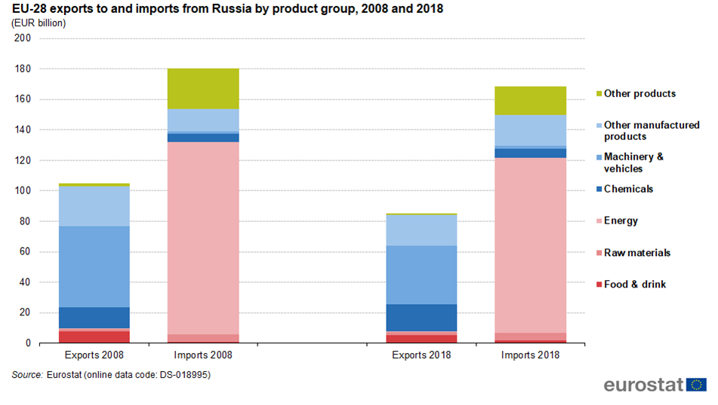
POTENTIAL CENTERS OF THE WORLD ECONOMY – RUSSIA

Slide 32
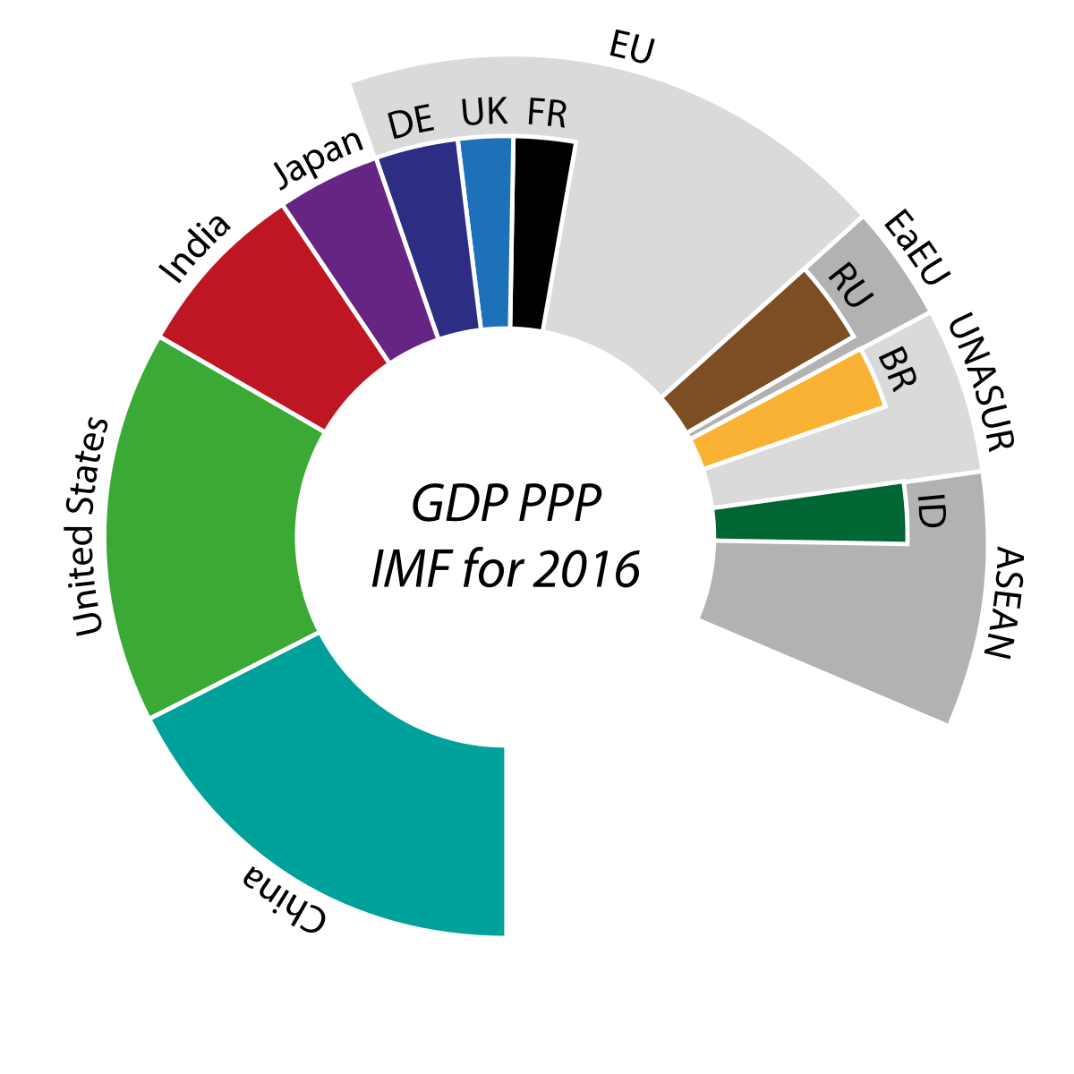
(POTENTIAL) CENTERS OF THE WORLD ECONOMY – COMPARISON

Slide 33
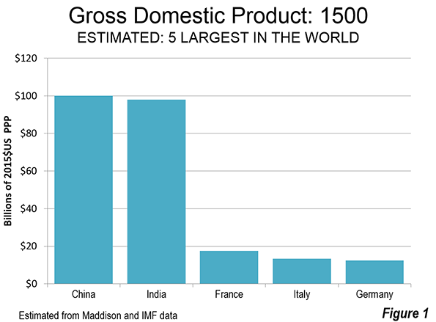
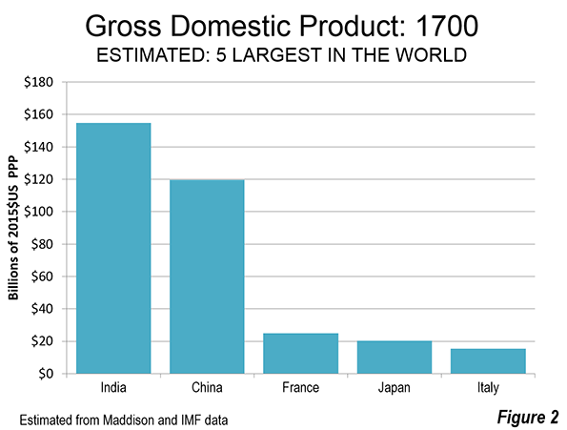
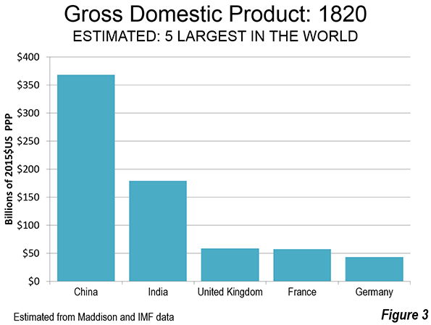
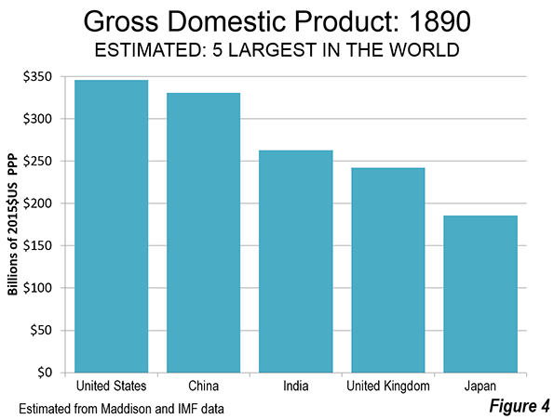
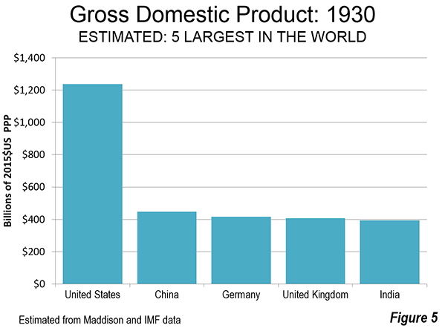
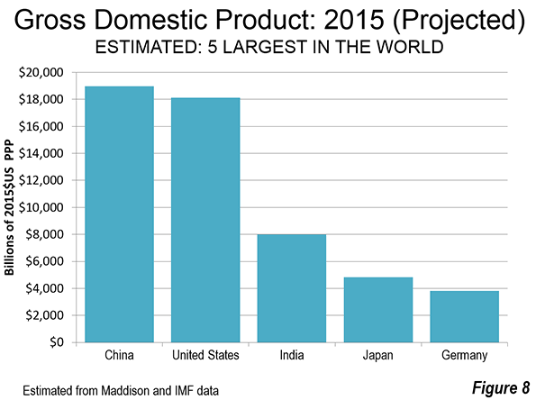
(POTENTIAL) CENTERS OF THE WORLD ECONOMY – COMPARISON

Slide 34
WORLD ECONOMY
Thank you for your Attention!

