Slide 1

OPEN ECONOMY AND BALANCE OF PAYMENT
LESSON VI
Dr. Ingrid Majerová
MACROECONOMICS/EVS/NAMAB

Slide 2
OPEN ECONOMY AND BALANCE OF PAYMENT
Outline of the lecture
Characteristic of Open Economy
International Flows of Goods and Capital
Nominal and Real Exchange Rate
Structure of Balance of Payment

Slide 3
OPEN ECONOMY
characteristic
An open economy is one that engages in international exchange of goods, services, and investments. Exports are goods and services sold to buyers outside the country, while imports are those purchased from foreigners.
The difference between exports and imports of goods and services is called net exports.
OPEN ECONOMY CLOSED ECONOMY
one that interacts freely one that does not interact
with other economies around with other economies
the world in the world
- no export, no import, no capital flows

Slide 4
OPEN ECONOMY
THE INTERNATIONAL FLOW OF GOODS AND CAPITAL
An open economy interacts with other countries in two ways:
  It buys and sells goods and services in world product markets.
  It buys and sells capital assets in world financial markets.
The value of a nation’s exports minus the value of its imports are net exports (NX).
Net exports are also called the trade balance.
A trade deficit is a situation in which net exports (NX) are negative Imports > Exports
A trade surplus is a situation in which net exports (NX) are positive Exports > Imports
Balanced trade refers to when net exports are zero—exports and imports are exactly equal.

Slide 5
OPEN ECONOMY
THE INTERNATIONAL FLOW OF GOODS AND CAPITAL
Factors that affect net exports:
  The tastes of consumers for domestic and foreign goods.
  The prices of goods at home and abroad.
  The exchange rates at which people can use domestic currency to buy foreign currencies.
  The incomes of consumers at home and abroad.
  The costs of transporting goods from country to country.
  The policies of the government toward international trade.

Slide 6
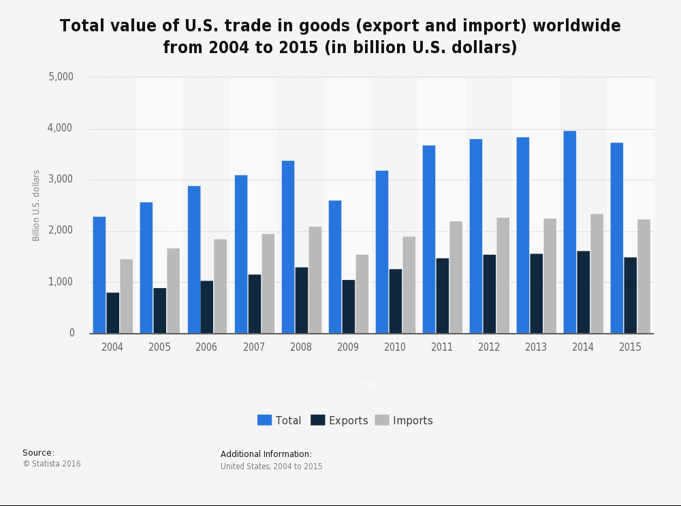
OPEN ECONOMY
THE INTERNATIONAL FLOW OF GOODS AND CAPITAL

Slide 7
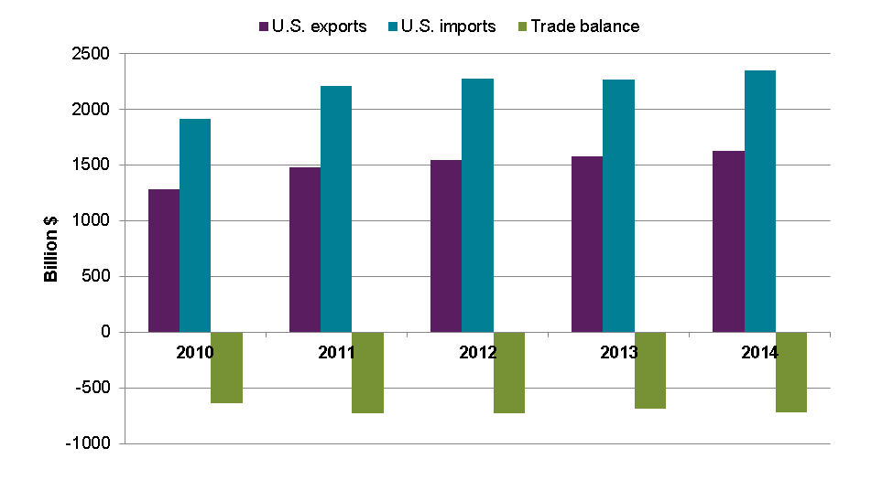
OPEN ECONOMY
THE INTERNATIONAL FLOW OF GOODS AND CAPITAL
Figure 2: Trade Balance of the U.S. Economy

Slide 8
OPEN ECONOMY
NET CAPITAL OUTFLOW
Net capital outflow refers to the purchase of foreign assets by domestic residents minus the purchase of domestic assets by foreigners.
  A U.S. resident buys stock in the Toyota corporation and a Mexican buys stock in the Ford Motor corporation.
When a U.S. resident buys stock in Telmex, the Mexican phone company, the purchase raises U.S. net capital outflow.
When a Japanese residents buys a bond issued by the U.S. government, the purchase reduces the U.S. net capital outflow.

Slide 9
OPEN ECONOMY
NET CAPITAL OUTFLOW
Variables that Influence Net Capital Outflow
  The real interest rates being paid on foreign assets.
  The real interest rates being paid on domestic assets.
  The perceived economic and political risks of holding assets abroad.
  The government policies that affect foreign ownership of domestic assets.

Slide 10
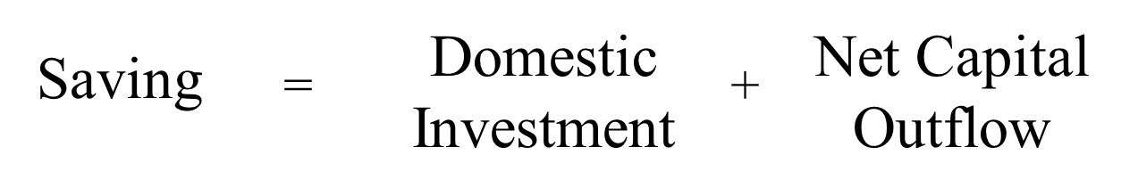
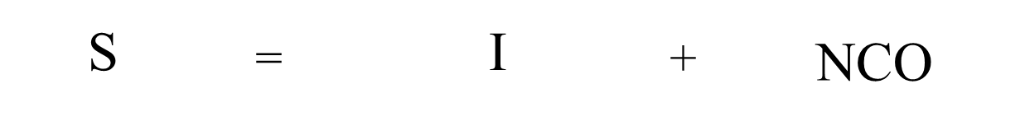
OPEN ECONOMY
SAVINGS, INVESTMENT and NET CAPITAL OUTFLOW
National saving (S) equals Y - C – G:
S = I + NX
or

Slide 11
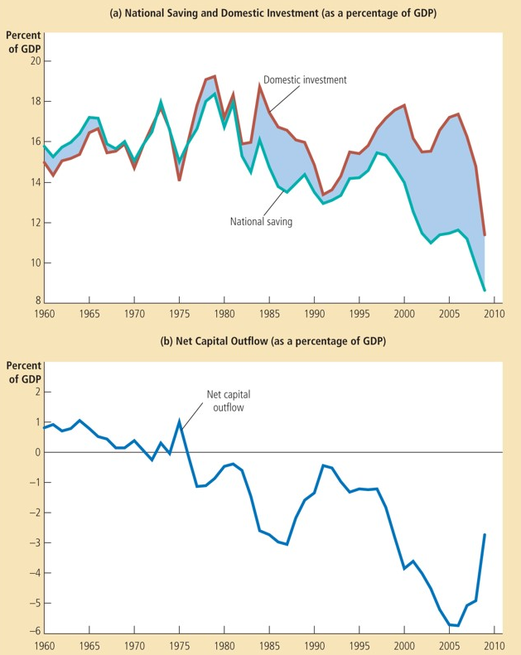
OPEN ECONOMY
SAVINGS, INVESTMENT and NET CAPITAL OUTFLOW
Figure 3:
S, I and NCO of the U.S. Economy
National saving has been lower since 1980 than in was before
This fall in S has been reflected primarily in reduced NCO rahter than in reduced I.

Slide 12
OPEN ECONOMY
PRICES FOR INTERNATIONAL TRANSACTIONS
International transactions are influenced by international prices.
The two most important international prices are the nominal exchange rate and the real exchange rate.
The nominal exchange rate is the rate at which a person can trade the currency of one country for the currency of another.
  The nominal exchange rate is expressed in two ways:
    In units of foreign currency per one domestic currency.
    And in units of domestic currency per one unit of the foreign currency.
The real exchange rate is the rate at which a person can trade the goods and services of one country for the goods and services of another.
  The real exchange rate compares the prices of domestic goods and foreign goods in the domestic economy.
    If a case of German beer is twice as expensive as American beer, the real exchange rate is 1/2 case of German beer per case of American beer.

Slide 13
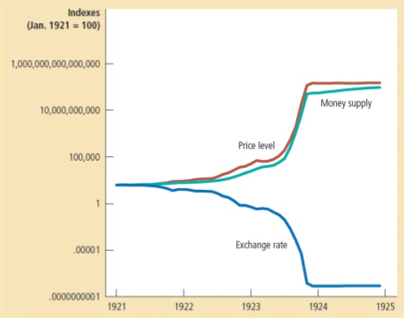
OPEN ECONOMY
Money, Prices and nominal Exchange Rate
Figure 4: Relation of Money, Prices and Exchange Rate During of Germany Hyperinfation
How similary these three variables move?
  when the quantity of money started growing quickly, the price level followed, and the mark depreciated relative to the dollar
  when German CB stabilized the money supply, the price level and ER stabilized as well

Slide 14
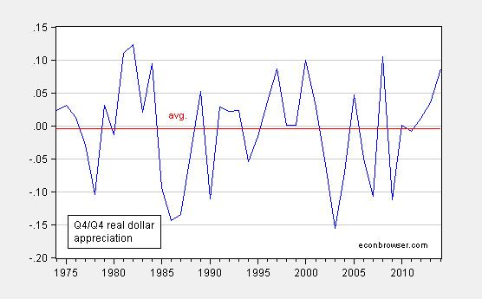
OPEN ECONOMY
PRICES FOR INTERNATIONAL TRANSACTIONS
Appreciation refers to an increase in the value of a currency as measured by the amount of foreign currency it can buy.
Depreciation refers to a decrease in the value of a currency as measured by the amount of foreign currency it can buy.
  If a dollar buys more foreign currency, there is an appreciation of the dollar.
  If it buys less, there is a depreciation of the dollar.

Slide 15
OPEN ECONOMY
PRICES FOR INTERNATIONAL TRANSACTIONS
The real exchange rate depends on the nominal exchange rate and the prices of goods in the two countries measured in local currencies.
The real exchange rate is a key determinant of how much a country exports and imports.

Slide 16
OPEN ECONOMY
PRICES FOR INTERNATIONAL TRANSACTIONS:
Example of usa
A depreciation (fall) in the U.S. real exchange rate means that U.S. goods have become cheaper relative to foreign goods.
This encourages consumers both at home and abroad to buy more U.S. goods and fewer goods from other countries.
As a result, U.S. exports rise, and U.S. imports fall, and both of these changes raise U.S. net exports.
Conversely, an appreciation in the U.S. real exchange rate means that U.S. goods have become more expensive compared to foreign goods, so U.S. net exports fall.

Slide 17
OPEN ECONOMY
Balance of payment
Anything that we buy or sell to the rest of the world must be paid for.
The current account (CA) tracks the flow of goods and services between the US and the rest of the world.
The capital and financial account tracks the payments for those goods and services (KFA)
CA + KFA = 0

Slide 18
OPEN ECONOMY
The current account
Any transaction that represents a flow of funds out of the domestic economy is represented by debit (-).
Transactions that represent a flow of money into the domestic economy are represented by a credit(+)
  Net Exports of Goods and Services
    Exports (+)
    Imports (-)
  Net Income From Abroad (NFP)
    Income Earned by domestic economy nationals abroad (+)
    Income earned by foreign nationals in the domestic economy (-)
  Net Unilateral Transfers
    Payments from foreign countries (+)
    Payments to foreign countries (-)

Slide 19
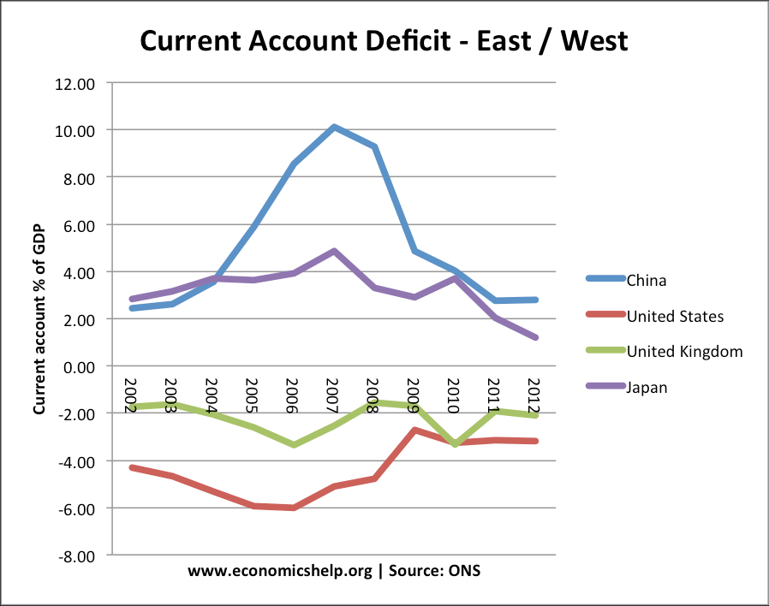
OPEN ECONOMY
The current account of US (in bill. Usd)
Net Exports of Goods & Services:
Services: $52
Goods: -$652
-$600
Net Factor Payments: -$12
Net Unilateral Transfers: -$72
Current Account Balance: -$684

Slide 20
OPEN ECONOMY
The CAPITAL AND FINANCIAL account
Capital/financial account (KFA) is composed of foreign direct investment (FDI), portfolio and other investment.
Any transaction that represents funds flowing into (out of) the domestic economy are credits (debits) in the KFA
Any transaction that represents funds flowing into (out of) the domestic economy are credits (debits) in the KFA
  Financial assets
    Foreign acquisition of domestic assets (+)
    Domestic acquisition of foreign assets (-)
  Official Reserve Assets
    Foreign acquisition of domestic reserve assets (+)
    Domestic acquisition of foreign reserve assets (-)

Slide 21
OPEN ECONOMY
The CAPITAL AND FINANCIAL account of US (in bill. Usd)
Private Assets:
Foreign acquisition of US assets: $1,060
US acquisition of foreign assets: -$472
$588
Official Reserve Assets:
Foreign acquisition of US ORA: $22
US acquisition of foreign ORA: $2
$24
US KFA account balance: $612
Note: CA (-$684) + KFA ($612) = -$72 (statistical discrepancy)

Slide 22
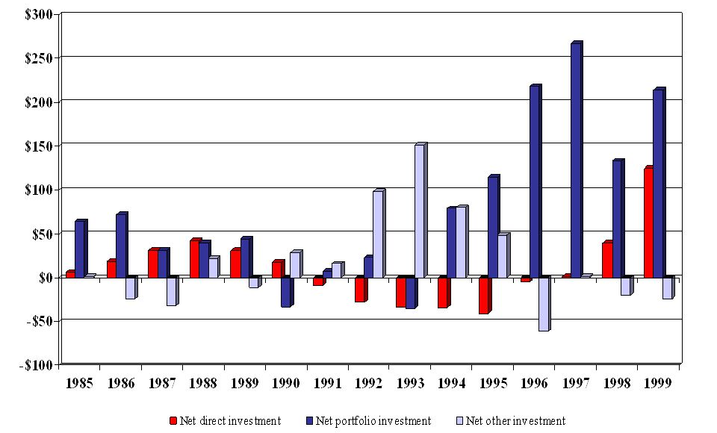
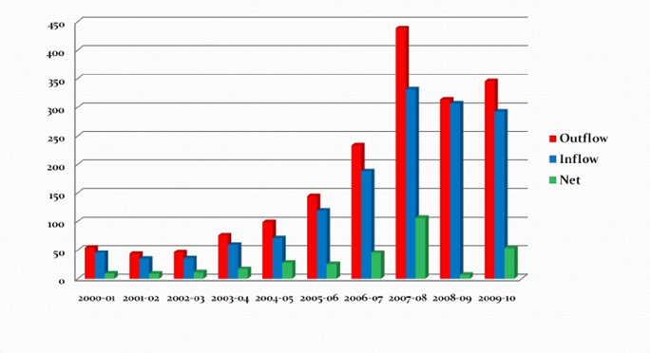
OPEN ECONOMY
CAPITAL AND FINANCIAL ACCOUNT OF USA
1985-1999
2000-2010

Slide 23
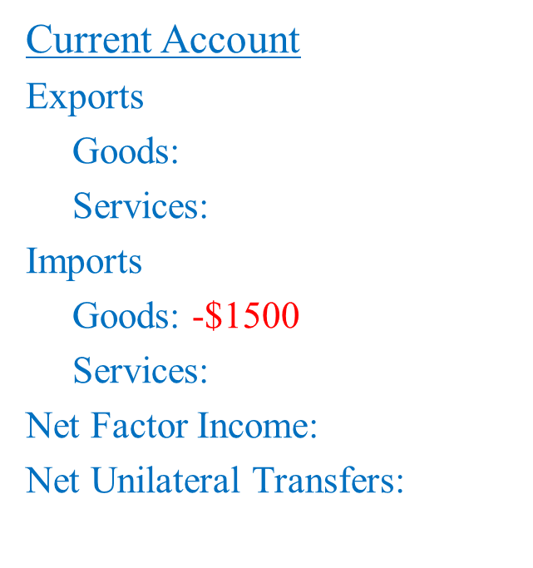
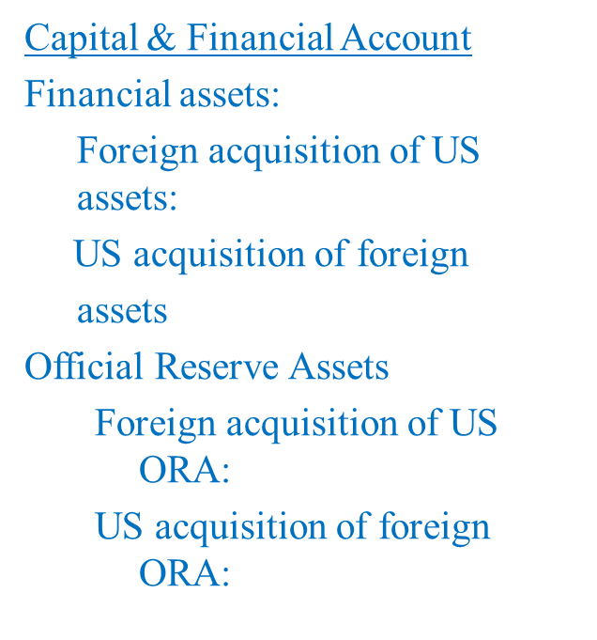
OPEN ECONOMY
BALANCE OF PAYMENT - EXAMPLES
Suppose that you purchase (as a US citizen) a case of French wine for $1500 (for simplicity, assume that you pay with cash).

Slide 24
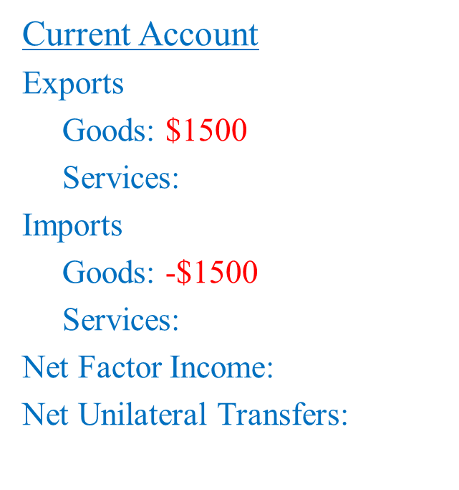
OPEN ECONOMY
BALANCE OF PAYMENT - EXAMPLES
Case #1: The French wine distributor uses the $1500 to purchase a computer from Dell.

Slide 25
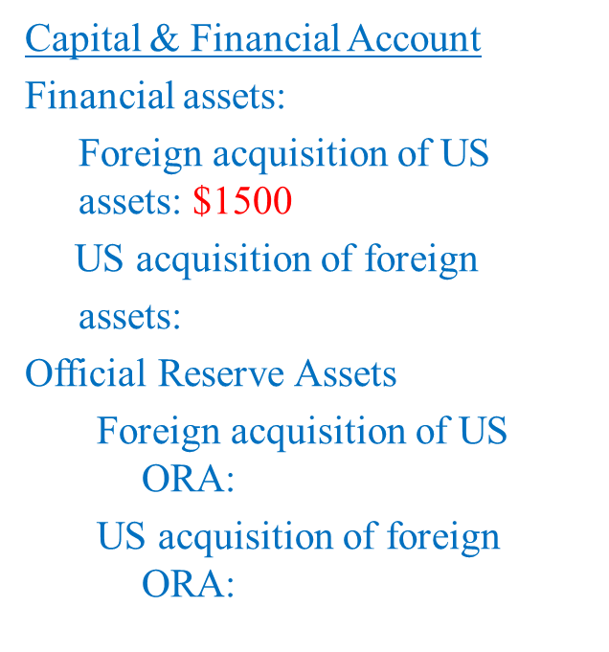
OPEN ECONOMY
BALANCE OF PAYMENT - EXAMPLES
Case #2: The French wine distributor uses the $1500 to buy a US T-Bill.

Slide 26
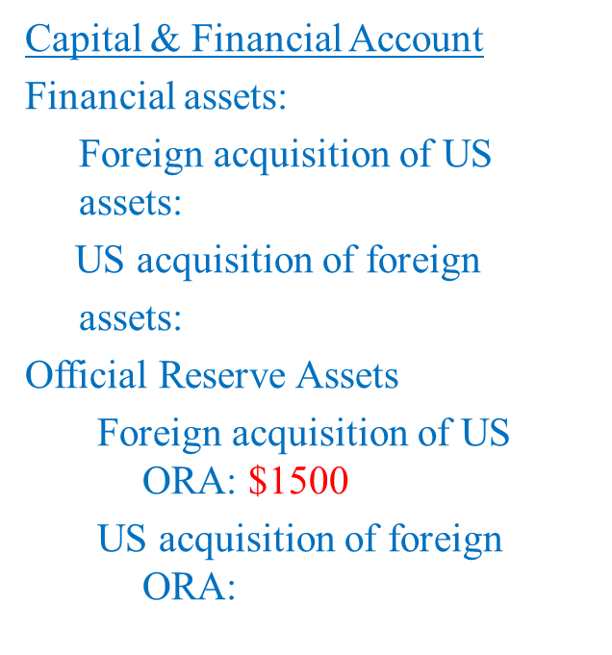
OPEN ECONOMY
BALANCE OF PAYMENT - EXAMPLES
Case #3: The French wine distributor uses the $1500 to buy Euros from the Federal Reserve.

Slide 27
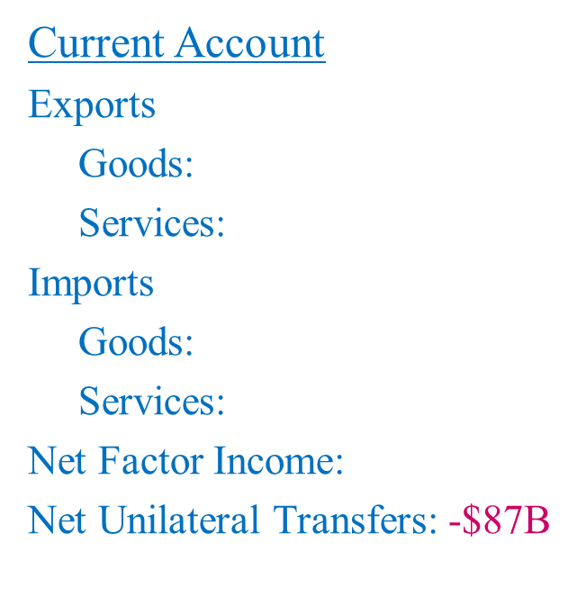

OPEN ECONOMY
BALANCE OF PAYMENT - EXAMPLES
The US government approved an $87 billion aid package to Somalia. How will this be reflected in the BOP accounts?

Slide 28
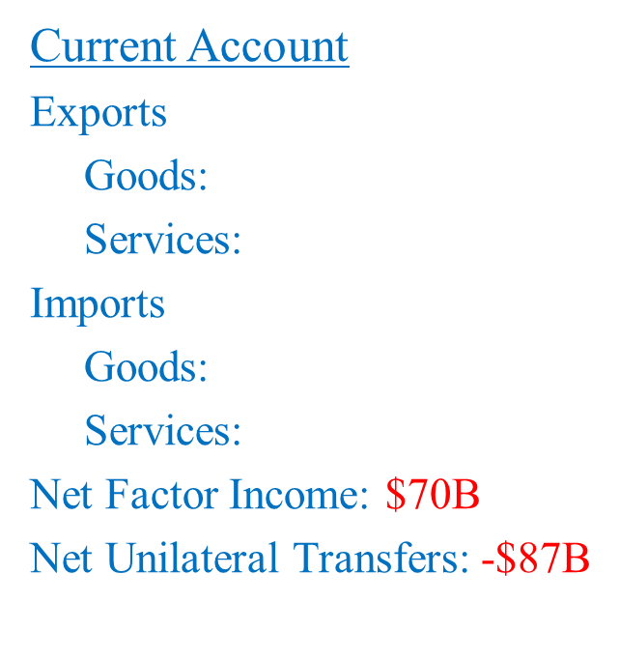
OPEN ECONOMY
BALANCE OF PAYMENT - EXAMPLES
The $87 billion payment is represented by a debit under unilateral transfers. Most of that money was used to pay US soldiers and US reconstruction companies (around $70B).

Slide 29

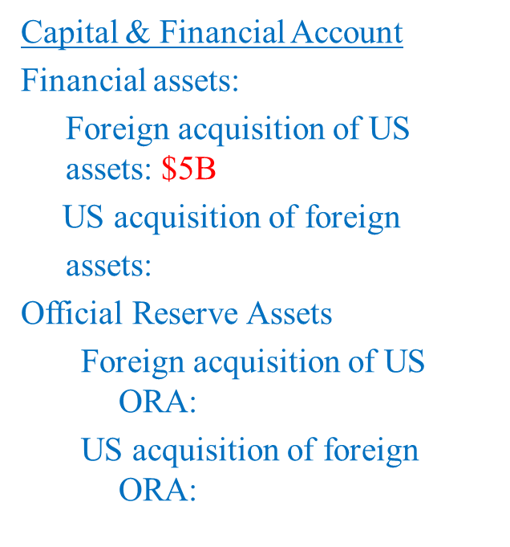
OPEN ECONOMY
BALANCE OF PAYMENT - EXAMPLES
The rest will be used to buy US goods or US assets (either by Iraq or by other countries).

Slide 30
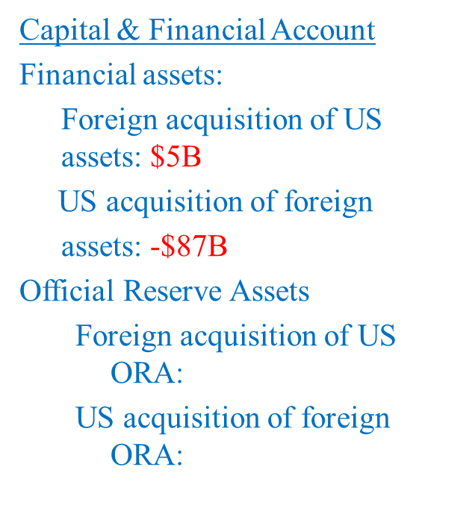
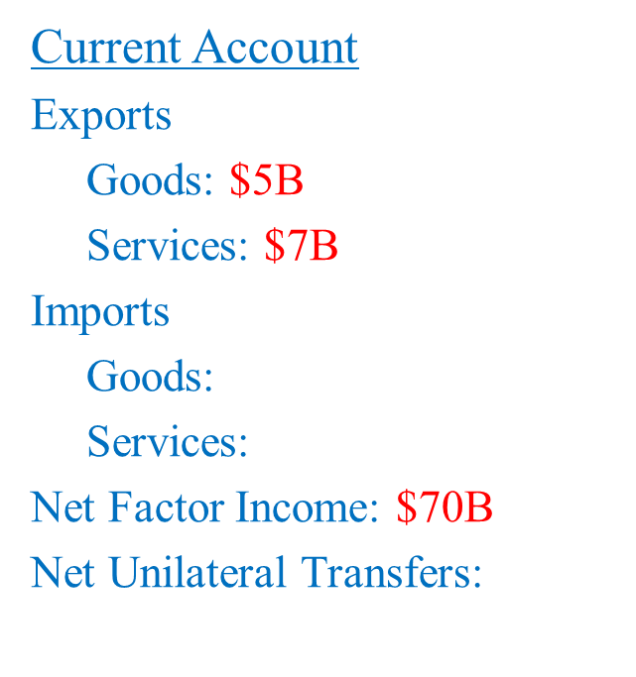
OPEN ECONOMY
BALANCE OF PAYMENT - EXAMPLES
How would the BOPs change if this $87B was a loan rather than aid?

Slide 31
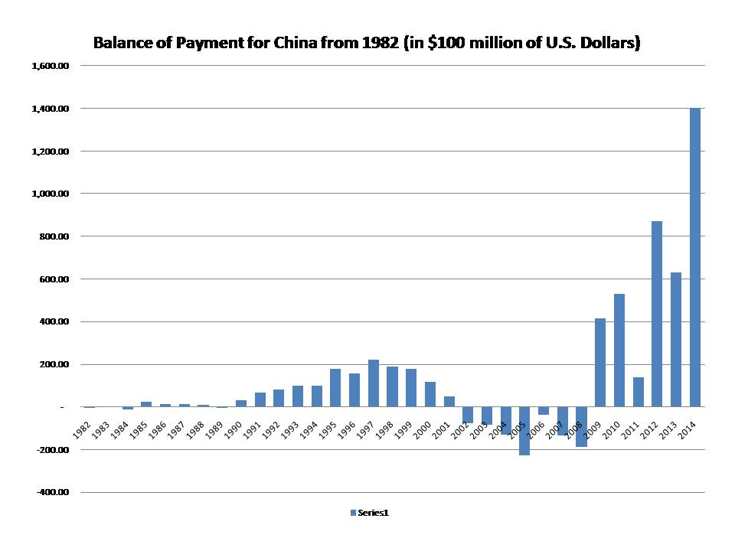
OPEN ECONOMY
BALANCE OF PAYMENT – EXAMPLES OF CHINA

Slide 32
OPEN ECONOMY
THANK YOU FOR YOUR ATTENTION…

