Slide 1

THE AS-AD MODEL
LESSON VIII
Dr. Ingrid Majerova
MACROECONOMICS/EVS/NAMAB

Slide 2
THE AS-AD MODEL
Outline of the lecture
The Characteristic of Model
Construction of AD Curve
Construction of AS Curve
Short and Long Run AS
AS-AD Equilibrium

Slide 3

THE AS-AD MODEL
WHY AS-AD MODEL?
The AS-AD Model is not more complicated than the IS-LM Model.
IS-LM can only deal with the demand side of the economy. Any increase in output is only an increase in aggregate demand.
IS-LM cannot deal with important changes related to the supply side of the economy, such as technological improvement, population increase or capital accumulation.
IS-LM cannot effectively deal with changes in general price level in the economy. It does not offer insights on inflation.
IS-LM works well only when wages and prices are rigid, or the aggregate supply curve is horizontal.
AS-AD is a more complete model

Slide 4
THE AS-AD MODEL
WHY AS-AD MODEL?
Intuitively, we know there is a limit to IS-LM:
  IS-LM cannot boost GDP forever using the Policy-mix
in real life, over-using these policies leads mainly to inflation
Where does this inflation come from?
Bottom line: if demand increases beyond the productive capacity of the economy, producers have no choice but to increase prices
The purpose of the AS-AD model is to correct the predictions of IS-LM in order to account for the fact that there is not always excess productive capacity.

Slide 5
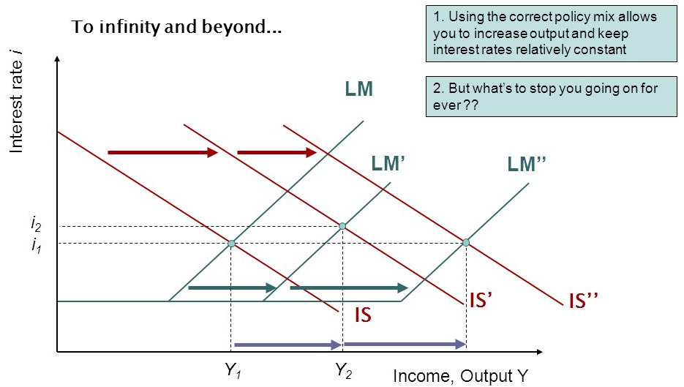
THE AS-AD MODEL
WHY AS-AD MODEL?

Slide 6
THE AS-AD MODEL
AGGREGATE DEMAND CURVE AD
The AD curve shows the amount of goods and services demanded for a given price level.
The AD curve has a negative slope: a lower level of prices tends to increase the aggregate demand for goods and services
  Prices affect the LM curve through real money balances: a higher price level leads to higher interest rates in IS-LM, reducing equilibrium output.
Beware: The negative slope of the AD curve is NOT linked to the negative slope of micro demand curves!

Slide 7
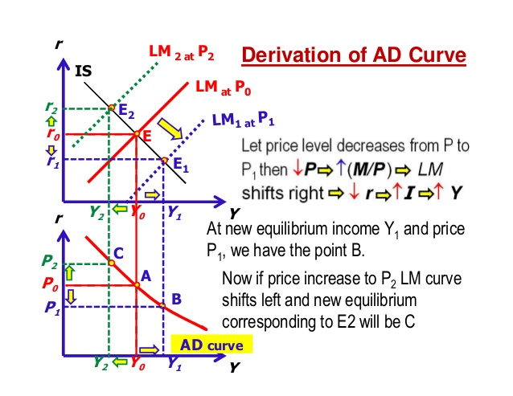
THE AS-AD MODEL
AGGREGATE DEMAND CURVE AD

Slide 8
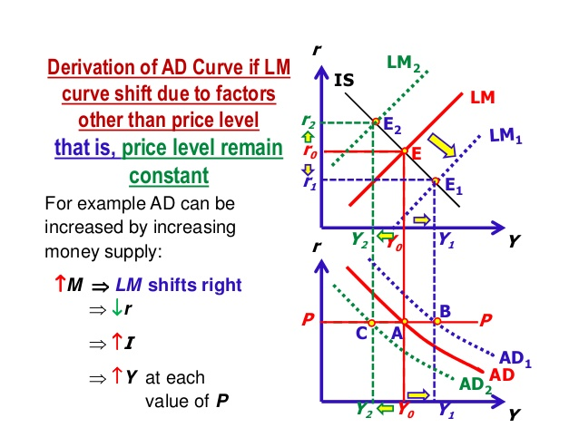
THE AS-AD MODEL
AGGREGATE DEMAND CURVE AD

Slide 9
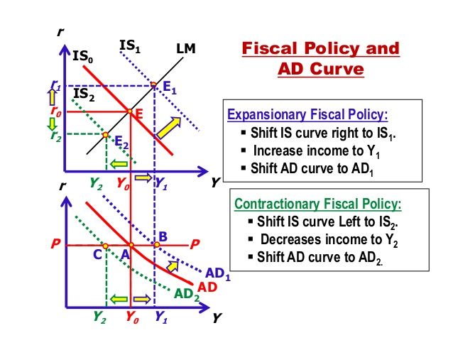
THE AS-AD MODEL
AGGREGATE DEMAND CURVE AD

Slide 10
THE AS-AD MODEL
NEGATIVE SLOPING OF AD CURVE
There is no need to derive in class the AD Curve from IS-LM.
One can go directly to the AD Curve.
There is an important difference between the aggregate demand AD and the demand curve for a specific good.
The demand curve for apples relates the quantity demanded for apples to the price of apples RELATIVE to the prices of other goods.

Slide 11
THE AS-AD MODEL
NEGATIVE SLOPING OF AD CURVE
The AD Curve relates the aggregate quantity of output to the general price level P.
For any given level of money supply M, an increase in P implies that the real supply of money M/P must go down.
  It becomes harder for people to borrow money, causing the price of loans, i.e., the interest rate r to go up.
  When interest increases, investment demand (and possibly consumption) decreases. Thus, aggregate demand Y goes down.
An increase in P can also create the so-called “real balance effect.” The resulting decline in M/P may lead people to believe that they are less wealthy. This further implies that they will reduce consumption. Thus, aggregate demand goes down.

Slide 12
THE AS-AD MODEL
FACTORS THAT SHIFT AD CURVE
Expected future increase in output
  =>reduces desired saving, raises desired present consumption => shifts AD curve to the right.
Increase in government spending.
Reduction in corporate or salary taxes.
Increase in M
  => real supply of money goes up => easier to borrow money => interest rate goes down =>output goes up.

Slide 13
THE AS-AD MODEL
AGGREGATE SUPPLY AS
The implications of the IS-LM framework are not really different from those of the AD curve.
The more important addition is the aggregate supply.
The classical model postulates that the AS curve is vertical, i.e., aggregate quantity produced in the economy Y is independent of the price level P.
Quantity supplied in an economy depends on labor employed, amount of capital used, technological level, human capital (health, knowledge) of its workers, efficiency in production, institutional support (such as good government or well defined property rights) and so on.

Slide 14
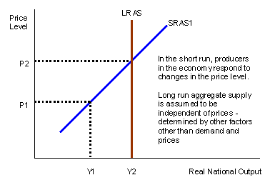
THE AS-AD MODEL
LONG-RUN AND SHORT-RUN AS
Compared to the AD curve, one has to distinguish between the short run AS (SRAS) and the long run AS (LRAS):
  LRAS: In the long run, the productive capacity of the economy does not depend on prices
  SRAS: A change in prices changes the real cost of labour, affecting the productive capacity of the economy.
Beware: The positive slope of the SRAS curve is NOT linked to the slope of micro supply curves !

Slide 15
THE AS-AD MODEL
LONG-RUN AND SHORT-RUN AS
It is often argued that in the short run, shifting of the AD curve may still have some effects on output and price level.
The short-run AS curve is postulated to be positively sloping.
  output Y may rise above the full-employment output temporarily when P is higher than expected
  An increase in the general price level P will cause producers to observe that the prices of the goods that they produce go up. They may mistakenly believe that this is due to an increase in the demand of the specific goods they produce and therefore will decide to produce more. Later on, they will discover that there is in fact no change in the demand and will cut back production.

Slide 16
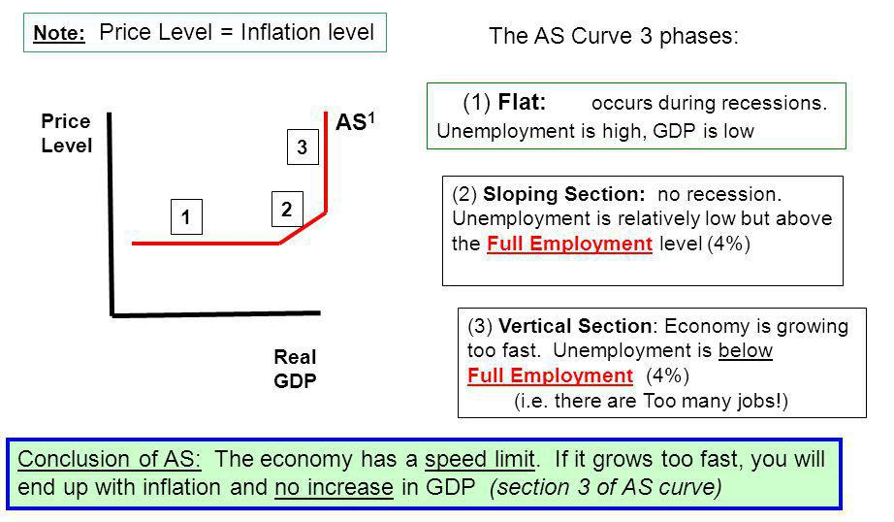
THE AS-AD MODEL
VARIOUS FORM OF AS CURVE

Slide 17
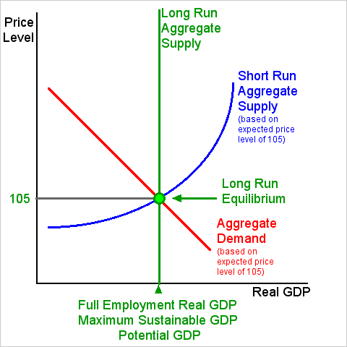
THE AS-AD MODEL
EQUILIBRIUM IN AS-AD MODEL

Slide 18
THE AS-AD MODEL
EQUILIBRIUM IN AS-AD MODEL
Shocks to demand and supply lead to fluctuations at the macroeconomic level.
By “shocks” economists mean exogenous variations to supply and demand
  A demand shock modifies aggregate demand: increase in G or T, change in M, etc.
  A supply shock modifies aggregate supply: increase in oil prices, change in technology, etc.
Stabilisation policies are policies that attempt to keep output, inflation and employment around their long run equilibrium levels.
  The aim is to minimise the fluctuations around equilibrium.

Slide 19
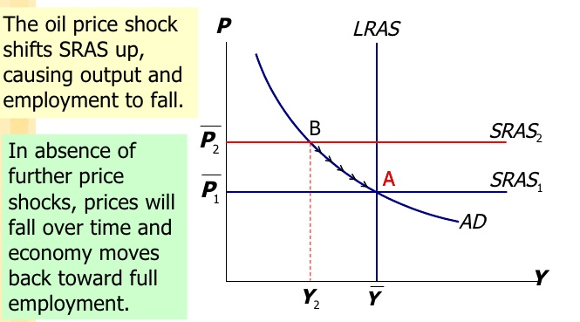
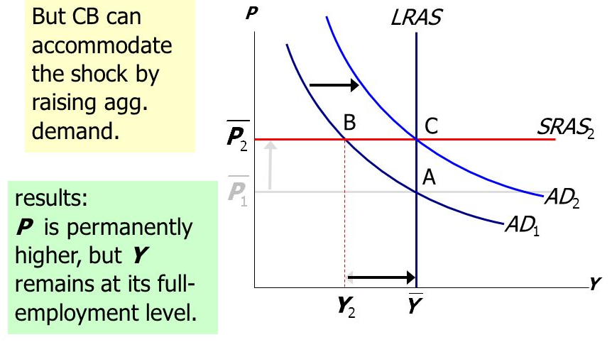
THE AS-AD MODEL
THE 1970s OIL SHOCKS IN AS-AD MODEL

Slide 20
THE AS-AD MODEL
EQUILIBRIUM IN AS-AD MODEL
The AS-AD model allows a better understanding of how to coordinate stabilisation policies
  The best response to a demand shock is a demand policy (such as a fiscal stimulus policy).
  The best response to a supply shock is a supply side policy (such as wage moderation and reduction of inflation expectations).

Slide 21
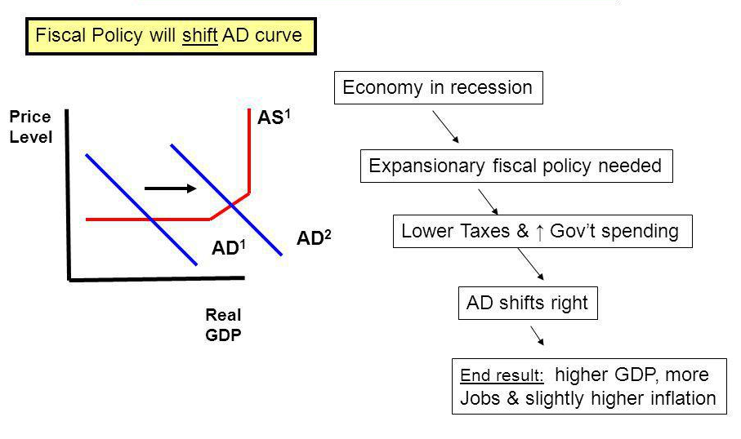
THE AS-AD MODEL
FISCAL POLICY IN AS-AD MODEL

Slide 22
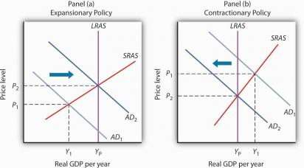
THE AS-AD MODEL
FISCAL POLICY IN AS-AD MODEL

Slide 23
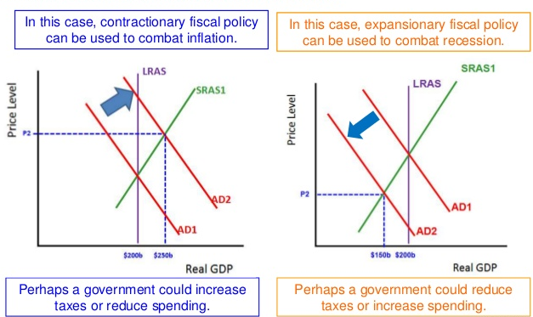
THE AS-AD MODEL
FISCAL POLICY IN AS-AD MODEL

Slide 24
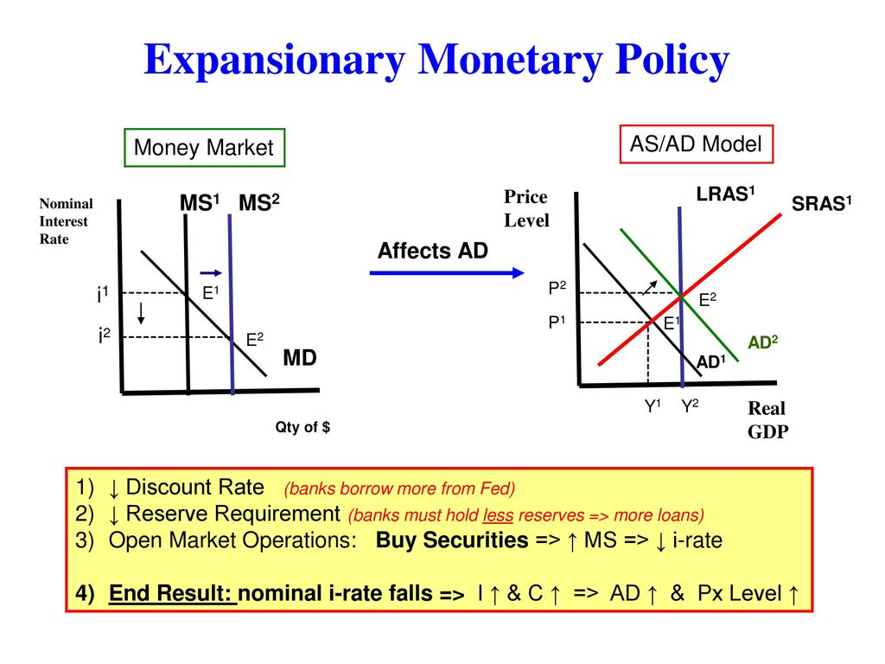
THE AS-AD MODEL
MONETARY POLICY IN AS-AD MODEL

Slide 25
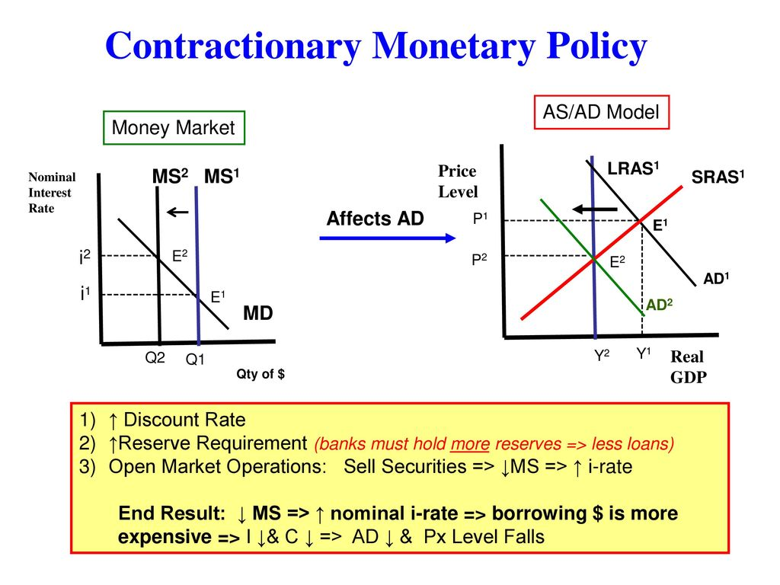
THE AS-AD MODEL
MONETARY POLICY IN AS-AD MODEL

Slide 26
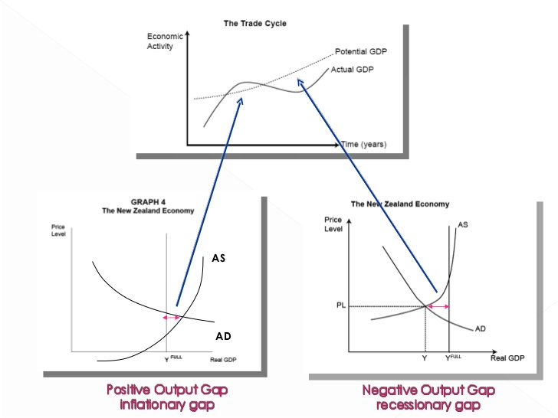
THE AS-AD MODEL
GAPS IN AS-AD MODEL

Slide 27
AS-AD MODEL
THANK YOU FOR YOUR ATTENTION…

