Slide 1

THE MUNDELL-FLEMING MODEL
IS-LM-BP
LESSON VII
Dr. Ingrid Majerová
MACROECONOMICS/EVS/NAMAB

Slide 2
IS-LM-BP MODEL
Outline of the lecture
The Natur of Mundell-Fleming Model
Model and BP Curve
Floating vs. Fixed Exchange Rates
Effectiveness of Policy

Slide 3

IS-LM-BP MODEL
NATUR OF MODEL
Last week we introduced the basic elements required to analyse an open economy
  The current account: imports and exports
  The capital account: saving/investment flows
  The balance of payments equilibrium as a combination of the two
  The role of exchange rates.

Slide 4
IS-LM-BP MODEL
NATUR OF MODEL
This week we integrate these elements into the Mundell-Fleming model, which is an IS-LM model extended to account for imports and exports (IS-LM-BP model)
  Although this will not be covered, in theory this can be used in turn to modify the AS-AD model to account for international trade with inflation.
  As we saw last week, the price level can be included through the analysis of real exchange rates.

Slide 5
IS-LM-BP MODEL
MODEL AND BALANCE OF PAYMENT
Model developed by Robert Mundell and Marcus Fleming
  It extends the IS-LM model to an open economy
Aggregate demand now contains the current account, i.e. the difference between exports and imports.
  X(Y*,e): Exports are a function of the income of the rest of the world (exogenous) and the exchange rate
  M(Y,e): Importations are a function of national income and the exchange rate.

Slide 6

IS-LM-BP MODEL
MODEL AND BALANCE OF PAYMENT
The balance of payments is the sum of the current account and the capital account:
The equilibrium exchange rate is achieved when BP is equal to zero, in other words when the deficits and surpluses of the two accounts compensate exactly.
This equilibrium condition can be expressed in the (Y,i) space of IS-LM.
We still need to relate the exchange rate e to these variables.

Slide 7
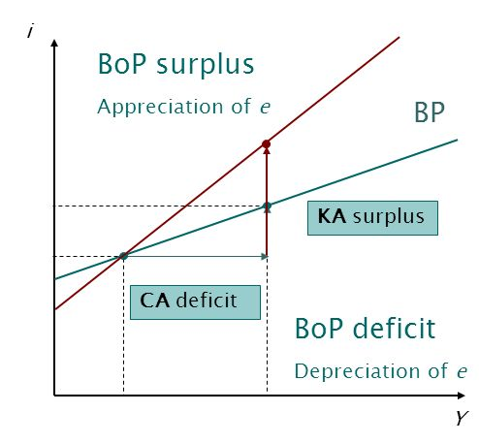
IS-LM-BP MODEL
BALANCE OF PAYMENT CURVE
On BP the balance of payments is in equilibrium
BP is upward-sloping
  An increase in Y leads to a BoP deficit (CA deficit)
  Returning to equilibrium requires a KA surplus, and hence a higher i
The slope depends on the international mobility of capital.
  The lower capital mobility, the larger the slope of BP.

Slide 8
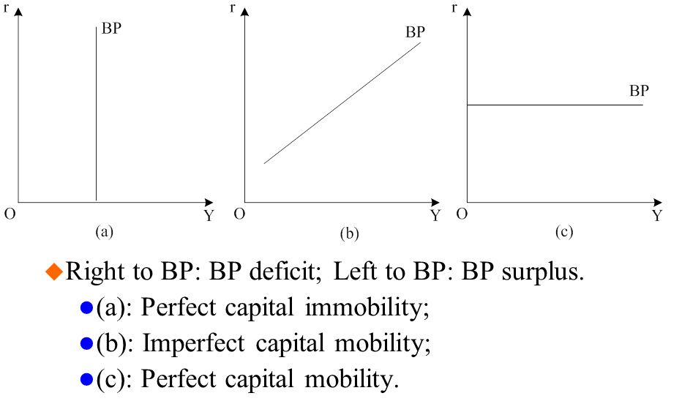
IS-LM-BP MODEL
BALANCE OF PAYMENT CURVE

Slide 9
IS-LM-BP MODEL
EXCHANGE RATES
In a system of floating exchange rates, e is allowed to fluctuate in response to changing economic conditions.
In contrast, under fixed exchange rates, the central bank trades domestic for foreign currency at a predetermined price.
Next policy analysis:
  first, in a floating exchange rate system
  then, in a fixed exchange rate system.

Slide 10
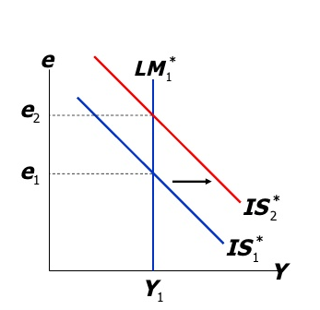
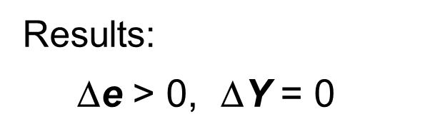
IS-LM-BP MODEL
FLOATING EXCHANGE RATES AND FISCAL POLICY
At any given value of e,
a fiscal expansion increases Y,
shifting IS* to the right

Slide 11
IS-LM-BP MODEL
FLOATING EXCHANGE RATES AND FISCAL POLICY
In a small open economy with perfect capital mobility, fiscal policy cannot affect real GDP.
“Crowding out”
  closed economy:
  Fiscal policy crowds out investment by causing the interest rate to rise.
  small open economy:
  Fiscal policy crowds out net exports by causing the exchange rate to appreciate.

Slide 12
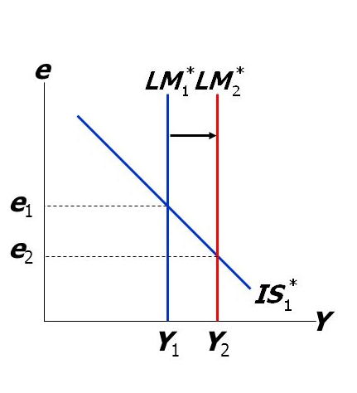
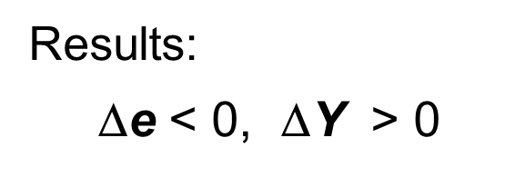
IS-LM-BP MODEL
FLOATING EXCHANGE RATES AND MONETARY POLICY
An increase in M
shifts LM* right
because Y must rise
to restore eq’m in
the money market.

Slide 13
IS-LM-BP MODEL
FLOATING EXCHANGE RATES AND FISCAL POLICY
Monetary policy affects output by affecting
the components of aggregate demand:
closed economy: ↑ M ⇒ ↓ r ⇒ ↑ I ⇒ ↑ Y
small open economy: ↑ M ⇒ ↓ e ⇒ ↑ NX ⇒ ↑ Y
Expansionary monetary policy does not raise world aggr. demand, it merely shifts demand from foreign to domestic products.
So, the increases in domestic income and employment are at the expense of losses abroad.

Slide 14
IS-LM-BP MODEL
FLOATING EXCHANGE RATES AND TRADE POLICY
At any given value of e,
a fiscal expansion increases Y,
shifting IS* to the right.

Slide 15
IS-LM-BP MODEL
FLOATING EXCHANGE RATES AND TRADE POLICY
Import restrictions cannot reduce a trade deficit.
Even though NX is unchanged, there is less trade:
  the trade restriction reduces imports
  the exchange rate appreciation reduces exports.
Less trade means fewer “gains from trade.”
Import restrictions on specific products save jobs in the domestic industries that produce those products, but destroy jobs in export-producing sectors.
Hence, import restrictions fail to increase total employment and so create “sectoral shifts,” which cause frictional unemployment.

Slide 16
IS-LM-BP MODEL
FIXED EXCHANGE RATES
Under fixed exchange rates, the central bank stands ready to buy or sell the domestic currency for foreign currency at a predetermined rate.
In the Mundell-Fleming model, the central bank shifts the LM curve as required to keep e at its preannounced rate.
This system fixes the nominal exchange rate. In the long run, when prices are flexible, the real exchange rate can move even if the nominal rate is fixed.

Slide 17
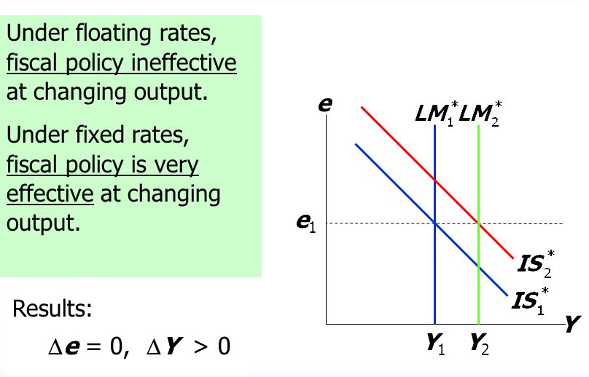
IS-LM-BP MODEL
FIXED EXCHANGE RATES AND FISCAL POLICY

Slide 18
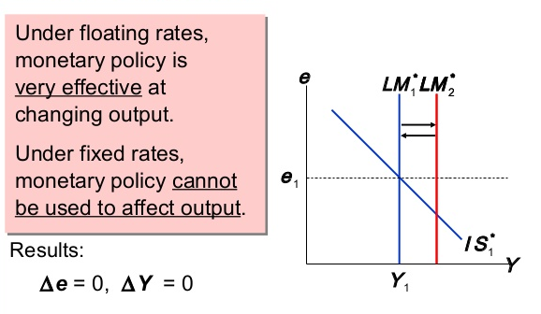
IS-LM-BP MODEL
FIXED EXCHANGE RATES AND MONETARY POLICY

Slide 19
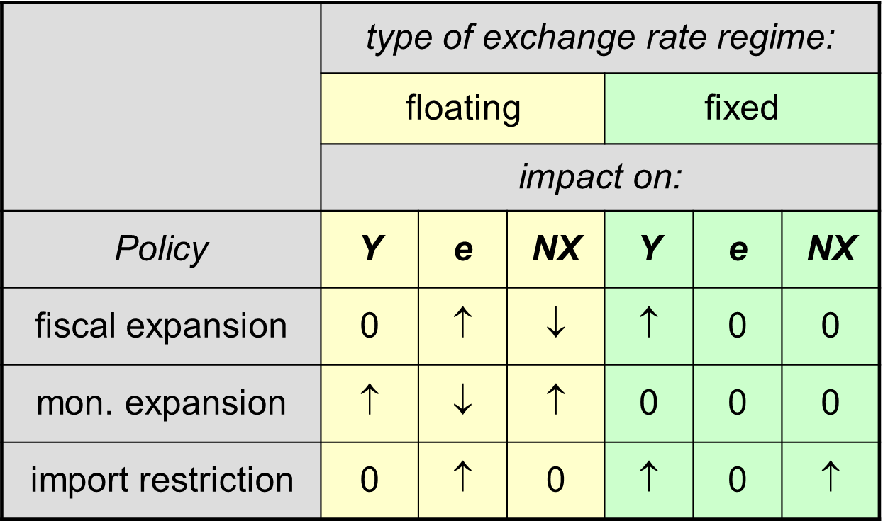
IS-LM-BP MODEL
EXCHANGE RATES

Slide 20
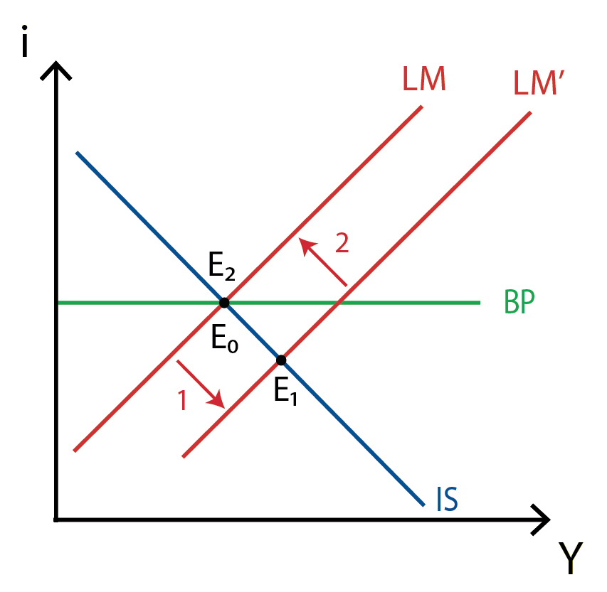
IS-LM-BP MODEL
FIXED EXCHANGE RATES AND MONETARY POLICY
LM shifts to the right
  The increase in the money supply lowers the rate of interest, leading to depreciation pressures on e.
In order to guarantee the fixed exchange rate the CB must immediately increase i to i=i* by reducing money supply
Such a policy cannot be carried out in practice.

Slide 21
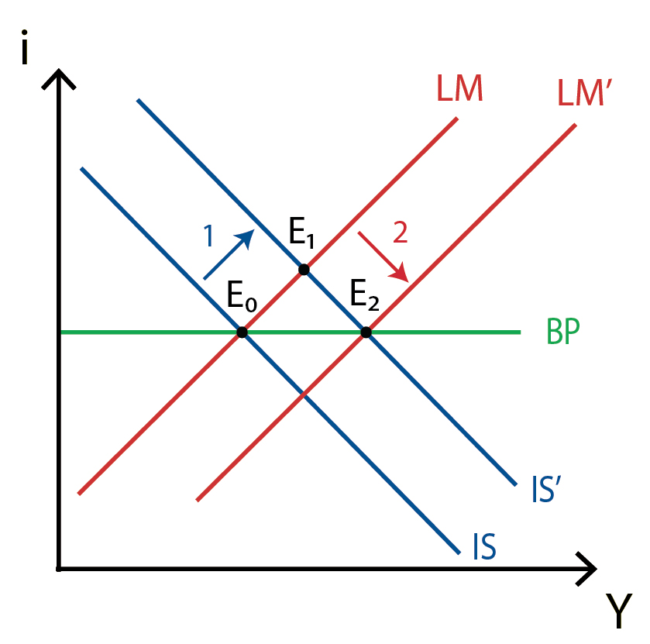
IS-LM-BP MODEL
FIXED EXCHANGE RATES AND FISCAL POLICY
IS shifts to the right:
  The crowding out effect increases the rate of interest, creating appreciation pressures on e
In order to guarantee the fixed exchange rate the CB must immediately reduce i to i=i* by increasing money supply.
Policy is effective in increasing Y.

Slide 22
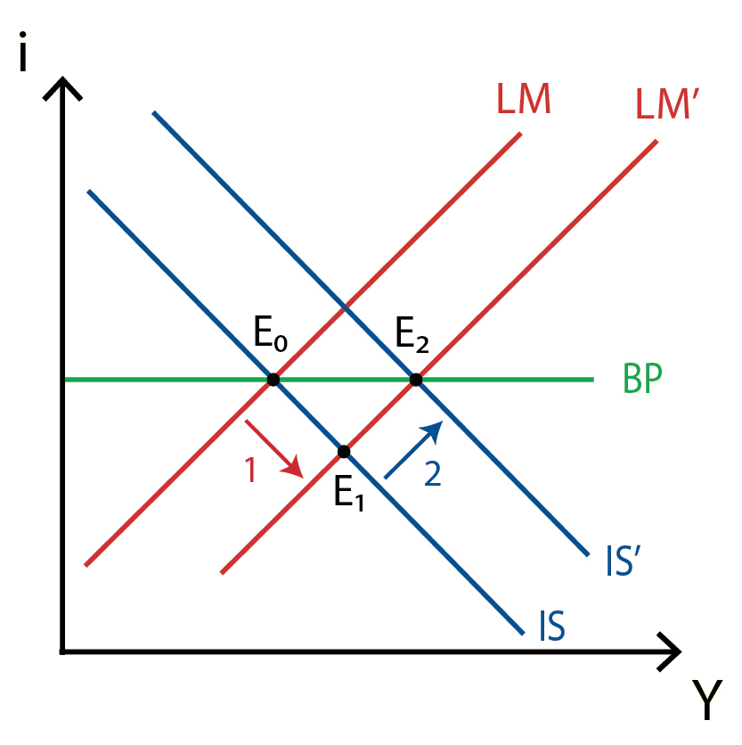
IS-LM-BP MODEL
FLOATING EXCHANGE RATES AND MONETARY POLICY
LM shifts to the right
  The interest rate falls, which leads to a depreciation of the exchange rate e.
The depreciation of the exchange rate stimulates exports and penalises imports.
  as a result IS shifts to the right.
Policy is effective.

Slide 23
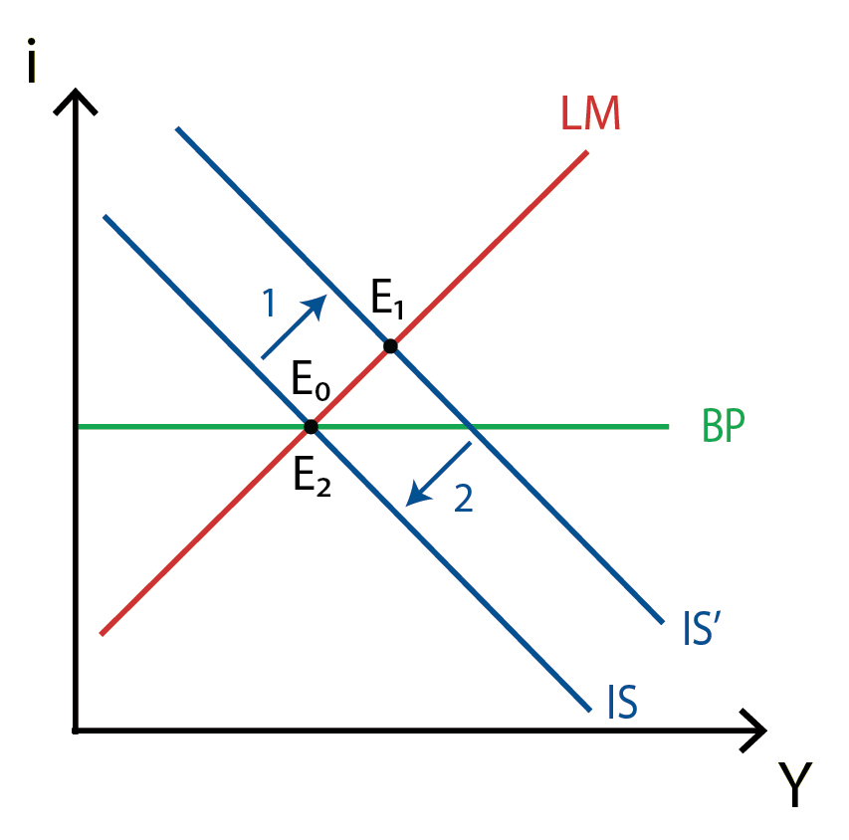
IS-LM-BP MODEL
FLEXIBLE EXCHANGE RATES AND FISCAL POLICY
IS shifts to the right:
  The Central Bank doesn’t have to react: The interest rate increases and the exchange rate appreciates.
The appreciation of the exchange rate penalises exports and stimulates imports
  IS shifts left.
Policy is ineffective.

Slide 24
IS-LM-BP MODEL
EFFECTIVNESS OF POLICY
 | Fixed exchange rate | Flexible exchange rate
Fiscal Policy | Effective | Ineffective
Monetary Policy | Impossible | Effective
Even with this simple example (assumption of perfect capital mobility), the effectiveness of policy depends on international conditions.

Slide 25
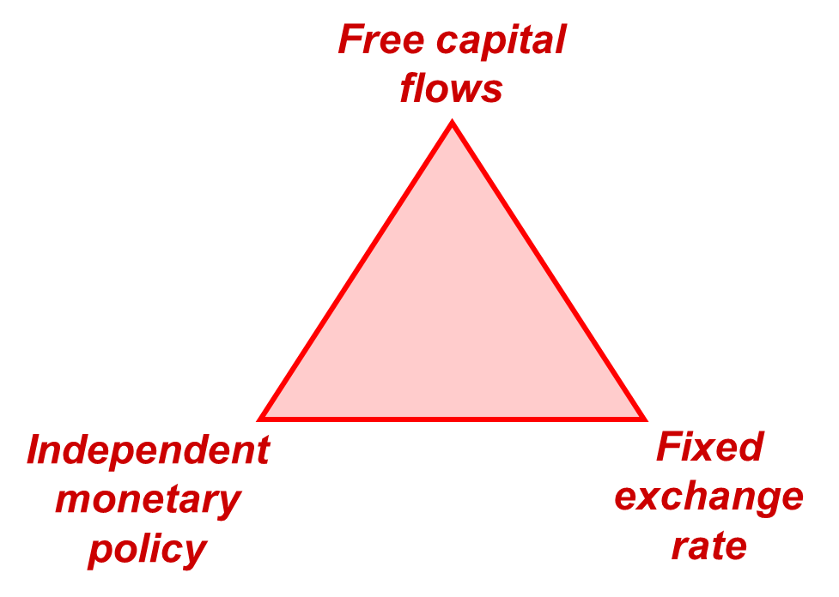
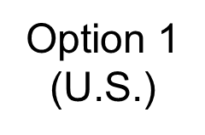
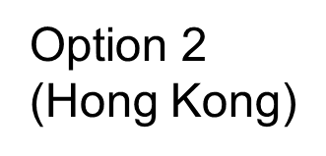
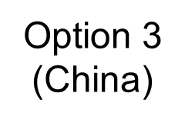
IS-LM-BP MODEL
EFFECTIVNESS OF POLICY
A nation cannot have free capital flows, independent monetary policy, and a fixed exchange rate simultaneously.
A nation must choose one side of this triangle and give up the opposite corner.

Slide 26
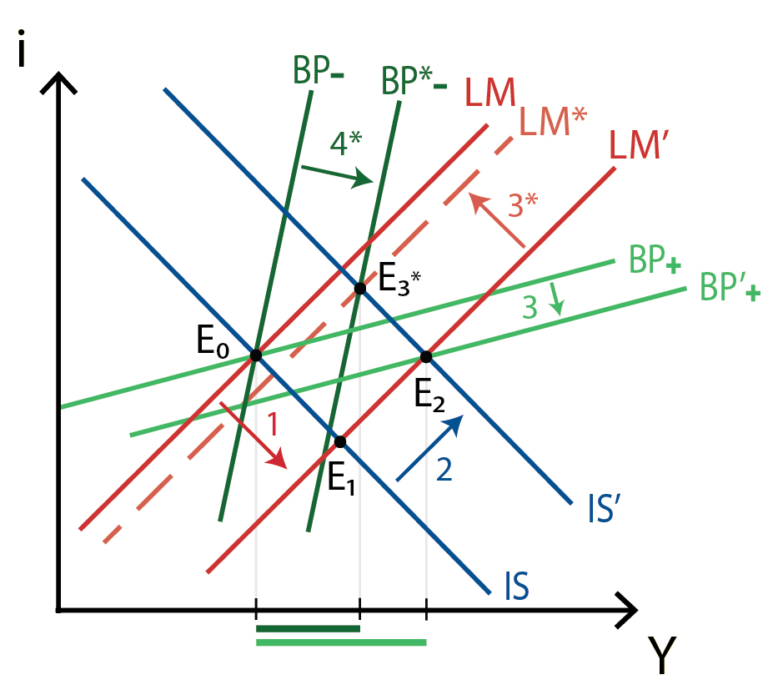
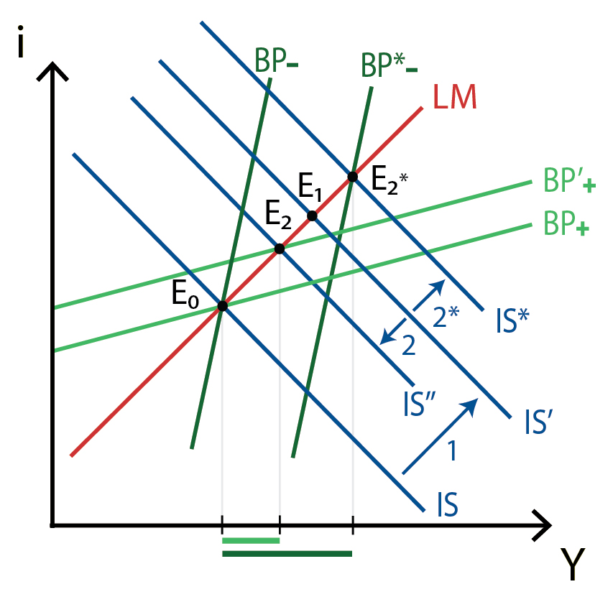
IS-LM-BP MODEL
IPMERFECT CAPITAL MOBILITY AND FLEXIBLE ER
Monetary Policy
Fiscal Policy

Slide 27
IS-LM-BP MODEL
THANK YOU FOR YOUR ATTENTION…

