Slide 1

THE KEYNESIAN IS/LM MODEL
LESSON V
Dr. Ingrid Majerová
MACROECONOMICS/EVS/NAMAB

Slide 2
IS-LM MODEL
Outline of the lecture
Theoretical Assumptions
Curve IS
Curve LM
IS-LM Model

Slide 3
IS – LM MODEL
THEORETICAL APPROACH
The IS-LM model translates the General Theory of Keynes into neoclassical terms (often called the neoclassic synthesis)
It was proposed by John Hicks in 1937 in a paper called “Mr Keynes and the "Classics": A Suggested Interpretation” and enhanced by Alvin Hansen (hence it is also called the Hicks-Hansen model).
The model examines the combined equilibrium of two markets :
  - The goods market, which is at equilibrium when investments equal savings, hence IS.
  - The money market, which is at equilibrium when the demand for liquidity equals money supply, hence LM.
  - Examining the joint equilibrium in these two markets allows us to determine two variables: output Y and the interest rate i.

Slide 4
IS – LM MODEL
THEORETICAL APPROACH
The model rests on two fundamental assumptions
  All prices (including wages) are fixed.
  There exists excess production capacity in the economy
This is a complete change in perspective compared to classical economics:
  The level of demand determines the level of output and employment.
  There can be an equilibrium level of involuntary unemployment.
Why can there be insufficient demand ?
  Criticism of Say’s law: Uncertainty can lead to precautionary saving rather than consumption.
  Monetary criticism: the preference for liquidity can lead to under-investment as savings are kept in the form of liquidity.

Slide 5
IS – LM MODEL
THEORETICAL APPROACH
The IS-LM model has become the “standard model” in macroeconomics.
Its essential contribution (linked to that of Keynes) is this potential equilibrium unemployment:
  Such a situation is impossible in earlier neoclassic models, as the price of labour (like all prices) is assumed to adjust naturally until supply and demand for labour are balanced.
This is why IS-LM (1937) remains central to modern macroeconomics, and has been extended to explain more markets/ variables:
  The Mundell-Fleming model deals with international trade
  The AS-AD model adds inflation into the problem

Slide 6
IS – LM MODEL
GOODS MARKET AND IS CURVE
Equilibrium in the goods market exists when production Y, is equal to the demand for goods AD.
In the simple model, the interest rate did not affect the demand for goods.
The equilibrium condition was given by:

Slide 7
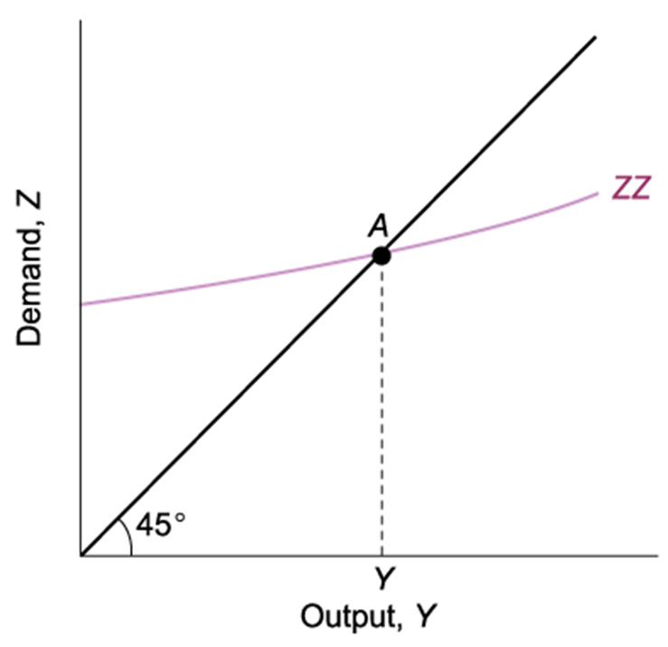
IS-LM MODEL
THE DETERMINATION OF OUTPUT
Equilibrium in the Goods Market
The demand for goods is an increasing function of output. Equilibrium requires that the demand for goods be equal to output.

Slide 8
IS – LM MODEL
GOODS MARKET AND IS CURVE
Now, we no longer assume I (investment) is constant
We capture the effects of two factors affecting investment:
  The level of sales/income (+)
  The interest rate (-)
Taking into account the investment relation above, the equilibrium condition in the goods market becomes:

Slide 9
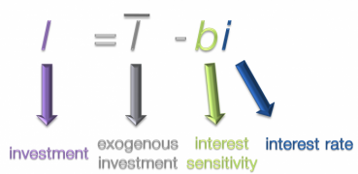

IS – LM MODEL
EQUATION OF IS CURVE

Slide 10
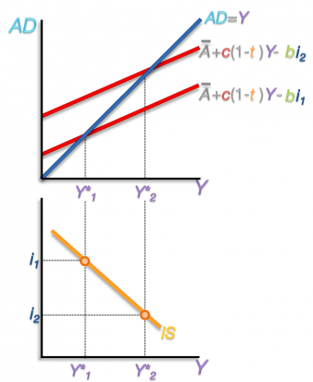
IS-LM MODEL
THE DETERMINATION OF OUTPUT
Interest Rate and Output
An increase in the interest rate decreases the demand for goods at any level of output.

Slide 11
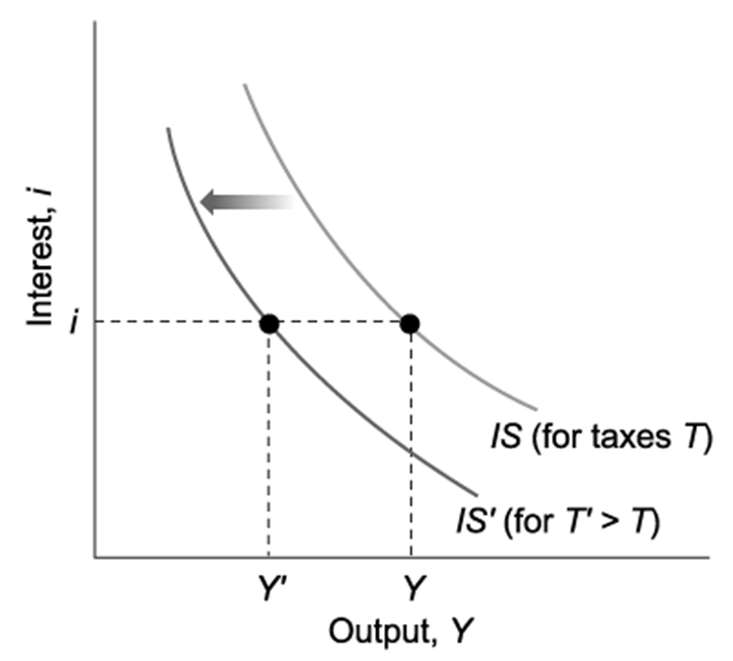
IS-LM MODEL
THE IS CURVE
Shifts in IS Curve
Example:
An increase in taxes

Slide 12
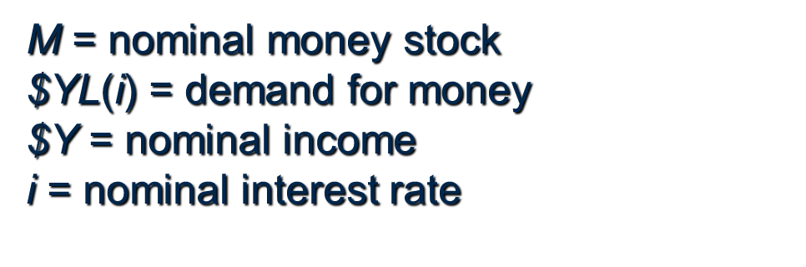
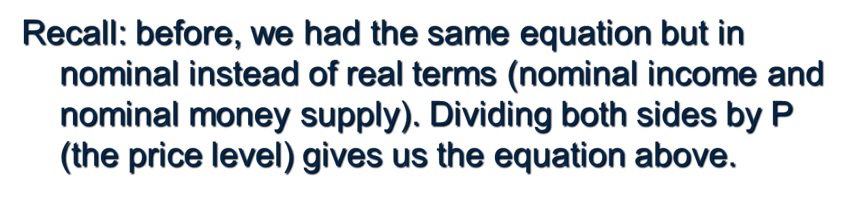
IS – LM MODEL
FINANCIAL MARKET AND LM CURVE
The interest rate is determined by the equality of the supply of and the demand for money:
The LM relation: In equilibrium, the real money supply is equal to the real money demand, which depends on real income Y, and the interest rate i:

Slide 13
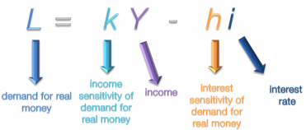
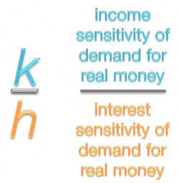

IS – LM MODEL
EQUATION OF LM CURVE

Slide 14
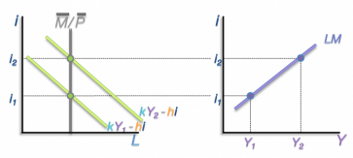
IS-LM MODEL
THE LM CURVE
Determination of LM Curve
Example:
The Effects of an Increase in Income on the Interest Rate

Slide 15
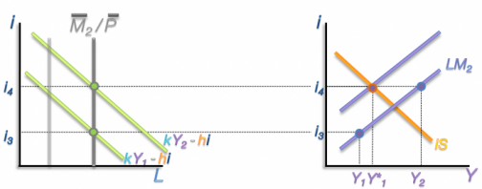
IS-LM MODEL
THE LM CURVE
Shifts in Money Demand
Example:
The Effects of an Increase in Income on the Interest Rate

Slide 16
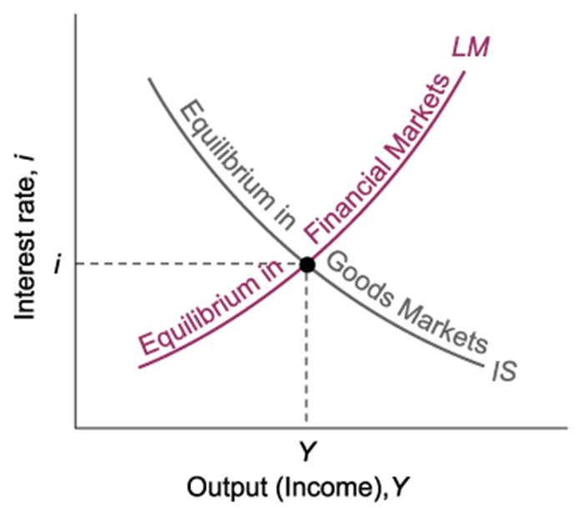
IS-LM MODEL
THE IS and LM Relations
IS-LM Model
Equilibrium in the goods market (IS).
Equilibrium in financial markets (LM).
  When the IS curve intersects the LM curve, both goods and financial markets are in equilibrium.

Slide 17
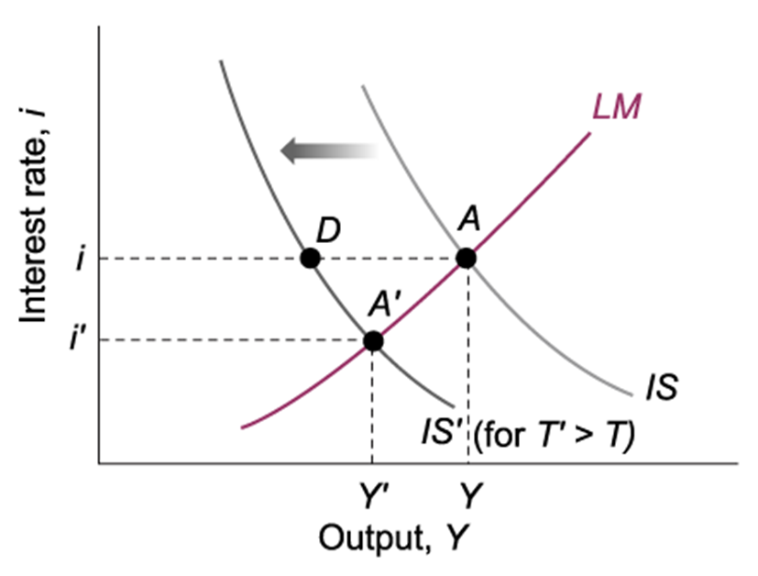
IS – LM MODEL
FISCAL POLICY
Fiscal contraction: a fiscal policy that reduces the budget deficit.
  Reducing G or increasing T
Fiscal expansion: increasing the budget deficit.
  Increasing G or decreasing T
Taxes (T) and government expenditures (G) affect the IS curve, not the LM curve.

Slide 18
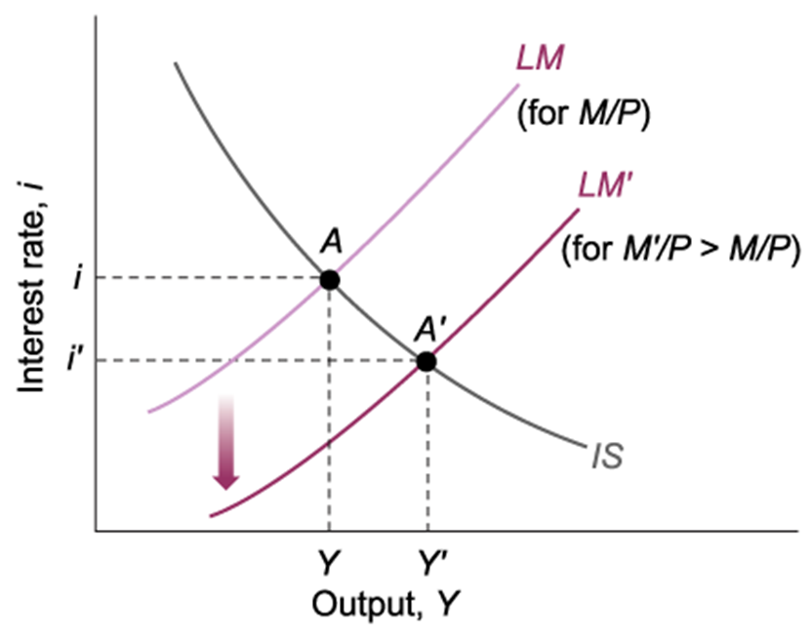
IS – LM MODEL
MONETARY POLICY
Monetary contraction (tightening) refers to a decrease in the money supply.
An increase in the money supply is called monetary expansion.
Monetary policy affects only the LM curve, not the IS curve.

Slide 19
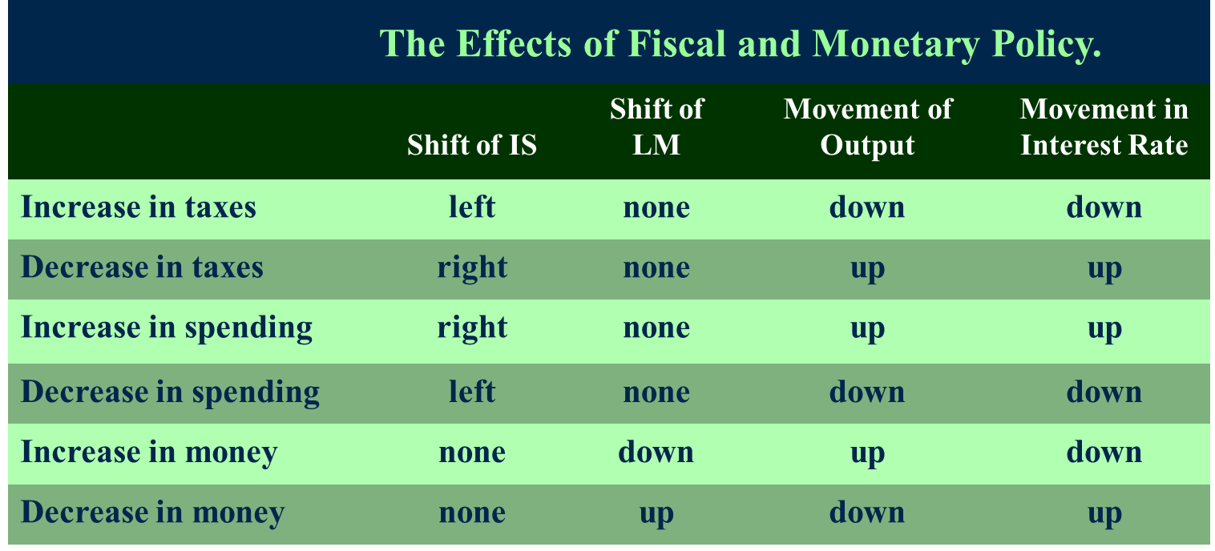
IS – LM MODEL
POLICY MIX

Slide 20
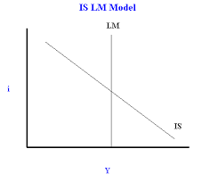
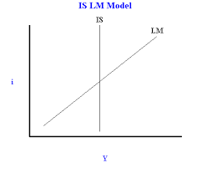
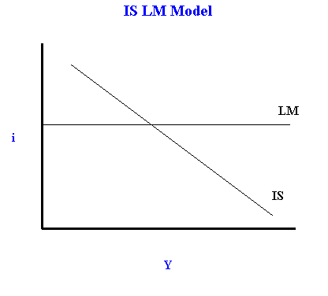
IS-LM EXTREME FORMS

Slide 21
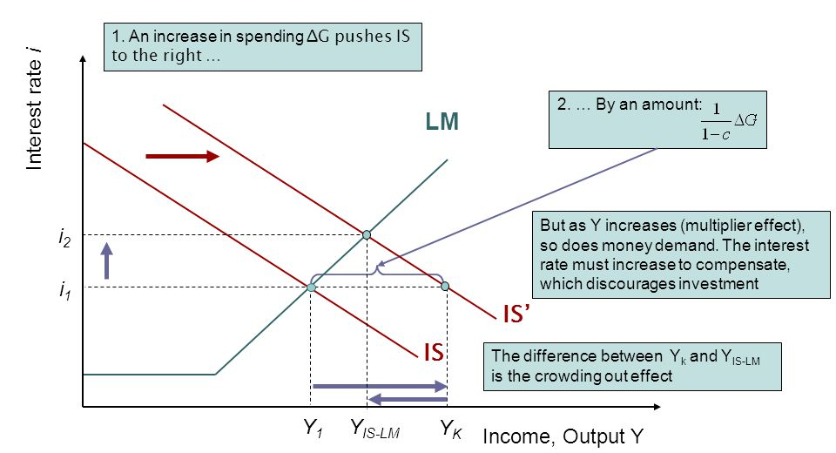
IS-LM MODEL
CROWDING OUT EFFECT

Slide 22
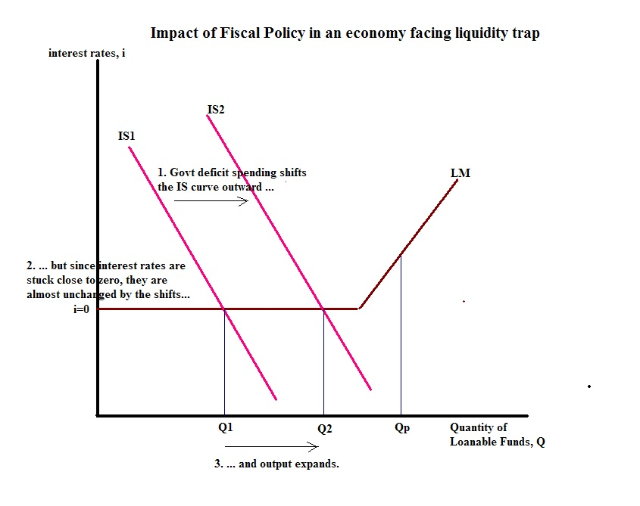
IS-LM MODEL
LIQUIDITY TRAP AND FISCAL POLICY

Slide 23
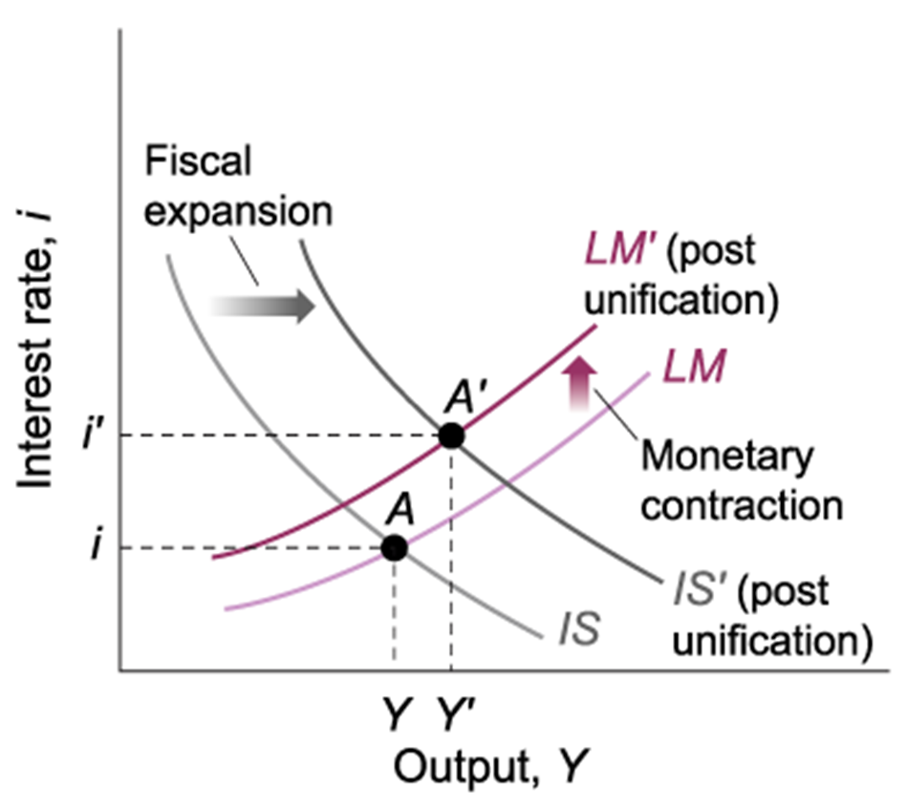
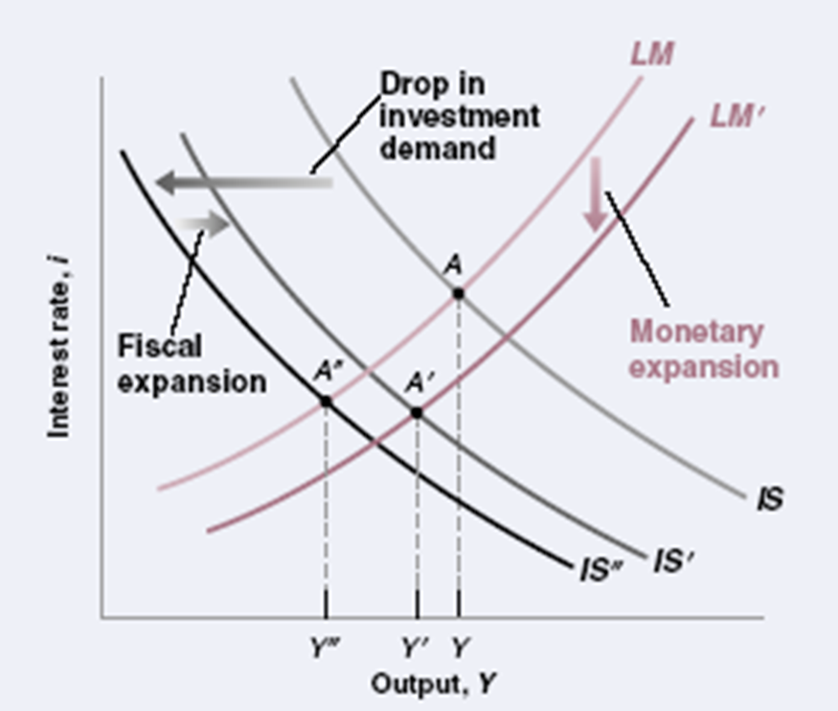
IS-LM EXAMPLES
German Reunification in 1991 The U.S. Recession of 2001

Slide 24
IS-LM MODEL
THANK YOU FOR YOUR ATTENTION…

