Slide 1

International Trade
Ing. Jana Šimáková, Ph.D.
simakova@opf.slu.cz

Slide 2

Essentials of International Trade
Purchase, sale, or exchange of goods and services across national borders
International trade is one of the driving forces of globalization
  Economic meaning of globalization is the increased openness of economies to international trade, financial flows, and foreign direct investment
International trade enhances economic growth
  Increases the efficiency of the allocation of resources
  Provides larger capital and product markets,
  Assists specialization based on comparative advantages
  Increases the efficiency of the flow of capital among countries
Importance of international trade to a nation can be examined by its trade volume relative to its total output
International Trade

Slide 3
Terminology of International Trade
Imports are goods and services that a domestic economy purchases from other countries
Exports are goods and services that a domestic economy sells to other countries
The terms of trade is the ratio of the price of exports to the price of imports
  Increasing terms of trade indicate improvement.
  Decreasing terms of trade indicate deterioration.
Net exports = Exports – Imports
  If positive, there is a trade surplus
  If negative, there is a trade deficit
International Trade

Slide 4
Terminology of International Trade
A country that does not trade with other countries is referred to as a closed economy or being in autarky; the price of goods and services is the autarkic price
An economy that is not closed is an open economy
  If there are no restrictions to trade, the price of goods and services is the world price
Free trade is the case in which there are no restrictions on a country’s trade with other countries
  Trade protections are restrictions on trade that prevent pricing based on supply and demand.
  Capital restrictions are limits on the flow of funds into or out of a country
International Trade

Slide 5
Factors Affecting International Trade Flows
Inflation
  Consumers and corporations in country with higher inflation will most likely purchase more goods by import (due to high local inflation), while the country’s exports to other countries will decline.
National income
  As the real income level rises, so does consumption of goods. A percentage of that increase in consumption will most likely reflect an increased demand for foreign goods.
Government policies
  A country’s government can have a major effect on its balance of trade by its policies on subsidizing exporters, restrictions on imports, or lack of enforcement on piracy.
Exchange rates
  As the currency strengthens, goods exported by that country will become more expensive to the foreign countries. As a consequence, the demand for such goods will decrease. Simultanously, imported goods will become cheaper for domestic consumptions and this demand will be higher.
International Trade

Slide 6
Questions and Applications
???What are the net exports of your home country???
???What are the main features of development of exports and imports in your home country in last 5 years???
Check statistical data of Balance of Payments (current account) of your home country. Find, what is the value of the net exports. Describe the main features of international trade in your home country in last 5 years. Are there any subsidies for exports or restrictions on imports?
International Trade

Slide 7
Questions and Applications
???What are benefits and costs of international trade for involved countries???
International Trade

Slide 8
Benefits and Costs of International Trade
BENEFITS
  Gain from exchange and specialization
  Greater economies of scale
  Greater product variety
  Increased competition
  More efficient resource allocation
  More jobs and new entrepreneurial opportunities
COSTS
  Greater income inequality
  Loss of jobs in developed countries
  Adjustments as resources are reallocated
International Trade

Slide 9
Trade and World Output
Total volume of international trade in merchandise and services was 20.44 trillion USD in 2016
  15.71 trillion USD (76.9%) merchandise and 4.73 trillion USD (23.1%) services
World output impacts international trade as growing output stimulates growth in trade and vice versa
World trade grows faster than world output
Persistent pattern of merchandise trade among nations
  Trade between the world’s high-income economies accounts for roughly 60%
  Trade between high-income countries and low- and middle-income nations accounts for around 34%
  Trade between low- and middle-income nations accounts for only about 6%
International Trade

Slide 10
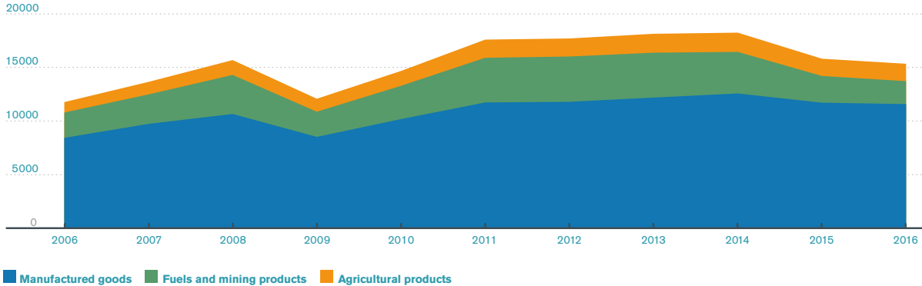
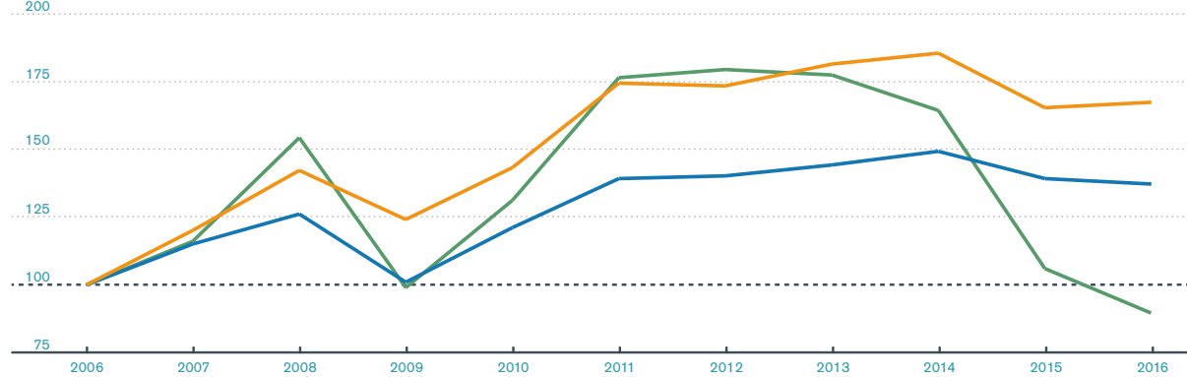
Product Groups of World Merchandise Trade (2006-2016)
(bil. USD)
(index 2006 = 100)
International Trade

Slide 11
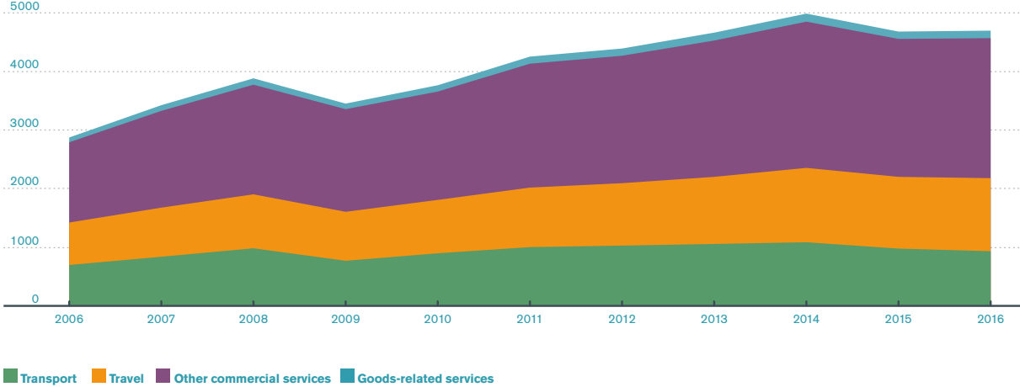
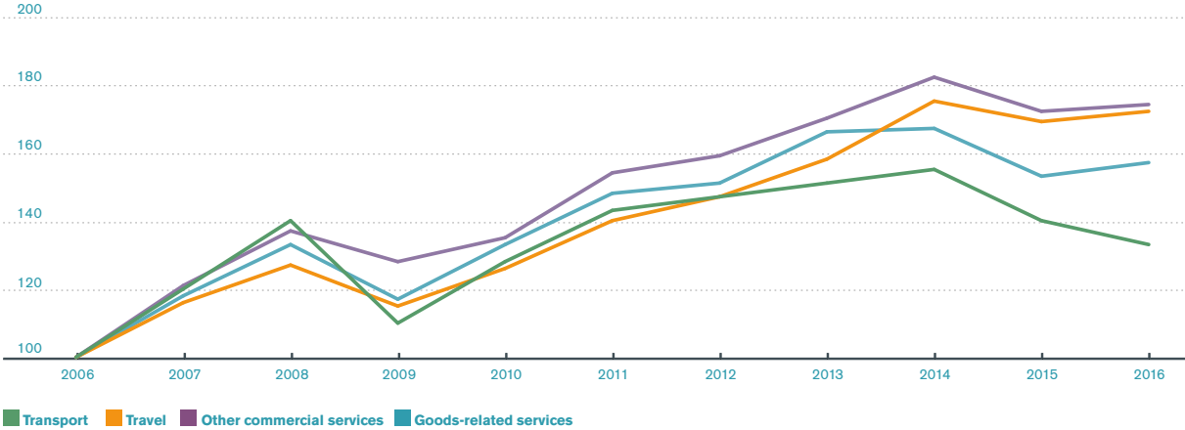
Product Groups of World Services Trade (2006-2016)
(bil. USD)
(index 2006 = 100)
International Trade

Slide 12
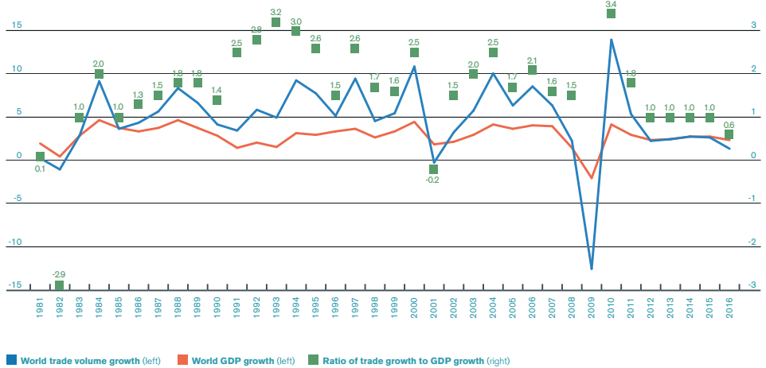
Growth of World Merchandise Trade and Real GDP
(Annual percentage change and ratio)
(index 2006 = 100)
International Trade

Slide 13
Questions and Applications
???Which countries are major exporters and importers in merchandise trade???
International Trade

Slide 14
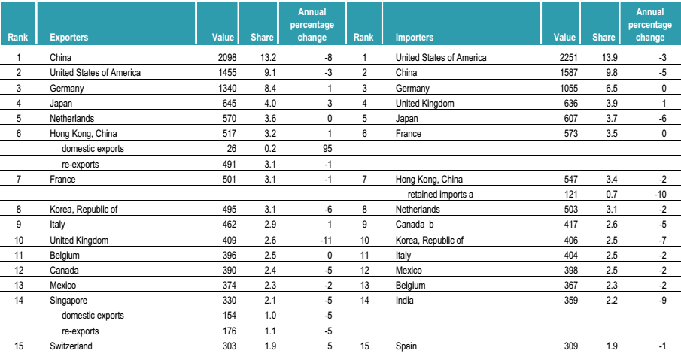
Leading Exports and Imports in Merchandise Trade (2016)
(bil. USD)
(bil. USD)
International Trade

Slide 15
https://data.worldbank.org/indicator/NE.TRD.GNFS.ZS?locations=CZ-CN-IN-1W

Slide 16
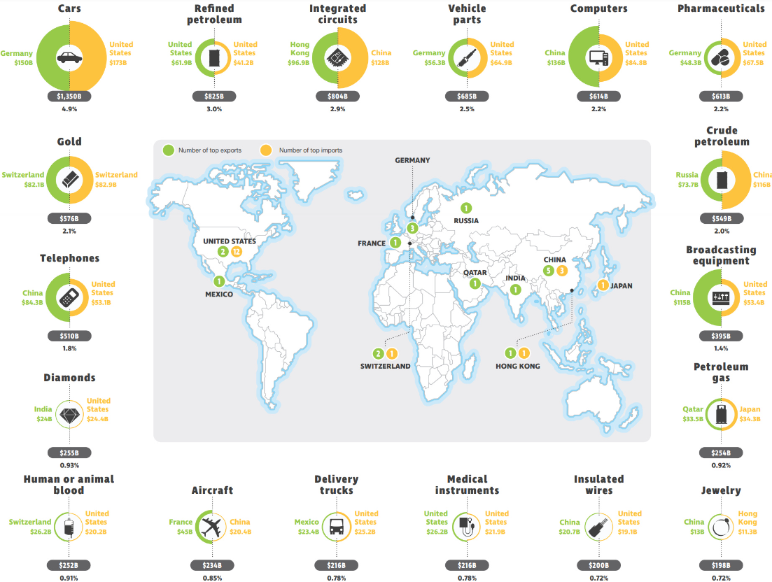
The Top Importers and Exporters of the World’s 18 Most Traded Goods (2018)

Slide 17
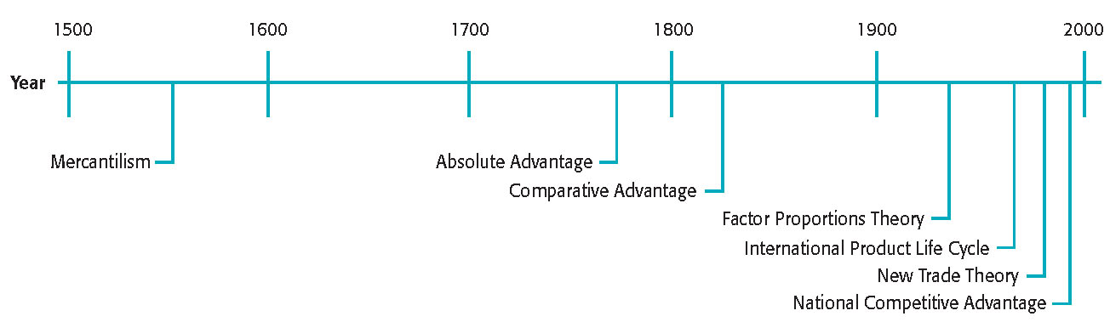
Trade Theory Timeline
(bil. USD)
(bil. USD)
International Trade

Slide 18
Foundations of Mercantilism
Nations should accumulate financial wealth, usually in the form of gold, by encouraging exports and discouraging imports
Three pillars of mercantilism
  Maintain trade surplus
  Government intervention
  Exploit colonies
Flows of mercantilism
  World trade is a zero-sum game
  Limits colonies‘ market potential
  Constrains output and consumption
International Trade
Notes:
The trade theory of mercantilism argues that nations should accumulate financial wealth, usually in the form of gold, by encouraging exports and discouraging imports.
European sea-faring nations practiced mercantilism from around 1500 to the late 1700s.
These countries acquired colonies in Africa, Asia, and the Americas as sources of inexpensive raw materials and as markets for higher-priced finished goods.
Mercantilist nations used profits from this trade to create armies and navies to control colonies and protect their shipping.
Mercantilism has several inherent flaws:
First, it views international trade as a zero-sum game. This is the idea that a nation benefits from trade only at the expense of other nations.
Second, market potential in the colonies was less than it could have been had people there received higher prices for their resources.
Third, mercantilist policies constrained the potential output and consumption for both the colonies and the mercantilist nations.

Slide 19
Absolute Advantage
Ability of a nation to produce a good more efficiently than any other nation (greater output using same or fewer resources)
Specialization and trade allows each to produce and consume more
Riceland
Tealand
1 resource unit = 1 ton rice or
1/5 ton tea
1 resource unit = 1/6 ton rice or
1/3 ton tea
International Trade
Notes:
Absolute advantage is the ability of a nation to produce a good more efficiently than any other nation.
This means that the nation can produce a greater amount of output using the same amount of, or fewer, resources.
Assume that Riceland and Tealand produce rice and tea, transporting goods costs nothing, and each nation produces and consumes its own rice and tea.
In Riceland, one resource unit produces one ton of rice or one-fifth of a ton of tea.
In Tealand, one resource unit produces one-sixth ton of rice or one-third ton of tea.
This means that Riceland has an absolute advantage in rice production and Tealand has an absolute advantage in tea production.

Slide 20
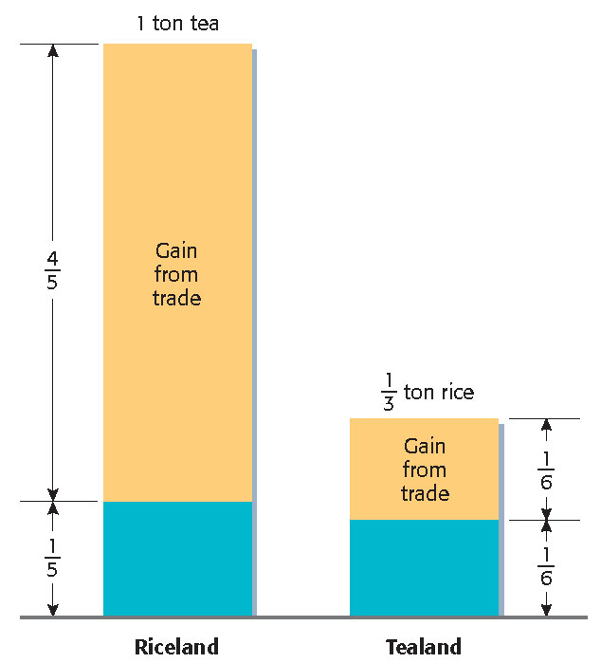
Trade Gains: Absolute Advantage
Specialization and trade
  Riceland gets five times more tea than it would have produced itself
  Tealand gets two times more rice than it would have produced itself
International Trade
Notes:
Assume that Riceland and Tealand expend additional resource units to produce extra rice and tea, respectively, and then trade additional output with the other nation on a one-to-one basis.
This means that Riceland expends an additional resource unit to produce one extra ton of rice that it then trades with Tealand to obtain one ton of tea. Riceland gets four-fifths of a ton more tea than the one-fifth of a ton it would have produced itself with one additional resource unit.
Tealand expends an additional resource unit to produce an extra one-third of a ton of tea that it then trades with Riceland to obtain one-third of a ton of rice. Tealand gets one-sixth of a ton more rice than the one-sixth of a ton it would have produced itself with one additional resource unit.
Specialization and trade gives Riceland five times more tea than it would have produced itself, and gives Tealand two times more rice than it would have produced itself.
This means that if each country specializes in the area in which it has an absolute advantage, world output (and consumption) of both goods increases. In other words, each nation benefits from specialization and trade.

Slide 21
Comparative Advantage
Inability of a nation to produce a good more efficiently than other nations, but an ability to produce that good more efficiently than it does any other good
  A country is less efficient in the production of all goods, but it is less inefficient in the production of one good
Riceland
Tealand
1 resource unit = 1 ton rice or
1/2 ton tea
1 resource unit = 1/6 ton rice or
1/3 ton tea
International Trade
Notes:
Comparative advantage is the inability of a nation to produce a good more efficiently than other nations, but an ability to produce that good more efficiently than it does any other good.
This means that a country is less efficient in the production of all goods, but it is less inefficient in the production of one good.
Again, assume two countries, two products, and transporting goods costs nothing.
In Riceland, one resource unit produces one ton of rice or one-half of a ton of tea.
In Tealand, one resource unit produces one-sixth of a ton of rice or one-third of a ton of tea.
This means that Riceland has absolute advantages in both goods because it is more efficient at producing each one.
However, Tealand has a comparative advantage in tea production because it produces tea more efficiently than it produces rice.

Slide 22
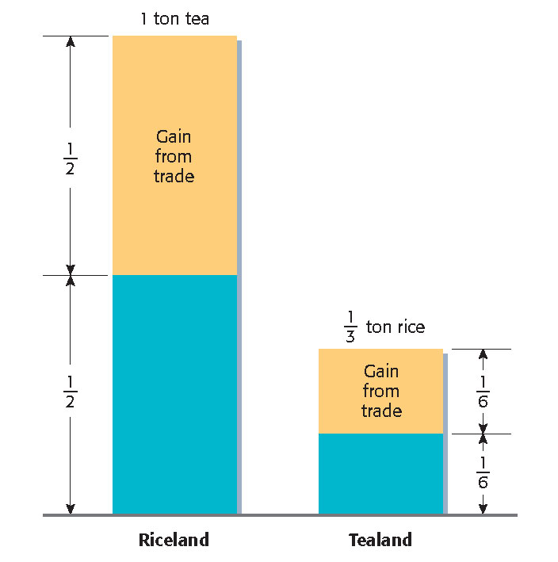
Trade Gains: Comparative Advantage
Specialization and trade
  Riceland gets two times more tea than it would have produced itself
  Tealand gets two times more rice than it would have produced itself
International Trade
Notes:
Again, assume that Riceland and Tealand expend additional resource units to produce extra rice and tea, respectively, and then trade additional output with the other nation on a one-to-one basis.
This means that Riceland expends an additional resource unit to produce one extra ton of rice that it then trades with Tealand to obtain one ton of tea. Riceland gets one-half of a ton more tea than the one-half of a ton it would have produced itself with one additional resource unit.
Likewise, Tealand expends an additional resource unit to produce an extra one-third of a ton of tea that it then trades with Riceland to obtain one-third of a ton of rice. Tealand gets one-sixth of a ton more rice than the one-sixth of a ton it would have produced itself with one additional resource unit.
Specialization and trade gives Riceland two times more tea than it would have produced itself, and gives Tealand two times more rice than it would have produced itself.
This means that if Riceland holds an absolute advantage in the production of each good and Tealand holds a comparative advantage in the production of one good, world output (and consumption) of both goods increases. In other words, each nation can still benefit from specialization and trade.

Slide 23
Assumptions and Limitations
Nations strive only to maximize production and consumption
Only two countries produce and consume just two goods
  There are more than 190 countries and countless products are produced, traded, and consumed
No transportation costs of traded goods
  Transportation costs are a major expense of international trade
Labor is the only resource used to produce goods and it cannot cross borders
  Production clearly needs additional resources and labor is increasingly mobile
Specialization does not create efficiency and improvement gain
International Trade

Slide 24
Factor Proportions Theory
Countries produce and export goods that require resources (factors) in abundance, and import goods that require resources in short supply
It predicts that a country will specialize in products that require labor if its cost is low relative to that of land and capital, and vice versa
Leontief Paradox: the United States exports require more, not less, labor-intensive production than its imports
Possible explanations of Leontief Paradox
  Theory assumes nation’s production factors to be homogeneous, particularly labor, although labor skills vary greatly within a country
  Theory is better predictor when expenditures on labor are considered
International Trade

Slide 25
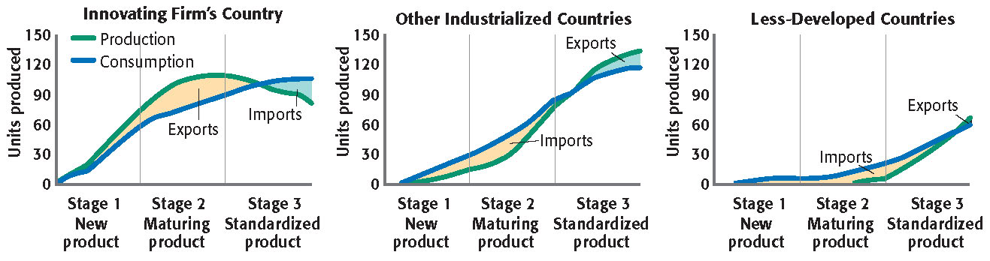
International Product Life Cycle
A company begins by exporting its product and later undertakes foreign direct investment as a product moves through its life cycle
International Trade
Notes:
The international product life cycle theory states that a company will begin exporting its product and later undertake foreign direct investment as the product moves through its life cycle. This means that a country’s export will eventually become its import.
In stage 1, the new product stage, high purchasing power and buyer demand encourage a company to design and introduce a new product concept. Although there is virtually no export market initially, exports increase late in this stage.
In stage 2, the maturing product stage, the domestic market and markets abroad become fully aware of the existence of the product and its benefits. Demand rises and is sustained over a fairly lengthy period of time. Near the end of this stage, sales begin in developing nations and manufacturing is established there.
In stage 3, the standardized product stage, competition from companies selling similar products pressures companies to lower prices to maintain sales levels. A search for low-cost production bases abroad begins and the home market may begin importing the product.

Slide 26
New Trade Theory
Fundamentals
  Gains from specialization and economies of scale
  Companies first to market create barriers to entry
  Government may help by assisting home companies
First-mover advantage
  Economic and strategic advantage of being first to enter an industry
  May create a formidable barrier to market entry for potential rivals
International Trade
Notes:
New trade theory says that:
There are gains to be made from specialization and increasing economies of scale.
Companies first to market can create barriers to entry.
And Government may play a role in assisting its home-based companies.
According to the theory, as a firm specializes and its output increases, it realizes economies of scale and its unit cost of production declines. The company can then expand, lower prices, and force competitors to produce a similar level of output if they are to remain competitive.
A major part of the theory is the first-mover advantage—which is the economic and strategic advantage gained by being the first company to enter an industry.
This advantage creates a barrier to entry for potential rivals and may allow a country to dominate in a product.

Slide 27
National Competitive Advantage
Nation’s competitiveness in an industry depends on the industry’s capacity to innovate and upgrade, which in turn depends on four main determinants (plus government and chance)
Factor conditions
Demand conditions
Related and supporting industries
Firm strategy, structure, and rivalry
International Trade

Slide 28
National Competitive Advantage – Determinants
Factor conditions
  Basic conditions are primarily natural endowments of resources
  Advanced factors result from a nation’s innovation and education, including the skill levels of the workforce and the quality of its technological infrastructure
Demand conditions
  Sophisticated home-market buyers drive companies to improve existing products and develop entirely new products and technologies
  This should improve the competitiveness of the entire group of companies in a market
International Trade

Slide 29
National Competitive Advantage – Determinants
Related and supporting industries
  Companies in an internationally competitive industry do not exist in isolation
  Supporting industries form “clusters” of economic activity in the geographic area
  Each industry reinforces the competitiveness of every other industry in the cluster
Firm strategy, structure and rivalry
  Highly skilled managers are essential because strategy has lasting effects on firm competitiveness
  Domestic industry whose structure and rivalry create an intense struggle to survive strengthens competitiveness
International Trade
Notes:
Related and supporting industries also feature prominently in national competitive advantage theory.
Companies in internationally competitive industries do not exist in isolation.
Rather, supporting industries arise to provide inputs and form regional clusters of related activities that reinforce productivity and competitiveness.
Exporting clusters—those that export products or invest outside a region—can become a region’s source of long-term prosperity.
Firm strategy, structure, and rivalry also play roles in national competitive advantage theory.
Strategic decisions have lasting effects on future competitiveness, as do industry structure and rivalry between companies.
In general, the more intense the rivalry between domestic companies, the greater is their global competitiveness. Heightened competitiveness at home helps businesses to compete against imports and against foreign companies trying to develop a presence in the domestic market.

Slide 30
Trade and Capital Restrictions
A tariff is a tax levied by a government on imported goods
  Intended to protect domestic industries
  Increases welfare of domestic country if (1) there is no retaliation, and (2) the deadweight loss is less than the benefit from improving trade
An import quota is a restriction on the quantity of a good that can be imported
  Controlled through import licenses
  Importers earn quota rents if they charge a higher price with a quota
An export subsidy is a payment by a government to a firm when it exports a specified good
  Encourages firms to shift to export goods, increases the domestic price
  A voluntary export restraint is a voluntary limit on goods exported to a specific country
  Allows exporter to earn quota rents
International Trade

Slide 31
Trade and Capital Restrictions
Domestic content provisions are requirements that a specific portion of value-added or components be produced domestically.
Capital restrictions are controls placed on ownership of assets, either of foreign assets or of ownership of domestic assets by foreign persons or firms.
The effect of restrictions on trade and capital depends on whether the country is a price taker or can affect price:
  A small country in the context of international trade is a price taker.
  A large country in this context can influence the price.
International Trade

Slide 32
Trade and Capital Restrictions – Summary of Effects
 | Tariff | Import Quota | Export Subsidy | Voluntary Export Restraint (VER)
Impact on | Importing country | Importing country | Exporting country | Importing country
Producer surplus | + | + | + | +
Consumer surplus | − | − | − | −
Government revenue | + | Mixed | − | 0
National welfare
Small country | − | − | − | −
Large country | + | + | − | −
Price | + | + | + | +
Domestic consumption | − | − | − | −
Domestic production | + | + | + | +
Trade
Imports | − | − |  | −
Exports |  |  | +
International Trade

Slide 33
Trading Blocs
A trading bloc is an agreement among countries to work toward eliminating trade barriers. Trading blocs may be regional (e.g., NAFTA, EU), yet there are different degrees of integration possible
Economic union
Common market
Coordination of economic policies among members
Free trade area (FTA)
Trading block with no trade barriers
Customs union
Common trade policy regarding nonmembers
Allows free movement of factors of production
International Trade

Slide 34
Why Trading Blocks?
Increased competition
  Lowers prices and increases quantity
Cost of production declines
  Easier access to natural resources and technology
Increased access to technology and knowledge
Increased specialization
Greater opportunity for economies of scale
Increased employment
Increased income
Increased interdependence among members
  Less chance of conflicts
International Trade

Slide 35
THANK YOU FOR YOUR ATTENTION
J

