Slide 1
International Financial Markets
Ing. Jana Šimáková, Ph.D.
simakova@opf.slu.cz

Slide 2
International Financial Markets Used by MNC
foreign exchange market
international money market
international credit market
international bond market
international stock market
International Financial Markets

Slide 3
International Financial Markets

Slide 4
Questions and Applications
???Why MNCs use international money market instead of domestic one???
International Financial Markets

Slide 5
International Money Market
Used to borrow short-term funds denominated in foreign currency
Borrowing funds to pay for imports denominated in a foreign currency.
Borrowing in a currency in which the interest rate is lower.
This strategy is especially desirable if the firms will have receivables denominated in that currency in the future.
Borrowing in a currency that will depreciate against MNC‘s home currency, as it would be able to repay the loan at a more favorable exchange rate over time.
Thus, the actual cost of borrowing would be less than the interest rate of that currency.
Used to invest short-term funds in foreign currency
Investing in short-term investments denominated in foreign currencies with higher interest rate in comparison to interest rate of short-term investment in local currency.
Investing in a currency that will appreciate against home currency, so MNC would be able to convert that currency into its home currency at a more favorable exchange rate.
Thus, the actual return on investment would be higher than the quoted interest rate on that foreign currency.
International Financial Markets

Slide 6
Risk of the International Money Market
Generally is considered as a market with low level of risk
the least risky money market instruments are, in particular, state treasury bills and sovereign bonds with a maturity of up to one year.
due to the higher risk of failure in the MNC, interest rates are somewhat higher for them in the money market.
Money market instruments are subject to exchange rate risk
For example, the profitability of an investment can be reduced when the currency in which a security is denominated depreciates against the currency of the investor. This implies that even though the security does not bear any credit risk, investors may lose money due to foreign exchange risk.
International Financial Markets

Slide 7
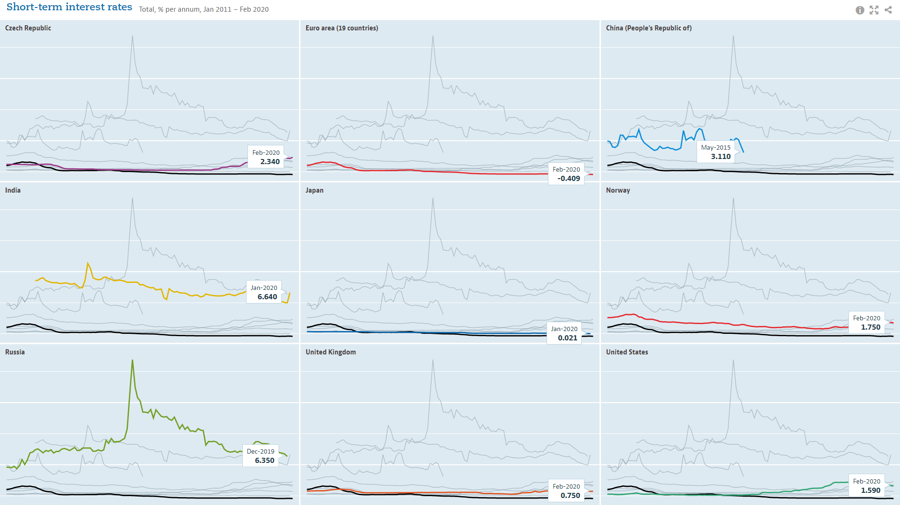
Interest Rates in the Money Market (March 2020)
International Financial Markets

Slide 8
Questions and Applications
???Why MNCs use international credit market instead of domestic one???
International Financial Markets

Slide 9
International Credit Market
Use for obtaining/investing medium and long term funds through financial institutions located on foreign markets.
Interest rate varies according to the movement of reference market interest rate
Often interbank interest rates, such as the LIBOR, EURIBOR
The basic reasons for using the international credit market by MNC are identical for the international money market, the difference is in the time horizon of the use of funds.
International Financial Markets

Slide 10
Standardizing Global Bank Regulations
(Basel I -> Basel II->) Basel III Accord
an internationally agreed set of minimum requirements which apply to internationally active banks
measures developed by the Basel Committee on Banking Supervision in response to the financial crisis of 2007-09.
measures aim to strengthen the regulation, supervision and risk management of banks.
Single European Act
Capital can flow freely throughout Europe.
Banks can offer a wide variety of lending, leasing, and securities activities in the EU.
Regulations regarding competition, mergers, and taxes are similar throughout the EU.
A bank established in any one of the EU countries has the right to expand into any or all of the other EU countries.
International Financial Markets

Slide 11
Syndicated Loans
When a single bank is unwilling or unable to lend the amount needed by a MNC, a syndicate of banks may be organized.
Lead bank is responsible for negotiating terms with the borrower.
Lead bank organizes a group of banks to underwrite the loans. The syndicate of banks is usually formed in about 6 weeks, or less if the borrower is well known (credit evaluation can be conducted more quickly).
Each bank in the syndicate participates in lending.
Borrowers that receive a syndicated loan incur various fees (besides the interest).
Front-end management fees - paid to cover the costs of organizing the syndicate and underwriting the loan.
Commitment fee (0.25 - 0.50 %) - charged annually on the unused portion of the available credit.
International Financial Markets

Slide 12
Syndicated Loans
Factors affecting interest rate on the syndicated loan
currency denominating the loan
maturity of the loan
creditworthiness of the borrower
interbank lending rate
Syndicated loans not only reduce the default risk of a large loan to the degree of participation for each individual bank, but they can also add an extra incentive for the borrower to repay the loan.
If a MNC defaults on a loan to a syndicate, word will quickly spread among banks, and the MNC will likely have difficulty obtaining future loans. Borrowers are therefore strongly encouraged to repay syndicated loans promptly.
From the perspective of the banks, syndicated loans increase the probability of prompt repayment.
International Financial Markets

Slide 13
Questions and Applications
In 2008, the USA experienced a credit crisis that was triggered by the substantial defaults on so-called subprime (lower quality) mortgages. This led to a halt in housing development, which reduced income, spending, and jobs. Financial institutions holding the mortgages or securities representing the mortgages experienced major losses. As the U.S. economy weakened, investors feared that more firms might default, and they shifted their funds out of risky debt securities. Financial institutions in some other countries such as the UK also offered subprime mortgage loans, and also experienced high default rates. Because of the global integration of financial markets, the problems in the U.S. and U.K. financial markets spread to other markets. Some financial institutions based in Asia and Europe were common purchasers of subprime mortgages that were originated in the USA and UK. Furthermore, the weakness of the U.S. and European economies caused a reduction in their demand for imports from other countries. Thus, the U.S. credit crisis blossomed into an international credit crisis.
??? What was the impact of this situation on loans provided for the MNC???
International Financial Markets

Slide 14
Questions and Applications
???Why MNCs use international bond market instead of domestic one???
International Financial Markets

Slide 15
International Bond Market
Factors affecting MNCs to issue bonds in the international bond markets
MNC may attract a stronger demand abroad (some countries have a limited investor base, so MNCs in those countries seek financing elsewhere).
MNCs may prefer to finance a specific foreign project in a particular currency and therefore may attempt to obtain funds where that currency is widely used.
Financing in a foreign currency with a lower interest rate may enable an MNC to reduce its cost of financing, although it may be exposed to exchange rate risk.
Major participants in the international bond market
Institutional investors (commercial banks, mutual funds, insurance companies), Pension funds
International bonds are typically classified as either foreign bonds or Eurobonds.
Foreign bond is issued by a borrower foreign to the country where the bond is placed.
Eurobond is bond sold in countries other than the country of the currency denominating the bonds.
International Financial Markets

Slide 16
Questions and Applications
???Why MNCs use international stock market instead of domestic one???
International Financial Markets

Slide 17
International Stock Market
MNC may obtain long term funds from foreign investors to issue shares in international markets.
Reasons for the issuance of shares on foreign markets:
Rate of sale of shares
Increase in MNC‘s image
Better emission conditions
Location of economic activities of the MNC
Existence of secondary markets
Liquidity of the foreign market
International Financial Markets

Slide 18
Questions and Applications
???Why MNCs use foreign exchange market???
International Financial Markets

Slide 19
Foreign Exchange Market
Widely used abbreviations: FX market or FOREX
The place where money denominated in one currency is bought and sold with money denominated in another currency
The place where purchasing power in one currency can be converted into purchasing power in another currency
The place where exchange rates of the traded currencies are determined
International Financial Markets

Slide 20
Meaning of the Foreign Exchange Market
The largest financial market made up of banks, commercial companies, central banks, investment management firms, hedge funds, and retail brokers and investors
Foreign exchange means the money of a foreign country; that is, foreign currency bank balances, banknotes, checks and drafts
A foreign exchange transaction is an agreement between a buyer and a seller that a fixed amount of one currency will be delivered for some other currency at a specified date
International Financial Markets

Slide 21
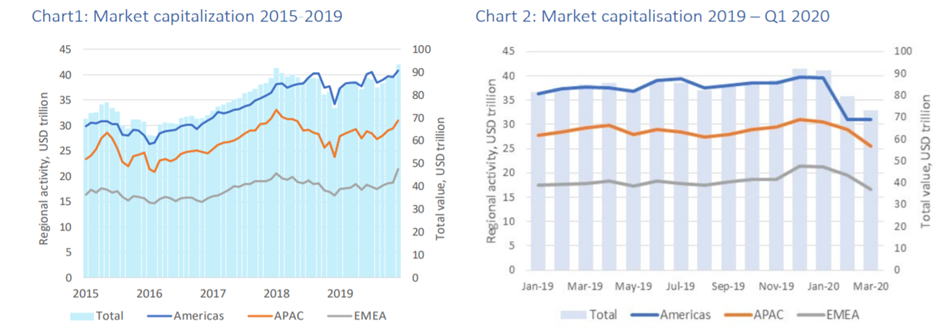
World Market Capitalization
International Financial Markets

Slide 22
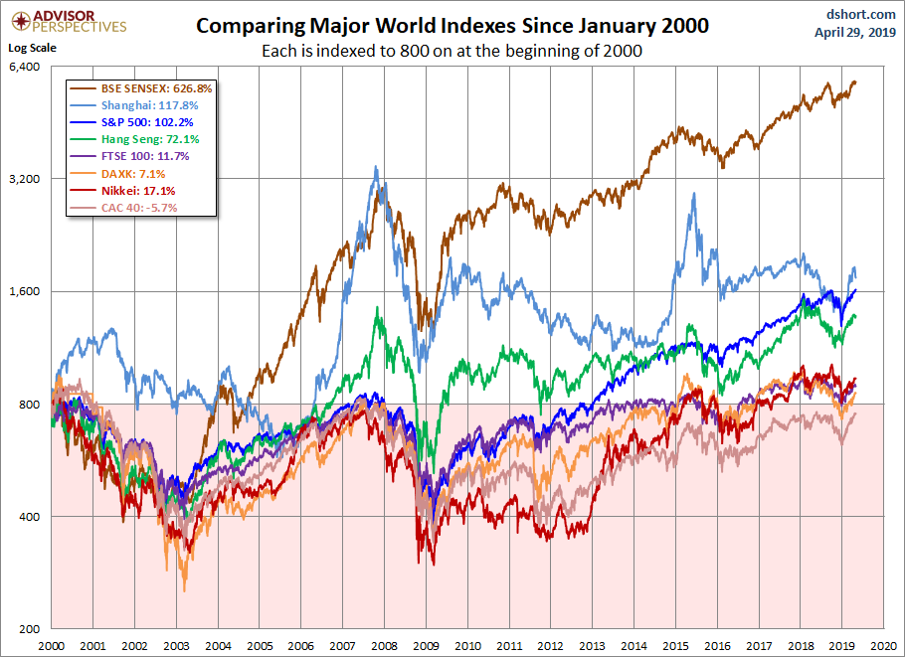
Major World Indexes 2000 – 2020 Comparison
International Financial Markets

Slide 23
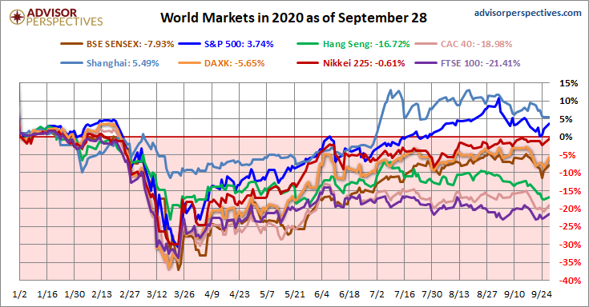
Major World Indexes 2020 Comparison
International Financial Markets

Slide 24
OECD Global GDP Prediction
International Financial Markets

Slide 25
THANK YOU FOR YOUR ATTENTION J

