Slide 1

Foreign Exchange Market and Exchange Rates
Ing. Jana Šimáková, Ph.D.
simakova@opf.slu.cz

Slide 2

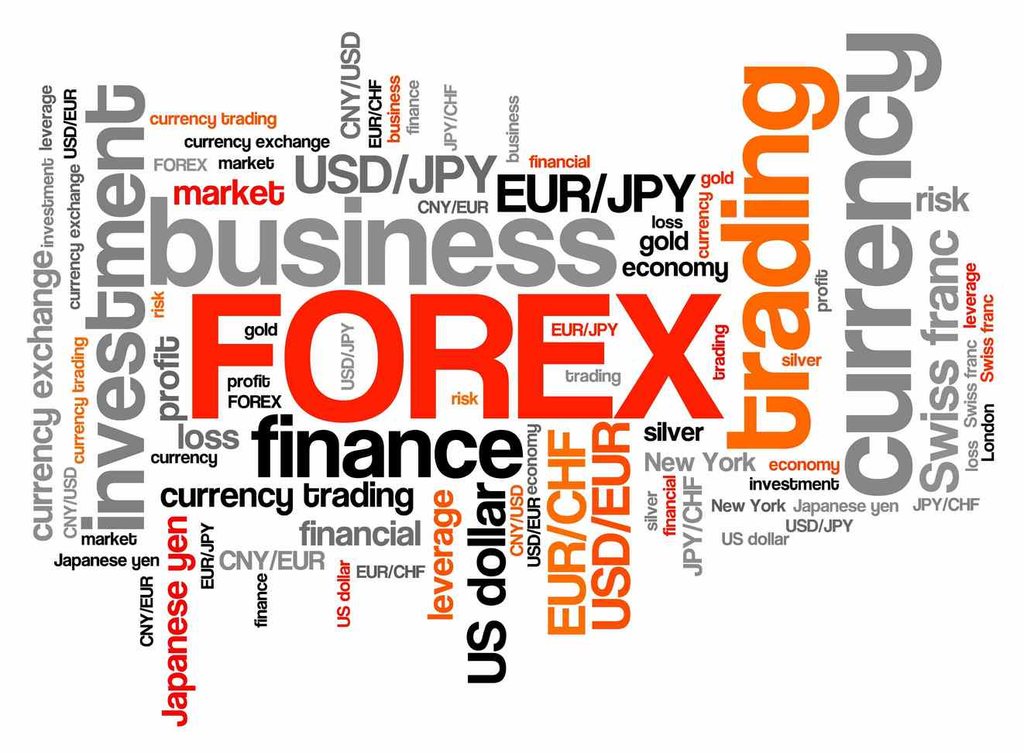
Foreign Exchange Market
Widely used abbreviations: FX market or FOREX
The place where money denominated in one currency is bought and sold with money denominated in another currency
The place where purchasing power in one currency can be converted into purchasing power in another currency
The place where exchange rates of the traded currencies are determined
Foreign Exchange Market and Exchange Rates

Slide 3
Meaning of the Foreign Exchange Market
The largest financial market made up of banks, commercial companies, central banks, investment management firms, hedge funds, and retail brokers and investors
Foreign exchange means the money of a foreign country; that is, foreign currency bank balances, banknotes, checks and drafts
A foreign exchange transaction is an agreement between a buyer and a seller that a fixed amount of one currency will be delivered for some other currency at a specified date
Foreign Exchange Market and Exchange Rates

Slide 4
Size, Composition and Location of the FX Market
Market size is USD 6 trillion daily and the U.S. dollar is the most important currency on the foreign exchange market
  Most of trades on the wholesale market
The most commonly traded currency pairs are EUR/USD and USD/JPY
FX market is a global market with no specific location
  Several financial centres where most of trading is done
Trading 24 hours a day
  Market activity first heightens when Europe and Asia are open and again when Europe and the United States are open
  FX market never sleeps…
Foreign Exchange Market and Exchange Rates

Slide 5
Size, Composition and Location of the FX Market
Electronic platforms made foreign currency transactions easier
  Electronic brokerage systems, phone, SWIFT
Market makers are crucial for trading on the FX market
There is no central clearing of FX transaction
Bank of International Settlements (BIS) plays a critical role in managing FX transactions worldwide
Main trading centers: London, New York, Tokyo
Foreign Exchange Market and Exchange Rates

Slide 6
World Map of the FX Market
Amsterdam
Brussels
Hamburg
Dusseldorf
London
Frankfurt
Toronto
Paris
Zurich
Basel
Rome
San
Francisco
Chicago
Madrid
Vienna
New
York
Tokyo
Hong Kong
Mexico
City
Bombay
Singapore
Sydney
Rio de Janiero
São Paulo
Melbourne
Foreign Exchange Market and Exchange Rates

Slide 7
Share of Global FX Market Trading in Main Centres
Foreign Exchange Market and Exchange Rates

Slide 8
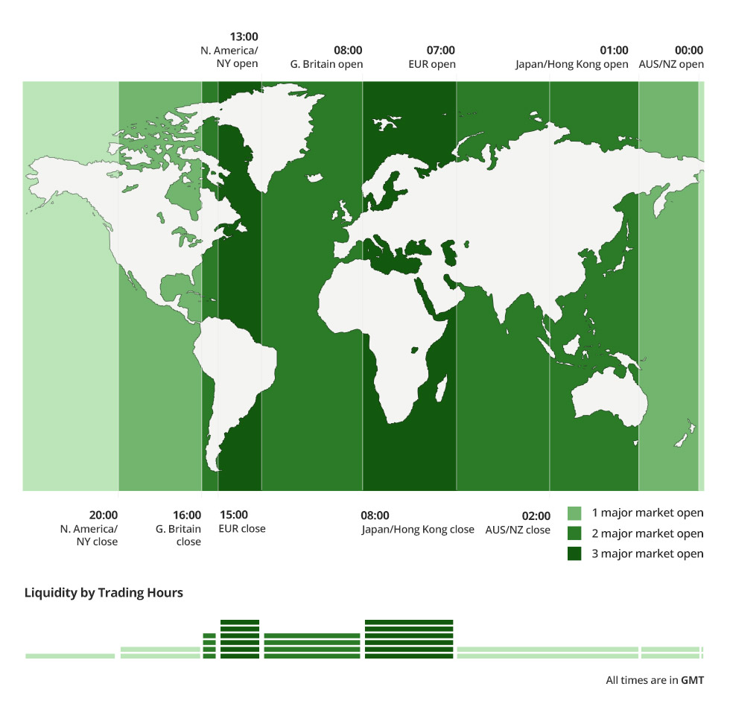
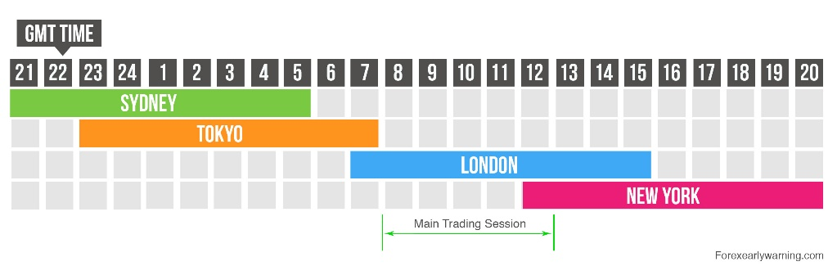
FX Market Never Sleeps…
Foreign Exchange Market and Exchange Rates

Slide 9
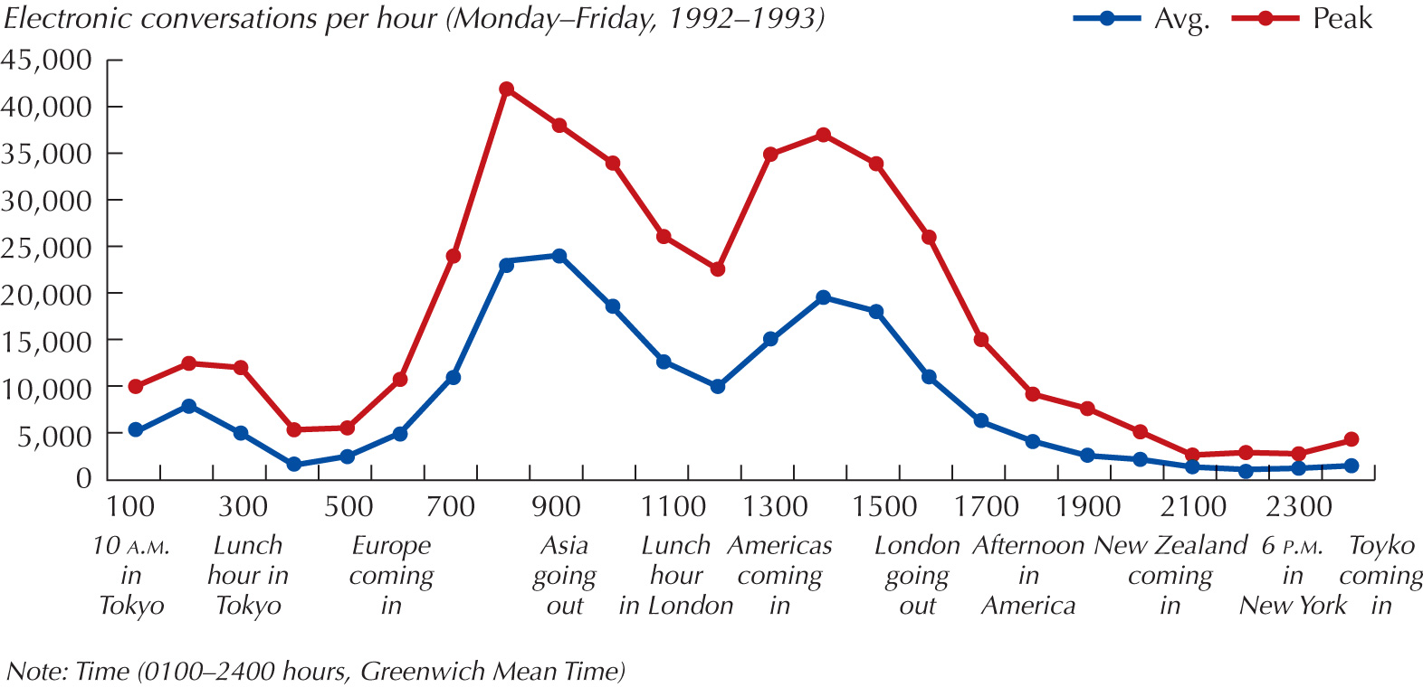
… but it Goes for a Lunch
Foreign Exchange Market and Exchange Rates

Slide 10
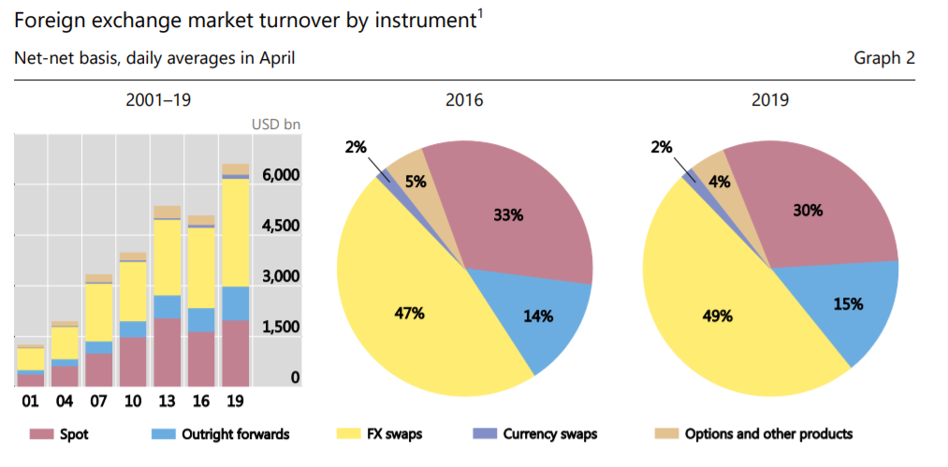
Global FX Market Turnover by Instrument
Foreign Exchange Market and Exchange Rates

Slide 11
Currency Distribution of the FX Market Turnover (in % of transactions)
 | 1998 | 2001 | 2004 | 2007 | 2010 | 2013 | 2016
USD | 87.3 | 90.3 | 88.7 | 85.6 | 84.9 | 87.0 | 87.6
EUR (DEM) | (30.1) | 37.6 | 37.2 | 37.0 | 39.1 | 33.4 | 31.4
JPY | 20.2 | 22.7 | 20.3 | 16.5 | 19.0 | 23.0 | 21.6
GBP | 11.0 | 13.2 | 16.9 | 15.0 | 12.9 | 11.8 | 12.8
AUD | 3.1 | 4.2 | 5.5 | 6.7 | 7.6 | 8.6 | 6.9
CAD | 3.6 | 4.5 | 4.2 | 4.2 | 5.3 | 4.6 | 5.1
CHF | 7.1 | 6.1 | 6.1 | 6.8 | 6.4 | 5.2 | 4.8
CNY | 0.0 | 0.0 | 0.1 | 0.5 | 0.9 | 2.2 | 4.0
CZK | 0.3 | 0.2 | 0.2 | 0.2 | 0.2 | 0.4 | 0.3
Foreign Exchange Market and Exchange Rates

Slide 12
FX Market Turnover by Currency Pair (in % of transactions)
 | 1998 | 2001 | 2004 | 2007 | 2010 | 2013 | 2016
USD/EUR (DEM) | (20) | 30 | 28 | 27 | 28 | 24 | 23
USD/JPY | 18 | 20 | 17 | 13 | 14 | 18 | 18
USD/GBP | 8 | 11 | 14 | 12 | 9 | 9 | 9
USD/AUD | 3 | 4 | 5 | 6 | 6 | 7 | 5
USD/CHF | 5 | 5 | 4 | 5 | 4 | 3 | 4
USD/CAD | 3 | 4 | 4 | 4 | 5 | 4 | 4
USD/CNY |  |  |  |  | 1 | 2 | 4
USD/others | 12 | 17 | 16 | 15 | 11 | 13 | 12
EUR/JPY | --- | 3 | 3 | 3 | 3 | 3 | 2
Foreign Exchange Market and Exchange Rates

Slide 13
Questions and Applications
???Why U.S. Dollar is so widely traded???
Foreign Exchange Market and Exchange Rates

Slide 14
Why U.S. Dollar is so Widely Traded?
Investment currency in many capital markets
Reserve currency held by many central banks
Transaction currency in many international commodity markets
Invoice currency in many contracts
Intervention currency employed by monetary authorities in market operations to influence their own exchange rates
Vehicle currency that expedites transactions between currencies of limited circulation
Foreign Exchange Market and Exchange Rates

Slide 15
FX Market Participants
International banks
  Around 100 large commercial banks dealers worldwide provide the core of the FX market and actively participate
  „Make a market" in FX, trading FX on behalf of bank customers (MNCs, money managers, exporters, importers, private traders)
  Most interbank trades are speculative or arbitrage transaction
Nonbank dealers
  Wholesale currency traders who are NOT commercial banks, e.g. investment banks (Solomon Smith Barney, Merill Lynch, JP Morgan, Goldman Sachs, etc.)
  Establish their own trading centers to trade directly in the FX market, and account for 28% of the interbank (wholesale) volume
Foreign Exchange Market and Exchange Rates

Slide 16
FX Market Participants
FX brokers/dealers
  Brokers/intermediaries who track quotes offered by many dealers in the global market, and then match buyers and sellers for a fee (bid/ask spread), and "make a market," without taking a position themselves (no currency inventory)
  More and more trading (50-70%) now takes place through automated electronic trading systems, making the role of FX brokers unnecessary
Central banks
  If a country has a fixed ex-rate (Argentina until recently, Hong Kong), or a pegged rate (China), the central bank (or currency board) has to make regular interventions to support the fixed/pegged ex-rate
Individuals and firms
  Use the FX market incidentally to their underlying commercial or investment purpose
Foreign Exchange Market and Exchange Rates

Slide 17
Benefits of Banks (dealers) Providing Foreign Exchange
Competitiveness of quote
  Savings related to better exchange rate quotes.
Special relationship with the bank
  Banks may offer cash management services or be willing to make a special effort to obtain even hard-to-find foreign currencies for the corporation.
Speed of execution
  MNC prefer a bank that conducts the transaction promptly and handles any paperwork properly.
Advice about current market conditions
  Banks may provide assessments of foreign economies and relevant activities in the international financial environment that relate to corporate customers.
Forecasting advice
  Banks may provide forecasts of the future state of foreign economies and the future value of exchange rates.
Foreign Exchange Market and Exchange Rates

Slide 18
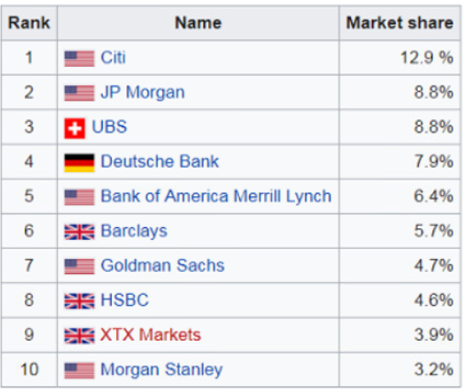
Top 10 Forex Traders in 2019
Foreign Exchange Market and Exchange Rates

Slide 19
Purposes of Trading on the FX Market
Hedging
  Operations to minimize foreign exchange risk
Arbitrage
  Non-risk operations to exploit differences in exchange rates
  Triangular arbitrage, covered interest rate arbitrage
Speculation
  Risky operations to bet on particular exchange rate development
  Leverage trading
  Carry trade, short selling
Investment
  Operations to invest in currencies as a class of assets
Foreign Exchange Market and Exchange Rates

Slide 20
Exchange Rate
A foreign exchange rate is the price of one currency expressed in terms of another currency
A foreign exchange quotation (or quote) is a statement of willingness to buy or sell at an announced rate
Each currency pair has a double exchange rate (to buy, to sell)
Most foreign currencies in the world are stated in terms of the number of units of foreign currency needed to buy one dollar
  Several exceptions exist, e.g. Euro, British pound, Australian dollar
Foreign Exchange Market and Exchange Rates

Slide 21
Basic Types of Exchange Rates
Nominal exchange rate vs. Real exchange rate
  While the nominal exchange rate expresses the relative price of currencies the real exchange rate incorporates relative price levels and tells about purchasing power of currencies
Bilateral exchange rate vs. Effective exchange rate
  While the bilateral exchange rate refers to the relative price of two currencies the effective exchange rates show the currency value against a basket of currencies
Nominal bilateral exchange rate
Real bilateral exchange rate
Nominal effective exchange rate
Real effective exchange rate
Foreign Exchange Market and Exchange Rates

Slide 22
Nominal Bilateral Exchange Rate
The most common type of exchange rate
Exchange rate at which the currency of one country can be swapped for that of another country
Most frequently quoted as price of one foreign currency unit in units of domestic currency
Important for international trade, price comparisons, clearing of international transactions
Change of the exchange rate
Foreign Exchange Market and Exchange Rates

Slide 23
Real Bilateral Exchange Rate
Nominal bilateral exchange rate multiplied by the ratio of price levels in foreign and domestic country
Information about purchasing power of the currency
Price of currency expressed in goods
Measured and reported as index
  Ratio of prices of foreign and domestic goods expressed in domestic currency units
Increase of the index means real depreciation of the home currency
Foreign Exchange Market and Exchange Rates

Slide 24
Nominal Effective Exchange Rate (NEER)
Any currency may rise against one currency but depreciate against another over any particular period – what is the total change?
Nominal effective exchange rate measures development of domestic currency against basket of the most important foreign currencies
Each currency included has its own weight according to its significance for foreign trade and investment in the particular country
Expressed in index for since many currencies included in the basket
    n is number of currencies in the basket
    s_{i} is exchange rate of the national currency against the currency of the country i
    s*_{i} is exchange rate of the national currency against the currency of the country i during the base period
    w_{i} is country’s weight (of the currency)
Foreign Exchange Market and Exchange Rates

Slide 25
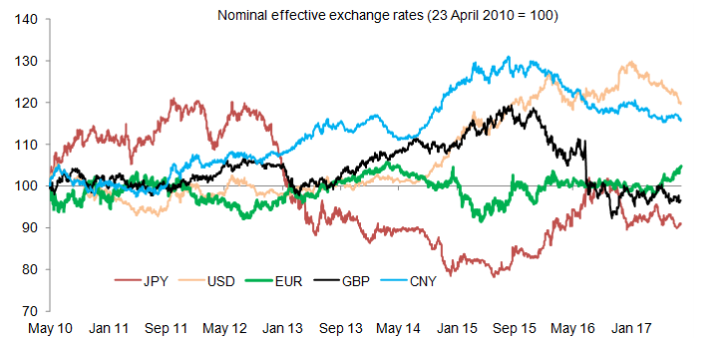
NEER in Leading Economic Centers
appreciation
depreciation
Foreign Exchange Market and Exchange Rates

Slide 26
Real Effective Exchange Rate (REER)
Real effective exchange rate is a weighted average of a country's currency against a basket of other major currencies adjusted to the effects of inflation
Widely used indicator of international competitiveness of the country
  Real appreciation (depreciation) means loosing (gaining) the competitiveness
Reported as index in several versions differing in number of currencies included in the basket
    n is number of currencies in the basket
    s_{i} is exchange rate of the national currency against the currency of the country i
    s*_{i} is exchange rate of the national currency against the currency of the country i during the base period
    w_{i} is country’s weight (of the currency)
    p_{i} is inflation rate in country i
    p is inflation in the home country
Foreign Exchange Market and Exchange Rates

Slide 27
Two-Way Quotation of Exchange Rates
Exchange rates are given as a bid and ask (also referred to as offer)
Bid exchange rate
  Price (i.e. exchange rate) in one currency at which a dealer will buy another currency
Ask exchange rate
  Price (i.e. exchange rate) at which a dealer will sell the other currency
Spread
  The difference between bid and ask rates
Dealers bid (buy) at one price and ask (sell) at a slightly higher price, making their profit from the spread between the buying and selling prices
A bid for one currency is also the offer for the opposite currency
Foreign Exchange Market and Exchange Rates

Slide 28
Two-way Quotation of Exchange Rates
Trader buys
Client sells
Bid exchange rate
Ask exchange rate
Trader sells
Client buys
EUR / USD
1.1741 / 1.1743
Spread = Ask – Bid = 1.1743 – 1.1741 = 0.0002 (2 pips)
Spread (%) = (Ask – Bid) / (Ask) = 0.0002 / 1.1743 = 0.017 %
Middle rate = (Bid + Ask) / 2 = (1.1741 + 1.1743) / 2 = 1.1742 EUR/USD
Foreign Exchange Market and Exchange Rates

Slide 29
Questions and Applications
The currency trader's quotation of the USD/EUR exchange rate for the client has the following form: 1.3442/70 (bid/ask). At what cost, you as his client, will you buy EUR expressed in USD?
Foreign Exchange Market and Exchange Rates

Slide 30
Questions and Applications
The currency trader's quotation of the USD/EUR exchange rate for the client has the following form: 1.3442/70 (bid/ask). At what cost, you as his client, will you buy EUR expressed in USD?
Ask is 1.3470 USD/EUR.
You will by 1 EUR for the 1.3470 USD.
Foreign Exchange Market and Exchange Rates

Slide 31
Questions and Applications
The bank is quoting the following DKK bid and ask exchange rate. Calculate the bid and ask exchange rate for USD (four decimal places).
 | Bid | Ask
USD/DKK | 0.1705 | 0.1782
Foreign Exchange Market and Exchange Rates

Slide 32
Questions and Applications
The bank is quoting the following DKK bid and ask exchange rate. Calculate the bid and ask exchange rate for USD (four decimal places).
 | Bid | Ask
USD/DKK | 0.1705 | 0.1782
BID _{DKK/USD}=1/ASK_{USD/DKK}=1/0,1782=5.6117
ASK_{DKK/USD}=1/BID_{USD/DKK=}1/0,1705=5.8651
Bid has to be lower than Ask!!!
Foreign Exchange Market and Exchange Rates

Slide 33
Questions and Applications
Bank's dealer is quoting the following US dollar exchange rates. Calculate the middle rate and the spread in absolute and percentage terms.
CHF/USD 0.9538 0.9582
Foreign Exchange Market and Exchange Rates

Slide 34
Questions and Applications
Bank's dealer is quoting the following US dollar exchange rates. Calculate the middle rate and the spread in absolute and percentage terms.
Bid Ask
CHF/USD 0.9538 0.9582
Spread = Ask – Bid = 0.9582 – 0.9538 = 0.0044 (44 pips)
Spread (%) = (Ask – Bid) / (Ask) = 0.0044 / 0.9582 = 0.459 %
Middle rate = (Bid + Ask) / 2 = (0.9538 + 0.9582) / 2 = 0.956 CHF/USD
Foreign Exchange Market and Exchange Rates

Slide 35
Direct vs. Indirect Quotation
Direct quote gives the home currency price of one unit of foreign currency
  For example 26.10 Czech korunas for 1 euro written as 26.10 CZK/EUR (European convention) or EUR/CZK 26.10 (American convention)
Indirect quote tells how many units of foreign currency can be purchased by one unit of domestic currency
  For example 0.0383 euros for 1 Czech koruna written as 0.0383 EUR/CZK (European convention) or CZK/EUR 0.0383 (American convention)
Direct quote is the reciprocal of the indirect quote
In this pair of definitions, the home or base country of the currencies being discussed is critical
The form of the quote depends on what the speaker regard as “home”
Foreign Exchange Market and Exchange Rates

Slide 36
Interpretation of Changes in Exchange Rates
Depreciation of home currency
  Value of home currency falls relative to the foreign currency
  Using direct quotation, depreciation of home currency means increase of the exchange rate !!!, e.g. change from 26.10 CZK/EUR to 27.00 CZK/EUR
Appreciation of home currency
  Value of home currency raises relative to the foreign currency
  Using direct quotation, appreciation of home currency means decrease of the exchange rate !!!, e.g. change from 27.10 CZK/EUR to 26.20 CZK/EUR
It is better to speak about value of currency than change of the exchange rate when using direct quotes
Foreign Exchange Market and Exchange Rates

Slide 37
Questions and Applications
The exchange rate of the euro (EUR) in the basic and current periods is specified as follows. Calculate the exchange rate of the Czech koruna (CZK) in both periods and the percentage change in the foreign exchange rate in both cases. Determine which currency has been appreciated and which has been depreciated.
E₀ = 24.20 CZK/EUR
E₁ = 26.70 CZK/EUR
Foreign Exchange Market and Exchange Rates

Slide 38
Questions and Applications
The exchange rate of the euro (EUR) in the basic and current periods is specified as follows. Calculate the exchange rate of the Czech koruna (CZK) in both periods and the percentage change in the foreign exchange rate in both cases. Determine which currency has been appreciated and which has been depreciated.
EUR:
E₀ = 24.20 CZK/EUR ΔE = (26.7 – 24.2) / 24.2 = 10.33 %
E₁ = 26.70 CZK/EUR Euro appreciated against CZK in 10.33 %.
CZK:
E₀= 1/24.20 = 0.04132 EUR/CZK ΔE =(0.03745 – 0.04132) / 0.04132 = -9.37 %
E₁= 1/26.70 = 0.03745 EUR/CZK CZK depreciated against EUR in -9.37 %.
Foreign Exchange Market and Exchange Rates

Slide 39
Main Instruments on the FX Market
Spot transactions
  Purchase of foreign exchange, with delivery and payment between banks to take place, normally, on the second following business day
  The date of settlement is referred to as the value date
Forward transactions (outright forward)
  Requires delivery at a future value date of a specified amount of one currency for a specified amount of another currency
  The exchange rate is established at the time of the agreement, but payment and delivery are not required until maturity (several standard maturity dates)
Swap transactions
  Simultaneous purchase and sale of a given amount of foreign exchange for two different value dates with the same counterparty
Foreign Exchange Market and Exchange Rates

Slide 40
Spot FX Trading
The simplest FX instrument for immediate exchange of funds and execution
Pricing on the spot market is by the actual demand and supply of the currency in the market
Spot exchange rate movements are highly impredictable even during a single trading day
  Relying solely on spot trading may be risky
Standard size of one trade is about USD 10 mil.
Trading is very fast and hectic, the stakes are high
Trading jargon widely used among traders to make communication as short and efficient as possible
Foreign Exchange Market and Exchange Rates

Slide 41
Forward FX Contracts
Contract settled today for future delivery/receipt of foreign exchange
Agree today on price (forward exchange rate) and quantity (size of the trade) and settlement at fixed future date
  Most typical are 30-day, 60-day, 90-day, 180-day, 360-day deliveries
Forward rates are typically quoted in terms of points
  It is not a foreign exchange rate as such
  Rather, it is the difference between the forward rate and the spot rate
Forward rate – spot rate = swap exchange rate
  Forward > spot : currency is trading at forward premium (is more expensive in future)
  Forward < spot : currency is trading at forward discount (is cheaper in future)
Foreign Exchange Market and Exchange Rates

Slide 42
Quotation of the Forward Exchange Rate
Add the premium to the spot rate
  If the bid-ask combination in swap rate is smaller-bigger number
Deduct the discount from the spot rate
  If the bid-ask combination in swap rate is bigger-smaller number
Foreign Exchange Market and Exchange Rates

Slide 43
Forward Premium / Discount
The forward premium or discount is the difference between the forward exchange rate and the spot exchange rate, expressed as a percentage of the spot rate
It is a standard to present the premium or discount annualized
  F_{n} = forward exchange rate
  S = spot exchange rate
  n = number of days in the forward contract (delivery period)
Foreign Exchange Market and Exchange Rates

Slide 44
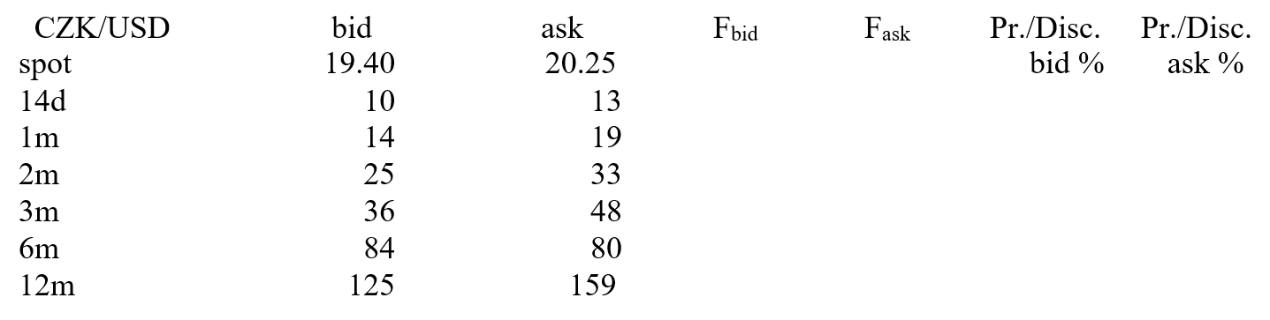
Questions and Applications
Calculate forward exchange rates for all maturity if you know the spot exchange rate and the quoted swaps. Calculate also the percentage annualised premium or USD discount.
Foreign Exchange Market and Exchange Rates

Slide 45
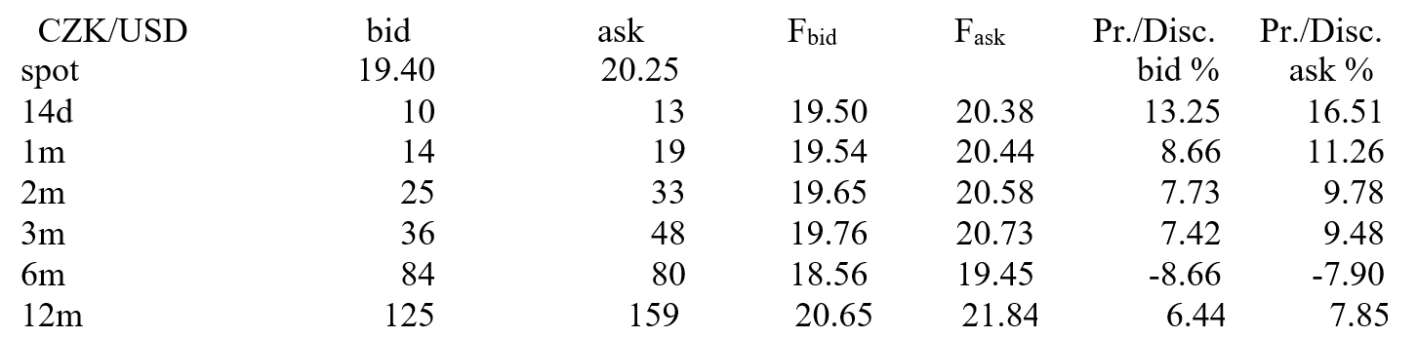
Questions and Applications
Calculate forward exchange rates for all maturity if you know the spot exchange rate and the quoted swaps. Calculate also the percentage annualised premium or USD discount.
<
<
<
<
>
<
Foreign Exchange Market and Exchange Rates

Slide 46
THANK YOU FOR YOUR ATTENTION
J

