Slide 1
Long-Term International Asset and Liability Management
Ing. Jana Šimáková, Ph.D.
simakova@opf.slu.cz
Notes:
Butler: Multinational Finance, 3rd ed. Chapters 15 + 16

Slide 2
Multinational Capital Budgeting
Like domestic capital budgeting, this focuses on the cash inflows and outflows associated with prospective long-term investment projects
Capital budgeting follows same framework as domestic budgeting
Identify initial capital invested or put at risk
Estimate the future cash flows generated by the project, including the terminal value or salvage value of the investment
Identify appropriate discount rate for NPV calculation
Apply traditional capital budgeting decision criteria such as NPV and IRR to determine the acceptability or ranking of potential projects
Long-Term International Asset and Liability Management

Slide 3
Complexities of Budgeting for a Foreign Project (1)
Several factors make budgeting for a foreign project more complex
Parent cash flows must be distinguished from project
Parent cash flows often depend on the form of financing, thus cannot clearly separate cash flows from financing – this changes the meaning of NPV
Additional cash flows from new investment may in part or in whole take away from another subsidiary; thus as a stand alone a project may provide cash flows but overall may add no value to the entire organization
Long-Term International Asset and Liability Management

Slide 4
Complexities of Budgeting for a Foreign Project (2)
Parent must recognize remittances from foreign investment because of differing tax systems, legal and political constraints
Non-financial payments can generate cash flows to parent in the form of licensing fees, royalty payments, etc. – relevant for parent’s perspective
Managers must anticipate differing rates of national inflation which can affect cash flows
Use of segmented national capital markets may create opportunity for financial gains or additional costs
Long-Term International Asset and Liability Management

Slide 5
Complexities of Budgeting for a Foreign Project (3)
Use of host government subsidies complicates capital structure and parent’s ability to determine appropriate WACC
Managers must evaluate political risk
Terminal value is more difficult to estimate because potential purchasers have widely divergent views
Long-Term International Asset and Liability Management

Slide 6
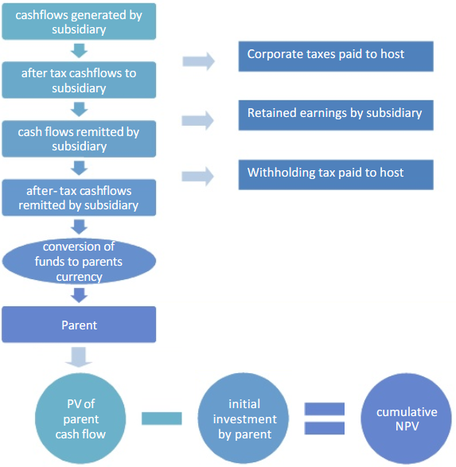
Scheme of Multinational Capital Budgeting
Long-Term International Asset and Liability Management

Slide 7
Input for Multinational Capital Budgeting
The following forecasts are usually required
Initial capital investment
Consumer demand over time
Product price over time
Fixed and variable cost over time
Project lifetime
Salvage (liquidation) value
Restrictions on fund transfers
Tax payments and credits
Exchange rate forecasts
Required rate of return
Long-Term International Asset and Liability Management

Slide 8
Project versus Parent Valuation
Strong arguments exist in favor of analyzing any foreign project from the viewpoint of the parent
Since most of the project’s cash flows to the parent are financing cash flows, this violates the capital budgeting concept that financing cash flows should not be mixed with operating cash flows
The evaluation of a foreign project from the project viewpoint is useful in determining its competitiveness compared to local firms
Multinationals should invest only if they can earn a risk-adjusted return greater than that of local competitors, otherwise investors are better off investing in the local firms
Long-Term International Asset and Liability Management

Slide 9
Project versus Parent Valuation
Most firms evaluate foreign projects from both parent and project viewpoints
The parent’s viewpoint analyzes investment’s cash flows as operating cash flows instead of financing due to remittance of royalty or licensing fees and interest payments
Funds that are permanently blocked from repatriation are excluded
The parent’s viewpoint gives results closer to traditional NPV capital budgeting analysis
Project valuation provides closer approximation of effect on consolidated EPS
Long-Term International Asset and Liability Management

Slide 10
Project versus Parent Valuation
START
Parent Firm
(Germany)
EUR invested in overseas
Foreign Investment
(Czechia)
Particular investment
END
Is the project investment
justified (NPV > 0)?
Estimated cash
flows of project
Parent Viewpoint
Capital Budget
(EUR)
Cash flows remitted
Project Viewpoint
Capital Budget
(CZK)
to Parent (CZK to EUR)
Long-Term International Asset and Liability Management

Slide 11
Foreign Currency Cash Flows
Foreign projects generate foreign currency cash flows that must be approprimately taken into account in cross-border capital budgeting
Recipe 1
Discount in the foreign currency and convert the foreign currency NPV to a domestic currency value at the spot exchange rate
Recipe 2
Convert foreign cash flows into the domestic currency at expected future spot rates and then discount in the domestic currency
Long-Term International Asset and Liability Management

Slide 12
Valuation when the Intl. Parity Conditions do not Hold
The project’s (local) perspective
Let NPV(i^{f}) represent the value of a foreign project when discounted in the foreign currency
The parent’s (domestic) perspective
Let NPV(i^{d}) represent the value of a foreign project when discounted in the domestic currency
These two NPVs may not be equal when the international parity conditions do not hold
NPV(i^{f}) > 0: The project has value from the perspective of a foreign investor (that is, relative to local financial market alternatives)
NPV(i^{d}) > 0: The project has value from the perspective of the parent
Long-Term International Asset and Liability Management

Slide 13
Valuation when the Intl. Parity Conditions do not Hold
Parent’s perspective
NPV(i^{d}) < 0
NPV(i^{d}) > 0
Reject
Look for better projects in the
foreign currency
NPV(i^{f}) < 0
Project’s perspective
Try to lock in
the time 0 value of the project
NPV(i^{f}) > 0
Long-Term International Asset and Liability Management

Slide 14
Alternatives for Capturing the time t=0 Value of a Project
In the asset markets
Sell the project to a local investor
Bring in a joint venture partner from the local market
In the financial markets
Hedge the cash flows from the project against currency risk
Finance the project with local currency debt or equity
Long-Term International Asset and Liability Management

Slide 15
Structuring the Deal
Parent’s perspective
NPV(i^{d}) < 0
NPV(i^{d}) > 0
Reject
Look for better projects in the
foreign currency
NPV(i^{f}) < 0
Project’s perspective
Try to lock in
the time 0 value of the project
Accept, then structure the deal
NPV(i^{f}) > 0
Long-Term International Asset and Liability Management

Slide 16
Comparison of NPVs
NPV(i^{f}) > NPV(i^{d}) > 0
The project has more value locally than it does from the parent’s perspective
You should hedge
Hedging provides the parent with higher expected value and lower exposure to currency risk
NPV(i^{d}) > NPV(i^{f}) > 0
The project has more value from the parent’s perspective than it does to local investors
Whether you hedge will depend on the firm’s hedging policy
Hedging the project cash flows lowers currency exposure risk but also lowers the expected NPV of the project
Long-Term International Asset and Liability Management

Slide 17
Capital Structure
The proportion of long-term debt and equity capital and the particular forms of capital chosen to finance the assets of the firm
Management must choose
The proportions of debt and equity
The currency of denomination
Fixed or floating rate interest payments
Indenture provisions
Conversion features
Callability
Seniority
Maturity
Long-Term International Asset and Liability Management

Slide 18
Project Valuation and Cost of Capital
Approaches to project valuation
WACC = Weighted average cost of capital
APV = Adjusted present value
Use an asset-specific discount rate
Nominal (real) cash flows should be discounted at nominal (real) discount rate
Domestic (foreign) currency cash flows should be discounted at a domestic (foreign) discount rate
Long-Term International Asset and Liability Management

Slide 19
Questions and Applications
As a financial manager of the company with exceeded liquidity, you have two investment opportunities. Their characteristics are as follows:
Project A: The initial investment is EUR 80 000, the projected annual net cash flow for 3 years is EUR 30 000, the residual value of the project after three years is EUR 0.
Project B: The initial investment is EUR 80 000, the projected annual net cash flow is 1st Year EUR 23 000; 2nd Year EUR 30 000; 3rd Year EUR 37 100, the residual value after three years is EUR 0.
Which investment do you prefer at the required fixed rate of return 2.6% p. a.? Why?
Long-Term International Asset and Liability Management

Slide 20
Questions and Applications (1)
$$NPV=−I+\sum_{t=1}^{n}{\frac{{CF}_{t}}{{\left(1+k\right)}^{t}}}+\frac{{RV}_{n}}{{\left(1+k\right)}^{n}}$$
$${NPV}_{A}=−80000 EUR+\frac{30000 EUR}{{\left(1+0.026\right)}^{1}}+ \frac{30000 EUR}{{\left(1+0.026\right)}^{2}}+\frac{30000 EUR}{{\left(1+0.026\right)}^{3}}+ \frac{0 EUR}{{\left(1+0.026\right)}^{3}}$$
$${NPV}_{A}= 5 515.17 EUR$$
Long-Term International Asset and Liability Management

Slide 21
Questions and Applications (2)
$$NPV=−I+\sum_{t=1}^{n}{\frac{{CF}_{t}}{{\left(1+k\right)}^{t}}}+\frac{{RV}_{n}}{{\left(1+k\right)}^{n}}$$
$${NPV}_{B}=−80000 EUR+\frac{23000 EUR}{{\left(1+0.026\right)}^{1}}+ \frac{30000 EUR}{{\left(1+0.026\right)}^{2}}+ \frac{37100 EUR}{{\left(1+0.026\right)}^{3}}+ \frac{0 EUR}{{\left(1+0.026\right)}^{3}}$$
$${NPV}_{B}= 5 266.35 EUR$$
Based on the net present value of the project, it is evident that the realization of an investment A is preferable. (NPV_{A}>NPV_{B})
Long-Term International Asset and Liability Management

Slide 22
Corporate Governance
Corporate governance is the structure of rules, practices, and processes used to direct and manage a company.
A company's board of directors is the primary force influencing corporate governance.
Bad corporate governance can cast doubt on a company's reliability, integrity, and transparency, which can impact its financial health.
Long-Term International Asset and Liability Management

Slide 23
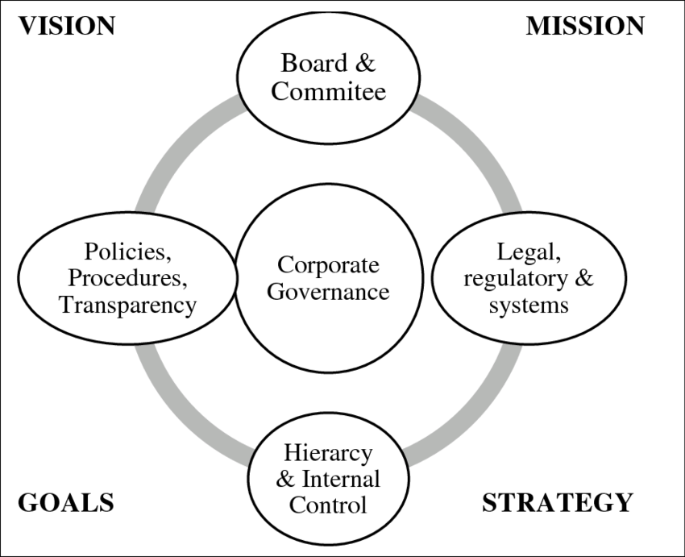
Corporate Governance Position
Long-Term International Asset and Liability Management

Slide 24
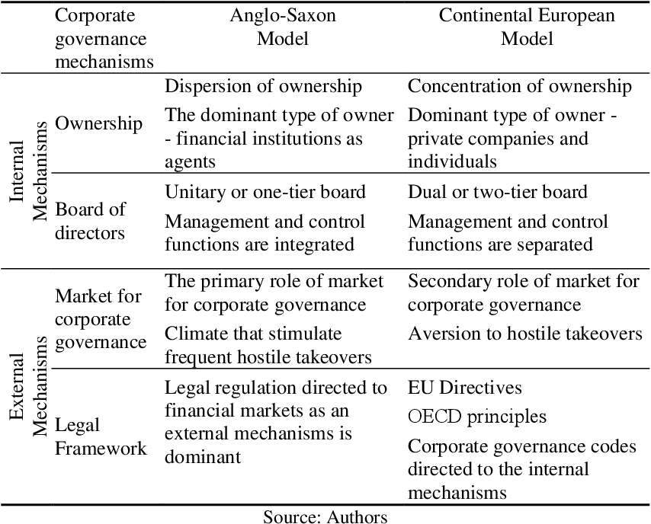
Corporate Governance
Anglo-Saxon vs. Continental European Model
Long-Term International Asset and Liability Management

Slide 25
THANK YOU FOR YOUR ATTENTION J

