Slide 1

International Investments
Ing. Jana Šimáková, Ph.D.
simakova@opf.slu.cz

Slide 2

Principal Categories of International Investment (BoP approach)
Commercial loans
  Primarily take the form of bank loans issued to foreign businesses or governments
Official flows
  Generally refer to the forms of development assistance that developed nations give to developing ones
Foreign direct investment
  International investment in which the investor obtains a lasting interest in an enterprise in another country
Foreign portfolio investment
  Investment more easily traded, may be less permanent, and do not represent a controlling stake in an enterprise
International Investments

Slide 3
Definition of Foreign Direct Investment
Foreign direct investment (FDI) occurs when a firm invests directly in new facilities to produce and/or market in a foreign country
FDI is investment in which the investor obtains a lasting interest in an enterprise in another country
Technically, the threshold for FDI is ownership of “10 percent or more of the ordinary shares or voting power” of a business entity (according to IMF)
Once a firm undertakes FDI it becomes a multinational enterprise
FDI includes all kinds of capital contributions, such as the purchases of stocks, as well as the reinvestment of earnings by a wholly owned company incorporated abroad and the lending of funds to a foreign subsidiary or branch
International Investments

Slide 4
Questions and Applications
Hungry Dragon Toys, a Chinese company, is sitting on a lot of cash. The company’s board of directors decides to take some of that money and purchase Cooperative Chemical, a plastics company in New Jersey. Hungry Dragon, a foreign investor, now owns a U.S. subsidiary company. Hungry Dragon’s ownership of Cooperative Chemical is substantial and more likely to be long term. Hungry Dragon is unlikely to sell if the U.S. economy faces a temporary downturn.
Hence, we consider this investment as FDI. FDI is considered as relatively stable form of international investment.
International Investments

Slide 5
Definition of Portfolio Investment
Cross-border transactions and positions involving equity or debt securities, other than those included in direct investment or reserve assets
The characteristic feature of portfolio investment is their negotiability
  Their legal ownership is readily transferable from one unit to another unit Negotiable instruments are designed to be traded on organized markets
Can be bought and sold, which makes them an efficient, flexible way of raising and investing money
Comes from many diverse sources such as a small company’s pension or through mutual funds held by individuals
Factors affecting portfolio investments
  Tax rates on interest or dividends; interest rates; exchange rates
International Investments

Slide 6
Questions and Applications
John Yamashita, a Japanese citizen, purchases one hundred shares of stock in General Motors (GM). John now owns part of a U.S. corporation, the shares of which are part of his personal investment portfolio. John is eligible to receive dividend payments from GM, participate in shareholder decisions, or sell the stock for a profit/loss. John’s share of GM is very minor, and his chief concern is not the long-term profitability of the company but the short-term value of his stock. He might therefore sell his share quickly if the share price goes up or down significantly.
Hence, we consider this investment as portfolio investment. Portfolio investment is usually more volatile than FDI.
International Investments

Slide 7
Questions and Applications
??? What are the principal differences between foreign direct investments and portfolio investments???
International Investments

Slide 8
Distinction between Direct and Portfolio Investment
Foreign direct investment | Foreign portfolio investment
Long-term investment | Generally short-term investment
Investment in physical assets | Investment in financial assets
Aim is to increase enterprise capacity or productivity or change management control | Aim is to increase capital availability
Leads to technology transfer, access to markets and management inputs | Results in only capital inflows
Flows into the primary market | Flows into the secondary market
Does not tend to be speculative | Tends to be speculative
Direct impact on employment and wages | No direct impact on employment and wages
Abiding interest in management | Fleeting interest in management
International Investments

Slide 9
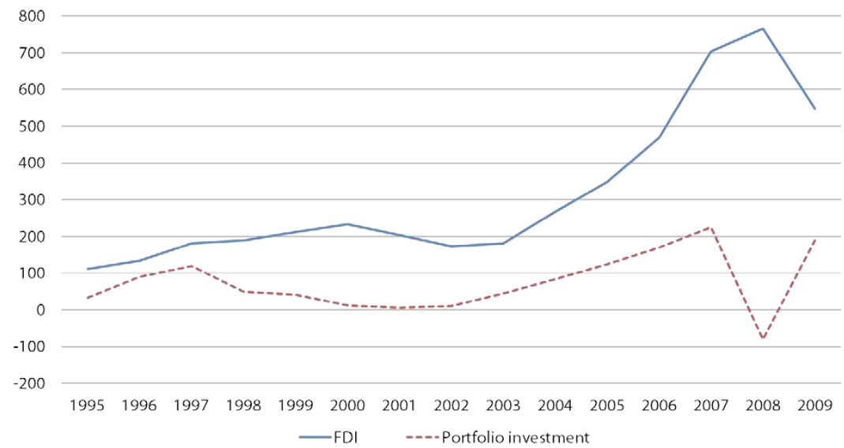
Composition of Private Capital Flows (bil. USD)
International Investments

Slide 10
Forms of Foreign Direct Investment
Acquisition of existing company
  Purchase an existing company in the foreign country (brownfield investment)
  Can be done through privatization, sell of to competitor, or merger
  E.g. Starbucks purchases an existing UK firm “British Coffee” and sells coffee/tea/desserts under the name “Starbucks”
Establishment of new company
  Usually in the form of greenfield investment
  Set up a new company “from the ground up” in the foreign country
  E.g. Hyundai invests money in Czechia and builds a new plant to produce cars
International Investments

Slide 11
Forms of Foreign Direct Investment
Subsidiary
  Company in the foreign country is entirely controlled/owned by one single company
  Full competencies and decision power
  Usually slightly different name than maternal company
  Independent book-keeping, profit taxed in host country
Branch
  Organizational unit in the maternal company‘s structure
  Limited competencies and decision power
  Similar name like maternal company
  Unified book-keeping with maternal company, profit taxed in home country
International Investments

Slide 12
Forms of Foreign Direct Investment
Joint venture
  Occurs when two or more companies together form a new company in the host country
  Each of the participants is responsible for profits, losses and costs associated with it
  The venture is its own entity, separate and apart from the participants' other business interests
  In the international context, usually occurs when one (or more) foreign company and one (or more) local company join to form a new company
International Investments

Slide 13
Motives for Foreign Direct Investments
Revenue-related motives
  Attract new sources of demand
  Enter profitable markets
  Exploit monopolistic advantages
  React to trade restrictions
  Diversify internationally
Cost-related motives
  Fully benefit from economies of scale
  Use foreign factors of production
  Use foreign raw materials
  Use foreign technology
  React to exchange rate movements
Selfish managerial motives
International Investments

Slide 14
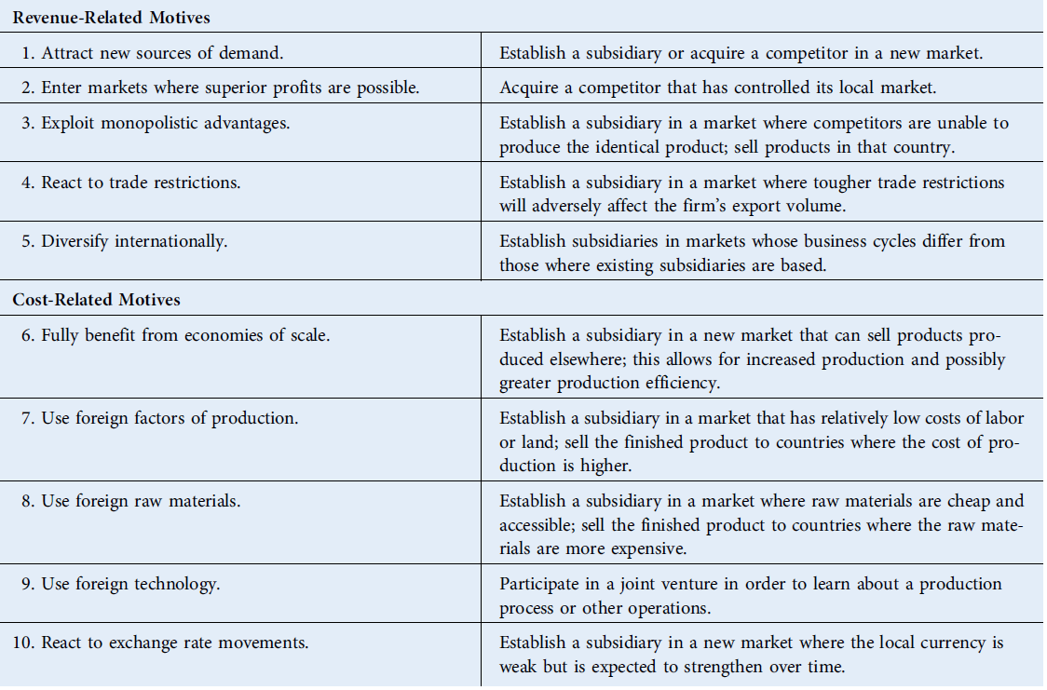
Possible means of Using FDI to Achieve Benefits
International Investments

Slide 15
Questions and Applications
??? How MNC make decision about industry where to realize the foreign direct investment???
International Investments

Slide 16
Horizontal Foreign Direct Investment
Investment in the “same” industry as a firm operates in at home
Reasons for horizontal FDI
  Transportation costs
  Market imperfections
    Impediments to exporting
    Impediments to sale of know-how
  Strategic behavior
  Product life cycle
  Location specific advantages
International Investments

Slide 17
Vertical Foreign Direct Investment
Investment in a downstream supplier (backward) or upstream purchaser (forward) as compared to the business that the firm operates in its home country
  Backward investment is more common than forward
Reasons for vertical foreign direct investment
  Strategic behavior
  Market imperfections
    Impediments to know-how
    Investments in specialized assets
International Investments

Slide 18
Conglomerate Foreign Direct Investment
Investment in a business that is unrelated to existing company‘s business
  Since it involves entering an inustry in which investor has n previous experience, it often takes form of a joint venture with a company already operating in the industry.
Reasons for foreign direct investments
  Diversification
  Strategic behaviour
International Investments

Slide 19
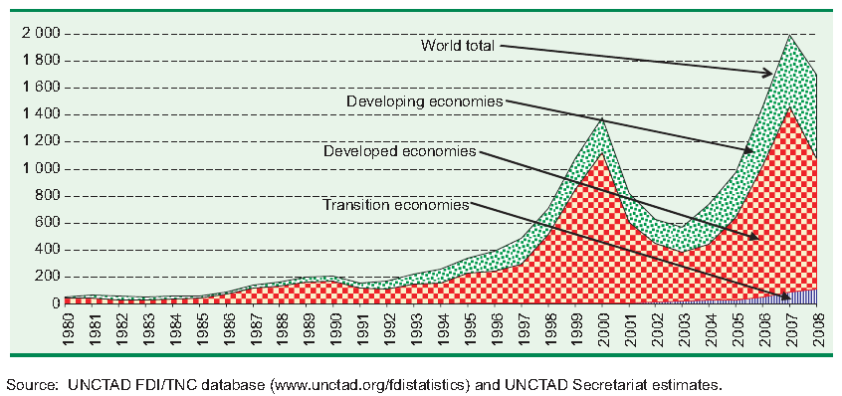
Foreign Direct Investment Inflows 1980-2008 (bil. USD)
International Investments

Slide 20
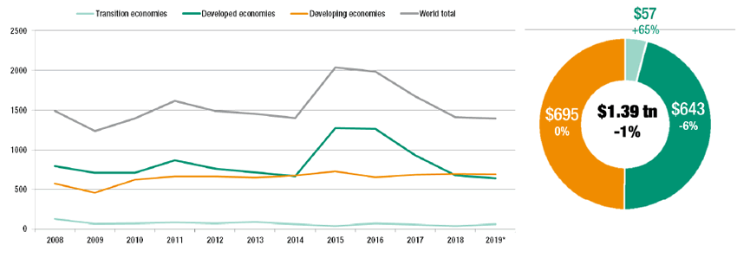
Foreign Direct Investment Inflows 2008-2019 (bil. USD)
International Investments

Slide 21
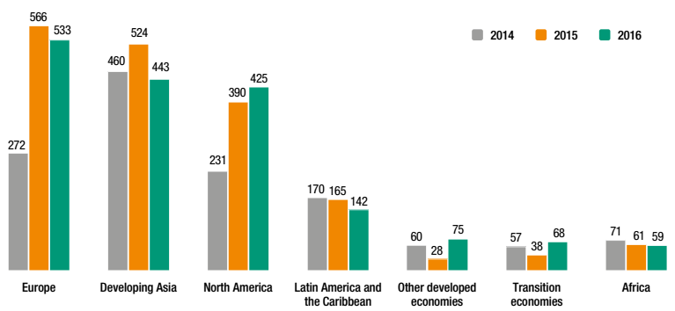
FDI Inflows by Region 2014-2016 (bil. USD)
International Investments

Slide 22
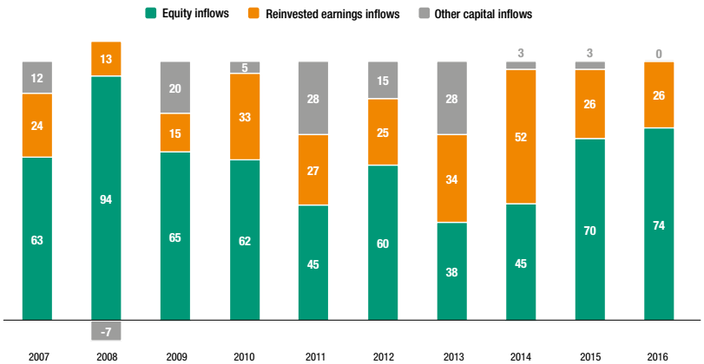
FDI Inflows by Component 2007-2016 (in %)
International Investments

Slide 23
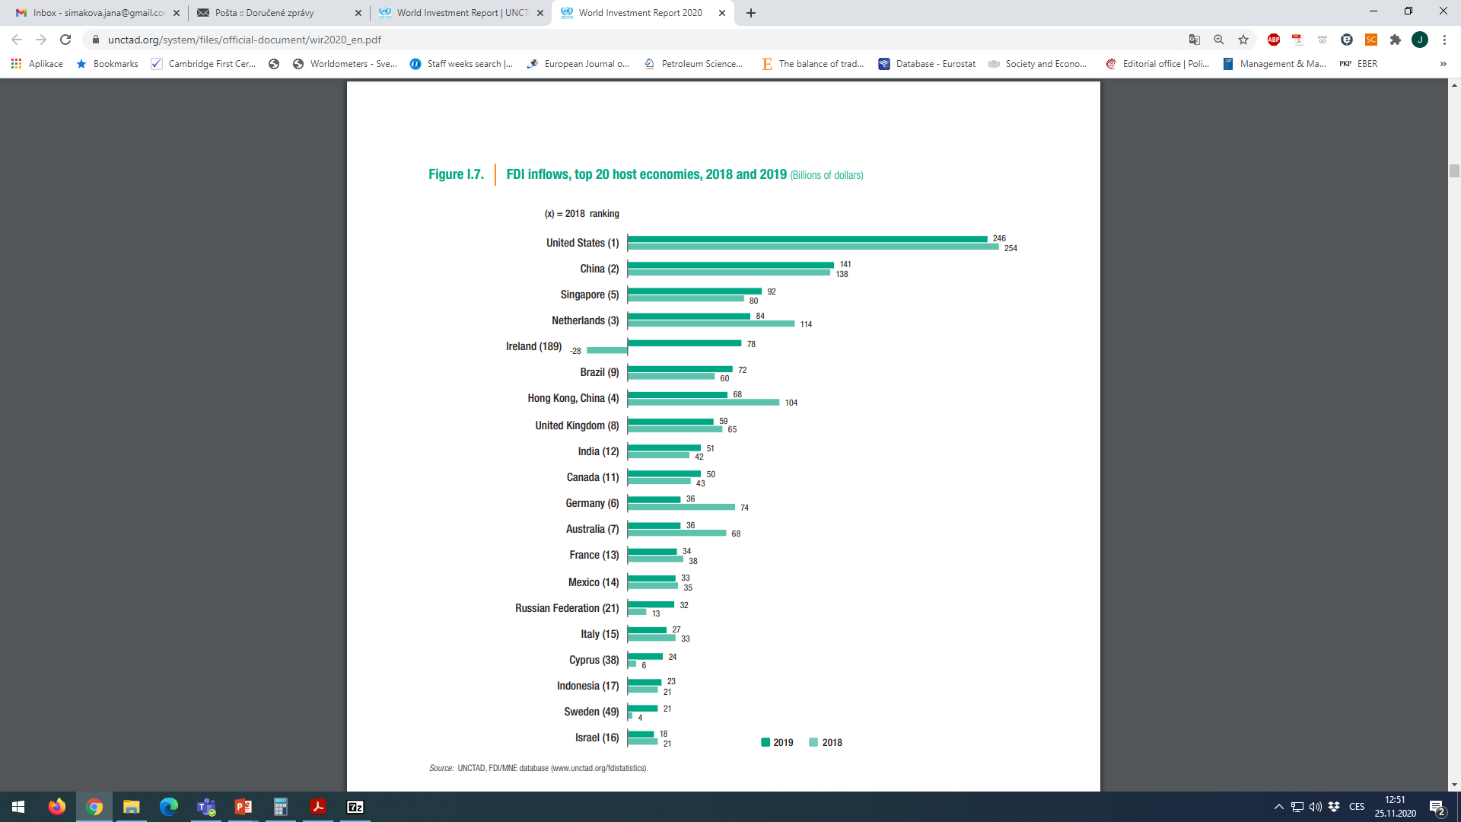
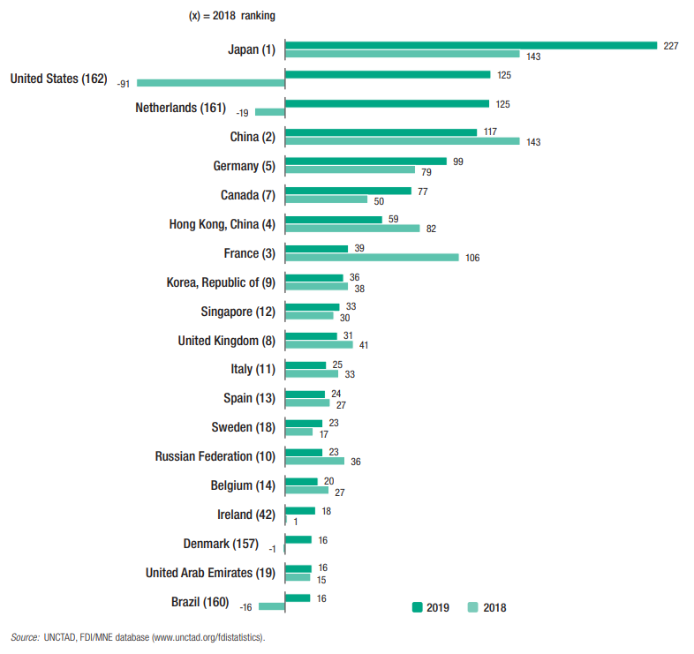
FDI Inflows top 15 Host and Home Economies (bil. USD)
International Investments

Slide 24
Political Economy of Foreign Direct Investment
Radical view
  “Imperialist” extraction of host country wealth
  Implication: Always bad for the host country
Free market
  Different countries have different comparative advantages; best to allow countries to engage activities for which they do so most efficiently
  Implication: Always good when countries are specializing in activities for which they have a comparative advantage
Pragmatic nationalism
  Belief that FDI has costs and benefits, and whether to engage in FDI depends on whether the benefits exceed the cost
International Investments

Slide 25
Questions and Applications
??? What are the costs and benefits to the host country???
International Investments

Slide 26
Benefits to the Host Country
Resource transfer effects
  Capital: MNC invests capital in foreign markets
  Technology: Research supports that MNCs do transfer technology when they invest in a foreign country
  Management: When MNCs invest and manage in a foreign country, they often transfer management skills to the host country’s workforce
Employment effects
  MNCs, by investing in foreign countries, can create employment opportunities for the local workforce
  But: Acquisition vs. Greenfield Investment
International Investments

Slide 27
Benefits to the Host Country
Balance of payments effects
  FDI can have beneficial and negative effects on a country’s balance of payment.
    Initial capital inflow
    Substitute for imports
    Inflow of payments from export of goods and services
Effect on competition
  Efficient functioning of markets require adequate level of competition between producers
International Investments

Slide 28
Costs to the Host Country
Adverse effects on competition
  MNCs may have “too much” power and kill off competition
Adverse effects on balance of payments
  After initial inflow of capital, subsequent outflow of capital from the earnings of the FDI
  FDI may import inputs from abroad
National sovereignty and autonomy
  Key decisions that affect the host country’s economy may be made by a foreign parent that has no real commitment to the host country
International Investments

Slide 29
Benefits and Costs to the Home Country
Benefits
  Stream of income from foreign earnings
  FDI may import intermediate goods or inputs for production from the home country, creating jobs
  MNCs may learn skills from exposure to foreign countries
Costs
  Initial capital outflow (but often set off by future stream of foreign earnings)
  Current account suffers if FDI is to serve home market from low-cost production location
  Current account suffers if FDI is a substitute for direct export
  FDI a substitute for domestic production
International Investments

Slide 30
Incentives to Encourage FDI by Host Country
Tax breaks on the income earned there
Rentfree land and buildings
Low-interest loans
Subsidized energy
Reduced environmental regulations
etc.
The degree to which a government will offer such incentives depends on the extent to which the MNC’s FDI will benefit that country.
International Investments

Slide 31
Barriers of FDI by Host Country
Protective Barriers
“Red Tape” Barriers
Industry Barriers
Environmental Barriers
Regulatory Barriers
Ethical Differences
Political Instability
International Investments

Slide 32
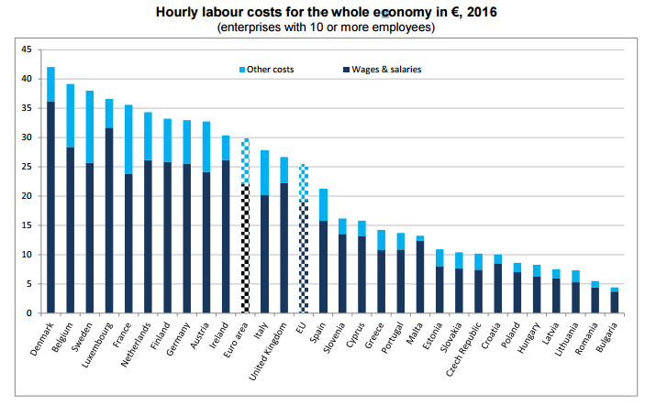
Labor Costs in the EU
International Investments

Slide 33
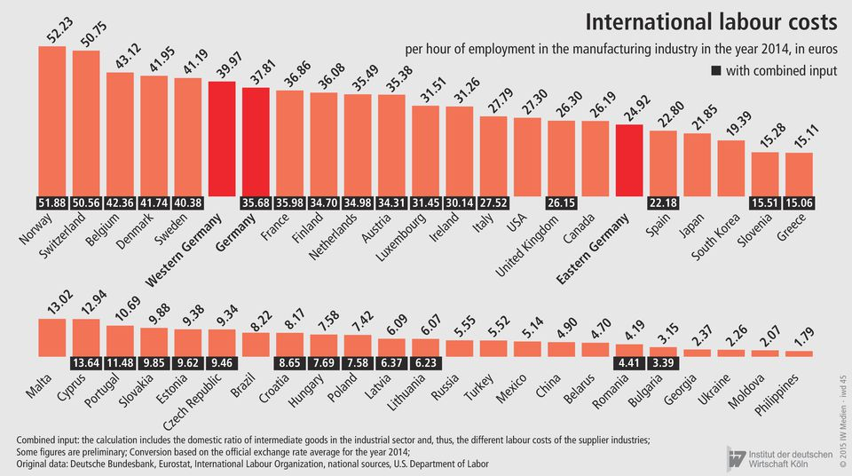
International Labor Costs
International Investments

Slide 34
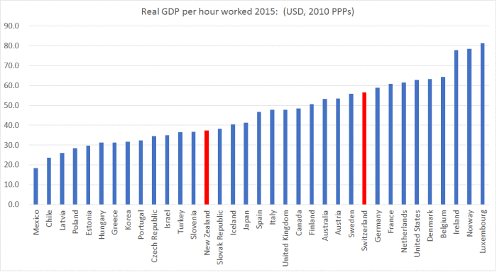
Productivity of Labor
International Investments

Slide 35
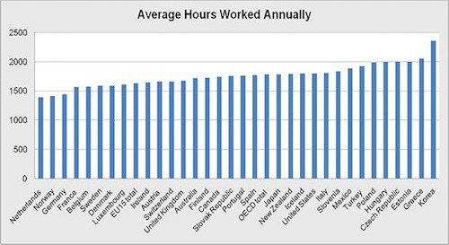
Annual Working Hours (2012)
International Investments

Slide 36
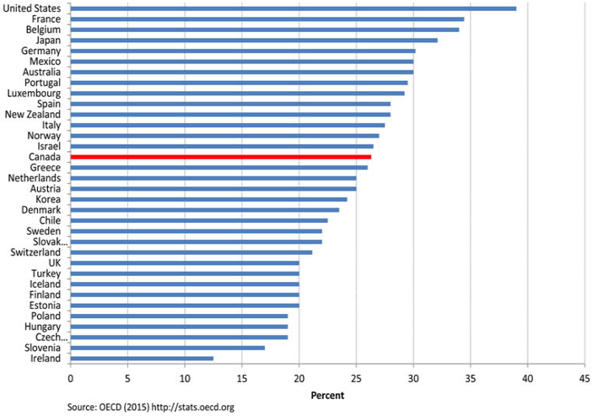
Corporate Tax Rates (Combined) in OECD Countries (2015)
International Investments

Slide 37
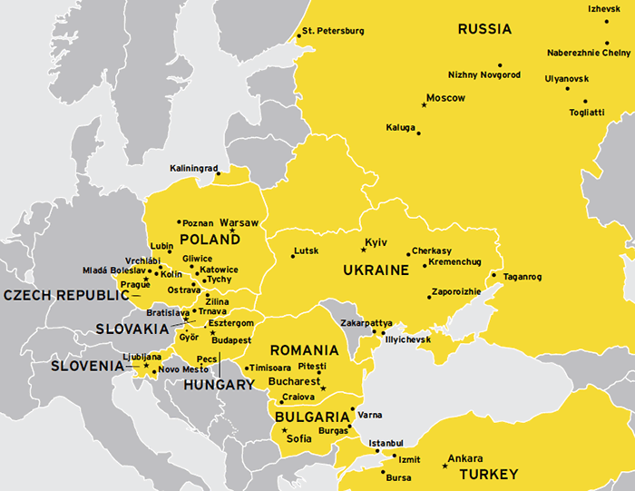
Following Business Partners in Automobile Industry
International Investments

Slide 38
Foreign Direct Investment Risks – Political
Economical expectations and reality
Success of economical proposals of government
Political instability and terrorism
Foreign conflicts
Corruption in government
Importance of army and church in politics
Power of legal tradition
Conflicts between nationalities and minorities, civic war
Development of political system
Quality of bureaucratic system
International Investments

Slide 39
Foreign Direct Investment Risks – Economic and Financial
Insolvency or unfavorable structure of debt
Delay of payable supplying loans
Governments non acceptation of its liabilities
Losses of foreign exchange control
Expropriation of private investments
Inflation risk
Ratio of debt service to annual export
Covering of one month import by net foreign currency reserves
Payment discipline of importers
Share of goods and services export on current balance amount
Percentage difference between official and „black“ exchange rate
International Investments

Slide 40
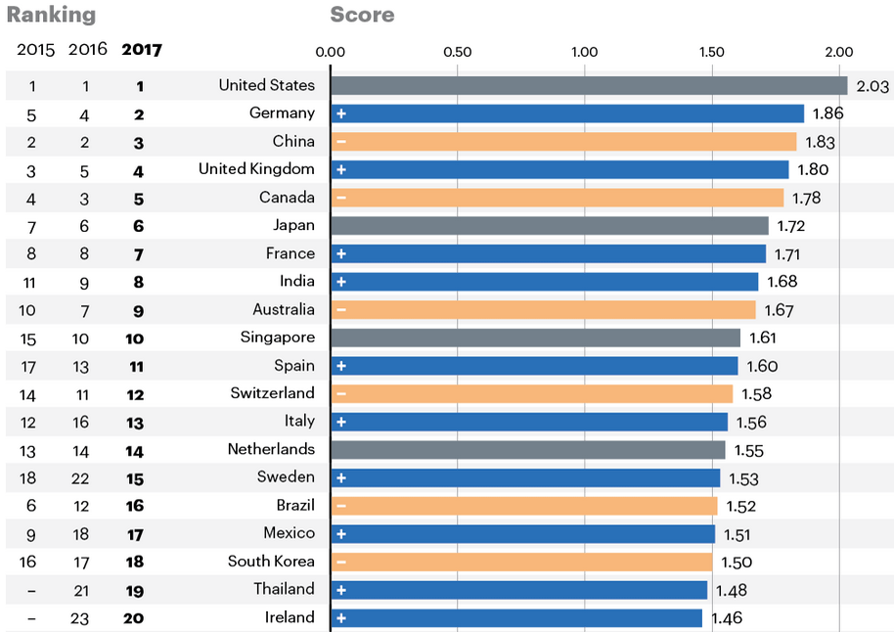
A.T. Kearney FDI confidence index
International Investments

Slide 41
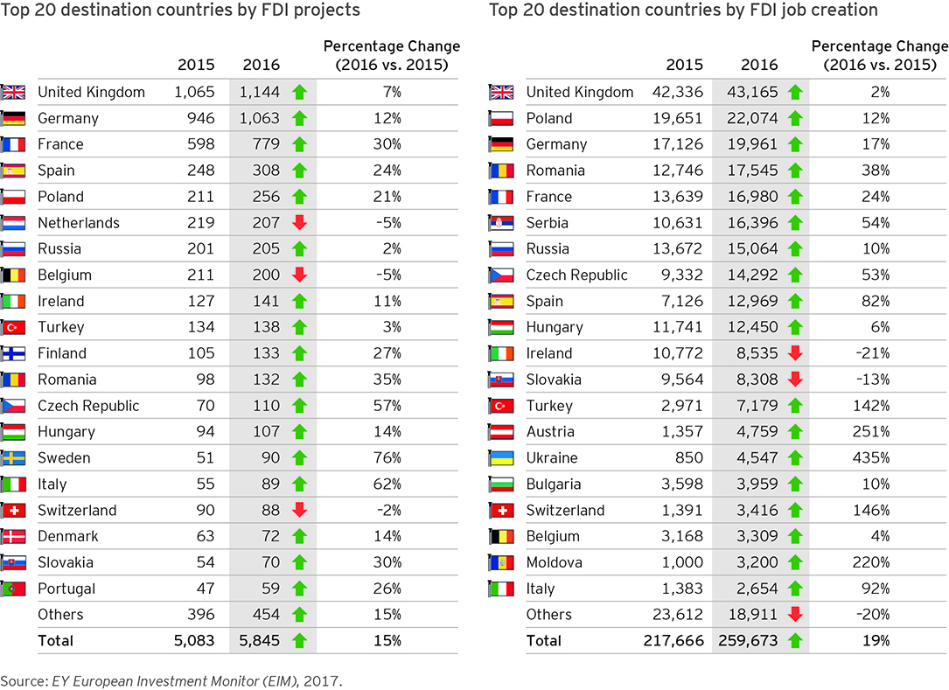
Ernst &Young FDI Attractiveness in Europe
International Investments

Slide 42
Questions and Applications
???What about FDI in your home country???
Find the development of FDI in your home country in the last 5 years. What are the net inflows/outflows of FDI there? What are current trends in development of FDI there? What are major determinants of FDI there?
International Investments

Slide 43
THANK YOU FOR YOUR ATTENTION
J

