Slide 1
Mathematics in economics
Lecture 7
Mgr. Jiří Mazurek, Ph.D.
Mathematics in Economics/PMAT

Slide 2
Lecture 7
Definite integral
Newton´s definite integral:
In the definition above, F is a primitive function to f,
and a and b are the limits of the integral.
The result of definite integral is not a function, but a number!

Slide 3
Lecture 7
Definite integral – elementary properties
Generally, when computing definite integral, we use the
same table of elementary integrals as for an indefinite
integral.
The elementary properties of the definite integral:

Slide 4
Lecture 7
Definite integral – a use
The definite integral can be used to calculation of:
The square under or above given function,
The length of a curve,
The volume of a 3D object,
The area of a 3D object.

Slide 5
Lecture 7
Definite integral – An area under/above a function
Find:
Solution:
What does the number 7/3 mean?
It is the area below the function f(x) on the interval (1,2),
See the next slide for a picture.

Slide 6
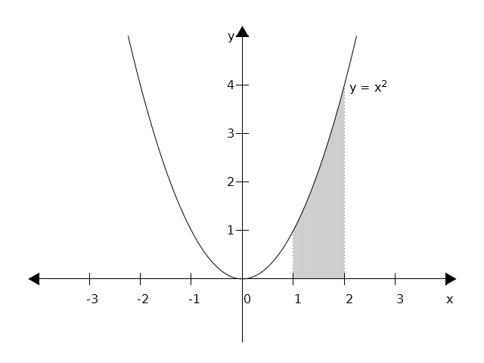
Lecture 7
Definite integral – An area under/above a function

Slide 7
Lecture 7
Definite integral – An area under/above a function
Find an area bounded by functions: , axis x,
x = -1 and x = 2.
Solution: We must divide the interval of integration
(-1,2) into two intervals: (-1,0) and (0,2) (WHY?):

Slide 8
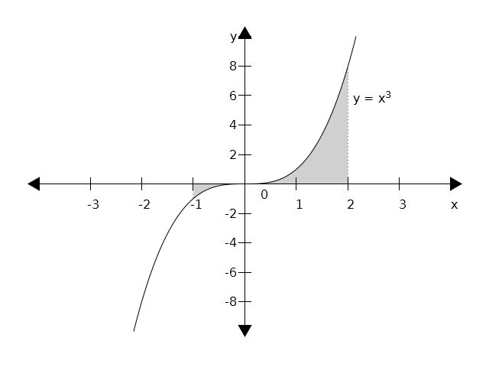
Lecture 7
Definite integral – An area under/above a function

Slide 9
Lecture 7
Definite integral – An area under/above a function
Problem 2
Find:
Solution:
This result means that the area under the function on
the interval (0,3) is 9.
Important note: if a function is positive on the interval
of integration, then the result will be a positive number.
However, for a negative function the result will be
negative!

Slide 10
Lecture 7
Definite integral – An area under/above a function
Problems 3 and 4
Find:
Solution:
Find:
Solution:

Slide 11
Lecture 7
Definite integral – per partes
Per partes method:
Example:

Slide 12
Lecture 7
Definite integral – substitution
A substitution in an definite integral, example:

Slide 13
Lecture 7
Problems to solve - 1
Find:

Slide 14
Lecture 7
An area between two curves
Let f(x) and h(x) be two curves, S an area between them
And a and b their intersections.
Then S is given as follows:

Slide 15
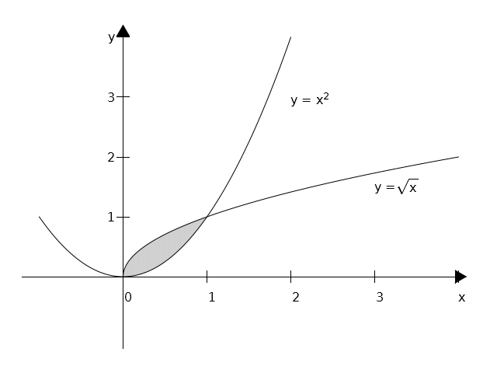
Lecture 7
An area between two curves – Problem 1
Find an are between two curves: and .
A picture:

Slide 16
Lecture 7
An area between two curves – Problem 1 cont.
Find an are between two curves: and .
Solution:
First, we find intersections: , hence x = 0 and x = 1.
Now, we can use the integral formula for the area:

Slide 17
Lecture 7
An area between two curves – Problem 2
Find an are between two curves: and .
Solution:
First, we find intersections: , hence x = 0 and x = 2.
Now, we can use the integral formula for the area:

Slide 18
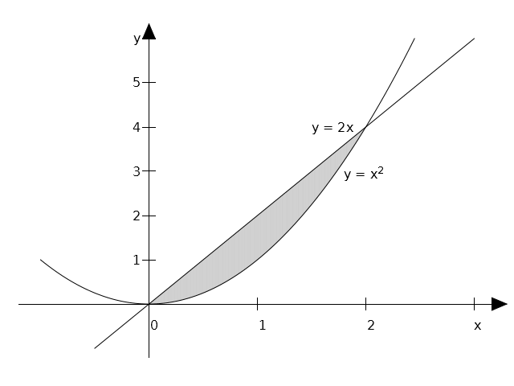
Lecture 7
An area between two curves – Problem 2 – cont.
Find an are between two curves: and .
A graph:

Slide 19
Lecture 7
A volume of a solid of revolution
We assume that a solid is generated by rotating a plane
curve around x axis.
In such a case, the volume of a solid is given as:

Slide 20
Lecture 7
A volume of a solid of revolution – Problem 1
Find a volume of a solid generated by a curve ,
rotating around x axis on the interval (0,3).
Solution:
Note: the solid is called a rotational parabolloid.

Slide 21
Lecture 7
A volume of a solid of revolution – Problem 2
Find a volume of a solid generated by a curve ,
rotating around x axis on the interval (1,2).
Solution:
Note: the solid is also a rotational parabolloid.

Slide 22
Lecture 7
A volume of a solid of revolution – Problem 3
Find a volume of a solid generated by a curve ,
rotating around x axis on the interval (1,4).
Solution:
Note: the solid is called a rotational hyperbolloid.

Slide 23
Lecture 7
Problems to solve – 1 (Assignment 10)
Find an are under/above the curve on the interval (1,3)
Find an are under/above the curve:
Find an are under/above the curve:
Find a volume of a solid generated by a curve ,
rotating around x axis on the interval (1,2).

Slide 24
Lecture 7
Problems to solve – 2 (Assignment 10)
Find an are under/above the curve:
Find an are under/above the curve:
Find an are under/above the curve:
Find an are under/above the curve:

Slide 25
Lecture 7
Problems to solve – 3 (Assignment 10)
Find an are between two curves:
Find an are between two curves:
Find an are between two curves:
Find a volume of a rotational solid: on interval (0,1).

Slide 26
Lecture 7
Thank you for your attention

