Slide 1

Mathematics in Economics
Lecture 2
Mgr. Jiří Mazurek, Ph.D.
Mathematics in Economics/PMAT

Slide 2
Lecture 2
Introduction to differential calculus of one real variable
The derivative of a function
Let y = f (x) be a function of one real variable. Then the
derivative of the function f is defined as follows:
The derivative is usually denoted f´(x) or y´. The process of finding a derivative is called differentiation.
Geometric interpretation: the derivative of a function f at a point x is equal to the slope of a tangent line to the curve at the point x.

Slide 3
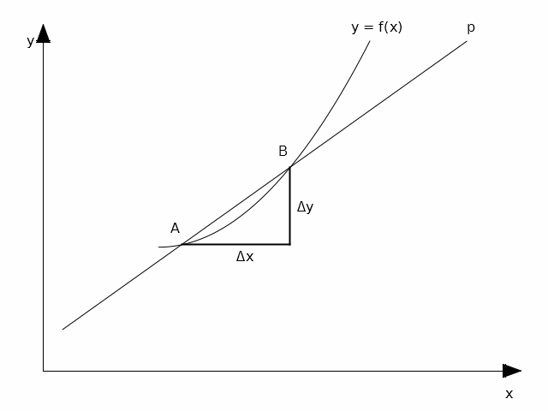
Lecture 2
Geometric interpretation of a derivative

Slide 4
Lecture 2
The rules of differentiation
Let f(x) and g(x) be functions with the derivative
in the interval Then:

Slide 5
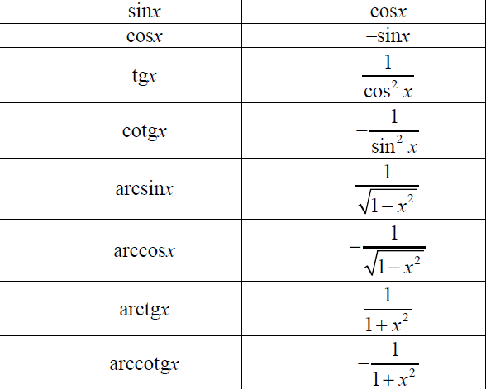
Lecture 2
Derivatives of elementary functions

Slide 6
Lecture 2
Examples

Slide 7
Lecture 2
Derivatives of higher orders
If a function f´(x) can be differentiated, we obtain
the second derivative of f(x), denoted as f´´(x), and so on.
First derivatives are used to find monotonicity and extremas of functions. The second derivative is useful in finding concavity and concavity or inflexion points. The use of derivatives of the order 3 and higher are rather rare.
Example:

Slide 8
Lecture 2
Differential of a function
The differential of a function y = f(x) is denoted as dy, and is defined as follows: .
The differential expresses an increment of the dependent variable dy in respect to the increment of independent variable dx. Also, the differential isused to linearization of more complex functions.
Example: Find the the differential of the function at a point x = 4.
Solution: dy=2xdx, and substituting x = 4 we obtain: dy = 8dx.

Slide 9
Lecture 2
The logarithmic differentiation
For functions of the type we use the so called logarithmic differentiation:

Slide 10
Lecture 2
Taylor and Maclaurin series
Let a function y = f(x) be differentiable of the order n at a point a, then it can be approximated by the Taylor series of the form:
If a = 0, we obtain a special case of the Taylor series, called Maclaurin series:

Slide 11
Lecture 2
Maclaurin series of selected functions
Function | Maclaurin series | Range of convergence
sinx
cosx
exp(x)

Slide 12
Lecture 2
Taylor and Maclaurin series
Example: Find the Maclaurin series of the function .
Solution:
Therefore, we obtain:

Slide 13


Lecture 2
Economic applications of derivatives
The elasticity of a function y = f(x):
The price elasticity of demand:
The price elasticity of supply:

Slide 14



Lecture 2
Economic applications of derivatives – cont.
Marginal product of labour:
Marginal revenue:
Marginal cost:

Slide 15
Lecture 2
Solved problems 1
Find the derivative of the function
Solution: The given function is a product of two elementary functions, so we must use the product rule.
We obtain:

Slide 16
Lecture 2
Solved problems 2
Find the differential of the function . Also, find the increment dy for x = 2 and dx = 0.1
Solution: and the differential is:
The increment dy:

Slide 17
Lecture 2
Solved problems 3
Find the Taylor series of the function at the point a = 1.
Solution:
Therefore, the Taylor series is given as follows:

Slide 18
Lecture 2
Solved problems 4
Find the Maclaurin series of the function .
Solution:
Therefore, the Taylor series is given as follows:

Slide 19
Lecture 2
Solved problems 5
Find the derivative of the function .
Solution:

Slide 20
Lecture 2
Solved problems 6
Find the derivative of the function .
Solution:

Slide 21
Lecture 2
Solved problems 7
Find marginal revenue MR (x) of the total revenue
and marginal costs of the total costs
.
Solution:

Slide 22



Lecture 2
Problems to solve 1
Differentiate:

Slide 23



Lecture 2
Problems to solve 2
Differentiate:

Slide 24
Lecture 2
Problems to solve 3
Find the Maclaurin series of the following functions:

Slide 25
Lecture 2
Thank you for your attention!

