Slide 1
Acculturation and culture shock.
Its overcoming.

Slide 2
Acculturation – adaptation to a foreign culture.
- longer stays abroad – from 3 month to……
- students, workers, migrants – refugees
-acculturation – a long- term process

Slide 3
Acculturation – the term
The term - first used in anthropology in the late 18th century
in Central and South America in connection with Indian-Spanish acculturation
the consequences of contact between Native American tribes and whites
Later - important topic in the social sciences, sociology, psychology, and public health

Slide 4
Acculturation
Adaptation to target culture without losing national identity
The first definitions and models - the USA
Various nationalities
Late 20th century – 1970´ -development of business relations with Japan – comparison of cultures

Slide 5
Health aspects of acculturation in the USA today
High levels of acculturation - mental health services provided for female Chinese immigrants in the USA
increased alcohol intake among Mexican-American women and Southeast Asian immigrants
increased smoking among Asian-American youth and Mexican-American women

Slide 6
Examples of different stages of acculturation
A first generation Italian who lives in an Italian enclave in the United States may continue to speak just Italian and to follow the norms of his Italian origins. This person will not have become highly acculturated to American culture.
The granddaughter of a Chinese immigrant has gone to American schools and will now attend an American college. She spends time primarily with her American friends, dresses as they do and shares their values and interests. She has become highly acculturated into American culture.

Slide 7
J. Berry´s model of acculturation
It is based on contact-participation
the extent individuals value and look for contact with people outside their own group, and wish to participate in the daily life of the larger society
Characteristics of acculturation:
• 1 Integrated individuals - individuals want to maintain their identity with home culture, but also want to take on some characteristics of the new culture

Slide 8
J. Berry´s model of acculturation
2 Assimilated individuals- people do not want to keep their identity from their home culture, but would rather take on all of the characteristics of the new culture
3 Separated individuals- want to separate themselves from the dominant culture, which can be called segregation if it is forced separation
4 Marginalized individuals- These individuals don’t want anything to do with either the new culture or the old culture

Slide 9
The Melting Pot Model
it is used to describe the assimilation of immigrants to the USA
In18th and 19th century the metaphor of a melting pot was used to describe the fusion of different nationalities and culture .
idealized process of immigration and colonization - different nationalities, culture and races were to blend into a new community, now
salad bowl

Slide 10
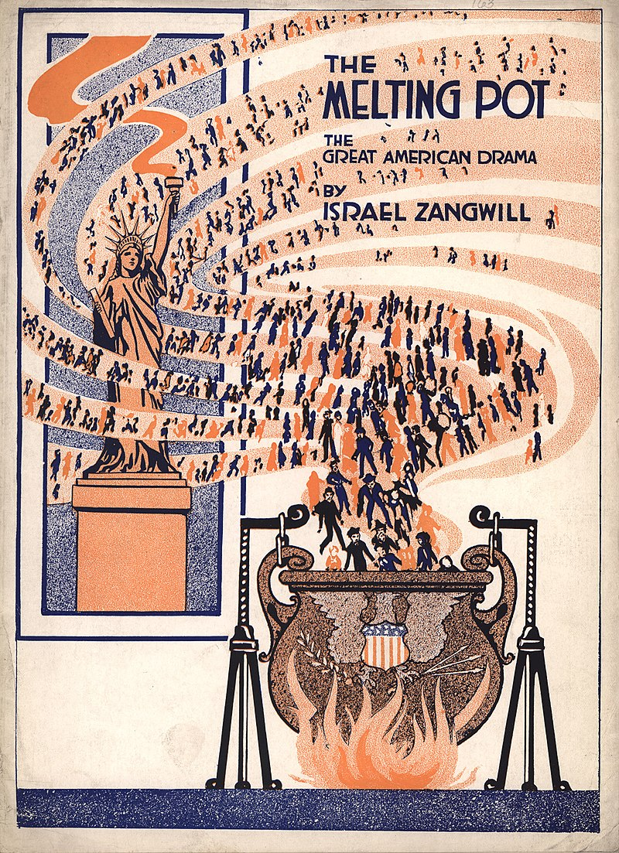
Melting pot model

Slide 11
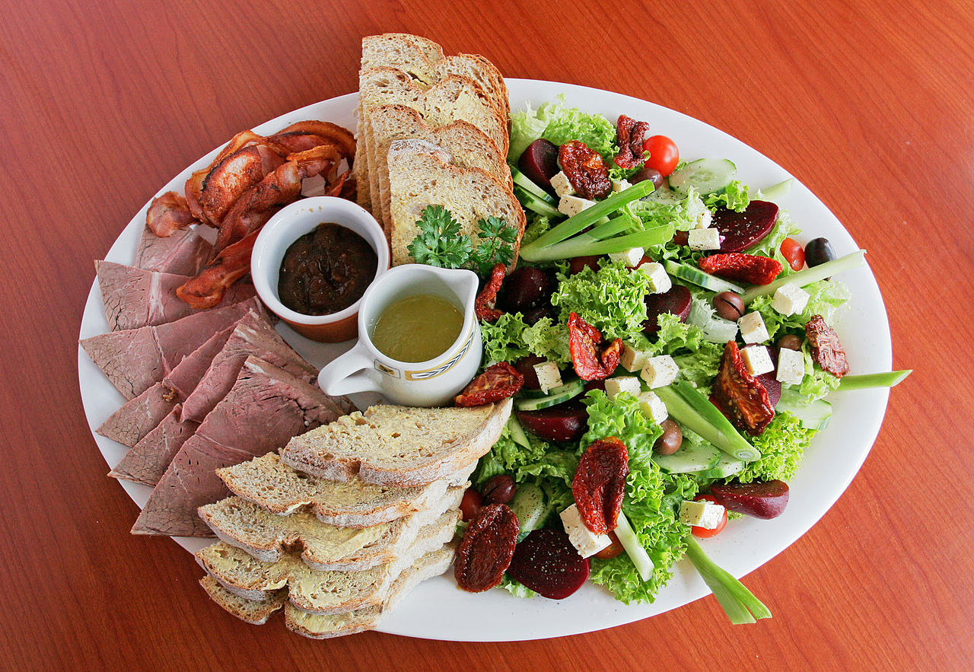
Salad bowl model

Slide 12
Acton-Walker acculturation model
Tourist – basic phrases, no culture knowledge
Survivor – simple conversations- after culture shock
Immigrant – good language skills, nonverbal signals, knowledge of culture phenomena
Citizen – behaves like a native person

Slide 13
Culture shock
Culture shock or acculturative stress-
Culture shock refers to the tension and feelings (of surprise, disorientation, uncertainty, confusion, etc.)
is felt when people have to operate within a different and unknown culture such as one may experience in a foreign country

Slide 14
Other feelings typical for culture shock
hostility
sadness
loneliness
homesickness
aggressivity

Slide 15
Sources of culture shock in the CR
Food – missing ingrediences
Relations
Environment
Weather
Language
Unfriendly people

Slide 16
Overcoming culture shock
Information about target culture
Contacts with people from home culture
Patience
Hobbies and interests
Activities enabling to practise the language

Slide 17
Reverse culture shock
may take place — after returning to one's home culture after getting accustomed to a new one
can produce the same effects
re-adjustment process to the primary culture
the affected person often finds this more surprising and difficult than the original culture shock

Slide 18
A case study
After 4 months living in Korea John, a Canadian, had a problem with garbage. He selected his garbage in the same way as in Canada. One day, the guard brought his bag with garbage back, dropped it in front of him and started yelling.
John knew he had done wrong but had no idea how or what.

Slide 19
Solution and explanation
In Korea, one has to separate everything. Cans go in one bin, the little yogurt drink containers go in the next, milk containers in another, paper in another, compost in another and so on. Then finally, the leftovers that don’t belong in any category go in a specially purchased and labelled garbage bag that indicates your neighborhood.
The guard had enough of John as he had had to be going through John´s garbage every time. For the guard he was the ignorant, disrespectful, lazy foreigner.

Slide 20
Video
https://www.youtube.com/watch?v=EkZyvDZFC8Q

Slide 21
Questions
What is the possible source of culture shock in your country?
Have you ever experienced culture shock or reverse culture shock? Where and when?
Do you know any foreigners living in your country who have acculturated?

