Slide 1
Environmental Scanning and Industry Analysis
EXTERNAL ENVIRONMENTAL VARIABLES, INDUSTRY ANALYSIS, COMPETITIVE INTELLIGENCE
MANAGEMENT - PEM/BAMNG
Pavel Adámek
adamek@opf.slu.cz

Slide 2
Environmental Scanning and Industry Analysis
Outline of the lecture
Identifying External Environmental Variables
Industry Analysis: Analyzing the Task Environment
Categorizing International Industries

Slide 3
Environmental Scanning and Industry Analysis
INTRODUCTION
Before an organization can begin strategy formulation, it must scan the external environment to identify possible opportunities and threats and its internal environment for strengths and weaknesses.
Environmental scanning is the monitoring, evaluation, and dissemination of information from the external and internal environments to key people within the corporation.
A corporation uses this tool to avoid strategic surprise and to ensure its long-term health.
Research has found a positive relationship between environmental scanning and profits.

Slide 4
Environmental Scanning and Industry Analysis
1. Identifying External Environmental Variables
In undertaking environmental scanning, strategic managers must first be aware of the many variables within a corporation’s natural, societal, and task environments.
The natural environment includes physical resources, wildlife, and climate that are an inherent part of existence on Earth. These factors form an ecological system of interrelated life.
The societal environment is mankind’s social system that includes general forces that do not directly touch on the short-run activities of the organization that can, and often do, influence its long-run decisions.

Slide 5
Environmental Scanning and Industry Analysis
1. Identifying External Environmental Variables
These factors affect multiple industries and are as follows:
Economic forces that regulate the exchange of materials, money, energy, and information.
Technological forces that generate problem-solving inventions.
Political–legal forces that allocate power and provide constraining and protecting laws and regulations.
Sociocultural forces that regulate the values, mores, and customs of society.
The task environment includes those elements or groups that directly affect a corporation and, in turn, are affected by it.
These are governments, local communities, suppliers, competitors, customers, creditors, employees/labor unions, special-interest groups, and trade associations.
A corporation’s task environment is typically the industry within which the firm operates.
Industry analysis (popularized by Michael Porter) refers to an in-depth examination of key factors within a corporation’s task environment.

Slide 6
Environmental Scanning and Industry Analysis
1. Identifying External Environmental Variables
Scanning the Natural Environment
The natural environment includes physical resources, wildlife, and climate.
Management must therefore scan not only the natural environment for possible strategic factors, but also include in its strategic decision-making processes the impact of its activities upon the natural environment.
Research reveals that scanning the market for environmental issues is positively related to firm performance because it helps management identify opportunities to fulfill future market demand based upon environmentally friendly products or processes - the Environmental Sustainability Issue.

Slide 7
Environmental Scanning and Industry Analysis
1. Identifying External Environmental Variables
Scanning the Societal Environment: STEEP Analysis
The strategic factors in the societal environment becomes enormous when we realize that, generally speaking, each country in the world can be represented by its own unique set of societal forces - some of which are very similar to those of neighboring countries and some of which are very different.
STEEP Analysis, the scanning of Sociocultural, Technological, Economic, Ecological, and Political-legal environmental forces.
(It may also be called PESTEL Analysis for Political, Economic, Sociocultural, Technological, Ecological, and Legal forces.)

Slide 8
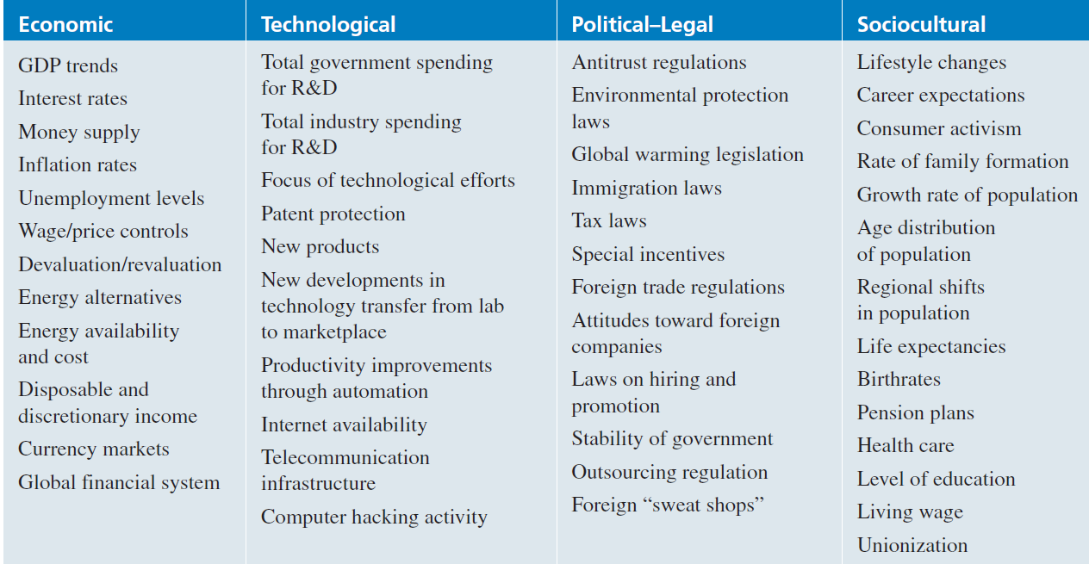
Environmental Scanning and Industry Analysis
1. Identifying External Environmental Variables
Some Important Variables in the Societal Environment

Slide 9
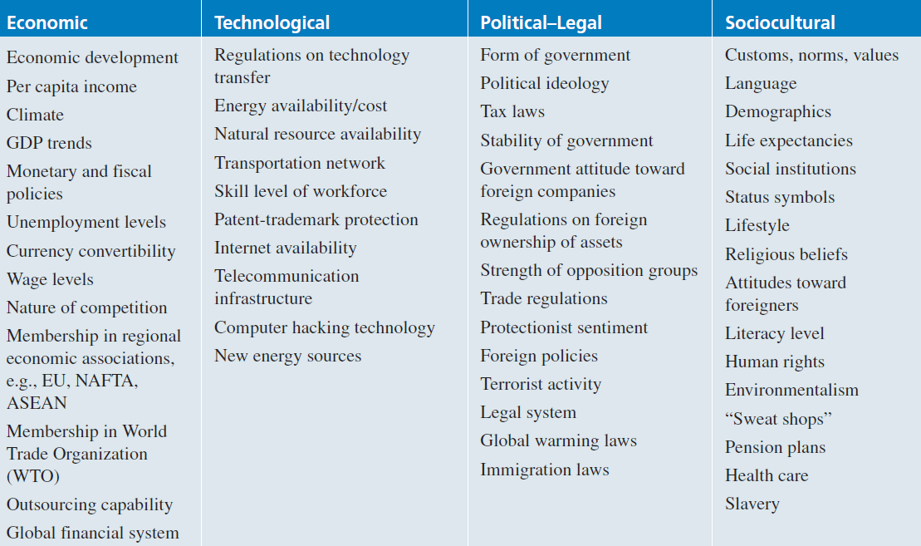
Environmental Scanning and Industry Analysis
1. Identifying External Environmental Variables
Some Important Variables in InternationalSocietal Environments

Slide 10
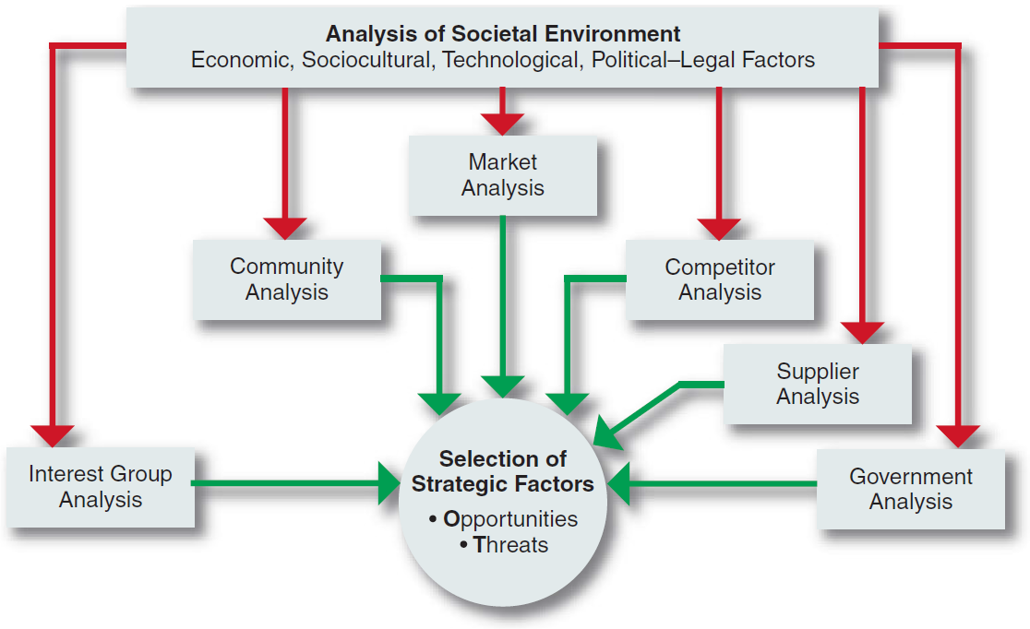
Environmental Scanning and Industry Analysis
1. Identifying External Environmental Variables
Scanning the Task Environment
A corporation’s scanning of the environment includes analyses of all the relevant elements in the task environment. These analyses take the form of individual reports written by various people in different parts of the firm.

Slide 11
Environmental Scanning and Industry Analysis
1. Identifying External Environmental Variables
Identifying External Strategic Factors
The origin of competitive advantage lies in the ability to identify and respond to environmental change well in advance of competition.
No firm can successfully monitor all external factors.
Choices must be made regarding which factors are important and which are not.
Even though managers agree that strategic importance determines what variables are consistently tracked, they sometimes miss or choose to ignore crucial new developments.
Personal values and functional experiences of a corporation’s managers as well as the success of current strategies are likely to bias both their perception of what is important to monitor in the external environment and their interpretations of what they perceive.

Slide 12
Environmental Scanning and Industry Analysis
1. Identifying External Environmental Variables
Identifying External Strategic Factors
One way to identify and analyze developments in the external environment is to use the issues priority matrix as follows:
Identify a number of likely trends emerging in the natural, societal, and task environments.
These are strategic environmental issuesthose important trends that, if they occur, determine what the industry or the world will look like in the near future.
Assess the probability of these trends actually occurring, from low to medium to high.
Attempt to ascertain the likely impact (from low to high) of each of these trends on the corporation being examined.

Slide 13
Environmental Scanning and Industry Analysis
1. Identifying External Environmental Variables
Identifying External Strategic Factors
One way to identify and analyze developments in the external environment is to use the issues priority matrix as follows:
Identify a number of likely trends emerging in the natural, societal, and task environments.
These are strategic environmental issuesthose important trends that, if they occur, determine what the industry or the world will look like in the near future.
Assess the probability of these trends actually occurring, from low to medium to high.
Attempt to ascertain the likely impact (from low to high) of each of these trends on the corporation being examined.

Slide 14
Environmental Scanning and Industry Analysis
1. Identifying External Environmental Variables
The issues priority matrix can then be used to help managers decide which environmental trends should be merely scanned (low priority) and which should be monitored as strategic factors (high priority).
SOURCE: Reprinted from Long-Range Planning, Vol. 17, No. 3, 1984,

Slide 15
Environmental Scanning and Industry Analysis
2. Industry Analysis: Analyzing the Task Environment
An industry is a group of firms that produces a similar product or service, such as soft drinks or financial services. An examination of the important stakeholder groups, such as suppliers and customers, in a particular corporation’s task environment is a part of industry analysis.
Michael Porter, an authority on competitive strategy, contends that a corporation is most concerned with the intensity of competition within its industry. The level of this intensity is determined by basic competitive forces.
“The collective strength of these forces,” he contends, “determines the ultimate profit potential in the industry, where profit potential is measured in terms of long-run return on invested capital.”

Slide 16
Environmental Scanning and Industry Analysis
2. Industry Analysis: Analyzing the Task Environment
In carefully scanning its industry, a corporation must assess the importance to its success of each of six forces:
threat of new entrants,
rivalry among existing firms,
threat of substitute products or services,
bargaining power of buyers,
bargaining power of suppliers,
and relative power of other stakeholders.
The stronger each of these forces, the more limited companies are in their ability to raise prices and earn greater profits.
Although Porter mentions only five forces, a sixth - other stakeholders - is added here to reflect the power that governments, local communities, and other groups from the task environment wield over industry activities.

Slide 17
Environmental Scanning and Industry Analysis
2. Industry Analysis: Analyzing the Task Environment
Forces Driving Industry Competition
SOURCE: Reprinted with the permission of The Free Press, A Division of Simon & Schuster, from COMPETITIVE ADVANTAGE: Techniques for Analyzing Industries and Competitors by Michael E. Porter.

Slide 18
Environmental Scanning and Industry Analysis
2. Industry Analysis: Analyzing the Task Environment
Threat of New Entrants
New entrants to an industry typically bring to it new capacity, a desire to gain market share, and substantial resources. They are, therefore, threats to an established corporation.
An entry barrier is an obstruction that makes it difficult for a company to enter an industry.
Some of the possible barriers to entry are:
Economies of scale: Scale economies in the production and sale of microprocessors, for example, gave Intel a significant cost advantage over any new rival.
Product differentiation
Capital requirements: The need to invest huge financial resources in manufacturing facilities in order to produce large commercial airplanes creates a significant barrier to entry to any competitor for Boeing and Airbus.

Slide 19
Environmental Scanning and Industry Analysis
2. Industry Analysis: Analyzing the Task Environment
Some of the possible barriers to entry are:
Switching costs: Once a software program such as Excel or Word becomes established in an office, office managers are very reluctant to switch to a new program because of the high training costs.
Access to distribution channels: Small entrepreneurs often have difficulty obtaining supermarket shelf space for their goods because large retailers charge for space on their shelves and give priority to the established firms who can pay for the advertising needed to generate high customer demand.
Cost disadvantages independent of size: Once a new product earns sufficient market share to be accepted as the standard for that type of product, the maker has a key advantage.
Government policy: Governments can limit entry into an industry through licensing requirements by restricting access to rawmaterials, such as oil-drilling sites in protected areas.

Slide 20
Environmental Scanning and Industry Analysis
2. Industry Analysis: Analyzing the Task Environment
Rivalry among Existing Firms
According to Porter, intense rivalry is related to the presence of several factors, including:
Number of competitors: When competitors are few and roughly equal in size, such as in the auto and major home appliance industries, they watch each other carefully to make sure that they match any move by another firm with an equal countermove.
Rate of industry growth: Any slowing in passenger traffic tends to set off price wars in the airline industry because the only path to growth is to take sales away from a competitor.
Product or service characteristics: A product can be very unique, with many qualities differentiating it from others of its kind or it may be a commodity, a product whose characteristics are the same, regardless of who sells it.
Amount of fixed costs: Because airlines must fly their planes on a schedule, regardless of the number of paying passengers for any one flight, they offer cheap standby fares whenever a plane has empty seats.

Slide 21
Environmental Scanning and Industry Analysis
2. Industry Analysis: Analyzing the Task Environment
Rivalry among Existing Firms
According to Porter, intense rivalry is related to the presence of several factors, including:
Capacity: If the only way a manufacturer can increase capacity is in a large increment by building a new plant (as in the paper industry), it will run that new plant at full capacity to keep its unit costs as low as possible—thus producing so much that the selling price falls throughout the industry.
Height of exit barriers: Exit barriers keep a company from leaving an industry.
Diversity of rivals: Rivals that have very different ideas of how to compete are likely to cross paths often and unknowingly challenge each other’s position.

Slide 22
Environmental Scanning and Industry Analysis
2. Industry Analysis: Analyzing the Task Environment
Threat of Substitute Products or Services
A substitute product is a product that appears to be different but can satisfy the same need as another product.
According to Porter, “Substitutes limit the potential returns of an industry by placing a ceiling on the prices firms in the industry can profitably charge.”
To the extent that switching costs are low, substitutes may have a strong effect on an industry.
Tea can be considered a substitute for coffee. If the price of coffee goes up high enough, coffee drinkers will slowly begin switching to tea. The price of tea thus puts a price ceiling on the price of coffee.
Sometimes a difficult task, the identification of possible substitute products or services means searching for products or services that can perform the same function, even though they have a different appearance and may not appear to be easily substitutable.

Slide 23
Environmental Scanning and Industry Analysis
2. Industry Analysis: Analyzing the Task Environment
Bargaining Power of Buyers
A buyer or a group of buyers is powerful if some of the following factors hold true:
A buyer purchases a large proportion of the seller’s product or service
A buyer has the potential to integrate backward by producing the product itself (for example, a newspaper chain could make its own paper).
Alternative suppliers are plentiful because the product is standard or undifferentiated (for example, motorists can choose among many gas stations).
Changing suppliers costs very little.
The purchased product represents a high percentage of a buyer’s costs, thus providing an incentive to shop around for a lower price.
A buyer earns low profits and is thus very sensitive to costs and service differences.
The purchased product is unimportant to the final quality or price of a buyer’s products or services and thus can be easily substituted without affecting the final product adversely.

Slide 24
Environmental Scanning and Industry Analysis
2. Industry Analysis: Analyzing the Task Environment
Bargaining Power of Suppliers
Suppliers can affect an industry through their ability to raise prices or reduce the quality of purchased goods and services. A supplier or supplier group is powerful if some of the following factors apply:
The supplier industry is dominated by a few companies, but it sells to many.
Its product or service is unique and/or it has built up switching costs.
Substitutes are not readily available (for example, electricity).
Suppliers are able to integrate forward and compete directly with their present customers (for example, a microprocessor producer such as Intel can make PCs).
A purchasing industry buys only a small portion of the supplier group’s goods and services and is thus unimportant to the supplier.

Slide 25
Environmental Scanning and Industry Analysis
3. Categorizing International Industries
According to Porter, world industries vary on a continuum from multidomestic to global.
Multidomestic industries are specific to each country or group of countries. This type of international industry is a collection of essentially domestic industries, such as retailing and insurance.
The activities in a subsidiary of a multinational corporation (MNC) in this type of industry are essentially independent of the activities of the MNC’s subsidiaries in other countries.
Within each country, it has a manufacturing facility to produce goods for sale within that country.
The MNC is thus able to tailor its products or services to the very specific needs of consumers in a particular country or group of countries having similar societal environments.

Slide 26
Environmental Scanning and Industry Analysis
3. Categorizing International Industries
Global industries, in contrast, operate worldwide, with MNCs making only small adjustments for country-specific circumstances.
In a global industry an MNC’s activities in one country are significantly affected by its activities in other countries.
MNCs in global industries produce products or services in various locations throughout the world and sell them, making only minor adjustments for specific country requirements.
Examples of global industries are commercial aircraft, television sets, semiconductors, copiers, automobiles, watches, and tires.

Slide 27
Environmental Scanning and Industry Analysis
3. Categorizing International Industries
Continuum of International Industries

Slide 28
Environmental Scanning and Industry Analysis
3. Categorizing International Industries
The factors that tend to determine whether an industry will be primarily multidomestic or primarily global are:
Pressure for coordination within the MNCs operating in that industry.
Pressure for local responsiveness on the part of individual country markets.
Between these two extremes lie a number of industries with varying characteristics of both multidomestic and global industries. These are regional industries, in which MNCs primarily coordinate their activities within regions, such as the Americas or Asia.

Slide 29
Environmental Scanning and Industry Analysis
SUMMARY OF THE LECTURE
Environmental scanning involves monitoring, collecting, and evaluating information in order to understand the current trends in the natural, societal, and task environments.
The information is then used to forecast whether these trends will continue or whether others will take their place.
How will developments in the natural environment affect the world?
What kind of developments can we expect in the societal environment to affect our industry?
What will an industry look like in 10 to 20 years?
Who will be the key competitors?
Who is likely to fall by the wayside?

Slide 30
Environmental Scanning and Industry Analysis
SUMMARY OF THE LECTURE
We use this information to make certain assumptions about the future - assumptions that are then used in strategic planning.
The key to winning is not to assume that your industry will continue as it is now but to assume that the industry will change and to make sure that your company will be in position to take advantage of those changes.

