Slide 1

Global Business Environment
5. lecture
Ing. Šárka Zapletalová, Ph.D.
Department of Business Economics and Management
BUSINESS ENVIRONMENT

Slide 2

Outline of the lecture
World economy
Elements of global business environment
Globalization

Slide 3
Introduction
Global business environment can be defined as the environment in different sovereign countries, with factors exogenous to the home business environment of the organization, influencing decision making on resource use and capabilities.
Global business environment is the broadest business environment. Global business environment consists of the environment of world economy.
Global business environment has supranational influence on business organizations. Supranational influence affects all business organizations in the world.

Slide 4
World Economy
The world economy includes world-wide economic activity between various subjects (countries, organizations etc.) that are considered intertwined and thus can affect other subjects negatively or positively. The term world economy refers to all of the economic activities within each country and between countries around the world.
The world economy is in a process of permanent change. It makes sense that as the population of the world has increased, and as technologies such as air travel and the Internet have made communication between people through the world easier, that the world economy has grown.

Slide 5
World Economy
Development of world economy
The age of mercantilism (c1500 – 1780) – the setting of the first transoceanic trade routes led to a remarkable expansion of the hegemony of Europe through the setting of colonial empires and their underlying mercantilist system where trade relations were monopolized and controlled, and did not permit mass production.
The industrial revolution (c1780 – 1880) – the setting of mechanized production and distribution systems and the emergence of industrial capitalism where mass production and consumption became a possibility. This required the usage of a larger production unit – the factory.

Slide 6
World Economy
Development of world economy
The emergence of fordism (c1880 – 1970) – resulted in a capitalist system dominated by large multinational corporations or corporations operating under a quasi-monopolistic status over their respective economies.
Post-fordism (c1970 – 2010) – acceleration of globalization, particularly with the emergence of export-oriented economies that gained from the offshoring of several manufacturing tasks and the setting of global production networks managed by corporate systems.
Contemporaneity – emerging environmental and resource scarcity concerns are indicative of a sustainable capitalism paradigm where economic activities are bound to minimize their externalities both because of regulatory and competitive pressures.

Slide 7
World Economy
Subjects of world economy
Subjects of a macroeconomic type
  National states;
  International integration groupings;
  International organizations.
Subjects of a microeconomic type
  Transnational companies;
  Small and medium-sized enterprises.

Slide 8
Elements of Global Business Environment
Global business environment has a character of macro environment. In the global business environment we can identify the following elements:
  Political;
  Legal;
  Economical;
  Technological;
  Social;
  Cultural;
  Demographical;
  Natural.

Slide 9
Elements of Global Business Environment
Global political environment
Global political environment is made up of the various political systems under which business operates. Especially in the past ten years, there have been substantial political changes around the world that have shaped business operations.
Political institutions, such as governments and parliaments, set of rules or codes of behavior that affect business are predictable and adaptable.
There are main political causes of instability that affect the global business environment:
  some forms of government seem to be inherently unstable;
  changes in ruling political parties;
  extreme nationalism;
  animosity targeted toward specific countries;
  trade disputes.

Slide 10
Elements of Global Business Environment
Global legal environment
Global legal environment is made up of the various legislative systems under which business operates.
Legislative institutions, such as governments and parliaments, pass laws and establish regulations which shape the legal environment within which business operates. The courts, the police and prisons ensure that the laws are enforced and lawbreakers are punnished.
Some laws that are essential to focus on that are involved with international entrepreneurial activities are:
  Intellectual property rights laws,
  Commercial laws within countries ;
  Environmental laws;
  Foreign countries´ antitrust laws;
  Cyber laws etc.

Slide 11
Elements of Global Business Environment
Global legal environment
There is no absolute international law system, so there are many ways to handle conflict. In order to resolve legal issues, there are three general ways to determine jurisdiction:
  on the basis of jurisdictional clauses in contracts;
  on the basis of where a contract was entered into;
  on the basis of where the provisions of the contract were performed.
There are three different ways of international legal disputes:
  between governments;
  between a company and a government;
  between two companies.

Slide 12
Elements of Global Business Environment
Global economical environment
The global economical environment comprises forces that affect large areas of the economy, like the rate of economic growth, interest rates and inflation, and the policies of domestic and international institutions that influence these economic variables.
Global financing operations based on the global standard gave rise to instability, so Bretton Woods, post World War II, saw the nascence of the International Monetary Fund and World Bank. The IMF deals with the International Monetary System. And the World Bank, or International Bank for Reconstruction and Development, deals with international capital.

Slide 13
Elements of Global Business Environment
Global economical environment
General indications of economy include population and income (distribution, per capita, GNP).
The World Bank classification of economies based on GNP per capita:
  Low income economies – GNP per capita income of between $675 or less, 41 nations including China, India, Tanzania, Kenya, Zambia etc.
  Middle income economies (lower middle income) – GNP per capita of between $676 and $2.695, 40 nations including Mexico, Thailand, Zimbabwe etc.
  Upper middle income economies – GNP per capita of between $2.676 and $8.355, 17 nations including Brazil, Portugal and Greece.
  High income economies (OECD member and others) – GNP per capita of between $8.356 or more, 24 nations including UK and the USA.

Slide 14
Elements of Global Business Environment
Global technological environment
Technology refers to the know-how or the pool of ideas or knowledge available to society. Business is particularly interested in advances in knowledge that it can exploit commercially.
Technological advance has been a fundamental force in changing and shaping the patterns of organizations as regards what it does and how it does it. It is through these technological innovations that organizations around the world have been able to flourish.
Technology is what makes economic growth and social change happen; it also help to make things better and easier for the society.

Slide 15
Elements of Global Business Environment
Global social environment
The social environment is concerned with social organization and structure of society. This includes many social characteristics which can vary significantly from one society to another.
Social aspects include the distribution of income and wealth, living and working conditions, health, education, social class, the degree of urbanization.
If a company operates in a multicultural society, then the social environment is even more complicated because the environment will consist of diverse sub-populations with their own unique values, beliefs and customs. A organization must be keenly aware of the society´s social preferences regarding its needs and wants.

Slide 16
Elements of Global Business Environment
Global cultural environment
The global cultural environment includes many cultural characteristics which can vary significantly from one society to another.
The cultural environment cover areas like language, religion, diet, values and norms, attitudes, beliefs and practices, social relationships, how people interact and lifestyles.
Responding to cultural differences, whether that is producing packaging in various languages or changing ingredients in food products due to different diets, can incur costs for companies.
Cross-cultural differences have time and time again been identified as the most significant impediment to successful international ventures and projects.

Slide 17
Elements of Global Business Environment
Global demographical environment
Global demographical environment is a set of demographic factors such as gender or ethnicity. Demography provides very specific information about different populations in different countries.
The future size of world population is projected on the basis of assumed fertility and mortality. Consumption trends are somewhat more difficult to predict because they depend more heavily than population projections on global economic conditions, efforts to pursue sustainable development, and potential feedbacks from the environmental systems upon which the global economy depends for resources and sinks.

Slide 18
Elements of Global Business Environment
Global natural environment
Business forms a major part of economic systems that impact on the environment by using up resources and altering the ecological systems on which the world depends.
Environmental challenges are a global phenomenon. Global warming is not confined within national borders; it affects the whole world. There is a widespread recognition that economic growth is harming the environment irrevocably, and that we need to move towards a system that values the natural environment and protects it for future generations.
There are growing pressures on the political authorities to respond to these ecological threats.

Slide 19
Globalization
Globalization means the huge growth in international trade, international capital flows and the ability of people to travel, communicate and work across an increasingly interconnected world. Globalization is creating a more closely interdependent world characterized by growing networks and has been a major influence in shaping the external business environment.
Globalization is a set of interrelated political, economic, and social processes involving international flows of goods, services, people and capital, which leads to the increasing interdependence of countries.
Globalization is mostly a cumulative process based on changes of the modes of accumulation (how growth is generated) and their functional relations (how growth is structured).

Slide 20
Globalization
Different views on globalization
Economist focus on the growth of international trade and the increase in international capital flows.
Political scientists view globalization as a process that leads to the undermining of the nation state and the emergence of new forms of governance.
Sociologists view globalization in terms of the rise of a global culture and the domination of the media by global organizations.
International relations experts tend to focus on the emergence of global conflicts and global institutions.

Slide 21
Globalization
Globalization drivers
The changing economic paradigm
The spread of international governance and regulation
Finance and capital spread – liberalization of cross-border movements
The diffusion of information and communication technology
Social and cultural convergence
Cooperation among countries
Rising incomes

Slide 22
Globalization
Advantages and challenges of globalization
Employment – globalization can increase or disrupt employment. Employment may increase for companies that otherwise could not sell their full capacity within their domestic markets. Domestic employment may fluctuate because of volatile foreign economic and politic situations that disrupt sales.
Environment – groups over the world are becoming more concerned about devastation of the environment, but countries have been taking diverse approaches to environmental problems. Much of the technology that spreads globally are resource-saving technologies, such as more efficient gasoline engines, recycling processes and stronger alloys that use less metal.

Slide 23
Globalization
Advantages and challenges of globalization
Monetary and fiscal conditions – advantages of globalization is that money, if allowed to move freely, should go where it will be most needed and have the highest productivity. The result has been growing cooperation among the richer countries, particularly in coordinating their monetary policies.
Sovereignty – globalization may undermine sovereignty in two ways. First, the contact with other countries creates more cultural borrowings. Languages add words from other languages, people embrace religions from other countries and consumers buy foreign products rather than traditional ones. Second, countries are concerned with the fact that important decisions may be made abroad that will undermine their national well-being.

Slide 24
Globalization
Measurement of globalization
Scope – the extent to which international economic integration is truly global rather than confined to the „triad“ of North America, Europe and Japan.
Intensity – the depth, embeddedness and extensiveness of the integration that has taken place, both between countries and within organizations.
Sensitivity – the degree to which events in one part of the global system transmit themselves to other parts of the system. The more integrated the system, the more rapid and complete will be the transmission of the effects of economic developments and crises throughout the system.

Slide 25
Globalization
Measurement of globalization
Scope – the extent to which international economic integration is truly global rather than confined to the „triad“ of North America, Europe and Japan.
Intensity – the depth, embeddedness and extensiveness of the integration that has taken place, both between countries and within organizations.
Sensitivity – the degree to which events in one part of the global system transmit themselves to other parts of the system. The more integrated the system, the more rapid and complete will be the transmission of the effects of economic developments and crises throughout the system.

Slide 26
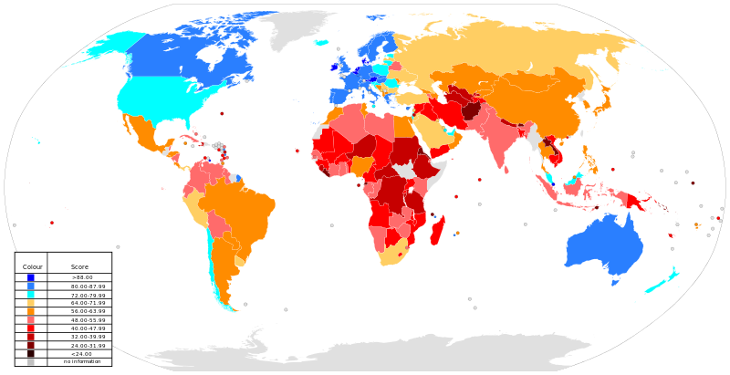
Globalization
Index of globalization

Slide 27
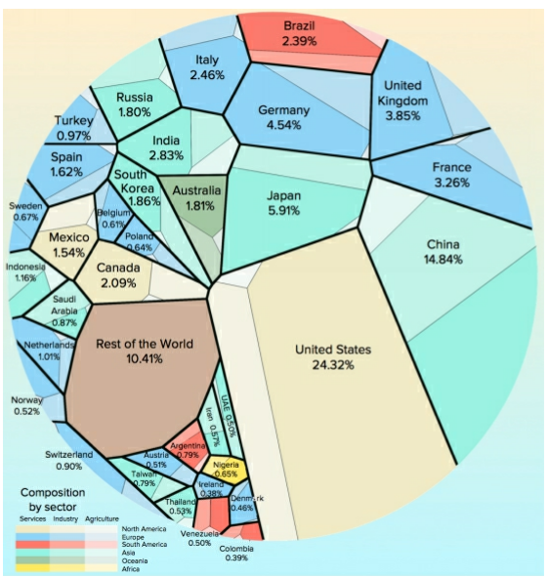
Globalization
Global interactions and global power

