Slide 1

Analytical Methods of Business Environment
Analytical Methods of Macroenvironment
6. lecture
Ing. Šárka Zapletalová, Ph.D.
Department of Business Economics and Management
BUSINESS ENVIRONMENT

Slide 2

Outline of the lecture
PEST analysis
LoNGPEST analysis
Forecasting
Executive opinion methods
Delphi method
Brainstorming
Naïve models
Time series forecast
Regression analysis
Econometric analysis
Simulation models
Mathematical programming
Structural variability
Scenarios

Slide 3
Introduction
The objective of analysis of macroenvironment is to determine the factors affecting the organization.
Information resources for analysis of macroenvironment are secondary resources.
Fundamental methods for the analysis of macroenvironment:
  PEST analysis, PESTLE analysis;
  Forecasting methods;
  Methods of scenarios.

Slide 4
PEST Analysis
The creator of PEST analysis is the Harvard professor Francis Aguilar. He included the tool in his 1967 book „Scanning the Business Environment“.
PEST is an acronym for the Political, Economic, Social and Technological factors which fashion the environment within which organization operates.
This analysis is used to identify Opportunities and Threats which can be combined with an internal analysis of a organization´s strengths and weaknesses to produce a SWOT analysis.
The analysis enables managers to assemble a logical and comprehensive picture of macroenvironment. Managers can use PEST analysis to understand and adapt to future business environment.

Slide 5
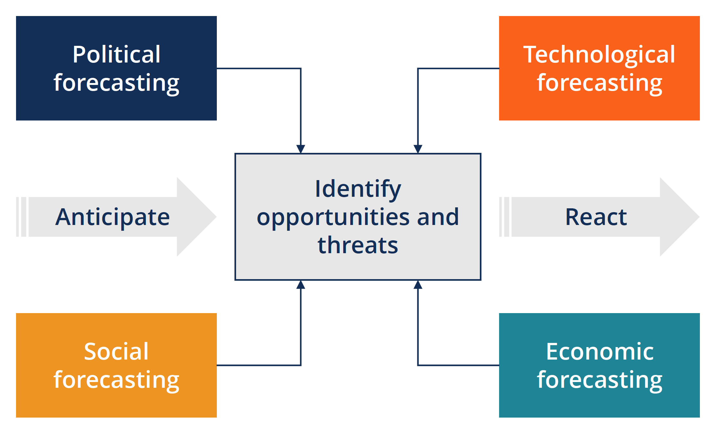
PEST Analysis

Slide 6
PEST Analysis
Main reasons for using of PEST analysis
It helps manager to spot business or personal opportunities, and it gives the manager advanced warning of significant threats.
It reveals the direction of change within company´s business environment.
It helps managers avoid starting projects that are likely to fail, for reasons beyond their control.
It can help managers break free of unconscious assumptions when companies enter a new country, region or market, because it helps managers develop an objective view of this new environment.

Slide 7
PEST Analysis
PEST factors
Political factors – include political stability, tax guidelines, trade regulations, safety regulations, and employment laws.
Economic factors – include factors like inflation, interest rates, economic growth, the unemployment rate and policies, and the business cycle followed in the country.
Social factors – company can understand how consumer needs are shaped and what brings them to the market for a purchase.
Technological factors – include technological advancements, lifecycle of technologies, the role of the Internet, and the spending on technology research by the government.

Slide 8
PEST Analysis
Modification of PEST analysis
  PESTLE analysis – Political, Economic, Social, Technological, Legial, Ecological factors;
  PESTLEE analysis – Political, Economic, Social, Technological, Legal, Ecological, Ethical factors;
  SLEPT analysis – Social, Legal, Economic, Political, Technological;
  STEEP analysis – Social, Technological, Economic, Ecological, Political;
  STEEPLED analysis – Social, Technological, Economic, Ecological, Political, Legal, Ethics, Demographic;
  STEER analysis – Social, Technological, Economic, Ecological, Regulators.

Slide 9
LoNGPEST Analysis
LoNGPEST analysis is a two-dimensional analysis (the traditional PEST analysis is a one-dimensional view of the external business environment).
LoNGPEST is an acronym for Local, National and Global PEST analysis. The analysis represents the view that these external influential elements, whether political, economic, sociocultural or technological, all exist at local, national and global levels. The political, economic and sociocultural influences are easily identified at the three different levels.
Benefits:
  Greater understanding of influences generating change;
  Better anticipation of threats and opportunities within a time-scale of long enough duration to allow responses to be considered.

Slide 10
LoNGPEST Analysis
Grid for LoNGPEST analysis
Identify external influences on the company
Put influences into one of PEST factors
Identify level of influences: local, national, global
 | Political | Economic | Sociocultural | Technological
Local
National
Global

Slide 11
Forecasting
Forecasting is concerned with the estimation of direction and intensity of change in environmental factors. In forecasting, changes in future are identified. Forecasting is an essential element in the environmental analysis.
Forecasting of various components of business environment helps in formulating plans and strategies.
Different quantitative and qualitative forecasting techniques are used for environmental forecasting. The main methods of environmental forecasting are as follows:
  According to the degree of subjectivity – subjective methods, objective methods, systematic methods;
  According to the approach to forecasting – quantitative methods, qualitative methods.

Slide 12
Forecasting
Classification of forecasting methods
The main methods of environmental forecasting can be divided according to the approach to forecasting:
  Qualitative methods – these methods have rather a subjective character
    Heuristic methods – executive opinion method, Delphi method, brainstorming, etc.
  Quantitative methods – these methods have rather an objective character
    Statistical methods – regression analysis, naive models, time series forecast, econometrics, cluster analysis, factor analysis, relevance trees etc;
    Methods of operation research – simulation models, mathematical programming etc;
    Methods of simulated experiments – structural analysis etc.

Slide 13
Executive Opinion Method
Executive opinion method/Executive judgement method/Jury method – business environmental forecasting is based on opinions and views of top executives. This is the oldest, simplest and the most widely used method.
The forecasts are made either by taking the average of all executives’ individual opinions or through discussions among the executives. Their individual opinions are analyzed and discussed in the panel meeting.
Advantages of the method: forecasting can be done quickly and easily, less expensive, very popular particularly among SMEs.
Disadvantages of the method: unscientific, subjective, difficult to break-down the forecast into subunits of the organization.

Slide 14
Delphi Method
Delphi method is similar to the executive opinion method and was developed during the late 1940s by Rand Corporation.
Members of expert panel do not meet or discuss in a committee. Each member of the expert panel submits in writing his or her forecast anonymously.
The procedure includes the selection of panel of experts from within and outside the organization. A coordinator asks each expert separately to make a forecast on some matter. The coordinator summarizes the forecasts into a report that is sent to each panel member. The experts are then asked to make another prediction separately on the same matter, with the knowledge of the forecasts of the other experts, on the panel. This process is repeated until the panel of experts arrives at some consensus.

Slide 15
Brainstorming
Brainstorming is a group process that follows specific rules and procedures designed for generating new ideas and concepts. A brainstorming session usually exposes an analyst to a greater range of ideas and perspectives than the analyst could generate alone.
To be successful, brainstorming must be focused on a specific issue and generate a final written report. Brainstorming techniques can be used also later in the analytic process to pull the team out of an analytic rut so as to stimulate new investigative leads or stimulate more creative thinking.
One type of brainstorming is a structured brainstorming. The structured brainstorming is a systematic, multistep process for conducting group brainstorming that employs silent brainstorming and sticky notes.

Slide 16
Naïve Models
Naïve models are based exclusively on historical observations of sales or other variables such as earnings and cash flows. They do not attempt to explain the underlying causal relationships that produce the variable being forecast.
Naïve models may be classified into two groups. One consists of simple projection models. These models require inputs of data from recent observations, but not statistical analyses. The second group is made up of models that are complex enough to require a computer.
Advantage of this method: the model is inexpensive to develop, store data and operate.
Disadvantage of this method: it is does not consider any causal relationships that may underlie the forecasted variable.

Slide 17
Time Series Forecast
Time series forecasting means that forecasts are made on the basis of data comprising one or more time series. A time series is a collection of observations made sequentially through time.
Time series model will provide forecasts of new future observations which can be checked against what is actually observed.
Time series forecasting is essentially a form of extrapolation in that it involves fitting a model to a set of data and then using that model outside the range of data to which it has been fitted. Extrapolation is rightly regarded with disfavor in other statistical areas, such as regression analysis. However, when forecasting the future of a time series, extrapolation is unavoidable.

Slide 18
Regression Analysis
Regression analysis is a statistical forecasting method that is used to predict sales, treated as a dependent variable, based on some independent variables which influence entrepreneurial activities. Regression analysis is performed to identify the functional relationship between entrepreneurial activities and the independent variables, which in turn is used to forecast activities in subsequent periods, given forecasted levels of the independent variables.
Advantages of the method: high forecasting accuracy if relationships between variables are stable, objective methods that can predict turning points of the company sales.
Disadvantages of the method: technically complex and potentially expensive and time consuming, the use of computer and software and software packages is essential.

Slide 19
Econometric Analysis
In econometric analysis, many regression equations are built to forecast industry sales, general economic conditions or future events.
A number of regression equations representing relationships between various factors are developed. A forecast is prepared by solving equations on computer.
Advantage of this method: accurate forecast of economic conditions and industry sales are possible.
Disadvantage of this method: large volume of data is required representing the various factors.

Slide 20
Simulation Models
Simulation is a living forecast model. Simulations are very different from mathematical equation-based models like regression analysis. With simulations, the solution is not solved or evaluated. With simulation, we create a controlled environment where artificial transactions are placed into the system.
The transactions work their way through the system just like real transactions in a real system. The simulation model is instrumented to closely observe and record transaction activity. To find out how the real system would react to certain changes, we can introduce these changes into the model and run the simulation.
When the simulation is complete, the data is analyzed and we can learn a lot about the real or proposed system.

Slide 21
Mathematical Programming
Mathematical programming problem is a special class of decision problem where we are concerned with the efficient use of limited resources to meet desired objectives. One of the most remarkable developments of the present century is the development of operations research techniques of which perhaps the most important is mathematical programming.
Programming problems, however, have long been of interest to economists. The trend can be traced back to the 18th century when economists began to describe economic systems in mathematical terms.
If the functions are all linear, the problem is known as a linear programming problem. Otherwise it is said to be a nonlinear program.

Slide 22
Structural Variability
Structural variability is in general a very important aspect of the economic planning process, but also a complicated one. One way to represent a structural change when modeling an economic system is to allow for parameter changes. Besides verifying the existence of such parameter changes, the ultimate purpose of the structural analysis is to further characterize them.
An analysis of structural variability also requires that this concept be considered to be related to the specific economic system „at work“. Irrespective of the definition of structural variability, it must be a measurable concept, in principle with a unique interpretation.
Modeling a specific economic system characterized by structural variability involves allowance for assumptions of parameter variability.

Slide 23
Scenarios
Scenarios are instruments for ordering people´s perceptions about alternative future environments in which today´s decisions might play out. In practice, scenarios resemble a set of stories built around carefully constructed plots.
Scenarios usually have four dimensions:
  „status quo“ – assumes that the present will continue into the future;
  „collapse“ – results when the system cannot sustain continued growth;
  „steady state“ – is based upon a return to some previous time;
  „transformation“ – presumes some fundamental change that may be spiritual, technological, political or economic.

Slide 24
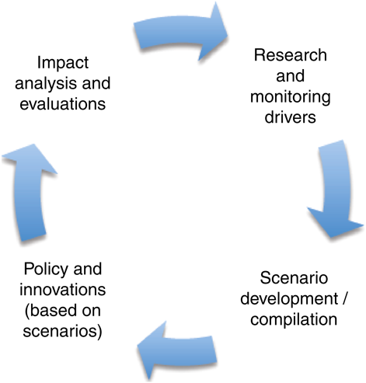
Scenarios
Scenario planning

Slide 25
Scenarios
Types of scenarios
At the risk of oversimplification, the scenario construction can be divided into two basic forms:
  Future backward;
  Future forward.
Borjeson scenario typology:
  Predictive – forecasts, what-if;
  Explorative – external, strategic;
  Normative – preserving, transforming.
Other ways in which scenarios can be categorized :
  Global scenarios;
  Industry scenarios;
  Competitor scenarios;
  Technology scenarios.

Slide 26
Scenarios
Scenario techiques
Judgement
Baseline
Elaboration of fixed scenarios
Event sequences
Backcasting
Dimensions of uncertainty
Cross-impact analysis
Modelling

Slide 27
Scenarios
Scenario development process
The scenario development process is relatively straightforward. Constructing scenarios is simply a matter of progressing through a series of well-defined, sequential steps.
Jungermann describes what constitues a generic, four-stage scenario generation process model, namely:
  Activation of problem knowledge within the world knowledge of the individual;
  Constitution of the mental model in terms of the activated problem knowledge;
  Stimulation of the mental model in order to draw inferences;
  Selection of the inference which appear appropriate for scenario construction.

