Slide 1
Analytical Methods of Business Environment
Analytical Methods of Task Environment
7. lecture
Ing. Šárka Zapletalová, Ph.D.
Department of Business Economics and Management
BUSINESS ENVIRONMENT

Slide 2
Outline of the lecture
Industry analysis
Market analysis

Slide 3
Introduction
Analysing industries involves building up a detailed knowledge of the competing organizations in the industry and the products (goods and services) they are selling.
A market is a group of customers for specific goods or services that are essentially the same. Analyzing market involves building up a detailed knowledge of the customer and customer groups.
Basic tool for market analysis is market research.
The goal of market analysis is to determine the attractiveness of a market and to understand its evolving opportunities and threats of the organization.

Slide 4
Industry Analysis
An industry is a group of organizations producing goods and services that are essentially the same.
Analysing industries involves building up a detailed knowledge of the competing organizations in the industry and the products (goods and services) they are selling.
Key questions to ask:
What is our company´s industry?
What are the characteristics of the industry?
How stable are these characteristics?

Slide 5
Industry Analysis
Industry structure
Industry structure is determined by the number and relative strength of organizations in the industry. There is a variety of industry structure:
Perfect competition;
Monopoly;
Monopolistic competition;
Oligopoly.
Industry structure can be influenced:
By the costs incurred by business;
By behavior of companies in the industry and the nature and intensity of competition;
By company performance.

Slide 6
Industry Analysis
Industry concentration
The distribution of power among organizations in an industry is assessed by the level of industry concentration. Industry concentration gives an indication of the competitive pressures in a industry.
Industry concentration can be measured by looking at the market share of organizations in the industry. High concentration levels usually indicate low intensity competition.
There are various ways of measuring industry concentration. The most straightforward methods are the following:
Concentration rate – calculated by taking the share of the largest organizations in industry sales or output by value or by volume;
Herfindahl-Hirschmann index – calculated by summing the squares of the individual market shares of all the organizations in the industry.

Slide 7
Industry Analysis
Porter´s five forces framework
Porter´s five forces model can be used to identify and evaluate the main threats to the organizations in an industry. The model helps identify the attractiveness of an industry in terms of five forces:
Competitive rivalry/Industry rivalry;
Potential entrants/Competition from new entrants;
Substitutes;
Buyers/Customers;
Suppliers.
Three of the forces are concerned with competition – industry rivalry, competition from new entrants to the industry, competition from products.
The other forces are concerned with the industry customers and suppliers.

Slide 8
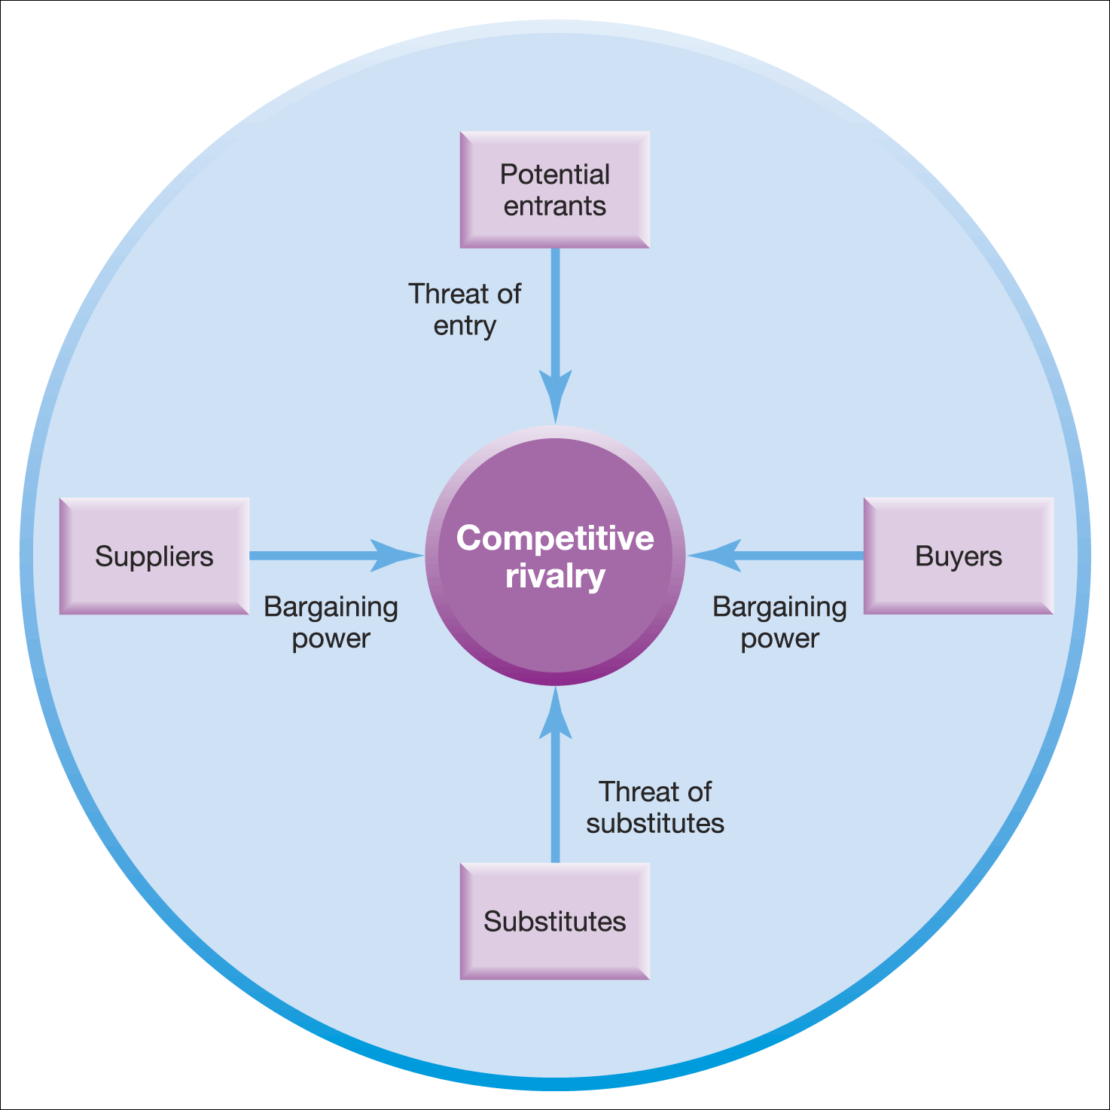
Industry Analysis
Porter´s five forces framework

Slide 9
Industry Analysis
Porter´s five forces: Competitive rivalry
Competitive rivalry (industry rivalry), rivalry among existing competitors, can vary in form and intensity from one industry to another and in particular industries over time. Rivalry can also take the form of a struggle for resources.
Rivalry among existing competitors takes many familiar forms: price discounting, new product introductions, advertising campaigns, service escalation and so forth.
The degree to which rivalry undermines an industry´ s profit potential depends:
On the basis on which organizations compete;
On the intensity with which organizations compete.

Slide 10
Industry Analysis
Porter´s five forces: Competitive rivalry
The degree of rivalry is increased when:
Competitors are of roughly equal size and power;
Competitors are aggressive in seeking leadership;
The industry is mature or declining, industry growth is slow;
There are high fixed costs and marginal costs are low;
The exit barriers are high;
There is a low level of differentiation or switching costs;
Capacity must be expanded in large increments;
The product is perishable.

Slide 11
Industry Analysis
Porter´s five forces: Potential entrants/new entrants
The entry of new organizations (potential entrants) is another threat to established organizations in the industry. New entrants will be attracted into industries by the prospects of high profits and growth.
New entrants to an industry bring new capacity and a desire to gain market share. The threat of new entry puts a cap on the profit potential of an industry. When the threat is high, profits cannot rise too high without attracting new competitors.
Entry increases the number of organizations and if it takes the form of greenfield investment, adds to industry capacity. As a result, competition could become more intense.
The probability of new entrants to the industry is dependent on the height of barriers to entry.

Slide 12
Industry Analysis
Porter´s five forces: Potential entrants/new entrants
Barriers to entry
Supply-side economies of scale – these economies arise when organizations that produce at larger volumes enjoy lower costs per unit, organizations can spread fixed costs over more units.
Demand-side benefits of scale – also known as network effects, they arise in industries where a buyer´s willingness to pay for a organization´s product increases with the number of other buyers who also patronize the organization.
Customer switching costs – switching costs are fixed costs that buyers face when they change suppliers.
Capital requirements – the need to invest large financial resources in order to compete creates a barrier to entry.
Incumbency advantages independent of size – incumbent organizations may have cost or quality advantages not available to potential rivals, no matter whatever is their size.
Unequal access to distribution channels – the newcomer on the block must secure distribution of its products.

Slide 13
Industry Analysis
Porter´s five forces: Substitutes
Substitutes are goods or services produced by organizations in an apparently different industry and delivering a similar service to the customer but in a different way. Substitutes are easy to overlook because they may look very different from the industry´s product. Substitutes nearly always exist. In many times, one substitute is to do without a product, and another is for customers to perform a service for themselves.
Threat from substitutes will be influenced by the cost and ease with which customers can switch to the substitute product.
Substitute products deserving the most strategic attention are those that:
Are subjects to trends improving their price-performance trade-off with the industry´s product,
Are produced by industries reaping high profits that may erode with competition.

Slide 14
Industry Analysis
Porter´s five forces: Buyers
Powerful buyers can force down prices, demand higher quality or more service, and play competitors off against each other, all at the expense of industry profits. Groups of buyers may differ in their bargaining power.
Customers are powerful if:
they have clout relative to industry participants and especially;
they emphasize price reductions as the means to exercise their clout.
Power relationships that organizations have with their customers depend on a combination of factors:
The number and size of organizations;
The proportion of customer costs constituted by the product;
The extent of product differentiation;
The ability of customers to integrate vertically.

Slide 15
Industry Analysis
Porter´s five forces: Suppliers
Suppliers refer to organizations selling inputs, such as fuel, raw materials and components to the organizations in an industry. The position of suppliers can be analyzed in a similar way to those of buyers, but in reverse.
Suppliers can exert bargaining power by raising prices, shifting costs downstream to industry participants or limiting the quality of the products they provide.
Powerful suppliers can thereby squeeze profitability out of an industry that is unable to pass on cost increases in its own prices.

Slide 16
Industry Analysis
Porter´s five forces: Suppliers
Power of suppliers
An industry will depend on multiple groups of suppliers. The power of each important supplier group depends on a number of structural characteristics of the industry. A supplier group is powerful if:
It is more concentrated than the industry it sells to;
Industry participants face switching costs in changing suppliers;
Suppliers offer products that are differentiated;
There are no substitutes to what the supplier group provides;
The supplier group can credibly threaten to integrate forward into the industry;
The supplier group does not depend heavily on the industry.

Slide 17
Industry Analysis
Porter´s five forces: Complementray products – sixth force
Complementary products are those that are used together by customers. They do not compete with each other but operate in tandem. It does not deal with the complementary relationship that can exist between products.
The Porter model pays particular attention to the relationships between competitors´ products and also to the threat from substitute products.
The suppliers of complementary products can play an important role in the competitive environment for organizations in an industry because:
The organizations making products depend on the efforts of the other in relation to product development;
There can be conflict over who gets most of the spoils.

Slide 18
Industry Analysis
Porter´s five forces: Implication of five forces analysis
Identifies the attractiveness of industries – which industries to enter of leave.
Identifies strategies to influence the impact of the forces, which happens, for example, in case of building barriers to entry by becoming more vertically integrated.
The forces may have a different impact on different organizations. Large organizations can deal with barriers to entry more easily than small organizations.

Slide 19
Industry Analysis
Porter´s five forces: Issues in Porter´s five forces model
Apply at the most appropriate level – not necessarily the whole industry.
Note the convergence of industries – particularly in the high tech sectors.
Note the importance of complementary goods and services.

Slide 20
Industry Analysis
Strategic groups
Strategic groups are organizations within an industry or sector with similar strategic characteristics, following similar strategies or competing on similar bases.
Strategic characteristics are different from those in other strategic groups in the same industry or sector.
There are many different characteristics that distinguish between strategic groups.
Strategic groups can be mapped on to two dimensional maps – positioning maps. These can be useful tools of analysis.

Slide 21
Industry Analysis
Strategic groups: Characteristics for identifying strategic groups
Scope of activities
Extent of product diversity;
Extent of geographical coverage;
Number of market segments served;
Distribution channels used.
Resource commitment:
Extent of branding;
Marketing effort;
Extent of vertical integration;
Goods and services quality;
Technological leadership;
Size of organizations.

Slide 22
Industry Analysis
Strategic groups: Uses of strategic groups analysis
Understanding competition – enables focus on direct competitors within a strategic group, rather than on the whole industry.
Analysis of strategic opportunities – helps identify attractive strategic spaces (gaps) within an industry.
Analysis of mobility barriers – obstacles to movement from one strategic group to another. These barriers can be overcome to enter more attractive groups. Barriers can be built to defend an attractive position in a strategic group.

Slide 23
Market Analysis
A market is a group of customers for specific goods or services that are essentially the same. Analyzing market involves building up a detailed knowledge of the customer and customer groups.
Basic tool for market analysis is market research.
The goal of market analysis is to determine the attractiveness of a market and to understand its evolving opportunities and threats of the organization.
Dimensions of a market analysis:
Market size;
Market growth rate;
Market profitability;
Market trends.

Slide 24
Market Analysis
Customer analysis
Customer analysis provides the collection and evaluation of data associated with customer needs and market trends, through market research, customer satisfaction measurement, field testing etc.
Customer analysis can be usefully partitioned into an understanding of how the market segments to behave, an analysis of customer motivations and an exploration of unmet needs.

Slide 25
Market Analysis
Market research
Market research is the method for monitoring and analyzing of markets, subject of markets, companies etc.
We can define market research as the systematic design, collection, analysis and reporting of data and findings relevant to a specific marketing situation facing the organization, and to enhance decision making throughout the strategic process.
Market research aims to help managers make better decisions or to develop a marketing plan for new target groups or which customer service components should be improved.

Slide 26
Market Analysis
Market research: Market research process
The marketing research process has been described as a set of standardized stages:
Determination of the research problem
Determine and clarify management´s information needs;
Redefine the decision problem as a research problem;
Establish research objectives.
Development of the appropriate research design
Determine the research design and data sources;
Determine the sample plan and sample size;
Determine the measurement issues and scales.
Execution of the research design
Collect and process data;
Analyze data;
Transform data structures into information.
Communication of the results

Slide 27
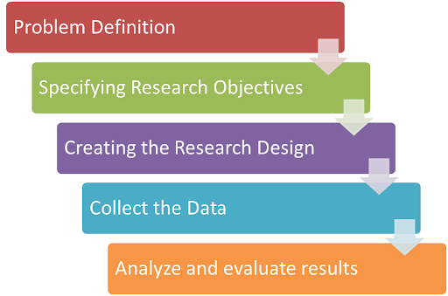
Market Analysis
Market research: Market research process

