Slide 1

Success of company
Managing Innovation
Ing. Žaneta Rylková, Ph.D.

Slide 2
Content
Strategy
Management system
Innovation
Skills
Measures
Business model

Slide 3
Strategy – strategic management
Strategic thinking
Strategic analysis – situation analysis
Setting strategy
Implementation
Control

Slide 4
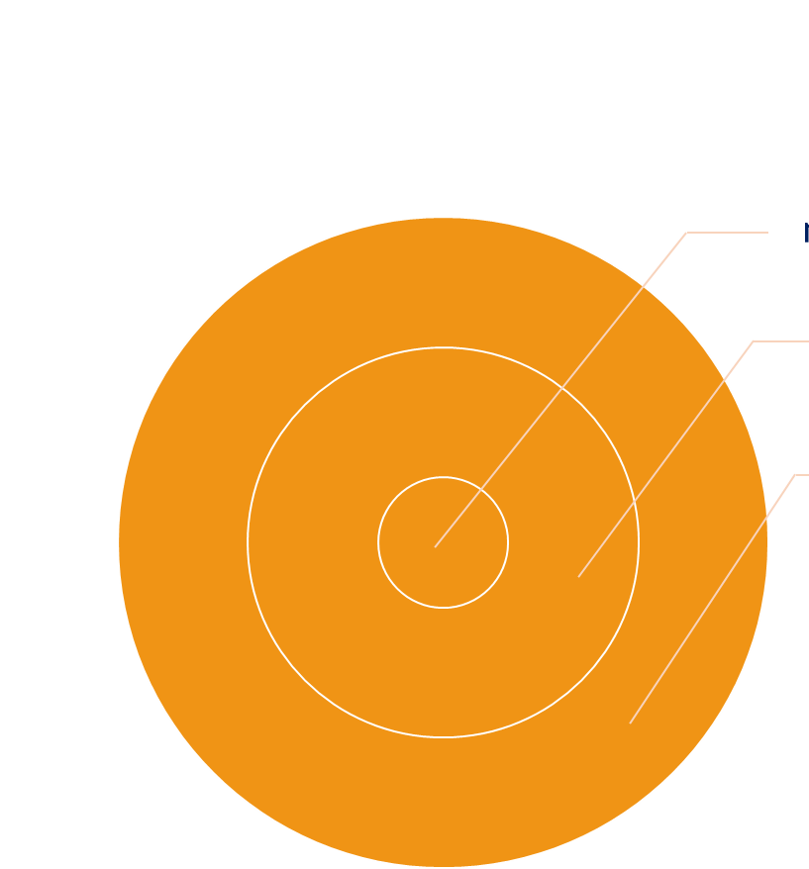
Strategy – strategic analysis
Enterprise as an economic and social system
Enterprise
– microeconomic environment
(internal environment of an enterprise)
– external microeconomic (task of specific) environment
– external macroeconomic (general) environment

Slide 5
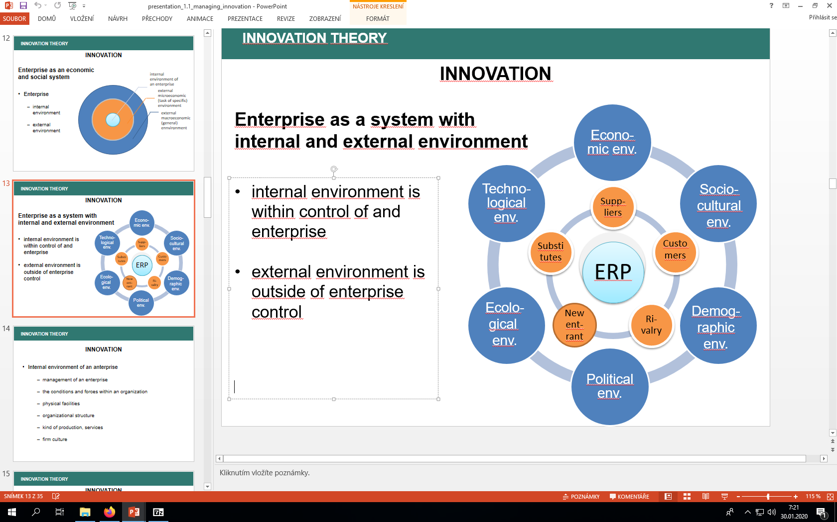
Strategy – Methods of external analysis
- PEST analysis …. STEP, PESTLE, SLEPTE
- Porter´s Five Forces
Stakeholder analysis
Analysis of the attractiveness of the industry
Competitiveness analysis
Industry life cycle analysis
Strategic maps
Method „4C“

Slide 6
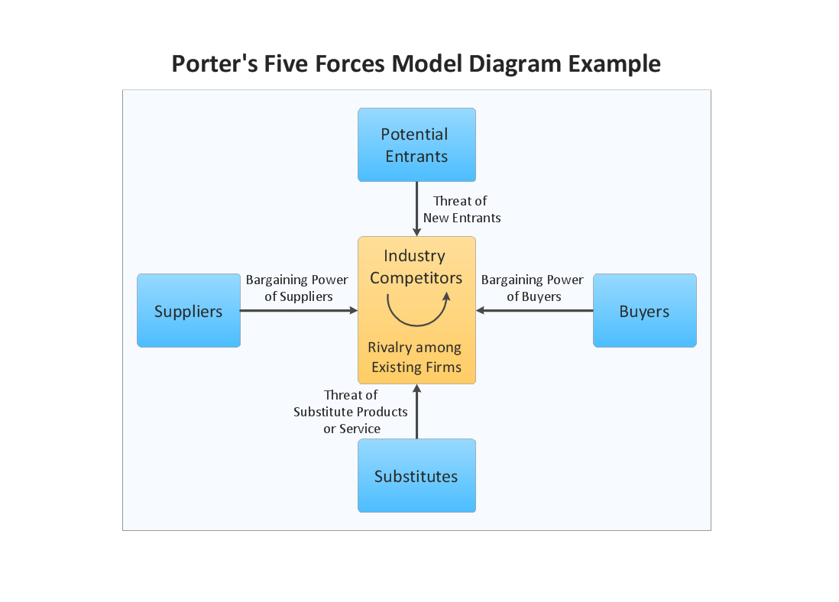
External microeconomic environment of an enterprise (special task environment)
Strategy – strategic analysis
Suppliers
Customers
Competitors
Substitutes
New firms

Slide 7
Strategy – Analysis of internal environment
Analysis of results in individual functional areas
Analysis of enterprise resources
Value chain -(primary and support activities)
Financial analysis

Slide 8
Strategy – Methods of internal analysis
Methods for making suggestions;
Methods for problem analysis;
Benchmarking;
GAP analysis;
Risk analyzes;
Self-assessment of organization performance;
Process analysis;
Cost-output analyzes.

Slide 9
Strategy: Output of situation analysis
SWOT analysis (strengths, weaknesses, opportunities and threats)

Slide 10
Strategy – Management of strategy risks connected with innovation
Risk of non-fulfillment of the ambition of growth of company value
Risk in the behavior of key employees
Risk of non-fulfillment of customer expectations

Slide 11
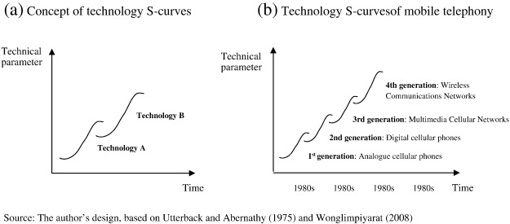
Innovation

Slide 12
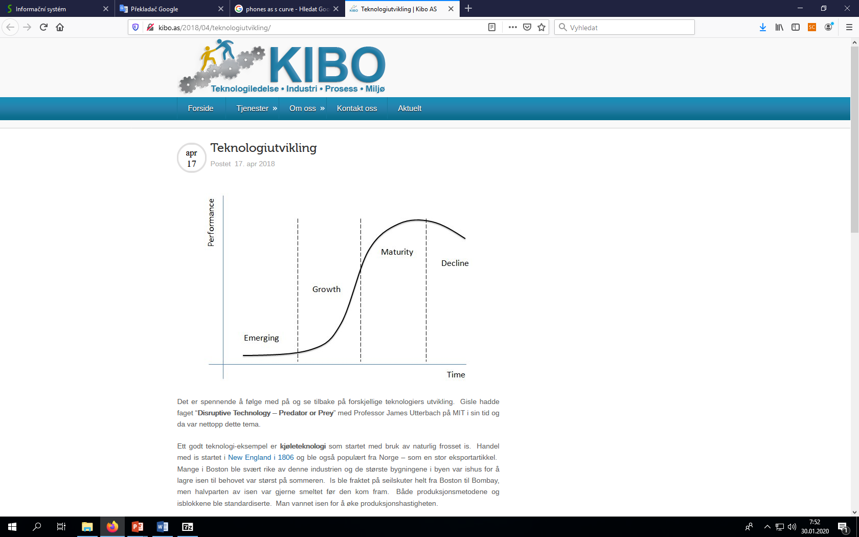
Innovation
Curve of the life cycle of innovation
Innovation is the basis of the company's long-term survival, because the company's products, processes, and entire business systems evolve in S curves, just like human life.
Innovation creates a new S curve and the improvement is oriented to the existing S curve and its phase.
S-curve of innovation

Slide 13
Management system
Process management replaces traditional management by function (activity) in the enterprise (information age enterprises work with "cross-cutting" processes that go beyond traditional business function
Customer and supplier interconnection (information technology allows today's businesses to integrate the delivery, manufacturing and shipping process so deliveries are driven by customer orders)

Slide 14
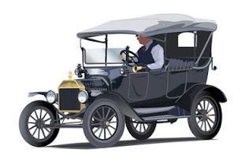
Management system
Information Age Businesses offer products and services tailored to different market segments (Henry Ford's quote about his car model was a typical attitude to a customer during the industrial era: "Any customer can have a car painted any color that he wants so long as it is black."

Slide 15
Management system
Globalization, (Large-scale investments require a large number of customers around the world to secure their return, transportation costs are offset by the construction of branch offices around the world, sensitive approach to local customers),
Innovation (product life cycle is constantly shortening, it is necessary to be able to anticipate future needs of customers),

Slide 16
Management system
Production according to customer requirements.
Restructuring of production and control systems.
New possibilities of cost savings through benchmarking, reengineering, outsourcing, lean production and lean management are being sought.
Management of Change, both changes in production and management.

Slide 17
Management system - characteristics of economic development at the end of the 20th century
Predominance of supply (end of the era of the manufacturer's market). This leads to the development of marketing (sales promotion, advertising development, market research, research of customer needs, rationalization of logistics).
Importance of environmental protection (environmental friendliness) is emphasized. Environmental legislation is emerging and a new direction - environmental management.

Slide 18
Management system: methods of current management?

Slide 19
Contemporary management and its methods
The list of basic methods currently applied in corporate governance:
  Restructuring
  Reengineering
  Turnaround method
  Just-in-time (JIT)
  Outsourcing
  Lean

Slide 20
Contemporary management and its methods
Method 3 C (Customer - Competition - Change)
Benchmarking method
Strategic Alliance
Virtual organization
Controlling
CRM
TQM
CSR
Balanced Scorecard

Slide 21
Business Management system
New management methods and procedures
The Balanced Scorecard method has initiated a new direction in “investment activity” where, in addition to investing in traditional areas of investment such as new facilities, infrastructure investment has been added in the form of people, systems and procedures.
EFQM method

Slide 22
Management system - Management methods - process innovation
Innovation of operational character
You can use method:
  TOC - finding a bottleneck and eliminating it
  Lean - eliminate non-value-generating activities
  Six Sigma - customer orientation, perfect information, continuous process improvement, flexible management, collaborative distribution, pursuit of excellence in failure tolerance. Five steps: define - measure - analyze - improve - control

Slide 23
Management system - Main risks in relation to internal processes
Technological risks:
- incorrect identification of market needs and requirements
- errors in the design of the research and in the choice of technical solutions
- poor choice of distribution channels
Operational and commercial risks:
- inappropriate production and working procedures
- unreliable subcontractors
- incorrect external communication
- inappropriate pricing policy
- poor choice of sellers.
Financial risks:
- underestimating the possibility of customer insolvency
- incorrect setting of exchange rate and inflation risks
- unpreparedness for legislative adjustments with respect to income taxation and payment of levies

Slide 24
Skills
Knowledge workers, people who are able successfully work with knowledge are not a great number in companies. Characteristic features of these workers are high intelligence, imagination and a relatively decent level of knowledge. But, as F. Drucker states, there is no significant correlation between the effectiveness of their work on the one hand and their intelligence, imagination and level of knowledge on the other.
It is very difficult to assess the effectiveness of a “mentally working” person.

Slide 25
Skills: knowledge management
Knowledge acquisition and sharing in the enterprise:
  regular upgrading and training of employees
  buying knowledge from outside
  regular informal discussions in work teams
  controlled discussion or brainstorming in teams
  teamwork on development projects
Notes:
csvukrs

Slide 26
Skills – management system
Factors increasing the intensity and quality of innovative activities in the company knowledge and innovation management in accordance with strategic, tactical and operational business management
Company culture:
  friendly environment
  entrepreneurship, intra-enterprise
  innovativeness
  teamwork
  promoting creativity
Appropriate remuneration system.
Notes:
csvukrs

Slide 27

Skills – team work
Teamwork as one of the factors increasing the intensity and quality of innovative activities in a company
  Teamwork is the most common form and method of activities in implementing innovative processes in a company.
  team means a working union composed of experts from different professions.
  It is usually a small union of 5-8 members.
  after solving a task, the team dissolves.
  each member plays a role in the team.
Notes:
csvukrs

Slide 28
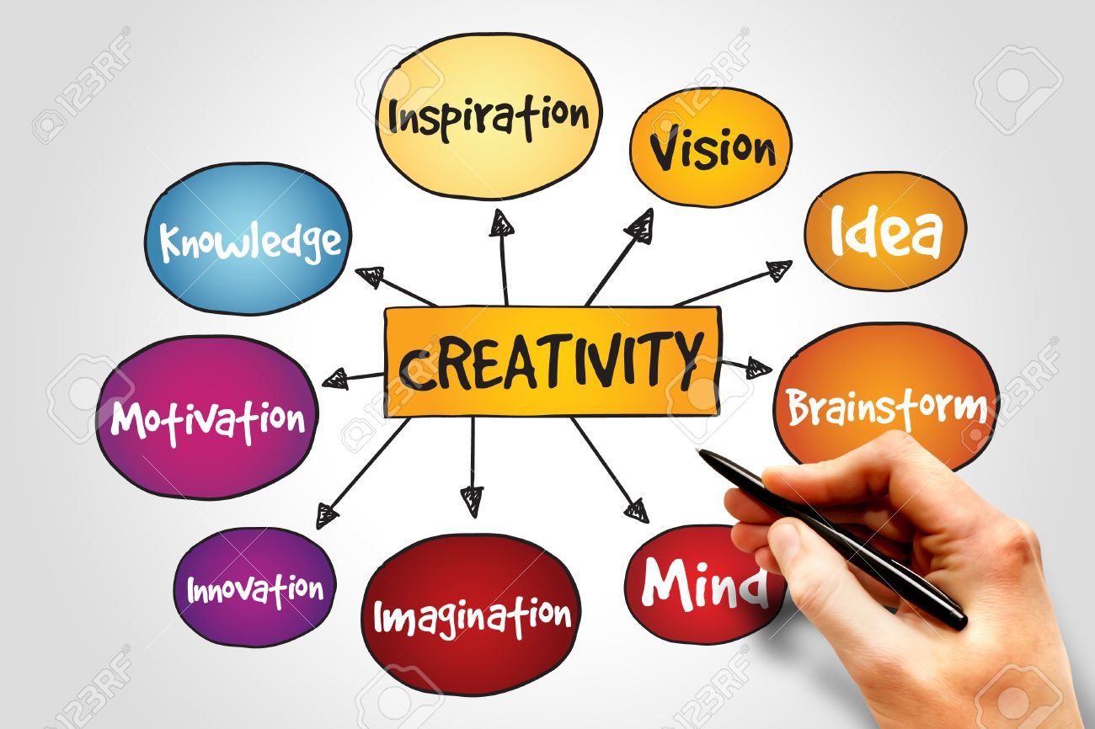
Skills

Slide 29
Measures
Measurement and management (airplane/enterprise)
Kelvin Wiliam (Scotman, Lord, mathematician and physicist 1824-1907):
“When you can measure what you are speaking about, and express it in numbers, you know something about it, when you cannot express it in numbers, your knowledge is of a meager and unsatisfactory kind; it may be the beginning of knowledge, but you have scarely, in your thoughts advanced to the stage of science.”

Slide 30
Measures – main indicators of financial analysis
Competitive abilities of the organization - profitability of the organization, profitability of sales, liquidity, indebtedness
Organization management - ROI, payback period, ROCE, ROE
Financial effect from investments - working capital turnover, profitability, total return

Slide 31
Measuring the effectiveness of innovation in a company
Measurement of efficiency of innovation activities and innovation processes
Examples of innovative metrics
Innovation performance indicators | Innovation efficiency indicators
Return on investment in innovation | Number of new ideas from the initiative of employees
Revenue from innovated products | Type of innovation
Revenue from innovated products to total revenue | Profitability of innovation according to individual phases of the life cycle
Percentage revenue growth due to successful innovation | Percent decrease in costs of innovated processes and products
Lifetime of the upgraded product | Revenue from innovation per worker
Number of patents per worker per year | Added value of successful patents
Number of innovation transfer per year
Notes:
csvukrs

